Slide 1
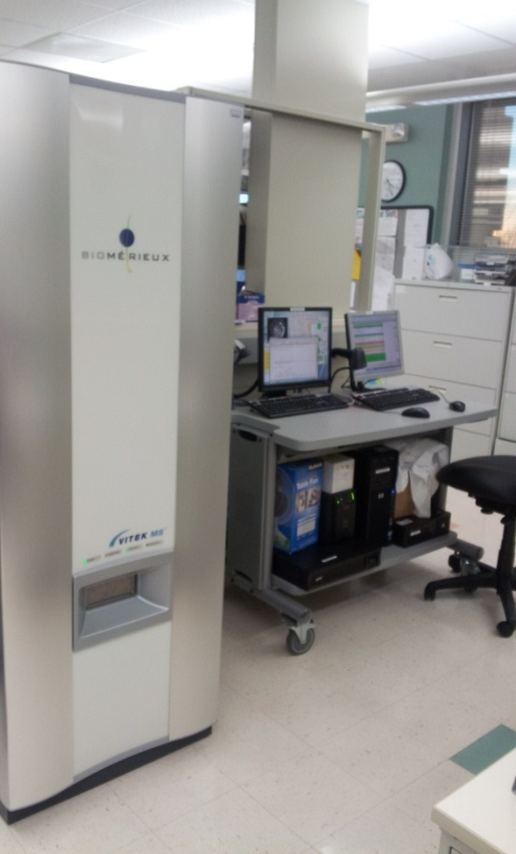
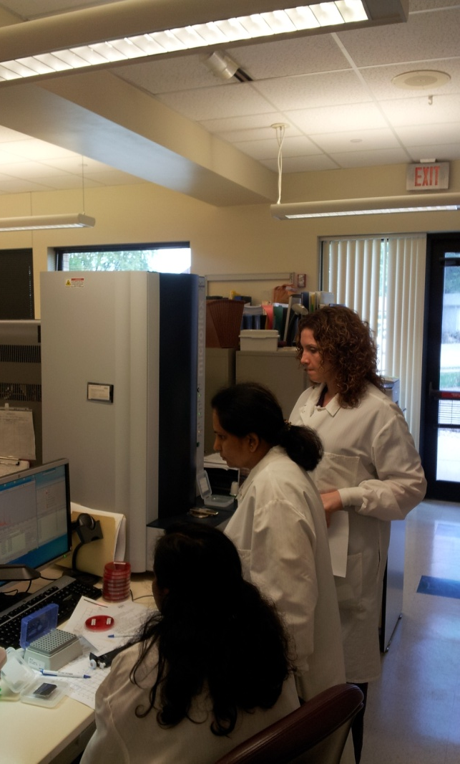
Implementation of MALDI-TOF in Clinical Microbiology
Michael Costello, Ph.D
Technical Director – Microbiology
ACL Laboratories
Mike.costello@advocatehealth.com
WSLH Teleconference
November 13, 2013

Slide 2
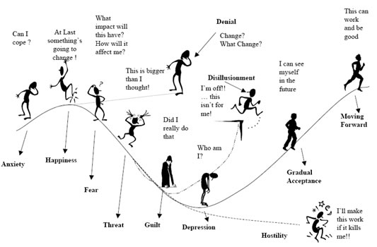


Matrix Assisted Laser Desorption Ionization – Time of Flight/Mass Spectrometry or MALDI-TOF/MS
Major
Notes:
Most significant change in the practice of Clinical |Microbiology in years. How Clinical Microbiology is done will change.

Slide 3
Objectives
A Microbiologist’s view of MALDI-TOF/MS technology
  Why are Laboratorians , Pharmacists, and Physicians so excited about this technology?
    Faster, better, cheaper identifications of a wide range of microorganisms
Thoughts on how this technology will change the practice of Clinical Microbiology
  Benefits of decreased time to detection of pathogens
    Directed patient care
    Antibiotic stewardship
      Right drug, right dose, for the right duration
  Consistent and comparable results between Microbiology Labs and all shifts in the same lab
  Fits well with automation – the next step
  MALDI-TOF Vs. Molecular Testing
    MALDI
      Rapid, efficient identification from isolated colonies and liquids (MALDI-TOF/MS)
    Molecular
      Direct detection from patient specimens (Molecular)
      Direct detection of resistance genes (MecA, VRE, CTX-M, KPC, NDM)

Slide 4
Objectives (Cont.)
Summarize our experience with bioMérieux MS and Bruker MALDI-TOF/MS
  Instruments comparable
    Advantages will be in improved databases , data analysis, and middleware integration.
  Expectations Vs. reality
    Should be able to decrease the number of secondary identification systems required in Clinical Microbiology
    Very good technology, but not perfect
    Experienced technologists still needed
    Better patient care through faster definitive results
    Positive effect on workflow??

Slide 5

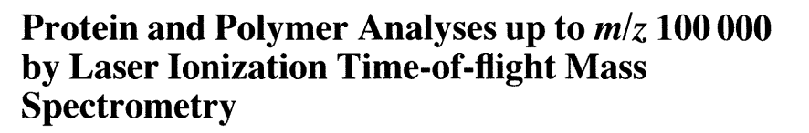

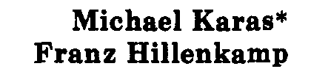
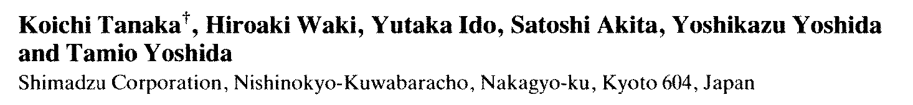
MALDI-TOF MS: History
Developed in 1980s by Karas and Hillenkamp
Detection of large molecules using TOF by Tanaka and Yoshida
Introduction of matrix compounds to analyze large molecules
First commercial instrument developed by Shimadzu
First commercial database developed by Anagnostec (1998)
Shimadzu scientist receives Nobel Prize in Chemistry
  Kiochi Tanaka (2002)
Technology in use in Europe for >10 years.

Slide 6
MALDI-TOF/MS – WHY CHANGE?
Factor | Traditional ID | MALDI ID
Decreased time to ID, should translate into better, more cost effective care. Faster ID should limit nosocomial infections. Better use of isolation beds. Address pressure to reduce TAT | ++(rapid methods faster) | ++++ (Definitive ID)
Training required - Different/additional skill set required. (Pipetting 1 μL, computer skills) | ++++ (more) | ++ (Less, different skill set)
LEAN (anaerobes, blood cultures, Mycology, Mycobacteriology, routine) | ++ (less LEAN) Results need to make sense | +++ (more LEAN) Results need to make sense!
Different technology, different IDs [Anaerobic GPC (Fingoldia magna, Pediococcus acidilactica), coagulase negative Staph, anaerobes, nonfermentors, others (Lysinibacillus Sp.) ] | ++ (mature technology, changes linear) | New technology (Proteomics) IDs are database dependent
Equalizer of expertise between shifts and Labs. All give comparable results. ID is database driven. | ++ | ++++
FASTER, BETTER, CHEAPER!

Slide 7
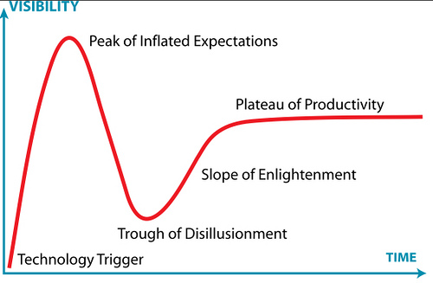
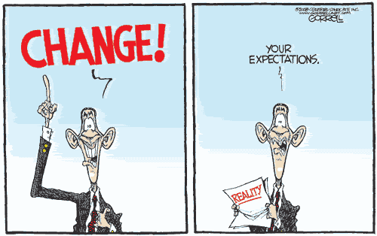


MALDI – TOF/MS EVALUATION STUDIES
Prior to Sep. 2011
E
X
P
E
C
T
A
T
I
O
N
S
Jan. 2012
Current Level
March, 2012
Good, but
not perfect
Dec. 2011
June, 2012

Slide 8
Factor Driving Switch from Biochemical to MALDI-TOF Bacterial Identification
Most significant advance in Clinical Microbiology in 25 years!
  Rapid and cost effective identification of bacteria directly from isolated colonies and positive culture bottles based on protein biomarkers
    Protein biomarkers measured are highly expressed proteins responsible for housekeeping functions, such as ribosomal (16S) and transcription/translation factor proteins
FASTER, BETTER, CHEAPER, BUT NOT PERFECT!

Slide 9
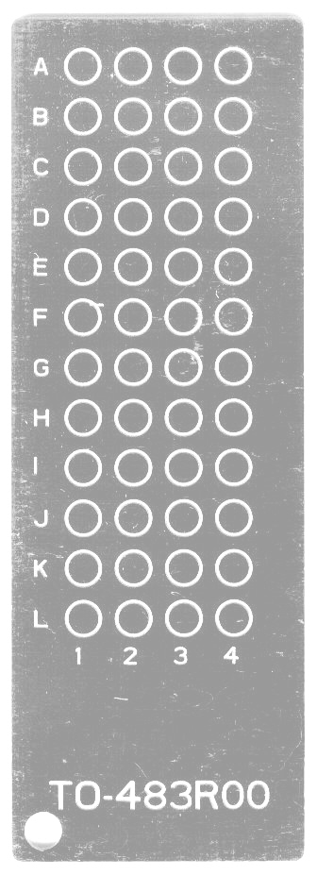

MALDI-TOF MS: Basic Principles
Time of Flight
in vacuum
< 10⁻⁷ Torr
α-cyano-4-hydroxycinnamic acid
analyte molecules incorporated in
matrix crystals
matrix adsorbs UV light
Notes:
Bacteria or yeasts placed on slide, overlaid with matrix, lyses and crystalizes bacterial proteins. Samples placed on instrument and ionized by short laser pulses with minimal protein fragmentation. Particles are then accelerated thru a vacuum tube

Slide 10
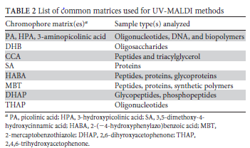
MALDI-TOF MS: Basic Principles
Matrix Assisted Laser Desorption
Ionization–Time of Flight/Mass Spectrometry
Time of Flight
Vacuum
tube
laser pulse:
- desorption of matrix and
bacterial proteins
- ionization by charge/energy
transfer
α-cyano-4-hydroxycinnamic acid
CMR 26;547-603, 2013
Courtesy of bioMérieux

Slide 11
MALDI-TOF MS: Basic Principles
Matrix Assisted Laser Desorption
Ionization–Time of Flight/Mass Spectrometry
Time of Flight
Vacuum
tube
Ring electrode
build-up of an
electromagnetic field
acceleration of ions
Courtesy of bioMérieux

Slide 12
MALDI-TOF MS: Basic Principles
ion detector
Small highly
charged molecules
separation of ions in a field free drift range of a fixed length by velocity
(Time Of Flight)
L ≈ 1 m
+
+
Time of Flight
Vacuum
tube
Larger less
charged molecules
+
+
Matrix Assisted Laser Desorption
Ionization– Time of Flight/Mass Spectrometry
Courtesy of bioMérieux

Slide 13
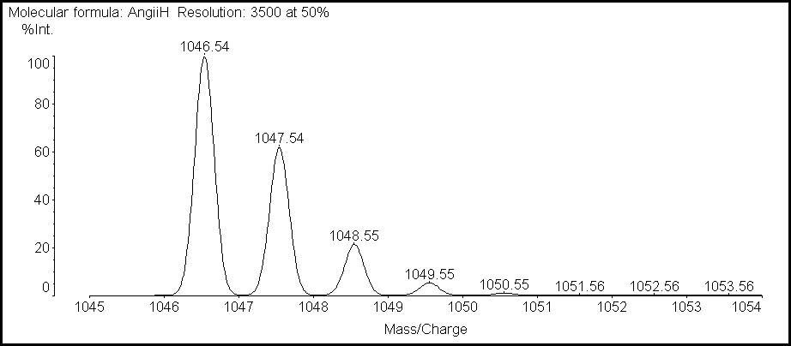
MALDI-TOF MS: Basic Principles
ion detector
mass-independent detection
of ions at a detector
time resolved output to
oscilloscope and computer
+
+
Time of Flight
+
+
Vacuum
tube
Courtesy of bioMérieux

Slide 14
MALDI-TOF MS Overview
detection
ion detector
Uncharged
Drift region
m
2eU
+
+
Vacuum
tube
=
t²
separation
z
L²
+
+
Time of Flight
ring electrode
m: mass
acceleration
z: charge
acceleration
U: acceleration voltage
+
zone
L: path length
ionization
t: time
+
desorption
e: elementary charge
matrix/analyte
Which protein molecules?
Those that are easily desorbed,
Like ribosomal proteins
Absorbs e
from LASER
crystals
target
Multiple LASER shots
Courtesy of bioMérieux
Notes:
14

Slide 15

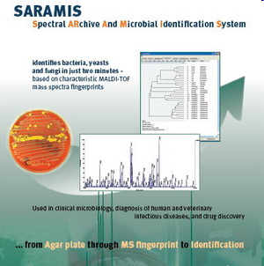
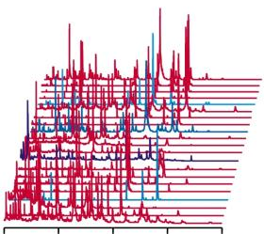
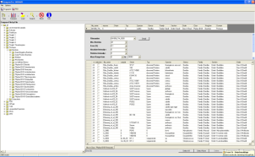
Data Interpretation
MALDI-TOF- MS Spectrum
Spectrum Acquisition
Spectral fingerprint compared to Database
Courtesy of bioMérieux
Notes:
The workflow is simple and takes less than one minute per sample. We start with picking a small part of a colony and transfer it to the template. Matrix is added and left for air drying. Second step is the automatic acquisition of a fingerprint spectrum with the AXIMA MALDI-TOF. The peak lists of the spectra were transferred to the SARAMIS software and automatically identified.
DHB = Di- hydroxy Benzoic Acid (Gives more stable signals than with other matrices).

Slide 16
MALDI-TOF SPECTRA
Intens. [a.u.]
Escherichia coli
3000
2000
1000
Intens. [a.u.]
0
Bacillus subtilis
8000
6000
4000
2000
0
1.0
Candida albicans
0.8
0.6
0.4
0.2
0.0
2500
Aspergillus fumigatus
2000
1500
1000
500
0
3000
4000
5000
6000
7000
8000
9000
10000
Courtesy of bioMérieux
m/z

Slide 17
Lysinibacillus fusiformis
Candida dattila
Candida utilis
Corynebacterium aurimucosum
Preparation for MALDI-TOF
MALDI-TOF Issues
New Technology – New Names,
Few CLSI Breakpoints
Trichosporon inkin
Pediococcus parvulus
Finegoldia magna
Propionibacterium propionicum
Eggerthella lenta

Slide 18
PATIENT HISTORY
  83 year old “questionably competent” man, living by himself in a rural area near Burlington, WI. was brought in by Social Services for evaluation of cellulitis in right leg.
  Physical exam – Ulcerations and maggot infected wounds on his right leg and groin area. Wounds cleaned and patient placed on Zosyn
    Mild erythema and shallow ulcerations consistent with venous disease
    No history of fever, chills. etc., but patient was not a reliable historian
  Labs
    WBC count 8500 mm³ (85% PMNs)
    Hgb/Hct 9.0/28.5
    Glucose 255 mg/dL
  Discharge
    Wounds clean and granulating (healing)
    Patient referred to Social Services due to inability to take care of himself

Slide 19
MICROBIOLOGY WORKUP
Wound and blood cultures taken
  Blood cultures were negative
  Wound cultures yields a Gram negative rod at 24 hours
    BAP colonies were gray-white, convex, smooth, with minimal spreading at 24 hrs. No growth on MAC at 24 hrs., pinpoint growth at 48 hrs.
    Vitek 2 – No ID
    Microscan – Oligella Spp., with low accuracy
    API 20 NE
      Brevundimonas diminuta or Oligella Spp. (~70% accuracy)
    GNR susceptibility set up
    Bruker MALD-TOF - Wohlfahrtiimonas chitinclastica (2.43)
  Sent to ARUP for sequencing (16S rDNA) and 10 days later
    Wohlfahrtiimonas chitinclastica

Slide 20
Wool farti – What!??
Spectra
Spectra comparison

Slide 21
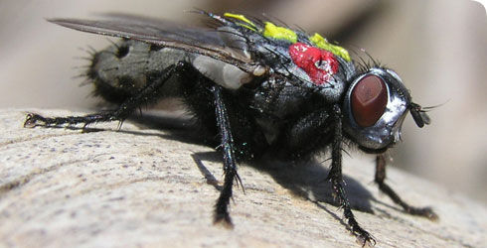
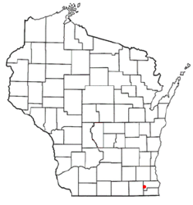
Wohlfahrtiimonas chitinclastica
Gram-negative, regular, non-motile rods. Strictly aerobic. Catalase and oxidase reactions are positive. Strong chitinase activity
Type strain, isolated from 3rd stage larvae of Wohlfahrtia magnifica
  Wohlfahrtia magnifica (spotted flesh fly) occurs in the Mediterranean basin, Near East, and Central and Eastern Europe. Not reported in U.S.
    most important myiasis-producing fly affecting camels
    Cause of myiasis in other mammals, mainly in sheep, but also in cattle, goat, horses and rarely in human
  In Cochliomyia and Wohlfahrtia infestations, larvae feed in the host for about a week, and may migrate from the subdermis to other tissues in the body, often causing extreme damage in the process
Class: Gammaproteobacteria
  Order: Xanthomonadales
    Family: Xanthomonadaceae
      (Aspromonas. Luteibacter. Silanimonas. unclassified_Xanthomonadales. Aquimonas. Dokdonella. Thermomonas. Arenimonas. Rhodanobacter. Lysobacter. Rudaea. Stenotrophomonas. Luteimonas. Dyella. Pseudoxanthomonas. Frateuria. Fulvimonas. Ignatzschineria. Xanthomonas. Xylella)
      Genus: Wohlfahrtiimonas
  Habitat
    Fly larvae
  Disease association
    Low pathogenicity, most commonly seen in debilitated or homeless individuals
      60 year old homeless person with open sores. Marseille, France (EID 2009: 15;985)
      70 year old homeless male with open sores. Buenos Aries, Argentina (JCM 49; 2011: 2333-2335)
      83 year old male “questionably competent” with open sores. – Burlington, WI

Slide 22
Summary - Wohlfahrtiimonas chitinclastica
MALDI-TOF gave correct ID within 30 hours of culture collection
  ID not reliable using conventional methods
  Sent to referral lab for Sequencing - took 10 days
Literature review
  Associated with open sores in debilitated or homeless individuals
    Limited pathogenicity
    Wohlfahrtia magnifica not reporting in U.S.
      Another vector?
  Very sensitive to β-lactams, aminoglycosides, flouroquinolones.

Slide 23
Additional Microorganisms Identified By
MALDI-TOF – Partial List
Nonfermenters
  Achromobacter denitrificans, Actinomyces europaeus,
Diptheroids
  Arthrobacter cumminsii, Propionibacterium propionicum
Anaerobic Gram positive Cocci
  Finegoldia magna, Globicatella sanguinis, Parvimonas micra, Peptoniphilus indolicus, Pediococcus parvulus
Gram positive bacilli
  Aneurinbacillus aneurinilyticus, bacillus atrophaeus, Bacillus badius, Bacillus simplex, Bacillus sporothermodurans, Carnobacterium divergens, Carnobacterium maltaromaticum, Clostridium fallax, Clostridium tyrobutyricum, Collinsella aerofaciens, Corynebacterium aurimucosum, Corynebacterium auris, corynebacterium bovis, Eggerthella lenta, Geobacillus thermodenitrificans, Lysinibacillus fusiformis, Lysinibacillus sphaericus, Weissella confusa, Virgibacillus pantothenticus,
Gram negative bacilli
  Arcobacter cryaerophilus, Campylobacter sputorum spp., Capnocytophaga ochracea, Capnocytophaga sputigena, Delftia acidvorans, Raoultella terrigena, Proteus hauseri
Yeast
  Candida dattila, Candida hellenica, Candida melibiosica, Candida norvegica, Candida silvicola, Candida valida, Cryptococcus humicola, Crypotcoccus curvatus, Cryptococcus gattii, Debaryomyces carsonii, Saccharomyces kluyveri

Slide 24
MALDI-TOF Workflow Overview

Slide 25
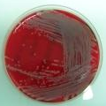
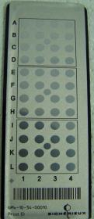
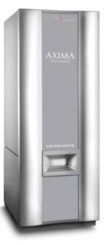


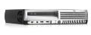
MALDI TOF Sample Preparation
Step 1
Step 2
Step 3
Step 4
Add matrix solution*
Air dry for 1-2 min.
Load target slides
Spot target slide with direct colony (can be up to 5 days old).
Create Spectra
NOTE:
Other sample types:
sediment from positive blood cultures
sediment from certain specimen (e.g. urines)
Bacteria, molds, yeasts,
mycobacteria
Target Slide
48 wells
Matrix Solution: (0.5 µl α-cyano-4-hydroxycinnamic acid)

Slide 26
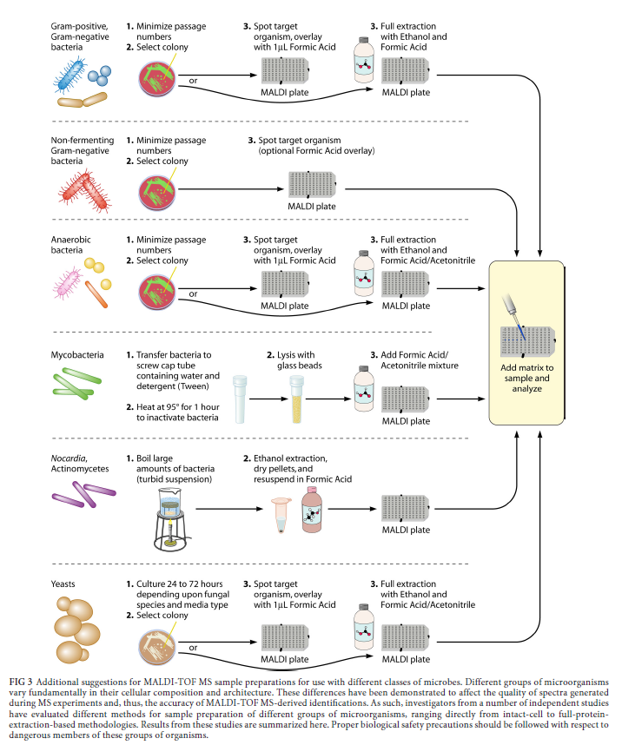
CMR 26;547-603, 2013

Slide 27
MALDI-TOF MS
Time Studies
*bioMérieux testing done in association with Limbach Labs, Germany

Slide 28
Benefits of Rapid Positive Blood Culture Identifications

Slide 29
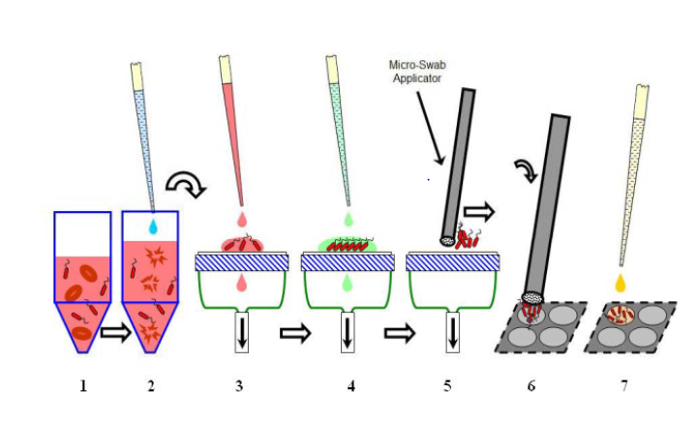
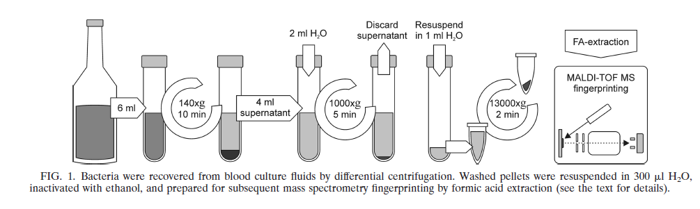
Direct Detection for Positive Blood Culture Bottles By MALDI
Purpose: Separate human and bacterial/yeast ribosomal proteins
Methods: Lysis/centrifugation or membrane filtration
Issues:
Removal of human proteins
  Extraction protocol required
Bacterial concentration
  need~10⁷/mL
Polymicrobial specimens
  Seen on Gram stain?
Charcoal
Antibiotic resistance genes
Yeasts?
Unique database, different cutoffs?
Journal of Clinical Microbiology 51;805-809, 2013
Bruker
Sepsityper
Kit
Journal of Clinical Microbiology 48;1584-1591, 2010
Definitive identifications as fast as current Gram stains!?

Slide 30
Impact of MALDI-TOF MS
Study from Methodist Hospital, Huston TX
Intervention arm (Gram Negative Bacilli):
  Integrated rapid ID with active antimicrobial stewardship
  Results called to infectious diseases pharmacist 24/7
  Pharmacist recommends de-escalation or adjustment of therapy based on the rapid ID
  Time to adjusted therapy was significantly reduced by 31 hrs.
P = 0.04
Perez KK, et al. Arch Pathol Lab Med. 2012
Notes:
The recent study by the Dr. Musser’s group at the Methodist hospital in Houston Texas integrated rapid identification of gram negative bacter from blood culture by MALDI-TOF MS with active antimicrobial stewardship using an infectious disease pharmacist as direct liaison to the clinicians. The intervention period was compared to the pre-intervention period. All blood culture results were called to the ID pharmacist 24/7 and the pharmacist would work with the clinicians to recommend de-escalation or adjustment of therapy based on the rapid ID and faster susceptibility results.
When looking at the time to inactive/no antibiotics, the difference between the pre-intervention and intervention period was significant at 24 and 48 h.
In addition, the time to adjusted therapy was significantly reduced by 31 h.

Slide 31
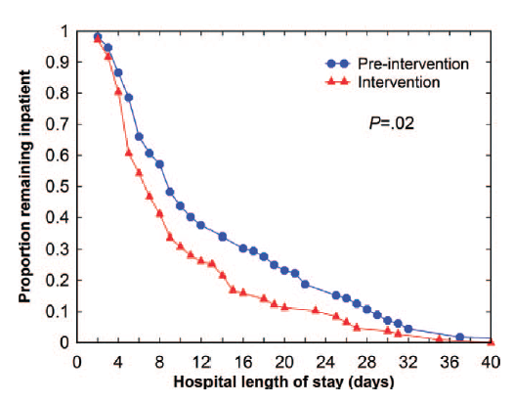
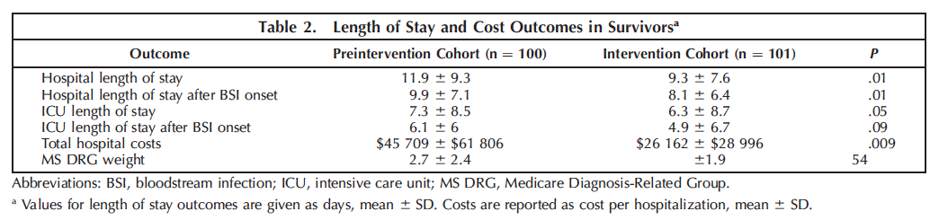
EFFECTS ON HEALTH CARE COST
Hospitalization cost reduction of $19,547/patient
Estimated cost savings of
~ $18 million annually
Perez KK, et al. Arch Pathol Lab Med. 2012
Notes:
The study also looked at the differences in length of stay, and estimated annual cost savings.
They found that the impact of combining MALDI-TOF with antimicrobial stewardship on hospital length of stay after bloodstream infection onset was 1.8 days with cost savings of $19,547/patient. Significantly, they estimated a annual cost savings of 18 million dollars.
Other study – 11% increase at 24 hours for MALDI IDs pts receiving appropriate therapy.
35%

Slide 32
MALDI-TOF Issues

Slide 33
No Test Is Perfect
E. coli Vs. Shigella
  Very closely related and cannot be differentiated
  Molecular methods
Streptococcus pneumoniae Vs. Streptococcus mitis group
  Very closely related, new databases can give a definitive ID
  Differentiate by Bile solubility or optichin disk
Bordetella pertussis Vs. Bordetella bronchioseptica
  Very closely related and cannot be differentiated
  Rarely cultured
Notes:
Tends to overcall S. pneumoniae, H. influenzae
May not differentiate taxomically related organisms Raoultella and klebsialla

Slide 34
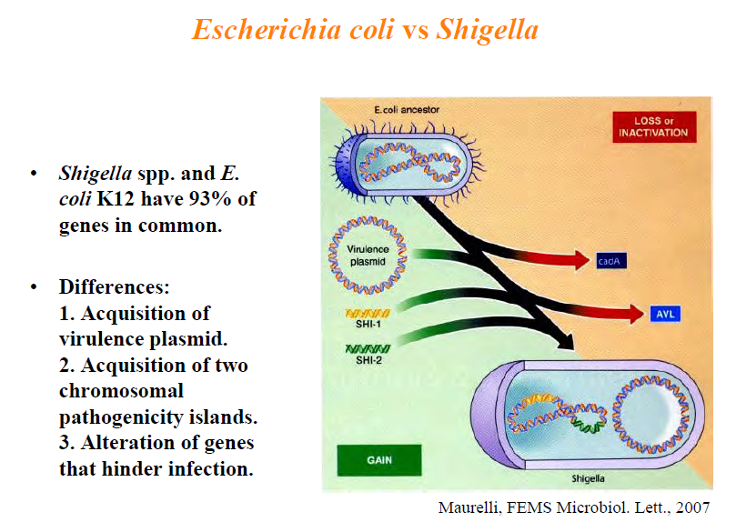

Slide 35
No Test Is Perfect
  Stenotrophomonas maltophilia Vs. Pseudomonas hibiscola, Ps. gentculata, Ps. betelli
    Very closely related and cannot be differentiated
    Biochemical ID required
  The Acinetobacter baumanii-calcoaceticus complex (A. baumanii, A. calcoaceticus, A. genospecies 3, A. genospecies 13):
    Species differentiation can be difficult.
      A. baumanii and A. calcoaceticus can be differentiated, there are several members of the “Genospecies 3” clustering with A. baumanii or A. calcoacteticus, this can lead to “A. genospecies 3” ID result where biochemistry will identify A. baumanii or A. calcoaceticus

Slide 36
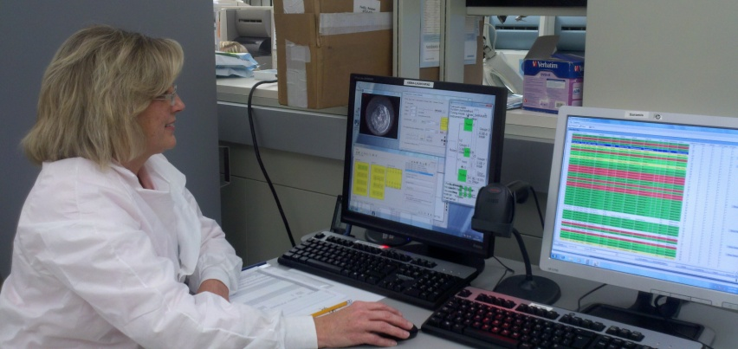
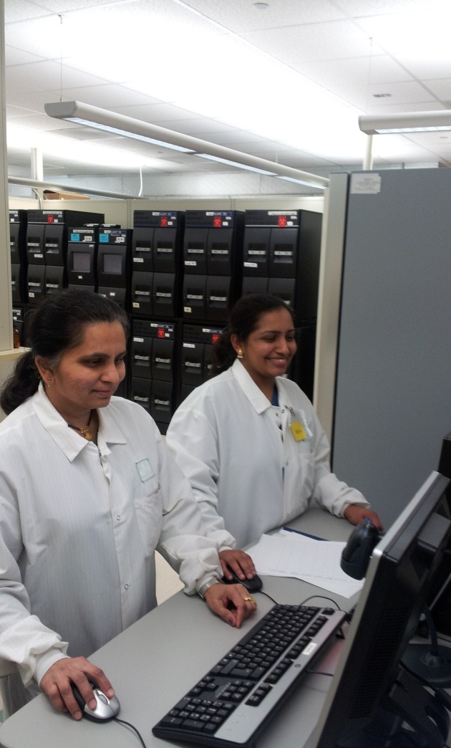
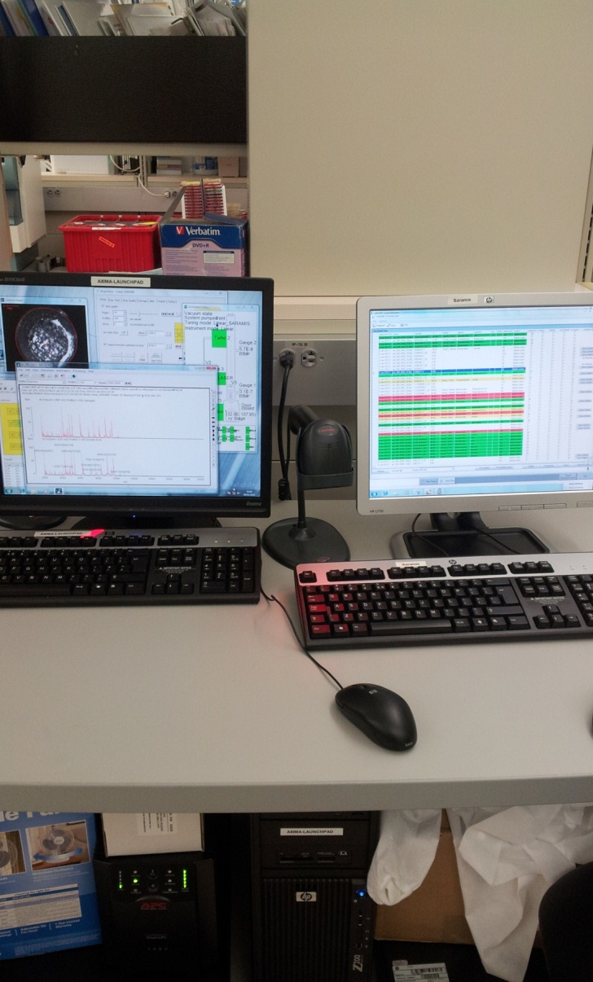
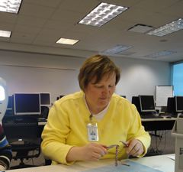
Vitek MALDI-TOF/MS Evaluation

Slide 37
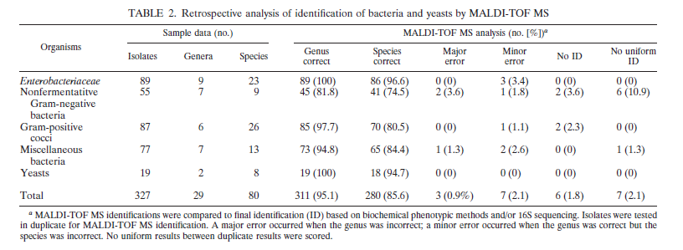
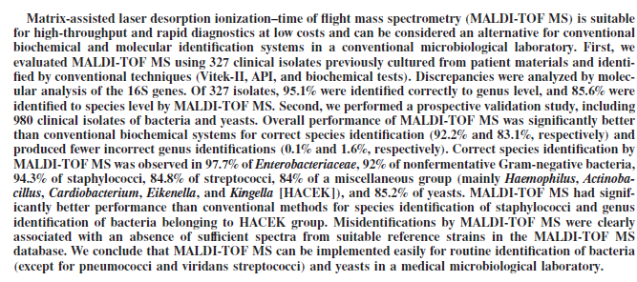
Setting Goals
v
v
v
v
v
Goals: <2% Major errors and <5% Minor errors – Better than Vitek2 or Microscan

Slide 38
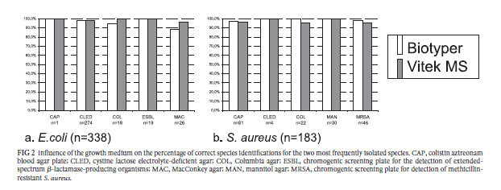
Influence of Growth Media
JCM 2012; 50;1313.

Slide 39
Evaluation Summary – Vitek MS
Bacteria | # | No ID | Minor Error | Major Error
Streptococcus | 160 | 5 (3.1%) | 5 (3.1%) | 2 (1.3%)
Staphylococcus | 171 | 2(1.2%) | 0 (0%) | 1 (0.6%)
Enterobacteriaceae | 392 | 43 (10.9%) 10 (2.6%) | 40 (10.2%) | 4 (1.0%) 2 (0.5%)*
Fastidious GNR | 27 | 4 (14.8%) 2 (7.4%) | 2 (7.4%) | 0 (0%)
Anaerobes | 109 | 11 (10.1%) 6 (5.5%) | 4 (3.7%) | 4 (3.7%)
Nonfermenters | 130 | 10 (7.7%) 6 (4.6%) | 13 (10.0%) | 3 (2.3%)
Corynebacterium | 23 | 3 (12%) 1 (4.3%) | 0 (0%) | 1 (4.3%)
Yeast | 64 | 3 (4.7%) | 1 (1.6%) | 0 (0%)
Totals | 1076 | 76 (7.4%) 35 (3.3%) | 56 (5.4%) | 13 (1.3%)
* Not including Shigella flexeri and Shigella sonnei

Slide 40
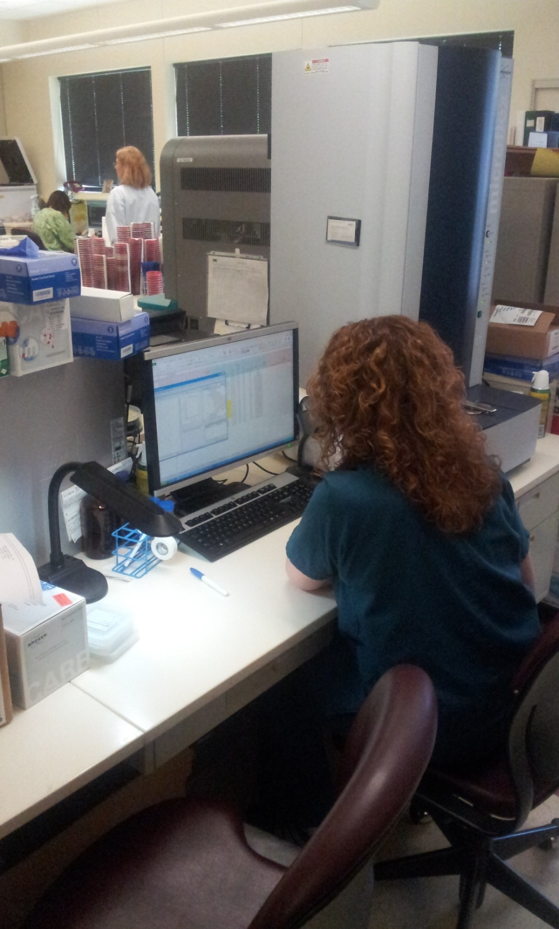
Microbiology Lab Automation
Bruker MALDI-TOF
Evaluation in progress at WAMH
Selection of automation dependent on
MALDI-TOF selection
Burker integrates best with BD or Siemens
bioMérieux MALDI-TOF integrates best
with bioMérieux products
Bacteria | # | No ID | Minor Error | Major Error
Streptococcus | 130 | 15 (11%) | 26 (20%) | 0 (0%)
Staphylococcus | 147 | 3 (2%) | 9 (5%) | 12 (8%)
Enterobacteriaceae | 435 | 12 (3%) | 37 (8.5%) | 20 (5%)
Fastidious GNR | 18 | 1 (5%) | 1 (5%) | 2 (11%)
Anaerobes | 52 | 3 (6%) | 7 (22%) | 2 (4%)
Nonfermenters | 116 | 4 (3%) | 18 (15%) | 6 (5%)
Yeast | 22 | 0 (0%) | 0 (0%) | 0 (0%)
Totals | 898 | 38 (4%) | 98(11%) | 42 (5%)

Slide 41
Evaluation Results
MALDI-TOFs are comparable
Selection should depend on your laboratories requirements.
  Current equipment
  Middle ware
  Volumes – Identifications/hour

Slide 42
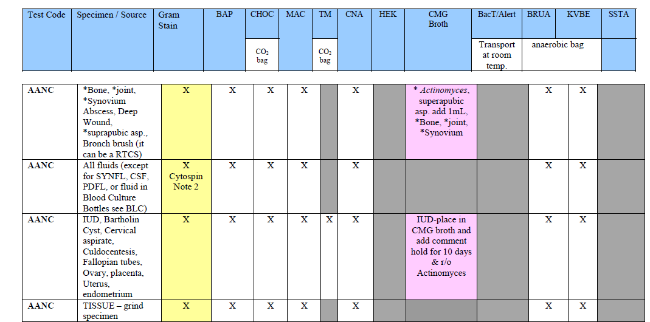
Growth Requirements for MALDI Identification
Isolated bacterial colony
The perfect MALDI Media:
Support growth of all pathogens
  Gram positive, Gram negative, aerobes, anaerobes
Small, well separated colonies
No “swarmers” allowed

Slide 43
Pre MALDI - Good Clinical Microbiology Begins With Good specimens –
Garbage In = Garbage Out
Control of sample acceptability
  Verification that appropriate sample(s) collected
  Correct volume submitted
  Sample placed promptly in correct transport media
  Optimal and timely transport conditions
  Sample handled properly in laboratory
    Shared samples
    Reflexed samples

Slide 44
MALDI-TOF Vs. Current Identification Methods
 | Tube Biochemicals | API | Rapid ID Methods | Automated Identification | Real-Time PCR | Mass Spectrometry
Sensitive and Specific |  |  |  |  |  | 
Rapid |  |  |  |  |  | 
Easy to perform |  |  |  |  |  | 
Easy to interpret |  |  |  |  |  | 
Cost Effective |  |  |  |  |  | 
High Through-Put |  |  |  |  |  | 
Use with multiple organism types |  |  |  |  |  | 
Able to interface to LIS |  |  |  |  |  | 
Can be automated |  |  |  |  |  | 

Slide 45
MALDI-TOF/MS – WHY CHANGE?
Factor | Traditional ID | MALDI ID
Antibiotic Stewardship (right antibiotic and the right time) | ++ | +++? Will rapid IDs change Rx? E. Coli Vs. P. aeruginosa
Reduce need for repeat IDs on different systems. Reduce secondary ID systems | More | Less (?)
Bioterrorism Select Agent Identification | + (rule out) | +++ (rule in?)
Automation. (Specimen prep. Total automation) | ++ | ++++
Lessen potential for contamination | ++ | +++ (less manipulation)
Medical Waste | +++ | +
Cost – To Microbiology (Equipment, reagent, and personnel costs) | More (ROI 2-5 years) | Less
Cost – To Health Care System - Use of beds, cost of inappropriate testing, nosocomial infections | More | Less
FDA approval | Yes | In progress

Slide 46
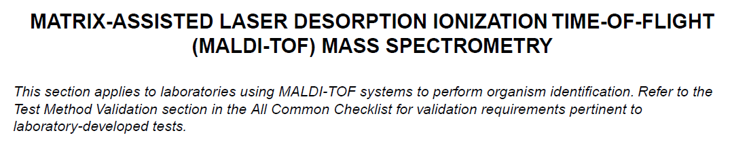
CAP Requirements
CAP Microbiology Checklist – 7/29/13

Slide 47
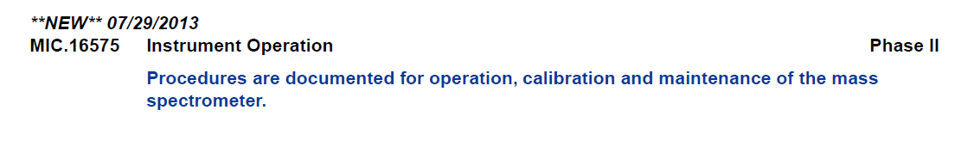
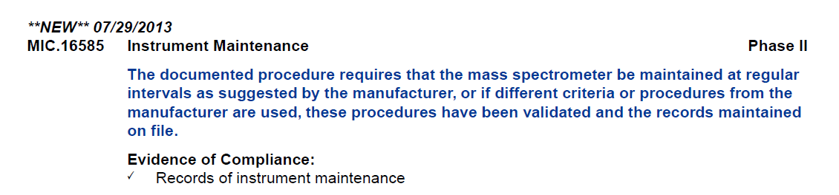

Slide 48
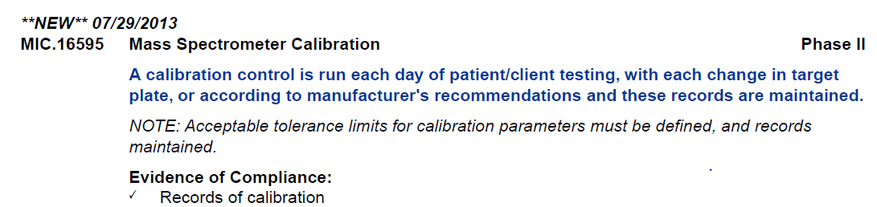
Notes:
Follow recommendations

Slide 49
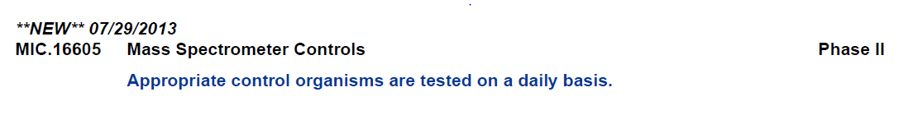
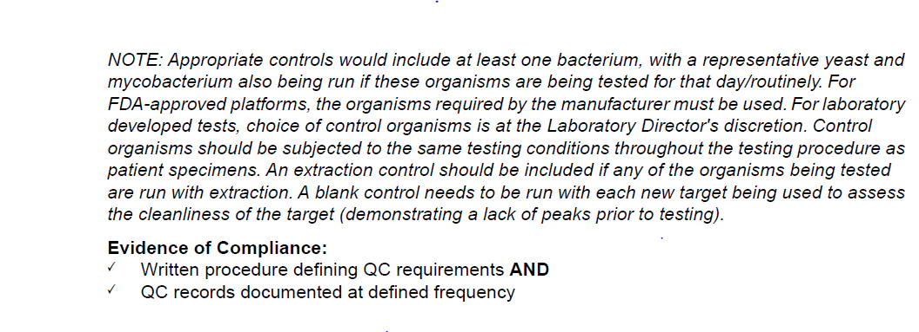
Procedure dependent – Bacteria (matrix only) Vs. yeast (formic acid and matrix)

Slide 50
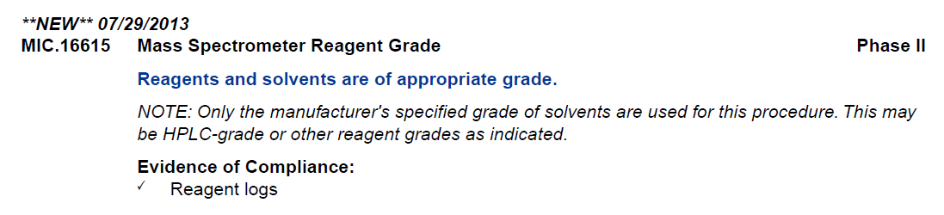
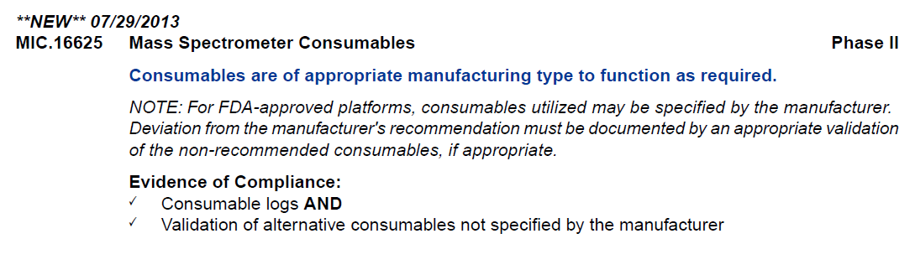
Tooth picks Vs. Culture Loops

Slide 51
MALDI Phase In Approach
Current Uses of MALDI-TOF at ACL
Blood cultures
  Not yet identifying blood culture pathogens directly form bottle. Still plating positive blood cultures.
    MALDI ID done from isolated colonies
      Time to ID decreased by 16-24 hrs.
Anaerobic cultures
  Anaerobes are now go for 72 hours before evaluation of plates.
    Colonies are identified by MALDI
      No aerotolerence testing
      Aerobic and anaerobic cultures used to be read together, but not required with MALDI.

Slide 52
Until specific CPT codes come out for the MALDI, use the following (same as current)
Anaerobe ID 87076
Aerobe ID 87077
Consult with MALDI-TOF manufacturer

Slide 53
Challenges
Comment | Pre-MALDI | Post-MALDI
Microorganism Identification | Physicians familiar with current names. CLSI breakpoints | New bacterial, fungal, yeast names. No/few CLSI breakpoints. Include ID physicians and Pharmacy in on MALDI decisions
Automation of IDs | Safety steps built-in. IDs include morphology, biochemical utilization, serological tests | Safety steps need to be defined. When to accept ID? Agree with Gram stain? Treatment?
New machine, new problems | Multiple ID methods available | Multiple ID methods retired. What do you do if you do if your MALDI breaks?

Slide 54
Challenges
Comment | Pre-MALDI | Post-MALDI
Middleware | ID and susceptibilites can be on same instrument | MALDI must interface with automated susceptibility systems, LIS, etc. Who is responsible for middleware issues?
Bacterial/yeast ID | Limited IDs. | New names, susceptibilities
Blood Cultures | Culture + bottles for ID | Culture + bottles for susceptibilities ID coagulase negative Staphylococcus. What is a contaminate? Dual infections?
TAT for susceptibilities | ID and susceptibilities reported at the same time | Delay of 24-48 hours between ID and reporting susceptibility. Redo antibiograms??
Rapid Vs. MALDI IDs |  | MALDI for sterile sites. Use rapid IDs for urines, latex IDs, indole, colony morphology.

Slide 55
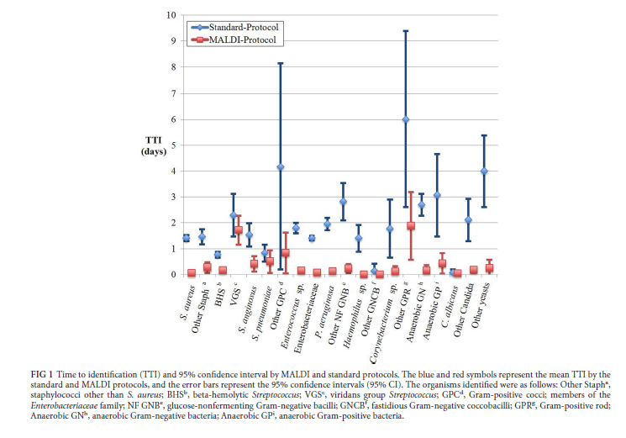
MALDI – Improved Time to Identification
JCM 50; 3301-3308, 2012

Slide 56
Summary (Cont.)
Problems with implementation
  FDA approval pending on Bruker
    Reimbursement
      New CPT code pending
  Rapid ID Vs. not so rapid susceptibility testing
    Rapid techniques are only valuable if there is someone to act on the results
      Who will act on results? Do you have a plan?
        Primary physicians, Consulting physicians, ID Pharmacists, Hospitalists?
          Team approach
      Real time, unit specific antibiograms
        Helpful because IDs are available so much sooner than suscweptibilities
      MALDI-TOF/MS susceptibilities?
        CREs?
  Connectivity - Middleware
    Positive identification of microorganism throughout the workup - Essential
  Acceptance by Microbiology Techs
    Just another tool

Slide 57
Future Uses - Detection of Carbapenemases in the Clinical Laboratory
Some β-lactamases can be inhibited by specific inhibitors
  Clavulanic acid for some ESBLs
  Boronic acid for KPC
  Chelating agents for MBLs
Reversal of sensitivity by production of carbapenemases
  Modified Hodge test
Carbapenemase detection by MALDI-TOF
  Directly measure changes in M/S by hydrolysis and, in some cases, decarboxylation of the antibiotic

Slide 58
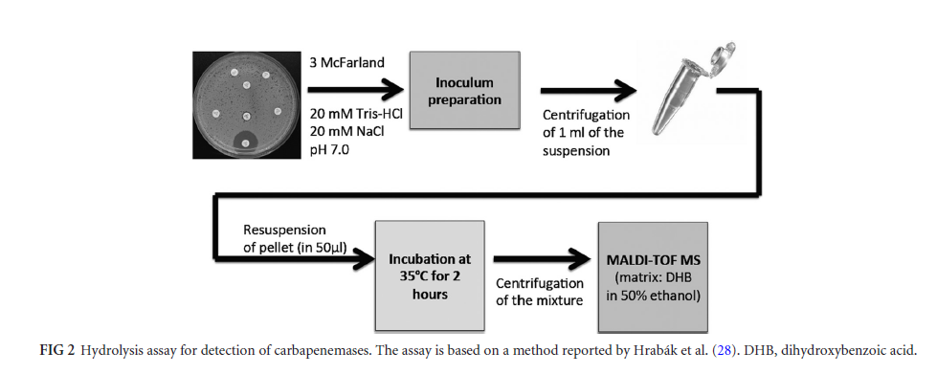
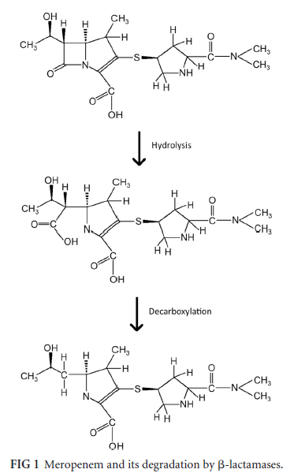
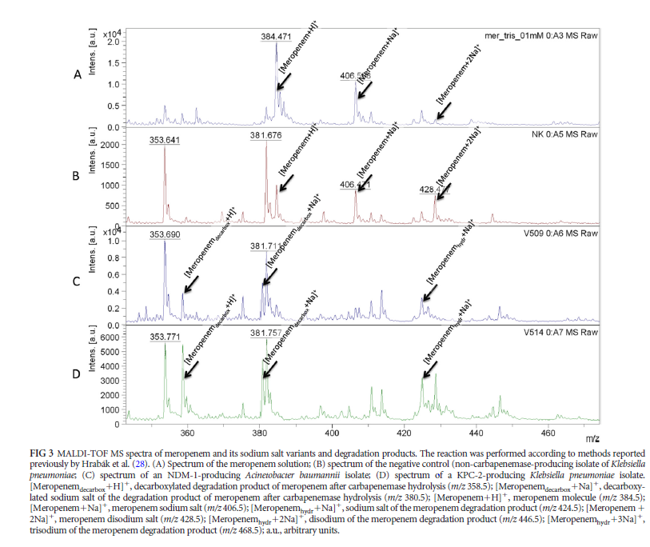
Of C-N
amine bond
Meropenem solution
Meropenem +
Carbapenemase S
K. pneumoniae
Meropenem +
NDM⁺ A. baumanii
Uses different matrix, DHB
Different scale
Meropenem +
KPC⁺ K. pneumoniae
CMR 26; 103-114, 2013

Slide 59
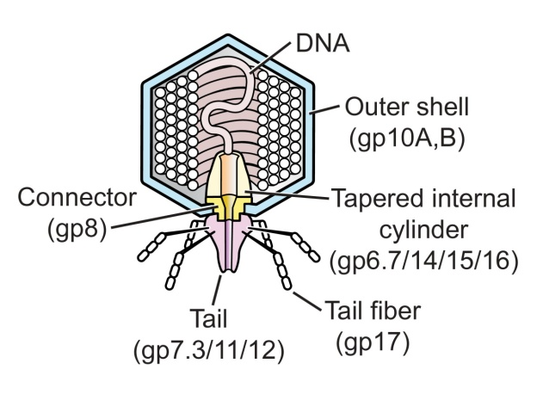
Bacterial Susceptibilities by Growth of Phages
Incubate bacteria in presence and absence of antibiotic and measure growth of bacterial phages
  Bacterial phages require viable cells to replicate, so you will only get an increase in bacterial phages if bacteria can grow in the presence of antibiotic.
  Bacterial phage proteins measured by MALDI
Detect presence of
caspid proteins
By MALDI-TOF

Slide 60
Justifications
Reagent cost savings – JCM 2012; 3301-3308
Return on investment (ROI) of 2-5 years. Reagent cost savings of 75% - JCM 2011;2980-2983
Mycobacterial culture ID. Cost savings of 40:1. – JCM 2010;4481-4486
Blood culture reduction of time to identification – JCM 2012, 3324-3328
Cost savings associated with rapid identification of positive blood cultures - Perez KK, et al. Arch Pathol Lab Med. 2012
Documents from bioMérieux or Bruker

Slide 61
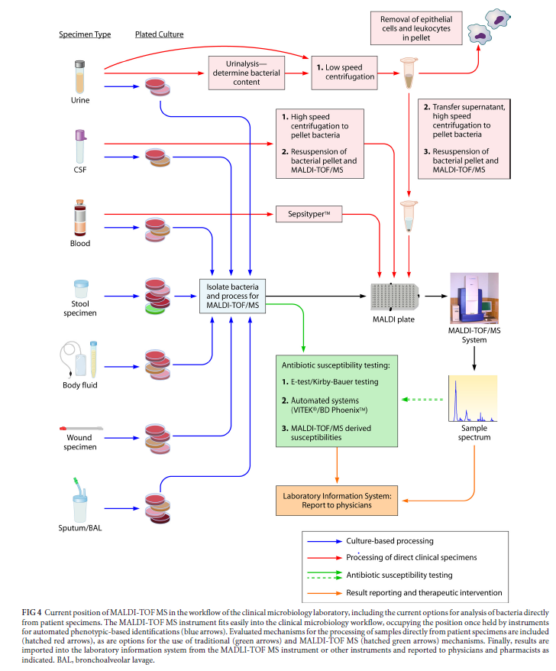
Post MALDI-TOF
CMR 26;547-603, 2013

Slide 62
Summary
Rapid identification ~ 1min per isolate
Consolidation of identification testing onto a single platform
  Current Phenotypic methods
    Gram stain, Vitek 2, Microscan, numerous API methods, disks on media, growth characteristics, selective media, chromogenic media, biochemical tests, serologic tests, enzymatic reactions
  Genotypic methods
    amplified nucleic acid methods, nucleic acid sequencing
Reduced cost per test
  Cost will be <$1.50 per determination
Reduced Hands-on-Time
    Tech setup time 2-3 minutes
Flexibility - each bench get their own target slide
High throughput – 192 isolates/run (4 hours)
Outbreak strain typing is possible, eventually. May need different matrix
  Local strains can be included in a user defined database
  Outbreaks can be identified prospectively rather than retospectively

Slide 63
Summary
MALDI-TOF/MS is faster, better, and cheaper than current full identification methods
  Modify to fit your laboratory.
    Use in conjunction with rapid methods
    RUO Vs. IVD databases
      Amount of validation required??
  Same identification expertise on all shifts
  Retrospective outbreak evaluations
  Identification directly from positive blood culture bottles and other body fluids
  Identification not dependent on interaction with biochemicals
Limited reference spectra in database for some genera and species
  Identifications will get better
Can be automated
  Next big change in Clinical Microbiology

Slide 64
Summary (Cont.)
MALDI-TOF/MS Vs. Molecular Identification
  Complementary technologies
    MALDI - requires isolated colonies or high bacterial concentrations (>10⁵/mL)
    Molecular - direct ID from patient specimens and detection of resistance genes
    Sequencing can back-up MALDI IDs
It is the future

Slide 65

Thank You!

