Slide 1
Influenza & Other Respiratory Viruses Update
2013-2014
Pete Shult, PhD.
Director, Communicable Disease Division
and Emergency Response
Erik Reisdorf, MPH M (ASCP)^{CM}
Team Lead, Virology Laboratory
WCLN Audioconference
September 25, 2013

Slide 2
Objectives
Describe influenza activity during the 2012-2013 season and what is anticipated for the upcoming season.
Discuss current influenza diagnostic technologies and trends.
Summarize strategies for laboratory-based surveillance for influenza, respiratory viruses and rotavirus in Wisconsin during the 2013-14 season.

Slide 3
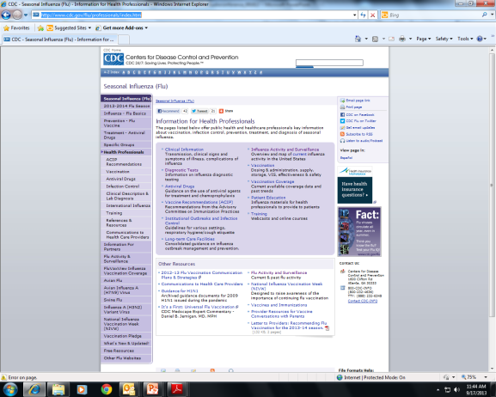
Influenza
The Latest Information
http://www.cdc.gov/flu/professionals/index.htm
Notes:
Excellent resources to be found at the CDC’s Seasonal influenza website and a subsite that provides updates on the influenza variant viruses we will hear more about in detail from Julie.
Best single source of basic influenza information, up-to-date info on the vaccine and antivirals, laboratory diagnostics and a portal for weekly surveillance updates
Information geared to both professionals and the general population
ProMED –mail (www.promedmail.org) good source of information on immediate occurrences (variants, H5N1, outbreaks, antiviral resistance etc.)

Slide 4
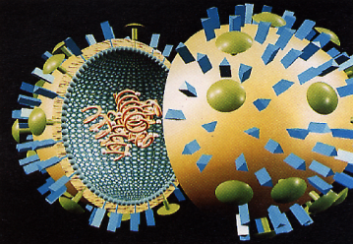
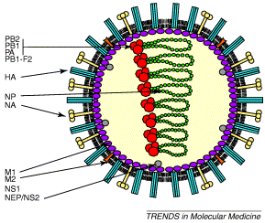
Influenza’s Gonna Continue to do What Influenza Does: Change!
Influenza types A, B and C
  A and B are major human pathogens
Negative-sense segmented RNA genome
  10 major proteins
Two major surface proteins of A and B viruses:
    Hemagglutinin (HA)
    Neuraminidase (NA)
Notes:
Now to get started , slide 5 presents a quick visual review of the key features of the influenza virus responsible for its ability to readily change antigenically: this is the real hallmark of this virus
Classification and nomenclature of influenza is based largely on its antigenic presentation.
Relevant key features:
There are 3 types of influenza based on internal antigenic determinants; only 2 of these (A & B) are significant clinically and in PH sense
RNA-containing genome
Consequences for mutation: very prone to mutation via errors in transcription and without adequate “proof-reading” mechanisms capable of editing out the errors
Key surface components
HA and NA
Relevance to nomenclature
Defines subtypes of influenza A
Importance in pathogenesis and against which a large measure of the host immune response is directed
Prone to mutation (particularly the HA
Essentially a moving target for the host population immune response
Genome is segmented
Enabling two different influenza A viruses that might infect the same host to “reassort” gene segments leading to a virus that might have a novel HA and/or NA
Influenza type A, but not type B, has subtypes based on antigenic determinants found on the HA and NA
The consequences of these genetic changes is highlighted on the following slide…slide 6

Slide 5
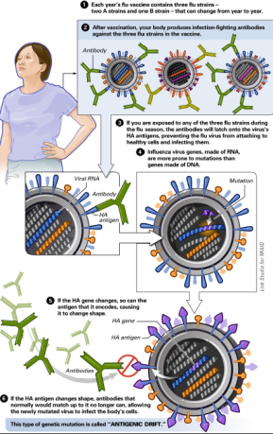
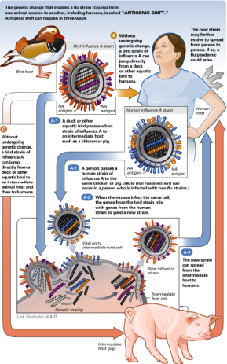
The Changeability of Influenza
Antigenic Drift and Shift www.flu.gov
Antigenic Shift
Antigenic Drift
Notes:
A nice diagram that describes the 2 main mechanisms of antigenic change:
Antigenic Drift
Which manifests in the HA and NA as a result of continuous and gradual accumulation of point mutations in the genes coding for these glycoproteins leading to development of new strains
Result of immune selection within the population
Occurs throughout year as virus circulates globally
Occurs with both influenza A and B
Associated with seasonal epidemics and results in the need to change one or more components of the vaccine almost every year
Antigenic Shift
When a new subtype of influenza A emerges in humans either directly from an avian source or possibly following a genetic reassortment event in an animal intermediate host
Can Occur suddenly
This can occur in 3 ways highlighted in the diagram
Necessary precursor for an influenza pandemic.
Antigenic Shift 1
A duck or other aquatic bird passes a bird strain of influenza A to an intermediate host such as a chicken or pig.
A person passes a human strain of influenza A to the same chicken or pig.
When the viruses infect the same cell, the genes from the bird strain mix with genes from the human strain to yield a new strain(reassortment).
The new strain can spread from the intermediate host to humans. (e.g. 2009H1N1, trH3N2)
Antigenic Shift 2
Without undergoing genetic change, a bird strain of influenza A can jump directly from a duck or other aquatic bird to humans.
Antigenic Shift 3
Without undergoing genetic change, a bird strain of influenza A can jump directly from a duck or other aquatic bird to an intermediate animal host and then to humans.
Now

Slide 6








Influenza: The Premise Behind
Antigenic Shift
    Influenza A
    H1 - H17
    N1 – N10
Aquatic birds
Poultry
Humans
Pigs
Horses
Aquatic
mammals
Cats
Dogs
Notes:
Influenza at the Human-Animal Interface
Influenza A naturally occurs in aquatic birds (waterfowl and shore birds), the natural zoonotic host for Inf A, but also a range of other species.
There are now 17 subtypes of HA and 10 subtypes of NA. These surface glycoproteins are the key antigenic determinants to man.
Most recent H and N subtypes identified in a new bat influenza recently discovered. Further extends the genetic pool of flu viruses that could impact man

Slide 7
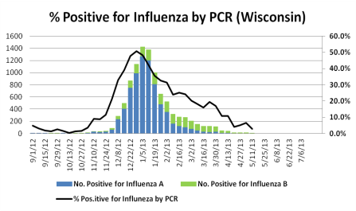
“Year in Review”– Influenza in WI
Primarily Influenza A (H3N2)
Peak activity last week in December
Co-circulation of both influenza types and subtypes
Influenza B—end of season
Antiviral resistance

Slide 8
“Year in Review”– Severity
National: Pneumonia & Influenza Diagnosis (P&I) index was highest recorded in nearly a decade
Statewide: Marked increase in influenza-related hospitalizations
Flu Season | A/H1 | A/H3 | Inf B
2010-2011 | 158 | 105 | 79
2011-2012 | 9 | 47 | 82
2012-2013 | 17 | 441 | 440
Data: Tom Haupt, MS. (2013)WI Division of Public Health

Slide 9
H3N2 variant—where did it go?
States Reporting Influenza “Variant” Virus Detections—Sept. 16, 2013
States-Influenza “variant” | H3N2v | H1N1v
Indiana | 14
Michigan | 2
Arkansas |  | 2
Illinois | 1
Ohio | 1
Wisconsin | 0 | 0
Effective implementation of mitigation measures for fairs
Increased awareness of fair attendees
May represent decreased circulation in swine

Slide 10
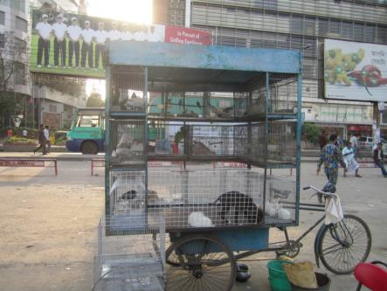
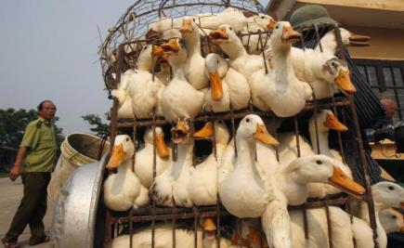
H7N9 —Emergence of a novel Avian Flu
Background
Emerged in March 2013 in Chinese bird markets
Quickly spread to many provinces and Taiwan
Drop in cases coincided with the end of “flu season”
Image source: Kham/Reuters. http://www.citypress.co.za/news/china-bird-flu-virus-found-in-more-markets-in-shanghai/

Slide 11
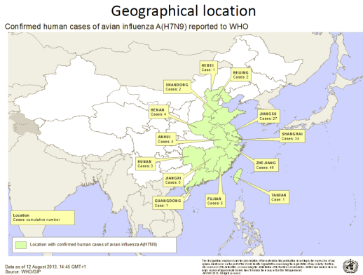
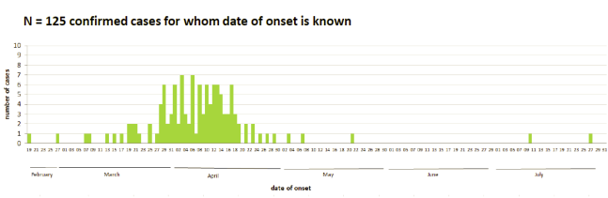
Geographic Distribution of human cases H7N9- Aug. 2013
Cases | Deaths
135 | 44
32% CFR
Source: WHO. Available at: www.WHO.int. Accessed on: 16 Sept. 2013

Slide 12
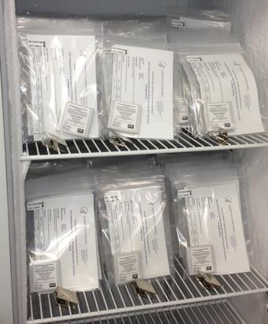
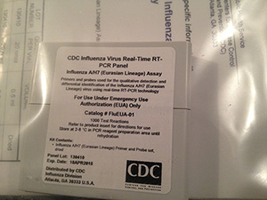
Public Health Response — H7N9
Mitigation
Sensitive to the antiviral neuraminidase inhibitor drugs
Candidate pre-pandemic vaccine studies underway
Contact LPH or WDPH with suspect cases
Diagnostics
EUA issued in April 2013
Image Source: www.cdc.gov

Slide 13
Key Points — H7N9
Virus is different than H5N1 avian flu.
H7N9 can infect different cell types.
Does NOT cause mortality in chickens.
H7N9 has NOT acquired all of the properties for efficient human transmission.
Detection ability of commercial assays Hatchette et al., (2013) Detection of Influenza H7N9: All Molecular Tests are Not Equal. JCM epub 21 Aug 2013
Influenza viruses are constantly changing---Monitoring high public health concern

Slide 14
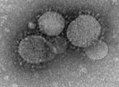
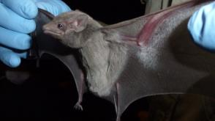
Middle Eastern Respiratory Syndrome-- MERS- Coronavirus
Background
Emerged from the Middle East in 2012.
Virus is different than SARS-Coronavirus.
Virus reservoir remains unknown.
Transmission dynamics not well understood.
Limited human transmission suspected.
Source: http://www.cdc.gov/coronavirus/mers/
Source: http://www.nature.com/news/deadly-coronavirus-found-in-bats-1.13597

Slide 15
Middle Eastern Respiratory Syndrome-- MERS- Coronavirus
Source: http://www.cdc.gov/coronavirus/mers/
Current Situation [Sept. 16, 2013]
Countries | Cases (deaths)
Saudi Arabia | 90 (44)
UAE | 6 (2)
Qatar | 5 (2)
United Kingdom | 3 (2)
Tunisia | 3 (1)
Italy | 3 (0)
France | 2 (1)
Jordan | 2 (2)
Cases | Deaths
114 | 54
47% CFR
Source: CDC (2013) Available at: http://www.cdc.gov/coronavirus/mers/faq.html

Slide 16
Middle Eastern Respiratory Syndrome-- MERS- Coronavirus
Source: http://www.cdc.gov/coronavirus/mers/
Public Health Response
FDA issued an EUA on June 5, 2013
Diagnostic testing available at WSLH for approved specimens
Contact Local Public Health or WI Div. of Public Health with suspect cases
NOTE: Criteria differs significantly from H7N9 suspect cases
Notes:
1. Geographic distribution differs from H7N9
2. Recommended specimens include combined NP/OP, serum, blood and stool.
3. Timing from onset to specimen collection is extended
If possible, multiple sampling is recommended

Slide 17
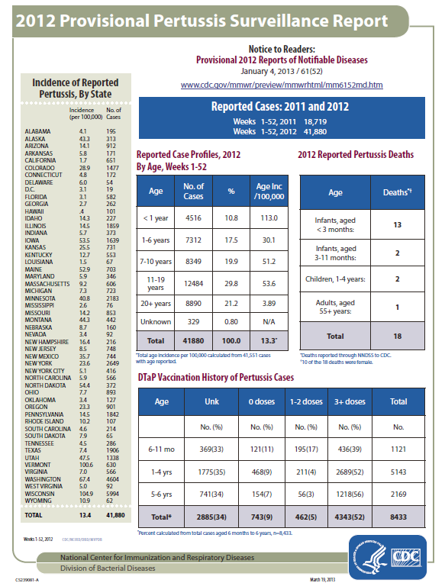
B. pertussis, 2012-2013
National
2X cases in the US

Slide 18
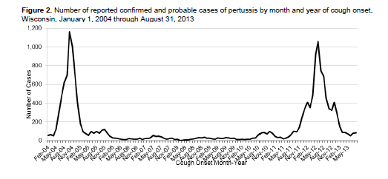
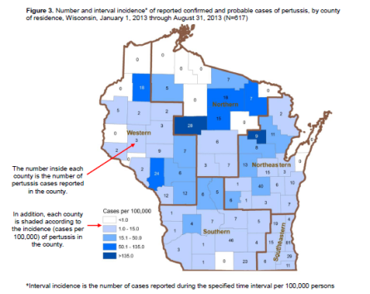
B. pertussis, 2012-2013
Wisconsin
Epidemiology (2013)
Median age:10.9yr
Range: <1mo to 95yr
Hospitalization: 4%
Data: WI Div of Public Health. Pertussis Report Sept. 2013.

Slide 19


U.S. Influenza Surveillance www.cdc.gov/flu/weekly
Morbidity
Surveillance
(3 components)
Virologic
Surveillance
(3 components)
Mortality
Surveillance
(2 components)
Health Departments
CDC
State-level data to state surveillance coordinators
Notes:
Every novel influenza event really highlights the necessity and importance of influenza surveillance.
The reason: when the influenza virus changes the concern is that their will be:
Changes in the clinical and epidemiological presentation of the resulting infections and illnesses
Change in effectiveness of treatments and prophylaxis
Changes in detection
Fortunately, the U.S. has a very robust and comprehensive surveillance program made up of three components:
Virologic surveillance:
Involves critical role for the PHL (both state and local) and clinical labs who function as :
US WHO Collaborating Laboratories (85 labs)
National Respiratory and Enteric Virus System (NREVSS, 60 mostly hospital clinical labs)
Morbidity surveillance: ILINet(outpatient), FluSurv-Net(hospitalizations), State/Territorial Epi surv(Level of spread of flu activity).
Mortality surveillance: 122 cities mortality reporting, Flu-associated pediatric deaths
Data from all elements of surveillance go to FluView and to State Flu Surv. Coordinators
State coordinators in turn share with LHDs, clinicians, media and public
We will focus on virologic surveillance over the next series of slides, including an update on efforts to improve the efficiency and effectiveness of virologic surveillance (the so-called Virologic Surveillance Right-Size project)

Slide 20
Influenza Virologic Surveillance
Goals
Provide situational awareness
  When season begins/ends; # tests performed/positivity rate; types/subtypes/strains circulating; when and where circulating; clinical severity; community impact; age groups targeted; reliability of diagnostic methods
Detect novel or reassortant viruses
Inform vaccine strain selection
Detect and monitor antiviral resistance
Notes:
Virologic Surveillance, the arm of surveillance that most impacts the lab, is key to monitoring circulating influenza viruses:
provides situational awareness, i.e….
Percent positivity is lab-based surrogate for influenza prevalence
allows for detection of novel viruses
informs vaccine strain selection, and…
allows antiviral resistance to be detected and monitored
PHLs play a principle and central role in virologic surveillance by:
routinely provide weekly reports to CDC that quantify the # of specimens tested and the # of specimens positive (including the type, subtype of virus age group)
routinely forward virus isolates and positive specimens(or extracts) to CDC for further characterization
can be either seasonal viruses or suspect novel viruses
to CDC directly or via contract PHLs (Hear more about guidelines for this during teleconferences later today and next Tuesday
Vaccine strain selection is carried out by CDC; however, it is critically important that PHLs consistently provide specimens/isolates to CDC throughout the year to support this effort
0f course, the primary diagnostic test employed by PHLs is: CDC Flu rRT-PCR Dx Panel
Other tests might be variably used in addition.
Provides highest sensitivity and specificity, uniformity across all PHLs and ability to detect novel influenza A viruses as demonstrated first during the 2009 H1N1 pandemic and more recently during the emergence of the various flu A variants
Jumping ahead a bit (and to plant the seed), in the context of the Influenza Virologic Surv. Right-size project, which I will discuss shortly, one needs to ask how much testing needs to be done in our individual labs and countrywide to achieve these

Slide 21
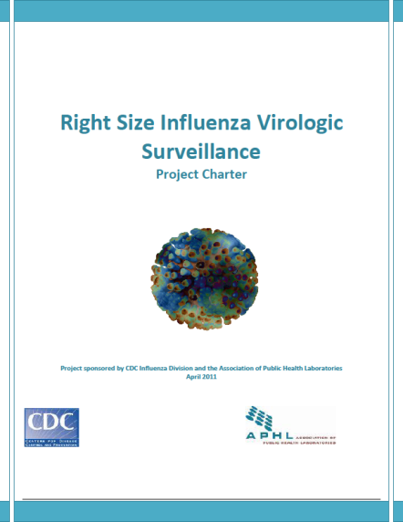
The Influenza Virologic Surveillance Right Size Project and Roadmap - The Process
Notes:
Issues that came to light during the ARR and recognized even before the pandemic include:
A statistical, systematic approach to virologic surveillance is lacking
Lack of uniform standards and data from state to state and difficulty in balancing state/local demands on capacity with national surveillance needs
Widely varying capabilities and capacities among PHLs meant that lab capacity was often a driver of testing decisions to support surveillance
During the past several years, there has been significant funding to build lab capacity including:
With potential declines in funding likely, need to sustain this capacity by improving efficiency?
The project began nearly 3 years ago and has been shepherded by a lead workgroup comprised of members of the APHL flu subcommittee, leadership and staff from the CDC Influenza Division, and current and former APHL staff. .
One of the first tasks was development of a Charter which was approved in April 2011 and is shown on this slide. The groups mentioned above all worked to create this document and it has been invaluable in guiding the project

Slide 22
Influenza Virologic Surveillance
Right Size Project - Objectives
Define core capabilities and optimal “right‐size” for influenza virologic surveillance to support state, national and global surveillance efforts and better help us to inform policy decisions and disease prevention efforts.
  Provide a statistical, systematic approach to virologic surveillance to enable better evidence-based decisions
Maximize available resources,
  Build new or re-direct existing capacity as needed for optimal surveillance.
Create a scalable approach to meet outbreak or
pandemic surge needs.
Notes:
The Charter defined several Project Objectives
You can essentially read these
No need to read sub-bullet under third bullet
The question has been posed: Why “right size”?
This does not imply “downsize”
We mean “right” in the context of the correct/optimal, size
Some states(after they go through the right-size process, which will be briefly described) might find they need to do more virologic surv., some less and some may be doing it “just right” for their jurisdiction and in support of national surveillance needs!

Slide 23
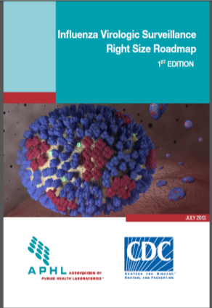
The Influenza Virologic Surveillance
Right Size Roadmap www.aphl.org/Right-Size-Influenza
Roadmap to achieve an effective virologic surveillance system:
Requirements: define state and national virologic surveillance needs, and associated functional requirements of state and local public health laboratories.
Implementation Guidance/toolkit for CDC, state and local health departments and public health laboratories
  Help operationalize the requirements
Sample Size Calculators to determine effective sample size needed to detect/monitor key virologic surveillance objectives.
Notes:
Pete
The Charter also defined key deliverables for the Project
These deliverables now reside in what is called the Influenza Virologic Surveillance Right Size Roadmap Document
Why call it a Roadmap?
This document helps us identify where we are now and where we want to get to in terms of more effective, efficient virologic surveillance…this document provides a map of how we might want to do this.
Can also think of this as a structured document to provide information, guidance, suggestions and best practices to help create a more efficient, more effective and more cost effective system for virologic surveillance that serves us not only at the local and state levels, which is this audience’s primary concern, but at the national level as well.
Document includes:
read each of the bullets. E.g. “There is a Requirements section that…
In this context, a requirement is an essential component of virologic surveillance that is needed to produce reliable results to achieve state and national surveillance goals
These are functional requirements:
Build optimal surv.system
Measure/improve existing systems
Focus resources
Justify funding needs

Slide 24
Right Size Influenza Virologic
Surveillance Requirements
Sampling (sample size and representativeness)
Laboratory Testing
Data Management
Partnerships and Communications
Quality Systems (performance metrics, benchmarks)
Surge (outbreaks, novel events, pandemics)
Financial Resources
Requirements developed based on multiple engagements
over 2 years of stakeholder (epi and lab) input.
Notes:
Focus on partnerships
A number of these, notably with epi’s; however… next slide
Epidemiologists/Influenza Coordinators
Public Health Laboratories
CDC
Clinical Laboratories
Commercial laboratories
Academic laboratories
RIDT Sites
Clinicians

Slide 25
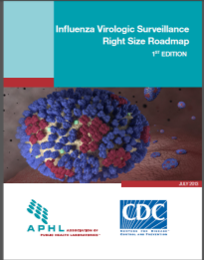
The Importance of Partnerships and Communication in Influenza Surveillance
Partnerships & Communication Section
“A strong PHL/epidemiology/
clinical-commercial-academic laboratory
partnership will support the
formation of an effective specimen
submitter network and enhance
information sharing and outbreak response.”
Notes:
Data and information

Slide 26
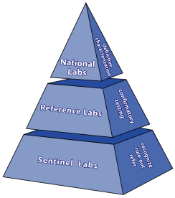
How Can the PHL-Clinical Lab Partnership Benefit Influenza Surveillance?
The LRN
  The original purpose
  “All hazards”
  Past impacts on influenza
    Routine surveillance
    2009 pandemic response
    2012 H3N2v outbreak
The LRN
Notes:
Start with question: How can the PHL-clinical lab partnership benefit surveillance
The framework for the laboratory response to BT or any PH emergency was developed over the last decade …I’m referring to the LRN with its front-line clinical diagnostic labs, the PHL serving a central coordinating, reference testing and, most importantly, surveillance role within each state, and at the top, the CDC, supported the efforts of all labs within each state, working primarily through the PHL…in essence coordinating a network of state-based networks.
Key elements of this framework: Partnering for preparedness and response across all diagnostic levels and uniform response across country with consensus methods, reagents and diagnostic equipment
This is an “all hazards” network
So a structure for the PHL-clinical laboratory partnership to support flu surveillance exists

Slide 27
How Can the PHL-Clinical Lab Partnership Benefit Influenza Surveillance?
LRN
Diagnostic technologies available
  Influenza rRT- PCR
    PHLs
    Clinical laboratories
Notes:
In all state and many local PHLs, rRT-PCR is now the primary diagnostic method for influenza
Provides rapid, sensitive and accurate detection and identification of influenza viruses for routine surveillance, outbreak detection and pandemic response
Has enabled rapid detection of novel strains as well
The CDC Human Influenza Virus Real-Time RT-PCR Diagnostic Panel (CDC Flu rRT-PCR Dx Panel) used …a warm base
As new subtypes detected(H7N9), under EUA new test roled out to PHLs
Standardized test across all PHLs
Detects current strains
Continually assessed and updated as needed to detect strain variations
Should detect novel viruses
The situation with clinical labs in regards to influenza diagnostics continues to rapidly evolve with a number of FDA-approved kits available and more and more labs employing rRT-PCR…Next slide

Slide 28
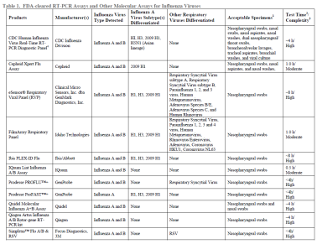
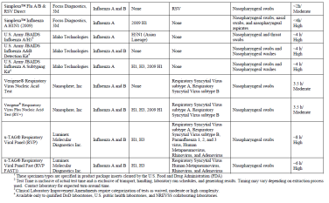
Commercially Available FDA-cleared Molecular Assays for Influenza Viruses – More Tests http://www.cdc.gov/flu/professionals/diagnosis/molecular-assays.htm
Notes:
Hundreds of sites in our states performing these tests creating 10,000s of data points
Critical to reach out to the users of these tests to get not only their data but access to specimens
For further subtyping as part of situational awareness
To confirm presence of novel viruses
If not subtypable with those tests capable of some degree of subtyping
If off season or travel history or some other indicator seems to point to possibility strain may be novel
May have to provide guidance for these labs…things to consider that push them to contact PHLs or forward specimens.
Requires close communication
PHL to clinical lab to event of concern (H7N9, H3N2v)
Clinical lab to PHL if they have suspicions of novel
Also need to facilitate specimen getting to PHL: free transport, collection supplies, testing

Slide 29
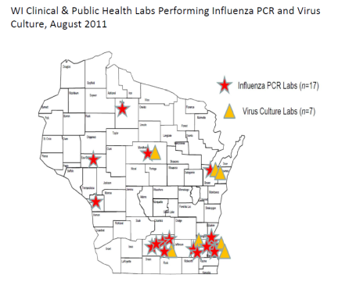
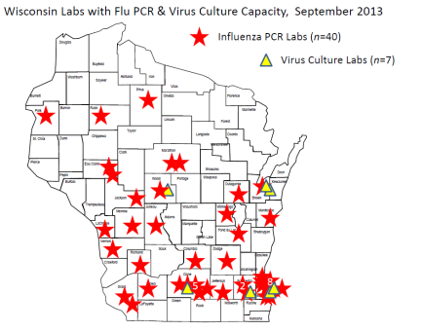
Commercially Available FDA-cleared Molecular Assays for Influenza Viruses - More and More Labs Using Them
Notes:
I want to highlight some points by looking at the situation in WI, particularly in the context of the emergence of H3N2v
The diagnostic times are indeed changing in the clinical lab and that probably comes as no surprise to anyone on this call
But the scope of change and rapidity with which it’s occurring frankly has surprised many of us
Immediately prior to the pandemic, we knew of ~4-6 labs doing PCR for flu; including our 2 largest PHLs
As of August, 2011, there were 17
As of Sept 2013….
A number of these are very small labs
Bottomline: We should recognize that labs performing these tests are critical to flu surveillance:
# of labs
Reliable test results
1000’s of tests being performed representing thousands of potential data points and thousands of potential specimens for further characterization

Slide 30
How Can the PHL-Clinical Lab Partnership Benefit Influenza Surveillance?
LRN
Diagnostic technologies employed
  PCR
  RIDTs
Notes:
Many clinical labs and physician office labs and more non-traditional testing sites continue to use these tests
I’m sure we are all familiar with the advantages and disadvantages of these tests
Limitation really came to the forefront when poor performance, specifically very low sensitivity, for a number of these kits was described both by the CDC and in the per-reviewed literature
However, a number of factors for why sites using these tests still can participate effectively in influenza surveillance
Need ongoing assessment of performance of these tests
Seasonal strains
When novel strains have been detected
Need awareness and then confirmation of results when tests performed early and off-season.

Slide 31
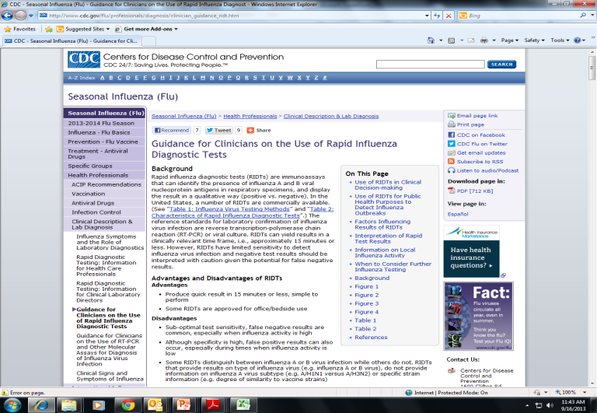
Guidance for Clinicians on the Use of Rapid Influenza Diagnostic Tests (RIDTs) http://www.cdc.gov/flu/professionals/diagnosis/clinician_guidance_ridt.htm
Notes:
See “On this page”
In addition, there is Table listing FDA-approved RIDTs
Despite the limitation of these tests, they are in large demand and consequently widely used. Therefore much effort in providing guidance for laboratorians and their clinicians to optimize usage and interpretation.
Topics on this page are listed include:
Advantages and disadvantages
Use of RIDTs in clinical decision making
Use of RIDTs for PH purposes (detect outbreaks)
Factors influencing results of RIDTs
Interpretation of RIDT results
Information on local flu activity
When to consider further influenza testing
Most importantly, series of algorithms to guide the use and interpretation of these tests

Slide 32
Factors Influencing Results of RIDTs
Clinical signs and symptoms consistent with influenza
Prevalence of influenza activity in the population tested
Timing of specimen collection during illness
Type and quality of the respiratory specimen
Proper specimen handling
  Use of appropriate VTM; maintain at 4-8°C
Virus type and strain
Age of patient
Recent vaccination with LAIV
Notes:
Importance of following kit instructions
Considerable body of data in the literature and kit inserts that indicates taking these factors into account can significantly improve RIDT test performance and value for clinical management and surveillance activities

Slide 33
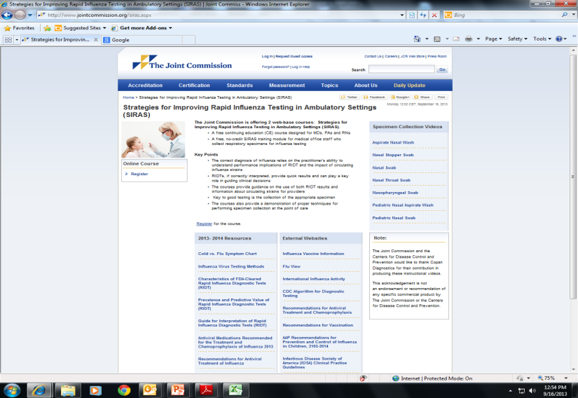
Further Guidance For the Use of RIDTs http://www.jointcommission.org/siras.aspx

Slide 34
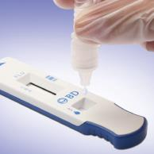
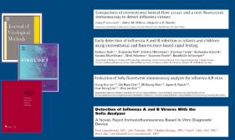
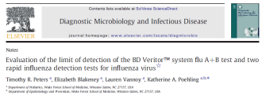
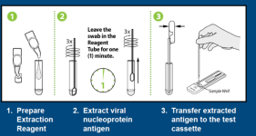
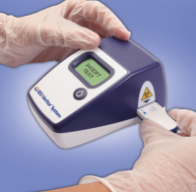
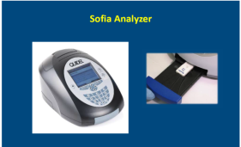

Technology Advances With the RIDTs(I)
Implications for Surveillance
B-D Veritor
QUIDEL Sofia
Notes:
Both B-D and Quidel have next-gen RIDTs
Both CLIA-waived and Moderately complex tests
Improved sensitivity, objectivity and easy performance

Slide 35
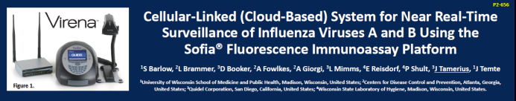
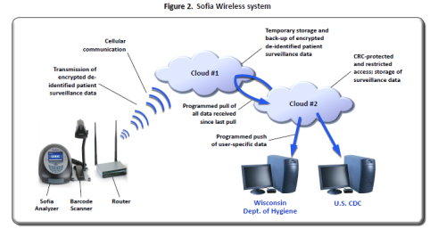
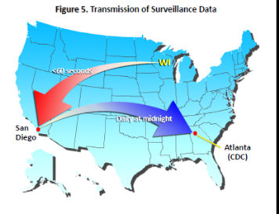
Technology Advances With the RIDTs(II)
Implications for Surveillance
Notes:
From a poster presented at the Options VIII Influenza meeting, South Africa
Collaborative study among CDC, UW-Madison and Quidel Corp.

Slide 36
How Can the PHL-Clinical Lab Partnership Benefit Influenza Surveillance?
LRN
Diagnostic technologies employed
  PCR
  RIDTs
  Molecular Respiratory Virus
  Panels(RVPs)
Notes:
Importance of other respiratory pathogens throughout year
Shared clinical and epi features with flu
Especially important early, late and off-season
Also important during very mild flu years
Clinicians find these data useful in patient assessment
When other PH threats like pertussis increase in prevalence: is it pertussis or something else
Outbreak detection and response especially in LTCF and other institutional setting

Slide 37
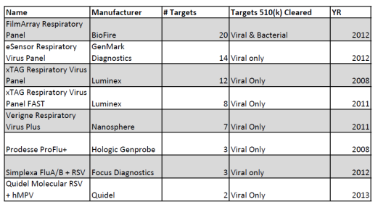
FDA-Cleared Molecular RVPs and Their Targets
Viral Targets
Influenza A and B
RSV A and B
hMPV
Parainfluenza viruses
Rhino/Entero
Coronaviruses
Adenoviruses
Notes:
Influenza(with and without subtyping) and non-influenza respiratory viruses, in one assay
bacteria (B.pertussis, Chlamydophila pneumoniae, M.pneumoniae)
Importance of assessing those sites within our state that perform this testing and willing to share data

Slide 38
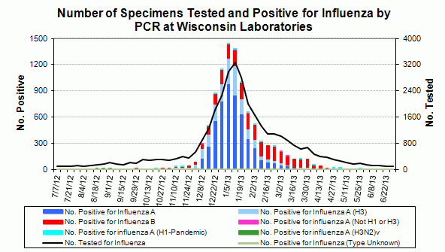
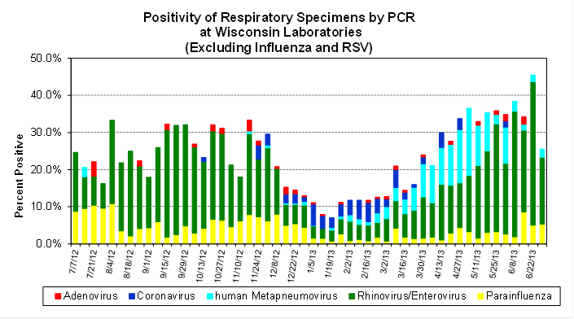
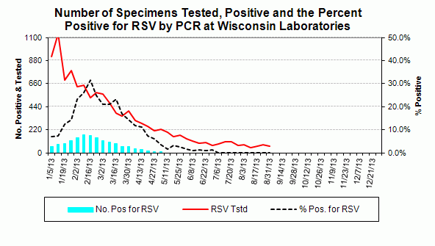
All That is “The Flu” is Not Influenza
Notes:
Expanding the data pool in each state especially if PHL not running RVP
Many sites running these tests and running many more of them (orders of magnitude more)
Much more data on RSV when rapid test data are included
Need to collect only data and not necessarily specimens for further characterization…less complex than with flu

Slide 39
How Can the PHL-Clinical Lab Partnership Benefit Influenza Surveillance?
LRN
Diagnostic technologies employed
Data sharing
  Electronic reporting
  Linkage of testing and clinical/demographic data
Notes:
Clinical labs↔PHLs by various means

Slide 40
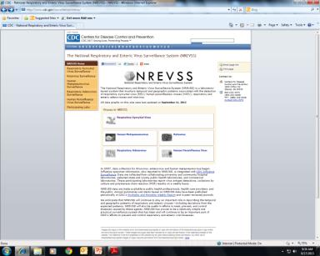
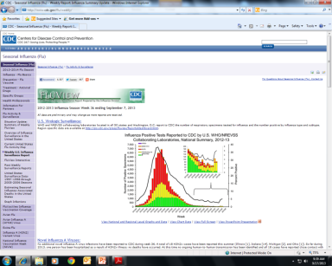
Better Coordination of Data and Information Sharing? http://www.cdc.gov/flu/weekly/ http://www.cdc.gov/surveillance/nrevss/
Notes:
This is needed at local, state and national levels
Perhaps coordinated effort at collecting RVP data can help
Again we need the whole picture, especially when trying to detect/characterize emergence of a novel event
What makes up the background noise
Important for epi’s and clinicians

Slide 41
How Can the PHL-Clinical Lab Partnership Benefit Influenza Surveillance?
Moving Forward
  How to Use the Roadmap
Notes:
WI is well ahead of the curve! A BIG thanks to all of our clinical partners.
We will continue to explore new ways with you to enhance flu surveillance, being respectful of staff and resource limitations within your organization
And we always appreciate your feedback.

Slide 42
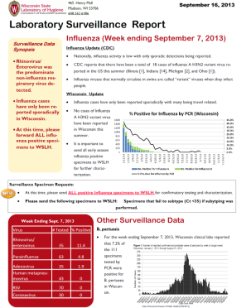
Lab-based Surveillance Plan, 2013-2014
Laboratory-based Surveillance
A collaboration between WI clinical labs, WI Div of Public Health and WSLH
Situational awareness
Detecting novel strains
Informing vaccine selection
Antiviral monitoring
www.slh.wisc.edu
Laboratory Surveillance Reports
Notes:
Current requests are from all clinical labs.

Slide 43
Lab-based Surveillance Plan, 2013-2014
Key Elements
RIDT sites
  Provide specimens & testing data weekly
PCR labs*
  Provide testing data summary weekly
Enrolled Surveillance Sites
  Provide specimens to WSLH weekly
Study sites
  Provide specimens + detailed clinical data
Notes:
There are four key components of the lab-based surveillance system in Wisconsin
PCR labs are becoming a more important component due to high quality data as assay are more sensitive than
Every component provides a vital contribution and provides representative data and clinical specimens to WSLH
In fact, WI serves as a model surveillance system and many components are considered “best practices” nationally
Annually, we meet with stakeholders to review the system and consider ways to improve.

Slide 44
Lab-based Surveillance Plan, 2013-2014
Current Requests
*Special Requests*
*Please send ALL influenza positive specimens to WSLH*.
  Include the test you performed and the detailed results (e.g. GeneXpert: FluA+, 2009H1N1-)
Specimens from patients with known or suspected swine contact. Please contact your local health department or the Wisconsin Division of Public Health for approval.
Patients with international travel history suspected of having risk for H7N9 or MERS-Coronavirus exposure.
Influenza A unsubtypable PCR results if your lab is performing influenza subtyping.
Notes:
Current requests are from all clinical labs.

Slide 45
Rapid Testing Sites/Antigen Detection 2013-2014 Season
Pathogen | Testing Data requested | Frequency | Confirmatory testing available at WSLH
Rapid Antigen Testing
Influenza A/B | # Positive tests and # tests performed | Weekly | ALL early season positives. Limited to first two consecutive confirmed A & B positives at WSLH. Additionally, please send positive specimens from: Hospitalized patients (sampling) International travel history Patients with swine contact NEW!
Rotavirus |  |  | Send one positive/week
RSV |  |  | NO
Strep A (rapid tests only)

Slide 46
PCR Laboratories 2013-2014 Season
Pathogen | Testing Data requested | Frequency | Confirmatory testing available at WSLH
PCR Laboratories
Influenza A/B | # Positive tests and # tests performed | Weekly | ONLY send the following: Unable to subtype (InfA Ct<35.0) if you perform routinely Hospitalized (sampling) International travel history Patients with swine contact NEW!
Respiratory viruses (other than influenza) |  |  | No
B. pertussis
Other viruses (e.g. VZV)
Enterovirus* |  |  | Yes* *paralysis, death, infants <2, and clusters of cases

Slide 47
Laboratory-based Surveillance, 2013-14
Summary
RIDT Sites:
* Confirmatory testing for the first 2 positive Influenza specimens
Enrolled Regional Sites:
* Send the first 3 specimens collected per week regardless of results
PCR Labs:
Report the number tested and number positive
Influenza A-Unsubtypable (Ct<35)
All Labs:
Send those with international travel histories
Sampling of influenza-related hospitalizations
47
Notes:
As we move forward, we will change our surveillance system to address increasing influenza activity and balance with surveillance needs and limited reagent resources.

Slide 48
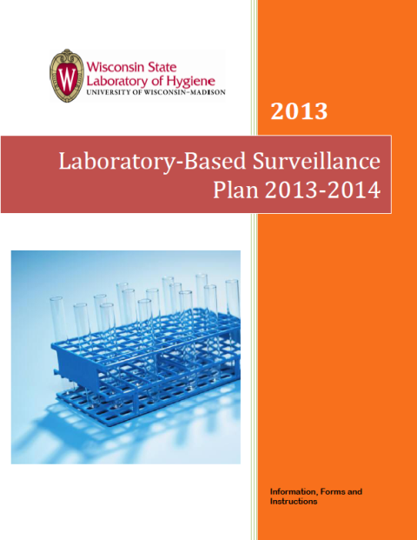
Includes no cost shipping instructions-Dunham Express
Specimen submission & reporting forms
Contact info for specimen kits
Notes:
It is true that there are still a few “free” things in life..including the lab surveillance report!

Slide 49
Plan for Laboratory-Based Surveillance for Influenza, 2013-14
WSLH Coordinators:
  Surveillance Coordinator & Technical
    Erik Reisdorf
    Email erik.reisdorf@slh.wisc.edu
    Phone 608-262-1021
  Data & Reporting
    Mary Wedig
    Email mary.wedig@slh.wisc.edu
    Phone 608-890-0353
Notes:
Please contact Mary Wedig or myself with questions or if you would like to receive the surveillance packet or shipping materials.

Slide 50

Thank you!
Your participation in the Wisconsin surveillance system is vital to monitor for emerging novel strains with pandemic potential and other pathogens that impact community health.
Notes:
On behalf of the WI State lab and PH in Wisconsin Pete and I wanted to thank you all for your participation……Clinical labs are our “eyes and ears” in the community.

Slide 51

Food for thought…..
"The key message I think is important … that our risks are very much connected to the public health capacity and sophistication of the diagnostic tools and systems that are in place ....”
-Dr. Kamran Khan, St. Michael’s Hospital, Toronto, Canada

