Slide 1
The ABC’s (and D & E’s) of the Viral Hepatitides
Part 2
Thomas Novicki PhD DABMM
Clinical Microbiologist
Division of Laboratory Medicine
novicki.thomas@marshfieldclinic.org
Notes:
Because of full frame graphic use title slide sparingly because too many of them will increase PP file size.

Slide 2
Objectives 2
Explain the various modes of transmission of each virus discussed.
Describe the mortality and morbidity associated with the viral hepatitides.
Give a basic description of the makeup and structure of each virus.
Be able to select the correct lab diagnostics for each virus discussed.
Discuss current treatments and efficacy.

Slide 3
Disclosures 3
I have nothing relevant to this topic to disclose.
All tables and graphs have been drawn from public domain websites.

Slide 4
diagnostic tests
4

Slide 5
Review of Acute Antigen (Ag)/Antibody (Ab) Responses 5
Acute (symptomatic)
Convalescence
Therapy
Viable virions
Free Ag
IgM
IgG
Ag/Ab complex
Intensity
Cx
Serology
Ag detection
Molecular Dx
?
Time

Slide 6
Ag/Ab Relationships in Chronic Infection 6
These patterns apply to acute viral hepatitis (VH) infections, but change in chronic VH:
  Viral antigen and virions (i.e. viral particles) usually remain detectable in blood and other fluids.
  IgG class Abs directed against the virus do not appear as expected.
These differences present many diagnostic opportunities.

Slide 7
Blood Studies for Suspected VH 7
Alanine and aspartate amino transferases
Total and Direct bilirubin
Albumin and total protein
CBC
aPTT, PT/INR
Alpha fetoprotein
HAV,HBV,HCV Ab/Ags (more in a moment…)

Slide 8
HAV & HEV 8
Diagnosis of HAV and HEV is less complex than the others, due to no chronic phase.
The primary markers measured are virus-specific antibodies.
However, the lack of an IVD assay for HEV antibody hampers testing in the USA.

Slide 9
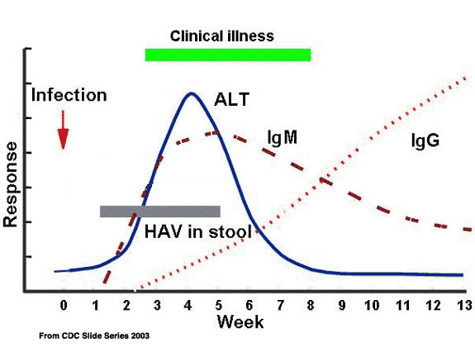

HAV & HEV Abs 9
HAV
HEV similar, EXCEPT that IgG anti-HEV falls off rapidly after 6-12 months, and may not confer immunity for life.

Slide 10
HAV Diagnosis 10
IgM detection is required for diagnosis; many commercial assays are available.
Total/IgG anti-HAV assays assess immune status only, since IgG anti-HAV persists for decades.
  While a positive result indicates immunity, commercial assays don’t reliably detect vaccine-induced immunity.
Antigen detection and nucleic acid amplification tests (NAAT) are not commercially available, and HAV is not cultivable.

Slide 11
HEV Diagnosis 11
IVD assays not available. At least one commercial reference lab and the CDC offers anti-HEV antibody testing: IgM detection is the key to diagnosis.
CDC also performs RT-PCR and genotyping.
Virus is not cultivable.
Best approach? Contact the WI DPH or WSLH if HEV is suspected.

Slide 12
HBV/HDV Diagnosis 12
The diagnosis of HBV & HDV is more complex due to acute and chronic phases of infection.
  Diagnosis initially made by detection of viral Ag & Ab.
  Staging and monitoring therapy also uses quantitative nucleic acid amplification testing (NAAT; i.e. ‘viral load’).
In contrast to HCV, HBV genotyping is not routinely done to begin therapy.

Slide 13
HBV Ag/Ab Detection: The Players 13
Ag/Ab | Abbreviation
Hepatitis B surface antigen | HBsAg
Hepatitis B core antigen | Not detectable
Hepatitis B e antigen | HBeAg
Anti-HBsAg antibody (Total) | Anti-HBs
Anti-HBcAg antibody (IgM &Total) | Anti-HBc
Anti-HBeAg antibody (Total) | Anti-HBe

Slide 14
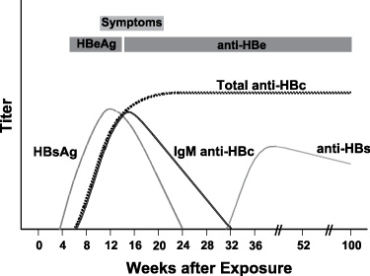
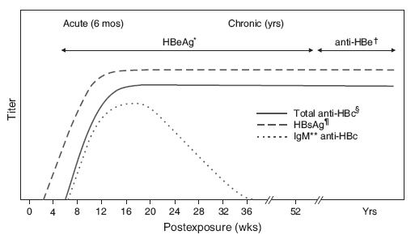
Serology of HBV Acute and Chronic Infection 14
Acute
Chronic
http://publichealthlab.ca/wp-content/uploads/2012/10/GTS-Anti-HBs-Chart-1.jpg
http://www.cdc.gov/immigrantrefugeehealth/guidelines/domestic/viral-hepatitis-figure4.html
(accessed 02/27/2013)

Slide 15
HBV Serological Tests 15
Primary Markers
  HBsAg Indicates ongoing infection, acute or chronic.
  OR
  Anti-HBs Indicates resolved infection. Alone, a marker of vaccination (> 10mIU/mL considered protective).
  IgM anti-HBc Indicates acute infection.
  REPLACED BY
  Total anti-HBc Denotes evolved infection; does not differentiate chronic vs. resolved infection.
Secondary Markers
  HBeAg Indicates rapid viral replication, high infectivity.
  REPLACED BY
  Anti-Hbe Seen in resolved acute & inactive chronic infection.

Slide 16
Chronic HBV Markers: A Closer Look 16
Phase (Stage) | Positive Lab Findings
Immune Tolerance | HBsAg, Total anti-HBc, HBeAg, ⇑ HBV DNA
Immune Clearance | HBsAg, Total anti-HBc, HBeAg, ⇑ HBV DNA, ⇑ transaminases, abnormal liver histology
Inactive CS | HBsAg, Total anti-HBc, anti-HBe, (Transaminases may flare)
(Occult hepatitis B) | + findings for Total anti-HBc, ⇑ transaminases, abnormal liver histology. HBV DNA detectable only by sensitive research assays
Isolated Anti-HBc – Positive | Negative for both HBsAg & anti-HBs is not unusual (0.5-20%); meaning unclear. Needs follow-up; may be infectious.
CS, HBsAg Carrier State; ⇑ HBV DNA, > 20,000IU/mL
Horvat, RT and GE Tegtmeier 2011. Hepatitis B and D Viruses, p 1670-71. In J. Versalovic et al (eds), Manual of Clinical Microbiology, 10th ed. ASM Press, Washington DC & A Valsamakis 2007 Clin Microbiol Rev 20:426

Slide 17
HBV NAAT 17
Quantitative NAAT
  Several commercially available assays
  A WHO HBV international standard exists. However, quantitation still varies among assays.
  Best practice is to consistently use the same assay.
    If changing a viral load assay, perform and report both assays (only charging for one) for 3-6mos to ‘reset’ all patient’s viral loads as a service to your providers.

Slide 18
HBV NAAT 18
Some HBV Viral Load Interpretive Guidelines
  >1log₁₀ (i.e. >10-fold) reduction is predictive of therapeutic success, while >1log₁₀ increase during treatment suggests development of antiviral resistance.
  Increasing levels correlate histologically with cirrhosis.
  Sustained suppression of viral DNA is the best measure of long term therapeutic success.
Horvat, RT and GE Tegtmeier 2011. Hepatitis B and D Viruses, p 1671. In J. Versalovic et al (eds), Manual of Clinical Microbiology, 10th ed. ASM Press, Washington DC

Slide 19
HDV Diagnosis 19
HBV co-infection required-also test for HBV.
Anti-HDV Ab detection
  Screen with Total anti-HDV
  Reflex to IgM anti-HDV to assess for acute state
Viral load testing for disease activity
But, there are no FDA cleared IVD assays.

Slide 20
HCV Diagnosis-Some Differences… 20
Acute infection usually asymptomatic, so most cases appear after years of silent chronic infection.
Unlike HBV, HCV genotype or level of viremia do not correlate with severity or likelihood of chronic disease progression. However genotype and viral loads are critical in making therapeutic decisions.
Only Total anti-HCV Ab is measured.
Recombinant immunoblot assay (RIBA) still used.
But like HBV, HCV diagnostics are not simple.

Slide 21
HCV Diagnosis 21
Gen 3.0 HCV Ab assays predominate in the USA, but one 2.0 assay still marketed.
  3.0 has better sensitivity and equal specificity, shortening seroconversion window by ~2 weeks.
Several 3.0 assays may report positive results when S/CO ratio is above a threshold set by manufacturer.
  If below threshold, OR any positive value in the other assays, requires confirmation.

Slide 22
HCV NAAT 22
Both qualitative and quantitative HCV RNA assays available as FDA-IVD, ASR or RUO.
Qualitative assays traditionally considered most sensitive, but several current quantitative assays are almost as sensitive.
HCV NAAT can assist in diagnosing acute infection before seroconversion (e.g. after exposure), but is most often used in Tx of chronic HCV.

Slide 23
HCV NAAT 23
HCV NAAT in chronic infection
  Plays an important part in the confirmation of anti-HCV Ab screen results.
  HCV viral loads, along with HCV genotype, are critical in monitoring and tailoring therapy.
Most labs now only use highly sensitive quantitative NAATs in all phases of diagnosis and treatment.

Slide 24
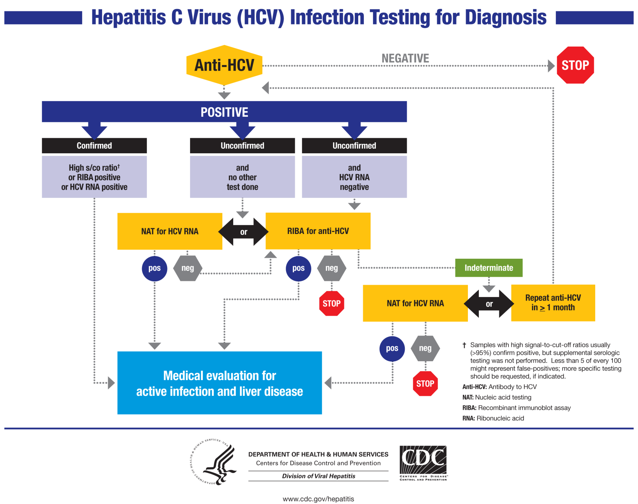

HCV Diagnosis 24
http://www.cdc.gov/hepatitis/hcv/labtesting.htm (accessed 03/04/12)

Slide 25
Prevention & Treatment
25

Slide 26
HV Prevention 26
Basic Public Health Efforts
  Clean water
  Sanitation systems
  Screening of blood/blood products supply
  Promotion of safe sex practices
  IVDU → Reduce/educate/needle exchange
  Vaccination

Slide 27
VH Vaccines 27
HAV Yes.
  Used in low-moderate incidence countries where symptomatic disease in adults occurs.
  Not necessary in highly endemic countries where all are asymptomatically infected as infants, and where there is no chronic stage.
HBV Yes. Used worldwide. (179 countries in 2010)
  Universally attractive since it prevents advancement to chronicity, cirrhosis and HCC.
HCV Many attempts, none successful.

Slide 28
VH Vaccines 28
HEV In development in China.
  Desirable in high- endemicity countries where pregnancy-related fulminant hepatitis occurs.
HDV Not needed - prevent HBV with vaccination.

Slide 29
VH Treatment 29
Acute HAV, HEV
  No effective antiviral Tx
  Supportive care as needed
HDV
  No effective antiviral Tx
  Target efforts at the concomitant HBV infection

Slide 30
Chronic HBV Treatment 30
Due to expense and toxicities of Tx, not all chronic HBV cases are treated.
  Tx reserved for those with high viral loads AND evidence of hepatic disease e.g. elevated transaminases (plus individual factors e.g. age, co-morbidities).
Tx is of long duration: > 48 weeks.
Emergence of resistance is not uncommon.

Slide 31
Chronic HBV Treatment 31
Two major drug classes
  Pegylated interferon-alpha (PEG-INFα)
    Stimulates immune response
    No resistance noted
    Cannot be given with severe liver disease
  Nucleoside/nucleotide analogs
    Similar to anti-HIV Rx; targets viral replication
    Varying rates of resistance occur
    Can be given when liver disease is severe
May be combined, but which cocktail is best?

Slide 32
Chronic HBV Treatment 32
Viral load is monitored during Tx
  > 1 log₁₀ (> 10X) rise suggests a new resistance.
Viral genotyping is of little benefit, but genotypic testing for antiviral resistance may be of value.
  Lab-developed tests only-buyer beware.
  Results are not straightforward.

Slide 33
Chronic HBV Treatment 33
Determining treatment ‘success’ is difficult
  Sustained suppression of viral replication?
  Normal transaminases?
  Anti-HBe seroconversion?
  Anti-HBs seroconversion (rare i.e. HBsAg persists)?
  Quantitation of HBsAg?
Goal is to suppress virus enough to prevent sequalae, not to completely eradicate.

Slide 34
Chronic HCV Treatment 34
Treatment is challenging due to the high mutability of HCV, leading to resistant strains in the background in an untreated patient.
  Once Tx begins the resistant strain predominates.
Combination therapy helps fight emergence of resistant strains.

Slide 35
Chronic HCV Treatment 35
Principles of HCV treatment similar to that of chronic HBV, but are more developed.
Standard treatment had been a cocktail of PEG-INFα and the antiviral ribavirin until the FDA approved boceprevir and telaprevir in 2011.
boceprevir and telaprevir
  Inhibits viral replication.
  For use against chronic HCV due to genotype 1, the most common genotype in the USA, and most difficult to treat.
  Used in combination with PEG-INFα and ribavirin.

Slide 36
Chronic HCV Treatment - Definitions 36
Treatment Response/Milestone | Definition
Rapid virologic response (RVR) | No detectable HCV RNA* at Tx wk 4
Early virologic response (EVR) | > 2log₁₀ drop in HCV RNA at Tx wk 12
End of treatment (EOT) | End of customized Tx period
End of follow-up (EFU) | Last time point for HCV RNA testing in VR+ patients, typically 24 wk EOT
Virologic response (VR) | No detectable HCV RNA* at EOT
Sustained VR (VR) | No detectable HCV RNA* at EFU
*HCV RNA limit of detection <50IU/mL; all HCV RNA measurements in plasma/serum
Forman, M and A Vasamakis 2011. Hepatitis C Virus, p 1439. In J. Versalovic et al (eds), Manual of Clinical Microbiology, 10th ed. ASM Press, Washington DC

Slide 37
Chronic HCV Treatment 37
Length of treatment ranges between 24-72 wks.
Is customized based on:
  Baseline HCV RNA load (< 400,000 commonly)
  Genotype (Gt1 requiring longer Tx)
  Milestones (RVR and/or EVR shortens Tx period)
  Co-morbidities.

Slide 38
Chronic HCV Treatment 38
As with HBV, Tx is generally reserved for those with active disease.
SVR ranges from ~40-80%.
  Gt1, high initial viral load have lowest SVR rate.
Relapse occurs; patients often respond to a second course of Tx.

Slide 39
Summary 39
The clinical laboratory plays a major part in both diagnosis and monitoring of treatment of HVs.
HAV and HBV are preventable with vaccination, while HCV is not.
While not fully curable, chronic HBV and HCV can now be successfully managed in the high resource setting of many developed countries.
In low-resource countries, HBV and in the future HEV vaccination offer the most effective approach.

Slide 40
Questions?

