Slide 1
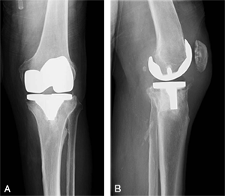
Culture of Orthopaedic Infections
Microbiology Testing in the Diagnosis of Prosthetic Joint Infections
December 9, 2013
Raymond P. Podzorski, Ph.D., D(ABMM)
Clinical Microbiologist
ProHealth Care Laboratories
262-928-7635
raymond.podzorski@phci.org

Slide 2

Disclosure
Raymond P. Podzorski, Ph.D., D(ABMM)
December 9, 2013
No relevant financial relationships to disclose.
Will mention some products by manufacturer name.

Slide 3
Objectives
Examine the prevalence of prosthetic joint procedures,
prosthetic joint infections (PJI), and bacteria involved.
Understand the role of P. acnes in PJI.
Review collection and transport devices for joint specimens.
Describe the strengths and weakness of the Gram stain in PJI.
Review guidelines around culturing of specimens from
prosthetic joints and the strengths and weaknesses of culture.
Review data on culture conditions needed for the isolation of P.
acnes from infected prosthetic joints.
Discuss some of the reasons for “culture negative” results from
infected prosthetic joints.

Slide 4
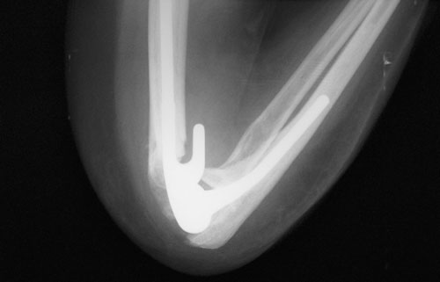
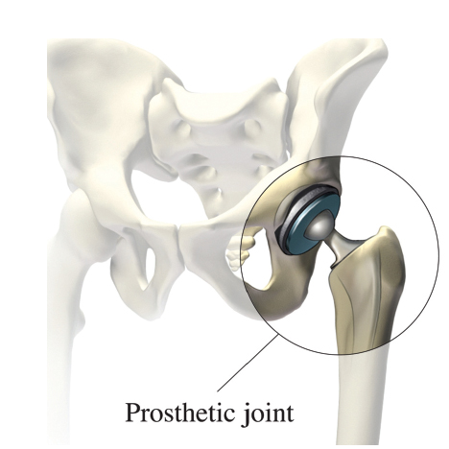
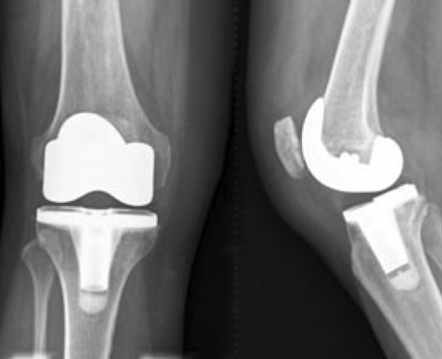
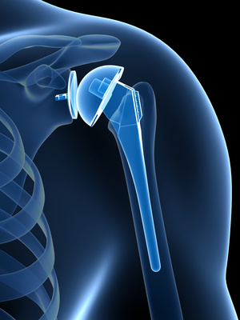
Prosthetic Joint Infections

Slide 5
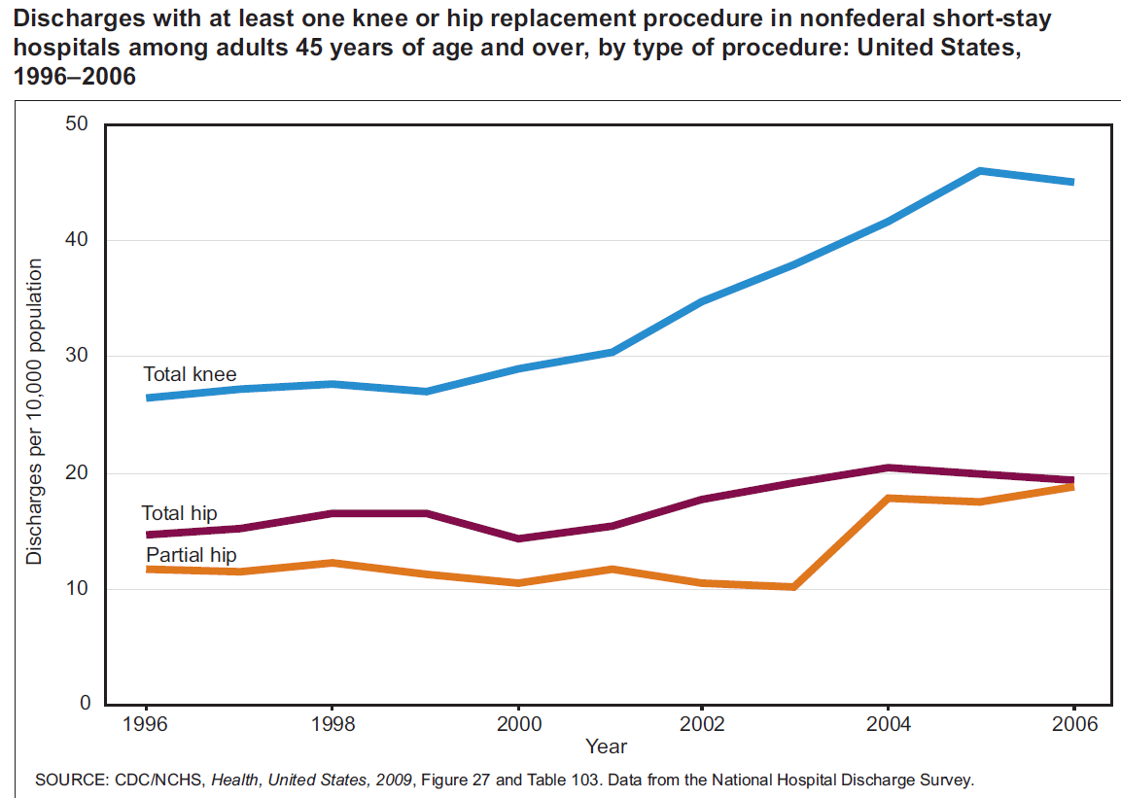

Slide 6
Knee Replacement Surgery
OCED Library: Health at a Glance 2011

Slide 7
Number of prosthetic joint infections
US incidence PJI hip/knee, 2001 – 2009, 2.0% to 2.4% and increasing
Kurtz, et. al. 2012. J Arthroplasty. 27(8 Suppl):61-65.
PJI Hospitalizations average 17, 600 - 1997 to 2000
29,200 – 2001 to 2004
Hellmann et. al. 2010. J Arthroplasty. 25(5):766-71.
Discharges for hip (partial and total) total knee 2010: 1,300,000
Health, United States, 2012. DHHS, CDC, NCHS
If 2.4% become infected = 31,500 hip/knee PJI

Slide 8
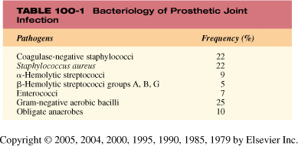
Bacteria Associated with PJI

Slide 9
Bacteria Isolated
Synovial Fluid Cultures*
S. aureus 57.1%
Coagulase-negative Staphylococcus spp. 19.0%
α-hemolytic Streptococcus 6.4%
Group B Streptococcus 4.8%
Corynebacterium striatum 4.8%
E. coli 3.2%
Streptococcus gallolyticus 1.6%
Pseudomonas aeruginosa 1.6%
Serratia marcesens 1.6%
Mixed infection (2 organisms) 1 culture
* 1/1/2005 – 6/11/2006

Slide 10
Propionibacterium acnes and PJI
P. acnes is an anaerobic Gram positive rod that is normally found on the skin and many other body sites.
Relatively recent studies demonstrate that P. acnes is a significant cause of delayed PJI (2.8% - 12%).
P. acnes is a slow growing, biofilm producing, low virulence bacteria, with an indolent clinical presentation that frequently lacks the classical clinical presentation of a PJI.
PJI caused by P. acnes are frequently associated with the shoulder, but infections of hip and knee can also occur.
Because P. acnes is a well known contaminate of bacterial cultures, it can be difficult to determine it’s significance when isolated (x cultures).

Slide 11
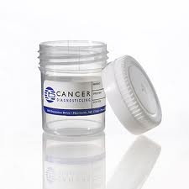
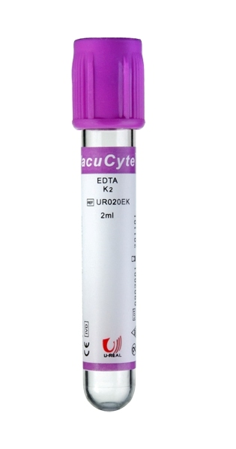
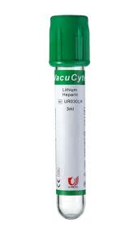

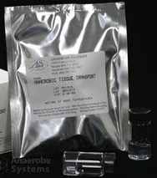


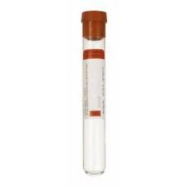
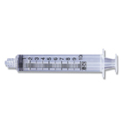
Orthopaedic Specimen Transport Containers
2013
Synovial Fluid
- Hematology
- Cell Count & Differential
- Crystals
- Microbiology/Culture
Tissue Specimens
- Histology
10% Neutral Buffered Formalin v/v
Mix gently
preferred
10% Neutral Buffered Formalin v/v
EDTA
heparin
- Microbiology/Culture
For quality microbiology/culture, send fluid or tissue.
Place tissue in tube
capped syringe
needle removed
Vacutainer Tube
No gel,
No anticoagulant
Tissue transport devices
(pea sized or smaller)
10/13/20113OA, RPP

Slide 12
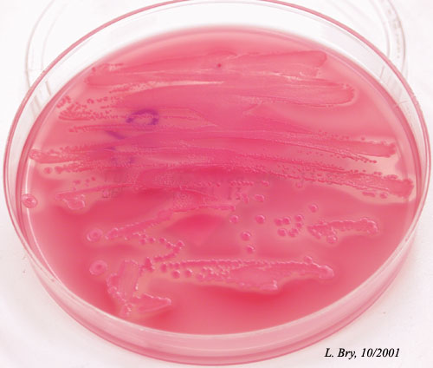

Tips for Collecting Quality Surgical Specimens for Microbiology
Swabs don’t do the job!
Out of every 100 bacteria absorbed on a swab,
only 3 make it to culture.
Anaerobes on swabs die upon exposure to air,
but survive in tissues and fluids.
Swabs hold only 150 microliters of fluid.
FOR QUALITY RESULTS, SEND TISSUE
AND FLUIDS TO MICROBIOLOGY

Slide 13
Orthopaedic Surgery Specimen Study
Specimen
Pairs T&S TO SO NG
noABX 57 41 8 0 8
ABX 67 27 15 0 25
T&S = same growth in tissue and swab specimens
TO = growth in tissue specimen only
SO = growth in swab specimen only
NG = no growth in either specimen
Ochs, BG., et. al. 2005. Improving microbiological diagnostics in septic orthopedic surgery. Comparative study
Of patients receiving systemic antibiotic therapy. Orthopade 34:345-351

Slide 14
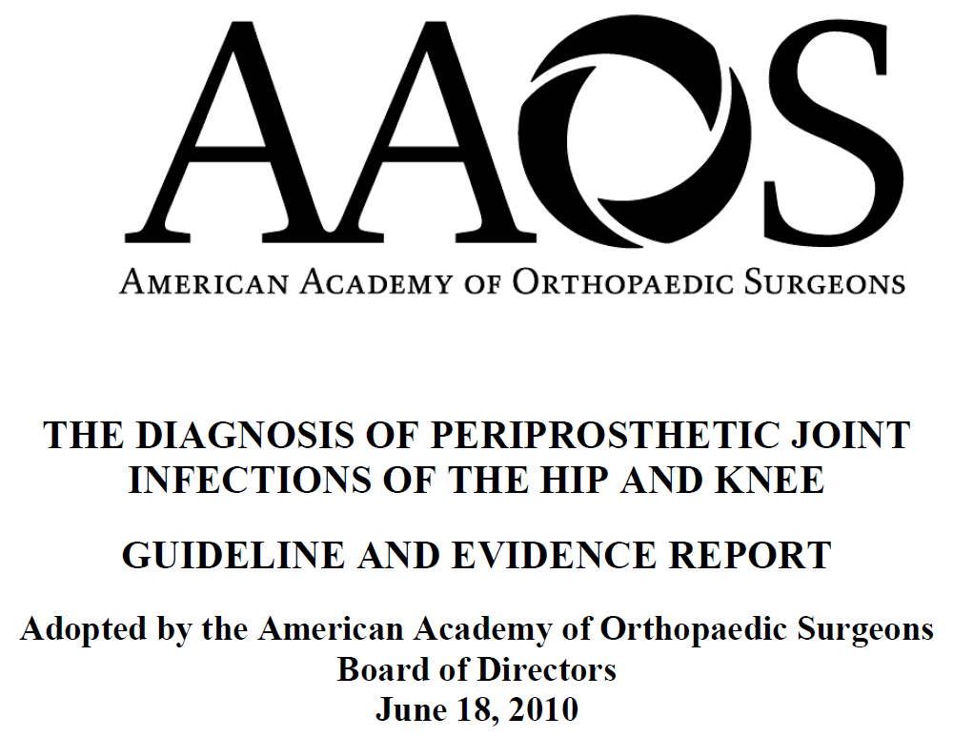
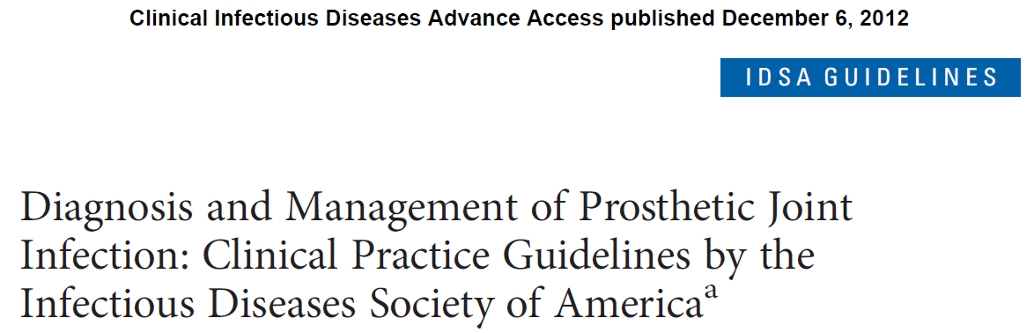
Recent PJI Guidelines

Slide 15
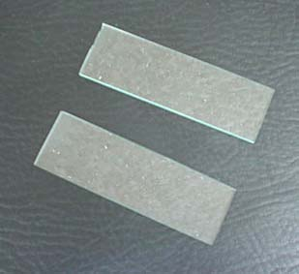
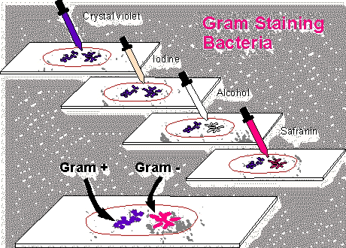
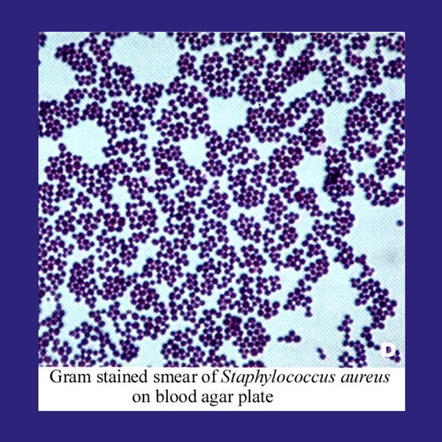
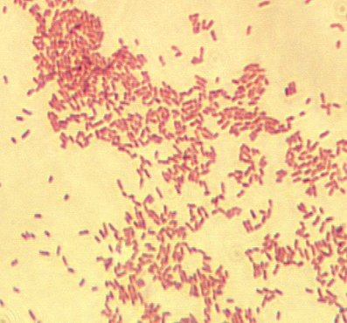
Are Gram Stains Really
That Hard To Do?
Why do
they take
so long?
Are they that
hard to
interpret?

Slide 16
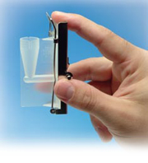
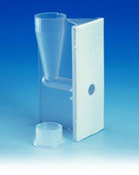
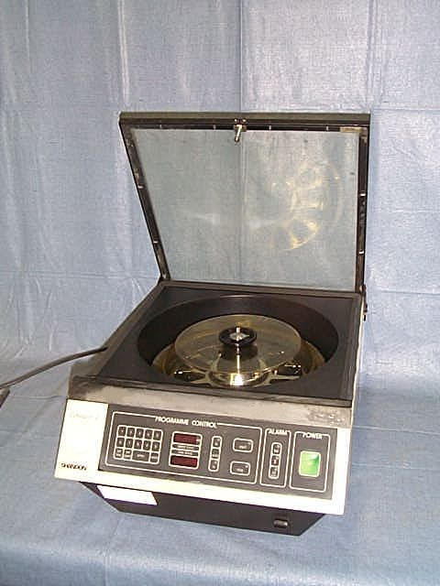
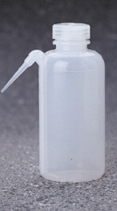
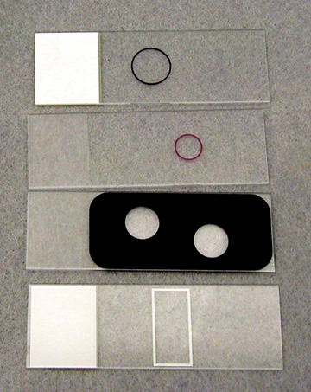
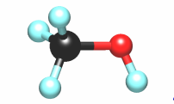
Cytospin Gram Stain
Saline
TSB
MHB

Slide 17
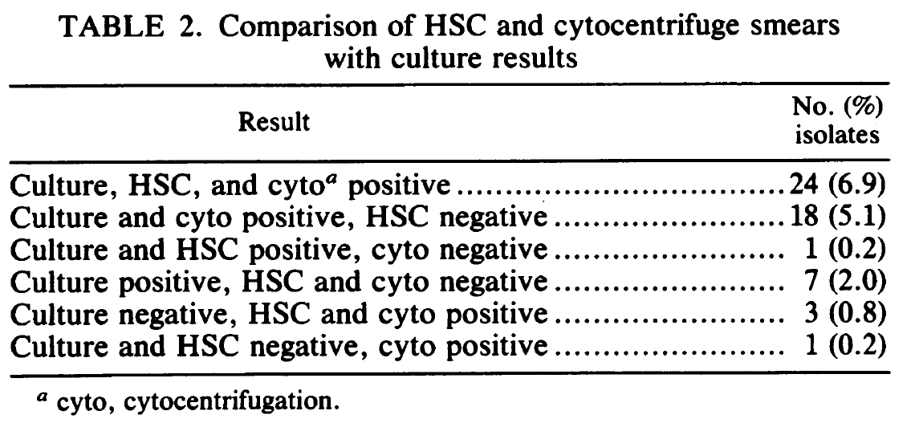
Cytospin sensitivity
Chapin-Robertson et. al., 1992. JCM 30:377-380.

Slide 18
Cytospin sensitivity
Chapin-Robertson et. al., 1992. JCM 30:377-380.

Slide 19
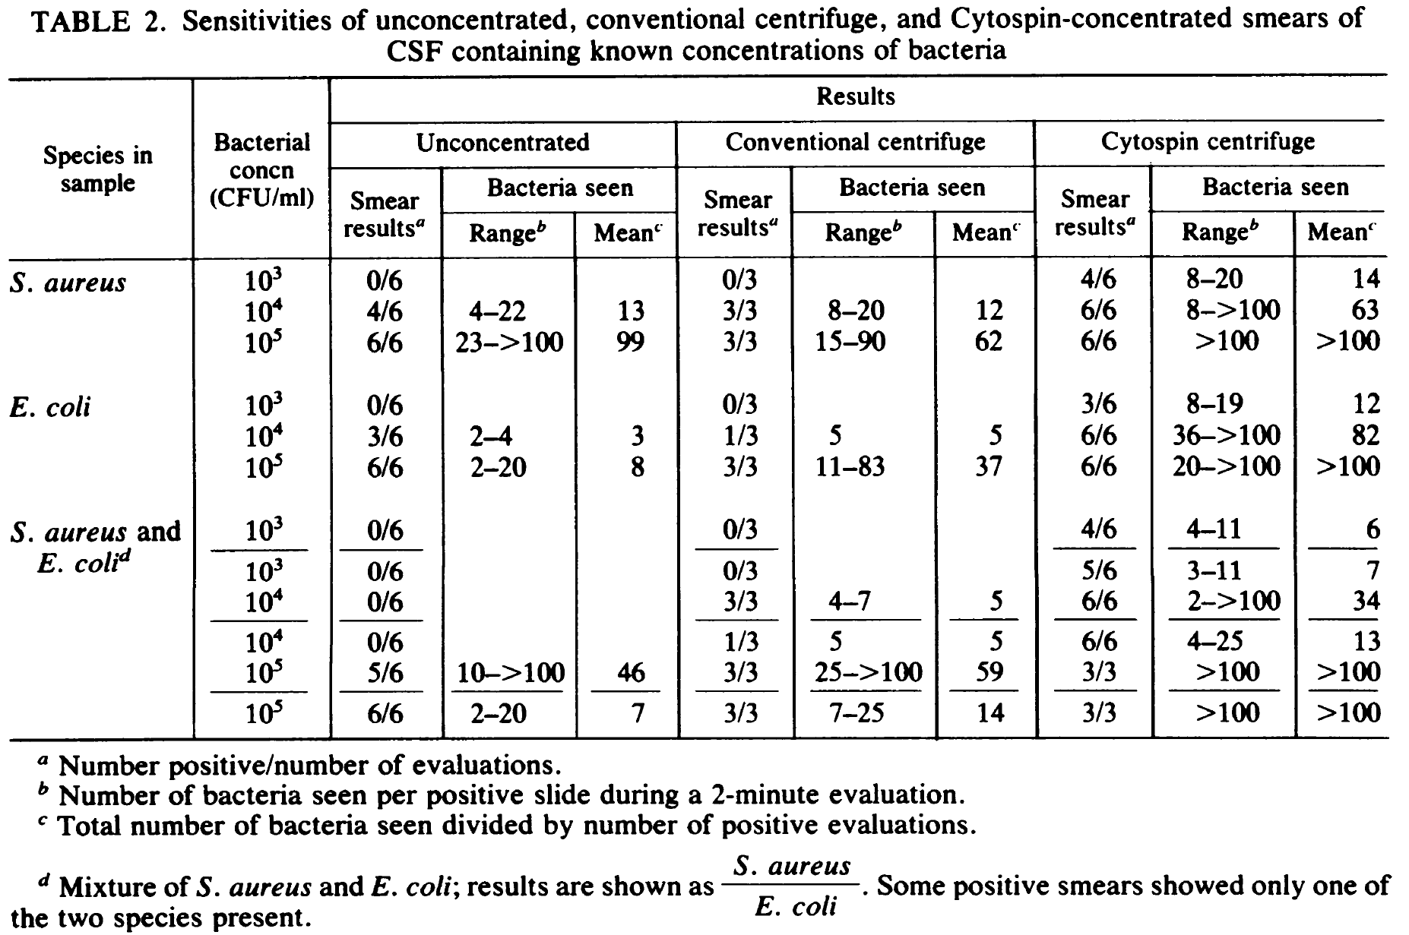
Cytospin sensitivity
Shanholtzer et. al., 1982. JCM 16:1052-1056.

Slide 20
Cytospin sensitivity
Shanholtzer et. al., 1982. JCM 16:1052-1056.

Slide 21
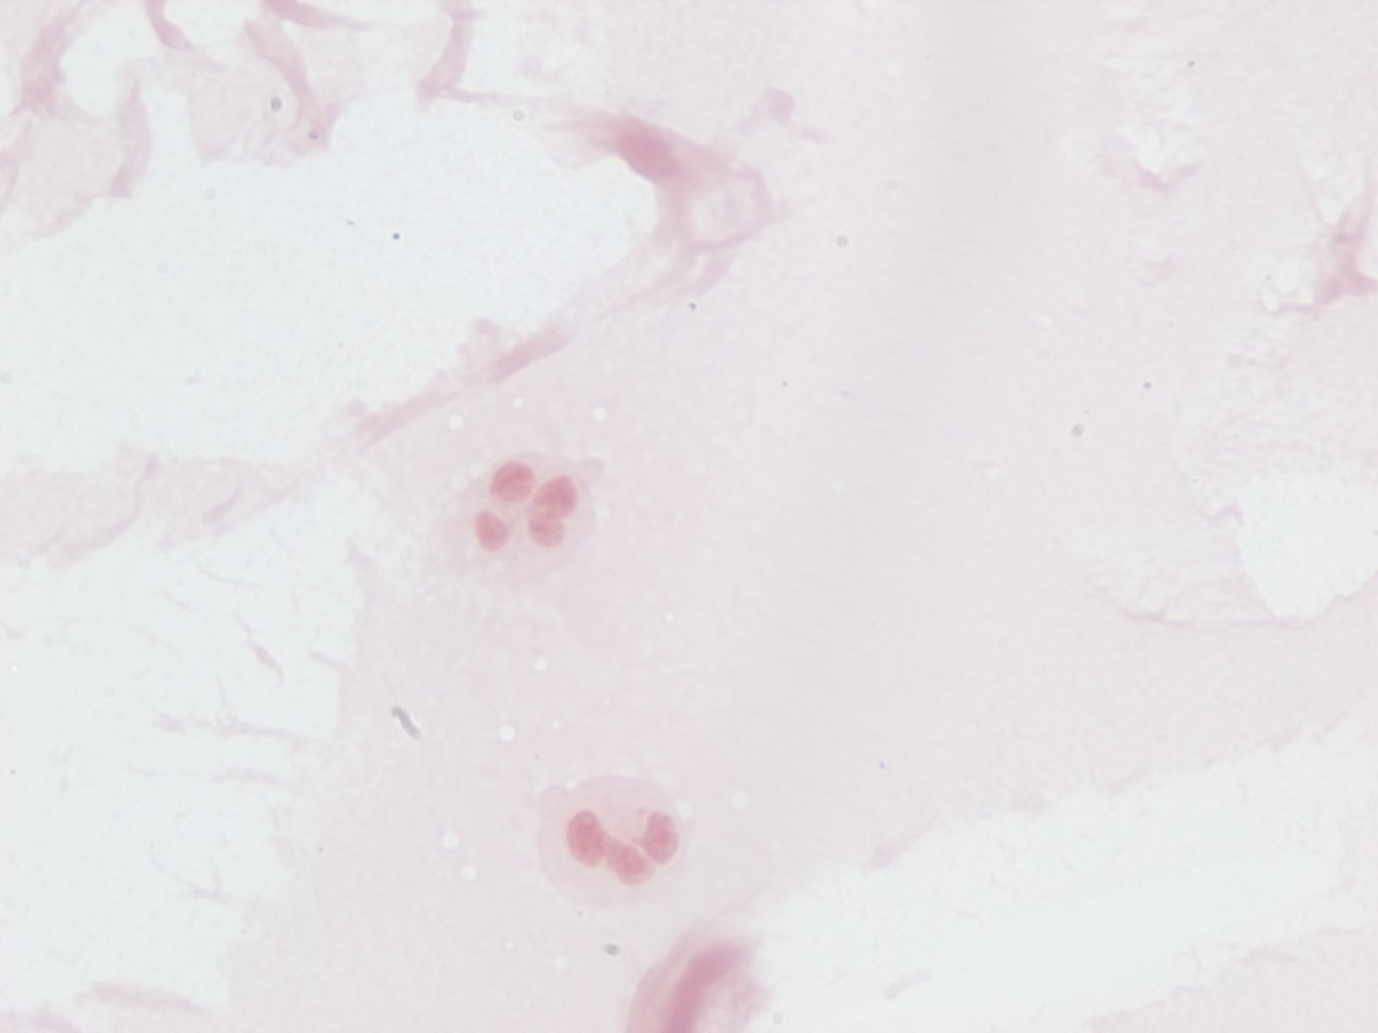
Drop of Synovial Placed on Slide

Slide 22
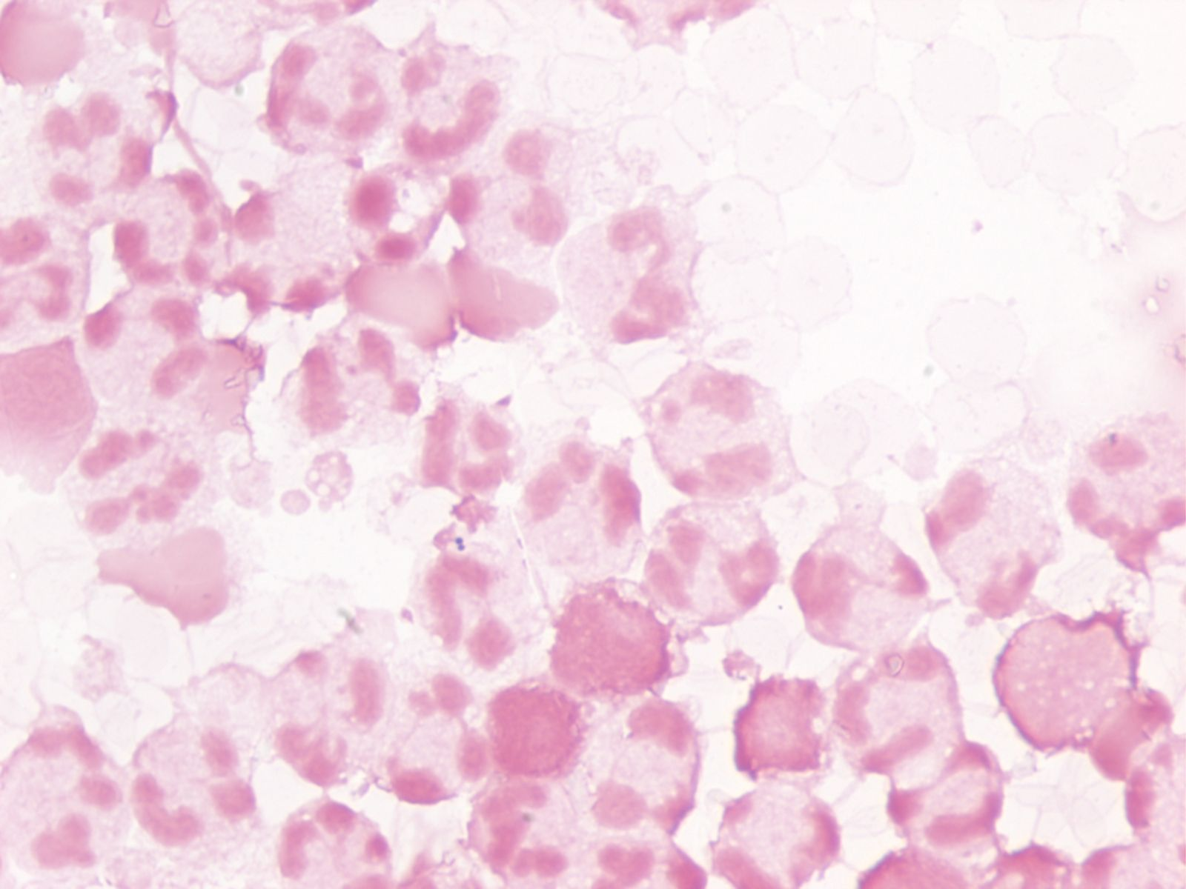
Cytospin Gram Stain

Slide 23
Gram Stain and PJI
Study Sensitivity Specificity
Chimento et. al. 1996 0% 0%
Atkins et. al. 1998 12% 99%
Della Valle et. al. 1999 15% 99%
Spangehl et. al. 1999 19% 98%
Ghanem et. al. 2008 31% 99%
Morgan et. al. 2009 27% 99.9%
Johnson et. al. 2010 10% 100%
Poor Negative Predictive values Associated with the Gram Stain

Slide 24
Intraoperative Gram Stains and PJI
AAOS 2010 Guidelines – We recommend against the use of intraoperative Gram stain to rule out periprosthetic joint infection.

Slide 25
ClinMicroNet Chatter
False Positive Gram Stains
“We just had an unfortunate series of experiences in which Gram positive cocci were falsely reported
to be present in specimens submitted to Microbiology from Orthopedic Surgery”. (TSB)
“….we reported 7 positive (probably false positive) Gram stains on allograft tissue being used for knee repair”. (TSB)
“Recently, after several cases of having reported Gram positive cocci in the direct Gram stain and no
growth on the cultures, we tracked down the source to dead organisms in the ‘sterile’ saline.”
(Saline)
“We have detected another lot of highly contaminated, yet sterile media from XX. Out of 10 broths that we did Gram stains on, 9 had Gram positive cocci.” (Saline)
“….dead organisms came from glue on the swabs they were using (resulted in false positive Gram stains), the company freely admitted that they can’t keep them (dead bacteria) out of the product.” (specimen collection swabs)
THIS IS A SERIOUS PROBLEM!

Slide 26
Sources of Gram Stain Contamination
Elution/Dilution fluids – Saline, TSB, MHB
Gram Stain Reagents
Rinse Water
Slides
Swabs
Transport Media
Cytocentrifuge Funnels
Tissue Grinder
Specimen Digestion Reagents
“Blue Blobs”

Slide 27
Sources of Gram Stain Contamination
Major manufacturer 1 ml tube a sterile saline

Slide 28
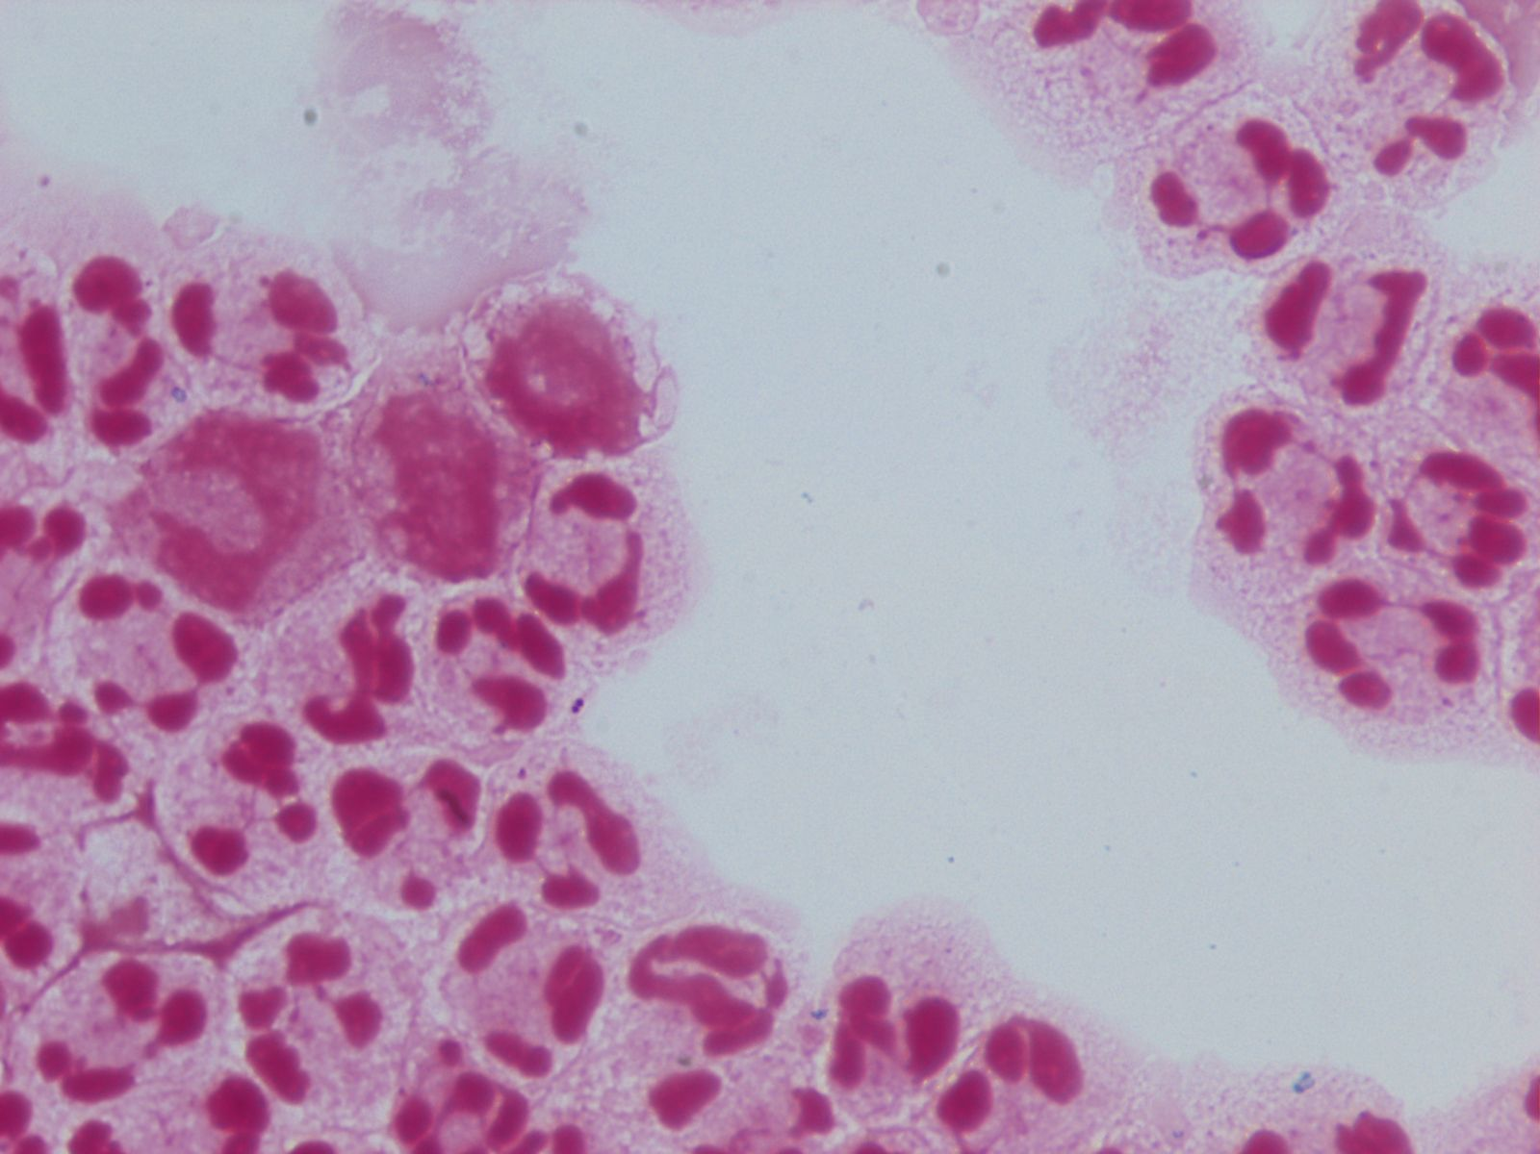

Slide 29
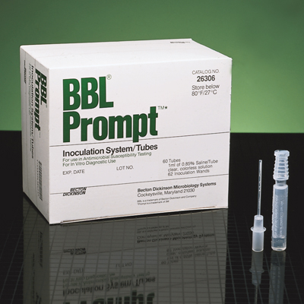
Gram Stain Contamination
1 ml 0.85% saline, filter sterilized

Slide 30
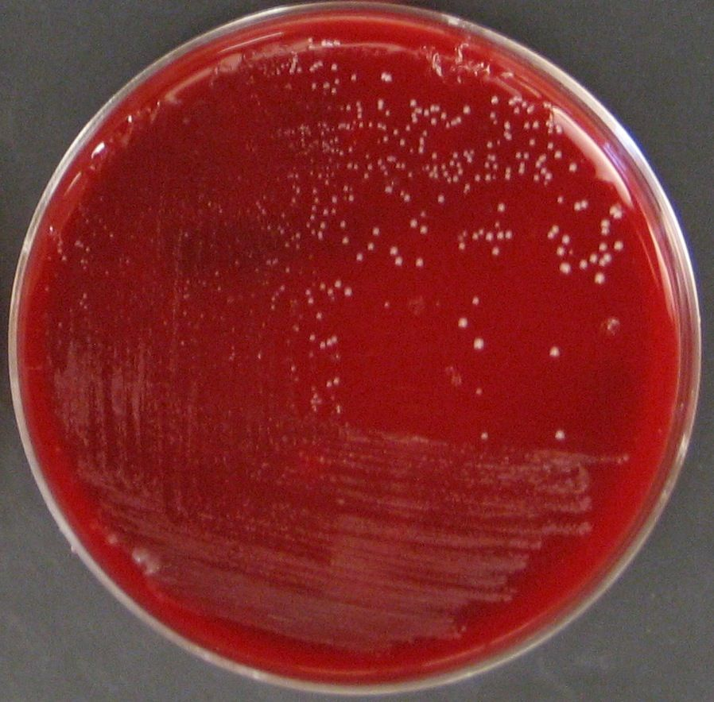
Bacterial Cultures

Slide 31
Joint Fluid Bacterial Cultures
Joint (synovial) Cytospin Gram stain, 0.5 – 3.0 ml inoculate a Peds Plus blood culture bottle; if < 0.5 ml inoculate onto Blood agar, Chocolate agar, incubate Peds bottle for 7 days, plates in 35º C, 5% CO₂ for 7 days
ASM manual - BAP, CAP, plate inc. time not clear, 35º, 5% CO₂, use BC bottles for large vol., broth ≥ 5 days up to 14 days to cover P. acnes
CMPH - BAP, CAP, inc. plates 4 - 7 days, 35º, 5% CO₂, Use BC bottles for lg. vol. incubate for 5-7 days, up to 14 to cover P. acnes

Slide 32
Joint Tissue Bacterial Cultures
Joint tissue Gram stain, blood agar, chocolate agar, MacConkey Agar, anaerobic CDC-Blood agar, anaerobic CDC-PEA agar, anaerobic CDC-LKV agar, anaerobic Thioglycolate broth, CNA agar, Incubate for 7 days, aerobic plates in 5% CO₂, anaerobic plates in jars
ASM manual - BAP, CAP, Mac, CNA, Thio, BBA, LKV, BBE, plate inc. time not clear, broth ≥ 5 days up to 14 days to cover P. acnes
CMPH - BAP, CAP, 35 5% CO₂, BBA, LKV, BBE inc. plates 4 days, broth anaerobic BHI/TSB with 0.1% agar/Thio (7 days), incubate for days, up to 14 to cover P. acnes

Slide 33
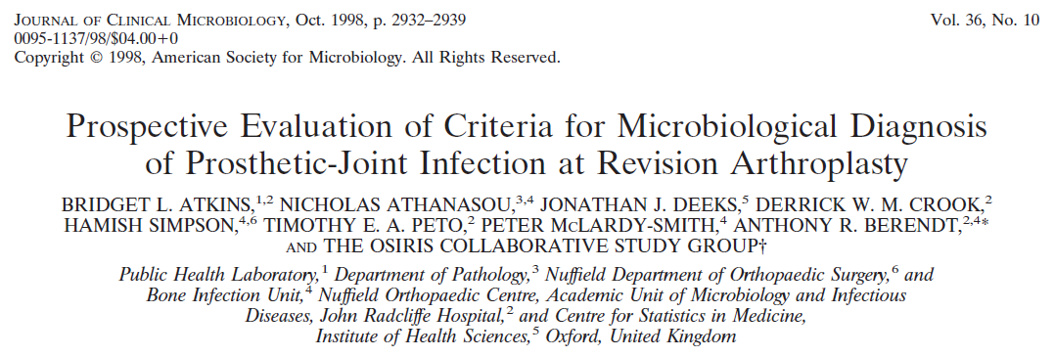
Why Multiple intraoperative cultures?
“We recommend five or six specimens be sent, …..”
Multiple positive specimens with an indistinguishable organism for a definite diagnosis.

Slide 34
Why Multiple intraoperative cultures?
1/2 vs 5/6
Changed Micro. Diagnosis 34%
Changed Antibiotic Therapy 30%
Negative Predictive value 5/6 95%
A. DeHann et. al., 2013. J. Arthroplasty, 28:59-65

Slide 35
Why Multiple intraoperative cultures?
IDSA Guidelines 2012 – At least 3 and optimally 5 or 6 periprosthetic intraoperative tissue samples or the explanted prosthesis itself should be submitted for aerobic and anaerobic culture at the time of surgical debridement or prosthesis removal.
AAOS Guidelines 2010 – Multiple cultures should be obtained at the time of reoperation in patients being assessed for PJI.
ASM Manual 2011 - Collect up to 5 separate pieces of tissue from surgical site.

Slide 36
Definition of a PJI
IDSA 2012 – Two or more intraoperative cultures/aspirations that yield the same organism may be considered definitive evidence of PJI.
CMPH 2010 - One or two colonies on a single plate, with multiple plates, and not growing on broth generally represent contamination when the bacteria are ones not typically associated with joint infections. Growth of one or two colonies on agar media in area outside the specimen inoculation area also likely represent contamination.
Bacterial contaminates are not typically detected in original Gram stain.

Slide 37
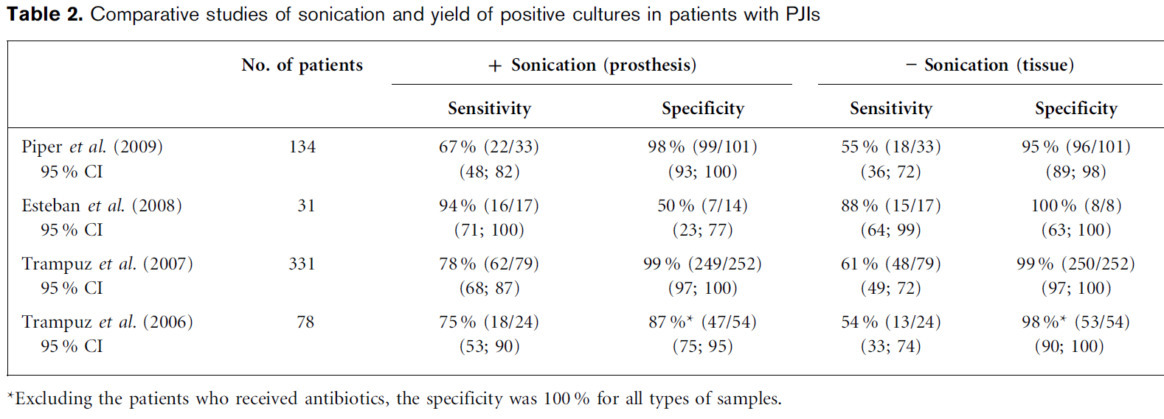
Bacterial Culture of Joint Hardware
L. Larsen et. al., 2012. J. Med. Microbiol. 61:309-316

Slide 38
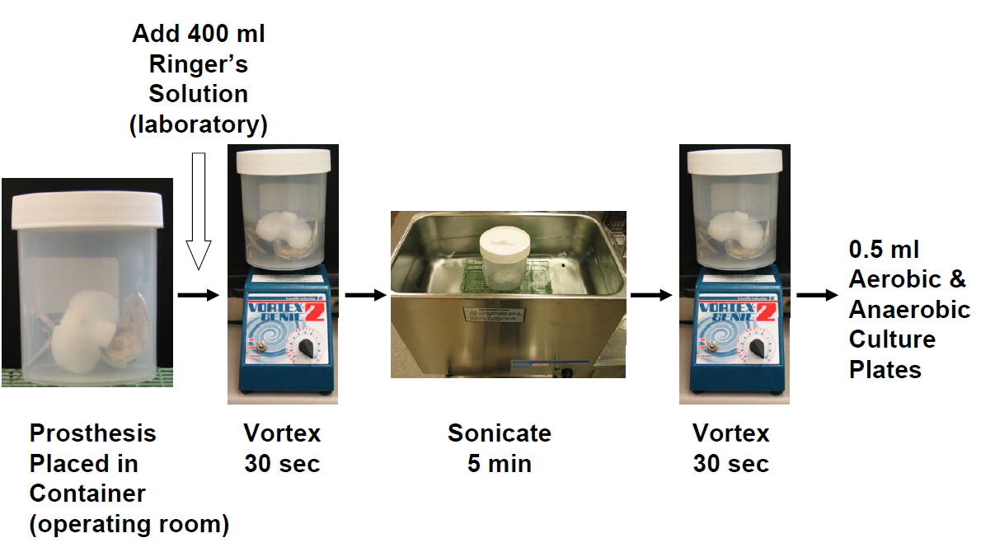
Bacterial Culture of Joint Hardware
A. Trampuz et. al., 2007. N. Engl. J. Med. 357:654-663

Slide 39
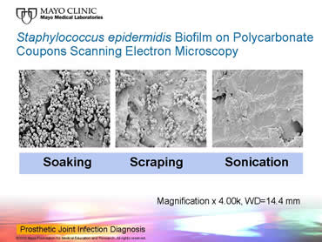
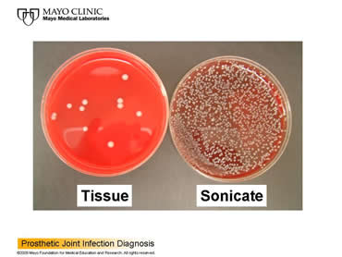
Bacterial Culture of Joint Hardware
Prosthetic Joint Infection Diagnosis January 4, 2010
Type: Hot Topic Video
Presenter/Author: Robin Patel, MD

Slide 40
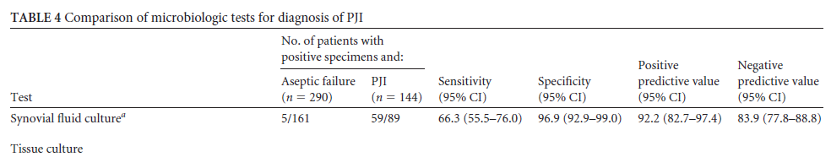
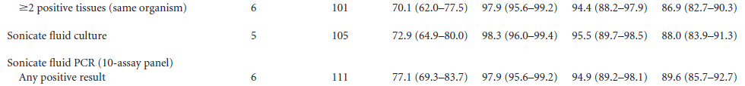
How Sensitive is Culture?
C. Cazanave et. al., 2013. J. Clin. Microbiol. 51:2280-2287

Slide 41
P. acnes PJI Culture Studies

Slide 42
P. acnes PJI Culture Studies
Study Schäfer, et. al Wu, et. al. Shannon, et. al.
P. acnes Cases 6 17 14
Media BAP, CAP BAP, CAP BAP,
Mac, BHI broth BHI broth ana. Thio,
Schaed. Agar Bruc. Agar CDC ANA
Schaed. Broth plate
Incubation 14 days 28 days 14 days
P. acnes grow
by Day 7 most not 80% 100%
P. Schäfer et. al., 2008. Clin. Infect. Dis. 47:1403-1409
S. Butler-Wu et. al., 2011. J. Clin. Microbiol. 49:2490-2495
S. Shannon et. al., 2013. J. Clin. Microbiol. 51:731-732

Slide 43
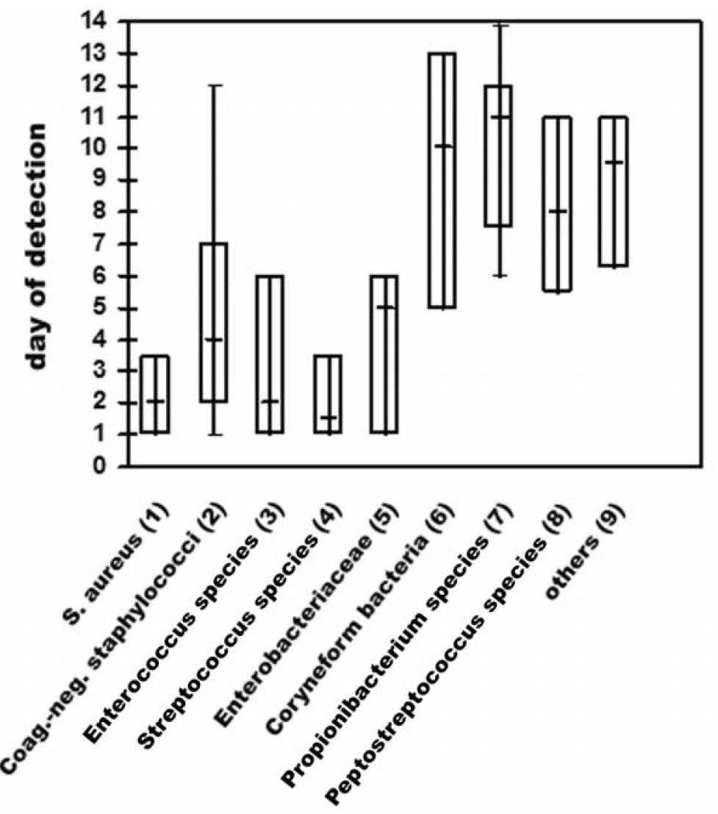
P. acnes PJI Culture Studies
P. Schäfer et. al., 2008. Clin. Infect. Dis. 47:1403-1409

Slide 44
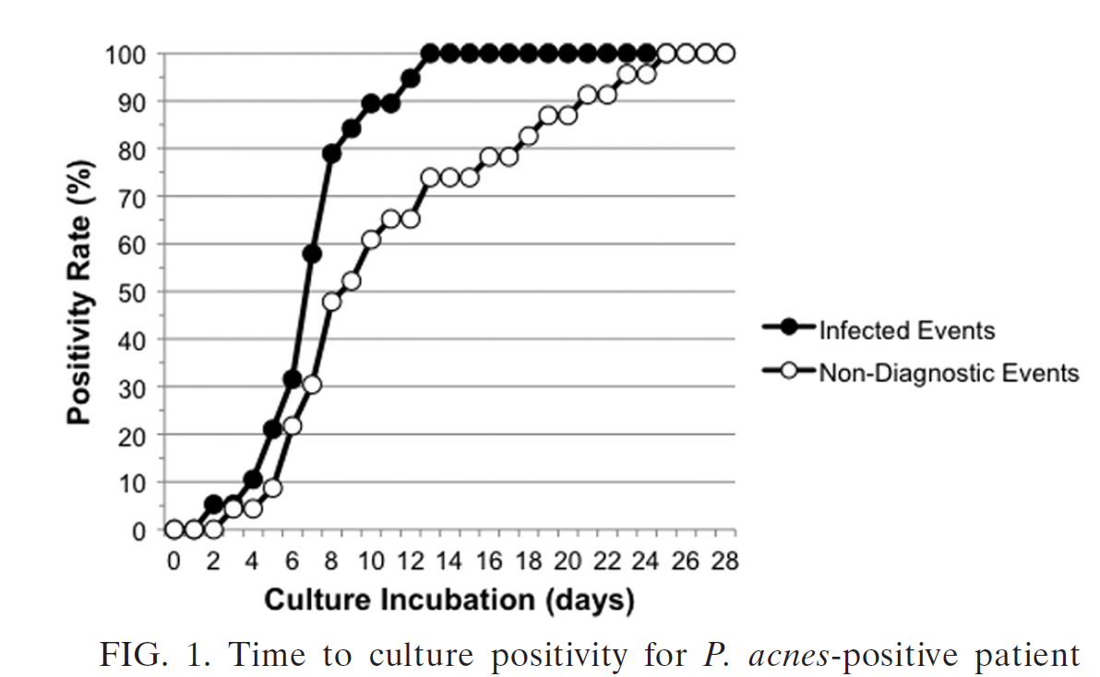
P. acnes PJI Culture Studies
S. Butler-Wu et. al., 2011. J. Clin. Microbiol. 49:2490-2495

Slide 45
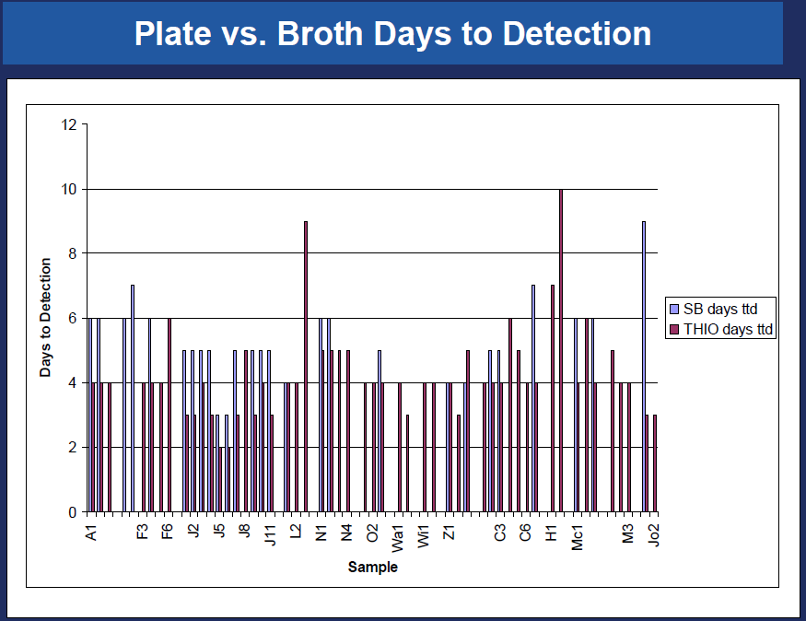
P. acnes PJI Culture Studies
S. Shannon et. al., 2013. J. Clin. Microbiol. 51:731-732

Slide 46
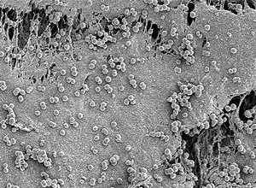
Culture Negative PJI
Antibiotic therapy within 14 days of surgery – no antibiotics 23% false negative cultures, antibiotics 55% false negative cultures
Bacteria are in a biofilm and not free in sampled tissue or fluid
Inability to culture fastidious/unusual bacteria that do not grow on routine media under standard incubation conditions
Transport conditions do not maintain the viability of bacteria

Slide 47


