Slide 2

2014 Updates:
Completing the New Bioterrorism Proficiency Testing Result Form and Changes to the Rule-out Algorithms
An overview of program
changes in 2014
Erin Bowles Amanda Weiss
Laboratory Network Coordinator Program Coordinator
Communicable Disease Proficiency Testing
WSLH WSLH
Phone: 608-890-1616 Phone: 608-224-4310
erin.bowles@slh.wisc.edu amanda.weiss@slh.wisc.edu

Slide 3
Objectives
Describe the steps for logging into PT Central and entering BPE results online.
Explain how to complete a paper result form, if needed.
Identify where the revised ASM Sentinel Level Clinical Laboratory Guidelines for Suspected Agents of Bioterrorism and Emerging Infectious Diseases are located.
Notes:
Slide 3 lists the objectives for today’s presentation.
At the end of the presentation you will be able to…
At the end of the presentation we will have time for any questions or comments, so please jot down any items you would like to discuss further and then bring them up at the end of the presentation.

Slide 4
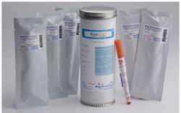
2014 Bioterrorism Proficiency Exercise Background & Procedure Changes
Notes:
Slide 4
I am going to begin today with a short review explaining why we do bioterrorism proficiency testing and then discuss some of changes made to the exercise and why they were made.

Slide 5
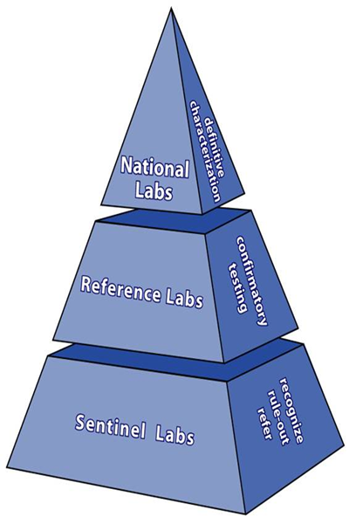
Sentinel Clinical Laboratory Role in the Laboratory Response Network (LRN)
Work closely with local and state public health and federal laboratories to recognize potential agents of terrorism and other emerging threats to public health
Strength of LRN is it’s tiered
capability construct
Sentinel laboratories serve as
the foundation
  Recognize
  Rule-out
  Refer
Notes:
Slide 5
You should all be very familiar with the information on this slide. This pyramid figure has been used since the beginning of the Laboratory Response Network. The Sentinel Clinical Laboratories form the base of the pyramid being the largest component of the network. The nature of the work performed by Sentinel Clinical Laboratories in performing direct patient care makes it likely that the Sentinel Clinical Laboratories will be the first to recognize and respond to a bioterrorism event, as sick patients come to the emergency department for treatment.

Slide 6
Definition: Sentinel
Clinical Laboratory
Laboratory is certified to perform high complexity testing by CLIA
Laboratory in-house testing includes Gram stains and culture of at least one of the following:
  Lower respiratory tract
  Wound
  Blood
  http://www.asm.org/images/PSAB/Sentinel-Clinical-Laboratory-Definition_2013.pdf

Slide 7
Purpose of the Bioterrorism Proficiency Exercise (BPE)
Sentinel Clinical Laboratories are responsible for demonstrating annual competency in performing rule-out testing as outlined in the ASM “Sentinel Level Clinical Microbiology Laboratory Guidelines for Suspected Agents of Bioterrorism and Emerging Infectious Diseases”
BPE is offered free of charge to WI clinical laboratories to meet the above requirement
Notes:
Start by reminding everyone of the reason why participation in BPE is important.

Slide 8
Results of September 2013
“Rule Out” Tests for Burkholderia
Test | Sample 1: (GNR) Expected Result | % Reporting Labs | Sample 2: (GNR) Expected Result | % Reporting Labs
α-hemolysis | Negative | 88.3% (of 77) | Negative | 85.7% (of 77)
β-hemolysis | Negative | 89.4% (of 76) | Negative | 86.7% (of 75)
Catalase * | Positive | 34.2% (of 76) | Positive | 50.6% (of 77)
Indole * | Negative | 88.2% (of 76) | Negative | 89.5% (of 76)
Motility * | Negative | 35.1% (of 74) ¹ | Positive | 47.3% (of 73)
Oxidase * | Positive | 90.8% (of 76) | Positive | 93.4% (of 76)
Urease | Positive | 21.9% (of 73) | Negative | 49.3% (of 73)
X Requirement | Not indicated | 91.5%(of 71) | Not indicated | 93.1% (of 72)
V Requirement | Not indicated | 91.5%(of 71) | Not indicated | 93.1% (of 72)
* Rule-out tests for Burkholderia
¹ >50% didn’t perform testing

Slide 9
ASM Sentinel Level Clinic
Laboratory Protocols Webpage
CDC, APHL, and ASM have updated the LRN protocols which can be found at the following:
  http://www.asm.org/index.php/guidelines/sentinel-guidelines
  NEW - Introduction, General Recommendations and Biochemical Test Procedures
  Anthrax (Bacillus anthracis)
  Brucella
  Burkholderia
  Plague (Yersinia pestis)
  Tularemia (Francisella tularensis)
Notes:
Also will find the Definition of LRN Sentinel Clinical Laboratories, Summary and utilization of Select Agent Forms, BT Readiness Plan, and Packing and Shipping
Revised documents, in CLSI format, have been harmonized to include the same information in each protocol in the same location.

Slide 10
Microbiology Technology
Advancements
YES - Few manual biochemicals are used by Sentinel Clinical Laboratories (SCL)
YES – Automated ID systems are the go to method for organism identification for many SCL
YES – Some SCL are using other methods to identify organisms (e.g.. Maldi-TOF, sequencing)
NO – SCL should identify BT agents
YES – SCL should rule-out BT agents
  Perform only on human clinical specimens
Notes:
Committee that gathered to revise the guidelines extensively discussed changes and advances in technology for the microbiology lab.

Slide 11
Changes to Protocols
Biosafety Levels changed to match “Biosafety in Microbiological and Biomedical Laboratories” (BMBL) and some changes to rule-out biochemicals.
  B. anthracis - BSL-2 unless working with high concentrations.
  Brucella spp. - BSL-3 (or BSL-2 with BSL-3 precautions)
  B. mallei and pseudomallei - BSL-2 for specimen processing but BSL-3 (or BSL-2 with BSL-3 precautions) for follow-up culture work & testing. Added susceptibility to amoxicillin-clavulanic acid and penicillin. Changed no pigment to no violet pigment.
  F. tullarensis - BSL-3 (or BSL-2 with BSL-3 precautions). Removed urease from rule-out test algorithm.
  Y. Pestis – BSL-2. Removed description of colonies as “fried egg” or “hammered copper” appearance. Growth slower at 37◦ than 25◦.

Slide 12
Revised Materials
Funding cuts to emergency response
  Development of shared training and resources
    Bioterrorism Agents poster
    Bench Guides for Bioterrorism Agents
    CDC TRAIN at http://cdc.train.org
      On-line packaging and shipping refresher training
      Basic Microscopy
    Free packaging and shipping workshops for employees with no previous training

Slide 13
Changes to BPE
Emphasis is on performing rule-out testing
No final identification is asked for
  Using an automated ID system or Maldi-TOF is not advised
Exercise is no longer designed to provide two organisms to practice the rule-out algorithm for a single bioterrorism agent (BT).
Each unknown sample may require laboratories to perform the rule-out algorithms for a different possible BT agent
Gram stain is only performed on isolate growth not primary inoculum.

Slide 14
BPE Tips for Success
Treat as a potential BT agent, perform all work in a BSC
Subculture to Bld, Choc, MAC
Subculture isolate to Bld, Choc, MAC
Perform “rule-out” testing from 2nd subculture
Use Gram stain and growth characteristics to guide choice of rule-out algorithm to perform
Perform “Rule-out” testing - dependent on manual biochemicals available in your lab
Report what you were and weren’t able to rule out and who you would notify
Report if you would refer for further testing and where you would refer

Slide 15

2014 Bioterrorism Proficiency Exercise Reporting Changes

Slide 16
Changes in 2014
Online result entry
ADDED
Worksheet
New Urease choices
Primary Gram stain
Final identification
REMOVED
Paper result form

Slide 17
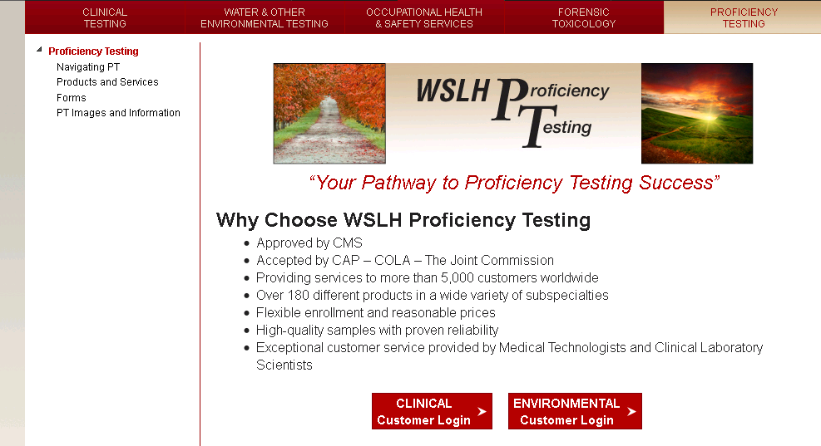
Entering Results Online
Go to the WSLH PT website: www.WSLHPT.org
Log on to PT Central
by clicking on
CLINICAL Customer Login

Slide 18
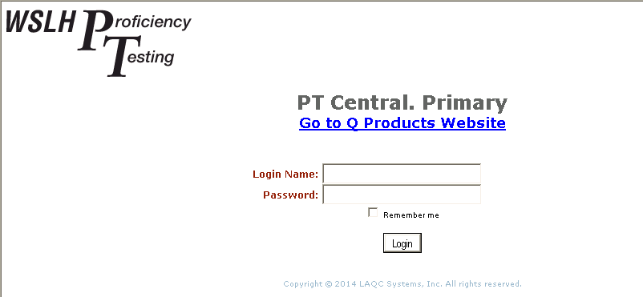
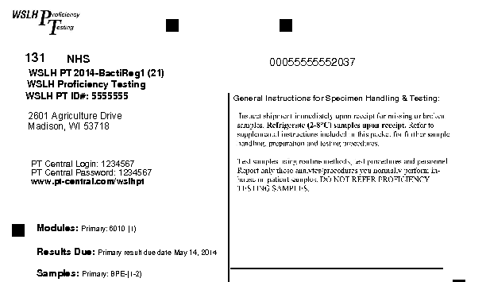
Entering Results Online
Enter your Login Name and Password in PT Central
This cover sheet will come with your samples

Slide 19
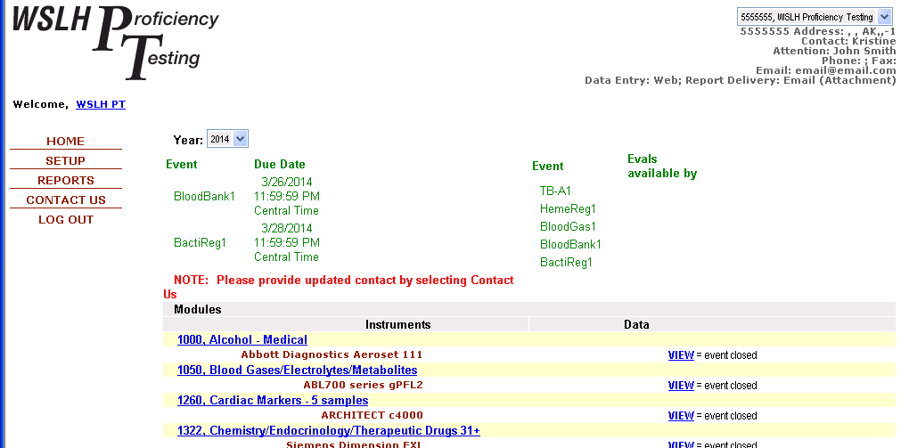
Entering Results Online
After logging in, you will see your HOME page

Slide 20
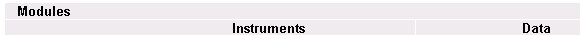
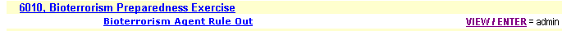
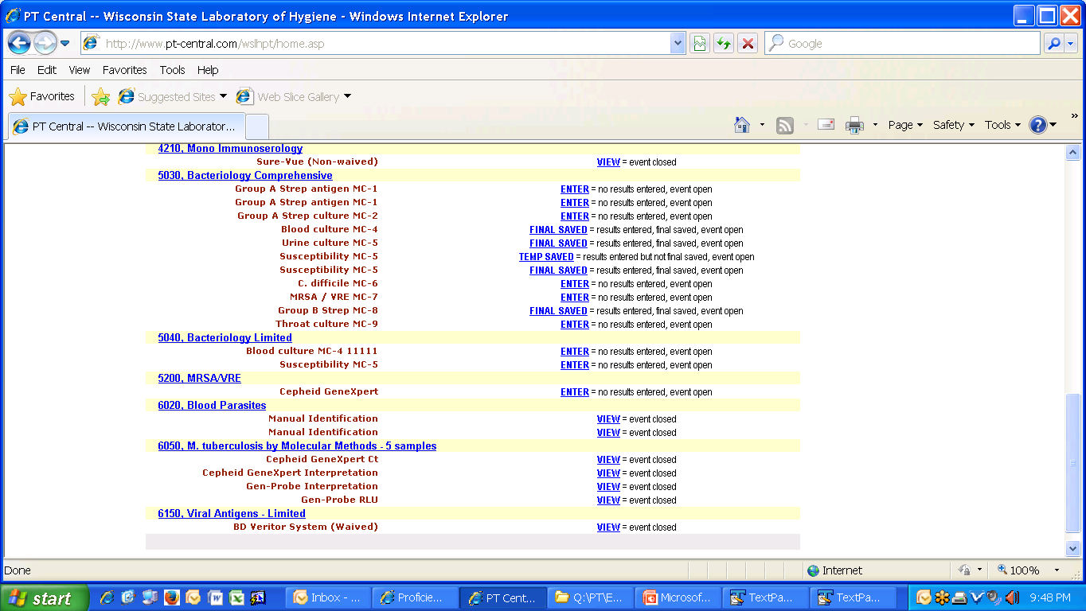
Entering Results Online
Click on Bioterrorism Preparedness Exercise to view sample instructions
Click on ENTER to report your results

Slide 21
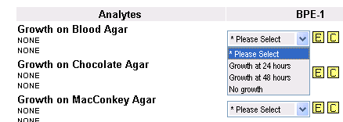
Entering Results Online
For EACH Analyte:
Select a result from each drop down menu
OR
Select an Exception code (click yellow E)
Comments may be added by clicking the yellow C

Slide 22
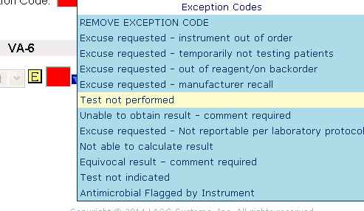
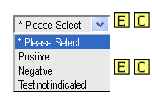
Entering Results Online
If a result cannot be provided:
You MUST choose either Test not indicated or Test not performed
Test not indicated:
This test is not appropriate for the organism isolated
Test not performed:
This facility does not have the capability to perform this test

Slide 23
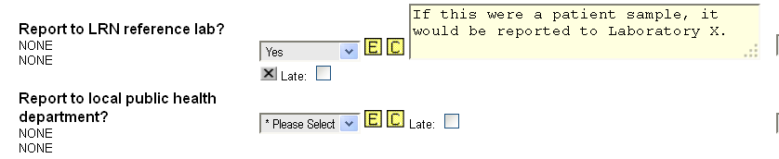
Entering Results Online
Add Comments to supplement responses
Comments are especially helpful to:
- Specify temperatures being used
- Indicate reference labs to which a patient sample would be sent

Slide 24
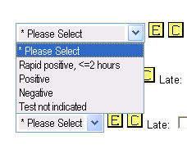
Entering Results Online
New reporting option for Urea test:
For positive Urease tests
“Rapid positive” if positive at <2 hrs
“Positive” if positive at >2 hrs
Urease

Slide 25
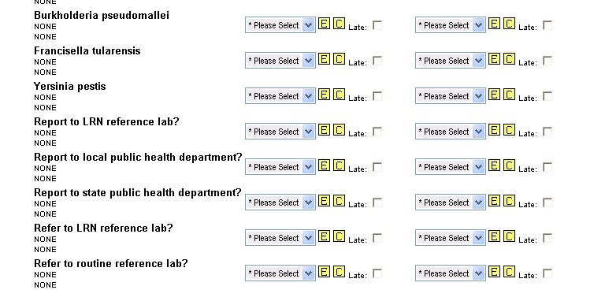
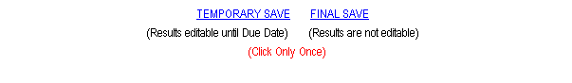
Entering Results Online
SAVE your results!
TEMPORARY SAVE:
Data is submitted and can be edited until the due date
FINAL SAVE:
Data is submitted and cannot be edited

Slide 26
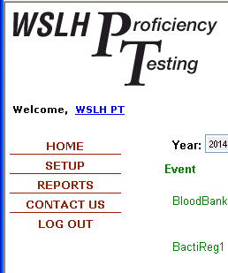
Building a Data Submission Report
After results have been entered and SAVED, build a Data Submission Report for your records
Click on REPORTS in the upper left hand side of the PT Central screen

Slide 27
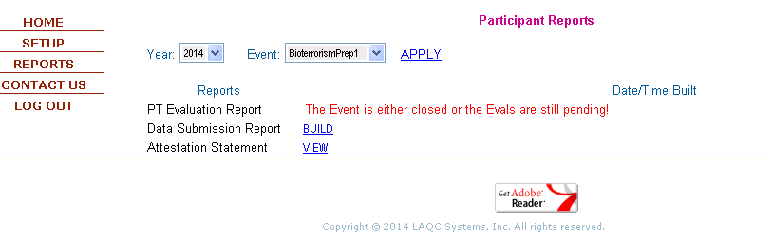
Building a Data Submission Report
2. Click APPLY
1. Choose the Year and Event (BioterrorismPrep1)
3. Click BUILD

Slide 28
Questions?
See our contact information on the second slide
Call proficiency testing at 800-462-5261

