Slide 2
Influenza and other Respiratory Viruses Update--2014
Pete Shult, PhD
CDD Director & Emergency Laboratory Response
and
Erik Reisdorf, MPH, M(ASCP)^{CM}
Surveillance and Virology Lab-Team Lead

Slide 3
Learning Objectives
Review of the 2013-2014 influenza season
Antiviral resistance surveillance
Emerging diseases impacting community health
Review of new diagnostic assays
Impact of new regulatory requirements
Discuss surveillance strategy for 2014-2015

Slide 4
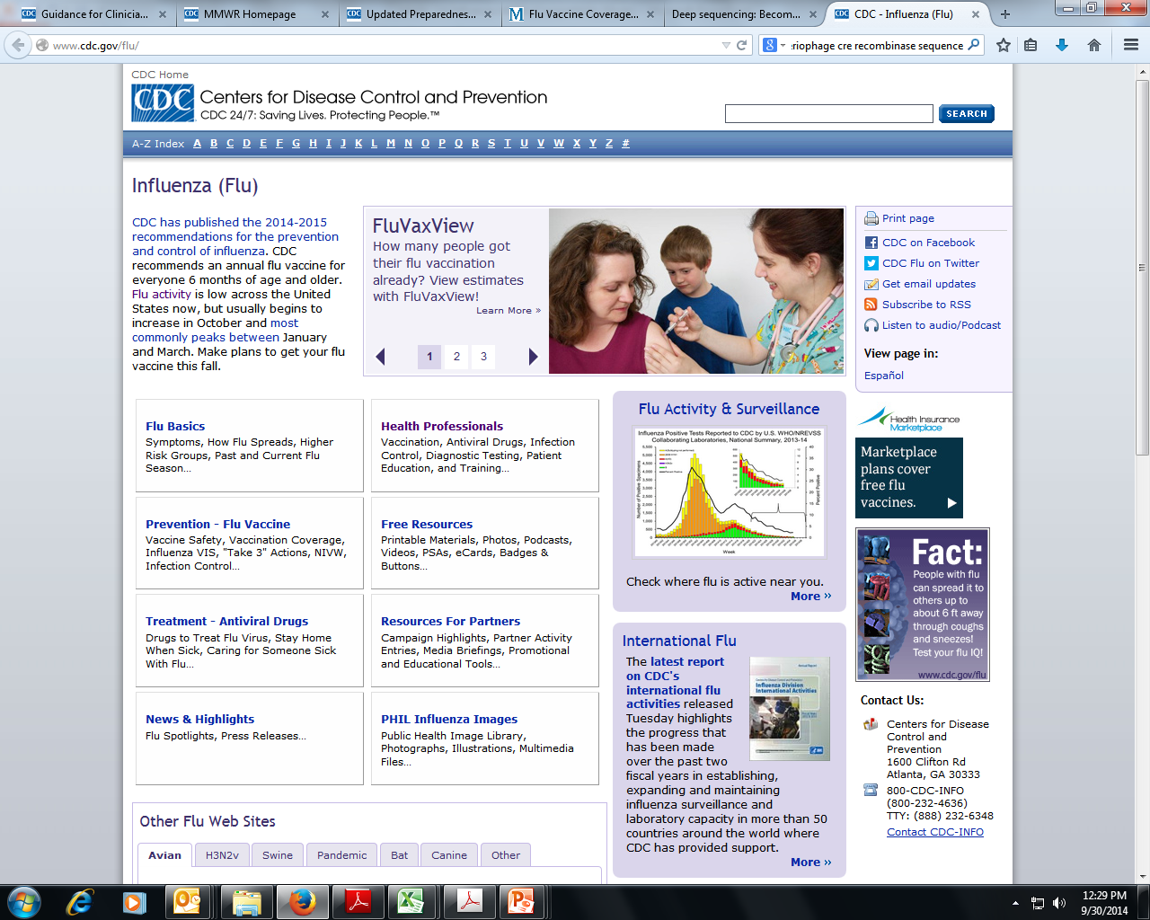
Influenza
The latest information
www.cdc.gov/flu/index.htm
Notes:
Excellent resources to be found at the CDC’s Seasonal influenza website and a subsite that provides updates on the influenza variant viruses we will hear more about in detail from Julie.
Best single source of basic influenza information, up-to-date info on the vaccine and antivirals, laboratory diagnostics and a portal for weekly surveillance updates
Information geared to both professionals and the general population
ProMED –mail (www.promedmail.org) good source of information on immediate occurrences (variants, H5N1, outbreaks, antiviral resistance etc.)

Slide 5
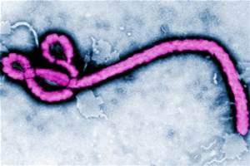
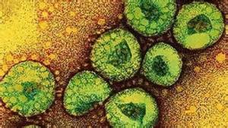
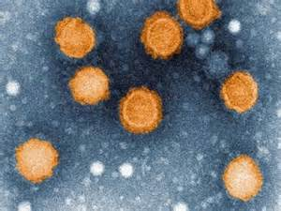

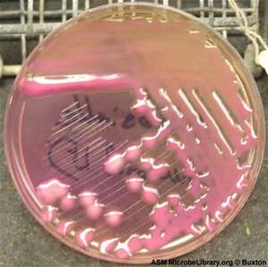
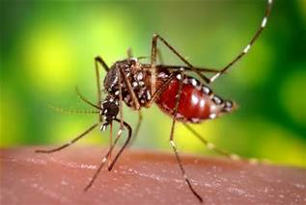
What We’re Dealing with Now
Ebola virus
EV-D68
MERS CoV
Dengue fever
Chikungunya
Pertussis
Measles/mumps
… So what’s the big deal with influenza?
Notes:
What makes influenza a particular public health challenge is: (i) Significant morbidity and mortality; (ii) pandemic potential; (iii) transmission widely and rapidly through the population be it community or institution; and (iv) incredible capacity for antigenic change
Every novel influenza event or severe influenza season really highlights the necessity and importance of accurate lab tests and a robust influenza surveillance system.
The reason: when the influenza virus changes the concern is that their will be:
Changes in the clinical and epidemiological presentation of the resulting infections and illnesses
Change in effectiveness of treatments and prophylaxis
Changes in detection
Julie’s going to provide a look at the past season, what we anticipate for the up coming season and I will provide an update on diagnostics and influenza surveillance improvement activities
For public health labs more details on a number of the topics touched on today will be covered during the APHL/CDC Annual Seasonal Influenza Surveillance Informational Webinar to be held this Thursday at 3:00pm ET

Slide 6
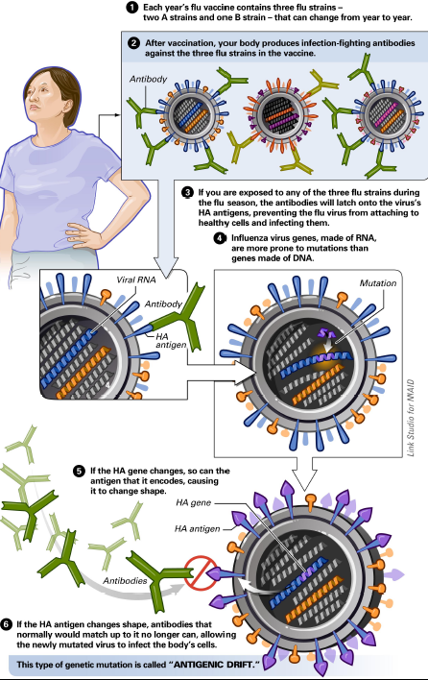
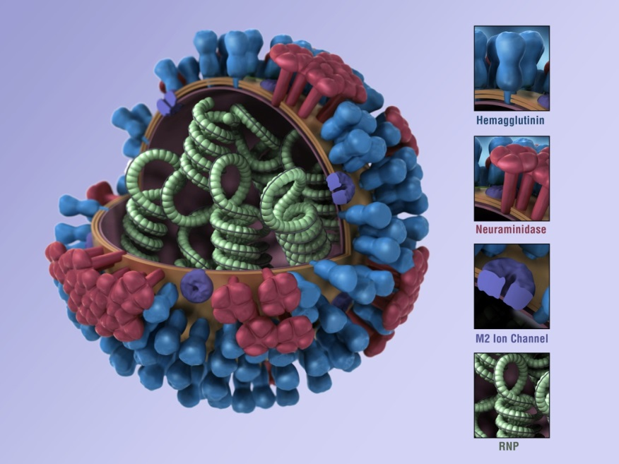
The Changeability of Influenza
Antigenic Drift →Seasonal Influenza
Antigenic Drift
Manifests in HA and NA as a result of continuous and gradual accumulation of point mutations in the HA and NA genes
www.flu.gov
Notes:
Now to get started , slide 6 presents a quick visual review of the key features of the influenza virus responsible for its ability to readily change antigenically: this is the real hallmark of this virus
Classification and nomenclature of influenza is based largely on its antigenic presentation.
Relevant key features:
There are 3 types of influenza based on internal antigenic determinants; only 2 of these (A & B) are significant clinically and in PH sense
RNA-containing genome
Consequences for mutation: very prone to mutation via errors in transcription and without adequate “proof-reading” mechanisms capable of editing out the errors
Key surface components
HA and NA
Relevance to nomenclature
Defines subtypes of influenza A
Importance in pathogenesis and against which a large measure of the host immune response is directed
Prone to mutation (particularly the HA)
Essentially a moving target for the host population immune response
Genome is segmented
Enabling two different influenza A viruses that might infect the same host to “reassort” gene segments leading to a virus that might have a novel HA and/or NA
Influenza type A, but not type B, has subtypes based on antigenic determinants found on the HA and NA
The consequences of these genetic changes is highlighted on the following slide
Antigenic Drift
Which manifests in the HA and NA as a result of continuous and gradual accumulation of point mutations in the genes coding for these glycoproteins leading to development of new strains
Result of immune selection within the population
Occurs throughout year as virus circulates globally
Occurs with both influenza A and B
Associated with seasonal epidemics and results in the need to change one or more components of the vaccine almost every year

Slide 7

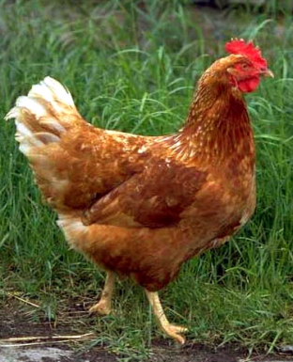






Influenza’s Gonna Do What
Influenza Does: Change!
    Influenza A
    H1 - H17
    N1 – N10
Aquatic birds
Poultry
Humans
Pigs
Horses
Aquatic
mammals
Cats
Dogs
Notes:
Influenza at the Human-Animal Interface
Influenza A naturally occurs in aquatic birds (waterfowl and shore birds), the natural zoonotic host for Inf A, but also a range of other species.
There are now 17 subtypes of HA and 10 subtypes of NA. These surface glycoproteins are the key antigenic determinants to man.
Most recent H and N subtypes identified in a new bat influenza recently discovered. Further extends the genetic pool of flu viruses that could impact man

Slide 8
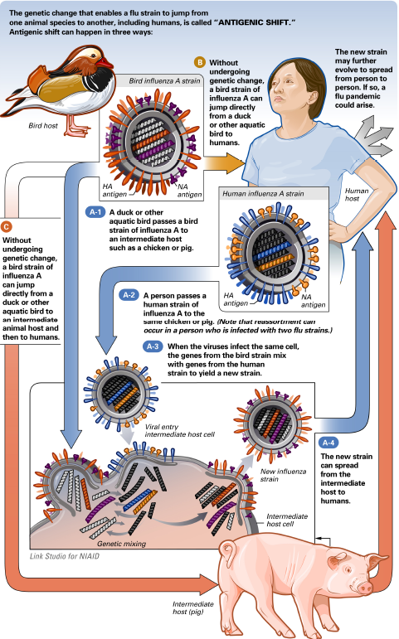
The Changeability of Influenza
Antigenic Shift www.flu.gov
Antigenic Shift When a new subtype (a novel HA and/or NA) of influenza A emerges in the host (humans)
Notes:
Antigenic Shift
When a new subtype of influenza A emerges in humans either directly from an avian source or possibly following a genetic reassortment event in an animal intermediate host
Can Occur suddenly
This can occur in 3 ways highlighted in the diagram
Necessary precursor for an influenza pandemic.
Antigenic Shift 1
A duck or other aquatic bird passes a bird strain of influenza A to an intermediate host such as a chicken or pig.
A person passes a human strain of influenza A to the same chicken or pig.
When the viruses infect the same cell, the genes from the bird strain mix with genes from the human strain to yield a new strain(reassortment).
The new strain can spread from the intermediate host to humans. (e.g. 2009H1N1, trH3N2)
Antigenic Shift 2
Without undergoing genetic change, a bird strain of influenza A can jump directly from a duck or other aquatic bird to humans.
Antigenic Shift 3
Without undergoing genetic change, a bird strain of influenza A can jump directly from a duck or other aquatic bird to an intermediate animal host and then to humans.

Slide 9
Timeline of Emergent and Pandemic
Influenza Viruses in Humans
Swine H3
Swine H1
Avian H9
Type A
Avian H7
Avian H5
2009 H1pdm A
H1
H3
H2
H1
1999
2011
1918
1940
1957
1968
1977
1997
2003
2009
2013
B/Yam
Type B
B/Vic
Notes:
A number of viruses bare watching: potential pandemic strains highlighted in red.
H5N1 and H7N9: briefly describe
H5N1: 667 cases, 393 deaths affecting mostly children & young adults; high mortality in birds
Where
H7N9:453 cases 171 deaths mostly in older adults and elderly; little illness in birds
Eastern China
Both occur after direct contact with birds; no sustained h-to-h transmission
H3v:306 cases in 2012, 18 in 2013, 3 in 2014; occurred in Midwest mainly in children after swine exposure at fairs. No more severe than seasonal…~20 hospitalizations, 1 death; no sustained h-to-h transmission
Just because we had pandemic recently does not mean we can’t have another soon. If one of these novel viruses acquires ability to transmit h-to-h, we could have next pandemic

Slide 10
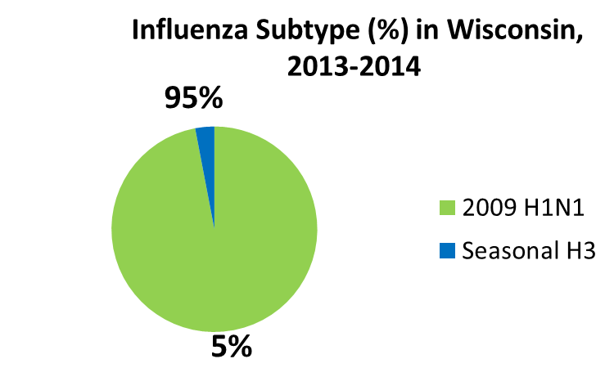
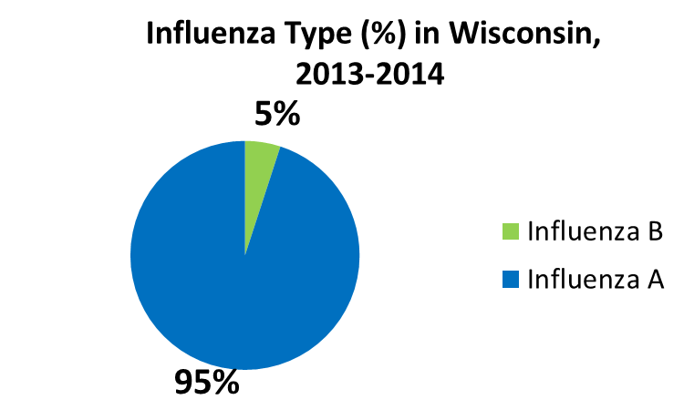
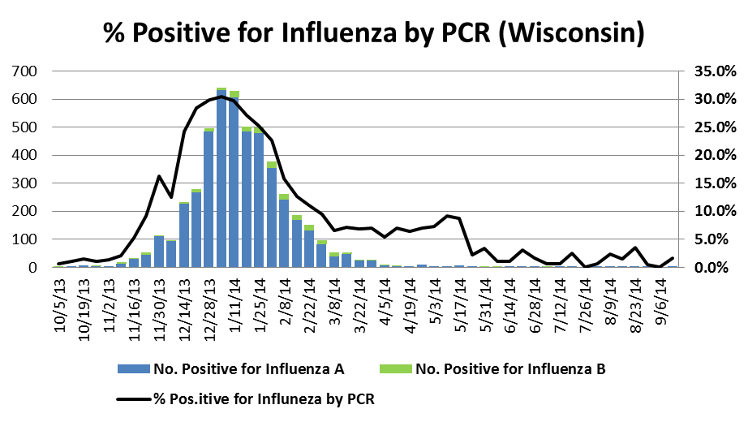
The Year in Review, 2013-2014
Influenza peak week ending 1/11/14.
Influenza B activity was minimal.
Influenza was detected every week except one all summer!

Slide 11
The Year in Review, 2013-2014
H3N2
pH1N1
2012-2013
2013-2014
Pneumoniae & Influenza Diagnostic Index, CDC
Notes:
2012-2013 season was characterized as one of the most severe in more than a decade.
Population most impacted by H3N2 is the elderly!
2013-2014 was less severe than 2012-2013; nevertheless, the

Slide 12
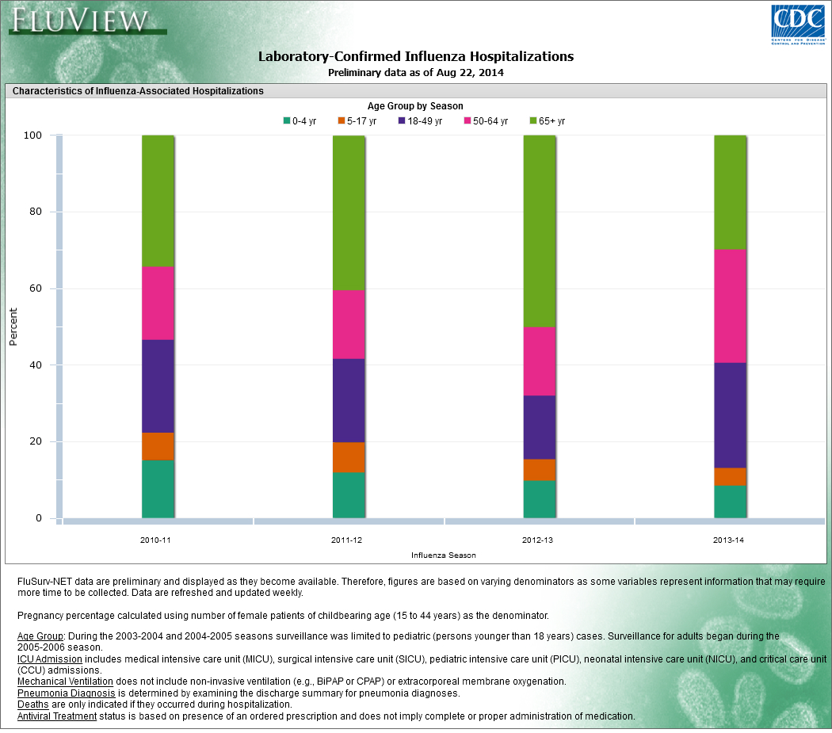
The Year in Review, 2013-2014
H3N2
pH1N1
30%
>50%

Slide 13
The Year in Review, 2013-2014
Antiviral Resistance Surveillance
Drug | 2009 H1N1 % Resistant | Seasonal H3 % Resistant | Inf B % Resistant
Oseltamivir | 1.2 | 0 | 0
Wisconsin: A total of 81 Influenza viruses were tested for neuraminidase inhibition and only 1 (2009H1N1) was characterized as resistant.
Data source: CDC Flu View (2014) Available at: http://www.cdc.gov/flu/weekly/summary.htm Accessed on: 8 October 2014.

Slide 14
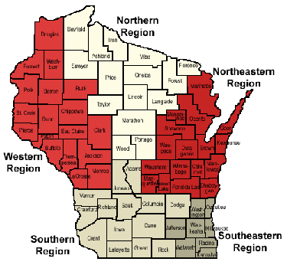
Early 2014-2015 Season….
PH Region | Date Received | Influenza type
NE | 9/3/2014 | FluA 09H1
N | 9/13/2014 | Flu A (H3)
N | 9/13/2014 | Flu A (H3)
N | 9/18/2014 | Flu A (H3)
S | 9/18/2014 | Flu B
N | 9/25/2014 | Flu A (H3)
SE | 9/25/2014 | Flu A (H3)
S | 9/26/2014 | Flu A (H3)
W | 9/27/2014 | Flu A (H3)
S | 10/2/2014 | Flu A (H3)
S | 10/2/2014 | Flu A (H3)
SE | 10/3/2014 | Flu A (H3)
SE | 10/6/2014 | Flu A (H3)
SE | 10/6/2014 | Flu A (H3)
SE | 10/7/2014 | Flu A (H3)

Slide 15

It’s NOT all about influenza…. other diseases of public health importance…..

Slide 16
Enterovirus D68
Background
  Enteroviruses are very common respiratory viruses (10-15M/year).
  Transmission respiratory route (person-to- person)
  Cause a wide variety of illnesses.
  Types that circulate are variable & unpredictable.
  >100 EV types
  Peak activity during summer and fall.
  There are no vaccines or antiviral therapeutics.
  Children with asthma are more vulnerable.

Slide 17
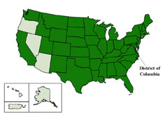
Enterovirus D68
Current Situation
  Mid-August to October 8, 2014, 664 cases reported from 45 states….widespread activity.
  As of October 8, there have been 11 CDC confirmed cases in Wisconsin.
  Not all hospitalized cases were diagnosed with EV68. Others included rhinoviruses and other enteroviruses.
States with Lab Confirmed EV D68 (CDC, October 8, 2014)

Slide 18
Enterovirus D68
Diagnostic Testing
  Genetically very similar to rhinoviruses.
  Most PCR assays cannot accurately discriminate!
  Some commercial PCR assays may have variable sensitivities for EV D68.
  Testing is limited to severe adolescent cases that meet WDPH established criteria.
  Combined NP/OP is the preferred specimen.
  WSLH is performing Enterovirus PCR on approved specimens.
  Specific EV D68 typing at CDC.
http://www.slh.wisc.edu/enterovirus-d68-confirmed-in-wisconsin/

Slide 19
MERS-Coronavirus
Current Situation
Two confirmed cases in the US in spring 2014.
As of June 11, 2014 699 cases and 209 deaths globally.
Activity has slowed since the peak in May.
Epidemic curve of MERS-CoV cases,
8 June 2014 (WHO, 2014)

Slide 20
MERS-CoV
What we know!
Initially referred to as novel coronavirus.
Virus is different than SARS-Coronavirus and seasonal coronavirues OC43, HKU1, 229E & NL63.
First cases documented in spring 2012 (nurse & university student)-Jordan.
All cases linked to the Middle East.
Age range 1 to 94.
Severe morbidity and mortality.
Limited human-to-human transmission.
Genetically stable.

Slide 21
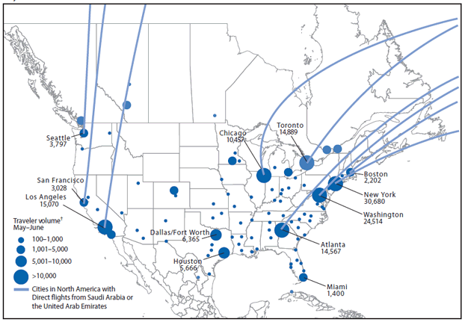
Are we at Risk for MERS-CoV?
Points of entry and volume of travelers on flights to the United States and Canada from Saudi Arabia and the United Arab Emirates — May–June 2014 Source: (MMWR, 2014)

Slide 22

Influenza
Diagnostic Technology
Update
NGS
RIDTs
Automation
Multiplex
PCRs
Regulations
Rapid
Molecular
Notes:
Laboratory testing is the key to influenza diagnosis and effective comprehensive surveillance
Lots of other viruses circulating
Clinical presentation can be very similar
Laboratory testing critical

Slide 23
Influenza Molecular Tests - PCR
Available at the WSLH
  CDC Flu rRT-PCR Dx Panel – FDA cleared
    A, B, H1, H3, 2009H1, H5
  Flu B lineage testing – FDA cleared
  H7N9 available under EUA
  H3v evaluation for FDA approval
    Multi-site PHL clinical study
Notes:
PHLs have been provided and have used the CDC Dx panel since before the 2009 pandemic
B lineage testing
Trivalent vaccine has B/Massachusetts/2/2012-like (Yamagata lineage) and quadrivalent adds B/Brisbane/60/2008-like (Victoria lineage)
Work underway by Flu subcommittee and CDC on a lineage typing algorithm
H7N9 kit available
Need to run 16 sample verification panel
A, RP, H7 primers
H3v kit evaluation for FDA-approval
A, H3s and H3v primers
As with H5N1 testing in the past, it is important that subtyping for novel viruses be performed when appropriate clinical and epi criteria are met
I’ll mention several times that it is critical PHLs and, through them, CDC be engaged to detect and confirm novel strains as well as characterize seasonal A subtypes and B lineages
More details on 50 state call in a couple of days.

Slide 24
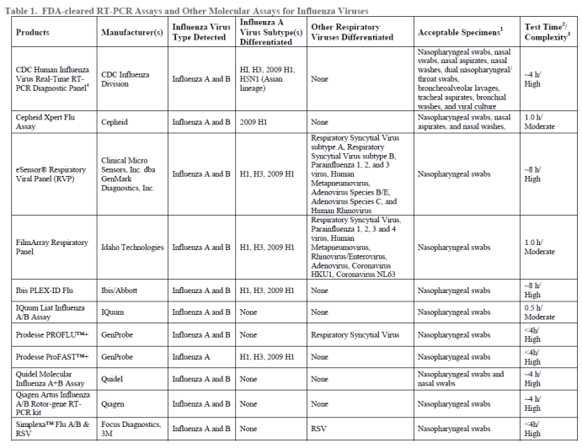
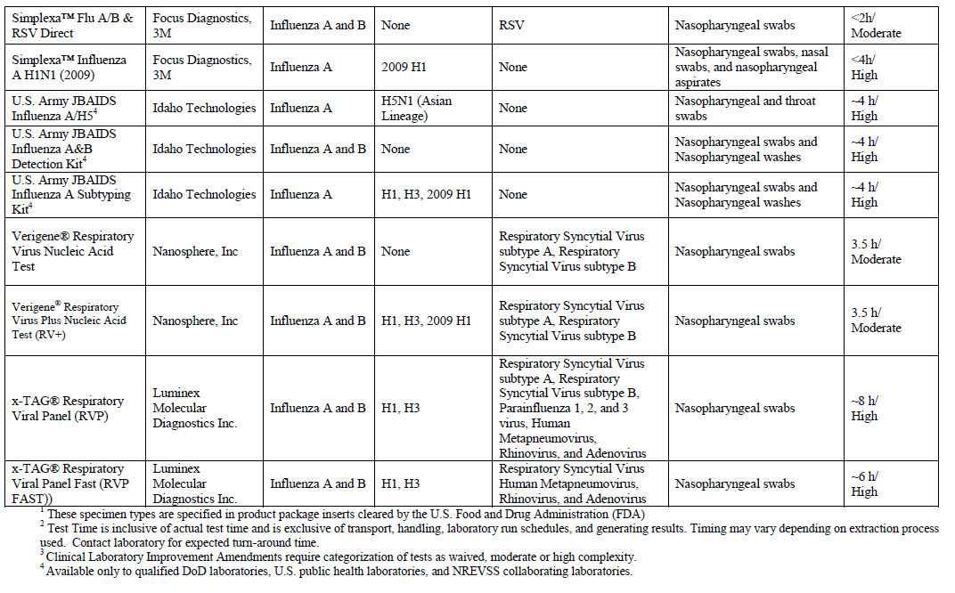
Influenza Molecular Tests - PCR
Commercially Available - FDA Cleared
CDC periodically updates list
More and more clinical labs using these
Literature in general indicates high level of performance
Concerns:
  Detection of novel influenza A’s
  Variable subtyping capabilities
http://www.cdc.gov/flu/professionals/diagnosis/molecular-assays.htm
Notes:
CDC working on update to “FDA-cleared RT-PCR Assays and Other Molecular Assays for Influenza Viruses”
For instance the Quidel Lyra Influenza A Subtype H7N9 Assay, which received FDA emergency use authorization last winter not on here. Likely other changes
Many(not all) of these tests detect and differentiate influenza A and B; a number of these can differentiate some subtypes of influenza A
Cautions:
Will they detect novel influenza A viruses
Subtyping capabilities and epi reporting
Don’t identify all relevant subtypes
Novel subtypes?
It is critical that Public Health reach out to the users of these tests to get not only their data (# tested; number positive) but access to specimens
For further subtyping as part of situational awareness
To confirm presence of novel viruses
If not subtypable with those tests capable of some degree of subtyping
If off season or travel history or some other indicator seems to point to possibility strain may be novel
Perhaps to confirm their performance
There will be a need for ongoing guidance for the use of these tests for influenza detection. Can novel viruses be detected when they emerge? Can current strains continue to be identified?
Requires close communication among CDC-PHLs -clinical labs
PHL to clinical lab in event of particular concern (H7N9, H3N2v)
Clinical lab to PHL if they have suspicions of a novel virus being involved
Also need to facilitate specimen getting to PHL: free transport, collection supplies, testing

Slide 25
Wisconsin Labs with Flu PCR & Virus Culture Capacity, September 2014
Douglas
Bayfield
Influenza PCR Labs (n=46)
Washburn
Saywer
Ashland
Iron
Virus Culture Labs (n=5)
Price
Vilas
Burnett
Oneida
Florence
Polk
Barron
Rusk
Marinette
Lincoln
Forest
Chippewa
Taylor
Langlade
Oconto
St. Croix
Dunn
Menominee
Clark
Marathon
Pierce
Eau Claire
Pepin
Shawano
Door
Buffalo
Wood
Portage
Waupaca
Outagamie
Kewaunee
Trempealeau
Jackson
Brown
Monroe
Juneau
Waushara
Winnebago
Manitowoc
LaCrosse
Adams
Marquette
Calumet
Fond du Lac
Sheboygan
Vernon
Green Lake
Richland
Sauk
Columbia
Dodge
Ozaukee
Crawford
Dane
Washington
8
6
Jefferson
3
Grant
Iowa
Waukesha
Green
Milwaukee
LaFayette
Rock
Walworth
Racine
Kenosha

Slide 26
Multiplex PCR Respiratory Pathogen Tests
Name | Manufacturer | # Targets | Targets 510(k) Cleared | Sample>Result | YR
FilmArray Respiratory Panel | BioFire | 20 | Viral & Bacterial | Yes | 2012
eSensor Respiratory Virus Panel | GenMark Diagnostics | 14 | Viral only | No | 2012
xTAG Respiratory Virus Panel | Luminex | 12 | Viral Only | No | 2008
xTAG Respiratory Virus Panel FAST | Luminex | 8 | Viral Only | No | 2011
Verigne Respiratory Virus Plus | Nanosphere | 7 | Viral Only | Yes | 2011
Prodesse ProFlu+ | Hologic Genprobe | 3 | Viral Only | No | 2008
Simplexa FluA/B + RSV | Focus Diagnostics | 3 | Viral only | No | 2012
Quidel Molecular RSV + hMPV | Quidel | 2 | Viral Only | No | 2013
Notes:
A number of the flu PCRs are part of multiplexed respiratory panels
Summary of FDA cleared multiplex PCR panels for respiratory pathogens.
Cover routine respiratory viral pathogens in addition to influenza A (some including subtyping)and B
Range from mini to mega panels of 2 to 20 targets.
RUO add ons, e.g. coronaviruses, parainfluenza 4
Biofire also includes bacterial pathogens(B.pertussis, Chlamydophila pneumoniae, M.pneumoniae)- ”Beyond RVPs”
Numerous manufacturers to choose from, but each requires a unique instrument!
Beyond RVPs with BioFire
Also note trend to sample to result testing

Slide 27
Multiplex PCR Respiratory Pathogen Tests
Their value?
Notes:
The value of these data is evident in this slide
The use of these tests raise many questions in clinical practice to be sure…
Utility(Effect on patient outcomes), performance, interpretation, cost/re-imbursement
But from a surveillance perspective, they are being used and the test data generated enable a more complete picture of the etiology of respiratory infections in the community…much more so than ever
Like with influenza, including data from clinical labs greatly expands the data pool (orders of magnitude)in terms of overall numbers, location within the state, varying patient populations in each state especially if PHL not running RVP
Much more data on RSV when rapid test data are included
It makes sense to make available these data with data on influenza …this is the direction we are/should be headed in surveillance
Value at local, state and national levels for epi’s and clinicians
Also if not flu, what
Value in determining “background” especially when trying to detect/characterize the emergence of a novel event
Background to ID other public health problems(pertussis) or emergence and spread of novel agents(H3v, MERS-CoV, EV-D68)
Need to collect only data and not necessarily specimens for further characterization…less complex than with flu. This takes advantage, however, of the existing clinical lab infrastructure
The elements of seasonality is similar to what has been observed for 50 years, but sensitivity of PCR much greater so numbers of identifications of each virus much greater
Used %’s to normalize from different lab sources
In addition, viruses not often identified in the past now seen
hMNV
Coronaviruses
Para 4

Slide 28
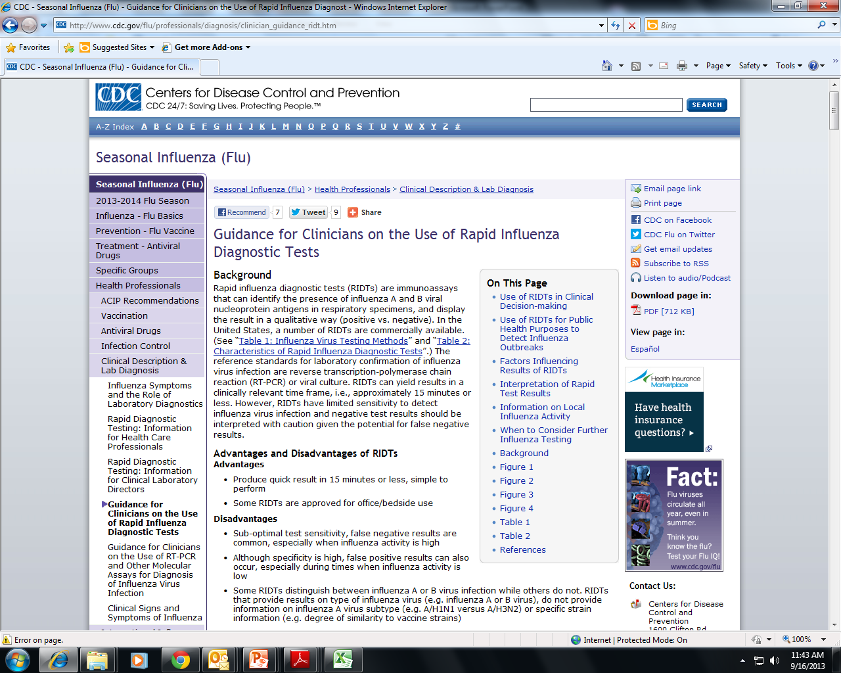
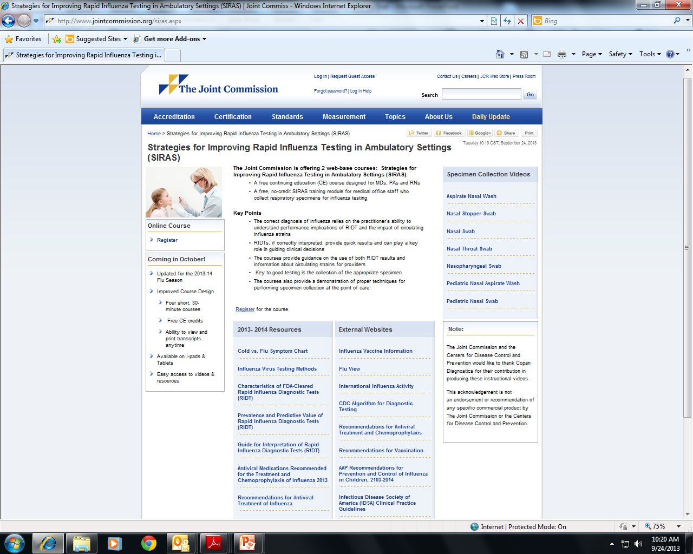
Rapid Influenza Diagnostic
Tests (RIDTs)
A perennial discussion
www.jointcommission.org/siras.aspx
www.cdc.gov/flu/professionals/diagnosis/clinician_guidance_ridt.htm
Notes:
10s to 100s of clinical labs and physician office labs and more non-traditional testing sites continue to use RIDTs in all of our states
We are all familiar with the advantages and limitations of these tests. I’ve covered this in detail in past presentations.
Limitation really came to the forefront during and after the 2009 pandemic when poor performance, specifically very low sensitivity, for a number of these kits was described both by the CDC and in the peer-reviewed literature
Despite these limitations, there remains a huge demand for these tests from our clinicians and great potential for influenza surveillance activities, including:
Monitoring data
Monitoring performance
Trigger for specimen submission to allow:
Confirmatory testing
Random community-based source of specimens
As a consequence of their widespread usage and well-documented limitations, excellent resources have been developed for clinicians and laboratorians to help optimize the usage and results interpretation of these tests.
There are 2 things currently going on to be aware of that are working in the direction of improving these tests and their diagnostic reliability

Slide 29
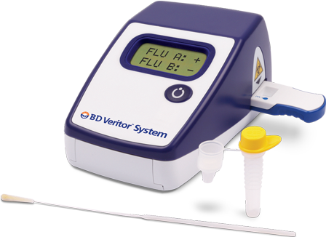
Rapid Influenza Diagnostic Tests
The Next Generation
Quidel Sofia Influenza A & B
Incorporates reader instrument
Reduces subjectivity
Improved sensitivity
CLIA-waved
Data transmission capabilities
A step in the right direction
B-D Veritor Influenza A & B
Notes:
Both B-D and Quidel that I am aware of have come out with “next-gen” RIDTs
B-D Veritor: rapid chromatographic immunoassay with reader
Quidel Sofia: rapid fluorescent immunoassay with reader
Both CLIA-waived and Moderately complex test configurations available
Growing body of literature, so far, indicates significantly improved sensitivity, objectivity and easy performance especially when taking into account the other factors mentioned before which are important in optimizing RIDT test results.

Slide 30
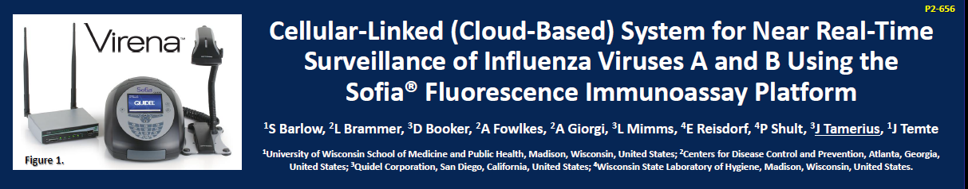
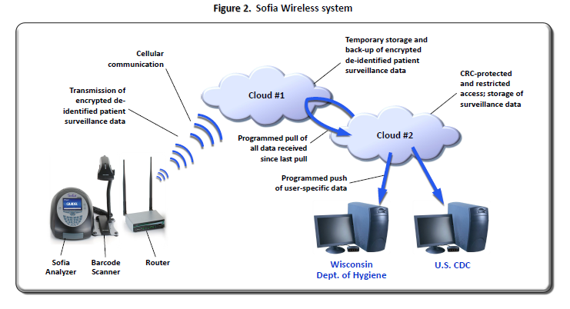
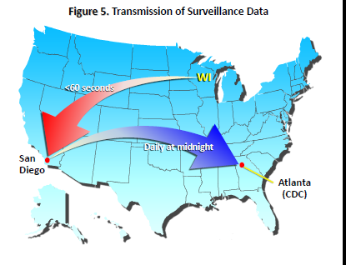
Rapid Influenza Diagnostic Tests
An Unique Application for Surveillance
Options for the Control of Influenza VIII Meeting,
Sept. 2013, Cape Town, South Africa
Notes:
A technology advance in reporting of RIDT test results is also being explored ….
From a poster presented at the Options VIII Influenza meeting, South Africa
Collaborative study among CDC, UW-Madison and Quidel Corp.
Poster describes a method for secure near real-time reporting of test results(flu A or B) and linked demographic (age, location, in-patient/out-patient, etc.) information ( patient de-identified) which is possible by linkage of the testing device (Sofia) to a cellular wireless capability which can transmit data to a “cloud” and allow subsequent rapid and reliable data transmission to public health(Local, state, CDC) officials
The potential here for influenza surveillance could be huge!

Slide 31
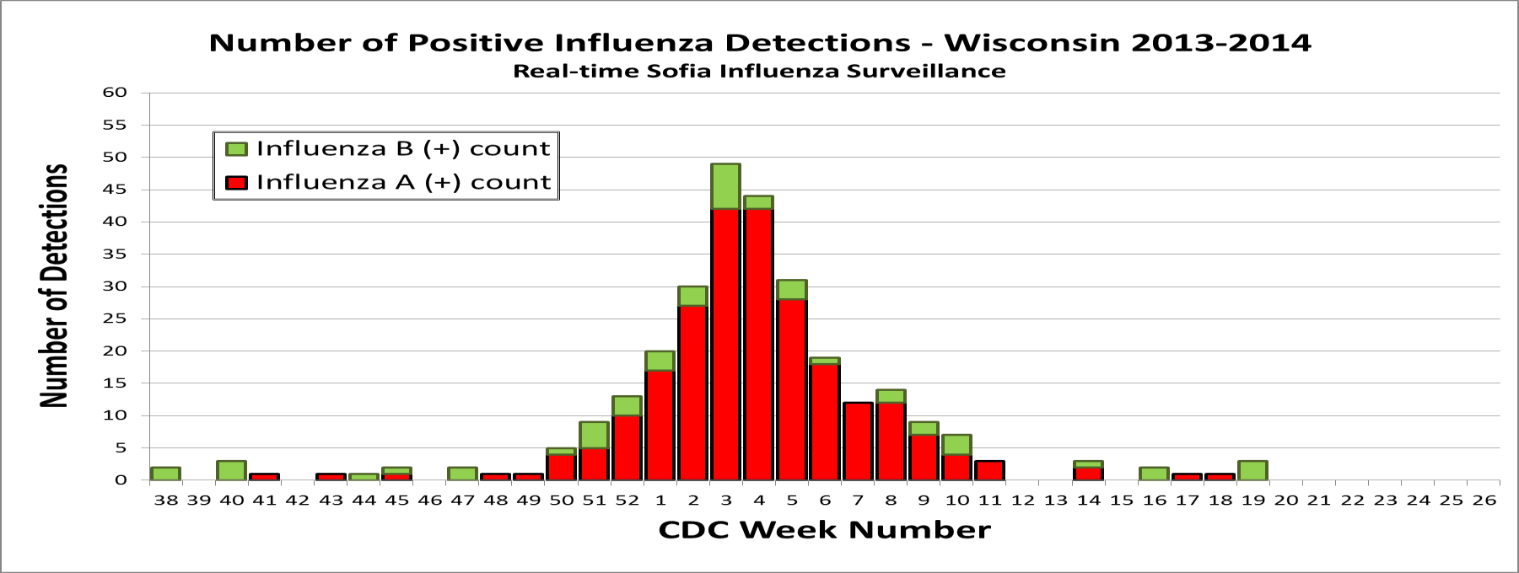
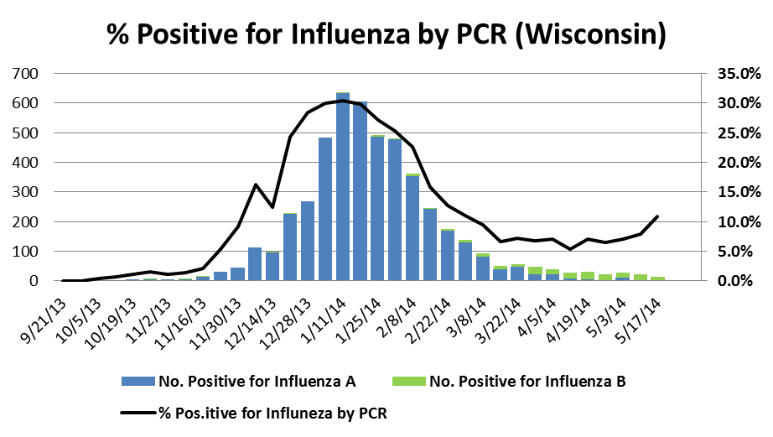
The Potential for“Real-time” Influenza Surveillance
Notes:
Summary data from WI
Potential value to surveillance in a real-time sense- note similarities of epi curve . Also data on location, in-patient/out-patient. Potentially valuable early detection with direct reporting to health Dept. and CDC
However, still need check on validity of results
Flu B specificity problem and PPV issues which we know are present during low prevalence periods.
At this point a possible adjunct to and not replacement of existing virologic surveillance-but there is potential
And this ‘cloud reporting” being investigated with a number of other testing platforms

Slide 32
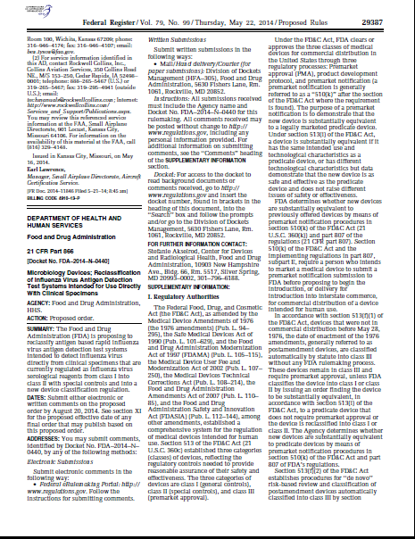
Improving RIDT Performance
There are new regulations in our future
https://www.federalregister.gov/articles/2014/05/22#food-and-drug-administration
New nomenclature proposed:
Influenza Virus Antigen Detection test
Notes:
Go to URL on slide and click on IVAD proposed rule
A proposed rule by the FDA was published in federal Register 5/22/14. Recently completed 90 day public comment period
“Microbiological Devices: Reclassification of Influenza Virus Antigen Detection Test Systems intended for use directly with clinical specimens”
The question is why?
Simple answer…”rapid influenza tests need to be more reliable”
Major concern with generally poor sensitivity of these assays and possible adverse effects for patients (inappropriate treatments with either false positives or false negatives), surveillance and public health detection and response to novel events
Need for reliable detection of both seasonal and novel viruses
Recognizes RIDTs will continue to have a significant role in patient management and a potential role in surveillance activities as I’ll discuss below

Slide 33
If you are an RIDT(IVAD) user…
What would the new regulations entail?
  Reclassifying RIDTs from Class I to Class II
  Add “special controls” to ensure device safety and effectiveness
    Set minimum clinical performance criteria for sensitivity and specificity
    Identify appropriate comparator tests for new assays
    Accuracy assessed by manufacturers each year and when novel strain emerges
When will this happen?
Possible impacts:
Better tests? Fewer tests?
Notes:
Reclassification so that FDA can more tightly regulate these tests
Different criteria for comparison to culture vs. PCR
Higher % criteria vs. culture
Annual analytical reactivity testing of seasonal strains and newly emergent strains
FDA along with CDC will identify appropriate strains for testing and CDC or CDC-designated source will provide
Testing to be conducted according to standardized protocol
Results (or a link) of analytical reactivity testing must be included in device labeling
Q: When will this happen?
A: 1 year after date of publication of final rule. When will that publication occur? This is uncertain…we are awaiting its publication
Stay tuned
In short most would agree this is a good thing that is long overdue
APHL flu subcommittee is exploring a process to measure the impact of the regulation and possible effects on clinical lab and flu surveillance effort
This reg. could have considerable logistic consequences for lab in keeping up with the published performance and which kits available and perhaps having to make routine decisions to keep a particular test or change.
Need for a centralized information data base to help the laboratory
Finally, it should be kept in mind that no matter how good the test it must be used appropriately and at the appropriate time
False positives with low flu prevalence

Slide 34
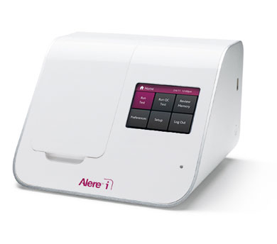
Rapid Influenza Diagnostic Tests
It gets even better…
Molecular Results in Minutes!
Novel isothermal amplification technology
Amplification of target NA at a single temperature
Results in ~15min
Point-of-care testing
J. Clin. Microbiol. published ahead of print 10 September 2014 , doi:10.1128/JCM.01639-14
J. Clin. Microbiol. September 2014 52:3339-3344
Notes:
It has been stated that the ideal diagnostic test for flu would have fast TAT and simplicity of RIDT with the sensitivity and specificity of NAAT
Well that test is apparently here with the FDA-approved Alere i Influenza A&B Nucleic Acid Testing system
Others (Quidel AmpliVue) likely in pipeline
Early evaluations:
Potential for significantly improved sensitivity
Suitable for POC testing
In this vein HHS(ASPR’s Biomedical Advanced research and Development Authority office) just announced (@ HHS.gov) it will provide awards to manufacturers to further advance development of such tests including CLIA waiver to allow performance in “near-patient” settings
Assistant Secretary for Preparedness and Response
It remains to be seen what will be the impact?
Cost?
vs. PCR and RIDT
I suspect clinician acceptance will be excellent
In any event, their value will have to be assessed in the POC setting and clinical lab and PHLs will have to account for these and their impact on surveillance

Slide 35
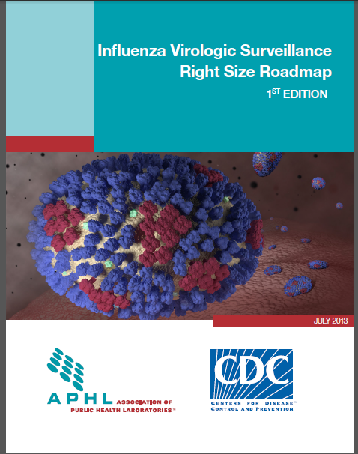
Update on Ongoing Efforts to “Right-Size”
Influenza Virologic Surveillance
Right Size Roadmap http://www.aphl.org/aphlprograms/infectious/influenza/Pages/Influenza-Virologic-Surveillance-Right-Size-Roadmap.aspx
Notes:
In keeping with the last few years I have presented the Influenza Update, I wanted to provide an update to The Influenza Virologic Surveillance Right Size Project, a joint APHL/CDC effort that was begun in 2010. This effort been advised by representatives from CDC, CSTE, state health depts., clinician and clinical/commercial lab professional societies
This is an ongoing national effort to develop a more efficient and effective Influenza Virologic Surveillance System
A “Roadmap” was developed that outline Requirements for an effective and efficient virologic surveillance system and tools and guidance for Implementation
I want to provide this update with particular, focus on the key partnership between PHLs and clinical labs needed for optimal influenza surveillance

Slide 36


U.S. Influenza Surveillance www.cdc.gov/flu/weekly
Morbidity
Surveillance
Virologic
Surveillance
Mortality
Surveillance
Health Departments
CDC
State-level data to state surveillance coordinators
Notes:
By way of quick review, you will remember that the U.S. has a very robust and comprehensive surveillance program made up of three components:
Virologic surveillance:
Involves critical role for the PHL (both state and local) and clinical labs who function as :
US WHO Collaborating Laboratories (85 PHLs)
National Respiratory and Enteric Virus System (NREVSS, ~60 mostly hospital clinical labs)
Novel virus surveillance
Morbidity surveillance: ILINet(outpatient), FluSurv-Net(hospitalizations), State/Territorial Epi surv(Level of spread of flu activity).
Mortality surveillance: 122 cities mortality reporting, Flu-associated pediatric deaths
Data from all elements of surveillance go to FluView and to State Flu Surv. Coordinators
State coordinators in turn share with LHDs, clinicians, media and public health
Our focus for the Right Size project is on virologic surveillance, the goals of which are stated on the next slide…
Every novel influenza event or severe influenza season really highlights the necessity and importance of influenza surveillance.
The reason: when the influenza virus changes the concern is that their will be:
Changes in the clinical and epidemiological presentation of the resulting infections and illnesses
Change in effectiveness of treatments and prophylaxis
Changes in detection

Slide 37
Influenza Virologic Surveillance
Goals
Provide situational awareness
Detect novel or reassortant viruses
Inform vaccine strain selection
Detect and monitor antiviral resistance
Notes:
Virologic Surveillance, the arm of surveillance that most impacts the lab, is key to monitoring circulating influenza viruses:
provides situational awareness, i.e, when season begins/ends; # positives/# tests performed=positivity rate; types/subtypes/strains circulating; when and where circulating; clinical severity; community impact; age groups targeted; reliability of diagnostic methods
Percent positivity is lab-based surrogate for influenza prevalence
allows for detection of novel viruses
informs vaccine strain selection, and…
allows antiviral resistance to be detected and monitored
PHLs play a principle and central role in virologic surveillance by:
routinely provide weekly reports to CDC that quantify the # of specimens tested and the # of specimens positive (including the type, subtype of virus age group)
routinely forward virus isolates and positive specimens(or extracts) to CDC for further characterization
can be either seasonal viruses or suspect novel viruses
to CDC directly or via contract PHLs (Hear more about guidelines for this during APHL 50 State teleconference on Thursday…for PHLs)
Vaccine strain selection is carried out by CDC; however, it is critically important that PHLs consistently provide specimens/isolates to CDC throughout the year to support this effort
For reasons I will highlight, the data generated and specimens/isolates obtained from clinical labs or RIDT testing sites may become more and more important in these surveillance efforts.

Slide 38
Right Size Influenza Virologic
Surveillance Requirements
Sampling (sample size and representativeness)
Laboratory Testing
Data Management
Partnerships and Communications
Quality Systems (performance metrics, benchmarks)
Surge (outbreaks, novel events, pandemics)
Financial Resources
Requirements developed based on multiple engagements
over 2 years of stakeholder (epi and lab) input.
Notes:
In the roadmap Requirement Section, the functional requirements (the “what”) are described under a number of broad headings listed on the slide
Also narrative on the Intent of the Requirement (the “why”)
Finally Implementation Guidance (The “how”)…a “tool kit”…is provided for the requirements
I have highlighted sampling and partnerships and communications because a lot of first year’s Road Map implementation efforts have been in these areas and most relevant to the mixed clinical, commercial and PH lab audience.
Clinical and commercial labs are among a number of other partners crucial to effective influenza surveillance
Epidemiologists/Influenza Coordinators
Public Health Laboratories
CDC
Clinical laboratories
Commercial laboratories
Academic laboratories
RIDT sites
Clinicians
Importance of partnerships
“A strong PHL/epidemiology/
clinical-commercial-academic laboratory
partnership will support the
formation of an effective specimen
submitter network and enhance
information sharing and outbreak response.”

Slide 39
  Using Alternative Data for Influenza Virologic Surveillance
What is Alternative Data ?
Alternative data is existing virologic data from non-public health laboratory sources that can be used to supplement public health laboratory testing data for improved situational awareness.
Include data from PCR(preferred) or RIDTs
Benefits to surveillance:
  Enhance influenza seasonal situational awareness
  Identify positives during low prevalence periods
  Detect potential geographic clusters
  Detect institutional outbreaks
Notes:
A number of key accomplishments during the first year of the “Right Size” effort
Opening dialogue with states to help with Roadmap implementation
“Using Alternative Data for Influenza Virologic Surveillance”
Development of sample size calculators
Roadmap Implementation Checklists
Right-size Example Practices, Resources and Tools
Communications Toolbox
Theseproducts found on Roadmap website
Only PHL rRT-PCR test data should be used to meet national novel influenza event detection thresholds.
Enhance situational awareness by allowing PHLs to meet Right Size sample size goals.
Value of the data as well as samples submitted for follow-up confirmatory testing
WI has been a model

Slide 40
Laboratory Surveillance Plan, 2014-2015
What YOU need to know!

Slide 41
Influenza Surveillance in Wisconsin
Multi-element approach
Rapid Influenza Diagnostic Testing (RIDT) Sites
  >50% of Influenza testing in WI.
  Next gen tests have eliminated subjectivity and improved performance characteristics.
  “Real-time” surveillance.
  Confirmatory testing during periods of low prevalence!
WSLH can provide confirmatory testing for out-of-season positives and the first two positive influenza A and influenza B specimens.

Slide 42
Influenza Surveillance in Wisconsin
Multi-element approach
2. Enrolled Surveillance Sites
  18 labs in 5 public health regions.
  Provide randomized specimens weekly.
  WSLH provides influenza PCR and multiplex PCR RVP testing.
Request to continue to submit the first 3 specimens per week with influenza test requests to WSLH.

Slide 43
Influenza Surveillance in Wisconsin
Multi-element approach
PCR Labs
  “Gold Standard” testing.
  Ability to type, subtype and antiviral resistance markers.
  Provide weekly testing data summary reports.
  46 WI PCR labs!
Request to report both the number positive and the number tested weekly.
**Send Flu A unsubtypable specimens when subtyping for both 2009 H1N1 and seasonal H3 were attempted (Ct<35).

Slide 44
Laboratory-based Surveillance
Summary
RIDT Sites:
* Confirmatory testing for the first 2 positive Influenza specimens
Enrolled Regional Sites:
* Send the first 3 specimens collected per week regardless of results
PCR Labs:
Report the number tested and number positive
Influenza A-Unsubtypable (Ct<35)
All Labs:
Send those with international travel histories
Sampling of influenza-related hospitalizations
Unusual presentations/results
Contact with swine
Notes:
As we move forward, we will change our surveillance system to address increasing influenza activity and balance with surveillance needs and limited reagent resources.

Slide 45


Reporting Lab Results
There are two options…..
Web-based reporting
FAX reporting

Slide 46
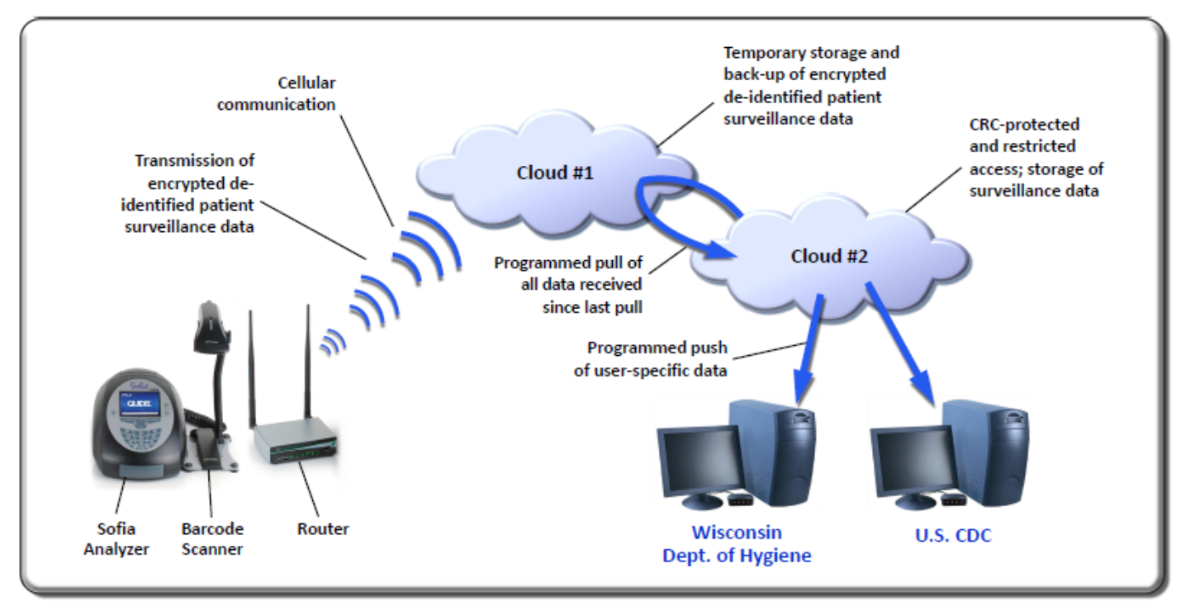
NEW! Real-time reporting
Image source: (2013) John Tamerius, Quidel Corp., Influenza Options VIII Meeting

Slide 47
What is the WSLH able to provide to support participating labs?
  Specimen collection supplies.
  Specimen shippers & packaging supplies.
  NO cost specimen transport.
  Influenza confirmatory testing.
  Influenza PCR validation specimen panel.
  Weekly updated surveillance data (B. pertussis, Influenza, RSV & others).
  Laboratory Surveillance Reports

Slide 48
Influenza Surveillance Strategy
WSLH Surveillance Coordinators
Erik Reisdorf
Virology Lab-Team Lead
Ph: 608-262-1021
erik.reisdorf@slh.wisc.edu
Mary Wedig
Electronic Reporting Coordinator
Ph: 608-890-0353
mary.wedig@slh.wisc.edu

Slide 49

Thank you!
Your participation in the Wisconsin surveillance system is vital to monitor for emerging novel strains with pandemic potential and other pathogens that impact community health.
Notes:
On behalf of the WI State lab and PH in Wisconsin Pete and I wanted to thank you all for your participation……Clinical labs are our “eyes and ears” in the community.

Slide 50


