Slide 1
Your Laboratory Ebola Plan
Peter Shult, Ph.D. - Director Communicable Disease Division and Emergency Laboratory Response, WSLH, Madison, WI, petershult@slh.wisc.edu, 608-262-5419
Cheryl Jordan, MT(ASCP)SM – Director Core Technical Services, UW Hospital and Clinics, Madison, WI, cjordan@uwhealth.org, 608-263-8712
Nathan Ledeboer, Ph.D., D(ABMM) – Associate Professor of Pathology, Medical College of Wisconsin and Medical Director Microbiology and Molecular Diagnostics, Dynacare Laboratories and Froedtert Hospital, Milwaukee, WI, nledeboe@mcw.edu, 414-805-7556
Michael Helgesen, B.S., MT(ASCP) - Microbiology/Histology Team Leader, Holy Family Memorial Hospital, Manitowoc, WI, mhelgesen@hfmhealth.org, 920-320-2243

Slide 2
Ebola: Laboratory Update
How is WSLH sharing information with labs?
Routine updates via WI Laboratory Messaging System
Posting of up-to-date general guidance and links on our website
http://www.slh.wisc.edu/clinical/diseases/ebola-virus-information-for-lab-professionals/
Facilitating information sharing on the WCLN listserv
Planning one or more interactive audio conferences for WCLN members
Notes:
We maintain one of the strongest clinical lab networks (the WCLN)in the country. We will be communicating with them in the same manner we have for over 12 years
Routine electronic sharing of messages and key information: minimum bi-weekly or as needed
Information on our website is routinely reviewed and updated. Broader information (beyond the Lab)can be found at WDPH website (link provided on WSLH website)
WSLH maintains and monitors the WCLN listserv and facilitates information sharing
Much interactive activity already occurring
Contact Erin Bowles to join if you have not done so already: erin.bowles@slh.wisc.edu
Building on the questions asked and insights shared on the Listserv…
First audio conference is scheduled for Nov 10 with enrollment currently open
More about this later
Now, I want to provide update on topics we have been getting the most enquiries about…

Slide 3
Ebola: Laboratory Update
Testing for Ebola
The WSLH will be offering the Ebola Zaire Real-time RT-PCR provided by the CDC
  Timeframe: Certification likely within 2 weeks
  Guidance for obtaining testing being developed and will be distributed widely
  Testing will require CDC/ WDPH approval
In the meantime, Ebola testing available at CDC or the Minnesota state public health lab
  Requires approval of WDPH and CDC
  Specimens to be submitted directly to these labs
Notes:
…a couple of “late breakers”
We will be one of ~35 PHLs that are able to offer the test
Within 3 week timeframe:
Train staff to safely perform; expand our Risk Assessment to include this testing
Obtain and successfully complete qualification panel
Develop specimen receipt, testing and reporting protocols
Receive certification that we can offer test
Test details:
PCR performed on small aliquot of blood; whole blood EDTA
Duplicate specimen will be concurrently shipped to CDC
We estimate 4-6 h to perform based on other PHL performance
Positive results will be presumptive but actionable; CDC will confirm
Guidance for requesting test, specimens needed, packaging, shipment to WSLH, reporting etc.
Will be distributed to all response partners along with formal announcement of test availability
In the meantime…
Process for obtaining testing for Ebola as been described in previous webinars and can be found both on WI DHS(Department of Health Services) and WSLH websites
Testing at CDC requires specimen be shipped directly to CDC. If decision is to have testing performed at neighboring PHL, WDPH will work with facility to facilitate most appropriate and expedient way to get specimen there.
Specimens should not be sent to WSLH first
In any event HCF must be aware of how to appropriately package and ship these specimens
More about this in a second

Slide 4
Ebola: Laboratory Update
Testing for Ebola
The testing landscape just got more complicated…
  FDA has issued EUA for two new commercial Ebola tests; more likely to follow
  Strict requirements for test usage
  Issues and concerns with these tests
  Potential impact on clinical and public health response being assessed at national and state levels
    Guidance likely forthcoming
If you are considering using these tests, PLEASE CONTACT THE WSLH!
Notes:
Both use BioFire Film Array platform
Currently detects battery of Respiratory and GI pathogens
Easy self-contained 1 hour test to detect ebola in blood or urine
300 hospitals nationwide use this platform
Strict requirements for test usage and reporting under the EUA; Nevertheless, performance of this test in real-life setting largely unknown
Note Nebraska experience
We have already received a guidance document for clinical labs from our professional society (APHL)
This has been posted to listsurv, will be sent as part of bi-weekly message and will be place on our website shortly
Potential impact on clinical and public health response being assessed
Who’s offering, who will be tested, how to verify results, how to ensure WDPH engaged, how to ensure specimens shared with WSLH/CDC, etc.

Slide 5
Ebola: Laboratory Update
Addressing other laboratory-related concerns
Packaging and shipping of suspect Ebola specimens to CDC
Clinical laboratory testing (non-ebola) of specimens from suspect Ebola case
  How to carry out Laboratory Risk Assessment
Laboratory infectious waste handling

Slide 6
Laboratory Risk Assessment
Thorough biohazard risk assessment (RA) should be performed for your facility
  Partners in performing your RA
  Diagnostic procedures
  Training and experience of staff
  Physical facilities
  Equipment and instruments
Implement appropriate procedures for risk mitigation
  Determine appropriate PPE, physical containment devices and disinfection and decontamination methods to employ
Notes:
RA’s should be conducted by laboratory director, biosafety officer and others to identify potential occupational exposures
Examples of Partners --------Infection control, infectious disease specialists, laboratory, emergency department,
Diagnostic procedure
Particular concern with potential for sprays, splashes or aerosols that might be generated
Pre-analytic through post-analytic
ID potential exposures to individuals or facility
Physical containment devices include BSC and plexiglass splash guards, sealed centrifuge rotors or centrifuge safety cups
No set format for RA
A number of good resources(checklists) to help
We have posted ASM, APHL and CDC resourecs
Recent guidance for PPE published on 10/20/14
Written for healthcare workers, but key principles applicable to lab including…
CDC suggests doing a walk-through of the lab with a pretend Ebola specimen. How is the specimen collected and by whom? How is the specimen transported? Who handles and processes the specimen? What PPE needs to be used? What testing is performed? What equipment is used for testing? What are instrument safety features? How is the area decontaminated after testing? In the event of a spill? Will you know that the specimen is from a suspect or know Ebola patient? How will that be communicated to the lab?
Identify potential occupational exposures
Alternative is employ facility-specific POC testing or refer patient or their specimens to another facility

Slide 7
Ebola: Laboratory Update
Parting thoughts
The laboratory needs to be fully engaged in facility Ebola preparedness planning
The laboratory need to continually monitor relevant guidance
The WSLH will continue to monitor guidance from CDC and others, share information with WCLN, and forward laboratory-related questions to CDC
Learn what your peers are doing!!
Notes:
Re-affirm WSLH commitment to help with the last 3 bullets
Most valuable resource right now maybe the WCLN listserv

Slide 8
UW Hospital and Clinics, Madison, WI

Slide 9
Dyncare Laboratory/
Froedtert Hospital, Milwaukee, WI

Slide 10
Laboratory Preparedness for Ebola, Managing Expectations in a Academic and Community Environment
Nathan A Ledeboer
Associate Professor of Pathology
Medical College of Wisconsin
Medical Director, Microbiology and Molecular Pathology
Dynacare Laboratories and Froedtert Hospital
Medical Director, Laboratory Outreach, Logistics, and Reference Services
Dynacare Laboratories
Milwaukee, WI

Slide 11
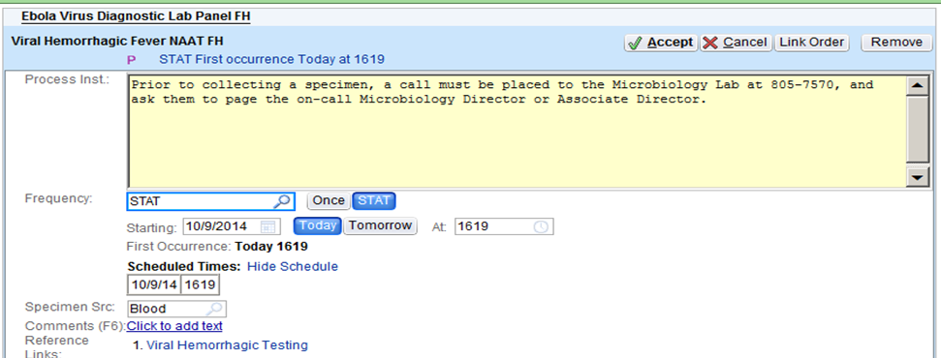
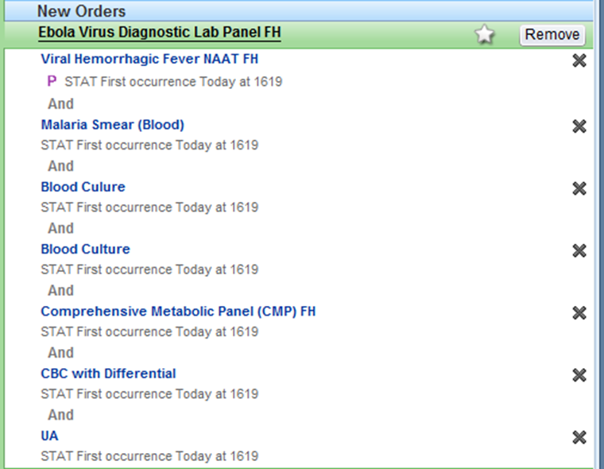

Slide 12
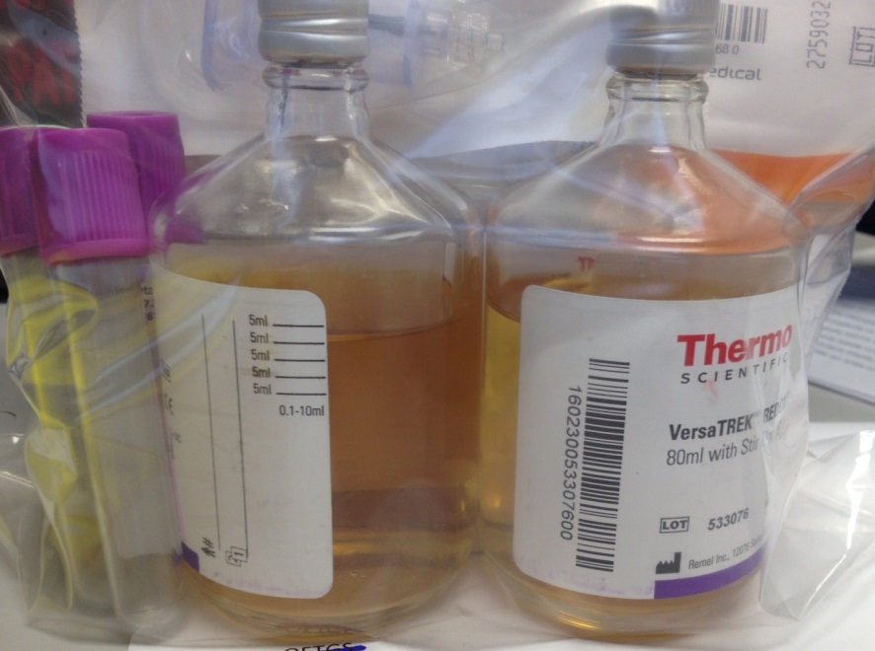
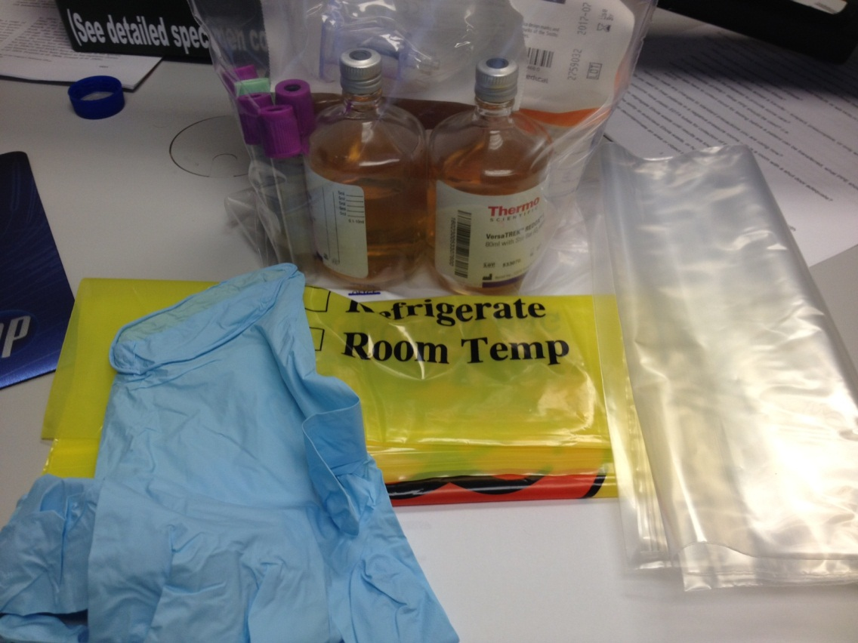
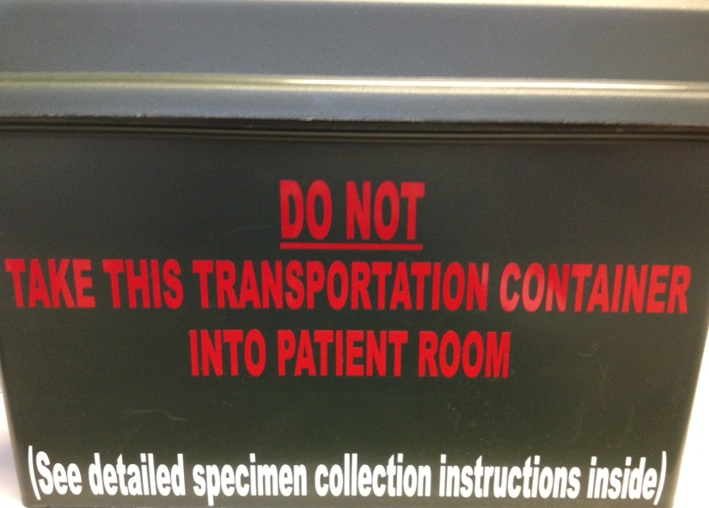
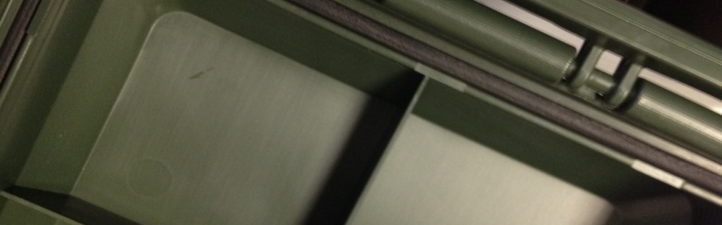
Specimen Collection Kit

Slide 13
Laboratory Collection Kit
Contains double bags, absorbent material, all necessary collection vessels, etc..
Dispatched staff member waits for nursing to collect and decontaminate packaging before returning to lab.
  Specimen accountability log maintained to document any staff member that will need monitoring
  Specimens are taken directly to negative-pressure lab (BSL-3) for testing and accessioning into the lab

Slide 14
Laboratory Test Menu
Ebola Screening Panel
  PT/INR (Mini-Sysmex)
  CBC with Differential (Mini-Sysmex)
  UA (dipstick)
  Comprehensive Metabolic Panel (Piccolo)
  Malaria Smears (thick and thin per CDC protocol)
    Rapid Malaria (BinaxNOW)
  Ebola PCR (BioFire)
    Combined with referral of specimen to CDC
  Respiratory Virus panel (BioFire)
  Blood Culture (manually incubated)

Slide 15
Confirmed Ebola Patient, Management Panel
Allow testing 24-7, but each day need to disinfect negative-pressure suite and process mycobacterial specimens
  Alternate locations for mycobacterial processing is mycology or pediatric hospital, if critical patient will not allow shut-down
Test Menu
  Type and Cross match
  PT/INR
  CBC with Differential
  UA
  Comprehensive Metabolic Panel

Slide 16
Laboratory PPE
CDC Recommendation
  Gloves
  Fluid-resistant gowns
  Face shield or goggles
  Masks to cover all of nose and mouth
  Recommended, class II Biosafety cabinet or Plexiglass splash guard with PPE to protect skin and mucous membranes.

Slide 17
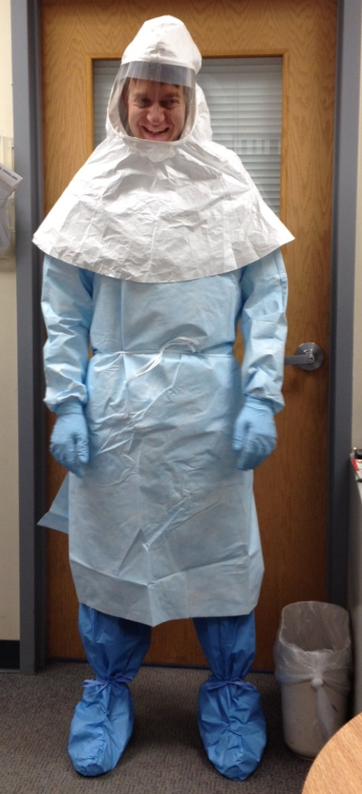
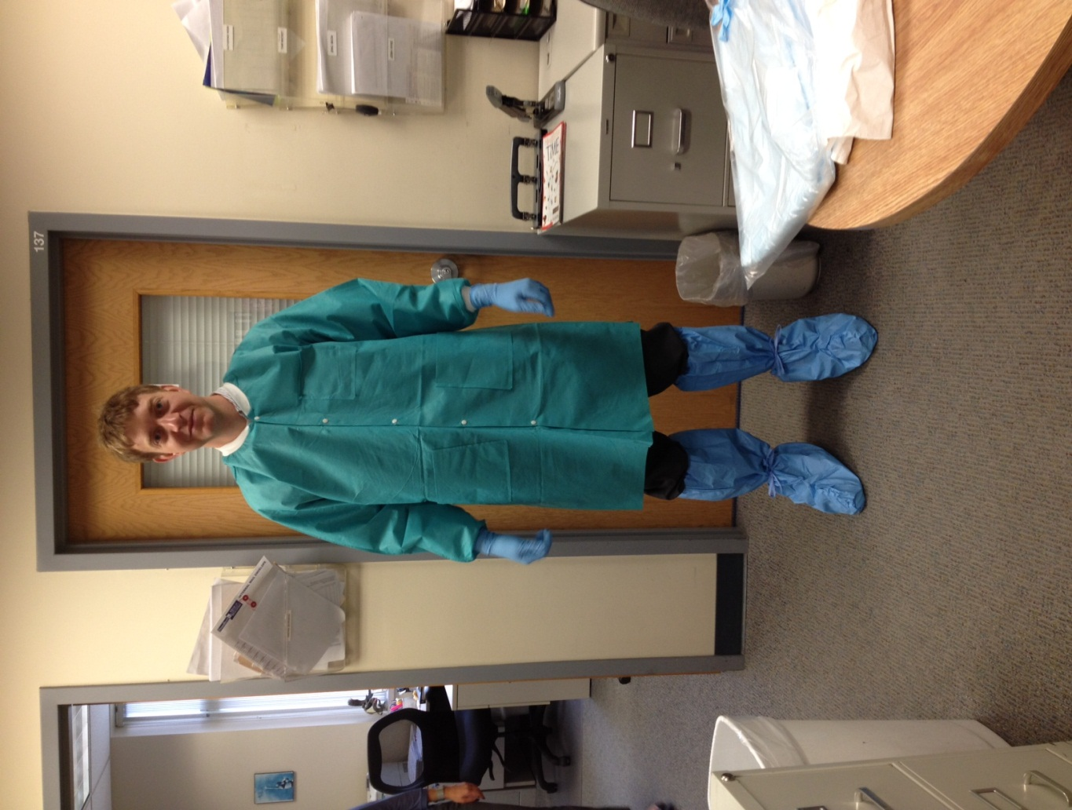
Dynacare Laboratory PPE
PAPR with full hood
Liquid-resistant lab coat
Liquid-resistant gown
Double gloves
Disposable scrubs
Knee-high, fluid-resistant shoe covers

Slide 18
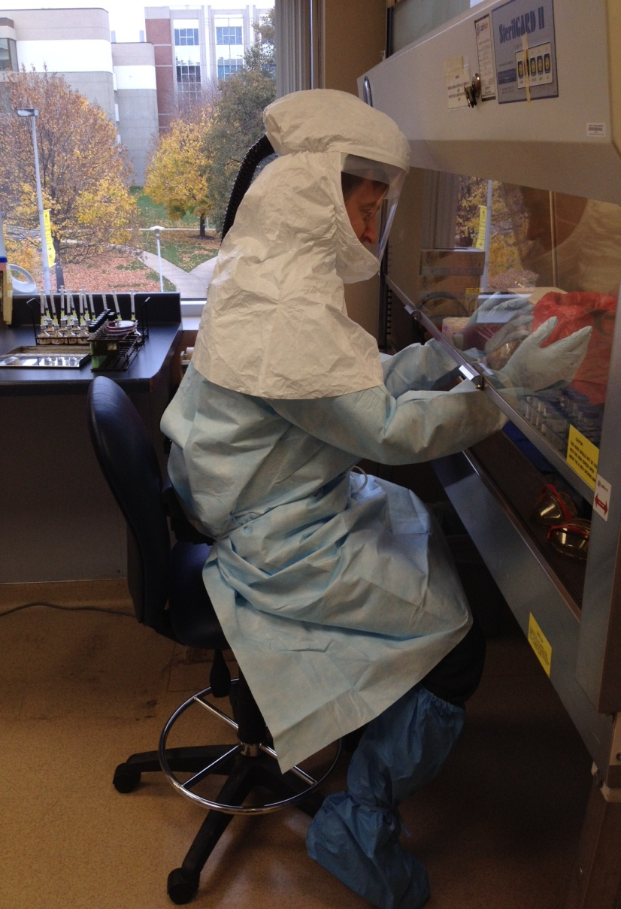
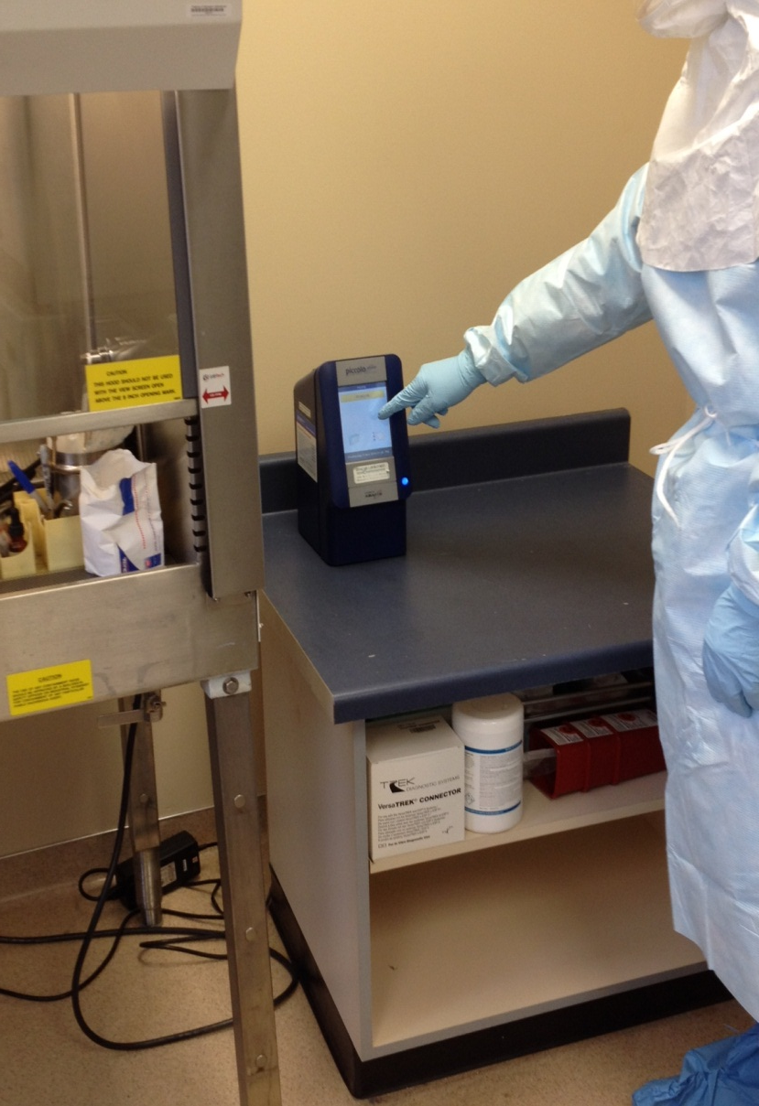
Work in BSL-3 Lab

Slide 19
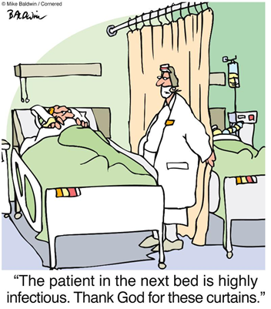
Questions?

Slide 20
Holy Family Memorial Hospital, Manitowoc, WI

