Slide 2

Chikungunya, MERS CoV, EV-D68---They Keep on Comin’
Dave Warshauer, Ph.D., D(ABMM)
Deputy Director, CDD
Wisconsin State Laboratory of Hygiene

Slide 3
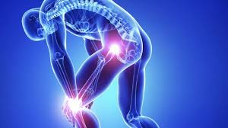
Chikungunya Virus Disease

Slide 4
Chikungunya
Mosquito-born viral disease
Acute onset febrile disease with severe polyarthralgias
Often causes large outbreaks with high attack rates
In Dec 2013, first locally-acquired cases reported in the Americas on St. Martin
  Puerto Rico in May. Now >10,000 cases

Slide 5
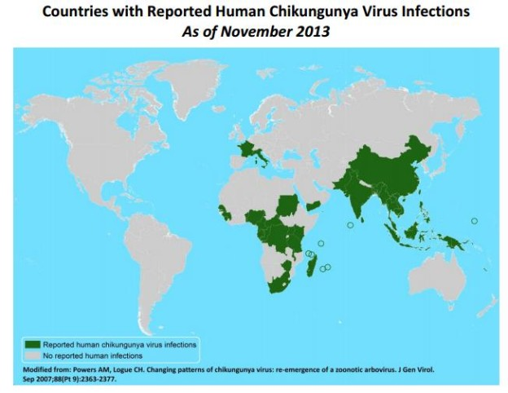

Slide 6
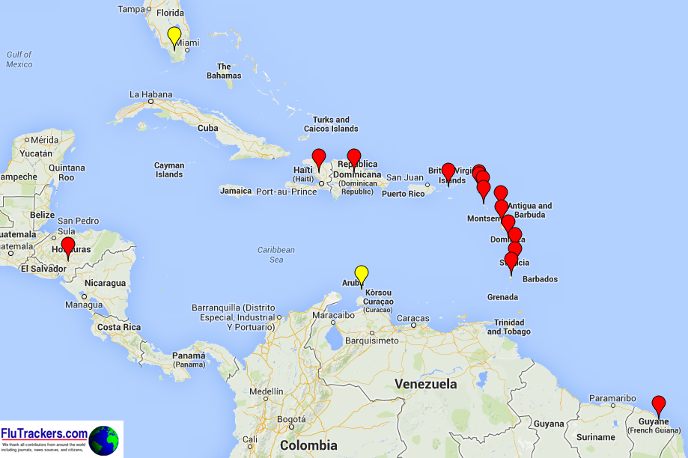
Chikungunya virus in the Americas
May 2014

Slide 7
Reported Cases in the Americas 2013-Dec 5, 2014
Country/Territory | Locally Acquired Suspected Cases | Imported Cases
USA | 11 | 1,900
Mexico | 74 | 13
Central America | 137,186
Caribbean | 772,878
Andes | 65,614
Total | 975,678

Slide 8
Chikungunya in the USA
Since 2006 averaged 28 imported cases/yr
  No local outbreaks triggered
Increase occurring in US travelers to the Caribbean
  243 traveler-associated cases in first half 2014
First Chikungunya case acquired in the US reported in FL in June 2014
  7 months after first recognized in the Western Hemisphere
  At least 11 more cases since then

Slide 9
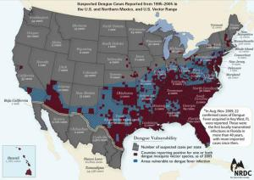
Aedes spp. Distribution
A. albopictus
A. aegypti
Notes:
56 species of mosquitos in wisconsin Aedes vexans and A. cinereus

Slide 10


Transmission
Urban cycle
  Human---Mosquito—Human---Mosquito
    Aedes aegypti and Aedes albopictus
Sylvatic cyle
  Animal---Mosquito---Animal---Mosquito
    Chimps, monkeys, baboons
    Aedes furcifer, Aedes africanus
Notes:
Mosquito bites an infected human. Human becomes viremic and mosquito feeds and picks up the virus. After 10 days mosquito can transmit to another human

Slide 11
Other Rare Modes of Transmission
In utero resulting in abortion
Intrpartum from viremic mother-to-child
Needlestick
Lab exposures
Possibility of transfusion or transplant transmission

Slide 12
The Virus
Family Togaviridae, genus Alphavirus
  Enveloped, single-stranded RNA virus
  Plus-sense, unsegmented genome of 11.5-11-8 kb
First isolated from human serum during an outbreak in Tanganyika in 1953
Asian and African strains
  Distinct biological and transmission patterns

Slide 13
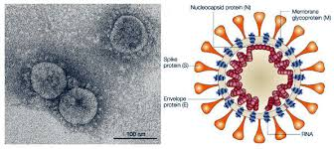
Chikungunya

Slide 14
Infection and Disease
72-97% of those infected develop clinical symptoms
Incubation period usually 3-7 days (1-12)
Primary symptoms of fever and polyarthralgia

Slide 15
Clinical Manifestations
Fever with abrupt onset
  >102.2F
Joint pain
  Severe
  Most common in hands and feet
  Multiple joints
  Usually bilateral and symmetric
Other manifestations
  Headache, nausea/vomiting, rash, conjunctivitis, myalgia, arthritis

Slide 16
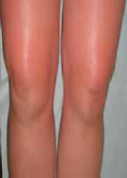
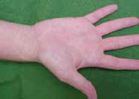
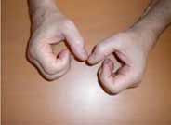
Maculopapular Rash
Arthritic Hands
5 months post-onset
Swelling of knees

Slide 17
Laboratory Diagnosis
Virus culture
RT-PCR
IgM serology and confirmatory neutralizing antibody testing
Serology for >4-fold antibody titer rise using PRNT or IFA

Slide 18
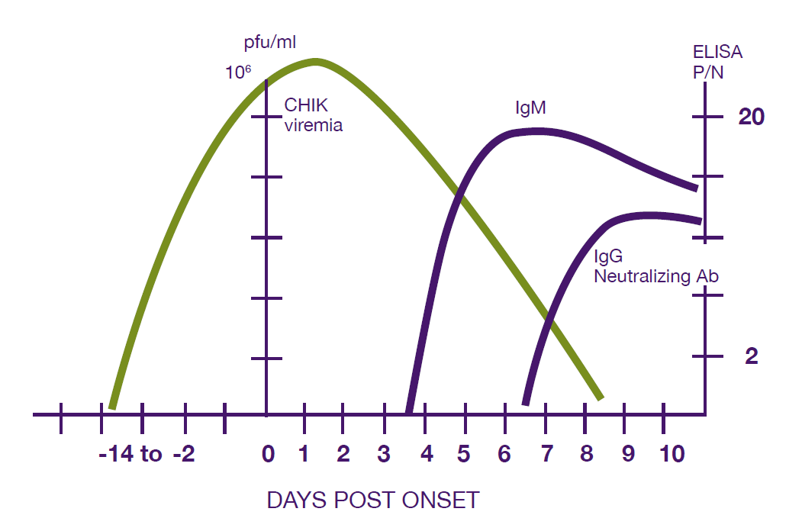
Viremia and Immune Response

Slide 19
Optimal Timing for Diagnosis
ASSAY | DAYS POST-ONSET
Viral Culture | <=3 days
RT-PCR | <=8 days
IgM Serology | >=4 days

Slide 20
Test Availability
CDC Arboviral Diseases Branch
State Public Health Laboratories
  California
  New York
  Florida
  Others
Commercial Laboratories
  Focus Diagnostics
    RT-PCR
    IgG and IgM IFA

Slide 21

Treatment
No specific antiviral therapy
Supportive care
  Rest and fluids
Non-steroidal anti-inflammatory drugs for fever and pain

Slide 22
Surveillance and Reporting
Consider chikungunya in travelers from areas where chikungunya is present who present with acute onset of fever and joint pain
Be aware of possible local transmission where there are Aedes mosquitos
Report suspect cases to local and state health departments

Slide 23
State Vectorborne Disease Epidemiologist
Diep Hoang-Johnson
Wisconsin Division of Public Health
Bureau of Communicable Diseases
608-267-0249

Slide 24
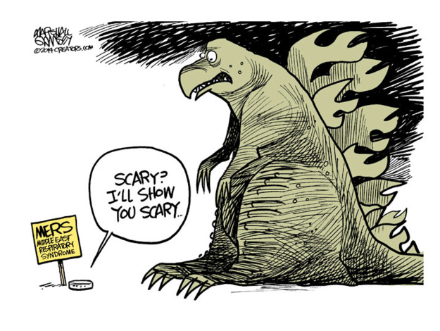
MERS-Coronavirus

Slide 25
MERS-CoV
What we know!
Initially referred to as “novel” coronavirus
Virus is different from SARS-Coronavirus and seasonal coronavirues OC43, HKU1, 229E & NL63
First cases documented in spring 2012 (nurse & university student)-Jordan
All cases linked to the Middle East
Age range 1 to 94
Severe morbidity and mortality
Transmission mainly human-to-human
Genetically stable

Slide 26
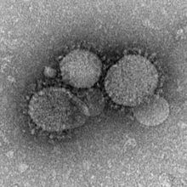
Coronaviruses
First identified in mid-1960s
Single-stranded RNA
Six infect humans
  229E, NL63, OC43, HKU1, SARS, MERS
MERS
  Clades A and B
  Earliest cases Clade A
  New cases Clade B
Bat reservoir?

Slide 27

Transmission
Human Human
Zoonotic
Recent evidence of camel to human transmission (Azhar et al, 2014)
  Index patient and 3 friends had contact with camels
  Index patient, friends and camels tested for MERS-CoV by PCR

Slide 28
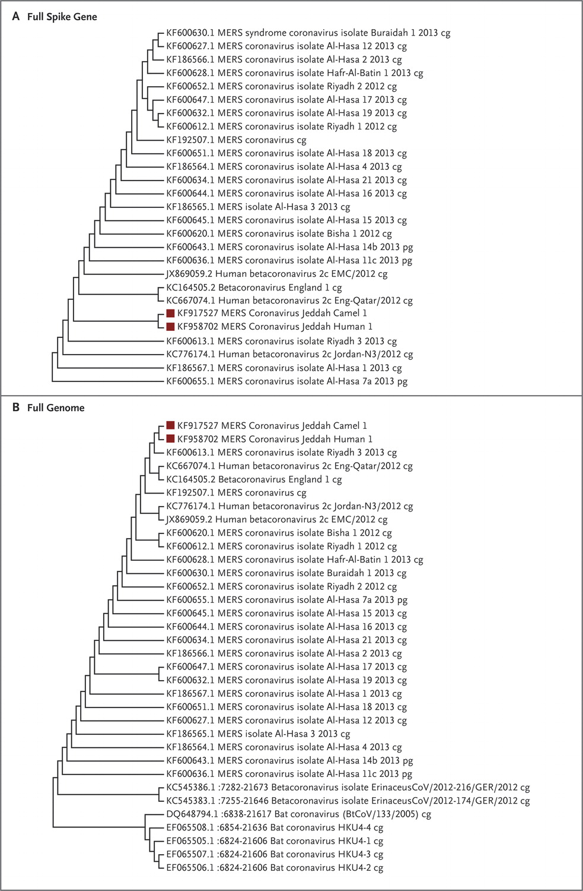
Spike Gene
First documented zoonotic transmission!
Full Genome

Slide 29
Epidemiology
Human infections (MMWR, May 2014)
Median age 49 years
65% male
19% healthcare workers
62% severe disease (hospitalization)
5% mild illness
21% asymptomatic (case investigations)
June 4, 2014: 815 cases and 313 deaths (38% mortality)
Role of co-morbidities

Slide 30
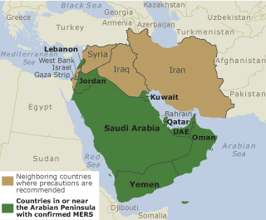

Slide 31
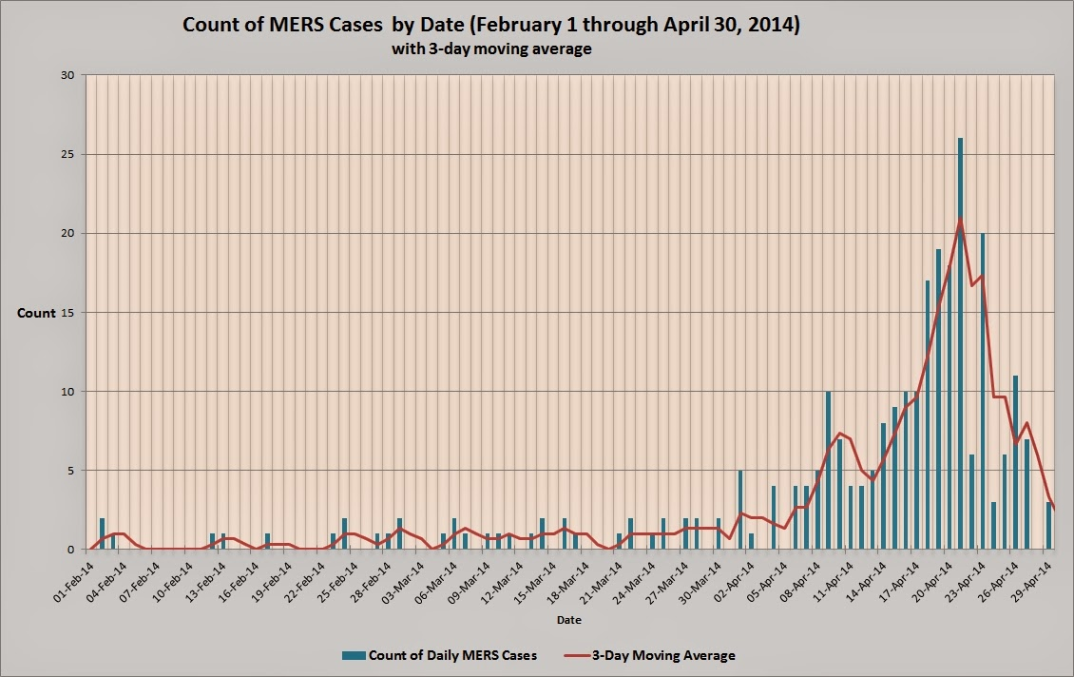
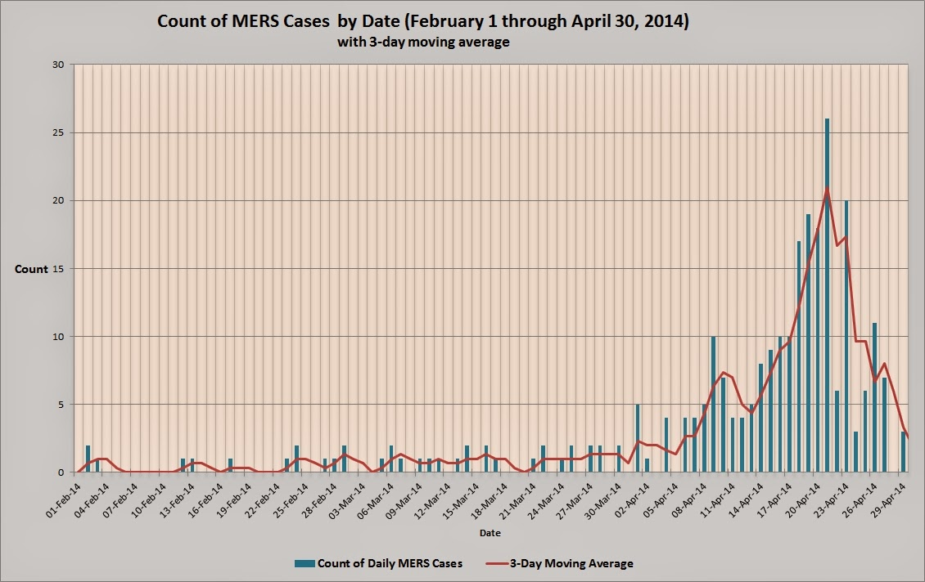

Slide 32
Geographic Distribution
Region/country | Cases | Deaths | Date of onset for most recent case
Middle East
Saudi Arabia | 689 | 283 | 28/05/2014
United Arab Emirates | 70 | 9 | 04/05/2014
Qatar | 7 | 4 | 04/11/2013
Jordan | 18 | 5 | 23/05/2014
Oman | 2 | 2 | 20/12/2013
Kuwait | 3 | 1 | 07/11/2013
Egypt | 1 | 0 | 22/04/2014
Yemen | 1 | 1 | 17/03/2014
Lebanon | 1 | 0 | 22/04/2012
Iran | 2 | 1 | 27/05/2014
Europe
UK | 4 | 3 | 06/02/2013
Germany | 2 | 1 | 08/03/2013
France | 2 | 1 | 08/05/2013
Italy | 1 | 0 | 31/05/2013
Greece | 1 | 0 | 08/04/2014
Netherlands | 2 | 0 | 05/05/2014
Africa
Tunisia | 3 | 1 | 01/05/2013
Algeria | 2 | 0 | 24/05/2014
Asia
Malaysia | 1 | 1 | 08/04/2014
Philippines | 1 | 0 | 11/04/2014
Americas
USA | 2 | 0 | 01/05/2014
Total | 815 | 313
Notes:
2 unlinked cases in the US----one in Indiana, one in Florida. Both in healthcare providers who lived and worked in Saudi Arabia. Both were hospitalized and recovered

Slide 33
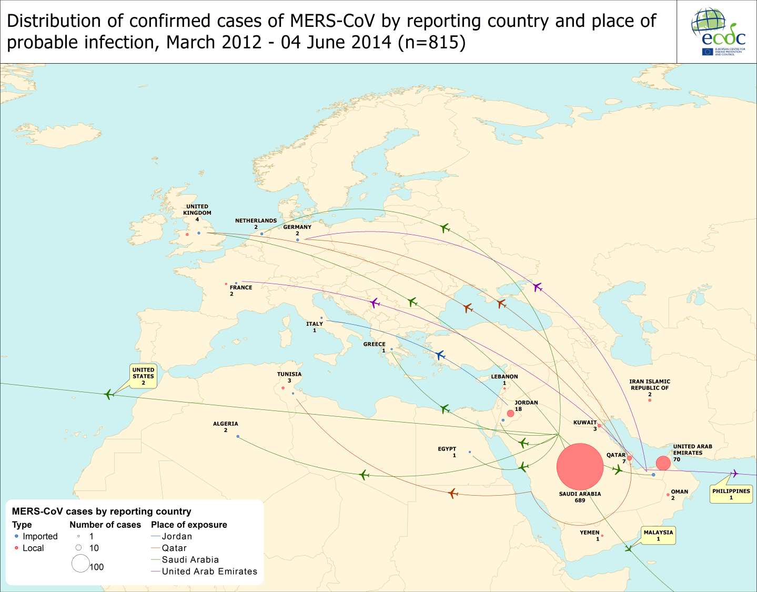

Slide 34


MERS-CoV in the US
Two cases identified in the US
Travel related (SA UK US)
Case 1: Indiana (Reported 5/1/2014)
    HCW w/onset 4/24/14
    Flew to Chicago 4/24/14
    Travelled to Indianapolis via bus 4/24/14
    Hospitalized 4/28/14
    Recovered and discharged 5/9/14
    Symptom monitoring for 14 days
    A small number of exposed WI residents were tested for antibody
Notes:
4/27---fever, runny nose, coughning and SOB

Slide 35
MERS-CoV in the US
Case 2: Florida (Reported 5/11/2014)
Travel related (SA UK Boston
Atlanta Orlando)
    HCW NOT linked to Indiana case
    Began travel 5/1/14
    Hospitalized 5/8/14
    MERS-CoV testing 5/10/14
    Patient recovered & discharged 5/19/14
    A small number of exposed WI residents were tested for antibody

Slide 36
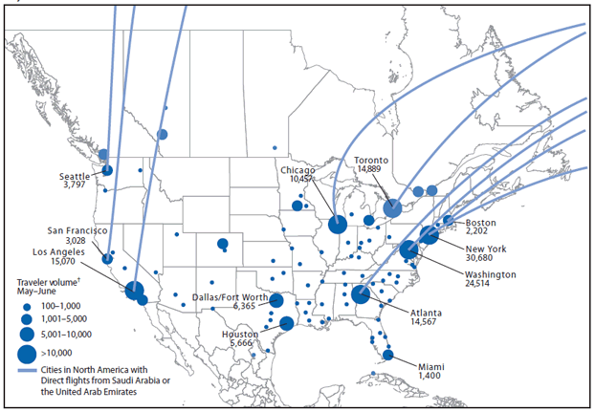
What is the Risk in the US?
Points of entry and volume of travelers on flights to the United States and Canada from Saudi Arabia and the United Arab Emirates — May–June 2014 Source: (MMWR, 2014)

Slide 37
What testing is available?
FDA issued an EUA in 2013 authorizing qualified PHL to perform MERS-CoV PCR
WSLH Test Code: VR01738
CPT Code: 87798
Fee exempt
Serology available only at CDC
If you have a suspect case of MERS-CoV, please contact your local public health agency, or Tom Haupt (608-266-5326) at the WDPH.
All requests for MERS-CoV testing must be approved by public health before the WSLH will perform any testing.

Slide 38
MERS Enhanced Surveillance
Criteria for testing
  History of travel from the Arabian Peninsula or a neighboring country
  OR close contact with a person with the above risk factor
  Exposure timeline
    Within 14 days prior to illness onset
  Signs and symptoms (must have all 3)
    Fever >100.4
    Cough
    Suspicion of pulmonary parenchymal disease
      Pneumonia, ARDS, consolidation

Slide 39
Specimens for Testing
PCR
  Lower respiratory tract specimen preferred
    Sputum
    Bronchoalveolar lavage
    Bronchial wash
    Tracheal aspirate
  Nasopharyngeal swab
  Stool
Additional specimen collection information is available from CDC at http://www.cdc.gov/coronavirus/mers/guidelines-clinical-specimens.html

Slide 40
Knowledge Gap
What we don’t know, but wish we did!
Limited person-to-person so why the spike in cases recently?
Camels intermediate host or natural reservoirs?
Natural reservoir that maintains the virus?
Community prevalence?
Route of transmission? Food, water, vector??
Treatment options?
Testing & surveillance capacity in other countries?

Slide 41
EV-D68
More than 70 types of HEVs
Less common than other Evs
First identified 1962 in CA
August 2014 increase in severe resp illness
  Kansas City, MO
  Chicago, IL
  >65% asthmatic or history of wheezing
  As of 9/15---104 confirmed cases in 10 states
    No deaths documented

Slide 42
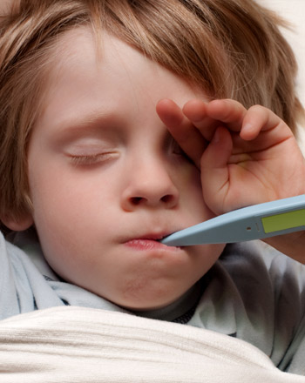
Symptoms
Low grade fever—many afebrile
Cough
Runny nose
Sneezing
Body/muscle aches
No specific treatment
  Supportive therapy

Slide 43
Association with Neurologic Disease
Colorado
  9 children ages 1-18 with suddene onset of neurologic illness from Aug 9 - Sept 15-2014
  Muscle weakness in one or more arms or legs
  Double vision, difficulty swallowing,difficulty speaking (dysarthria)
  All had fever, most with respiratory illness about one week prior to onset of muscle weakness
  No altered mental status or seizures

Slide 44
Association with Neurologic Disease
MRI scans ---abnormalities in the gray matter in the spinal cord
CSF negative for viruses, including WNV and enteroviruses
8 tested with RVP
  6 Rh/Ent; 4 of those were EV-D68
Evs known to cause aseptic meningitis, less commonly encephalitis, and rarely, acute myelitis and paralysis

Slide 45
Association with Neurologic Disease
Sept 26---CDC isssued request for states to report similar neurologic illnesses
As of Oct 23
  51 cases reported in 23 states
  Investigating another half-dozen
Other possible causes
  Guillain-Barre, other Enteroviruses, Adenovirus, WNV and similar viruses, HSV

Slide 46
Enhanced EV-D68 Surveillance
Population for surveillance
  Inpatient pediatric clusters with severe respiratory illness (w/wo fever)
  Individual ICU-admitted pediatric cases of severe respiratory illness
Specimens
  Combined NP/OP swabs placed in viral transport medium

Slide 47
Diagnostic/Surveillance Testing
Clinical laboratory testing
  Perform normal diagnostic testing for RV/ENT
  If patient meets surveillance criteria:
    Set aside a 1 ml aliquot and store at 2-8C
  If specimen positive for RV/ENT
    Send aliquot to WSLH
  WSLH
    Test for RV/ENT with single-plex PCR assay
    Submit specimens to CDC for typing

Slide 48
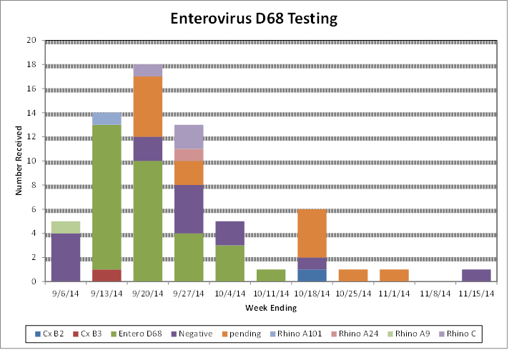
RV
EV68

Slide 49
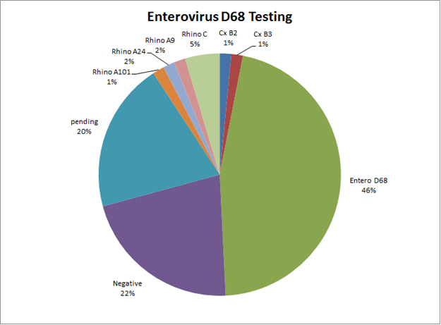

Slide 50
References
ECDC (2014) Epidemiological Update: MERS-CoV) Available at: http://www.ecdc.europa.eu/en/press/news/_layouts/forms/News_DispForm.aspx?List=8db7286c-fe2d-476c-9133-18ff4cb1b568&ID=1016
MMWR (2014) First Confirmed Case of MERS-CoV Infection in the US, Updated Information on the Epidemiology of MERS-CoV Infection, and Guidance for Public, Clinicians and Public Health Authorities May 2014. Available at: www.cdc.gov/mmwr
Azhar EI et al., (2014) Evidence of Camel to Human Transmission of MERS-CoV. NEJM. Available at: www.nejm.org
Acute Neurologic Illness of Unknown Etiology in Children — Colorado, August—September, 2014, MMWR, October 3, 2014 (http://www.cdc.gov/mmwr/)

Slide 51
References
Neurologic Illness with Limb Weakness in Children, COCA Call, October 3, 2014
(http://emergency.cdc.gov/coca/calls/2014/callinfo_100314.asp)
Gibney KB, Fischer M, Prince HE, Kramer LD, St George K, Kosoy OL, Laven JJ, Staples JE. Chikungunya fever in the United States: a fifteen year review of cases. Clin Infect Dis. 2011 Mar 1;52(5):e121-6.
Leparc-Goffart I, Nougairede A, Cassadou S, Prat C, de Lamballerie X. Chikungunya in the Americas. Lancet. 2014 Feb 8;383(9916):514.
CDC. Notes from the Field: Chikungunya Virus Spreads in the Americas — Caribbean and South America, 2013–2014. MMWR 2014. 63(22);500-501.

