Slide 1
Syndromic Multiplex Panels – What’s New, How Will We Use Them and What is the Impact on the Microbiology Laboratory
Nathan A Ledeboer
Associate Professor of Pathology
Medical College of Wisconsin
Medical Director, Microbiology and Molecular Pathology
Wisconsin Diagnostic Laboratories and Froedtert Hospital

Slide 2
Outline
How changes in laboratory organization and POC will change microbiology test menus
Respiratory Syndromic (or everything but the kitchen sink) Panels
GI Panels and outcome studies
Meningitis Panels
Future Panels

Slide 3
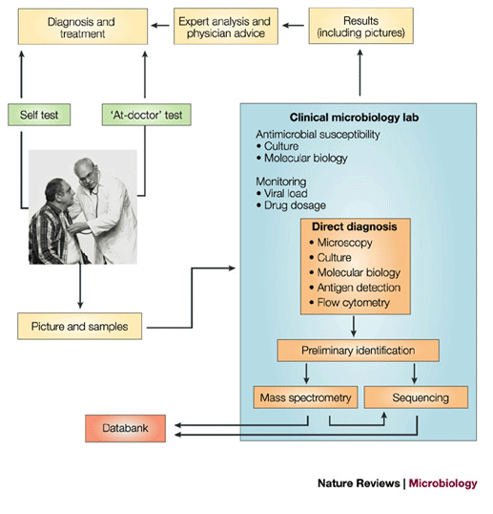
The future organization of clinical microbiology services – a Paradigm Shift

Slide 4
The Future of Molecular Biology
Migration away from singleplex PCR to disease state testing
  Eg. stool pathogen panels, sepsis panels, pneumonia panels
Moving testing closer to patient
Increased competition based on menu
  Menu will be king, less capital for boxes
Increased competition based on price
Increased need for clinical data supporting use of molecular tests
Movement to FDA approved kits

Slide 5
Performance of POC Molecular Influenza Tests
Binnicker et al., JCM 2015
  Compared Liat (Roche, Indianapolis, IN) to laboratory based Simplexa (Focus, Chantilly, VA)
  Enrolled 197 respiratory swabs
  Found Liat was 99.2% and 100% sensitive for Flu A and B, respectively
  Found Liat was 100% specific compared to Simplexa

Slide 6
The Impact of Rapid PCR
Chu et al., J Med Virology, 2015.

Slide 7
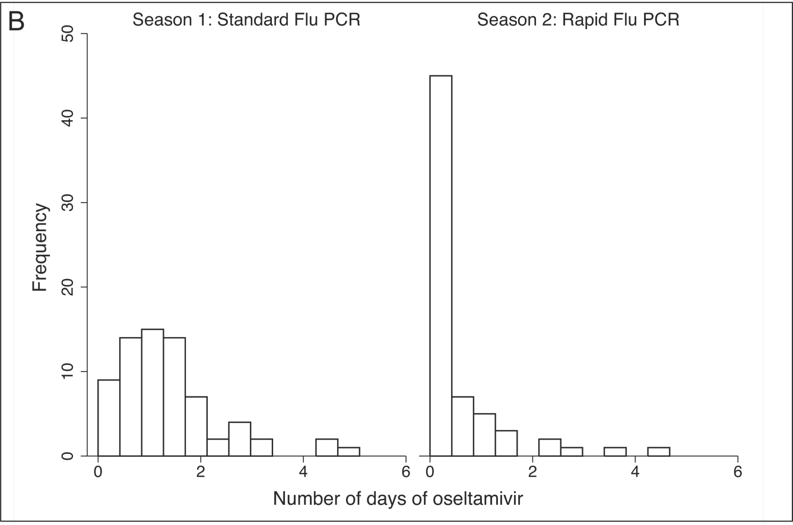
The Impact of Rapid PCR
Chu et al., J Med Virology, 2015.

Slide 8
Respiratory Panels

Slide 9
Use of Large Multiplex Respiratory Panels
Point
Counterpoint
Influenza accounts for a minority of viral respiratory infections
May contribute to increased patient satisfaction
May contribute to better laboratory stewardship
Identify outbreaks of resp viruses earlier
Panels need to be linked to clinical syndromes
Most panels are fixed design and do not allow reporting flexibility
Testing for pathogens should be risk-guided
When you hear hoof-beats, think horses, not zebras – ie common things are common
Effects on cost are not clear
Sensitivity of panels may be inferior to single-plex assays
Schreckenberger and McAdam, 2015. JCM: 53(10)

Slide 10
Respiratory Tract Infections: Diagnostic Challenge
The Problem
      Respiratory tract most common site of infection
      Symptoms alone are not sufficient for clinicians to determine optimal patient management
        True infection? Bacterial? Viral?
      Wide array of know respiratory pathogens
      Flu/RSV remain most common pathogens ordered/detected
      Other pathogens requested:
        Human Metapnuemovirus, Parainfluenza, Adenovirus, Rhinovirus, B. pertussis

Slide 11
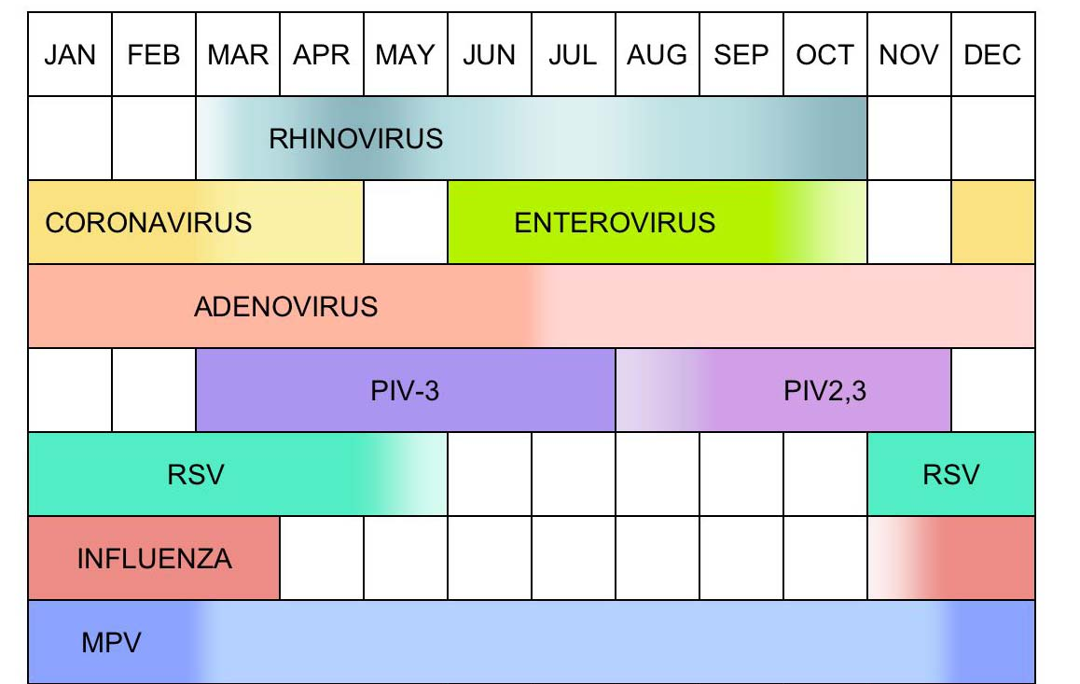
Respiratory Tract Infections: Diagnostic Challenge

Slide 12
Respiratory Tract Infections: Diagnostic Challenge
Lab: Important considerations for diagnostic(s) choice
      Sensitivity
        DFA, RIDTs don’t provide desired sensitivity
      Cost to laboratory
        Expensive to purchase multiple molecular platforms
        Expensive to send out samples to reference lab for testing
      Cost to patient
        When physicians order flu testing, costs more to run a broad RVP
        Patients may be under insured or have no insurance
      Burden on Lab
        QC testing, proficiency testing, tech training
        Reporting of positive diagnostic results for testing not requested by clinician

Slide 13
Details for the four FDA-cleared respiratory panels
Assayª | Manufacturer | Methodology | Preextraction required | Viruses reported^{b}
FilmArray RP^{c} | BioFire Diagnostics | Endpoint melt curve analysis | No | AdV; CoV HKU1, NL63; influenza virus A (H1/2009, H1, H3); influenza virus B; MPV; PIV1, -2, -3, -4; RSV; RhV/EV
eSensor RVP | GenMark Dx | Voltammetry | Yes | AdV (C, B/E); influenza virus A (H1/2009, H1, H3); influenza virus B; MPV; PIV1, -2, -3; RSV (A/B); RhV
xTAG RVPv1 | Luminex Molecular Diagnostics | Fluorescence-labeled bead array | Yes | AdV; influenza virus A (H1, H3); influenza virus B; MPV; PIV1, -2, -3; RSV (A/B); RhV/EV
xTAG RVP fast | Luminex Molecular Diagnostics | Fluorescence-labeled bead array | Yes | AdV; influenza virus A (H1, H3); influenza virus B; MPV; RSV; RhV/EV
Popowitch, et al. JCM 2013

Slide 14
Comparison of the Biofire FilmArray RP, Genmark eSensor RVP, Luminex xTAG RVPv1, and Luminex xTAG RVP Fast Multiplex Assays for Detection of Respiratory Viruses
Virus | No. of true-positive specimens (n = 300 specimens tested) | % Sensitivity (95% CI) of:
 |  | FilmArray RP | eSensor RVP | xTAG
 |  |  |  | RVPv1 | RVP fast
AdV | 35 | 57.1 (40.8, 72.0) | 100 (88.2, 100) | 74.3 (57.8, 86.0) | 82.9 (66.9, 92.3)
Influenza virus
A | 30 | 86.2ª (68.8, 95.1) | 100 (86.5, 100) | 100 (86.5, 100) | 86.7 (69.7, 95.3)
A H1/09 | 16 | 73.3ª (47.6, 89.5) | 100 (77.3, 100) | 100 (77.3, 100) | 81.3 (56.2, 94.2)
A H3 | 14 | 100 (74.9, 100) | 100 (74.9, 100) | 92.9 (66.5, 99.9) | 78.6 (51.7, 93.2)
B | 22 | 77.3 (56.2, 90.3) | 100 (82.5, 100) | 95.5 (76.5, 99.9) | 45.5 (26.9, 65.4)
MPV | 26 | 96.2 (79.6, 99.9) | 100 (84.8, 100) | 100 (84.8, 100) | 100 (84.8, 100)
PIV
1 | 14 | 100 (74.9, 100) | 100 (74.9, 100) | 100 (74.9, 100) | NA^{b}
2 | 13 | 92.3 (64.6, 99.9) | 100 (73.4, 100) | 100 (73.4, 100) | NA
3 | 13 | 100 (73.4, 100) | 100 (73.4, 100) | 100 (73.4, 100) | NA
RSV
A | 22 | 86.4 (65.8, 96.1) | 100 (82.5, 100) | 86.4 (65.8, 96.1) | 86.4 (65.8, 96.1)
B | 14 | 100 (74.9, 100) | 100 (74.9, 100) | 92.9 (66.5, 99.9) | 85.7 (58.8, 97.2)
RhV/EV | 43 | 83.7 (69.7, 92.2) | 90.7 (77.8, 96.9) | 93.0 (80.7, 98.3) | 93.0 (80.7, 98.3)
Popowitch, et al. JCM 2013

Slide 15













The Problem with multiplex RVPs
Physician ordering preference is based on clinical presentation and local/seasonal epidemiological considerations
Current multiplex products contain fixed panels at fixed costs – no flexibility
No single test covers the continuum of respiratory multiplexing
Rapid
Flu A/B
Flu A/B & RSV
Full RVP

Slide 18
Current respiratory Algorithm
Benefits
      Able to offer 4 orderable viral respiratory panels to clinicians
        Limit unnecessary testing (test stewardship)
      Minimize unnecessary cost to patient
Limitations
      Complicates ordering -> Multiple LIS mnemonics
      Costly to purchase “multiple boxes”
        Multiple reagents -> Inventory control, rapid scale-up
        Maintain staff proficiency on multiple systems
        QC and instrument comparability (COM.04250)
        Space
      $$$

Slide 19
Gastrointestinal Assays

Slide 20
Enteric pathogen “panels”
Potential Benefits
  Higher sensitivity for detection/identification of enteric pathogens
  More rapid TAT
Considerations
  Cost of molecular testing
  Technologist expertise
    Test complexity
  Level of automation
    Sample – Result? Off line extractions or PCR
    Volume!!!!
  Breadth of targets
    All inclusive (viral, parasitic, bacterial, toxin)
    Targeted (common causes of CA enteritis)
Notes:
Symptoms are similar for all etiologies so how can you pick the correct panel?
C. Perfringins is common in stool but only few carry genes for enterotoxins, how would you assess a positive results?
C. Diff on a panel with “community acquired” pathogens….why? Problem is that there is asymptomatc carriage in community. How would you assess results?

Slide 21
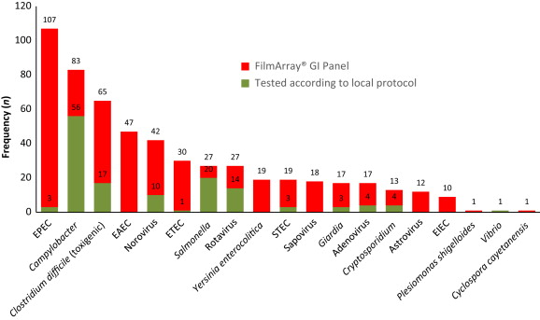
Frequency distribution of pathogens detected in 709 stool samples by diagnostic approach employed
Spina A. et al. CMI. 21(8): 719-728

Slide 22
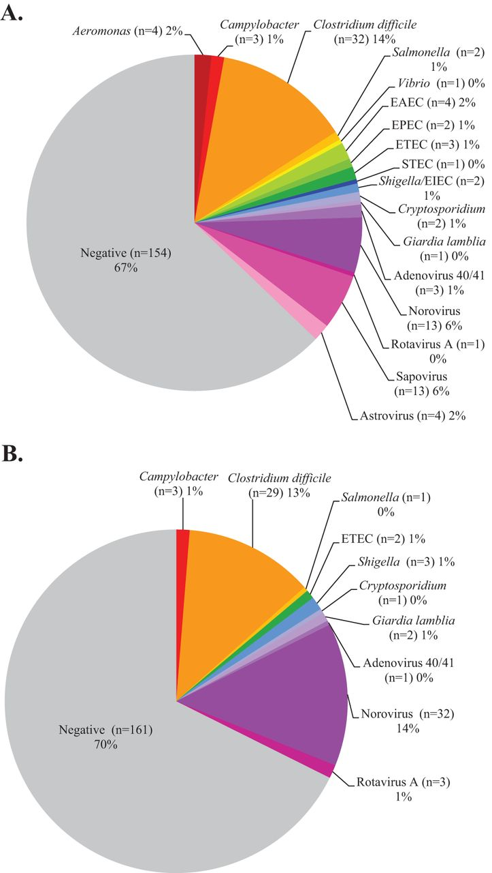
Distribution of pathogens detected by FilmArray (A) and Luminex (B) multiplex assays using prospective clinical specimens (n = 230)
Reeti Khare et al. J. Clin. Microbiol. 2014;52:3667-3673

Slide 23
Performance
Khare R. et al. J. Clin. Microbiol. 2014;52:3667-3673

Slide 24
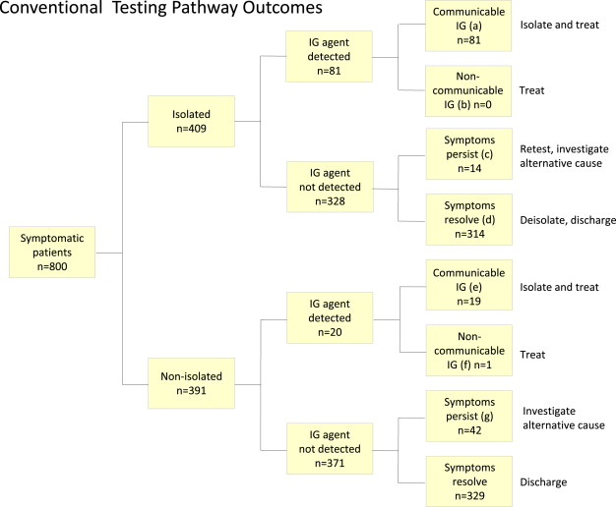
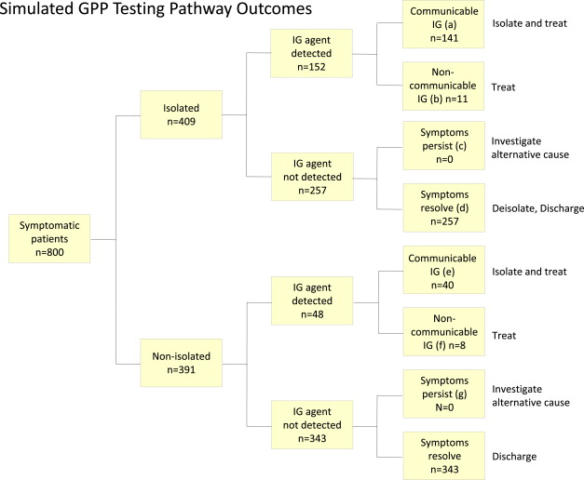
Benefits of GI Panels
Goldenberg et al. 2015. J Infection. 70(5).

Slide 25
Cost Savings
Isolation days | 3.0 days | 2.5 days | 2.0 days | 1.5 days | 1.0 days
Total isolation days GPP testing pathway | 1715 | 1581 | 1447 | 1313 | 1179
Total isolation cost under GPP testing pathway | £151,602 | £139,754 | £127,944 | £116,057 | £104,209
Total laboratory testing costs for GPP | £56,243 | £56,243 | £56,243 | £56,243 | £56,243
Total costs for GPP testing pathway | £207,845 | £195,997 | £184,187 | £172,300 | £160,452
Total costs for conventional testing pathway | £228,661 | £228,661 | £228,661 | £228,661 | £228,661
Net savings using GPP testing pathway | £20,816 | £32,664 | £44,474 | £56,361 | £68,209
Goldenberg et al. 2015. J Infection. 70(5).

Slide 26
Distribution of pathogens detected by the FilmArray GI Panel in diarrheal stool specimens that were negative for C. difficile and/or rotavirus by conventional testing
Pathogen on FilmArray GI Panel | Number of samples testing positive for indicated analyte on the FilmArray GI panel that were originally negative or not tested for:
 | C. difficile, N = 142 | Rotavirusª, N = 16 | All negative patients, N = 158
Norovirus | 9 (2)^{b} | 1 | 10
Rotavirus | 8 (2) |  | 8
EPEC | 8 (3) |  | 8
EIEC/Shigella | 2 (2) | 1 | 3
EAEC | 2 |  | 2
ETEC | 2 (1) |  | 2
Astrovirus |  | 2 (1) | 2
Salmonella |  | 1 | 1
Cryptosporidium | 1 |  | 1
Aeromonas | 1 |  | 1
C. difficile | 2 | 1 (1) | 3
Adenovirus |  | 1 | 1
Total pathogens | 35/142 (24.6%) | 7/16 (43.8%) | 42/158 (26.6%)
Total patients | 29/142 (20.4%) | 6/16 (37.5%) | 35/158 (22.2%)
Rand et al. 2015. DMID. 82(2).

Slide 27
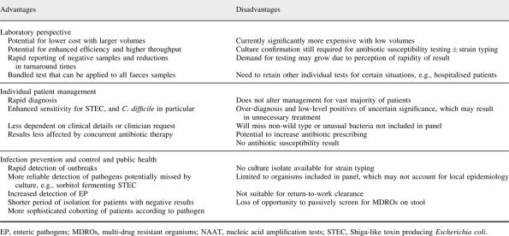
Advantages and Disadvantages
Molecular testing for viral and bacterial enteric pathogens: gold standard for viruses, but don't let culture go just yet?.
Bloomfield, Maxim; Balm, Michelle; Blackmore, Timothy
Pathology. 47(3):227-233, April 2015.

Slide 28
Meningitis Panels

Slide 29
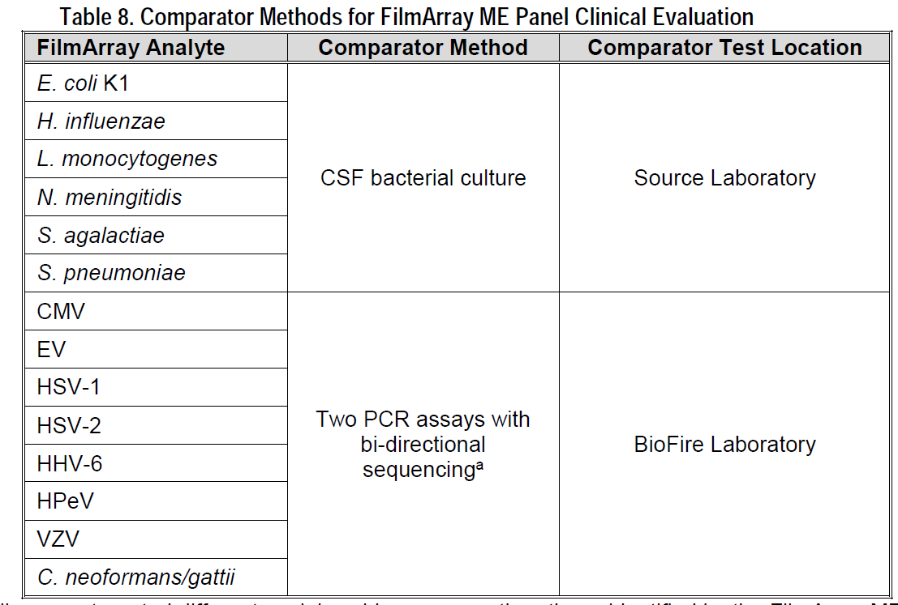
Biofire ME

Slide 30
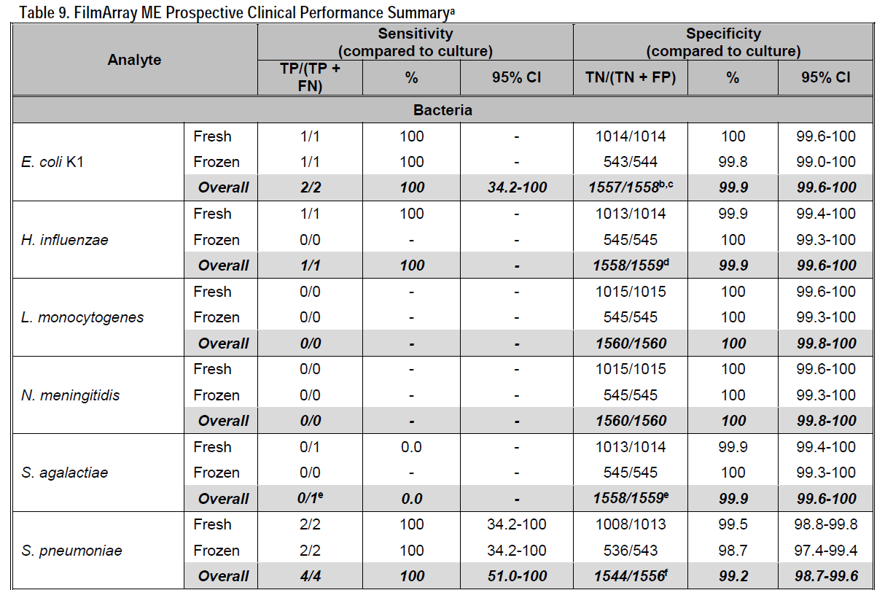
BioFire ME Bacterial Performance

Slide 31
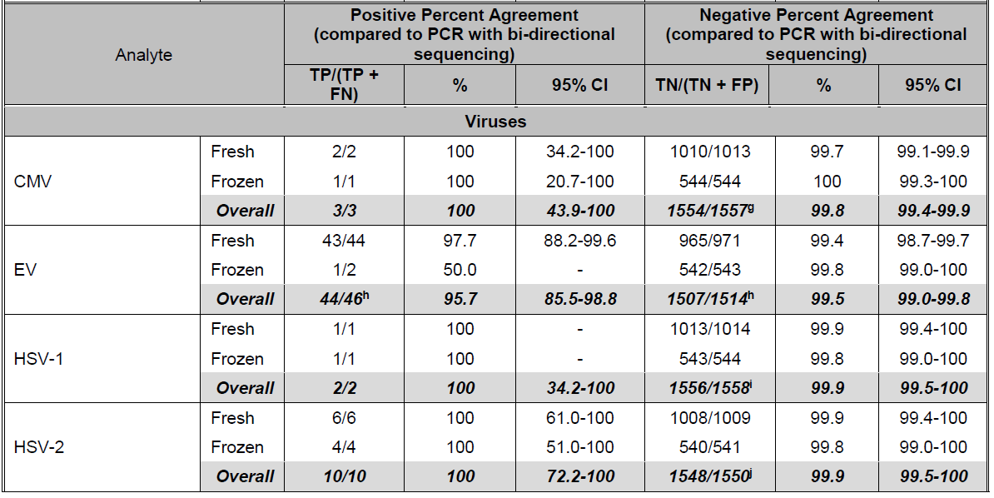

Slide 32
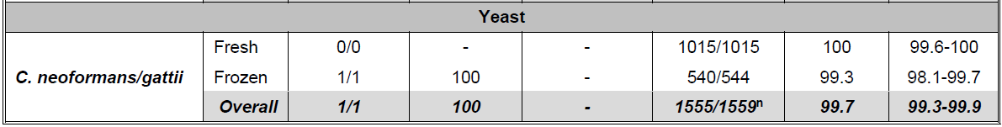
Yeast Performance

Slide 33
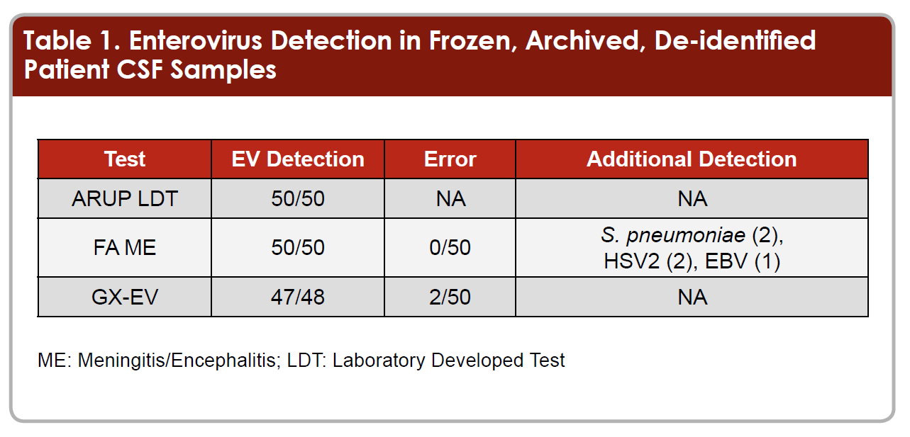
How does ME compare in Published Studies?
Too early to establish performance and clinical outcomes
  But…
Lunt, T et al. ASM Poster #1668. 2015

Slide 34
Future Panels
Zoonotic Diseases Panel
Arthropod-bourne Diseases Panel
Pneumonia Panel
STI Panel
Atypical Pneumonia Panel
BV Panel

