Slide 2

Board of Director’s Meeting June 16, 2020 1:00 p.m. – 4:00 p.m. Zoom Virtual Meeting

Slide 3
Item 1. Roll Call Item 2. Approval of Minutes Item 3. Reorganization of Agenda Item 4. Public Appearances Item 5. Board Members’ Matters

Slide 4
Impact of COVID-19 on WSLH Operations David Webb Director WSLH Environmental Health Division

Slide 5
COVID-19 Response
COOP Plan Activated
Early on in Pandemic, Safer-at-Home
Essential Status Declared
Stakeholder engagement about essential services
Incident Command, Consolidate and Coordinate communications

Slide 6
COVID-19 Response
Effective Teamwork to Address COOP Response:
Infrastructure and Staffing
Workload Impacts
State and UW Emergency Operations
Campus and DOA Partners

Slide 7
COVID-19 Response
Infrastructure and Staffing:
Ag Drive, Henry Mall, Walton Commons
Re-engineer front desk
Work with DOA on more intensive cleaning
Limit visitors, vendors – pre approval required
Travel restrictions imposed
Lower staff density (telecommuting, split/staggered shifts, etc)
Masks, hand sanitizer readily available
Significant inter-divisional support to CDD to enhance capacity

Slide 8
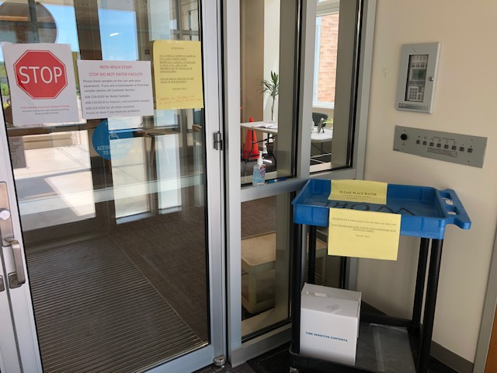
Ag Drive inside front door

Slide 9
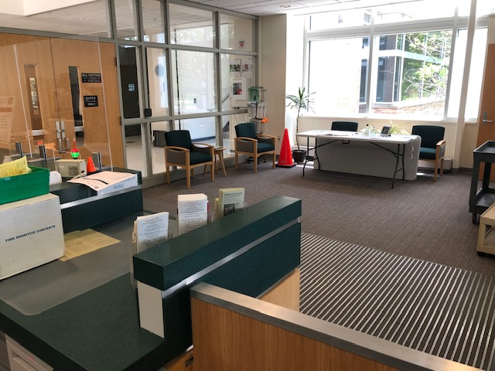
Ag Drive front desk area

Slide 10
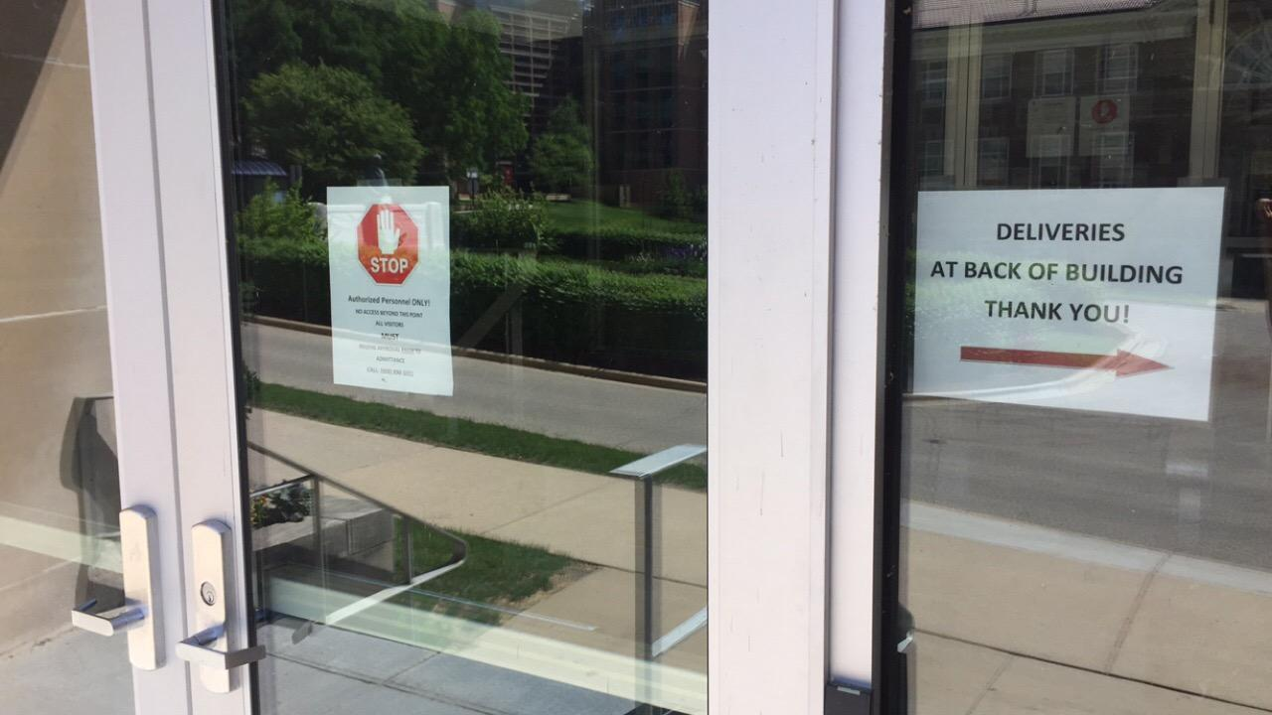
Henry Mall front door

Slide 11
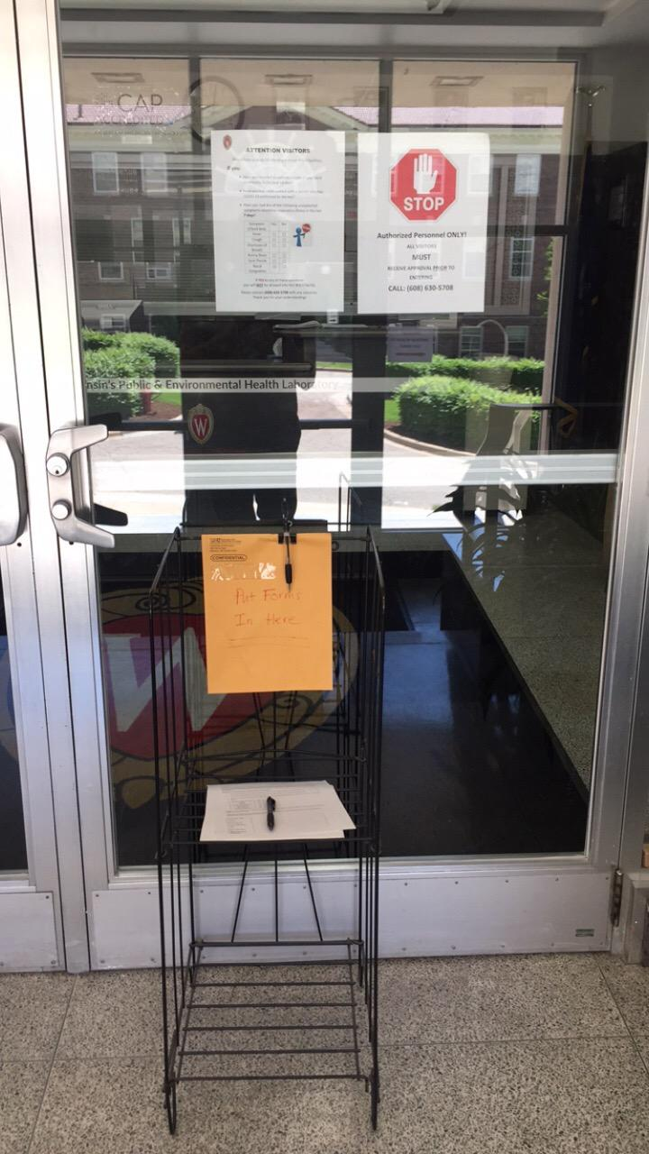
Henry Mall inside front door

Slide 12
WSLH COVID-19 Staffing
March 17 – May 31, 2020

Slide 13
COVID-19 Response
Workload Impacts:
Each Division/Program Effected Differently
Increased Workload: COVID, PFAS
Minimal Impact: SDWA, Proficiency Testing, Newborn Screening, HR, Finance, IT
Moderate Drop: Forensic Toxicology, Clean Water Act, Cytology, Cytogenetics.
Large Drop: OSHA, Beach/Rec. Testing, Discretionary monitoring

Slide 14
COVID-19 Response
EOC: UW and State Efforts:
Daily interactions with DHS
Frequent communications at various levels with UW
Dr. Alana Sterkel (CDD) embedded - testing
WISCON support – PPE decon
DOA building management assist in preparedness
Aided in PPE distribution (masks and hand san)
Helped navigate communication

Slide 15
COVID-19 Response
Operational Changes to WSLH:
Numerous communications and guidance to reconcile
Visitor access and review of each circumstance
Mask usage
Leave usage
Communications have been key, working together
Truly all in this together

Slide 16
PFAS Research Update Dr. Martin Shafer WSLH Environmental Health Division

Slide 17
Wastewater Surveillance of SARS-CoV-2 in Wisconsin
WSLH Board Meeting June 16, 2020
Wisconsin State Laboratory of Hygiene (WSLH)
Dr. Dagmara Antkiewicz
Dr. Kayley Janssen
Dr. Jocelyn Hemming
Dr. Martin Shafer
University of Wisconsin-Milwaukee (UWM)
Dr. Sandra McLellan
Wisconsin Department of Health Services
Jon Meiman, MD
Wisconsin Department of Natural Resources
Jason Knudson, Amy Garbe, Tim Ryan
Funding of $997,588 (to WSLH), $250,000 (to UWM) from DHS.

Slide 18
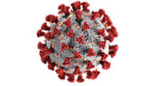
Our overarching goal is to determine whether, and to what extent, the SARS-CoV-2 (the virus causing COVID-19) is circulating in communities, both large and small, across WI
While testing individuals for the virus can provide definitive evidence of the virus in the population, that is not always practical. Reasons may include:
Not all communities have easy access to SARS-CoV-2 testing
Testing/diagnosis requires people to actively seek out the testing – many do not
People infected with the virus may have mild symptoms or be asymptomatic and therefore do not seek out testing or only seek out testing after exhibiting symptoms, leading to a lag in confirmation of new cases
These differences in SARS-CoV-2 testing availability, accessibility and utilization mean that it may be difficult to determine how widespread COVID-19 is in communities until adverse health outcomes are obvious, such as a rise in hospitalizations or deaths. COVID-19 transmission may occur for days or weeks in a community until it is detected by testing people.

Slide 19
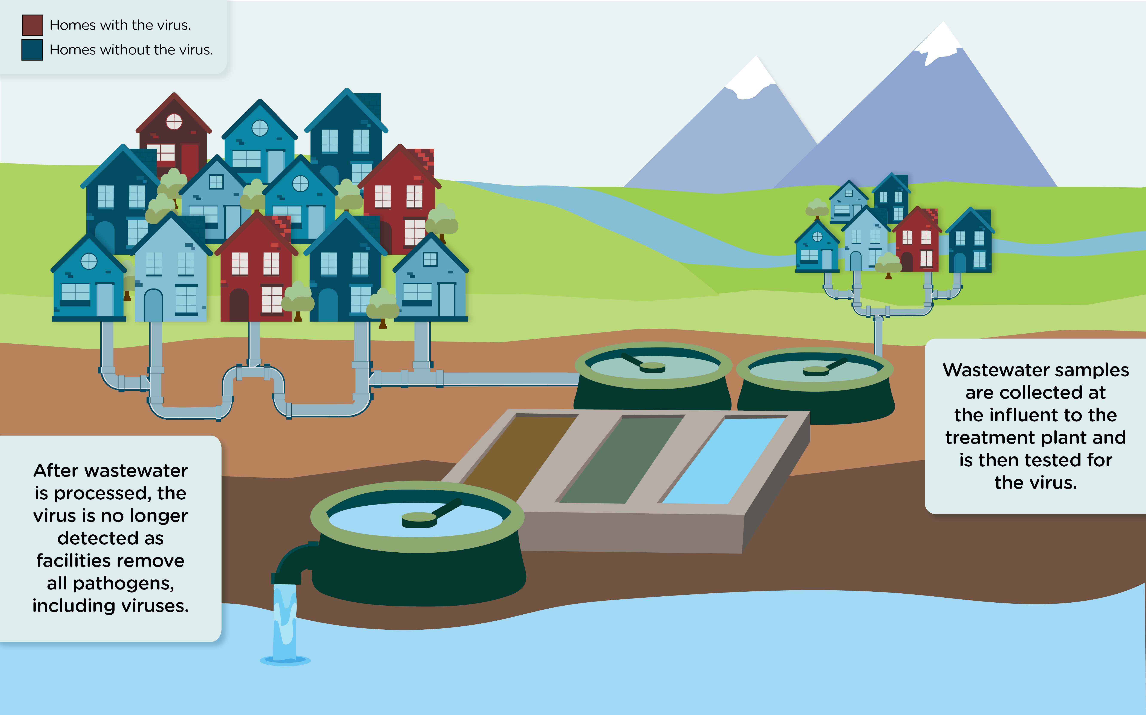
Wastewater-Based Epidemiology (WBE) of SARS-CoV-2 (COVID-19)
SARS-CoV-2 is shed from humans in their fecal matter. Sanitary sewer systems collect and aggregate wastewater to a central location and by the time it reaches the plant, it is a well-mixed sample of many households and businesses; thus by sampling the influent at the wastewater treatment facility (WWTF) a representative snapshot of the whole community served by WWTF can be obtained.
https://udwq.shinyapps.io/pilot-ww-virus-db/#dashboard-1

Slide 20
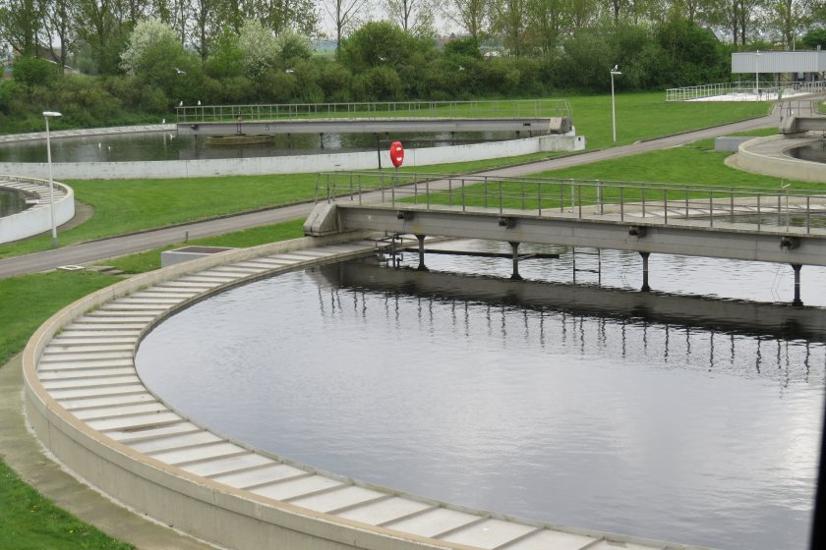
What the Study is Designed to Tell Us
Is transmission increasing or decreasing in a given community?
In communities where cases are already present, trends in virus concentrations in wastewater over time will inform whether the spread is increasing or decreasing. These changes are important, because they can inform policy makers if the pandemic prevention measures are working, whether areas that have been re-opened are experiencing a rebound of infections, potentially days or weeks before acute health outcomes can be reported. Trends/trajectories between communities can also be compared.
Is COVID-19 circulating in a community? Early Warning Potential
Detection of the virus in sewage in an area where cases have not been reported may be an early indication of spread to and within that area. Alternatively, wastewater monitoring may be able to confirm areas with low levels of infections.
This approach is not designed to replace existing public health surveillance systems, but to supplement them.

Slide 21
Synopsis of Approach
SARS-CoV-2.
Quantifying the genetic material (characteristic viral RNA) (not the infectivity or viability of the virus). GC/L of N1, N2, by qRT-PCR or ddPCR
Spiked bovine coronavirus (BCoV) as recovery control
Hep G RNA (armored virus) as a PCR inhibition check
Human fecal marker (HF183) to allow for normalization of influent dilution
Duration of the study. The study will sample WWTPs weekly or monthly over a 12-month period.
WWTPs Chosen and Samples Collected. In collaboration with the WI DNR, we will begin enrolling WWTPs in late June with routine sampling to begin sometime in July 2020. Our goal is to:
Recruit two WWTPs from the most populated 21 counties (42 WWTPs) for weekly sampling (74% of Wisconsin’s population). and
80 smaller and/or rural WWTP facilities for monthly sampling (where testing has been inconsistent or low reports of COVID cases)
Flow-weighted 24-hour composite influent samples will be collected from each facility and express shipped to the labs. Sludge also being evaluated.
To capture trends in virus concentrations (and correlate with population epidemiology of COVID-19) over the past few months several WWTPs have been archiving influent samples for the WSLH and UWM teams.

Slide 22
How Will the Data be Used ?
Are public health actions – COVID-19 mitigation efforts working? Trends in wastewater virus concentrations along with the regional epidemiology data will inform if public health actions are working.
By acting as an early warning system, (observing an increase in wastewater virus concentrations potentially weeks before measurable health outcomes), communities will have information that can be used to encourage greater testing and prepare for a potential surge in patients with COVID-19.
The researchers will work with local health departments, the WI Department of Health Services (DHS) and Wastewater Utilities to interpret the data. Correlation between wastewater viral RNA concentrations and population epidemiology of COVID-19 will be examined at an individual community level.
Data will be released by the DHS to the public in a timely manner via a reporting mechanism under development (likely a dashboard). Data release will be accompanied by an explanation of what they mean and with a Frequently Asked Questions (FAQ) summary.

Slide 23
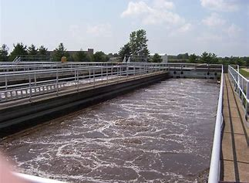
Working to Establish Best Practices
Weekly calls and method sharing with 6 (and growing) research groups across the country conducting wastewater SARS-CoV-2 surveillance
Virus concentration approaches
RNA Extraction methods
Amplification tools
QA practices
We will participate in a Water Research Foundation round-robin study of best practices for wastewater SARS-CoV-2 quantification
We are currently conducting studies comparing various performance metrics of INFLUENT and SLUDGE (primary and thickened) for SARS-CoV-2 monitoring

Slide 24

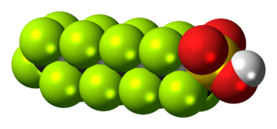
PFAS RESEARCH INITIATIVES ONGOING or RECENTLY COMPLETED
NADP / WSLH / WDNR / Sea Grant / EPA
Collaborations
WSLH Board Meeting June 16, 2020

Slide 25
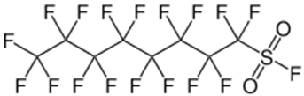
PFAS Dispersal & Atmospheric Processing
Atmospheric Transport, Processing and Deposition
is Underappreciated and Under-Studied
Figure from ITRC
Industrial Sources
Major Entry Points
Paper mills
Metal finishers
Textile mills
Foam factories
PFAS factories
(manufacturing aids)
Industrial Sites
Fire Fighting Training
Commercial Fugitive Emissions
Landfills
WWTP

Slide 26

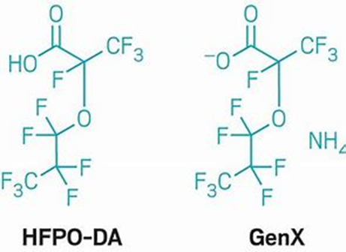
PFAS Compounds
Carboxylic
Acids
>4500 compounds known/suspected
220 with authentic standards
50 with “routine” robust methods
18 in EPA 537.1 (drinking water)
3-5 with regulatory limits (States)
-C_{n}F_{2n}-head →
Repel oil and water
Chemical and Thermal stability
Reduce friction
High surface activity
Sulfonates
Fluorotelomers
Sulfonamides
Buck et al. 2011

Slide 27
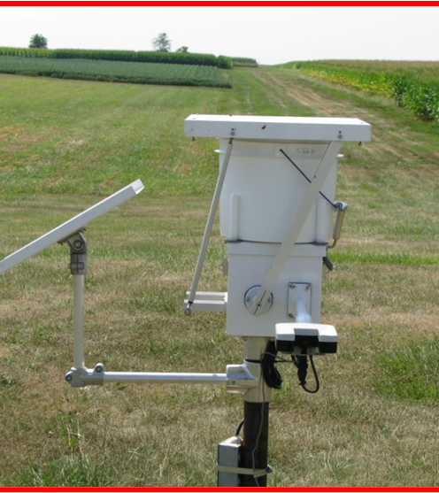
Atmospheric Deposition of PFAS via Precipitation
Goals of the 2019/2020 NADP/WSLH Pilot Study
Assess the efficacy of the NADP infrastructure and current sample collection methods, for PFAS studies
Broaden the number of PFAS compounds evaluated
Few studies quantify more than 20 compounds
Initiate a synoptic overview study of PFAS concentrations in precipitation across the US
Extant data is quite limited
Improve the Quality Assurance documentation of PFAS precipitation studies
limited QA in many of few published studies
NTN Wet-Only Collector

Slide 28
Outcomes of Efficacy Study: SUMMARY
Loss of PFAS is minimal for compounds of carbon number <10 under current (and planned) NTN protocols.
Losses are observed for longer-chain (>10 carbon) PFAS compounds.
But recoverable with a methanol rinse of the bucket
The current NTN protocols are “CLEAN” for a broad range of PFAS compounds.
Alternate handling/collection protocols can be implemented to address losses of longer-chain compounds (MeOH rinsing).
Precipitation (and Air) are effective monitoring matrices for detection of trends (likely better than other environmental receptors (e.g. fish))

Slide 29
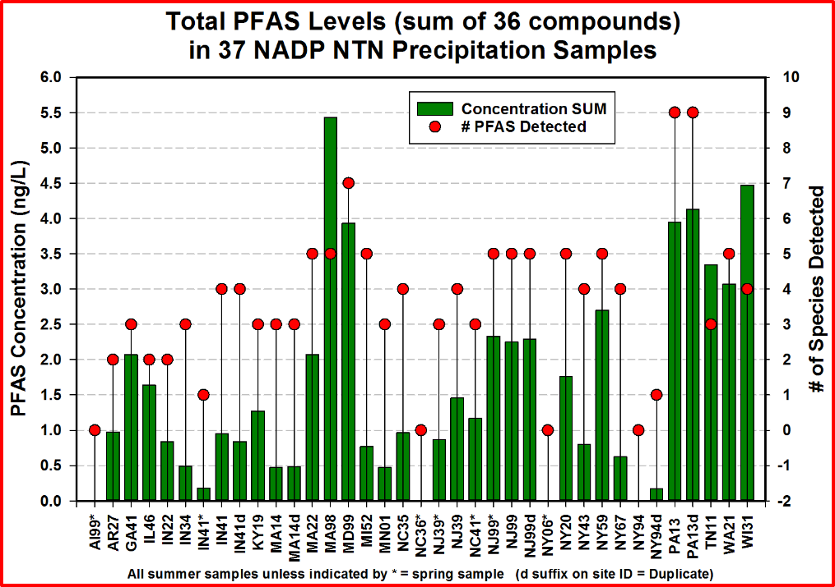
Atmospheric Deposition of PFAS via Precipitation
Pilot Synoptic Study: Key Findings
Levels of many PFAS compounds were low (1 ng/L), though the ∑ exceeded 4 ng/L at several sites.
Sites in the mid-Atlantic states generally had the greatest # of detectable PFAS species and the highest concentrations.
30 Sites, 37 Samples, Summer & Spring 2019

Slide 30
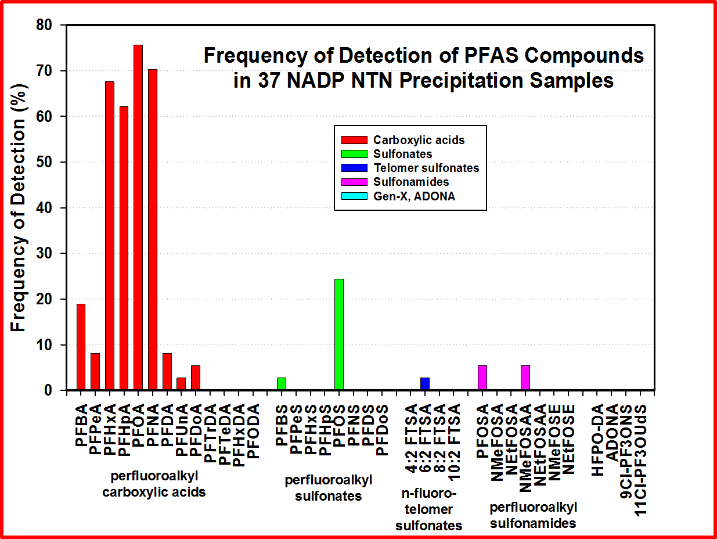
Atmospheric Deposition of PFAS via Precipitation
Pilot Synoptic Study: Key Findings
PFHxA, PFHpA, PFOA and PFNA were each present in nearly 70% of all samples.
The carboxylic acid compounds were by far the most frequently detected and largest class contribution to the total targeted PFAS.

Slide 31
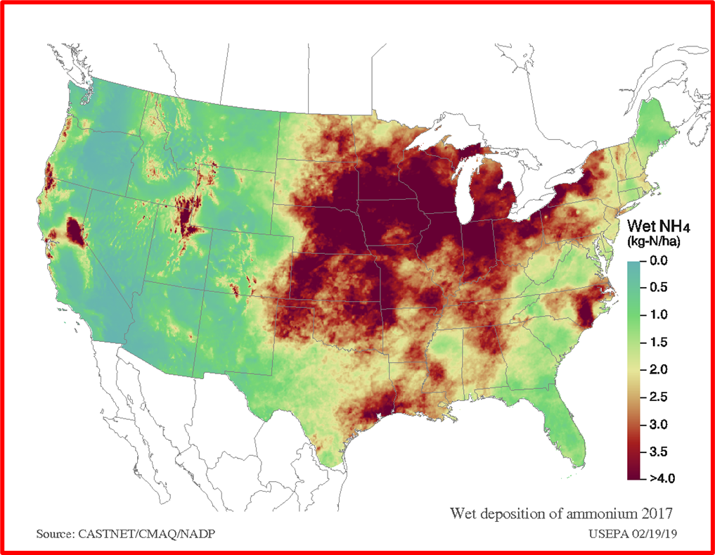
Atmospheric Deposition of PFAS via Precipitation
Pilot Synoptic Study: Key Findings
PFAS Deposition Fluxes
Concentrations of 0.2 to 6.0 ng/L equate to a wet deposition PFAS flux of 0.7 to 21 ng/m²/day (at an annual precipitation volume of 125 cm/year).
This flux is significant for many environments (e.g. large lakes with long residence times – for Lake Michigan → annual flux of 4.4x10¹⁴ ng/year → 0.1 ng/L/year PFAS accumulation throughout the water column)
Field & Laboratory Effort Complete. Manuscript Draft Prepared

Slide 32

WSLH-NADP PFAS TOOL-BOX
Developed a standardized robust protocol (SOP) for PFAS wet-deposition measurements using the NADP-NTN infrastructure
Incorporates optimized analytical methods
Could support site-specific, State, regional, and national PFAS wet-deposition efforts
Model (process) for other emerging contaminants
Regulatory Limits and Reference Concentrations
EPA Reference Concentration: 70 ng/L (PFOA+PFOS)
State Drinking Water Limits: 5 – 70 ng/L
WI proposed 20 ng/L WQL, 2 ng/L action level
Research suggests biological impacts at < 1 ng/L

Slide 33
Atmospheric Deposition of PFAS
Major Unresolved Issues
The role of point, regional, and global emission sources at a given location
Primary emission source versus secondary (reactive transformation) pathway
Is source reconciliation possible from compound “fingerprint” profiles?
Emission factors from major classes of emission sources
The magnitude of dry deposition
Composition of PFAS pool. Unaccounted for fraction, oxidizable fraction, C2, C3, >C12?
Our Follow-up Studies will be Addressing Many of these Issues

Slide 34
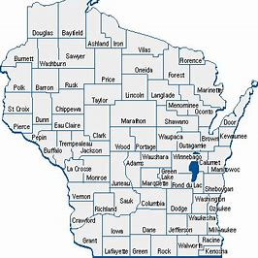
Atmospheric Deposition of PFAS via Precipitation
Wisconsin Precipitation PFAS Intensive
All 7 NADP-NTN Sites in Wisconsin
14 Weeks (April – July 2020)
WDNR Funded: NADP, WSLH Partners
Optimized PFAS Sampling Protocols with MeOH rinsing
Comprehensive Analytical Protocols
36 Targeted PFAS (LC/MS) - WSLH
Total Organic Fluorine (CIC) - WSLH
Non-Targeted Analysis (LC/MS) - EPA
This initiative incorporates further method enhancements for neutral PFAS species that are very important to atmospheric transport and transformations

Slide 35
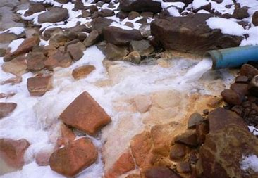
Assessment of the Impacts of PFAS in Municipal Wastewater Effluents and Land-Spread Biosolids on Wisconsin Ground- and Surface Waters
Study Component A: Determine the TYPE and QUANTITIES of PFAS Associated with POTWs and Streams Receiving POTW Effluents
Funding from WI Sea Grant & WDNR to the WSLH

Slide 36
Assessment of the Impacts of PFAS in Municipal Wastewater Effluents and Land-Spread Biosolids on Wisconsin Ground- and Surface Waters
Study Component A: Determine the TRANSFORMATIONS of PFAS Compounds within POTWs and FLUXES to the Atmosphere
Funding from WI Sea Grant & WDNR to the WSLH

Slide 37

Assessment of the Impacts of PFAS in Municipal Wastewater Effluents and Land-Spread Biosolids on Wisconsin Ground- and Surface Waters
Study Component B: Determine the Impacts to Soils, Surface- and Ground Waters of PFAS-Containing Municipal Biosolids Spread on Agricultural Fields
Effort in planning stages. Site identification & recruitment in-progress
Funding from WI Sea Grant & WDNR to the WSLH

Slide 38

PFAS COLLABORATIONS PLANNED

Slide 39
NADP & EPA & States & WSLH
Several States, as well as USEPA, have expressed interest in establishing precipitation monitoring as well as PFAS deposition modeling programs
NADP & EPA & WSLH & WDNR
Sharing of precipitation extracts for non-targeted PFAS analysis at EPA ORD
WSLH & NADP & Researchers
Method Exchange
Research Proposals
We have (in response to RFAs) submitted several proposals that (in-part) address the atmospheric PFAS issues noted previously

Slide 40
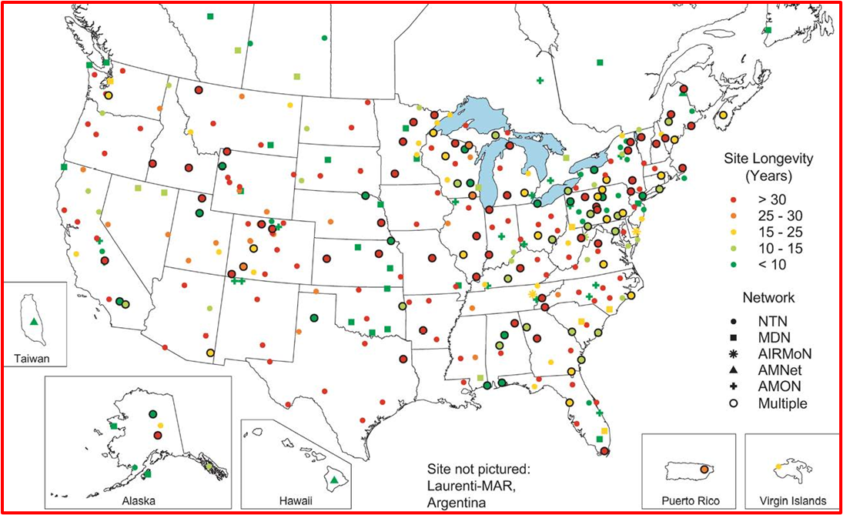
National Atmospheric Deposition Program
Operated by the Wisconsin State Laboratory of Hygiene
Expand “synoptic” sampling using NADP infrastructure
Whiteface
Mountain
NJ99
Duke
Forest
Deposition Modeling (CMAQ, etc.)

Slide 41
PFAS Method Development @ WSLH

Slide 42
Human Serum
The WSLH has initiated development of an expanded comprehensive method for PFAS in serum
Goal of up to 40 compounds
This effort is in-part supported by a $50K grant from APHL to “establish PFAS testing in Wisconsin”
The APHL grant and in-kind WSLH funds will support the analysis of 600 serum samples
A collaboration with DHS and UW-Madison/SHOW
Archived serum species from SHOW
Assess historic PFAS burdens in WI residents
Precipitation
Further Method Enhancements (uncharged species)

Slide 43
PFAS Methods/Matrices at WSLH
PFAS in Drinking Water (EPA 537.1)
All 18 Compounds from EPA 537.1
PFAS in Non-Potable Water (ISO 21675)
All 36 Compounds on the WDNR List
PFAS in Wastewater (WSLH Method)
All 36 Compounds on WDNR List
PFAS in Solids (Modified ISO 21675/ASTM D7968)
31 of 36 Compounds on WDNR List
Not Analyzed: FOSA, N-MeFOSA, N-MeFOSE, N-EtFOSA, N-EtFOSE
In process of method development, plan to have all 36 in second quarter
PFAS in Tissue (ISO 21675)
27 of 36 Compounds on WDNR List
Not Analyzed: PFBA, 4:2 FTSA, 6:2 FTSA, FOSA, N-MeFOSA, N-MeFOSE, N-EtFOSA, N-EtFOSE, PFHxDA, PFODA

Slide 44
PFAS Accreditation
PFAS in Drinking Water
NELAC accredited, Audited and Awaiting WDNR accreditation
PFAS in Non-Potable Water
Audited and Awaiting WDNR accreditation
Will apply for NELAC accreditation after WDNR is granted
PFAS in Wastewater
Audited and Awaiting WDNR accreditation
Will apply for NELAC accreditation after WDNR is granted
PFAS in Solids
Audited and Awaiting WDNR accreditation
Will apply for NELAC accreditation after WDNR is granted
PFAS in Tissue
Audited and Awaiting WDNR accreditation

Slide 45

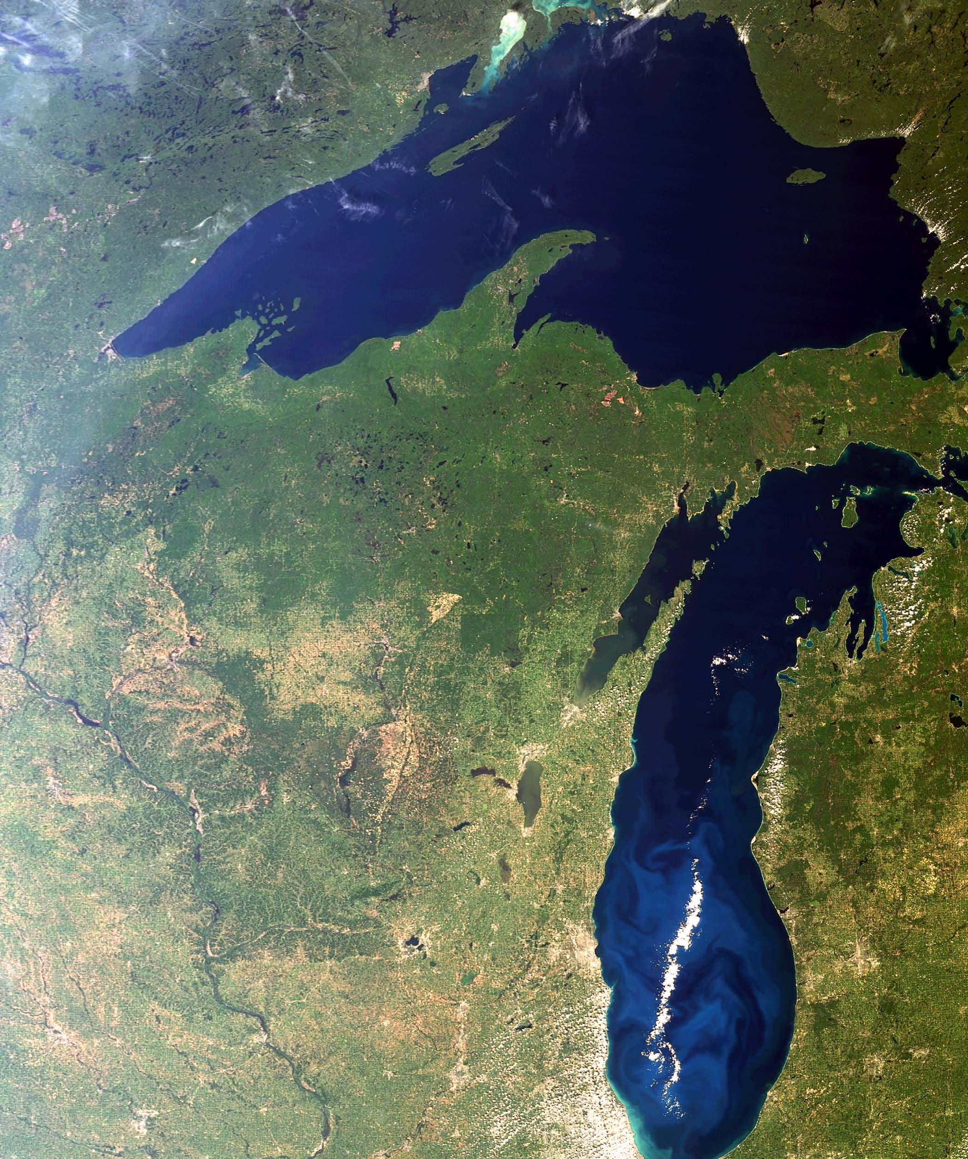
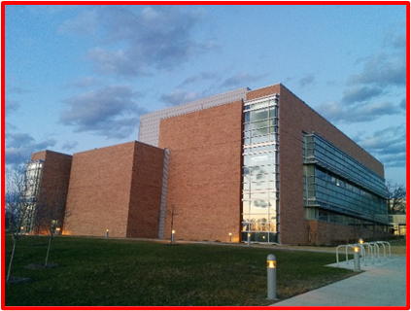
QUESTIONS
Thank You
Acknowledge: NADP: Mark Olson, Amy Mager & her team, Camille. WSLH: Erin Mani & PFAS analytical team. WDNR: Mark Allen, Katie Praedel. EPA: Melissa Puchalski, Donna Schwede, John Offenberg

Slide 46
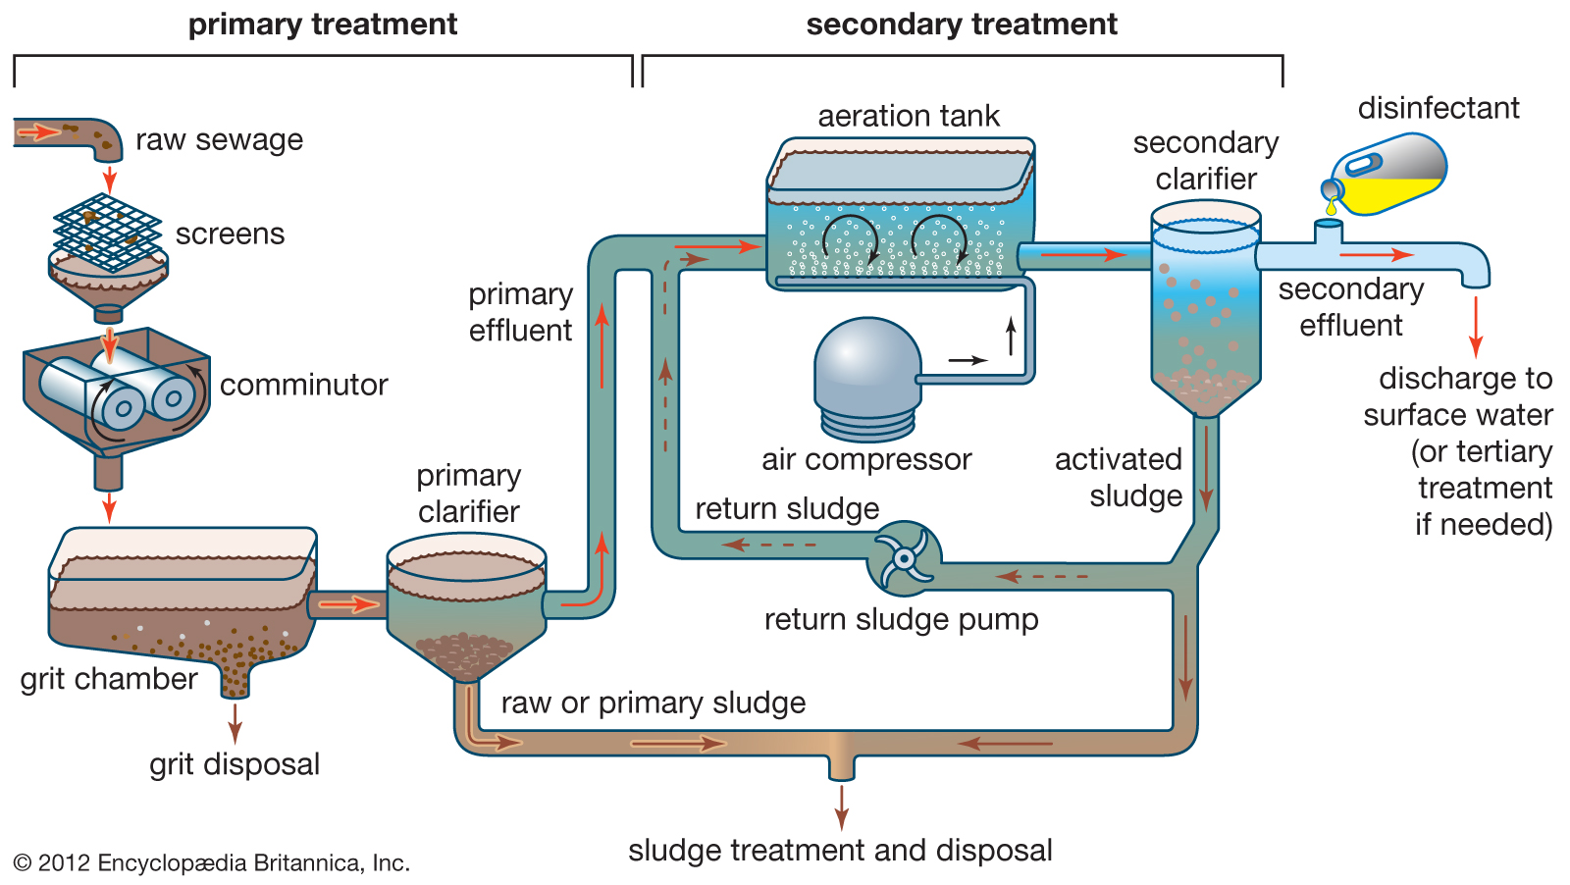
Synopsis of Approach

Slide 47
PFAS Measurement Approaches
Total
PIGE
XRF
TOF/CIC
EOF/CIC
Non-targeted
Discovery
Semi-Quant
Pathway analysis
Total Oxidizable Precursor (TOP)
Oxidative conversion of targeted & unknown precursors
Targeted
12-50 species
Quantitative
Tox relevant
Small fraction of total

Slide 48
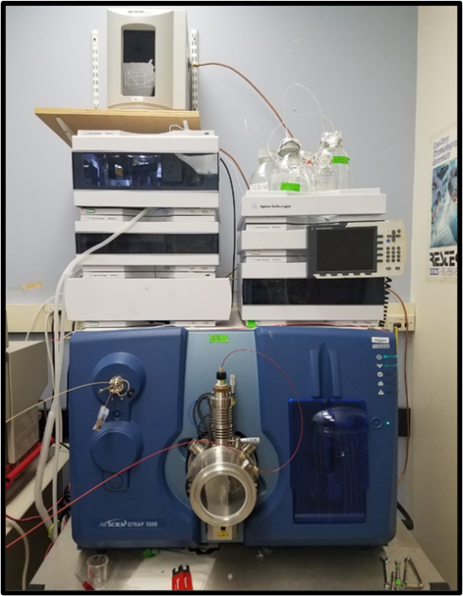
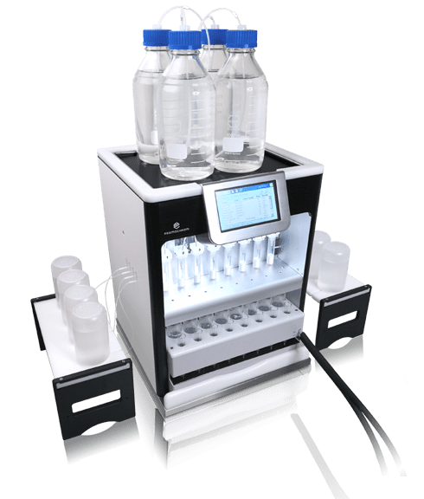
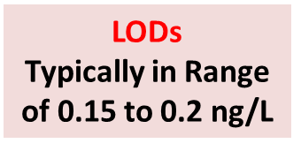
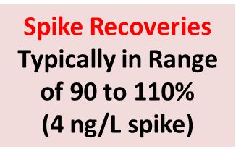
PFAS Analytical Methods
Analytical methods:
ISO Method 21675 (PFAS in Water by LC-MS/MS). 36 PFAS compounds. 26 isotopically-labeled internal-standards
500 mL sample volume; entire sample extracted
Automated SPE (Oasis-WAX; 8-station Promochrom Tech.)
Sciex QTRAP 5500 LC/MS/MS, Waters Acquity UPLC
Contamination Control:
QC’d polypropylene collection bottles
Gloves worn during sampling
NO Teflon or related materials

Slide 49
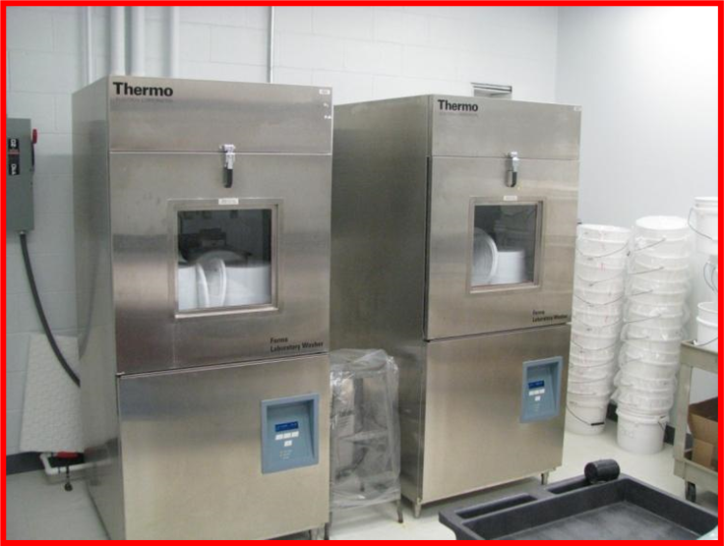
Outcomes of Efficacy Study: BLANKS
System Blanks:
Both Bucket & Bag Collectors
Both Lab & Field Deployments
7-day Trials, Run in Triplicate
Bucket Washers
High Purity Water (7-day field conditions)
Bags: no detects for 36 species (except PFOA, 0.23 ng/L, one sample)
Buckets: no detects for 36 species (except PFOA, 0.44 ng/L, one sample)
NTN Bottle: no detects for 36 species
Methanol Rinses
Buckets: no detects for 36 species

Slide 50
Outcomes of Efficacy Study: RETENTION STUDIES
PFAS Retention/Loss Studies
Both Bucket & Bag Collectors in Lab & Field Deployments
Both MQ & Precipitation Matrices
Kinetic Studies (0, 1, 3, 7-day samples)
Spiked with 36-PFAS Compound Mixture
10 ng Spike in 2L of MQ
7-Day Exposure
50 mL MeOH
Bucket Rinse
Average of
Triplicate Buckets

Slide 51
In House and Upcoming Work
In House:
Madison Water Utility Project
NADP/WDNR Rain water project
WDNR Fish and Deer tissue
~400 logged in
Upcoming:
WDNR Surface water (~60)
WDNR Water Quality (90-170)
USGS POCIS (~70)
WDNR Drinking Water Program (~500-600 samples over 2 years)
Many projects proposed waiting to hear about funding

Slide 52
COVID-19 Testing Dr. Alana Sterkel WSLH Communicable Disease Division

Slide 53

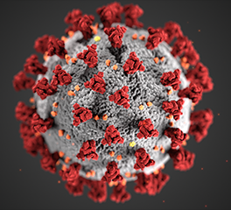
Board Meeting CDD COVID-19 Update 06/16/20
Alana Sterkel
PhD, D(ABMM), SM(ASCP)^{CM}
Assistant Director
Communicable Disease Division
Wisconsin State Laboratory of Hygiene

Slide 54
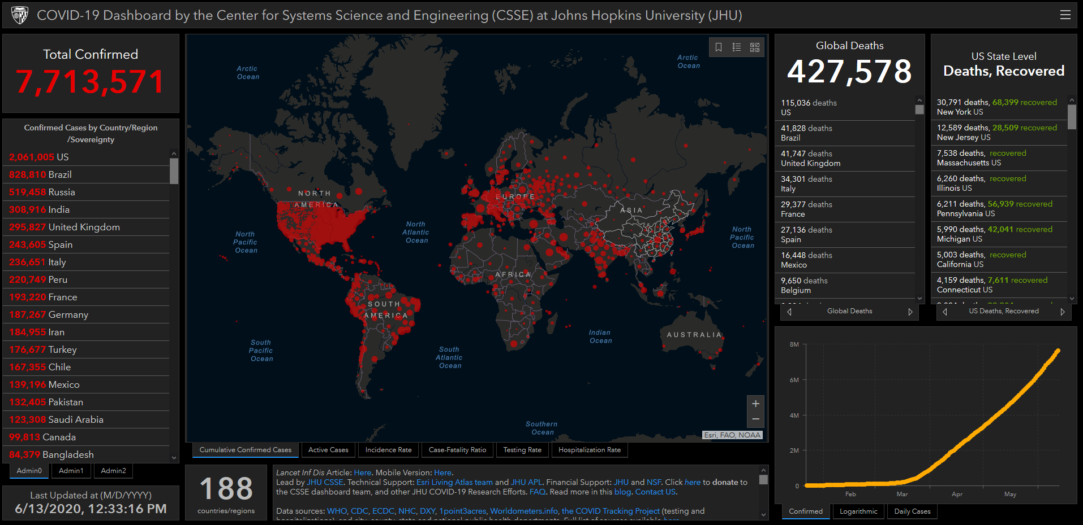

Slide 55
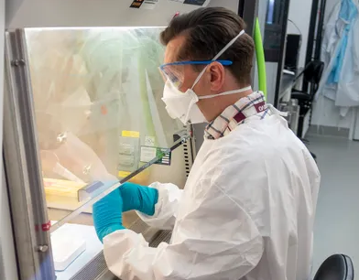
Overview of COVID-19 at WSLH
Feb 5th was the first case of COVID in Wisconsin
WSLH starts officially testing on March 2nd
Staff Cross-trained to meet the exploding demand
Worked with DHS to set tier testing criteria to allow us to focus on high risk patients
Issues with supply chain threatened to shut down testing
Strategy for testing diversification allows us to source multiple supply lines and we never went down!
Work with WCLN helps 68 labs in WI start testing to date, 25 more in process
Work with SEOC helps labs get supplies for testing
Tested over 17,000 specimen at WSLH
Find a way to continue other mission critical work, new hires

Slide 56
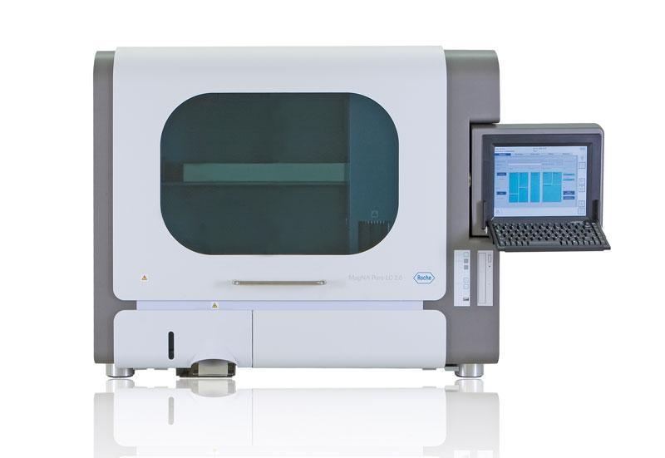
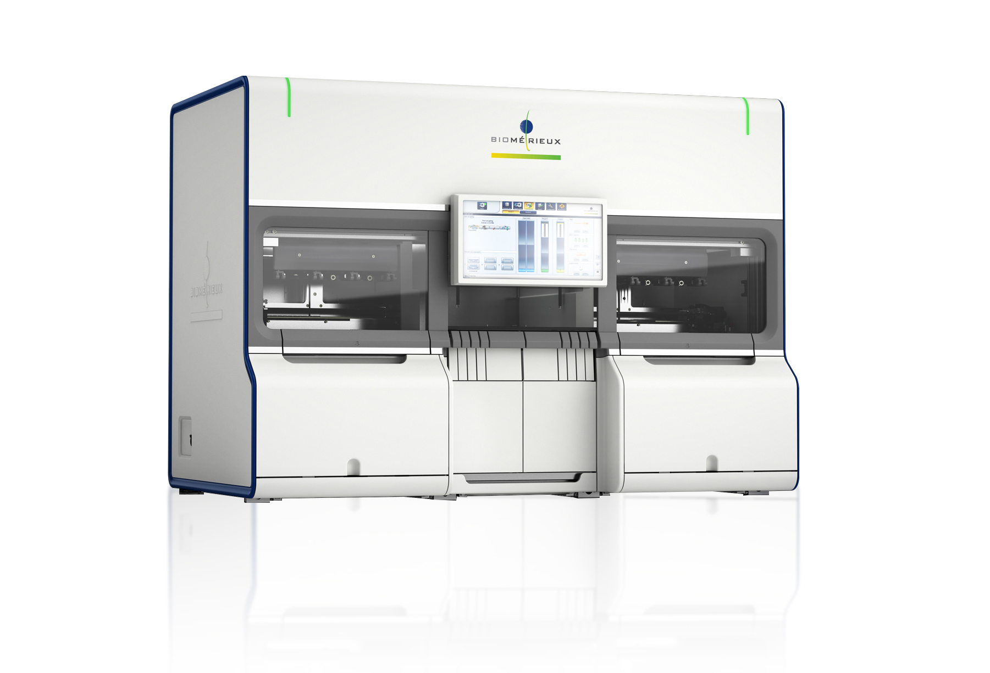
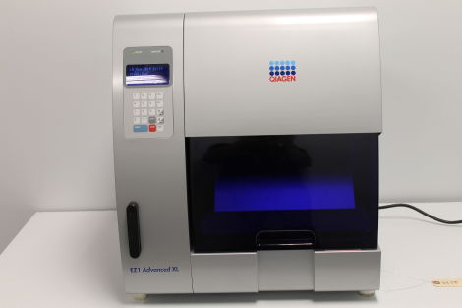
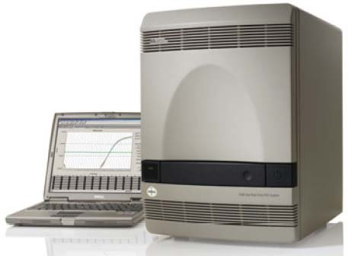
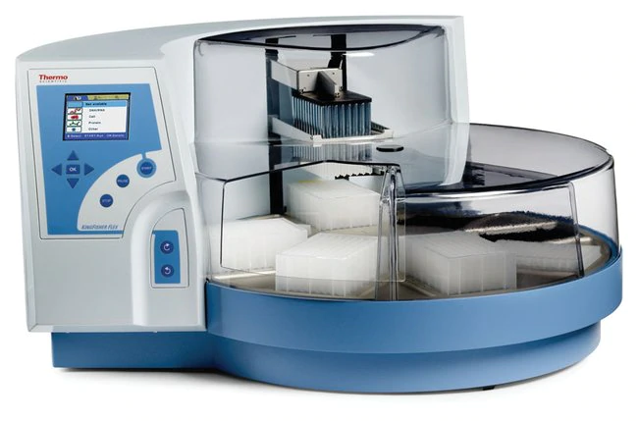
Testing Advancements
Magna Pure- 24 samples
eMAG- 48 samples
EZ1- 14 samples
ABI 7500 Fast Dx- 96 samples
KingFisher Flex- 96 samples
*Started at 50 tests/day, now at 500 tests/day

Slide 57
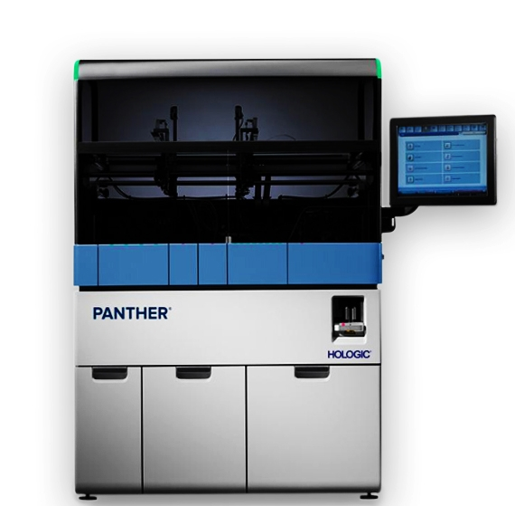
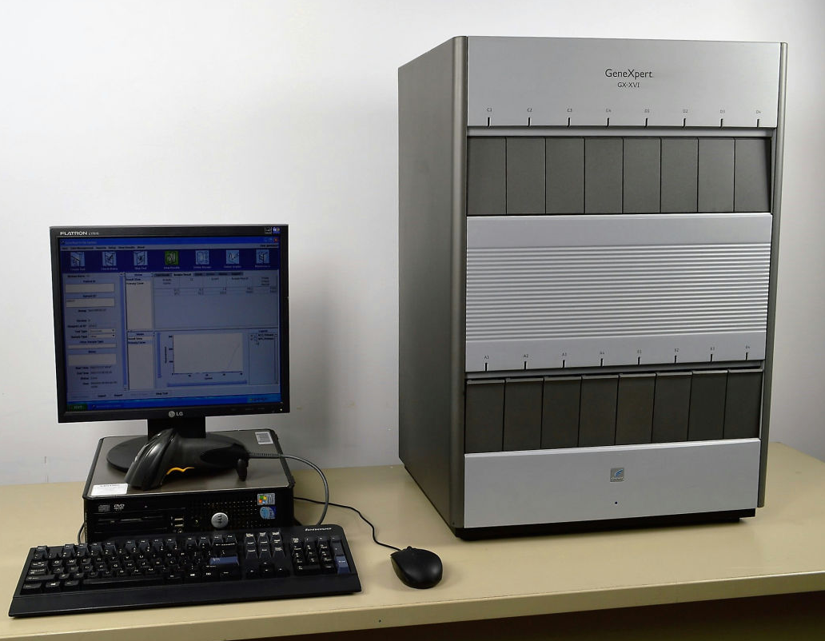
Future Testing
KingFisher Flex + ABI 7500 Fast Dx
x3
+
x5
Current capacity 500/day
Future capacity 800+/day
Cepheid GeneXpert- 1 hour
Hologic Panther- 300/day
x2
*Greatest bottle neck is pre-analytical
(data entry, specimen processing)

Slide 58
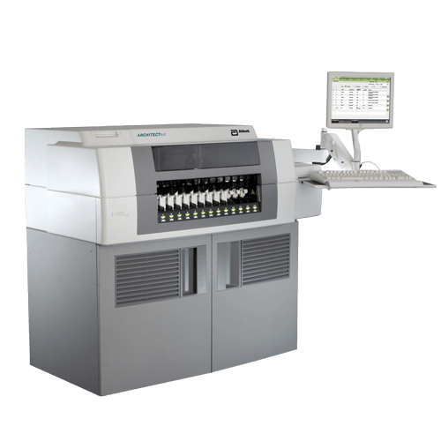
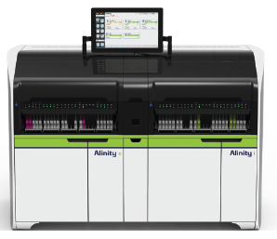

Serology
Abbott Alinity i
Abbott Architect
3 Surveillance Strategies
1000 samples/month with SHOW
1000 samples/month with other surveillance sites
Collect data from other labs

Slide 59
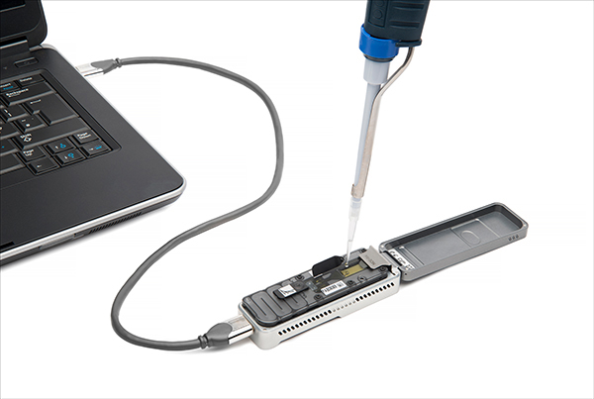
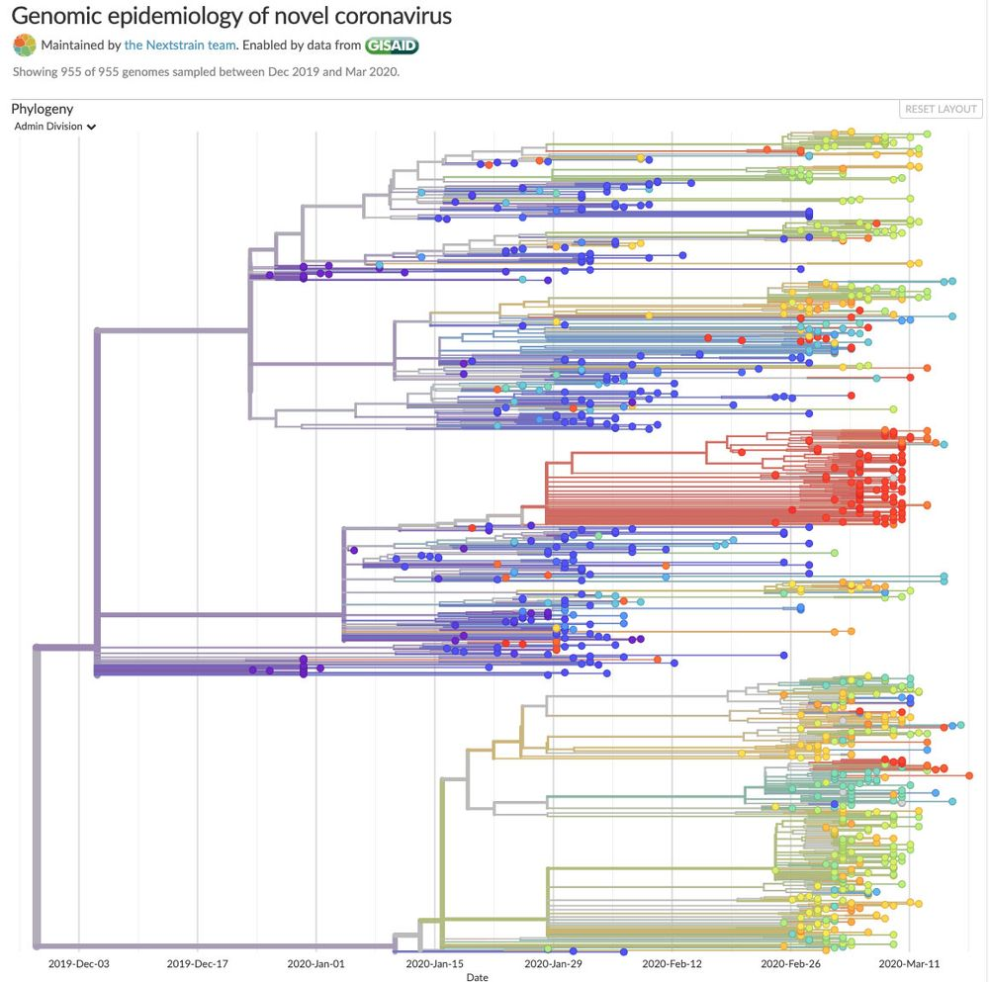
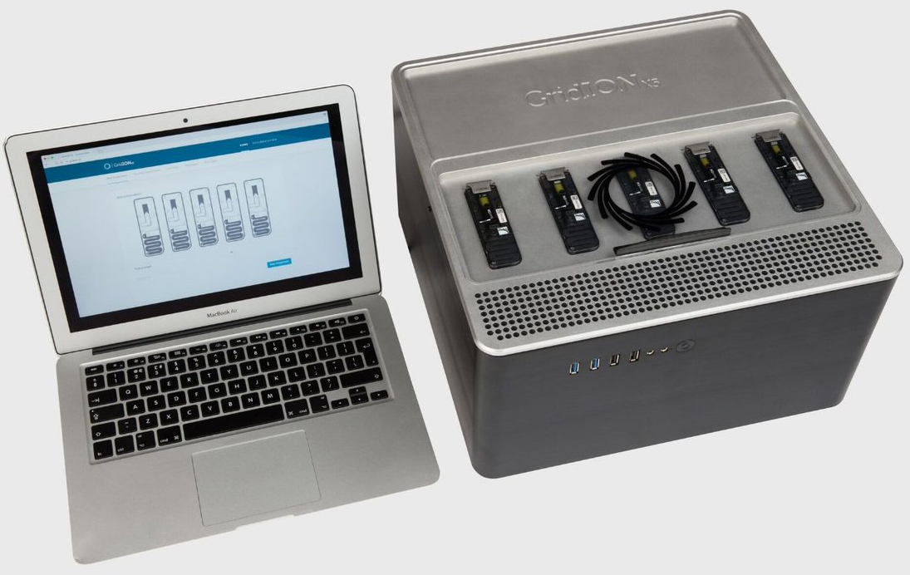
Sequencing
MinION
Detail that allows for genetic comparison and phylogenetic tree assembly
Allows for outbreak response
GridION

Slide 60

Funding
$500,000 ELC emergency funds
$5,236,295 ELC Cares
$16,107,809 ELC Enhancing Detection
$21,844,104 Total
*started at $250/test now at $44/test

Slide 61
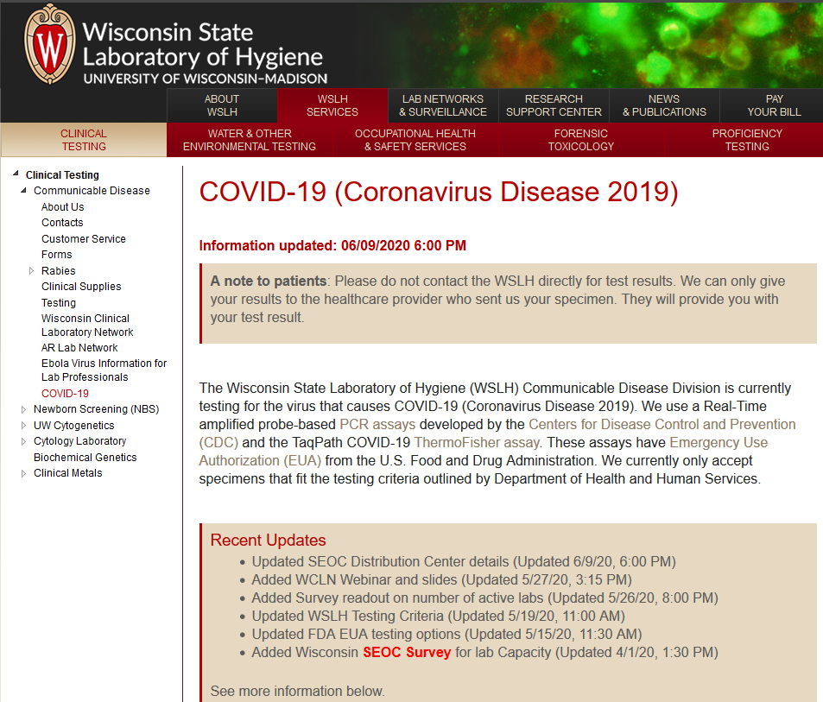
Outreach-WCLN
Detailed Webpage
Validation Panels
10 Webinars
Lab Messages
Email listserv for community discussion
Technical Consultants

Slide 62
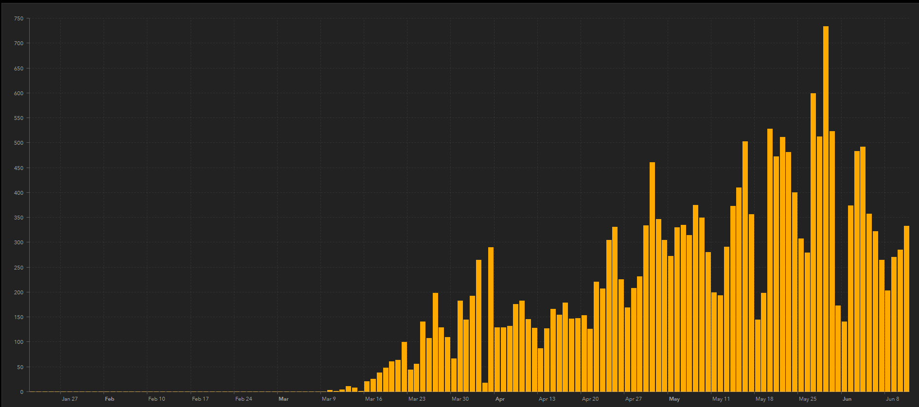
Collection Kits Timeline
*Nearly 500,000 items distributed to date
Appointed SME contact to HHS
FEMA starts sending relief supplies
Embedded at SEOC
SEOC opens distribution portal
Asked SEOC to distribute VTM
Cases/day
Asked to join SEOC daily calls
WSLH partners with other labs to make VTM
WSLH starts testing

Slide 63
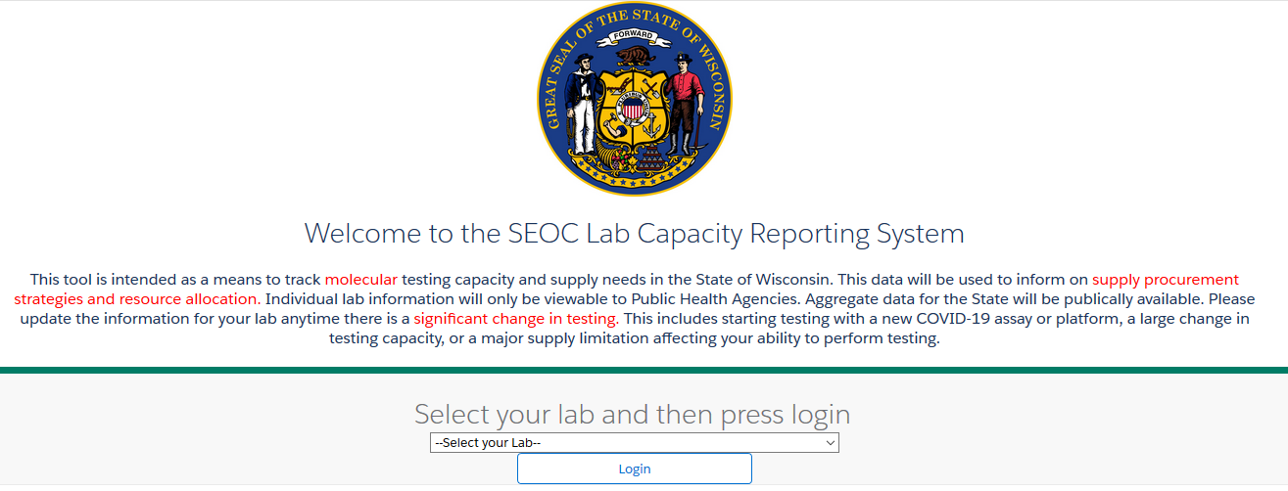
WSLH/SEOC Survey for WCLN

Slide 64
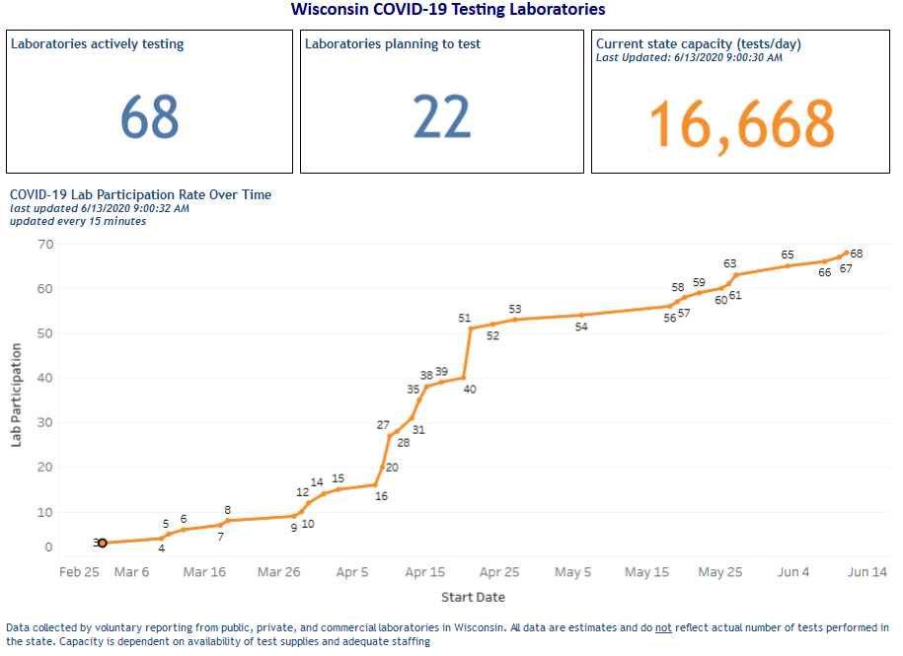

Slide 65
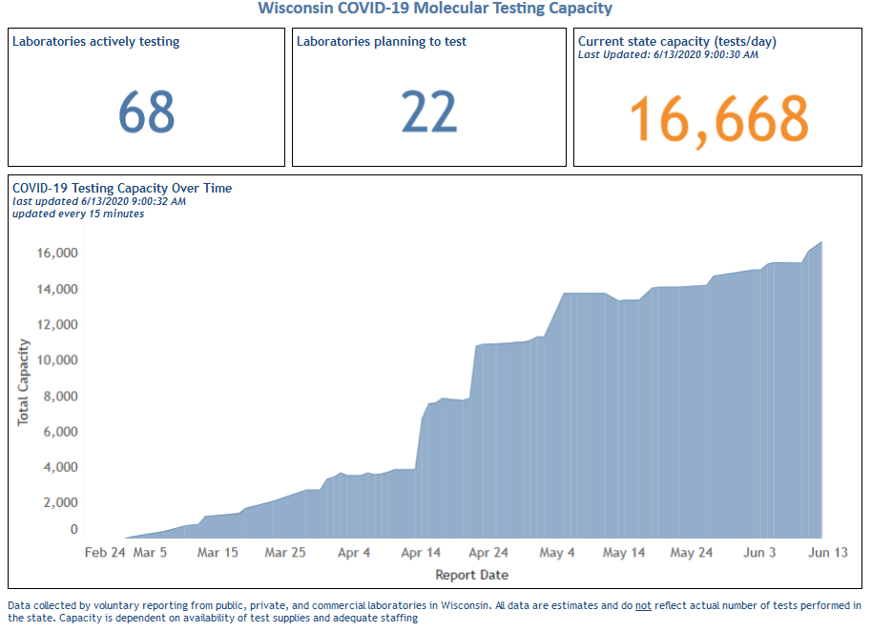
State Goal
Fed Goal

Slide 66

UW Madison
We have been asked by campus to support massive testing of students and faculty
We were clear that this could not be adsorbed into our existing testing efforts
We are working with WVDL to develop a plan to meet campuses needs.

Slide 67
Summary
WSLH is a valuable resource for Wisconsin’s COVID-19 pandemic response
Testing
Leadership
Technical Expertise
Diversification in test strategies has allowed us to continue to meet the needs of our clients
Maintain a 48 hour turn-around time
Never stop testing
External partnerships have strengthened Wisconsin’s response to the pandemic

Slide 68
Financial Report April 30, 2020 Kevin Karbowski Chief Financial Officer Wisconsin State Laboratory of Hygiene

Slide 70
Working Capital

Slide 71
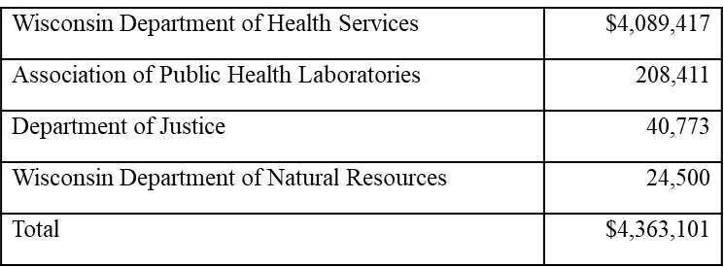
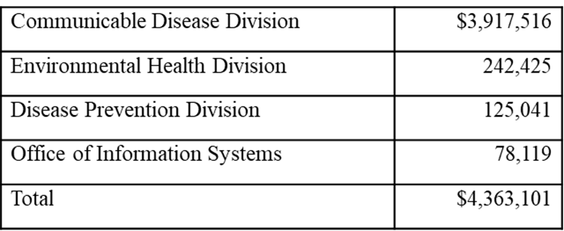
WSLH Contract Summary
By Division
By Customer

Slide 72
FY21 Budget Approval Kevin Karbowski Chief Financial Officer Wisconsin State Laboratory of Hygiene

Slide 73
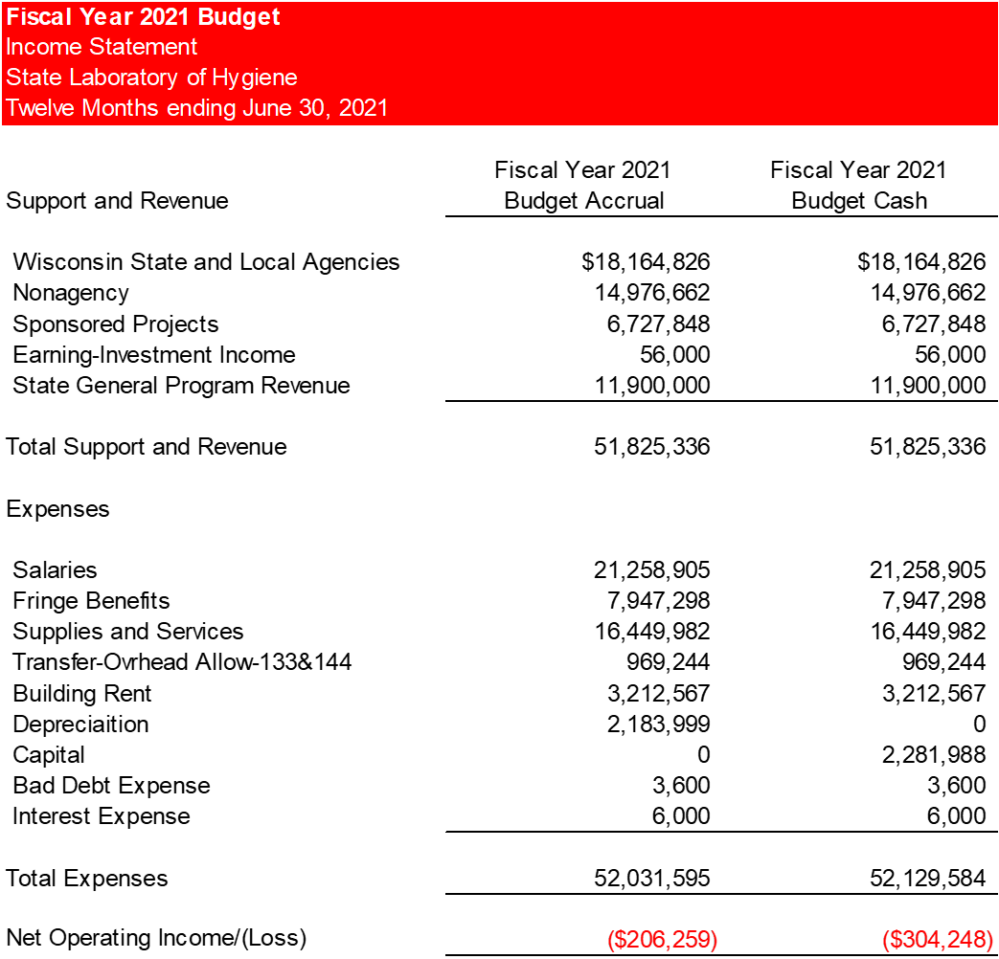

Slide 74
Strategic Plan Update Kevin Karbowski Chief Financial Officer Wisconsin State Laboratory of Hygiene

Slide 76
Human Resources Report Cynda DeMontigny HR Director Wisconsin State Laboratory of Hygiene

Slide 77
HR Report March 11, 2020– June 5, 2020
Division | Recruitments
Disease Prevention Division | 1
Environmental Health Division | 1
Laboratory Improvement Division | 0
Communicable Disease Division | 2
Administration | 2
Occupational Health Division | 0
TOTAL | 1

Slide 78
Staff turn-around December 10– March 10, 2020
Hires/Resignations/Retirements
 | DPD | EHD | LID | CDD | Admin | OHD
Hires | 1 | 4 | 0 | 0 | 0 | 0
Resignations | 2 | 3 | 0 | 1 | 1 | 0
Retirements | 0 | 0 | 0 | 0 | 1 | 0

Slide 79
Director’s Report Dr. James Schauer Director Wisconsin State Laboratory of Hygiene

Slide 80
WSLH Recent Events
UW SMPH Quarterly article
PFAS in human serum research
Blastomycosis journal article
NADP Spring Meeting
WI DHS, Wastewater Surveillance of SARS-CoV-2
UW/WARF COVID-19 Accelerator Challenge
CDC Cyanide Materials Project

Slide 81
Water Systems Boil Notice Report
Report to the
Wisconsin State Laboratory of Hygiene Board
Water Systems Tests by the WSLH
For the period March 1– May 31, 2020
There were no boil notices!

Slide 82
Soils Lab Dr. James Schauer Director Wisconsin State Laboratory of Hygiene

Slide 83
Open Board Seats Dr. James Schauer Director Wisconsin State Laboratory of Hygiene

