Slide 1
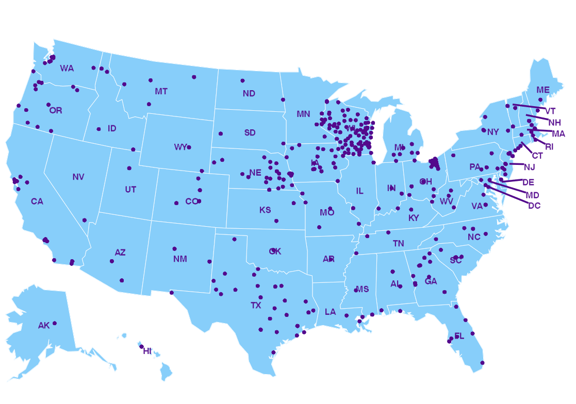

Year in Review: 2022-23
Erika Hanson
Wisconsin State Laboratory of hygiene
Virology Team Lead
The National Respiratory and Enteric Virus Surveillance System (NREVSS)
Notes:
To kick of this conference, I will be presenting a summary of the 2022-23 respiratory season. Mary Wedig usually does this presentation and retired from the state lab this spring after 34 years of hard work at the WSLH.
My name is Erika Hanson. I am the virology team lead and the virology surveillance coordinator at the Wisconsin State Laboratory of Hygiene (WSLH). I have worked at the Wisconsin State Laboratory of Hygiene in the Communicable Disease Division since 2014 and this is my second year hosting the Wisconsin Virology Conference.
The testing data from this presentation are compiled largely from the data that you all submit to us on a weekly basis. This data is summarized and submitted to the CDC and also sent to the Wisconsin department of health for incorporation into their weekly respiratory report. We at the State lab also send out a bi-weekly laboratory surveillance report which summarizes testing data from around the state.
So I want to say a big thank you to all of you for submitting your testing data and clinical specimens! Your participation makes our surveillance network one of the best in the country!

Slide 2
2022-23 Timeline of events
First Confirmed Mpox case in WI
2022
2023
Notes:
Last year as Covid was winding down from the Omicron peak in January of 2022, fears about mpox in the US were starting to increase.

Slide 3
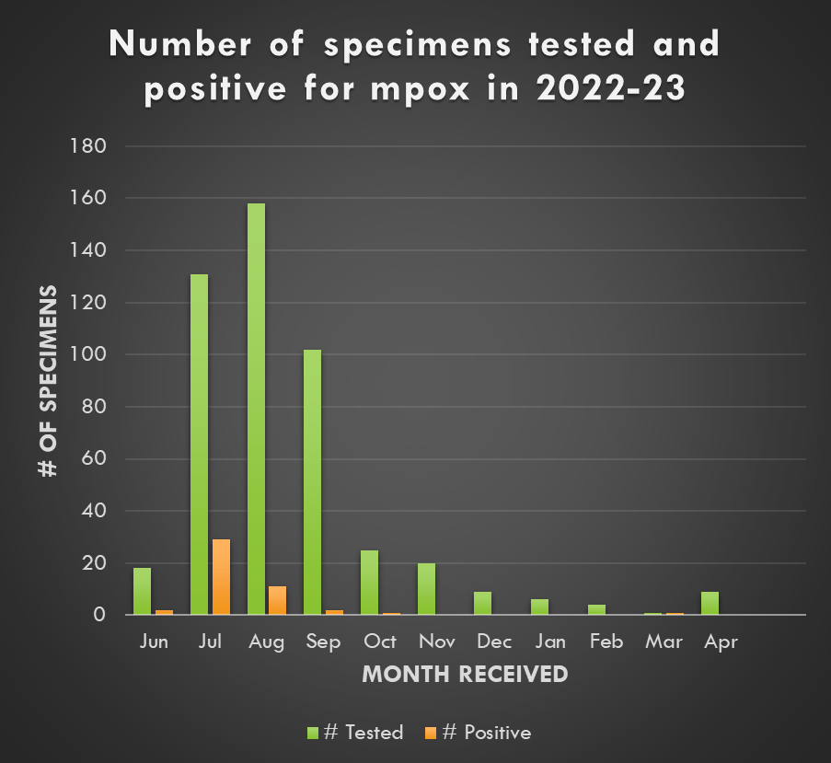
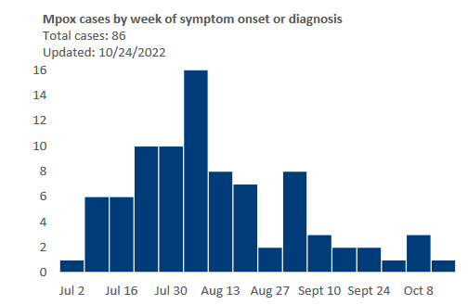
MPOX Outbreak
First case in US on 5/18/2022
First case in WI on 6/29/2022
Number of Specimens Positive for Mpox in Wisconsin – Statewide data, 2022
# of specimens positive for mpox
Week of symptom onset/diagnosis
Notes:
In May of 2022 the first confirmed case of mpox was detected in the US, and shortly after, the first case of mpox was detected in Wisconsin.
The number of positive cases in WI continued to rise through July and August, before starting to decline in the fall.
At the WSLH, we saw a spike in the number of specimens submitted for mpox testing through the summer, and then saw a fairly dramatic decrease in testing requests through the fall and winter.
This spring, we have been seeing an increase in testing requests again, and saw one additional positive case in March.

Slide 4
2022-23 Timeline of events
First Confirmed Mpox case in WI
H1N2 Swine variant
2022
2023
Notes:
While mpox was carrying on in August, there was also an H1N2 Swine variant that was detected in a Wisconsin patient.

Slide 5
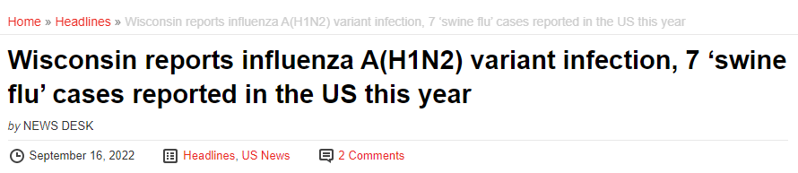
H1N2 Swine variant
Detected in late August, 2022
<18 years old
Located in south-central WI
All PCR results appeared normal – variant could only be detected with whole genome sequencing
Notes:
This case was in a child less than 18 years of age, located in south-central WI. With this specimen, all influenza PCR results appeared normal, it was only caught that it was a variant virus during whole genome sequencing.
This highlights the importance of submitting your out of season influenza positives to the WSLH for confirmation, subtyping and inclusion into the National influenza surveillance workflow.

Slide 6
2022-23 Timeline of events
First Confirmed Mpox case in WI
H1N2 Swine variant
Positive Mumps
Rhino/Entero peak
2022
2023
Notes:
Also in August, there was the only positive mumps by PCR for the year.
In September, positivity rates of rhino/enterovirus were increasing, and clinicians were seeing an increase in hospitalizations of pediatric patients with severe respiratory illness and positive rhinovirus/enterovirus tests.

Slide 7
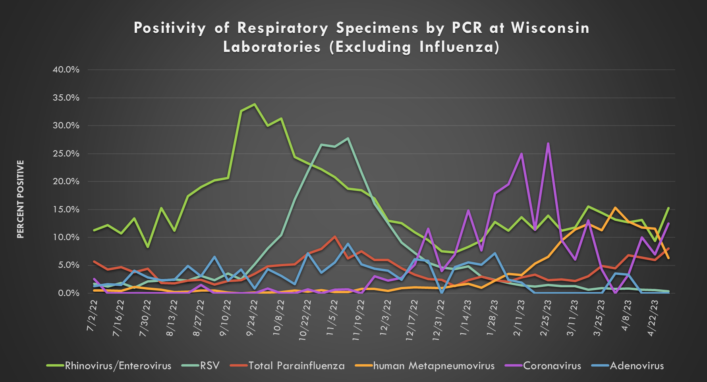
Notes:
Rhino/Enterovirus positivity peaked in late September at 34% and occurred around the same time as peaks in the pre-covid seasons

Slide 8
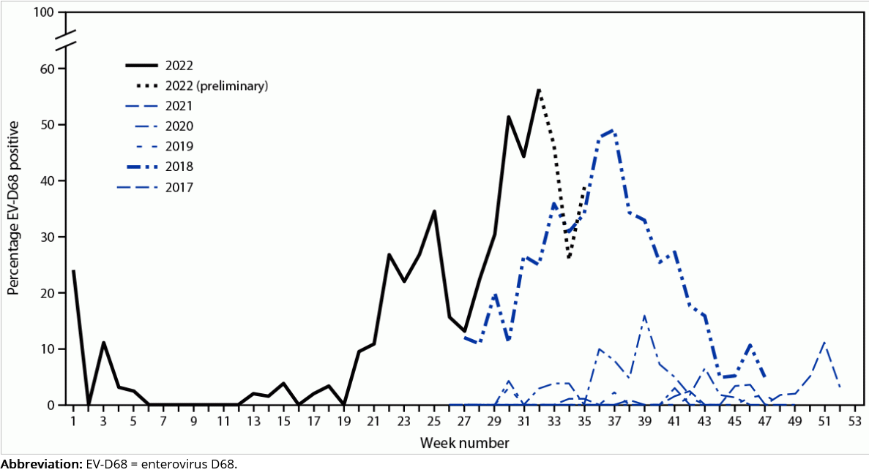
Enterovirus D68
Randomized study of 5,633 children with ARI seeking emergency care
Children positive for Rhino/Enterovirus were also tested with an EV-D68 specific RT-PCR.
  EV-D68 positivity peaked at 56% in August 2022
Positivity of Specimens for EV-D68 Among Children with ARI and Positive Rhino/Enterovirus Test Results Who Received Care in the Emergency Department
https://www.cdc.gov/mmwr/volumes/71/wr/mm7140e1.htm?s_cid=mm7140e1_x
Notes:
In an MMWR released in October of 2022, national data indicated that among children with a positive rhino/enterovirus test who received care in an Emergency room, the positivity rate of EV-D68 testing was also increasing, and peaked at 56% in Mid-August
Previous increases in EV-D68 respiratory illness have also coincided with increases in cases of Acute Flacid Myelitis.

Slide 9
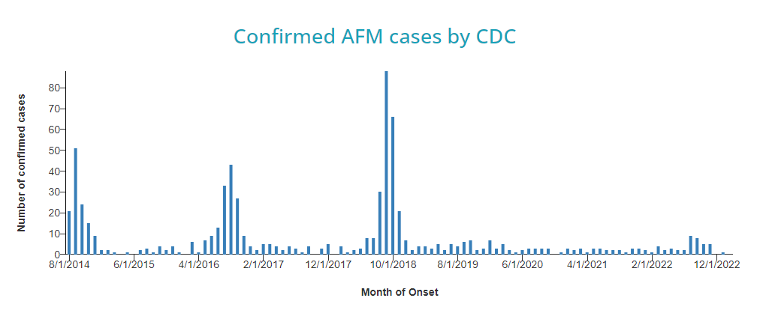
Acute Flaccid Myelitis (AFM)
https://www.cdc.gov/acute-flaccid-myelitis/cases-in-us.html
Notes:
It was feared that there would also be an increase in AFM cases in summer/fall of 2022, but thankfully the spike did not materialize and only 1 case of AFM was reported in Wisconsin in 2022.

Slide 10
2022-23 Timeline of events
First Confirmed Mpox case in WI
H1N2 Swine variant
Positive Mumps
Rhino/Entero peak
2022
2023
Avian Flu Suspects – 7 in Total
Notes:
In late fall of 2022, WSLH saw an increase in requests for testing of Avian influenza suspects.

Slide 11

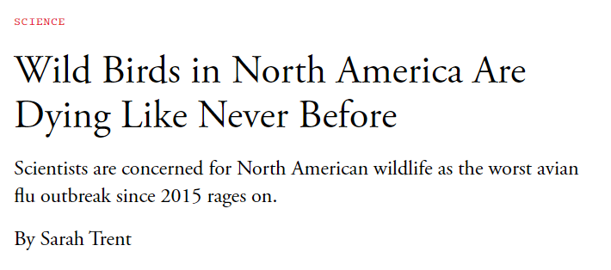
Avian Influenza Suspects
Total of 7 tested in fall of 2022 (October-December)
All specimens were negative for Influenza
  3 positive for Rhinovirus/Enterovirus
  1 positive for SARS-CoV-2
  1 Positive for seasonal coronavirus HKU1
Notes:
A total of 7 avian influenza suspects were tested from October to November of 2022. All specimens were negative for influenza. 3 were positive for RV/EV, 1 was positive for SARS-CoV-2, and one was positive for seasonal coronavirus HKU1.

Slide 12
2022-23 Timeline of events
First Confirmed Mpox case in WI
H1N2 Swine variant
Positive Mumps
Rhino/Entero peak
RSV Peak
2022
2023
Avian Flu Suspects – 7 in Total
Notes:
RSV peaked in mid November, which was earlier timepoint normal – usually the peak falls in Jan or Feb

Slide 13
Notes:
RSV peaked at 28% positivity.
Around the same time, Parainfluenza peaked at 10% positivity.

Slide 14
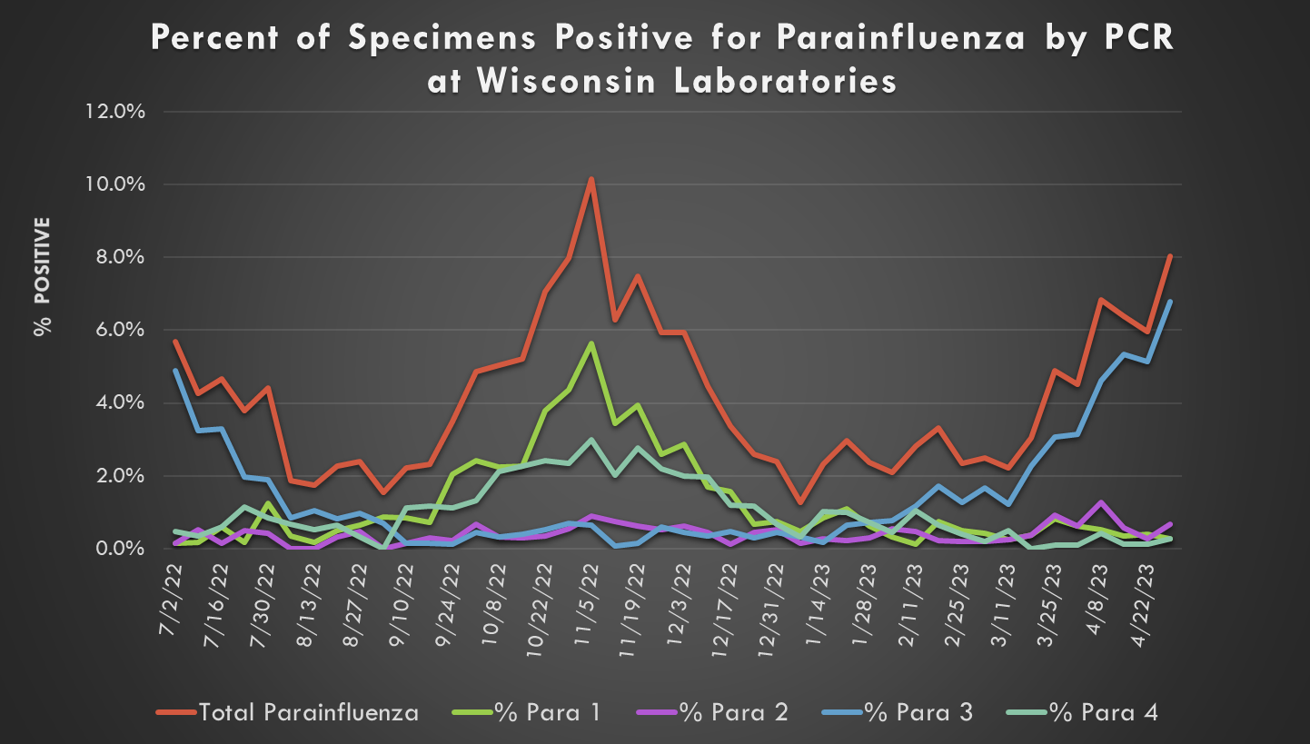
Parainfluenza Virus by Type
Notes:
For the preakdown of parainfluenza virus by type, most detections were Parainfluenza types 1 and 4. There was also a peak of Parainfluenza type 3 seen in April and May of 2023.

Slide 15
2022-23 Timeline of events
First Confirmed Mpox case in WI
H1N2 Swine variant
Positive Mumps
Rhino/Entero peak
Influenza Peak
RSV Peak
2022
2023
Avian Flu Suspects – 7 in Total
Notes:
Influenza A peaked in mid December, at around 31% positivity.

Slide 16
Influenza virus positivity by Subtype
Notes:
The 2022-23 Season was predominantly Influenza A H3, with 71% H3N2 detected overall and 29% H1N1pdm09 detected overall. The influenza A season peaked in mid December, which was earlier than in pre-pandemic years, where we had been seeing the peak in January to March.
Influenza B specimens were pretty scarce throughout the entire 2022-23 season. Influenza B had a small peak in early April at about 0.5% positivity.

Slide 17


Influenza Strain Characterization Wisconsin 2022-23
 | Antigenic Characterization | HA Genetic Group
H1N1pdm09 | A/Wisconsin/588/2019 (H1N1)pdm09-like | 6B.1A | 100%
H3N2 | A/Darwin/6/2021 (H3N2)-like | 3C.2A1b | 100%
B-Victoria | B/AUSTRIA/1359417/2021-LIKE | VIA.3 | 100%
B-Yamagata | No confirmed cases in the 2022-23 season
In 2022-23 Egg-based influenza vaccine
In 2022-23 Recombinant influenza vaccine
Very few influenza B specimens in 2022-23 season
Notes:
In the 2022-23 season, only one strain was circulating from each of the influenza A subtypes H3 and H1pdm09. Both of these strains were included in the recombinant vaccine, but not in the egg-based vaccine.
I like to point out that the H1pdm09 component of the vaccine is a strain that originated in Wisconsin in 2019!
Only one strain of B Victoria was circulating, and it was included in both the recombinant and egg-based influenza vaccines. Influenza B Yamagata was not detected in the US in the 2022-23 Season and there are predictions that it may have been eliminated altogether.

Slide 18
Flu Vaccine selection 2023-24
Egg-based vaccines
  A/Victoria/4897/2022 (H1N1)pdm09-like virus*
  A/Darwin/9/2021 (H3N2)-like virus
  B/Austria/1359417/2021 (B/Victoria lineage)-like virus
  B/Phuket/3073/2013 (B/Yamagata lineage)-like virus *Q
Cell culture- or recombinant-based vaccines
  A/Wisconsin/67/2022 (H1N1)pdm09-like virus*
  A/Darwin/6/2021 (H3N2)-like virus
  B/Austria/1359417/2021 (B/Victoria lineage)-like virus
  B/Phuket/3073/2013 (B/Yamagata lineage)-like virus *Q
  *Updated Vaccine strains for 2023-24 season
  *Q - Present in Quadrivalent vaccine only
Notes:
Overall the influenza vaccine recommendations for the 2023-24 Season are largely the same, only the H1pdm09 components were updated. Wisconsin has a 2022 strain incorporated in next years vaccine.
This strain was isolated from a sample that was submitted to us for respiratory virus surveillance from Beloit.
This again goes to show you how important surveillance specimans are – both state-wide and nation-wide surveillance programs depend on them!

Slide 19
2022-23 Timeline of events
Increase in Non-mumps Parotitis
First Confirmed Mpox case in WI
H1N2 Swine variant
Positive Mumps
Rhino/Entero peak
Influenza Peak
RSV Peak
2022
2023
Avian Flu Suspects – 7 in Total
Notes:
Around the same time that influenza was peaking, we saw an increase in specimens being submitted for mumps testing, from patients presenting with parotitis.

Slide 20
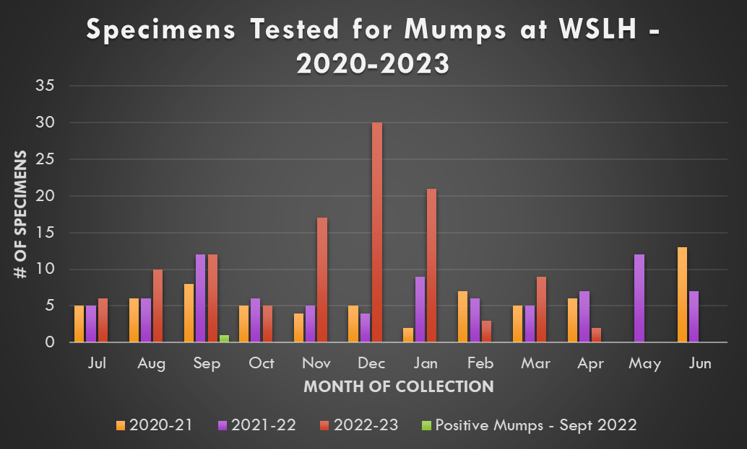
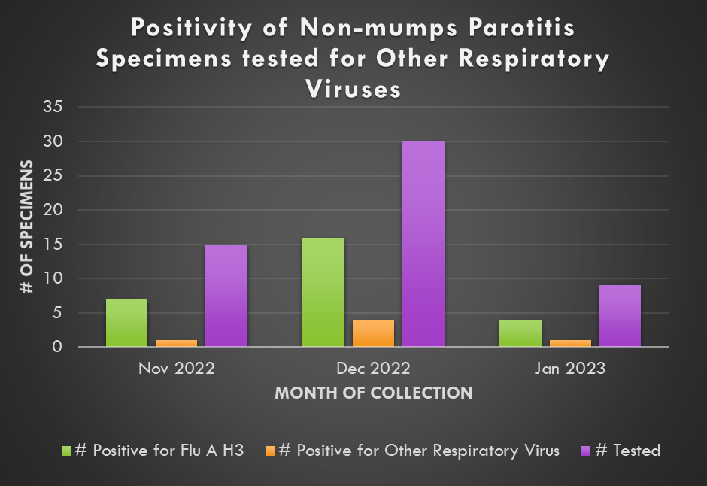
Non-mumps parotitis
Notes:
The chart on the left shows the number of specimens submitted to WSLH for mumps testing from July 2020 to April of 2023. Over that three-year time period, only one specimen was positive for mumps, in September of 2022.
As compared with previous years, there was a definite increase in mumps testing this past winter.
To further investigate what was causing the increase in non-mumps parotitis, respiratory panel testing was performed on the negative mumps specimens collected from November 2022-January of 2023.
Overall, 50% of specimens were positive for influenza A H3, 11% were positive for a variety of other respiratory viruses, and 39% were negative for all pathogens tested.

Slide 21
2022-23 Timeline of events
First Confirmed Mpox case in WI
H1N2 Swine variant
Positive Mumps
Seasonal CoV Peak
Rhino/Entero peak
Influenza Peak
RSV Peak
2022
2023
Avian Flu Suspects – 7 in Total
Notes:
As winter was winding down, Seasonal Coronaviruses peaked in late February

Slide 22
Notes:
Seasonal Coronaviruses peaked at 27%. Human metapneumovirus peaked shortly after in early April at 15% positivity. The timing of both of these peaks was pretty normal as compared with pre-pandemic years.

Slide 23
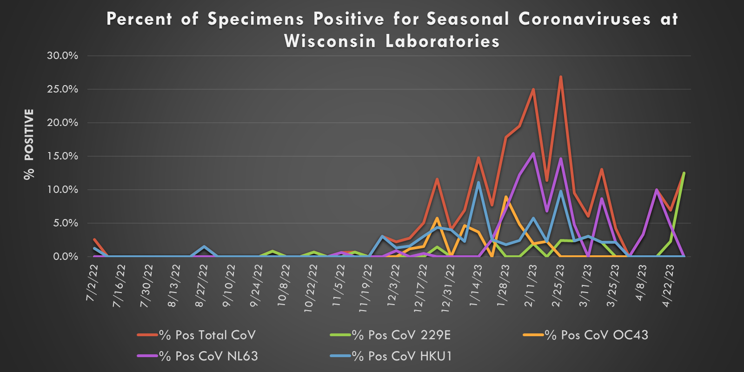
Seasonal Coronavirus virus positivity by type
Notes:
The predominate strains of seasonal coronaviruses circulating were HKU1 and NL63. Later in the spring, 229E became the predominant strain circulating.

Slide 24
2022-23 Timeline of events
First Confirmed Mpox case in WI
H1N2 Swine variant
Positive Mumps
Seasonal CoV Peak
Rhino/Entero peak
Influenza Peak
Norovirus Peak
RSV Peak
2022
2023
Avian Flu Suspects – 7 in Total
Notes:
Moving into spring, positivity rates of some gastrointestinal pathogens were increasing.

Slide 25
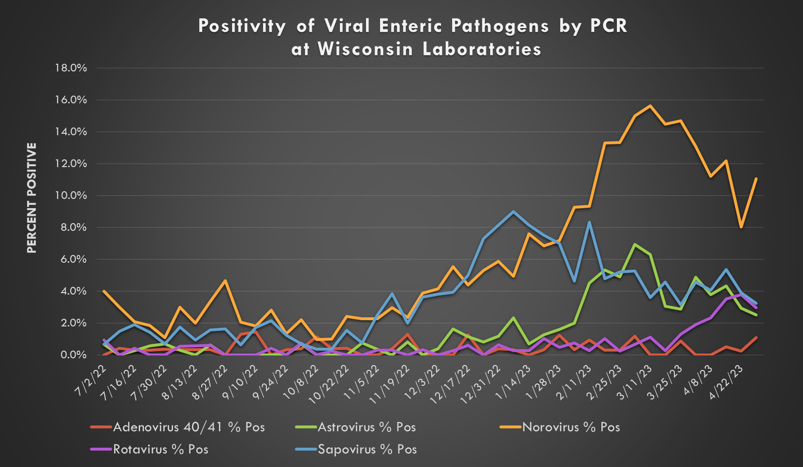
Notes:
Norovirus peaked at 16% in mid- March of 2023. Astrovirus, Sapovirus and Rotavirus also had small peaks through the winter and spring of 2023.

Slide 26
Thank you for your Data and Specimen Submissions!
The National Respiratory and Enteric Virus Surveillance System (NREVSS)
For more information about Virology Surveillance in Wisconsin including:
Laboratory-based surveillance plan
Link to report testing data
Specimen submission instructions
Surveillance graphs for a variety of pathogens
VISIT
www.slh.wisc.edu/wcln-surveillance/surveillance
https://www.cdc.gov/surveillance/nrevss/labs/map-H.pdf
Notes:
With that, I would like to thank you all for your data and specimen submissions! We couldn’t do it without you!
Visit our website for more information about virology surveillance including
The Laboratory-based surveillance plan
The Link to report testing data
Specimen submission instructions
WI Surveillance data
Thank you all for listening. I would be happy to take any questions.

Slide 27
Strains included in the 2022-23 influenza vaccine:
Strains included in the 2022-23 influenza vaccine:
Egg-based Vaccines
  Victoria/2570/2019 (H1N1)pdm09-like virus;
  A/Darwin/9/2021 (H3N2)-like virus;
  B/Austria/1359417/2021 (B/Victoria lineage)-like virus
  B/Phuket/3073/2013 (B/Yamagata lineage)-like virus*
Cell culture or recombinant Vaccines
  A/Wisconsin/588/2019 (H1N1)pdm09-like virus
  A/Darwin/6/2021 (H3N2)-like virus
  B/Austria/1359417/2021 (Victoria lineage)-like virus
  B/Phuket/3073/2013 (Yamagata lineage)-like virus*

Slide 28
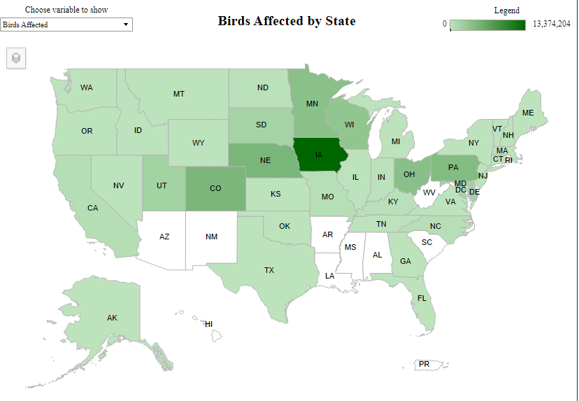
Avian Influenza – 2021-23
New H5N1 strain of avian influenza affecting entire world
Began in the U.S. in December 2021
In Wisconsin:
  11 affected commercial flocks
  18 affected backyard flocks
  >3 million total poultry affected
  Orders of magnitude larger in wild
  bird populations
Commercial and Backyard Flocks
https://www.aphis.usda.gov/aphis/ourfocus/animalhealth/animal-disease-information/avian/avian-influenza/hpai-2022/2022-hpai-commercial-backyard-flocks

