Slide 1
RSV Update: June 2023
Maria Sundaram, MSPH, PhD
WSLH Virology Conference
June 8, 2023

Slide 2
RSV virology and clinical manifestations

Slide 3
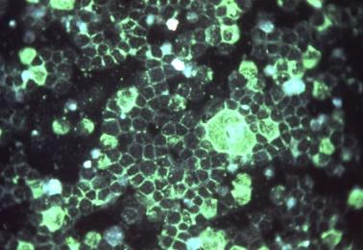
RSV
https://www.niaid.nih.gov/diseases-conditions/respiratory-syncytial-virus-rsv; https://www.nature.com/articles/s41579-019-0149-x
Notes:
RSV is a filamentous enveloped, negative-sense, single-stranded RNA virus.
It belongs to the Orthopneumovirus genus in the Pneumoviridae family. This family also contains human metapneumovirus; the symptoms caused by human metapneumovirus and RSV are very difficult to distinguish and both are generally transmitted through close contact.

Slide 4
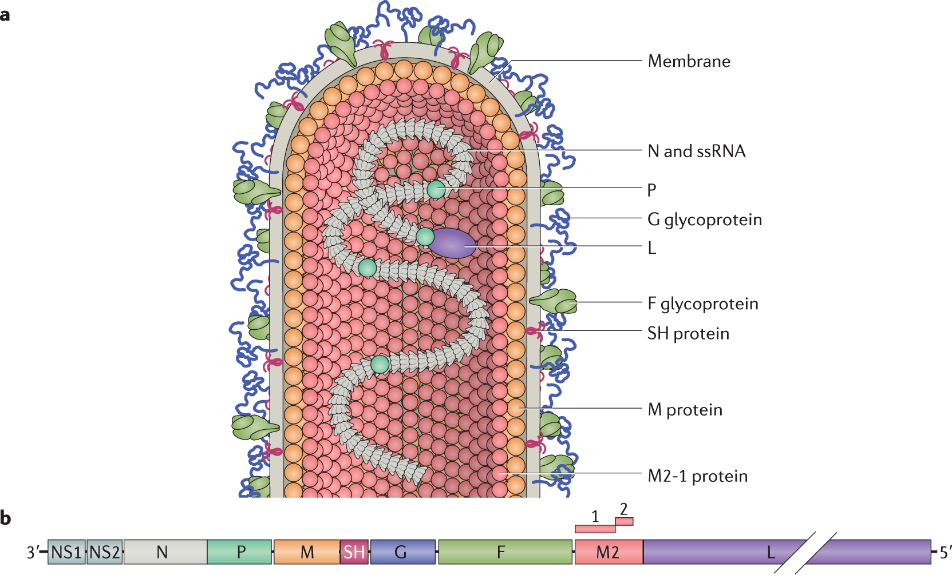
https://www.nature.com/articles/s41579-019-0149-x/figures/1
Notes:
RSV has two key transmembrane proteins which are relevant for prevention and therapeutics. These are the G glycoprotein, and the F glycoprotein. The G protein facilitates cell attachment, while the F facilitates fusion with the cell.
The G protein is the most variable structural protein, and its variability dictates the RSV antigenic groups (RSV A and RSV B).

Slide 5
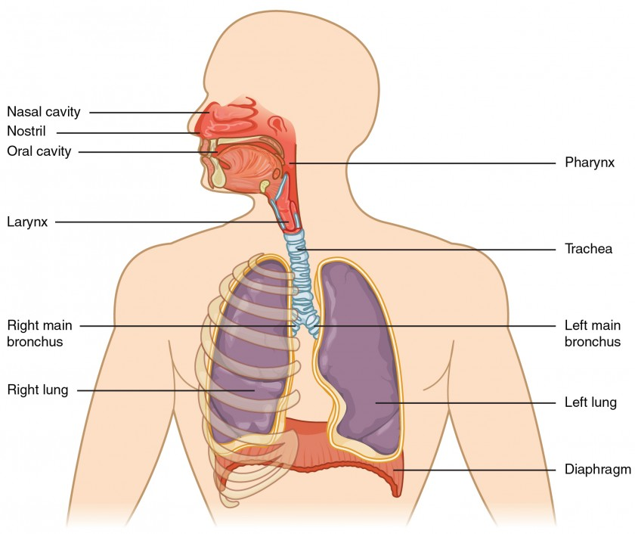
RSV illness
https://www.niaid.nih.gov/diseases-conditions/respiratory-syncytial-virus-rsv
Notes:
RSV first replicates in the epithelial lining of the nasopharynx and upper respiratory tract
Then it may spread to bronchioles or alveoli, leading to mucus production and inflammation
This may also involve tightening of the airways, resulting in bronchiolitis (particularly in younger children) and acute respiratory illness (particularly in older adults/adults with chronic conditions)

Slide 6
RSV illness
Symptoms (runny nose, cough, sneezing, fever, wheezing) usually begin 4-6 days after exposure, and develop slowly over a period of several days
Contagious period usually less than 10 days (beginning 1-2 days before symptom onset)
Some symptoms (particularly cough) may last for longer, up to several weeks
(Potential) prolonged symptomatic period
Exposure to RSV
Contagious period*
Acute symptomatic period
Day 0
Day 2-3
Day 4-6
Day 10
Day 14
(up to weeks)
https://www.health.ny.gov/diseases/communicable/respiratory_syncytial_virus/,
https://www.cdc.gov/rsv/about/transmission.html
Notes:
*The contagious period may be longer for certain individuals, including folks who are immunocompromised.

Slide 7
RSV epidemiology

Slide 8
RSV epidemiology (pre-COVID)
About 70% of children have RSV by the time they are 1, and nearly all individuals have had an RSV infection by the age of 2 years; RSV is the most common cause of lower respiratory tract infections in children
In the US, RSV causes ~58,000 hospitalizations and 100-300 deaths among children <5 years each year
For infants, RSV may pose a similar or greater risk of severe disease compared to influenza; risk of severe disease in children seems to peak at approximately 2 months of age
https://www.cdc.gov/rsv/about/transmission.html, https://pubmed.ncbi.nlm.nih.gov/3706232/
Notes:
Nearly all – this means about 97%. However, protection following infection is incomplete and individuals can be infected again
RSV severity has more or less a linear relationship with age in children, and (in the reverse direction) with age in older adults
Highest-risk individuals:
Premature and very young infants (2 months of age)
Children with congenital heart or chronic lung disease
Children or adults who are immunocompromised
Children with neuromuscular disorders
Older adults, especially those with COPD or heart failure
Other high-risk adults?

Slide 9
https://jamanetwork.com/journals/jamanetworkopen/fullarticle/2789446
Notes:
This is the estimated excess mortality rate for respiratory and circulatory conditions, we’ve got influenza in black and gray here and RSV in the gold. And you can see for children under 1 year, RSV is actually higher than influenza for all the seasons listed. As we move into the 1-4-year age group, it’s evening out a bit, and then for adults 65 years and up, it’s a bit of a grab bag. I also want you to keep your eye on the x-axis here—it’s really very variable depending on the age group!

Slide 10
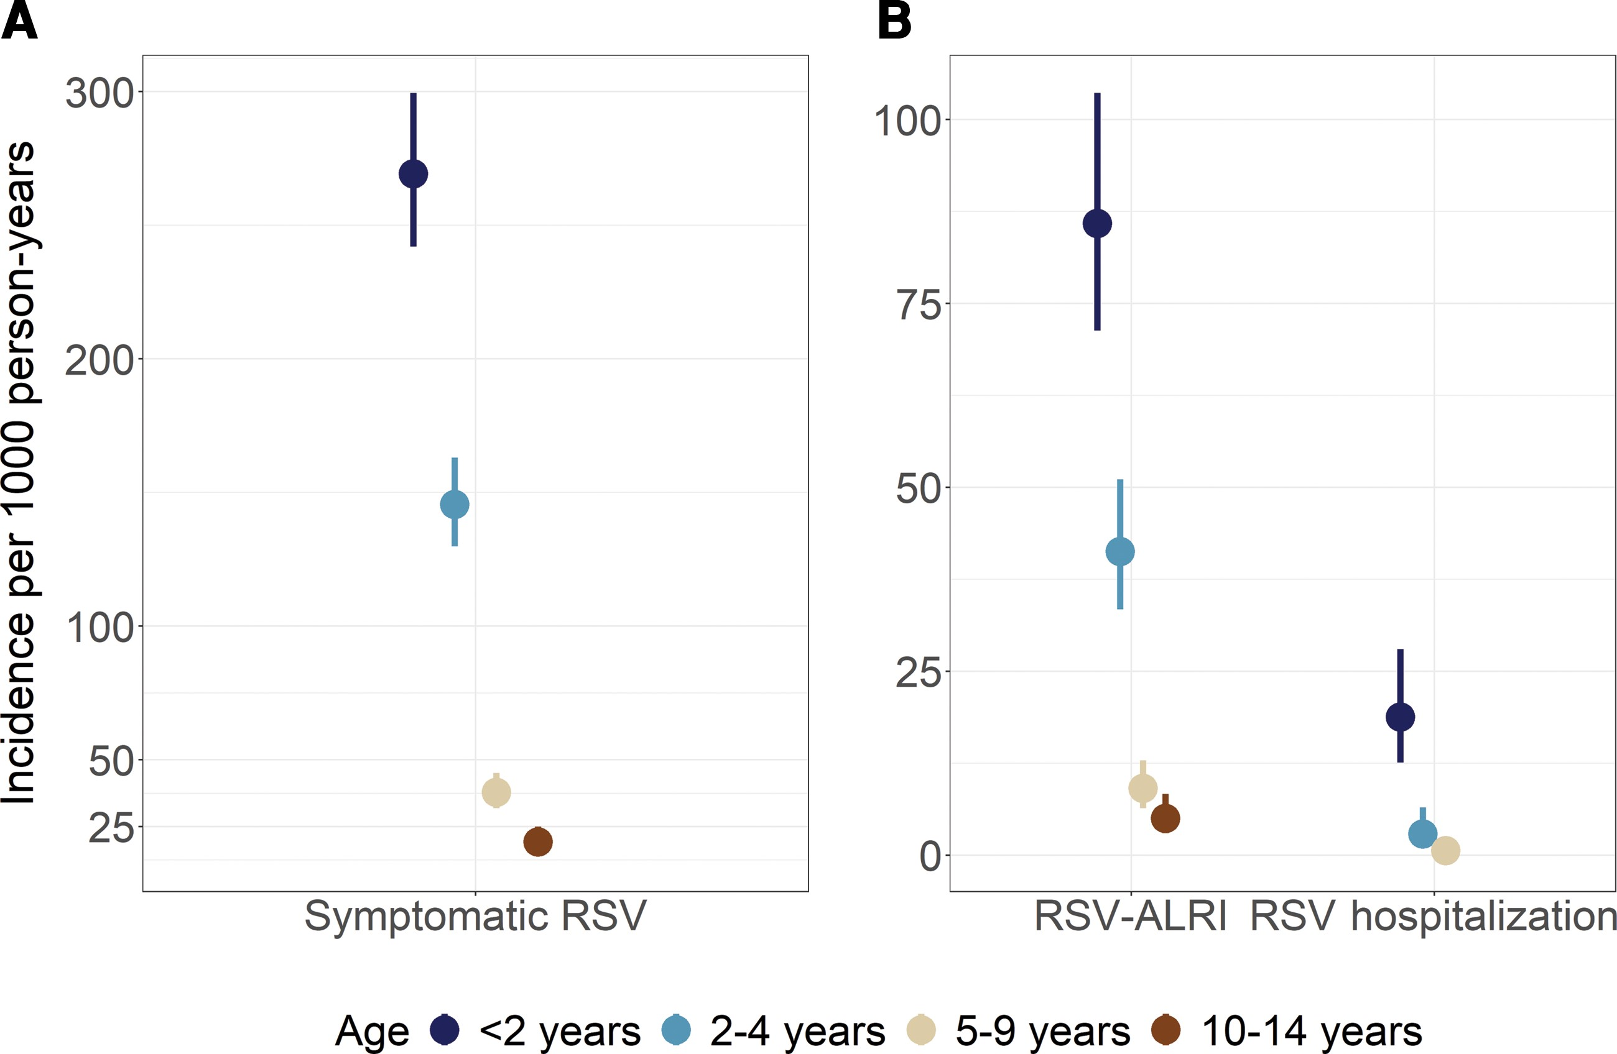
https://academic.oup.com/ofid/article/9/11/ofac598/6809070
Notes:
As you can see, incidence of symptomatic infection and incidence of ALRI and hospitalization is highest in children under 2 years (this is from a cohort study in children in the Netherlands).

Slide 11
RSV A vs. RSV B
RSV A may cause more severe disease than RSV B in infants hospitalized for RSV ARI
In a given winter respiratory virus season, usually one (either RSV A or RSV B) is a ‘dominant’ strain
RSV has high genetic variability, and there are frequently emerging RSV A/B genotypes
Emergent RSV genotypes can occur that are detected globally (Buenos Aires 1999; Ontario 2010)
https://pubmed.ncbi.nlm.nih.gov/35062975/, https://pubmed.ncbi.nlm.nih.gov/15338801/, https://pubmed.ncbi.nlm.nih.gov/36225856/,
https://www.ncbi.nlm.nih.gov/pmc/articles/PMC4588507/pdf/srep14268.pdf

Slide 12
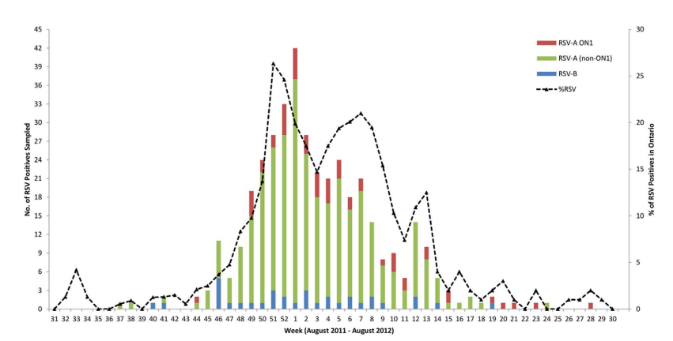
RSV emerging genotypes
https://www.ncbi.nlm.nih.gov/pmc/articles/PMC4588507/pdf/srep14268.pdf
Notes:
From the linked paper: RSV-A and RSV-B viruses subdivide into 12 genotypes [GA1-GA7, SAA1, NA1–2 and ON1–2] and 20 genotypes [GB1–4, BA1–10, SAB1–4, and URU1–2], respectively, based on the genetic variability of the G-protein gene. The RSV-A ON1 genotype was first detected in November, 2010 in Ontario, Canada.

Slide 13
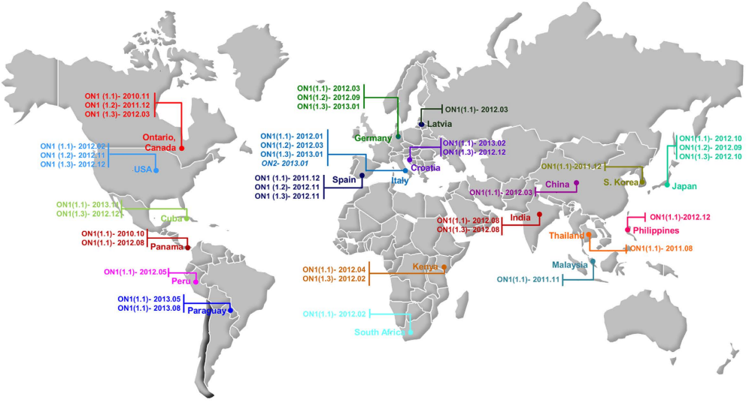
RSV emerging genotypes
https://www.ncbi.nlm.nih.gov/pmc/articles/PMC4588507/pdf/srep14268.pdf
Notes:
From the linked paper: RSV-A and RSV-B viruses subdivide into 12 genotypes [GA1-GA7, SAA1, NA1–2 and ON1–2] and 20 genotypes [GB1–4, BA1–10, SAB1–4, and URU1–2], respectively, based on the genetic variability of the G-protein gene. The RSV-A ON1 genotype was first detected in November, 2010 in Ontario, Canada, and subsequently a retrospective study (2008–2012) from Panama found RSV-A ON1 in a sample collected in October, 2010. The RSV-A ON1 signature is a tandem repeat of 72 nucleotides (corresponding to 24 amino acid residues) in the C-terminal region of the G-protein. Interestingly, BA genotype strains (first detected in 1999) of RSV-B from Buenos Aires, Argentina exhibited a 60 nucleotide duplication in the second variable region of the G protein gene, and became established globally with different lineages (BA1 to BA10)

Slide 14
Potential long-term impacts of RSV infection: Asthma
Infants with RSV bronchiolitis often have recurrent wheezing and may be more likely go on to develop asthma
Does early RSV bronchiolitis cause asthma?
Or is RSV opportunistically infecting vulnerable infants who would have gone on to have asthma anyway, with or without RSV infection?
Is the asthma related to bronchiolitis of all etiologies, or is it secondary to RSV bronchiolitis in particular?
The majority bronchiolitis in this age group is caused by RSV; this could change with advent of vaccines
https://www.ncbi.nlm.nih.gov/pmc/articles/PMC3215509/
Notes:
Tennessee Asthma Bronchiolitis Study (TABS): Retrospective birth cohort of 100,000 infants
Infants who were 4 months old at the winter viral peak more likely to develop clinical bronchiolitis and childhood asthma
Over the viral seasons studied, the winter viral peak shifted nearly 2 months, but the age-related risk remained the same relative to the viral peak
This suggests that asthma as an outcome is related to a viral infection and not necessarily just an outcome in children who would have developed it anyway
Several other observational studies suggest an increased risk of asthma associated with RSV bronchiolitis, persisting through early childhood but not consistently through adolescence/adulthood

Slide 15
Would delaying RSV infection prevent long-term asthma outcomes?
RSV immunoprophylaxis reduces RSV-related morbidity in high-risk infants
It is likely that RSV immunization of pregnant people and regular (seasonal) immunoprophylaxis of infants would change the average age at first infection with RSV
It remains to be seen whether this will have an impact on longer-term asthma outcomes for children
https://www.ncbi.nlm.nih.gov/pmc/articles/PMC3215509/

Slide 16
RSV during COVID-19

Slide 17
Seasonal RSV transmission and disruption
https://www.thelancet.com/journals/laninf/article/PIIS1473-3099%2822%2900525-4/fulltext

Slide 18
Seasonal RSV transmission and disruption

Slide 19
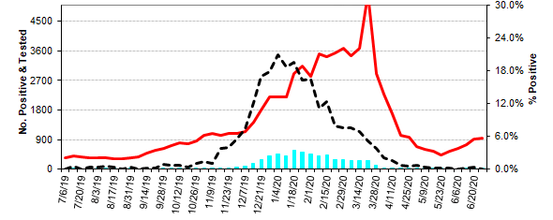
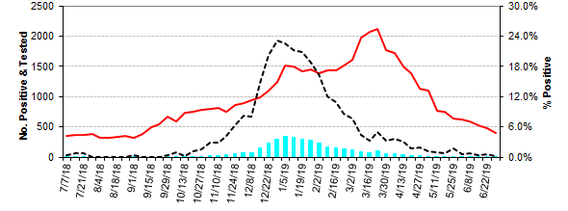
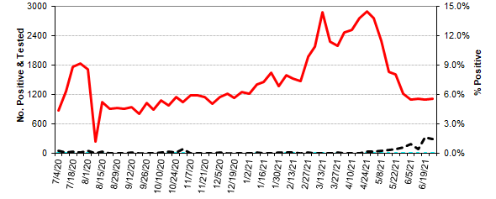
Seasonal RSV transmission and disruption
2018-19
2019-20
2020-21
2021-22
https://www.slh.wisc.edu/wcln-surveillance/surveillance/virology-surveillance/current-rsv-activity/
Notes:
Take a look at the x-axis from 2020-21 to 2021-22. And now take a look at the percent positive! It’s still higher at the peak than the peak of 2019-20.

Slide 20
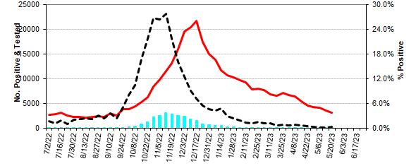
RSV in Wisconsin, 2022-23
https://www.slh.wisc.edu/wcln-surveillance/surveillance/virology-surveillance/current-rsv-activity/
Notes:
This year, we are seeing a little bit of a return to RSV’s seasonality, perhaps a little earlier than in 2018-19 and 19-20. Same delay in number tested for RSV, and still a very high number of individuals tested.

Slide 21
RSV vaccines and therapeutics

Slide 22
https://www.nature.com/articles/s41579-019-0149-x/figures/1
Notes:
RSV has two key transmembrane proteins which are relevant for prevention and therapeutics. These are the G glycoprotein, and the F glycoprotein. The G protein facilitates cell attachment, while the F facilitates fusion with the cell.
The G protein is the most variable structural protein, and its variability dictates the RSV antigenic groups (RSV A and RSV B).

Slide 23
https://www.nature.com/articles/s41579-019-0149-x/figures/4
Notes:
This is a closeup of the F protein as the virus attaches to the cell. You can see here that it has a prefusion (football) and postfusion (ice cream cone) state

Slide 24
https://biologicmodels.com/wp-content/uploads/2018/03/fusionF_banner_2.jpg
Notes:
If you prefer a neon candy-colored space-filling model, here you go.

Slide 25
RSV vaccine development history
1967: A formalin-inactivated vaccine against RSV was developed and rolled out
Infants who received this vaccine developed robust antibodies against the F glycoprotein
However, immunized infants subsequently experienced a greater risk of severe disease compared to their un-immunized counterparts, including 2 deaths (vaccine-associated enhanced respiratory disease)
The anti-F antibody developed after vaccination had low neutralizing capacity
It appears that the process of formalin inactivation altered the F and G glycoprotein epitopes that would otherwise have resulted in the creation of neutralizing antibodies
There has not been another approved RSV vaccine for infants since
https://pubmed.ncbi.nlm.nih.gov/4305198/,
https://www.ncbi.nlm.nih.gov/pmc/articles/PMC266671/pdf/jcm00080-0171.pdf

Slide 26
RSV vaccine development priorities
It is thought that newborn infants receive some protection against RSV through maternally-derived antibody that is transferred across the placenta in late pregnancy
In a prospective cohort study on Malian mothers and infants, RSV antibody was transferred efficiently, and infant titers were 3x higher against RSV A compared to RSV B
Infants who went on to contract RSV within the first 6 months of life had significantly lower RSV A and RSV B antibody titers at birth
There is substantial interest in developing a maternal vaccine for RSV for the purpose of infant protection, especially since this might mitigate some concerns about vaccine safety for infants
https://www.cdc.gov/rsv/about/transmission.html, https://pubmed.ncbi.nlm.nih.gov/3706232/

Slide 27
FDA approved May 3, 2023
Nirsevimab recently approved in Canada and EU
FDA BLA application accepted January 2023
https://media.path.org/documents/RSV-Snapshot_04MAY2023_clinical-stage.pdf
Notes:
You’ll also notice here that the majority of pediatric vaccines (not immunoprophylaxis, but vaccines themselves) are listed up here in the live-attenuated or chimeric category. This class of vaccines is thought to be safer for infants because it avoids the danger of vaccine-mediated enhancement of disease, by ensuring that immune systems are seeing the “real deal” of the F glycoprotein and developing neutralizing antibodies accordingly. mRNA vaccines and viral vector vaccines would have similar benefits on the vaccine safety side.
**Note: This slide should be updated as soon as PATH updates their snapshot!

Slide 28
RSV F protein vaccines for older adults
GSK has an adjuvanted, monovalent (RSV A) recombinant protein subunit vaccine (“Arexvy”), approved 5/3 for use in adults 60 years of age and older
Pfizer has a bivalent (RSV A + RSV B) recombinant protein subunit RSV vaccine (“Abrysvo”) approved 5/31 for use in adults 60 years of age and older
Both vaccines protect against the prefusion form of the F protein
At present, these vaccines are meant to be given as a single dose; it remains to be seen whether seasonal vaccines will be given or whether periodic updates will be needed
https://www.fda.gov/news-events/press-announcements/fda-approves-first-respiratory-syncytial-virus-rsv-vaccine, https://www.fda.gov/vaccines-blood-biologics/arexvy, https://www.fda.gov/media/165622/download

Slide 29
RSV therapeutics for infants
Palivizumab is already licensed and in use for preventing severe RSV infections in high-risk infants
Nirsevimab’s BLA was accepted by the FDA in January 2023 and has already been approved by Health Canada and the EMA as Beyfortus
It is a “passive immunization” in the form of a monoclonal antibody
Nirsevimab is an antibody to the prefusion conformation of the F protein, with a modified Fc region to extend its half-life
It has robust neutralizing capability
In contrast to palivizumab, nirsevimab is meant to be administered to all infants (not just high-risk infants) to offer protection during an infant’s first RSV season
ACIP additionally considering whether nirsevimab should be offered for high-risk infants’ second RSV seasons
https://www.cdc.gov/rsv/about/transmission.html, https://pubmed.ncbi.nlm.nih.gov/3706232/

Slide 30
RSV maternal vaccines in development
Pfizer has a bivalent (RSV A + RSV B) maternal recombinant protein subunit RSV vaccine currently in phase III trials; the BLA was submitted February 2023 for action by FDA in August 2023
This vaccine also is geared to provide immunological protection against the prefusion form of the F protein
Two co-primary endpoints:
Medically-attended severe lower respiratory tract infection in infants from birth through the first 90 days of life (interim efficacy: 82%; 99.5% CI: 40 – 96%)
Medically-attended lower respiratory tract infection in infants from birth through the first 90 days of life (interim efficacy: 57%; 99.5% CI: 15 – 80%)
In an interim analysis, endpoint for MA-LRTI was met, but MA-severe LRTI was not met
No safety signals detected in maternal participants or infants/toddlers up to 24 months of age
https://media.path.org/documents/RSV-Snapshot_04MAY2023_clinical-stage.pdf

Slide 31
Past and upcoming VRBPAC discussions
FDA has signaled they would likely classify nirsevimab as a “drug” (not a vaccine). This would mean:
Any adverse events would be reported to FDA rather than VAERS
Unknown whether nirsevimab would be included in Vaccines For Children program
Unknown whether nirsevimab would be included in state immunization information systems (and potentially different by state)
Certain types of HCW may be able to administer vaccines but not monoclonal antibodies, depending on jurisdiction
FDA has already issued approvals for the 2 RSV vaccines targeting older adults
Nirsevimab and maternal RSV vaccine to be discussed in future VRBPAC meetings
https://www.youtube.com/watch?v=H3KYJ9iF7XA&list=PLvrp9iOILTQb6D9e1YZWpbUvzfptNMKx2
Notes:
If nirsevimab not included in VFC, then state Medicaid, Medicaid expansion (children’s health insurance programs), and private insurance would likely cover nirsevimab. But the underinsured and uninsured would have reduced access to nirsevimab.
VRBPAC is meeting in mid-June to discuss COVID-19 vaccine strain selection, but may try to shoehorn in a discussion on maternal RSV vaccine if information is ready at that time. If not, it may be later this year

Slide 32
Past and upcoming ACIP discussions
Findings from the Maternal/Pediatric RSV ACIP workgroup were discussed in the February 23 ACIP meeting
Nirsevimab questions:
Should one dose of nirsevimab be recommended a) at birth for all infants born during October to March, and b) when entering first RSV season and <8 months of age for all infants born during April through September?
Should one dose of nirsevimab be recommended for children <20 months of age with increased risk of severe disease entering their second RSV season?
https://www.youtube.com/watch?v=H3KYJ9iF7XA&list=PLvrp9iOILTQb6D9e1YZWpbUvzfptNMKx2

Slide 33
Past and upcoming ACIP discussions
Findings from the Maternal/Pediatric RSV ACIP workgroup were discussed in the February 23 ACIP meeting
Maternal vaccine questions:
Should the Pfizer RSV bivalent prefusion F vaccine be recommended for all pregnant people as a single dose given at 24-36 weeks gestation?
June 2023 meeting is planned for GRADE, cost-effectiveness analysis and EtR
October 2023 meeting is planned for an ACIP vote (if the product is licensed by this time)
https://www.youtube.com/watch?v=H3KYJ9iF7XA&list=PLvrp9iOILTQb6D9e1YZWpbUvzfptNMKx2
Notes:
(This recommendation is meant to be considered in context of current standard of care for prevention of RSV in infants at the time of the ACIP vote)

Slide 34
Current/future RSV-related questions
Will RSV fully return to its “normal” seasonal schedule, or will it continue to experience disruptions with asynchronous peaks/waves of SARS-CoV-2 transmission?
What impact might maternal RSV vaccination and/or nirsevimab have on the average age of first RSV infection?
What is the effectiveness of an original maternal RSV vaccination during a subsequent pregnancy?
What is the safety of a subsequent maternal RSV vaccination during a subsequent pregnancy?
How should vaccine/immunization rollout be timed to maximally protect populations?
Will regular updates to RSV vaccines be needed?
How will we handle nirsevimab from a regulatory standpoint?
What is the burden of RSV in high-risk, younger adults?
(And others)

Slide 35
Questions/Discussion

