Slide 1
Wisconsin Immunization Program
Stephanie Schauer, Ph.D.
Wisconsin Virology Conference
June 2023

Slide 2
Overview
Trends in vaccination rates in Wisconsin
Communication best practices
DPH Programs/Efforts

Slide 3
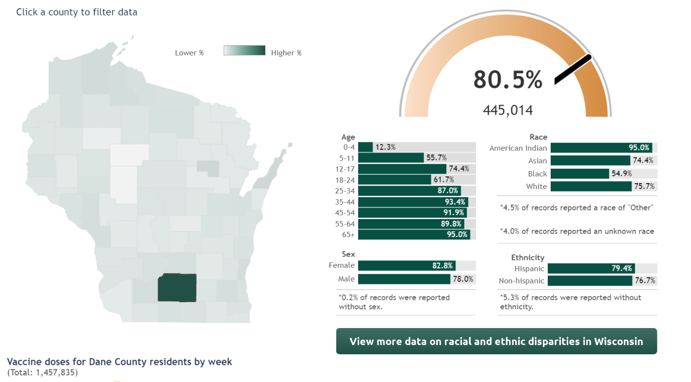
Dane County COVID-19 Immunization Rates
Percent of Dane County residents who have received the primary series.

Slide 4
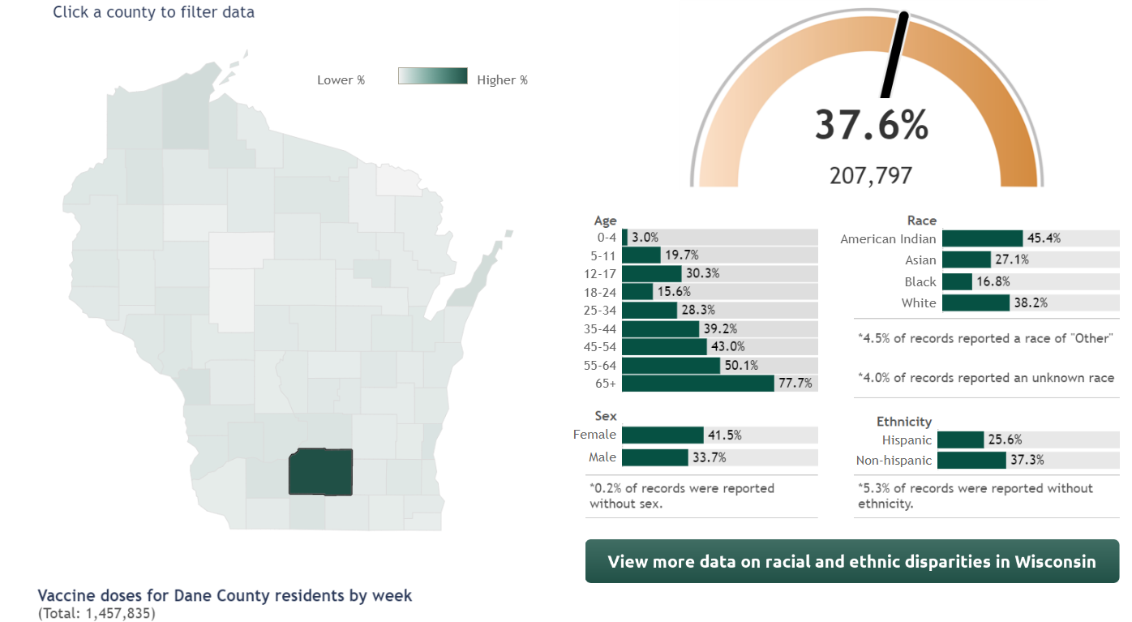
Dane County COVID-19 Immunization Rates
Percent of Dane County residents who have received the updated booster.

Slide 5
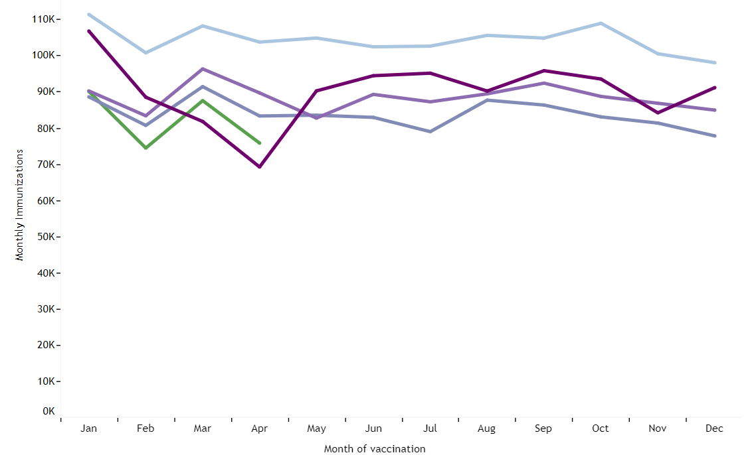
WI—Doses of Vaccine Administered: Up to 24 Months
Source

Slide 6
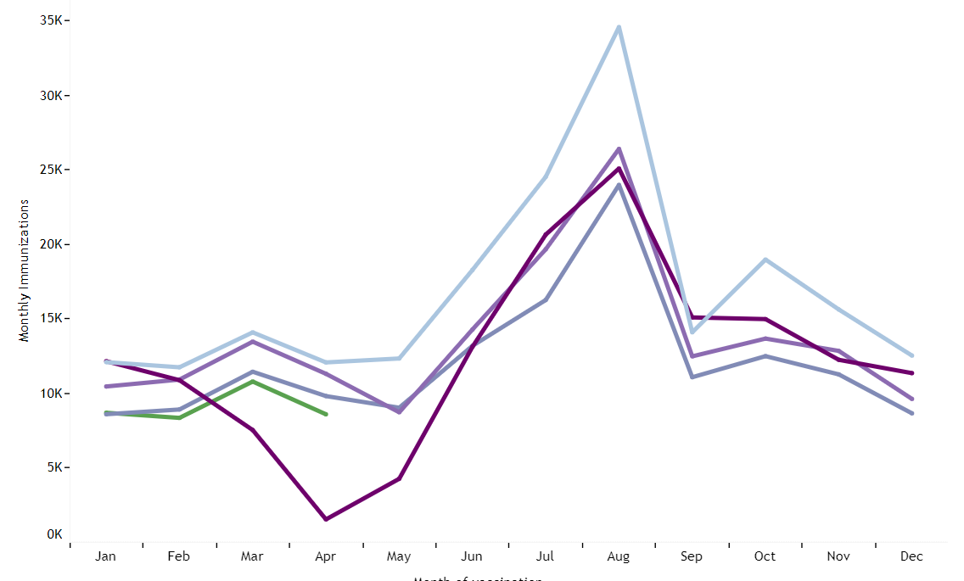
WI—Doses of Vaccine Administered: 13–18 Years Old
Source

Slide 7
Measles—2022
Ohio outbreak
85 cases among children ages <1 year to 17 years old
80 were unvaccinated
Four were partially vaccinated
One had unknown vaccination status
None of the cases were fully vaccinated against measles

Slide 8
Polio—2022
June 2022
Poliovirus was confirmed in an unvaccinated adult residing in Rockland County, New York.
60.3% of Rockland County children had received at least three doses of polio by 24 months old, as of August 2022.*
*New York State Immunization Information System (NYSIIS)

Slide 9
WI Immunization Rates— Up to 24 Months
Source

Slide 10
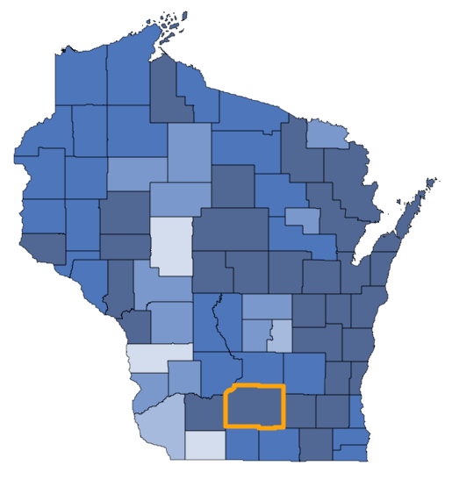
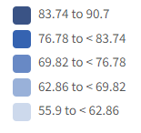
Polio Immunization Rates
Three doses of polio vaccines by 24 months
Source

Slide 11
Polio Immunization Rates
Three doses of polio vaccines by 24 months
Source

Slide 12
Childcare Immunization Rates
Source

Slide 13
WI Immunization Rates— 13–18 years
Vaccination coverage among Wisconsin adolescents aged 13 through 18 years, by vaccine, region of residence, and year
Source: https://www.dhs.wisconsin.gov/publications/p02004a.pdf

Slide 14
School Immunization Rates
Source

Slide 15
School Waiver Rates
Source

Slide 16
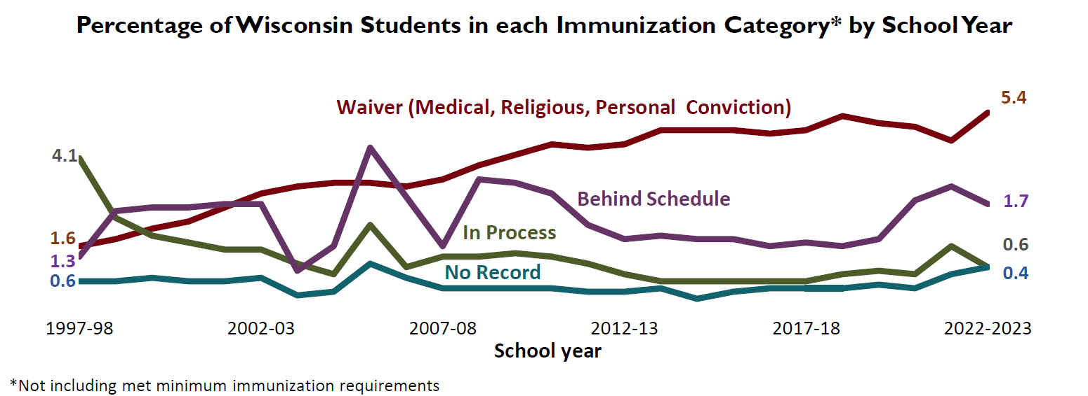
School Waiver Rates
Source

Slide 17
School Waiver Rates
Source

Slide 18
School Immunization Waivers
Medical
Medical provider signature required
Should only be used for medical reasons
Religious
Parent signature required
Personal Conviction
Parent signature required
Waivers completed on the student immunization form

Slide 19
Administrative Rule DHS 144

Slide 20
DHS 144
Updates to Wisconsin Administrative Code Ch. DHS 144 took effect 2/1/23
Joint Committee hearing on 3/7/23
Suspension of certain portions of DHS 144 on 3/9/23

Slide 21
DHS 144
Promulgated changes:
Tdap grade change—from 6th to 7th grade
Added MenACWY-containing vaccine for 7th and 12th graders
Varicella vaccination exception change—parental report → health care provider
Substantial outbreak definition changes
Added requirement for schools to report compliance to DHS and LHD
Removed outdated provisions related to phase-in of Tdap and varicella

Slide 22
DHS 144
Updates to Wisconsin Administrative Code Ch. DHS 144 took effect 2/1/23
Joint Committee hearing on 3/7/23
Suspension of certain portions of DHS 144 on 3/9/23

Slide 23
DHS 144
The changes impacted by the suspension included:
MenACWY containing vaccine requirement
Suspended rule: Adding MenACWY containing vaccine to the requirements for students entering seventh grade, and a booster dose for eligible students entering 12th grade.
Current rule: MenACWY containing vaccine is not required for school entry.
Report of varicella disease
Suspended rule: A physician, physician assistant, or an advanced practice nurse prescriber must document a reliable history of varicella disease by indicating on the department's student immunization record form that the student has had varicella disease.
Current rule: Parental report of varicella disease is acceptable.
Substantial outbreak definition
Suspended rule: Updating the definitions of “substantial outbreak" to add chickenpox and meningococcal disease to the definitions.
Current rule: The diseases still included in the substantial outbreak definition are measles, mumps, rubella, polio, pertussis, diphtheria, and Haemophilus influenzae type b.

Slide 24
DHS 144
The changes not impacted by the suspension and remain in effect for the upcoming 2023–2024 school year and beyond include:
Changing the requirement for Tdap (tetanus, diphtheria, and acellular pertussis vaccine) from the start of sixth grade to the start of seventh grade. This change is to better align with the recommended age (age 11) at which children should receive the vaccine.
Substantial outbreak definitions—some outdated information removed. Now allows use of current standards and definitions for listed diseases.

Slide 25
DHS 144
The changes not impacted by the suspension and remain in effect for the upcoming 2023–2024 school year and beyond include:
Requiring schools to provide reports of vaccine compliance to DHS in addition to the previously existing requirement to report to local health departments.
Removing outdated provisions relating to the 2008–2009 phase-in of Tdap and varicella vaccines.

Slide 26
Adolescent Vaccination

Slide 27
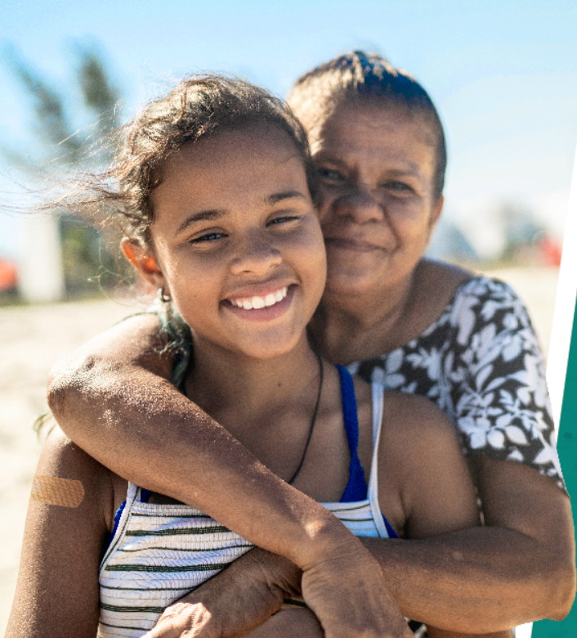
Adolescent Vaccination
The pre-teen visit at age 11 years is an opportune time to assess for all ACIP recommended vaccines at this age.
Often referred to as the adolescent platform
Notes:
(to meet school immunization requirement for Tdap for 7th grade entry

Slide 28
Source

Slide 29
Source

Slide 30
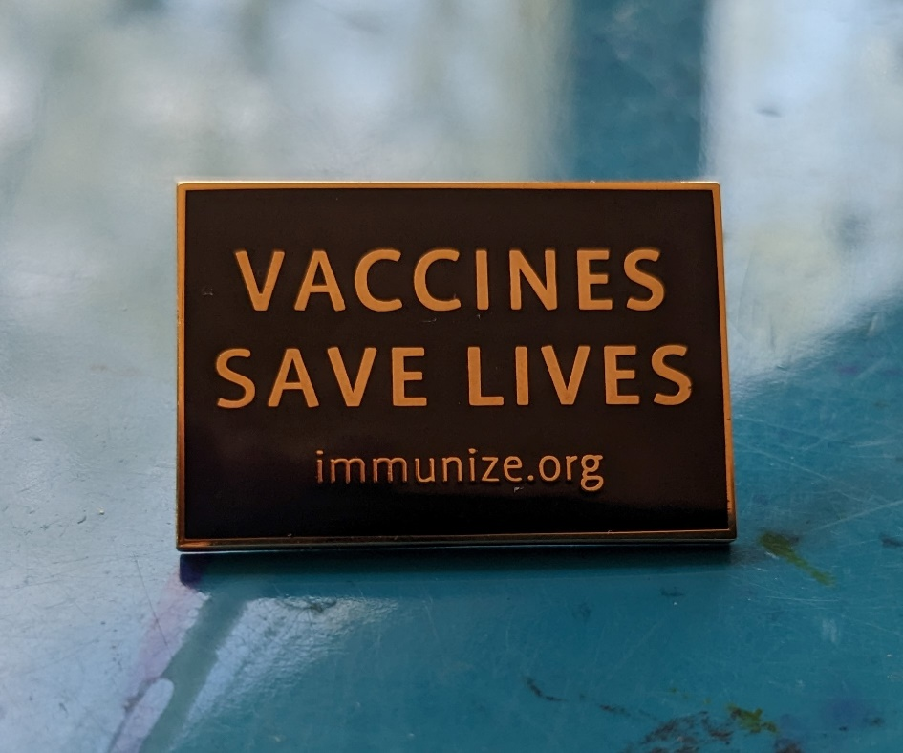
It is now even more important to communicate the value of vaccines.

Slide 31
Communication About Vaccines

Slide 32
Best Practices for Vaccine Communications
Talk about the benefits of vaccination for the common good.
Talk about improving vaccination access as a preventive public health measure.
Focus on how vaccines are beneficial to children’s and adolescents’ long-term health and wellbeing.
Use a computer updates metaphor to explain how the immune system improves its performance through vaccination.
Use a literacy metaphor to explain how the immune system learns how to respond to viruses through vaccination.
Source

Slide 33
Best Practices for Vaccine Communications
Talk about the benefits of vaccination for the common good.
Talk about improving vaccination access as a preventive public health measure.
Focus on how vaccines are beneficial to children’s and adolescents’ long-term health and wellbeing.
Use a computer updates metaphor to explain how the immune system improves its performance through vaccination.
Use a literacy metaphor to explain how the immune system learns how to respond to viruses through vaccination.
Source

Slide 34
Vaccine as Trainer
Viewing vaccines as trainers for the immune system
(instead of war or fighting analogies)

Slide 35
Computer Analogy
People view computer updates as a necessary process
Used to explain how vaccines work in the body and why vaccination is important
Notes:
Getting vaccinated is like updating your computer. Vaccines are like software that contains information for our bodies to improve their performance.
Just like our computers know how to detect a virus after they’ve received a software update, the body can remember how to detect and react to a virus even after the vaccine has left the body

Slide 36
Computer Example
Getting vaccinated is like updating your computer. Vaccines are like software that contains information for our bodies to improve their performance.
Just like our computers know how to detect a virus after they’ve received a software update, the body can remember how to detect and react to a virus even after the vaccine has left the body

Slide 37
DHS Programs

Slide 38
Vaccines for Children Program
Who?
Children 18 and younger may be eligible if they are enrolled or eligible for Medicaid, are American Indian or Alaska Native, don’t have health insurance or have health insurance that doesn’t pay for all vaccines.
Where can you find materials?
Multiple languages: https://www.dhs.wisconsin.gov/library/p 02984.htm
American sign language: https://vimeo.com/739774714/a882e54f34

Slide 39
Vaccines for Adults Program
What?
The Vaccines For Adults program helps adults 19 and older get free vaccines if you’re uninsured or underinsured.
Approximately 100 providers
Funding provided for 11 vaccines
VFA website

Slide 40
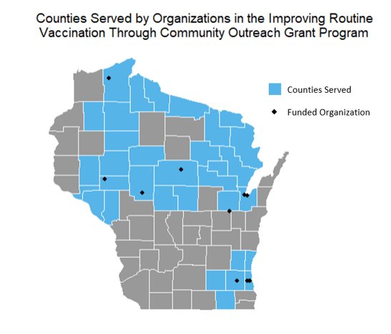
DHS’ Work with Partners
Routine Immunization Community Engagement (RICE) Grant
RICE grant program was created to fund community-based organizations (CBOs) to do outreach on routine immunizations.
Grant period: 12/15/2023–06/30/2023​
11 awards​
Six pediatric awards at $25,000 maximum​
Five adult awards at $20,000 maximum​
33 counties served by RICE grantees​

Slide 41
BigShot Award
Three Clinic Categories:
At least 90% of patients 2 years old and younger​ up to date on routine vaccines.
At least 80% of patients up to date on adolescent vaccines.
At least 90% of patients up to date on hepatitis A
2023: 115 awardees
16 awardees for childhood series (4313314)
One awardee for adolescent (Tdap, HPV, Meninge)
98 awardees for hepatitis A

Slide 42
Thank you!

Slide 43
Communication Resources
Plan to Protect
Who?
Primary audience: Expecting and new parents
Secondary audience: Parents with children up to 3 years old
Results
1.8 million impressions delivered
Where can you find materials?
Materials for parents
Materials for partners

Slide 44
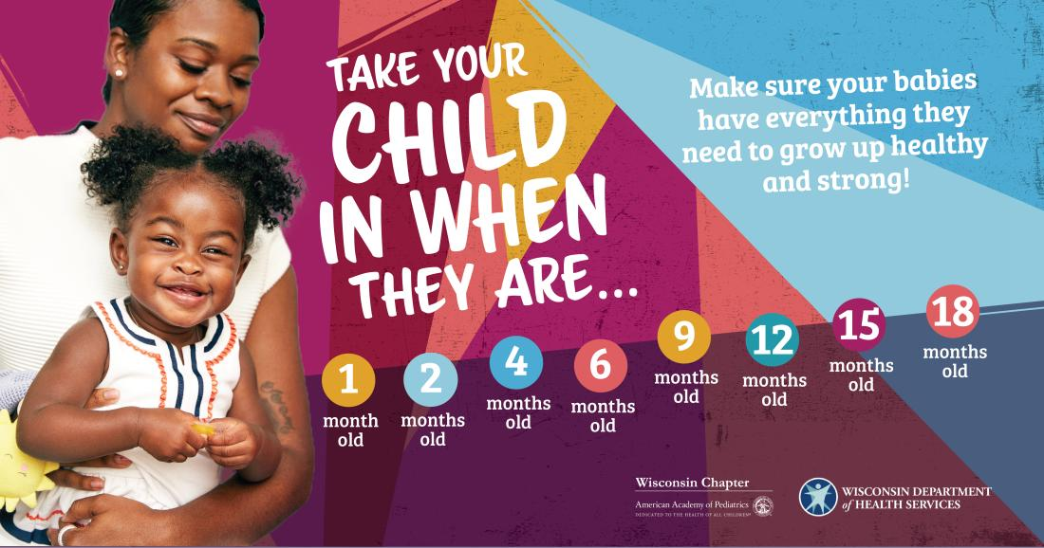
Communication Resources Back on Track
Who?
Parents, caretakers, partners who work with children that are behind schedule due to the pandemic
Where can you find materials?
English materials
Spanish materials

Slide 45
Communication Resources
Communication Resources Influenza Messages
Who?
Focused on Kenosha, Racine, Dane, and Milwaukee counties
Results
1.8MM impressions, 2.5k clicks
Where can you find materials?
Materials for providers
Materials for the public

Slide 46
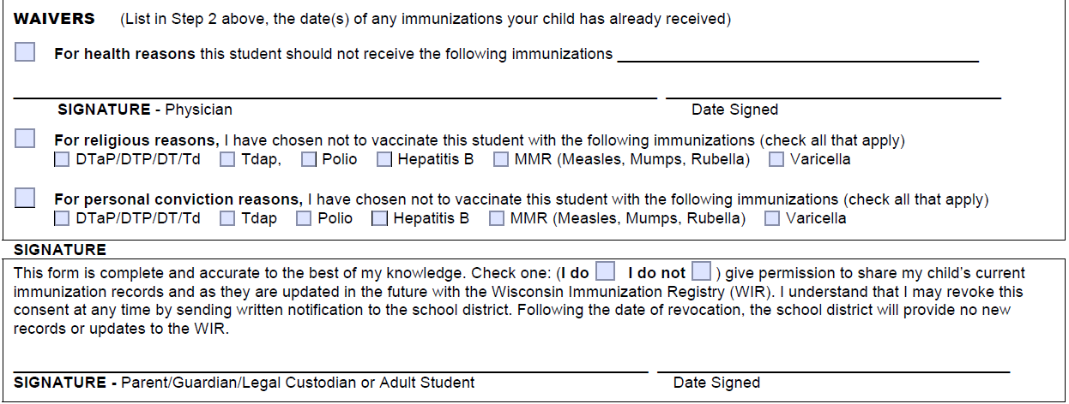
School Immunization Waivers
https://www.dhs.wisconsin.gov/forms/f0/f04020l.pdf

