Slide 1


UW Health Mpox (Monkeypox) Virus Assay
William M. Rehrauer PhD
University of Wisconsin School of Medicine and Public Health
Associate Professor of Pathology
Director of Molecular Diagnostics

Slide 2
Disclosures
William M. Rehrauer
Various consulting and advisory roles (Promega, Roche, Hologic, Salus)
UW Health Molecular Diagnostics is a member of the Roche Molecular Center of Excellence (MCOE)
No commercial interests in any of the instruments/products discussed in today’s presentation
UW Health Molecular Diagnostics prepared for Mpox (Monkeypox) testing, but has not implemented it

Slide 3

Outline:
1) Very brief introduction/review of Mpox (Monkeypox) (10 minutes)
(https://www.cdc.gov/poxvirus/mpox/index.html)
2) UW Health Molecular Diagnostics Overview (15 minutes):
  Assay Design/Workflow/Considerations
  Assay Validation
3) Conclusions and Discussion (5 minutes)

Slide 4
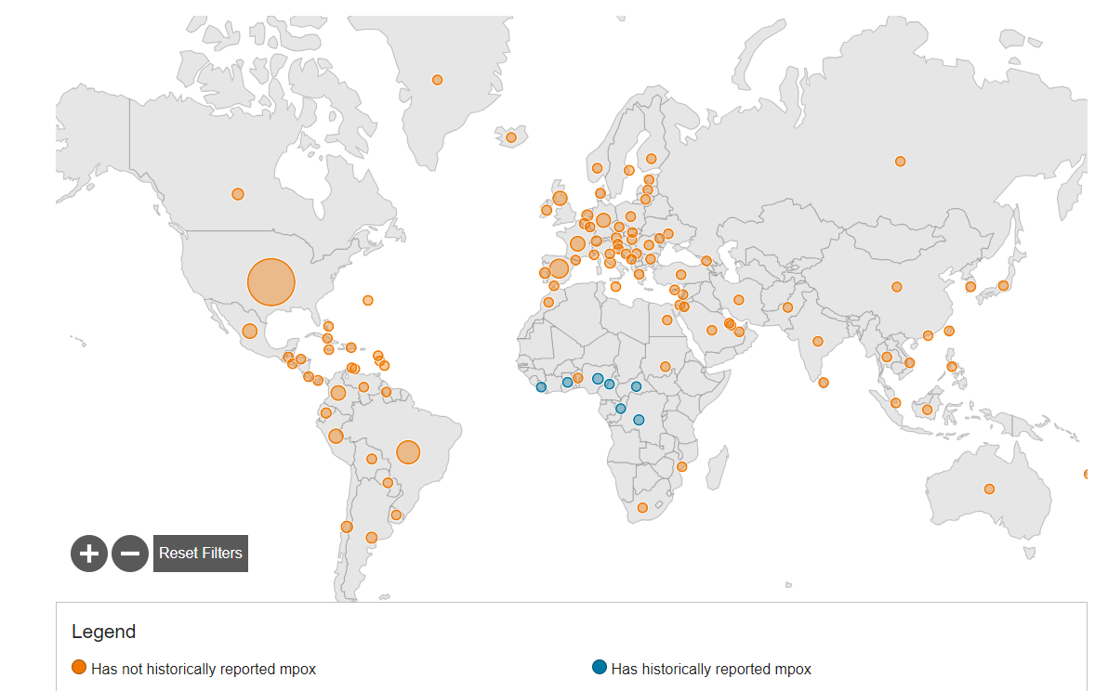






Monkeypox (Mpox)
Other Orthopoxviridae:
  Variola virus (smallpox agent)
  Vaccinia virus (used in the smallpox vaccine)
  Cowpox
Genus: Orthopoxvirus
Family: Poxviridae
Discovered in 1958 after two pox-like disease outbreaks in research monkey colonies
Zoonotic infections (specific animal reservoir unknown, but likely small African mammal) in humans
2022-2023 Monkeypox outbreak (May 2022: endemic→pandemic)
June 25, 2022: World Health Organization (WHO) declares Monkeypox a global health emergency
November 28, 2022: WHO implemented a new preferred term “ Mpox ” to reduce racist and stigmatizing language and other issues associated with the prior terminology
https://www.cdc.gov/poxvirus/mpox/response/2022/world-map.html (as of 05/23/23)

Slide 5
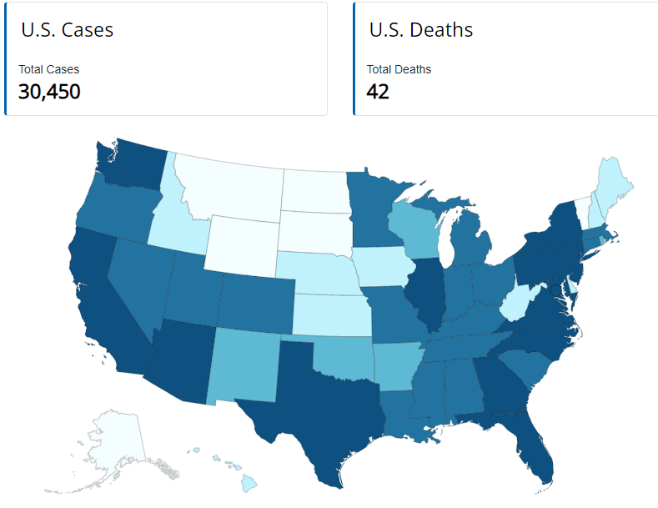
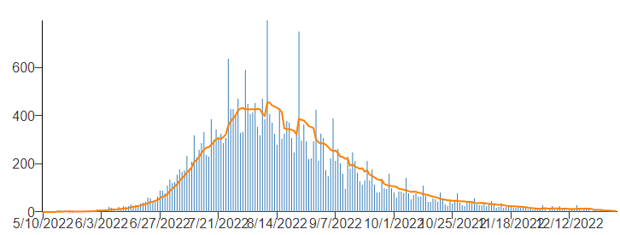
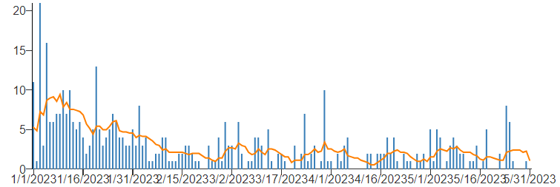
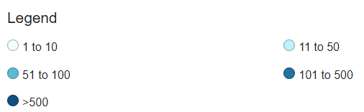
Monkeypox (Mpox) in the United States
United States data as of May 31, 2023
UW Health MDx
2022
2023
https://www.cdc.gov/poxvirus/mpox/response/2022/us-map.html

Slide 6
Monkeypox (Mpox)
Transmission
direct or indirect contact with body fluids or lesions
patients may be infectious up to ~4 days before symptom onset
patients remain infectious until lesions scab, fall off and fresh skin forms
Clinical Presentation
incubation: 3-17 days; illness: 2-4 weeks (longer in those at greatest risk
initial symptoms (prodromic): fever, malaise, headache, weakness, lymphadenopathy
after initial symptoms: rash (lesion evolution: macular, papular, vesicular, pustular, scabbing/resolution)
lesions are deep seated (firm) clusters; painful, severe lesional disease (oral, genital, perinatal) may require special care
many complications to severe disease: neurologic, myopericarditis, sepsis, hemorrhagic disease, ocular
Patients at greatest risk of severe disease
People with underlying medical conditions:
  Inadequately treated HIV (CD4+ counts < 350 cells/mm3)
  Moderate or severe primary immunodeficiency
  Immunosuppression (e.g., organ transplant, therapy for autoimmune disorder, chemotherapy)
Lesions on certain surfaces (e.g., penile foreskin, urethral meatus, or vulva)
History of atopic dermatitis, eczema, or extensive breaks in the dermal barrier

Slide 7
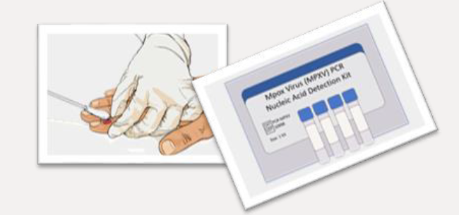
Monkeypox (Mpox)
Surveillance (patient/clinician education and awareness)
  Case identification (most U.S. clinicians have never seen Mpox; lesions look like other herpes infections)
  Majority of cases: immunocompetent men who are gay, bisexual, and other men who have sex with men
Laboratory testing to identify Mpox is crucial
Containment (Infection Control)
  isolation of cases
  contact tracing
Mpox vaccine (JYNNEOS) prior to exposure or as postexposure prophylaxis
  1.2 million JYNNEOS mpox vaccine doses have been administered in the United States since the beginning of the outbreak, only 23% of the estimated population at risk for Mpox has been fully vaccinated

Slide 8
Why UW Health Molecular Diagnostics?

Slide 9
Brief Review of our Assay Design/Workflow/Considerations

Slide 10
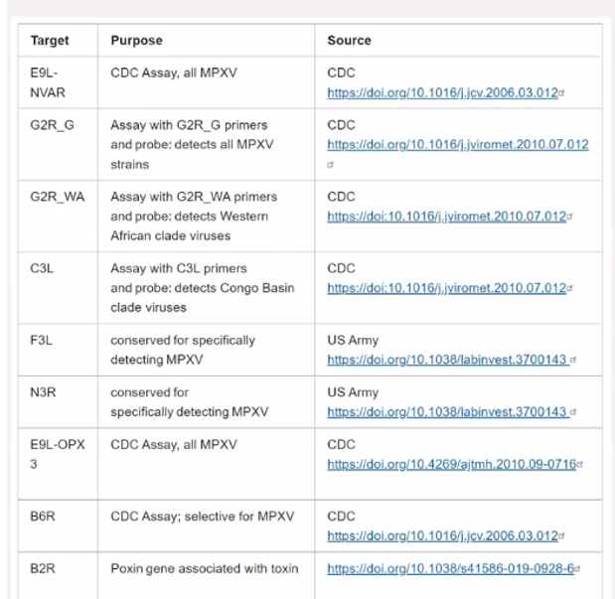
Numerous available real time PCR designs for Orthopox and/or Mpox to consider…..

Slide 11
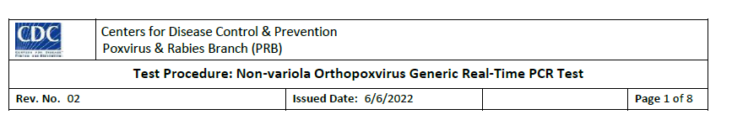
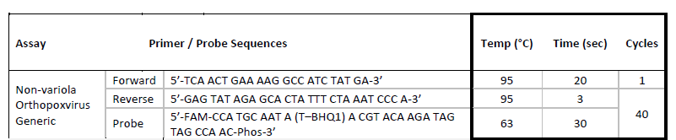
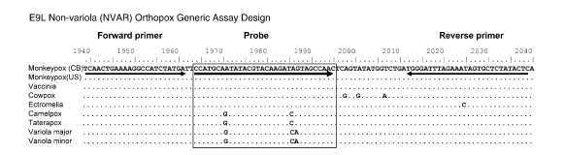

Based on Li Y, Olson VA, Laue T, Laker MT, Damon IK. 2006 JClinVirol. 36:194-203

Slide 12
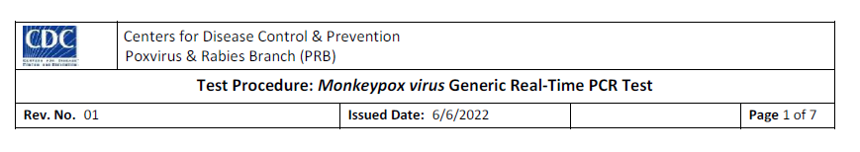
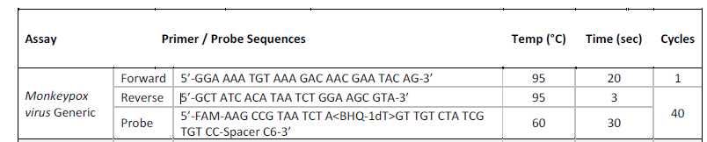
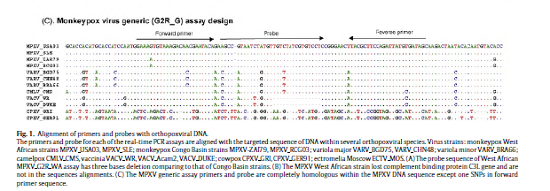
Li Y, Zhao H, Wilkins K, Hughes C, Damon IK. 2010 J.Virol.Meth. 169:223-227

Slide 13
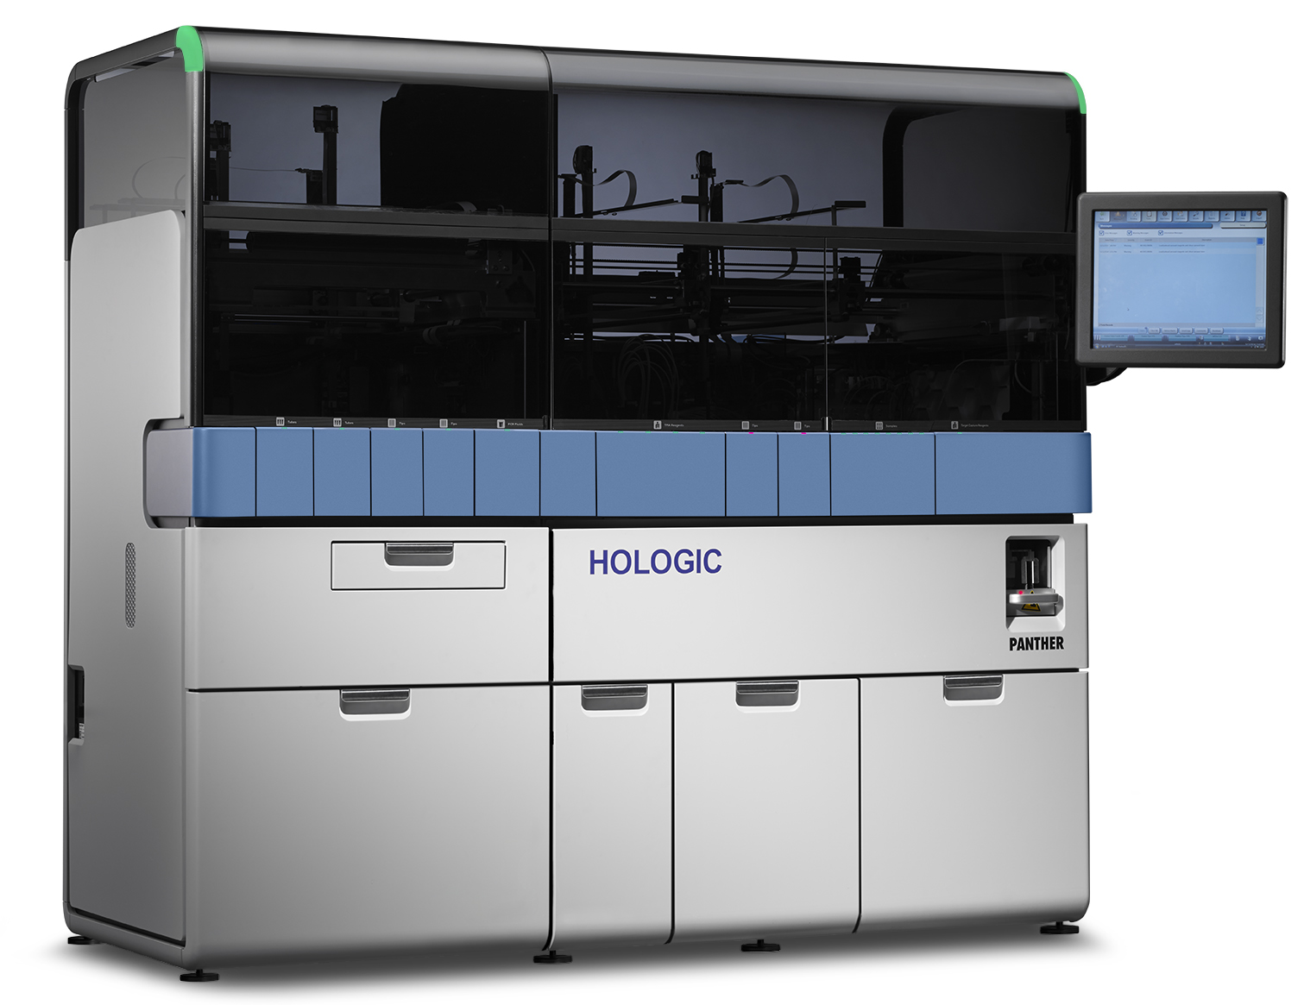
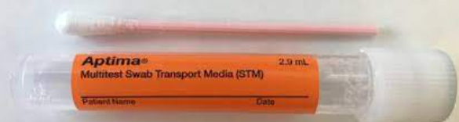
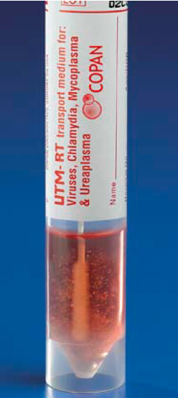
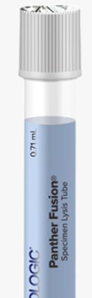
Instrumentation/Samples/Pre-processing
Hologic Panther Fusion®
Fully automated
Random and continuous access sample loading
Run multiple IVDs/LDTs simultaneously
Up to 16 LDTs run simultaneously (UW Health MDx: HSV1, HSV2, VZV)
Extraction and Enzyme reagents are ready to use
Multiple PCR reactions (3) from one extraction
Multiplex up to 5 detections/reaction (5 color real time PCR detection)
Process controls: eliminate operator/instrument error (chain of custody, clot detection, volume verification, etc.)
Interfacing to LIS (HealthLink Beaker)
Hologic Aptima® Multitest Swab Specimen Collection Kit
Universal Transport Medium
Specimen Lysis Tube
or
aliquoting/diluting
Can be directly loaded on Panther instrument
Cannot be directly loaded on Panther instrument

Slide 14
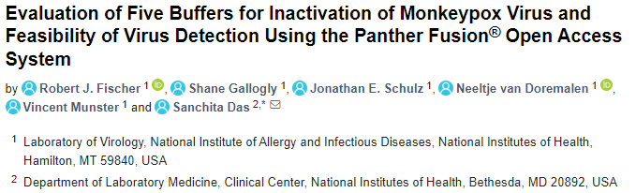
Samples/Pre-processing/Safety
Hologic Aptima® Multitest Swab Specimen Collection Kit
Universal Transport Medium
Specimen Lysis Tube
or
aliquoting/diluting
BSL2 facilities using BSL3 procedures
Hologic Sample Lysis buffer is inactivating* (see below and UK Health report)
UW Health Molecular Diagnostics Staff have access to vaccine

Slide 15
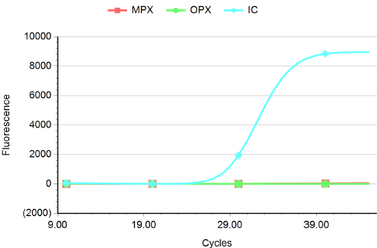
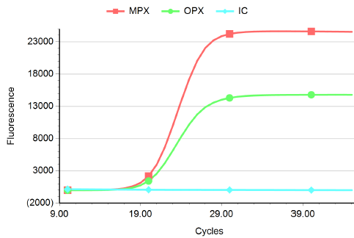
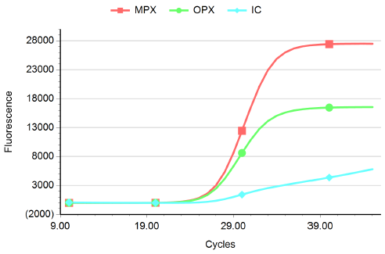
UW Health Mpox (Monkeypox) Virus Assay
1) Non-variola Orthopox design, probe labeled with HEX, targets E9L (DNA pol)
Multiplex
(UWHealth modified)
2) Generic MPX design, probe labeled with FAM, targets the TNF receptor gene (G2G_G)
3) Unlike CDC, we use the Hologic Internal Control primers/probe instead of RNaseP.
Negative
Clinical Specimen
Positive
Clinical Specimen
Positive
Clinical Specimen
(MTS Direct Load)
(SAT Not-Direct Load
Sample Aliquoted/Diluted)

Slide 16
Brief Overview of our Validation

Slide 17
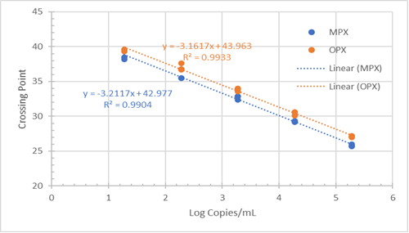
UWH Molecular Diagnostics
Orthopox and Mpox Assay:
Linearity
and
Limit of Detection
(Mpox NIST)

Slide 18
UWH Molecular Diagnostics
Orthopox and Mpox Assay: Interferences (Specificity)

Slide 19
UWH Molecular Diagnostics
Orthopox and Mpox Assay: Correlation with other labs
Direct Load
Multitest Swab
Not-Direct Load
Specimen Aliquoting
3 commercial
reference materials
Correlation Summary (Processing Type)
  Direct Load (MTS): >96% (31/32)
  Not-Direct Load (SAT): >95% (20/21)

Slide 20
UWH Molecular Diagnostics
Orthopox and Mpox Assay:
Precision

Slide 21
Primer/Probe Mix and Sample Stability
UWH Molecular Diagnostics Orthopox and Mpox Assay:

Slide 22
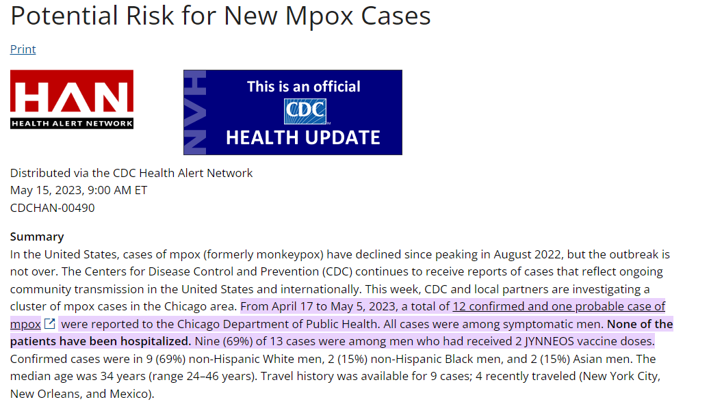
Conclusions
Mpox (monkeypox): another viral pathogen example (endemic →pandemic)
Translational research/clinical diagnostics: PREPAREDNESS and DILIGENCE are key
Clinician/patient education and awareness is very important; Infection control is critical
Regulatory oversight is evolving (IVD, EUA and LDT), but this continues to be a concern
Validated Mpox (monkeypox) testing via molecular amplification methods is available and necessary

Slide 23
Acknowledgements
UWH Clinical Labs Developmental Specialist Molly Accola PhD
UWH Clinical Labs Molecular Diagnostics Staff
    Wyatt Parry, Angela Hanson, Kendra Lehman
UWH Clinical Labs Core Laboratory Client Services Staff
    Cassandra Berry
UWH Clinical Labs Quality Department
    Jill Palmer, Jing-Joo Lee
UWH Clinical Labs Medical Director David Yang MD PhD

Slide 24
Thank you!
Questions?

