Slide 1
Using wastewater to monitor respiratory viruses in Wisconsin
Adélaïde Roguet
Environmental Health Division
WSLH Virology conference
6/8/2023

Slide 2
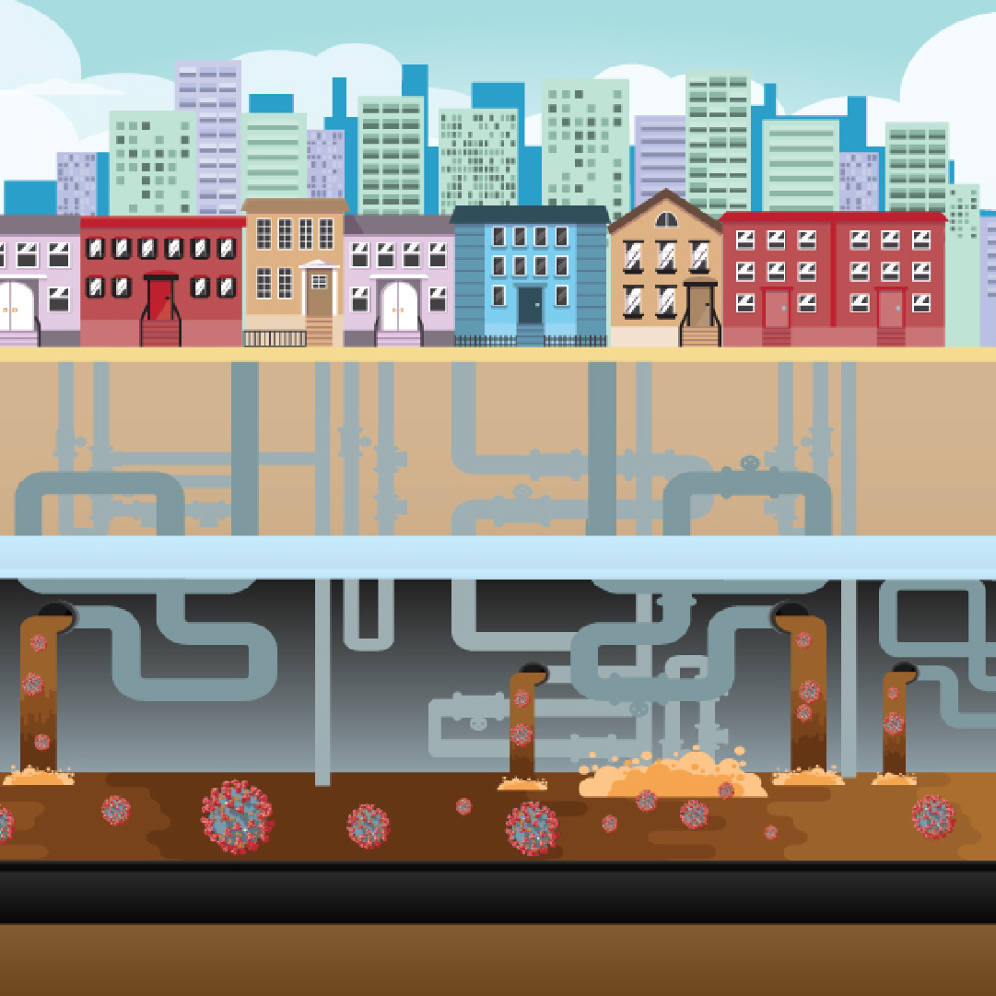
Wastewater surveillance
Fecal/throat shedding in COVID-19 patients
➤
Natarajan et al. 2022 (graphical abstract)
Source: CDC

Slide 3
Wastewater surveillance
COVID-19 pandemic
Popular in 2000s
Choi et al., 2018

Slide 4
Wastewater surveillance
Monitor entire
community in a
sewershed
No geographic/
demographic/
testing bias
Time efficient
Wastewater surveillance
Low cost
Test symptomatic & asymptomatic

Slide 5
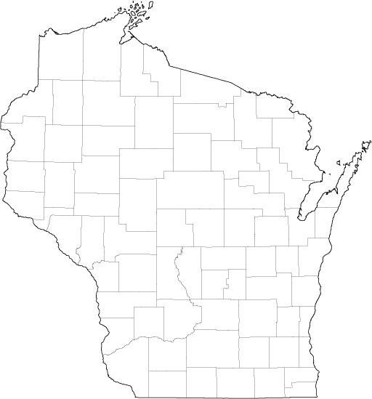
Wisconsin wastewater surveillance
Fall 2020
72 WWTFs
49 out of 72 counties
60% population
UW-dorms
Funded by
Major cities
Smaller cities
Tribal nations
Mostly 2x per week

Slide 6
Wisconsin wastewater surveillance
Fall 2020
72 WWTFs
49 out of 72 counties
60% population
UW-dorms
Currently
44 WWTFs
48% WI population
Funded by
Major cities
Smaller cities
Tribal nations
2x per week

Slide 7
Wastewater surveillance
7

Slide 8
1
Monitoring
SARS-CoV-2 levels
SARS-CoV-2 variants
Beyond SARS-CoV-2

Slide 9
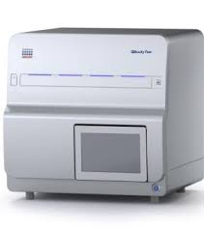
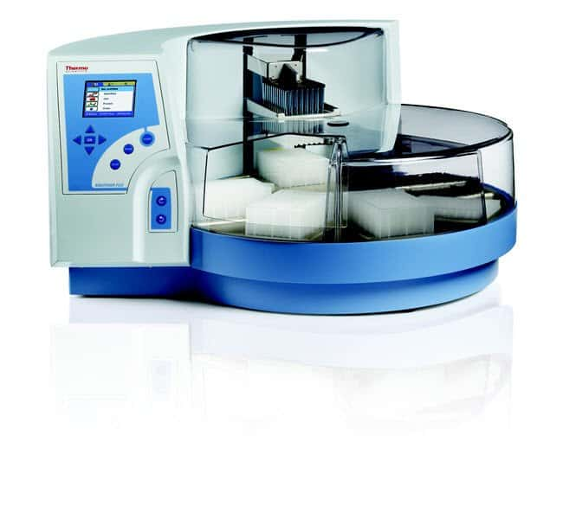
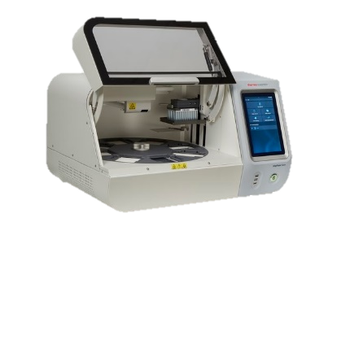
Sample processing workflow
WWTFs
WSLH/UWM
DHS
Collection
24h
composite samples
Data
analysis &
Quality
control
RNA
extraction
WI
dashboard
National dashboard
Concentration
Quantification
KingFisher Flex
KingFisher Apex
Automated concentration
Nanotrap ER2 (Ceres)
= nanoparticle capture
Automated extraction
Maxwell® HT Viral TNA
kit (Promega)
Digital PCR
QIAcuity (Qiagen) N1/N2 CDC assays

Slide 10
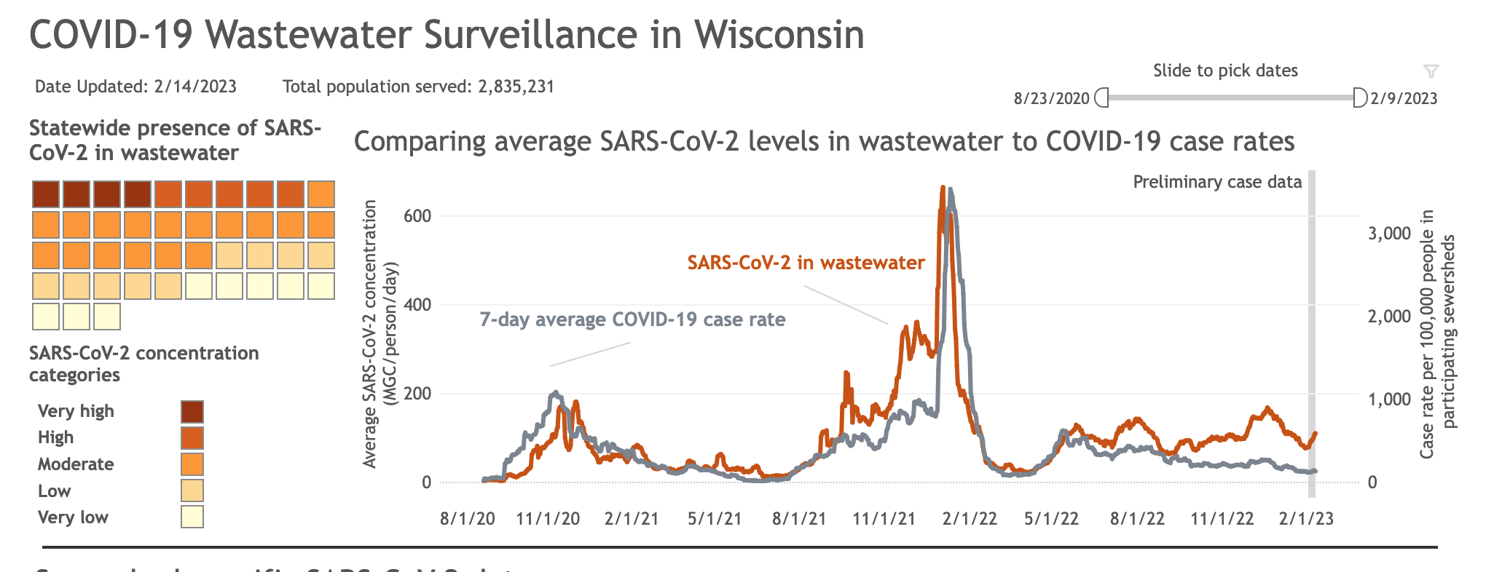
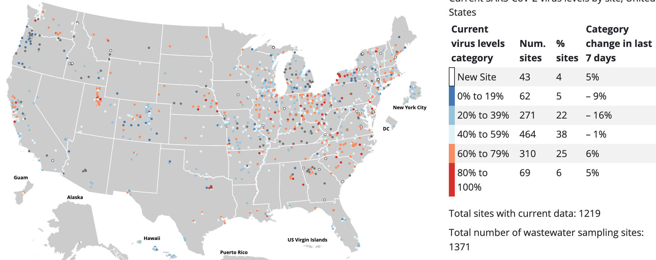
Sample processing workflow
WWTFs
WSLH/UWM
DHS
Collection
24h
composite samples
Data
analysis &
Quality
control
RNA
extraction
WI
dashboard
National dashboard
Concentration
Quantification
Centers for Disease Control and Prevention (CDC) dashboard
WI Department of Health Services (DHS) dashboard
https://dhs.wisconsin.gov/covid-19/wastewater.htm
https://covid.cdc.gov/covid-data-tracker/#wastewater-surveillance

Slide 11
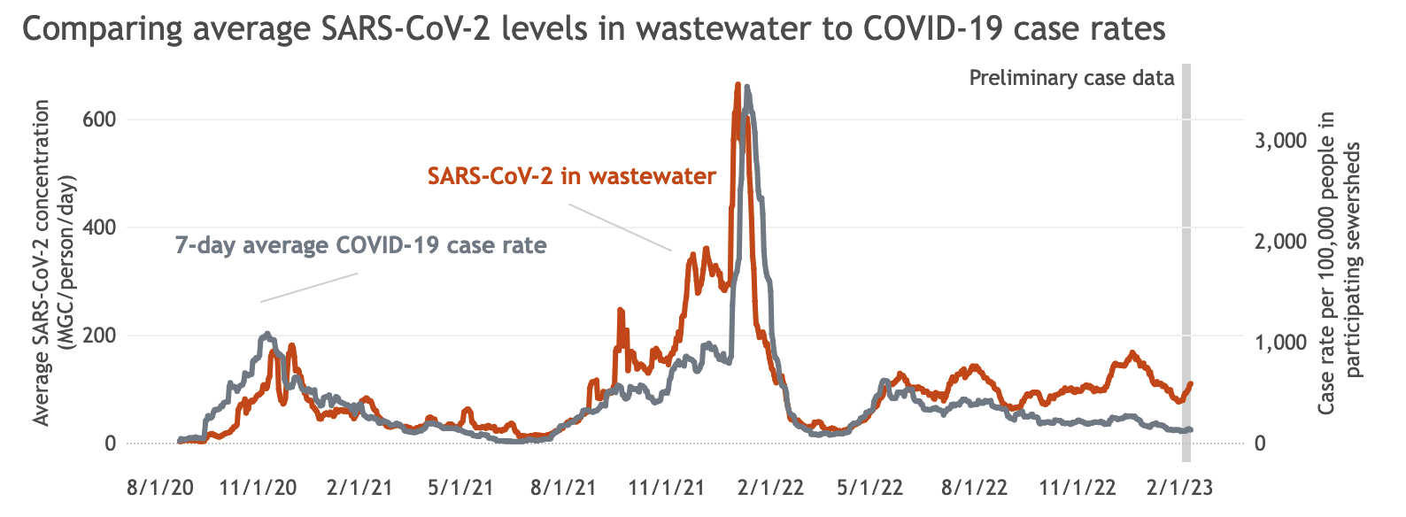
Wisconsin wastewater surveillance
Symptom onset date
Wastewater concentrations correlate with clinical case rate (stronger for large sewersheds) Serve as an early warning (−2 to +3 days lag ww vs specimen collection date) (Feng et al. 2021)

Slide 12
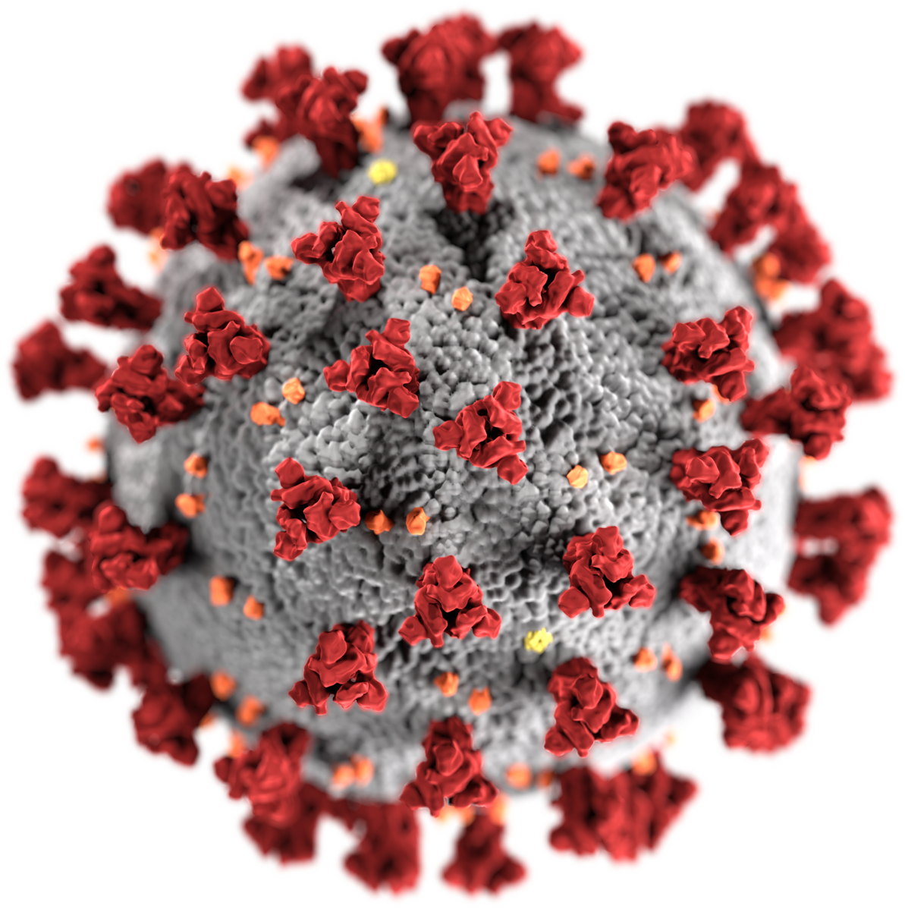
How can wastewater surveillance data be used?
Early warning that may inform decisions in hospital preparedness
Wastewater data can be supportive of clinical case-based surveillance
Fill in the gaps of case-based surveillance
One of the limitations: Does not inform about circulating variants
🧐
Alpha, Delta, Omicron?

Slide 13
2
Monitoring
SARS-CoV-2 levels
SARS-CoV-2 variants
Beyond SARS-CoV-2

Slide 14
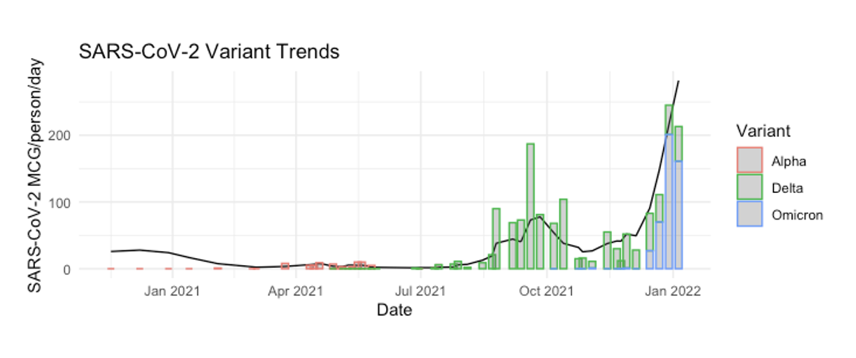
Tracking SARS-CoV-2 variants
Quantitative PCR assays targeting variant-specific SNPs/InDels
Advantages
Quantitative (incl. mutation / non-mutation ratio)
Sensitive and specific
Low cost
Limitations
Screen for one specific SNP/InDel
Not proactive screening
Analysis performed by: Melissa Schussman (UW-Milwaukee)

Slide 15
Tracking SARS-CoV-2 variants
Quantitative PCR assays
Sequencing
Advantages
Screen multiple SNP/InDel
Proactive screening
Limitations
Semi-quantitative (relative proportion)
Not sensitive
More expensive than dPCR
Analysis performed by: Melissa Schussman (UW-Milwaukee)

Slide 16
Sequencing workflow
WWTFs
WSLH/UWM
DHS
Collection
24h
composite samples
Data
analysis &
Quality
control
RNA
extraction
National dashboard
DCIPHER
WI
dashboard
Concentration
Quantification
SRA
Whole
genome
sequencing
Data
analysis &
Quality
control
National dashboard
DCIPHER
WSLH genomic
dashboard
Amplicon-based whole genome sequencing
QIAseq SARS-CoV-2 Enhancer (Qiagen)
Enrichment
MiSeq
(2x 150pb)
Amplify 420+ regions to cover the whole genome

Slide 17
Principle
Unknown strain
Mutations
Sequencing
Alignment to a reference
Reference Wuhan-1
Data analysis/Visualizations

Slide 18
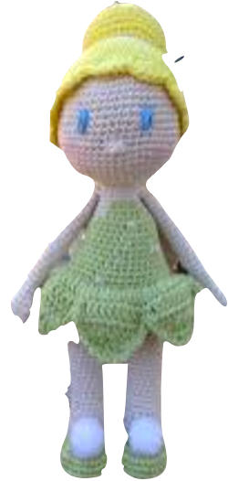
Challenges
Genome coverage (%)
Depth
(X)
Coverage/Depth
Samples considered
At 10X, genome coverage ≥80%
Median depth ≥500X
?
?
?
?
Sequencing error
?
?
?
?
Multiple variants per sample
Identify variant signatures Low abundant variant vs sequencing error

Slide 19
Freyja identifies the lineages and estimates their relative abundances from mixed SARS-CoV-2 samples
Compares the sample mutation patterns to a variant-mutation signatures reference database (generated using UShER global phylogenetic tree).
Relies on:
mutation frequency
depth
Mutation frequency(%)
100%
66%
Depth (X)

Slide 20
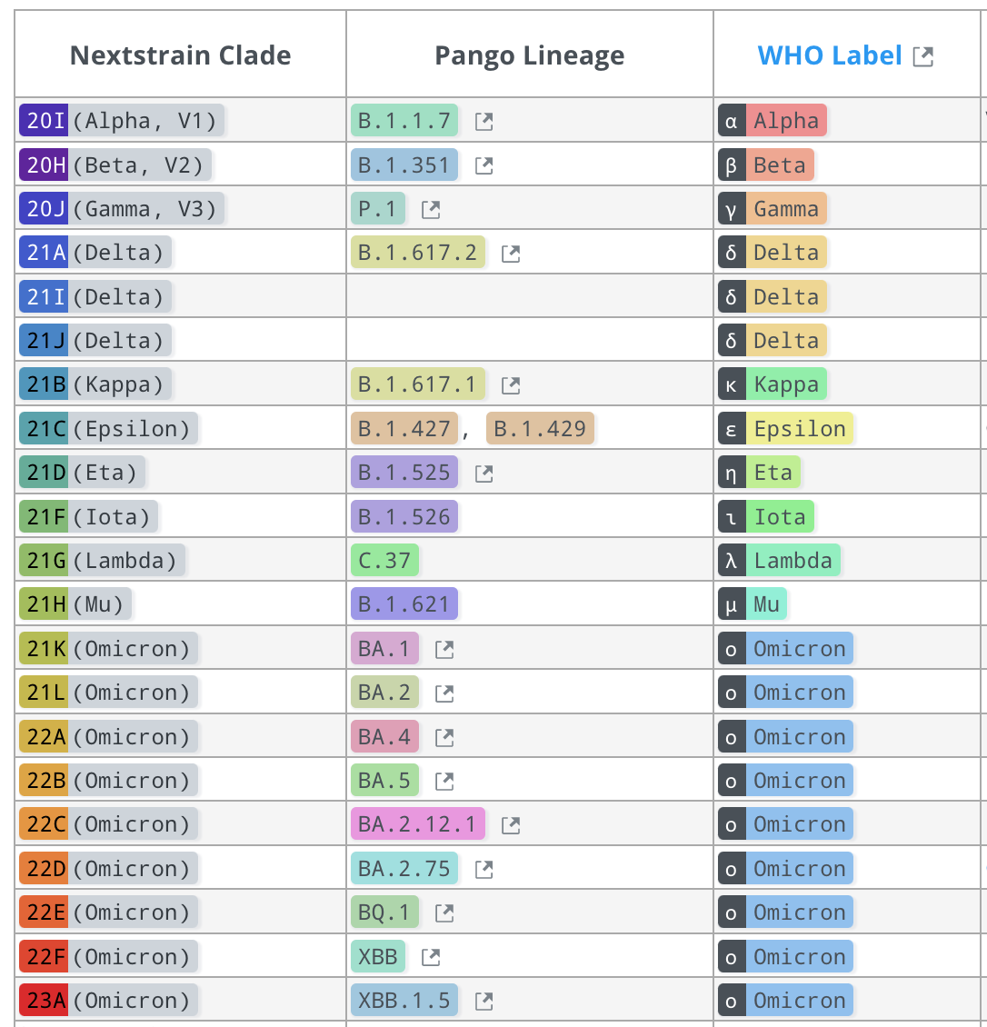
Raw output
SARS-CoV-2 naming systems
https://covariants.org/

Slide 21
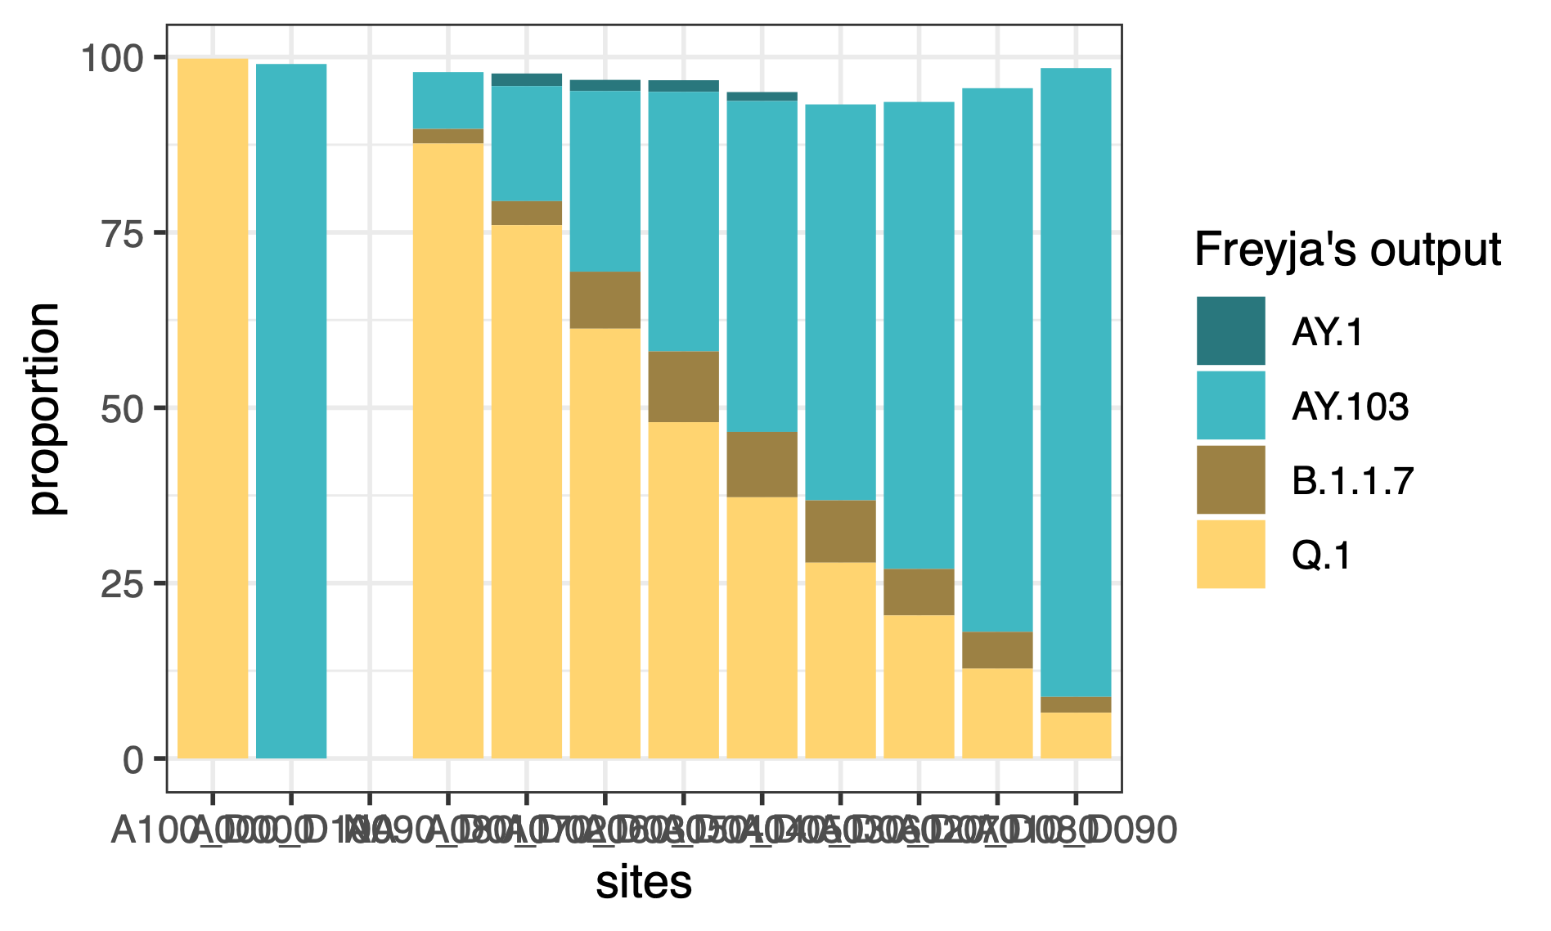
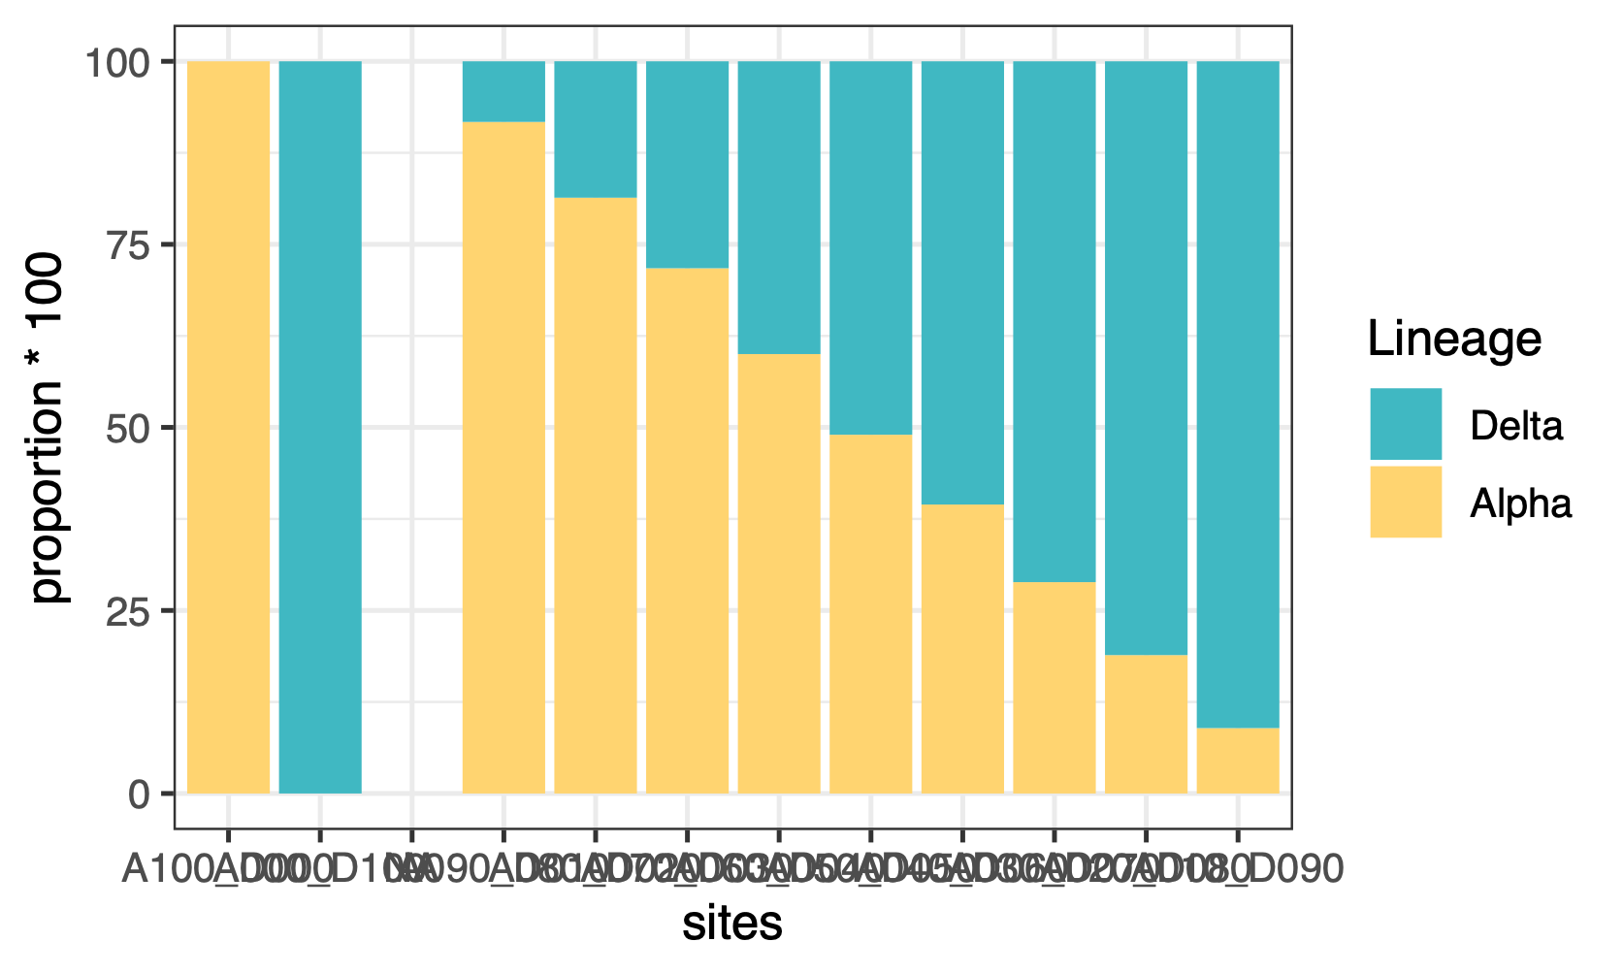
Freyja’s output
100% Delta
100% Alpha
?
in silico analysis
Simplification
Alpha
Delta
100 | 0 |  | 90 | 80 | 70 | 60 | 50 | 40 | 30 | 20 | 10
0 | 100 |  | 10 | 20 | 30 | 40 | 50 | 60 | 70 | 80 | 90
100% Delta
Simplified lineages
100% Alpha
Limitations in Freyja’s outputs interpretation
misleading classifications, ratio

Slide 22
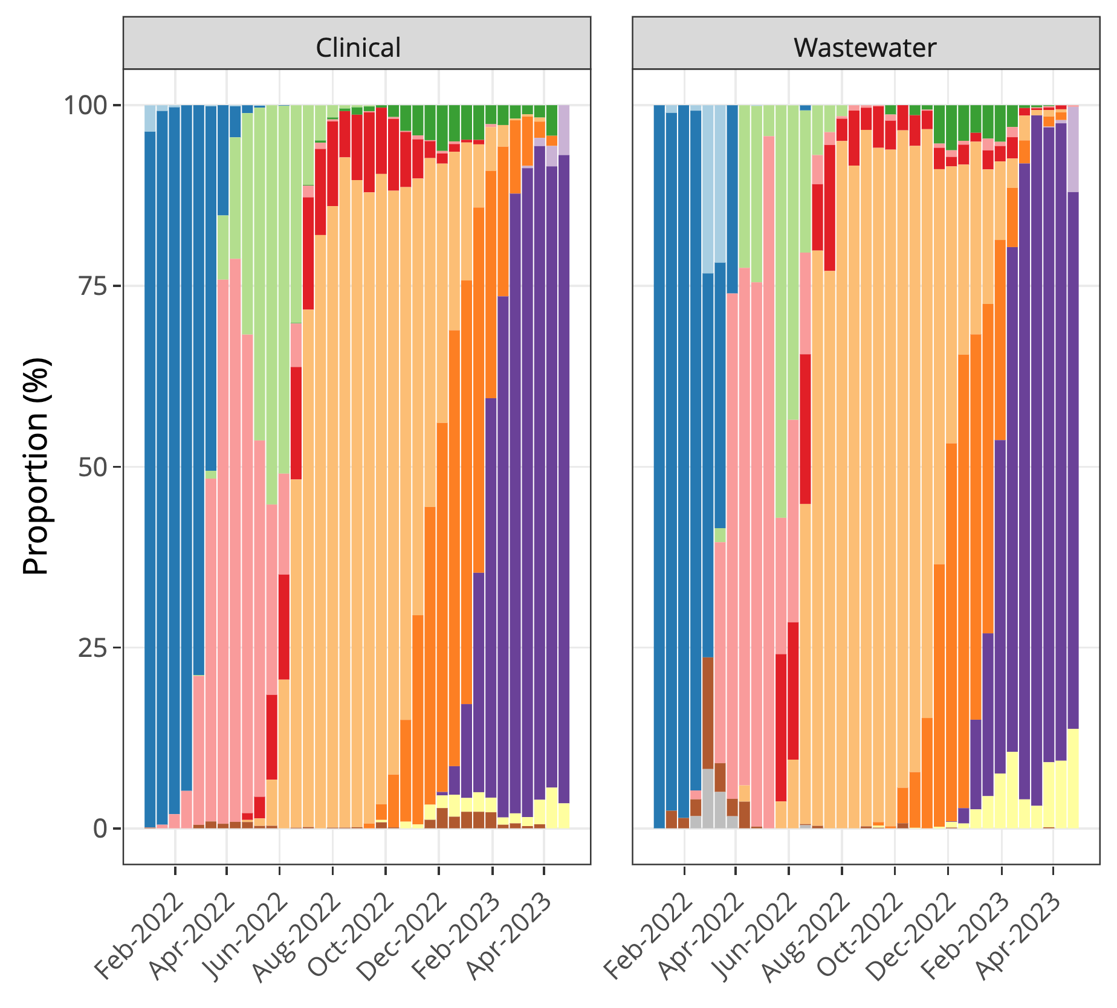
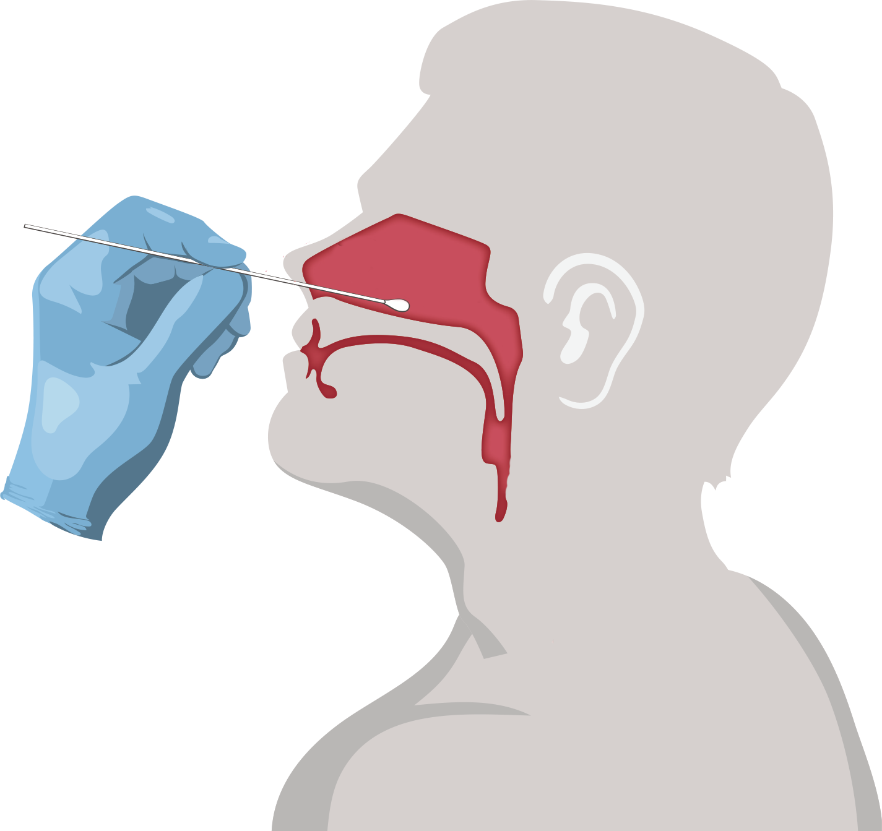
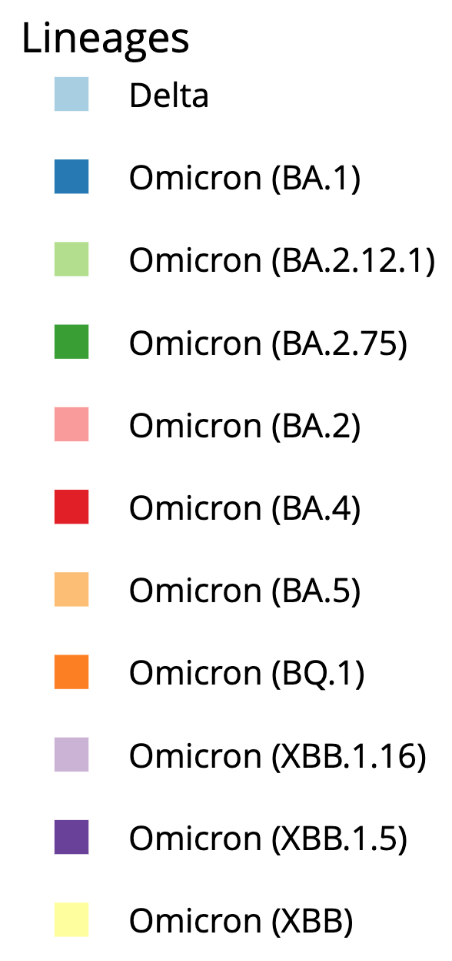
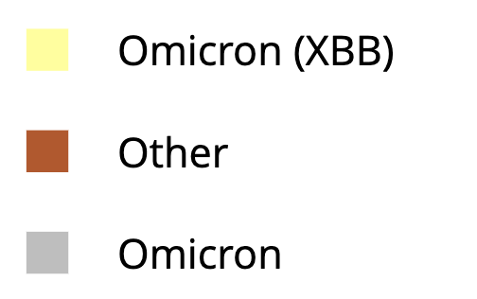
Proportion of variants over time
Similar clinical vs wastewater variant profiles

Slide 23
Proportion of variants over time per lineage
-0.24
0.98
0.84
Signal confirmed by ddPCR
0.77
0.99
0.84
0.78
0.98
0.24
-0.53
Good correlation between clinical vs wastewater variant proportions
0.82

Slide 24
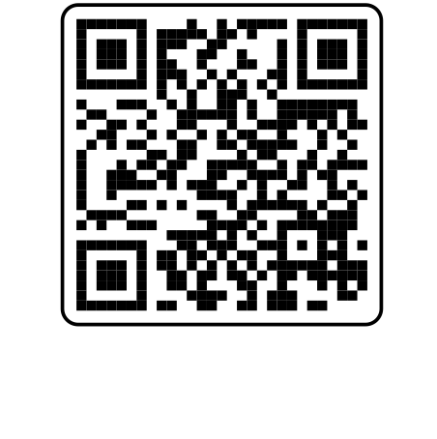
https://dataportal.slh.wisc.edu/sc2-ww-dashboard

Slide 25
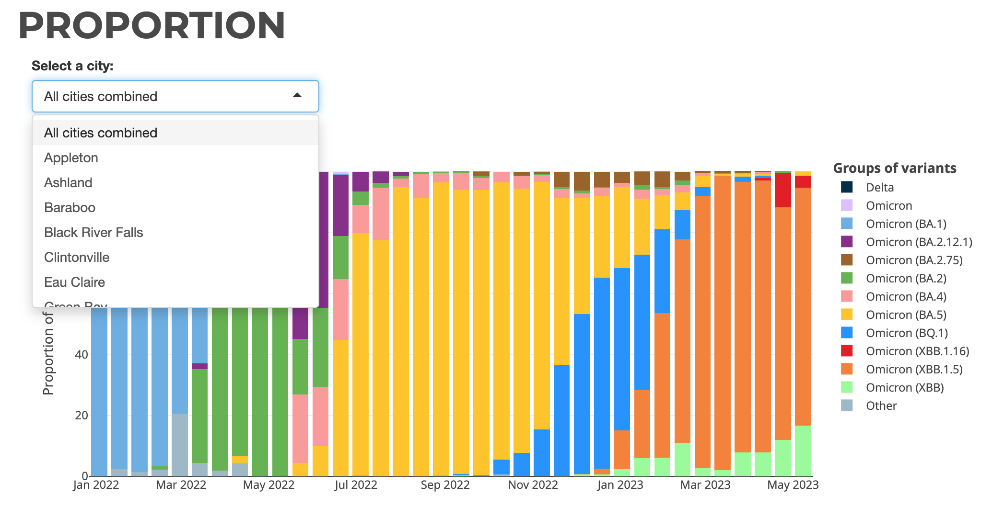
https://dataportal.slh.wisc.edu/sc2-ww-dashboard

Slide 26
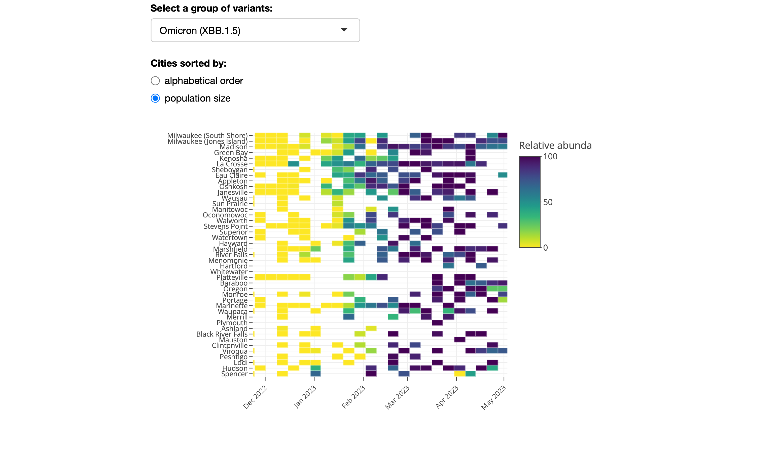
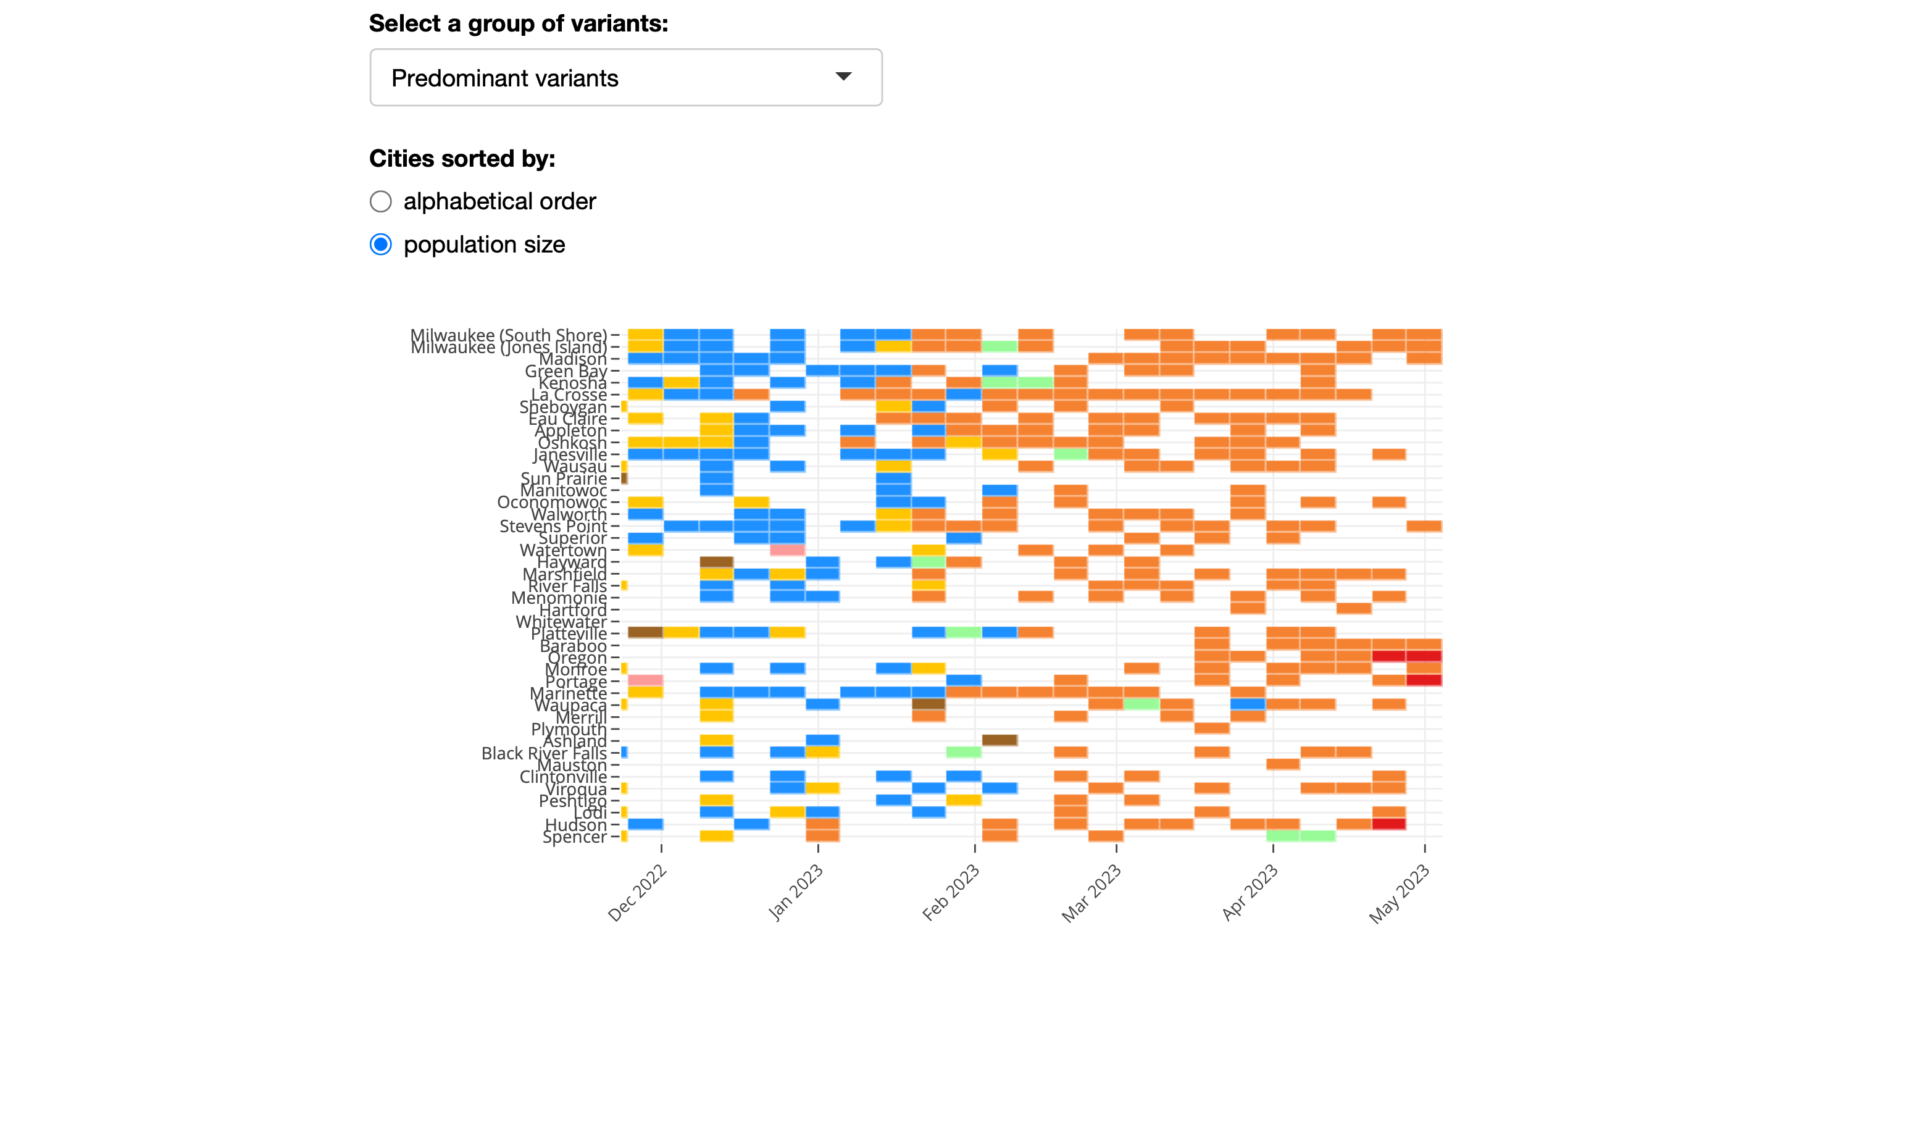
Proportion
XBB.1.5
https://dataportal.slh.wisc.edu/sc2-ww-dashboard

Slide 27
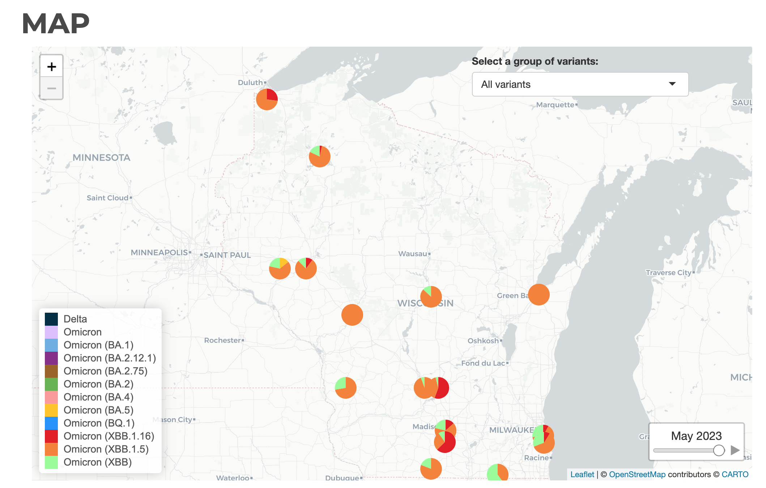
https://dataportal.slh.wisc.edu/sc2-ww-dashboard

Slide 28
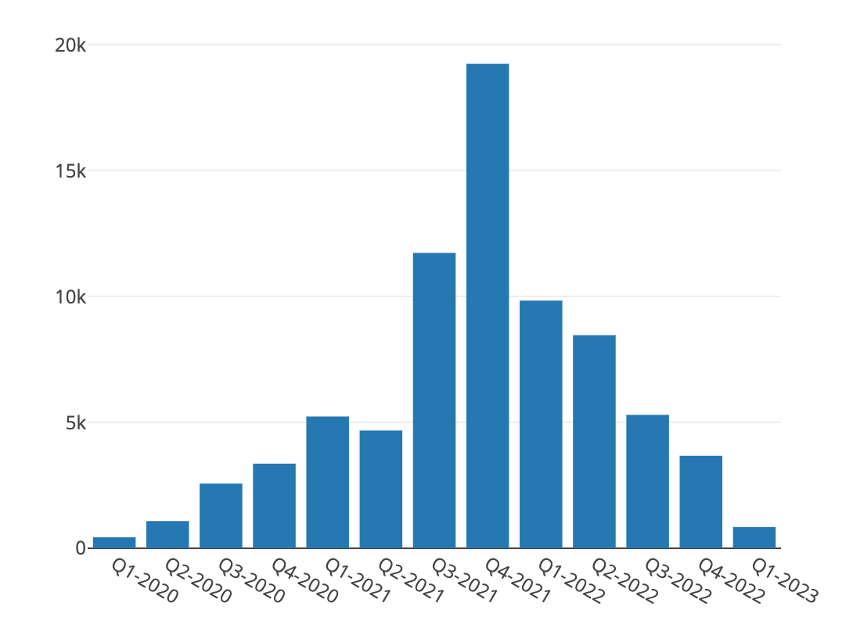
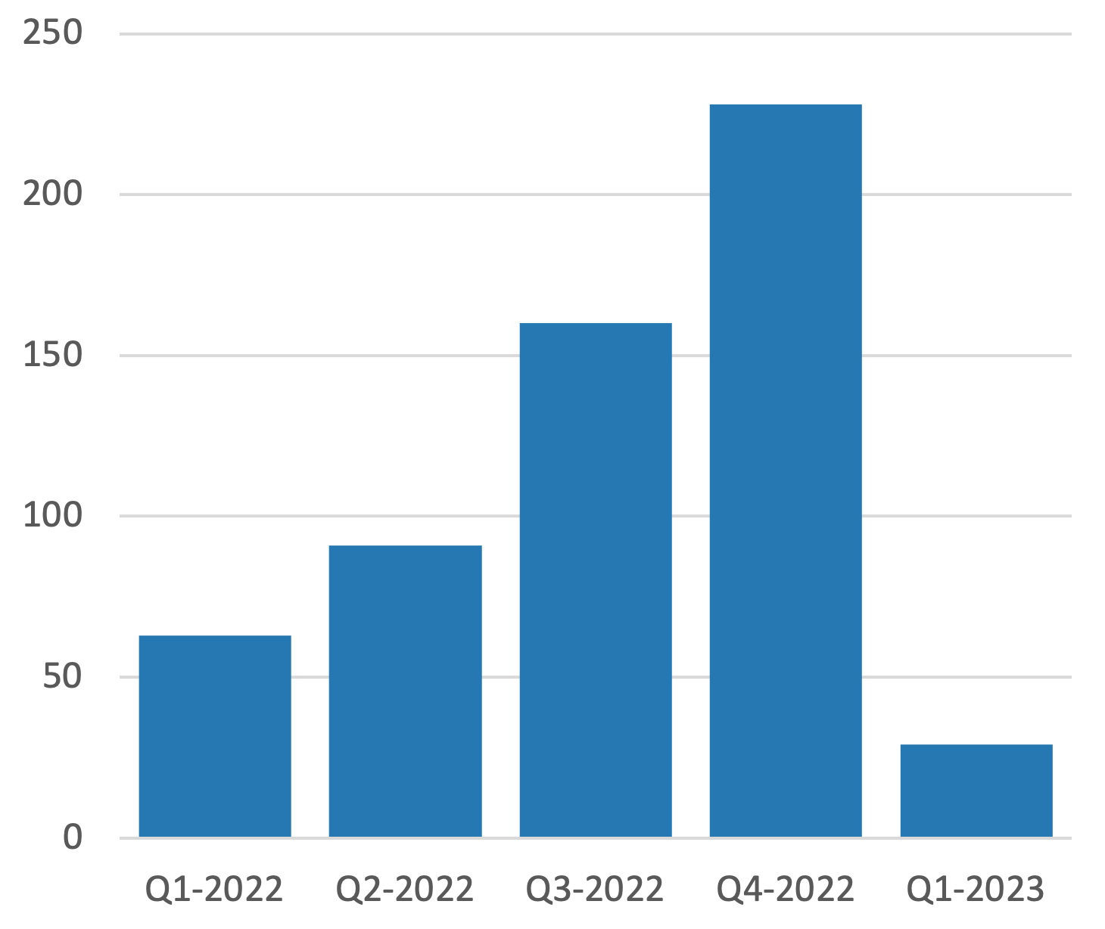
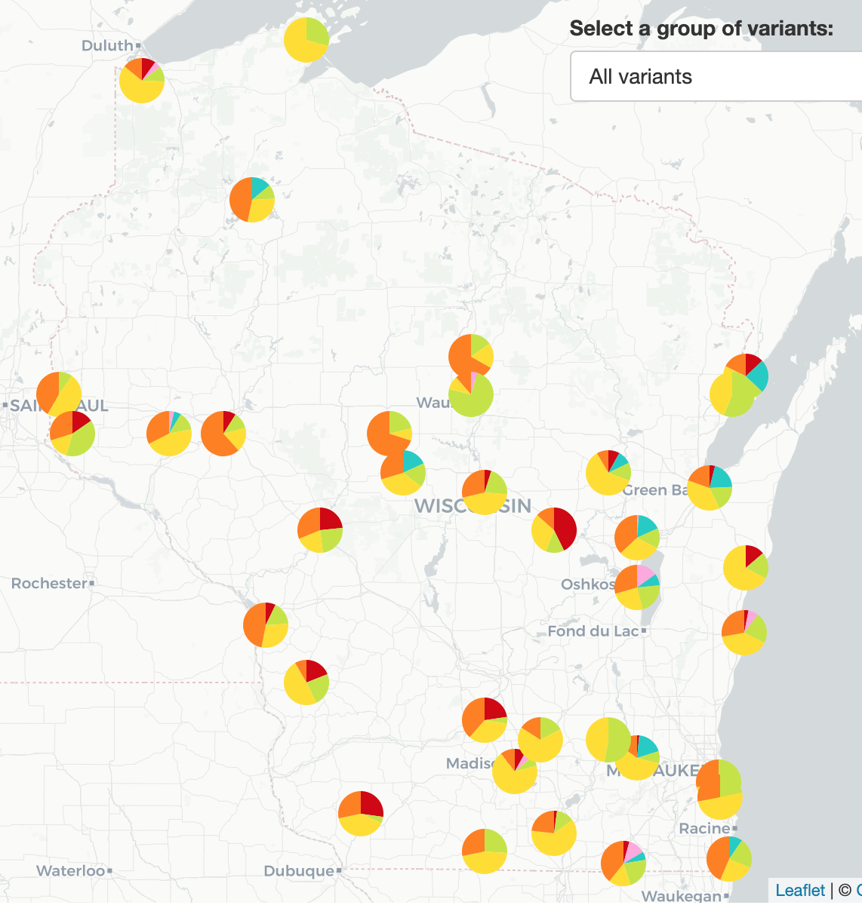
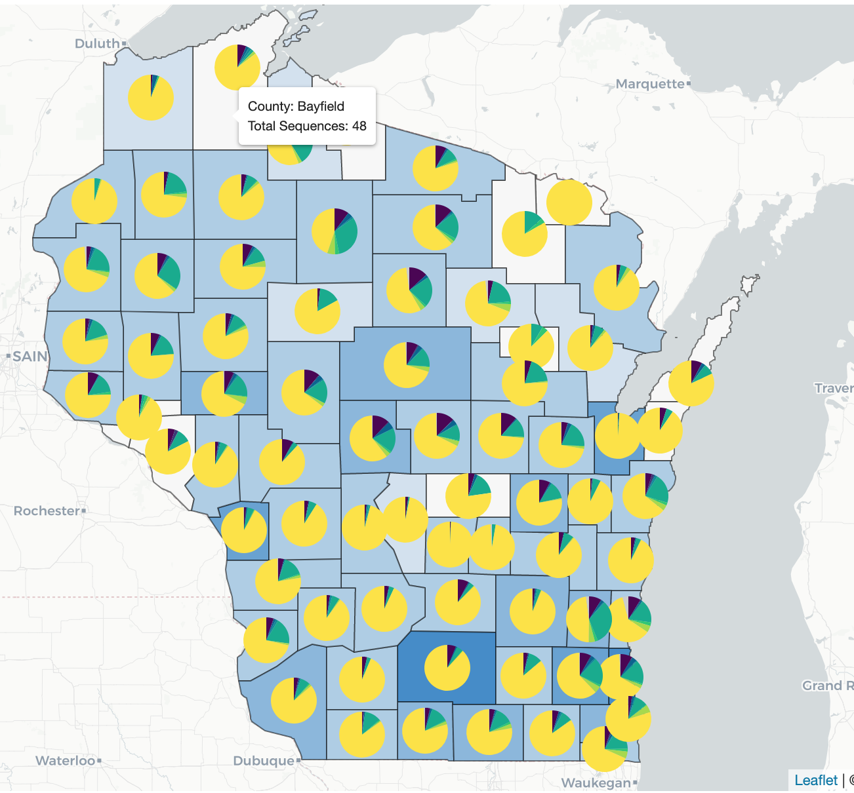
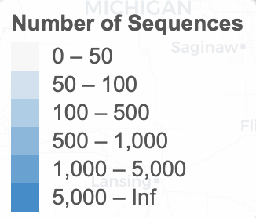
Population coverage
Wastewater surveillance
Clinical surveillance
https://dataportal.slh.wisc.edu/sc2dashboard
No. samples processed
No. samples processed
Sequence 20 samples per week

Slide 29
Genomic surveillance
Wastewater surveillance mirrors clinical trends
Pearson correlation coefficient >0.7
Challenging to validate the presence of low prevalence lineages.
Wastewater represents integrated samples representative of the entire serviced population.
Less bias induced by low clinical testing coverage of certain communities (e.g., urban vs rural).
Independent and complementary to traditional clinical tools
Promising powerful epidemiological tool
Independent and complementary to traditional clinical tools
Promising powerful epidemiological tool

Slide 30
3
SARS-CoV-2 levels
SARS-CoV-2 variants
Beyond SARS-CoV-2 monitoring

Slide 31
Wastewater surveillance in Wisconsin
SARS-CoV-2
September
Routine sampling (72 WWTFs)
December
DHS dashboard launched
July
Transition to (48 WWTFs)
Begin sequencing development
January
Begin routine genomic surveillance
December
WW genomic dashboard launched
2020
2021
2022
2023
2024
January-June
Flu surveillance
September-…
Flu/RSV surveillance
Influenza genomic surveillance
Influenza/RSV
Norovirus/Adenovirus
MDRO/HepA/Rotovirus
31

Slide 32
Influenza/RSV wastewater surveillance
44 WWTFs
48% WI population
~15 WWTFs monitored for …………………….. flu/RSV
(UWM + WSLH)
2x per week
Funded by

Slide 33
Flu/RSV surveillance in Wisconsin
Influenza A and B dPCR (CDC assays): - InfA: matrix protein (M1) gene
- InfB: nonstructural 2 (Ns2) gene
RSV (subtypes A and B) dPCR target nucleoprotein (N) gene (Hughes et al. 2022)
Chung et al. 2021 (Clinical)
Hughes et al. 2022 (WW)
Assay sensitivity is fundamental for wastewater
33
Notes:
Flu is a contagious respiratory illness caused by influenza viruses that infect the nose, throat, and sometimes the lungs. It can cause mild to severe illness, and at times can lead to death. Influenza C virus infections generally cause mild illness and are not thought to cause human epidemics. Influenza D viruses primarily affect cattle and are not known to infect or cause illness in people.

Slide 34
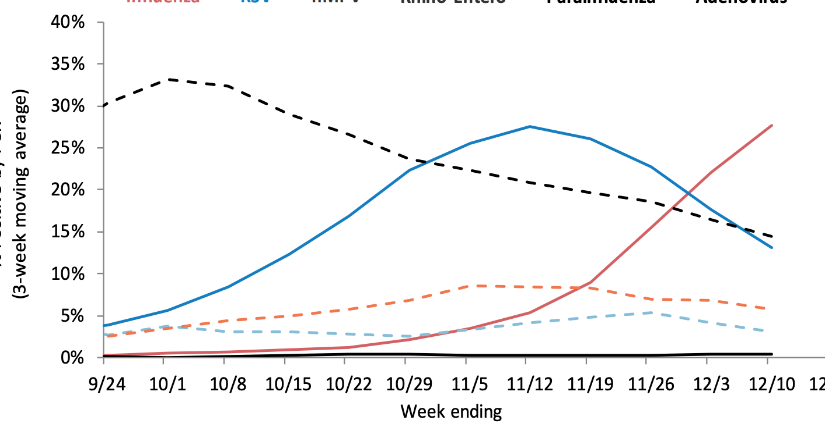
Flu/RSV surveillance in Wisconsin
dPCR level classification
Not detected
Trace
Detected
Detected (high)
LOD
LOQ
34

Slide 35
Flu/RSV surveillance in Wisconsin
2022-2023 season
Not detected
Trace
Detected
Detected (high)
RESPIRATORY VIRUS SURVEILLANCE REPORT
LOD
LOQ
Influenza A
Influenza B
RSV
40%
40%
30%
30%
Sample classification (%)
% Positive by PCR
% Positive by PCR
20%
20%
10%
10%
Week ending
Week ending
Week ending
Wastewater data follow clinical trends (PCR and syndromic data). Early warning for influenza
35

Slide 36
Conclusion
Monitor entire
community in a
sewershed
Wastewater surveillance
No geographic/
demographic/
testing bias
Time efficient
Wastewater surveillance
Complementary & independent
epidemiological tool
Development/Optimization needed
Statistical modeling
Method sensitivity
Decay in sewer network
Shedding variability
Low cost
Test symptomatic & asymptomatic
Public health surveillance
Public health surveillance

Slide 37
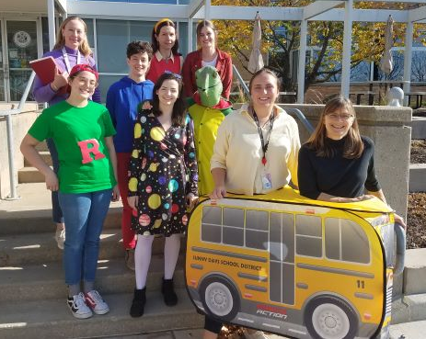
Acknowledgment
Jocelyn Hemming
Martin Shafer
Dagmara Antkiewicz
Kayley Janssen
Angellica, Becca, Devin, Evelyn, Griffin, Hannah, Kaitlyn, Paige, Ellie, Dash
Clinical Division:
Florek Kelsey
Jossart Christopher
Shockey Abigail
WWTF operators
Sandra McLellan
Melissa Schussman
Angie Schmoldt
Shuchen, Melinda, Brooke
Amy Garbe
Jon Meiman
Nathan Kloczko
Matthew Schinwald
Peter DeJonge

Slide 38
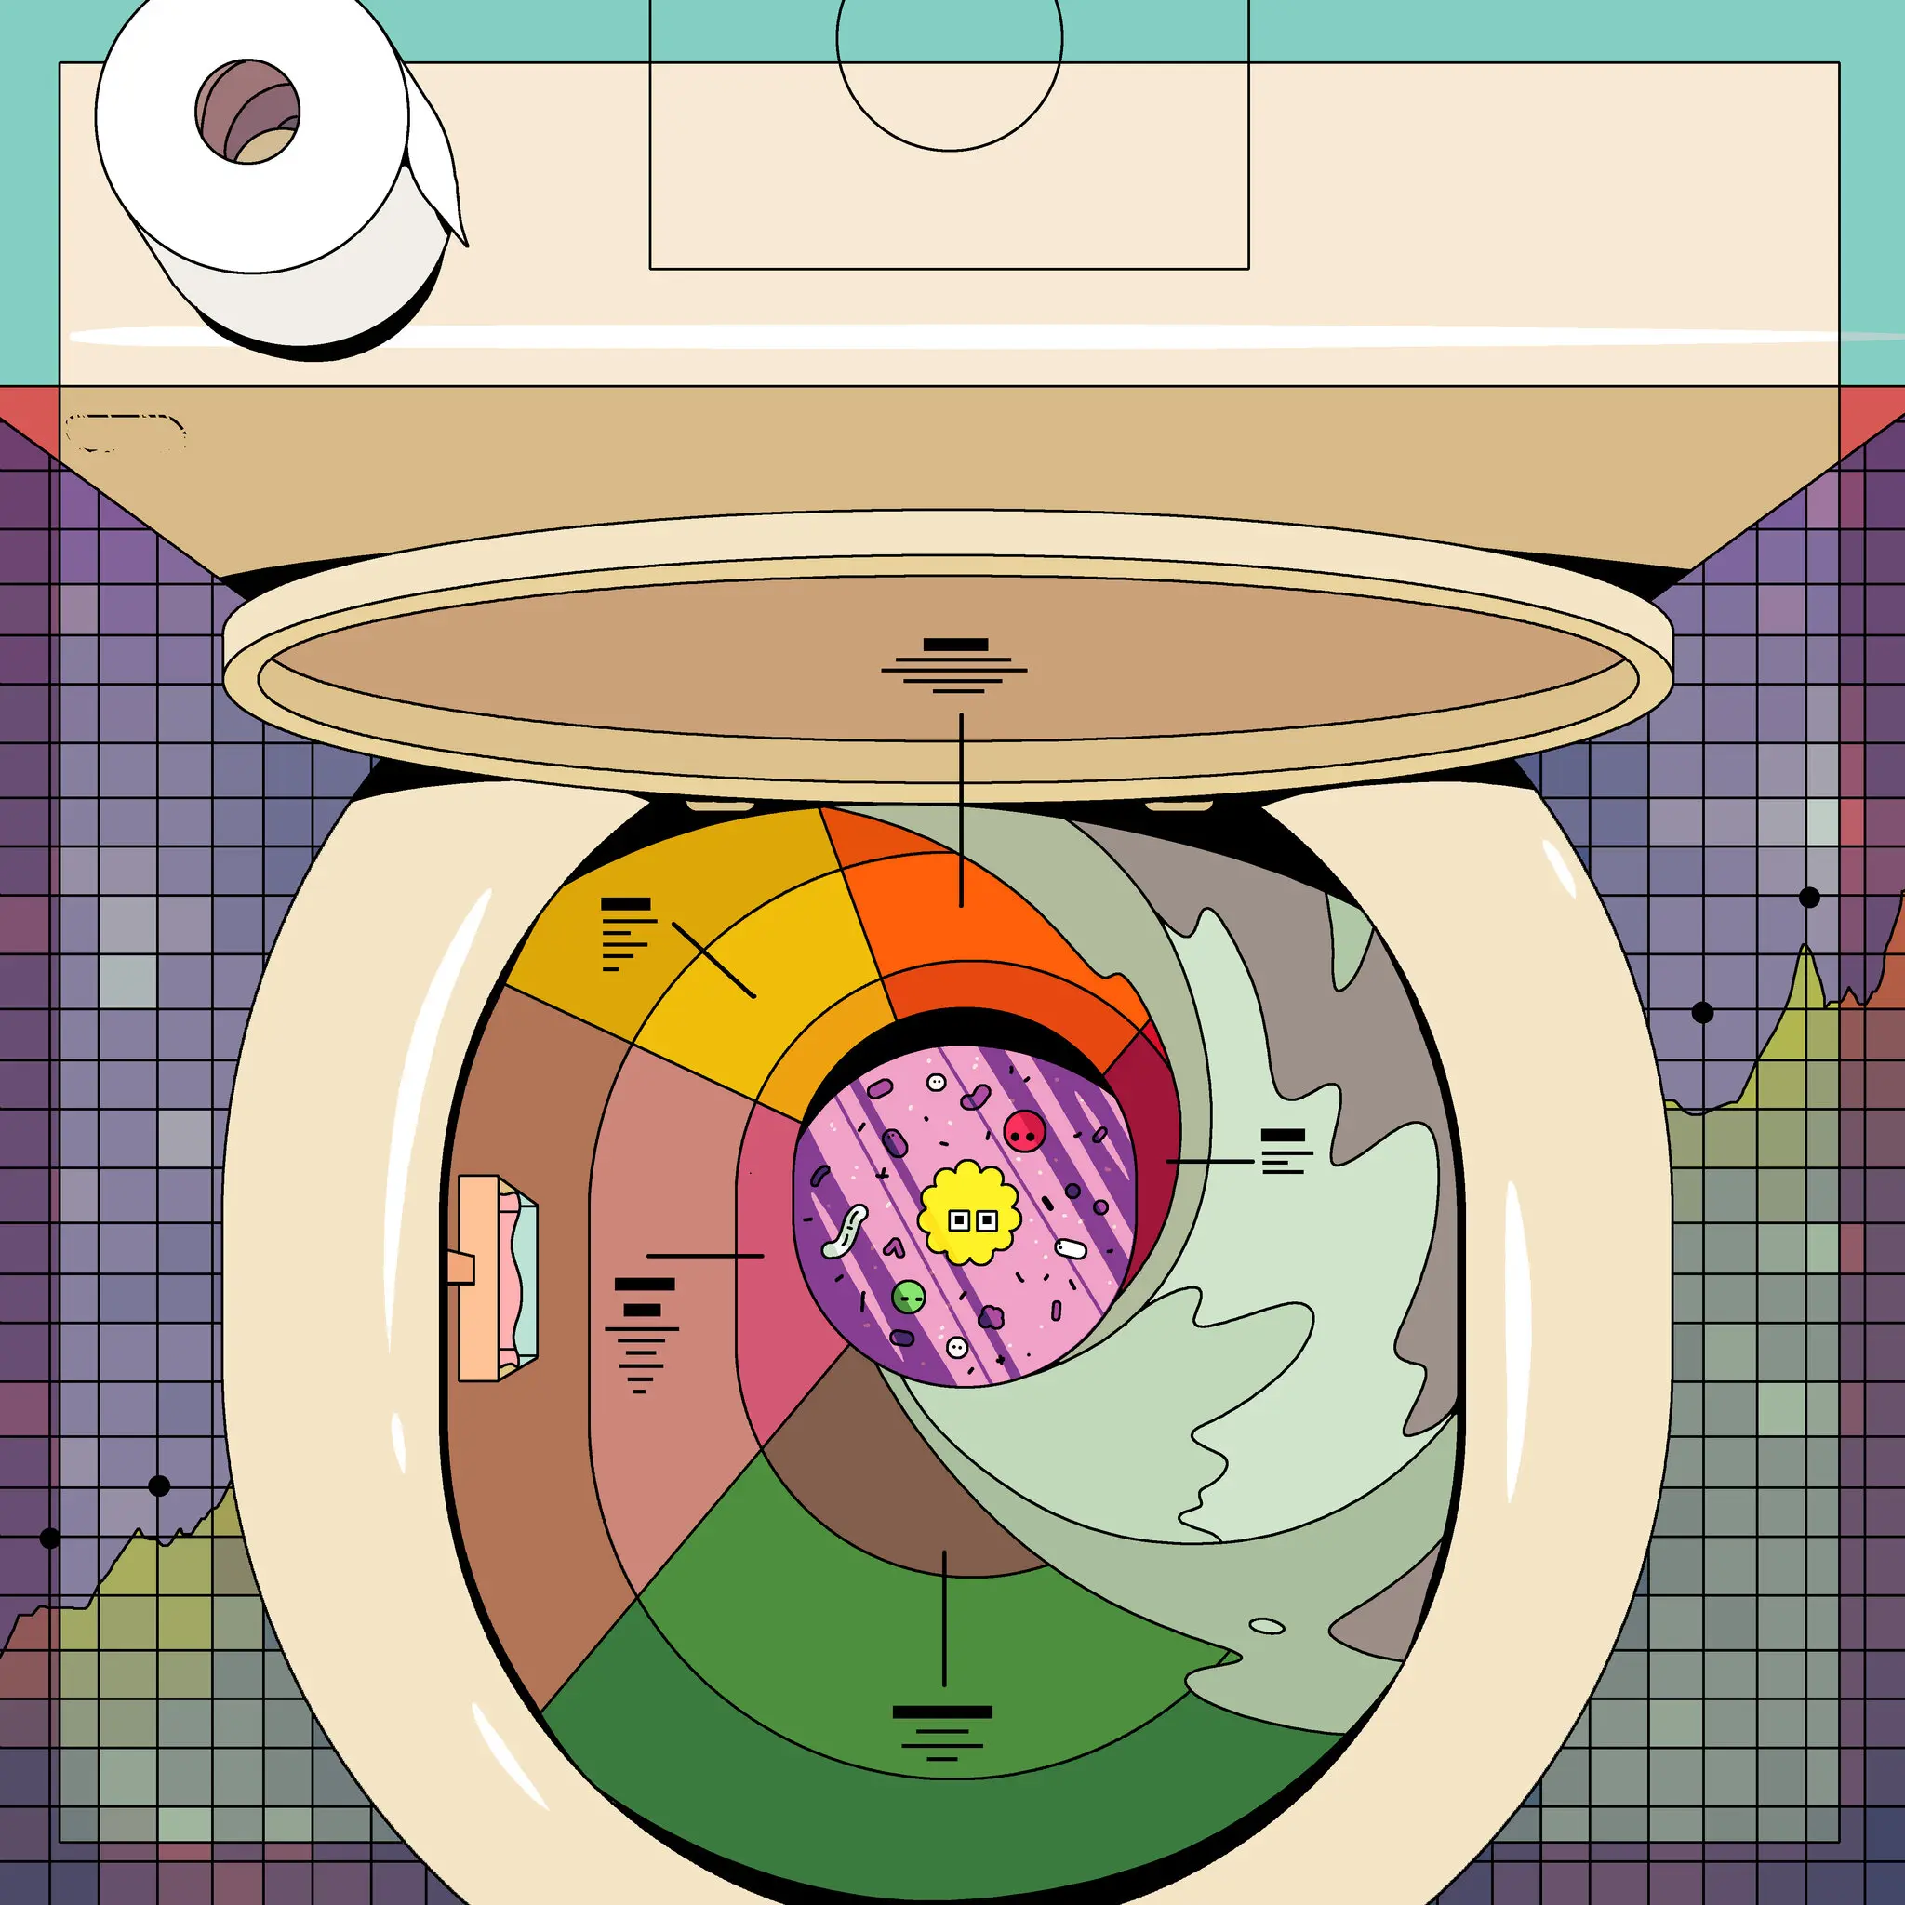
Thank you
https://www.nytimes.com/2020/11/24/magazine/coronavirus-sewage.html

Slide 39
Concentration step
Depth (X)
Better:
depth
genome coverage
The concentration step affects sequencing data quality

Slide 40
Extraction step
Sample 1
Sample 2
Automated extraction (Promega kit)
Depth (X)
Manual extraction (Promega kit)
Better:
depth
genome coverage
The extraction step affects sequencing data quality

Slide 41
SARS-CoV-2
Genome
Tracking SARS-CoV-2 variants

Slide 42
SARS-CoV-2
Genome
Tracking SARS-CoV-2 variants
Single-nucleotide polymorphism (SNP)
Insertion or Deletion (InDel)
Delta
Omicron

