Slide 1

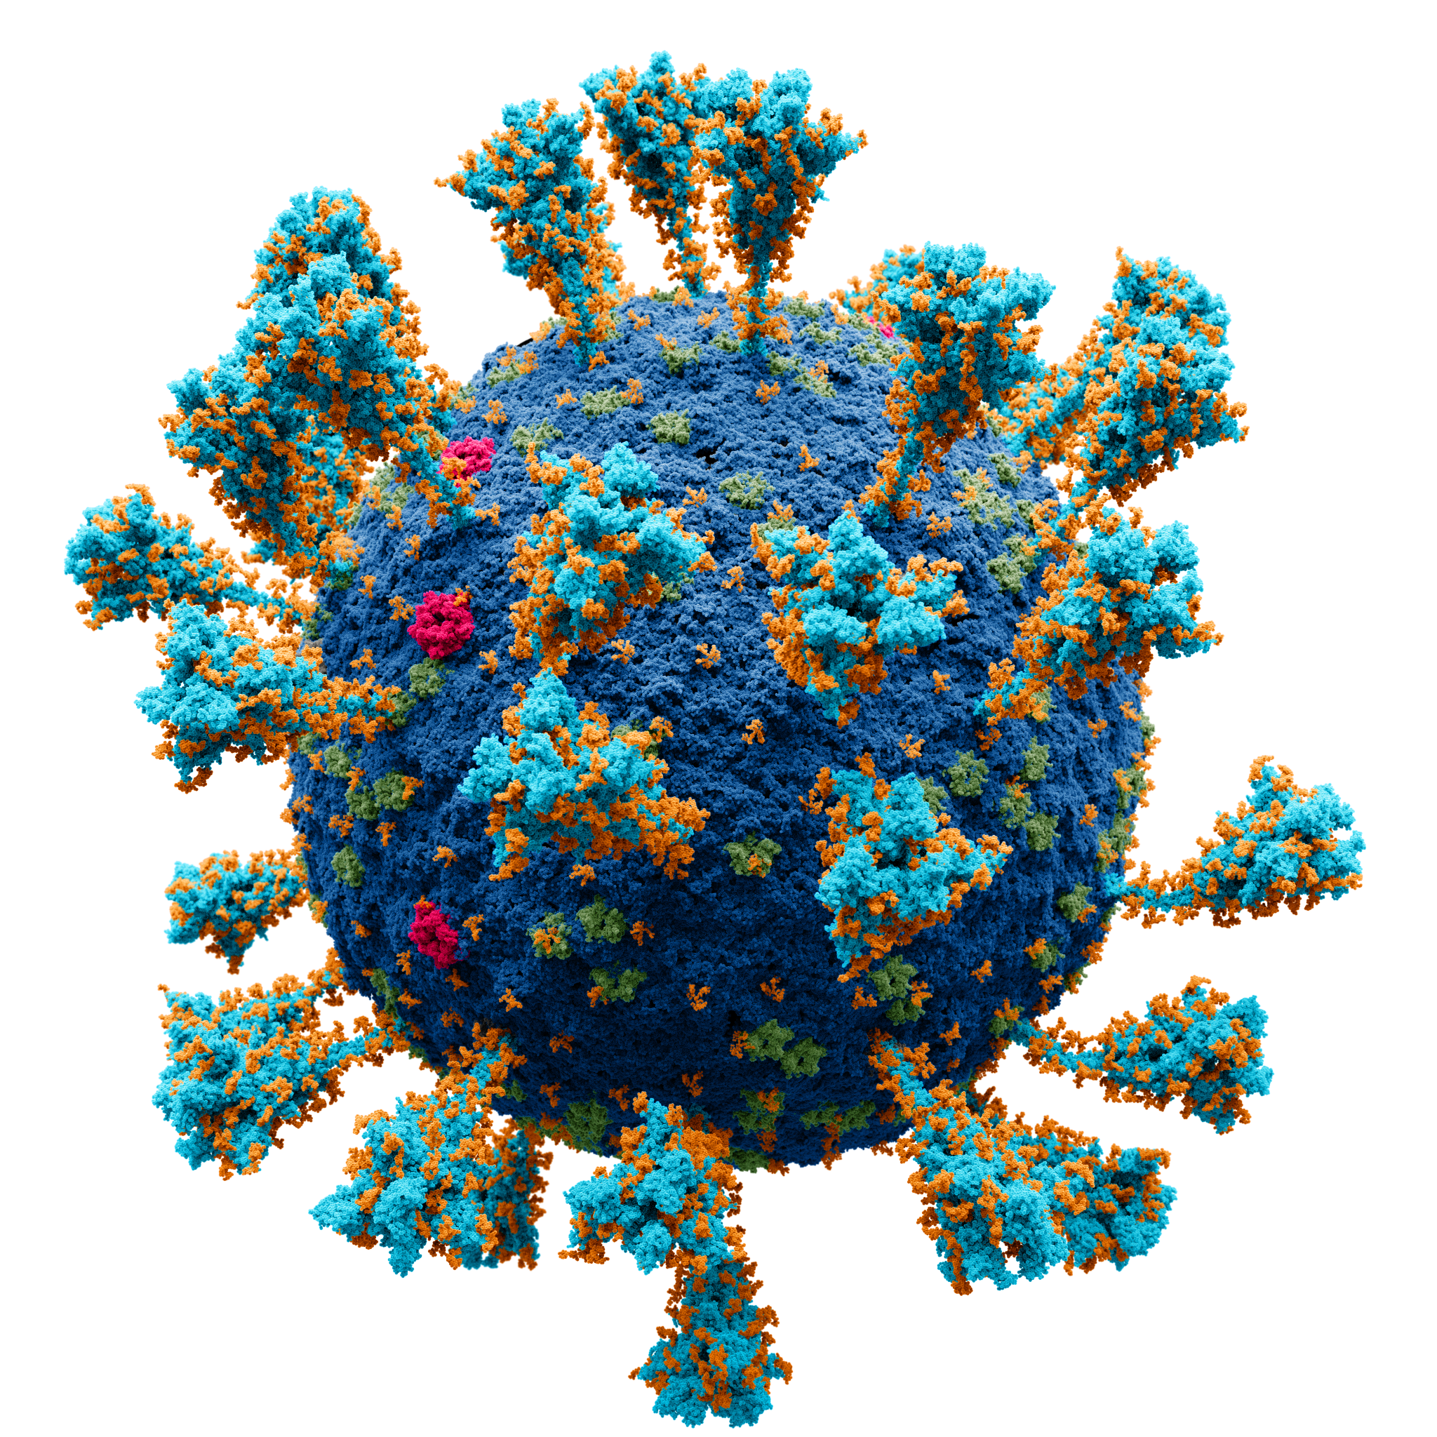
Virology at the Wisconsin State Laboratory of Hygiene:
Diagnostic and Surveillance Testing for Wisconsin and Beyond
Allen Bateman, PhD, MPH, D(ABMM)
Director, Communicable Disease Division
Wisconsin State Laboratory of Hygiene

Slide 2
Outline
Intro to WSLH, CDD, and Virology team
Wisconsin Clinical Laboratory Network (WCLN)
Virology testing
  Respiratory
  GI
  VPD
  Rabies
  Others

Slide 3

State public health laboratory
  ~375 employees
Part of UW-Madison (SMPH)
What do we do?
  Clinical and public health testing
  Teaching
  Outreach
  Research

Slide 4
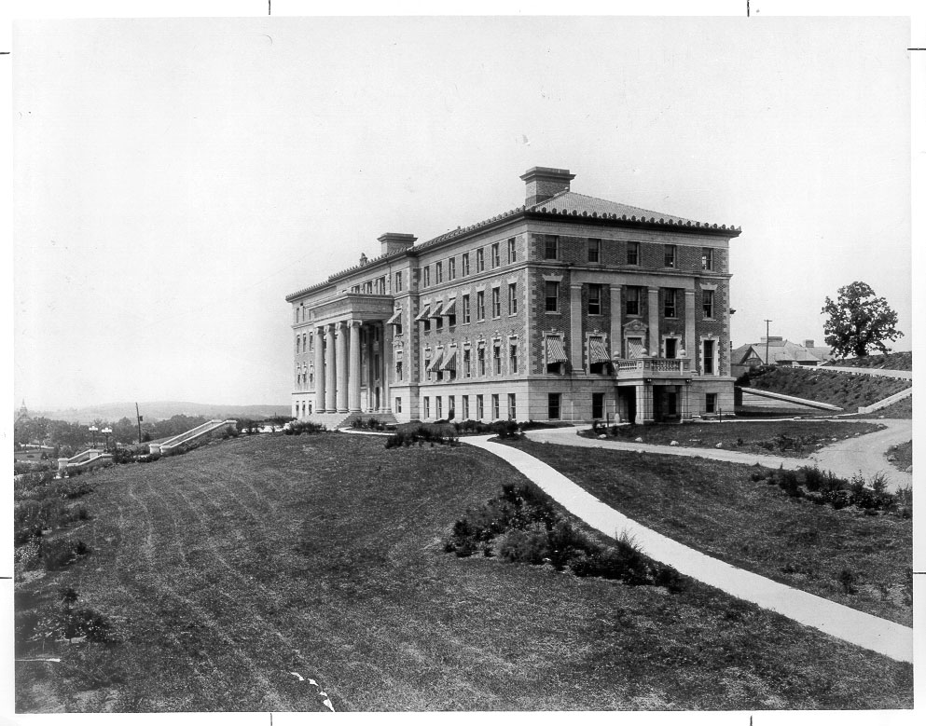
In the Beginning…
1903 Laws of Wisconsin Chapter 344:
$1,500 appropriated annually to UW for establishment and maintenance of a hygienic laboratory in connection with existing bacteriological laboratories
UW-Madison’s Agriculture Hall, the WSLH’s first home, as it was in 1903. During its first year, the WSLH tested just over 100 samples in its modest, one-room basement laboratory.
Notes:
Dr. Harry Russell,
Directed to examine water supplies and contagious diseases such as typhoid, diphtheria, and anthrax

Slide 5
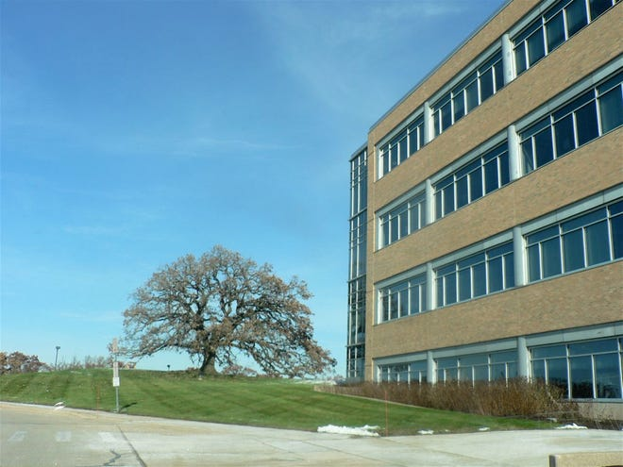
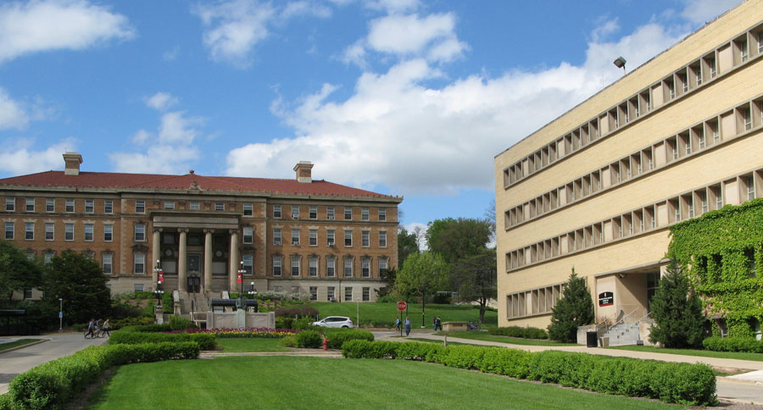
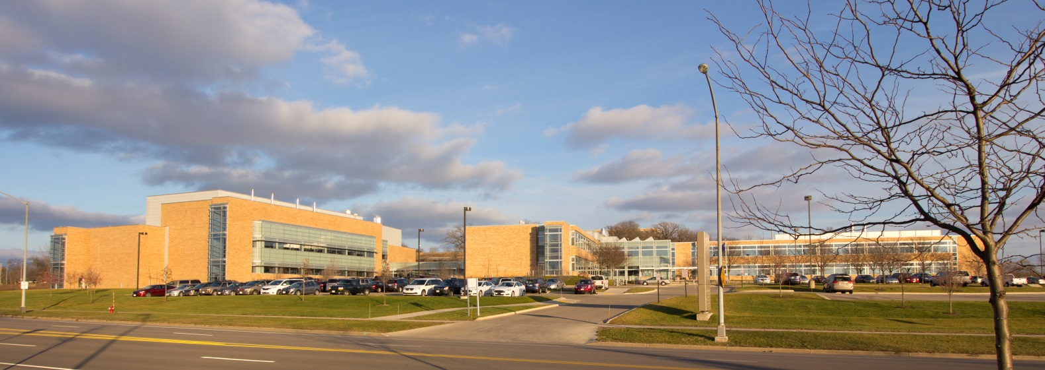
121 Years Later

Slide 6
Newborn screening
Biochemical Genetics
Cytogenetics
Cytology
Occupational Health
Forensic Toxicology
Clinical Metals Toxicology
Drinking Water Quality
Communicable Diseases
Emergency Response
Air
Quality
Notes:
newborn screening, cytogenetics and biochemical genetics, cytology, occupational health, Forensic and clinical metals toxicology, emergency response, communicable diseases, and a large environmental health division that includes air quality, drinking water quality, and many other areas of testing.

Slide 7
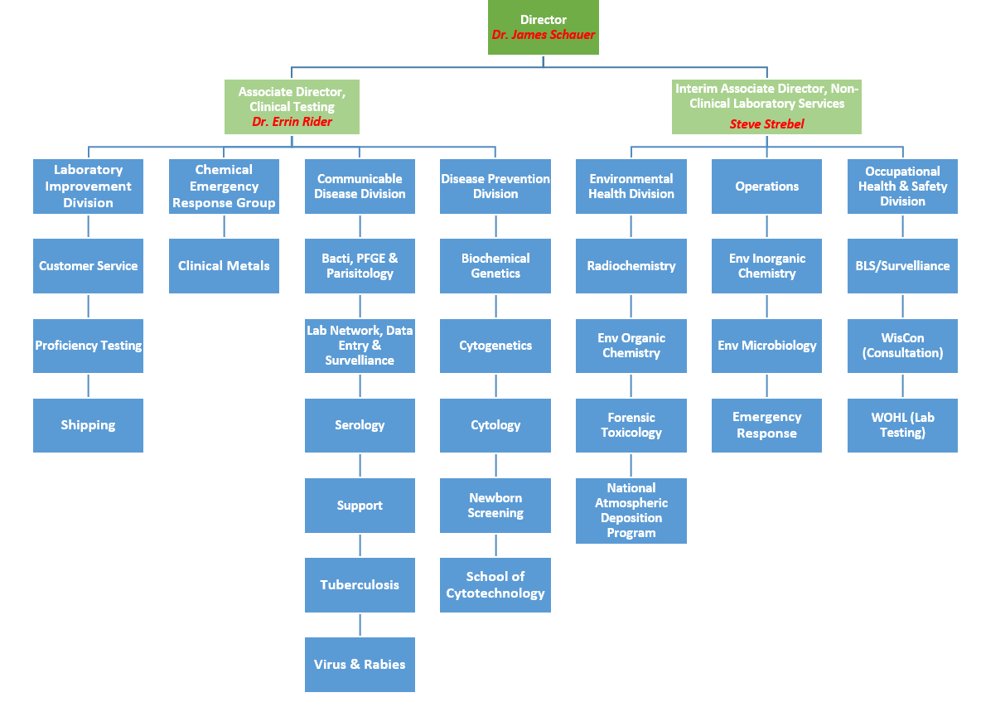
All-star group of 8 testing microbiologists

Slide 8
Outline
Intro to WSLH, CDD, and Virology team
Wisconsin Clinical Laboratory Network (WCLN)
Virology testing
  Respiratory
  GI
  VPD
  Rabies
  Others

Slide 9
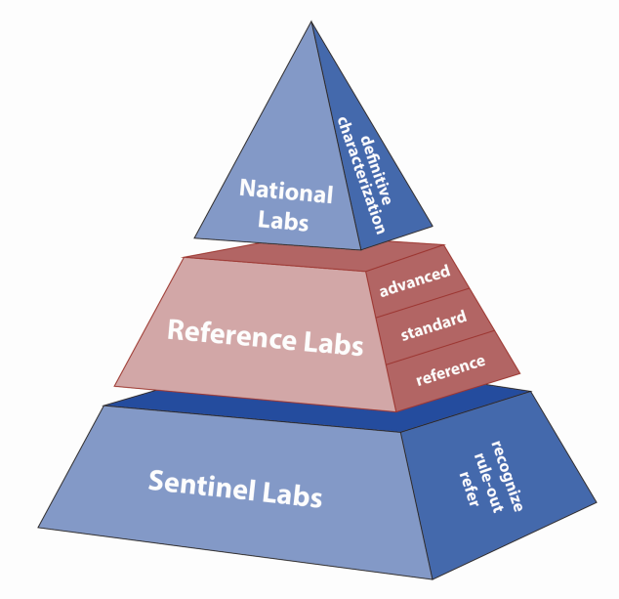
The Laboratory Response Network (LRN)
A Model for Networking and Emergency Response
National Labs – CDC,
USAMRIID, NMRC
Reference Labs - State & local PHLs, state agency labs
Sentinel Labs - Community clinical hospital labs
An integrated network of state & local public health, clinical, federal, military, & international laboratories to respond to bioterrorism, chemical terrorism and other public health emergencies.
MMWR Recommendations and Reports
April 21, 2000 /Vol. 49 / No. RR-4
Notes:
The concept was first conceived and articulated in 2000 in a strategic plan developed by the CDC and the PHL and clinical lab communities
Talk about how it intially came to be; PHL directors having dinner and drinks after a meeting, talking about how to structure this. It was actually first drafted on a napkin, which unfortunately wasn’t kept, available anymore otherwise it would probably be worth something!
Reference lab (State PHLs) central to the LRN
Strong historical working relationship with the CDC
Highly state-variable relationship between PHLs and CDC
Little in the way of uniformity or interactions among PHLs and how the interact with CDC
Big differences state-to-state in capability and capacity

Slide 10
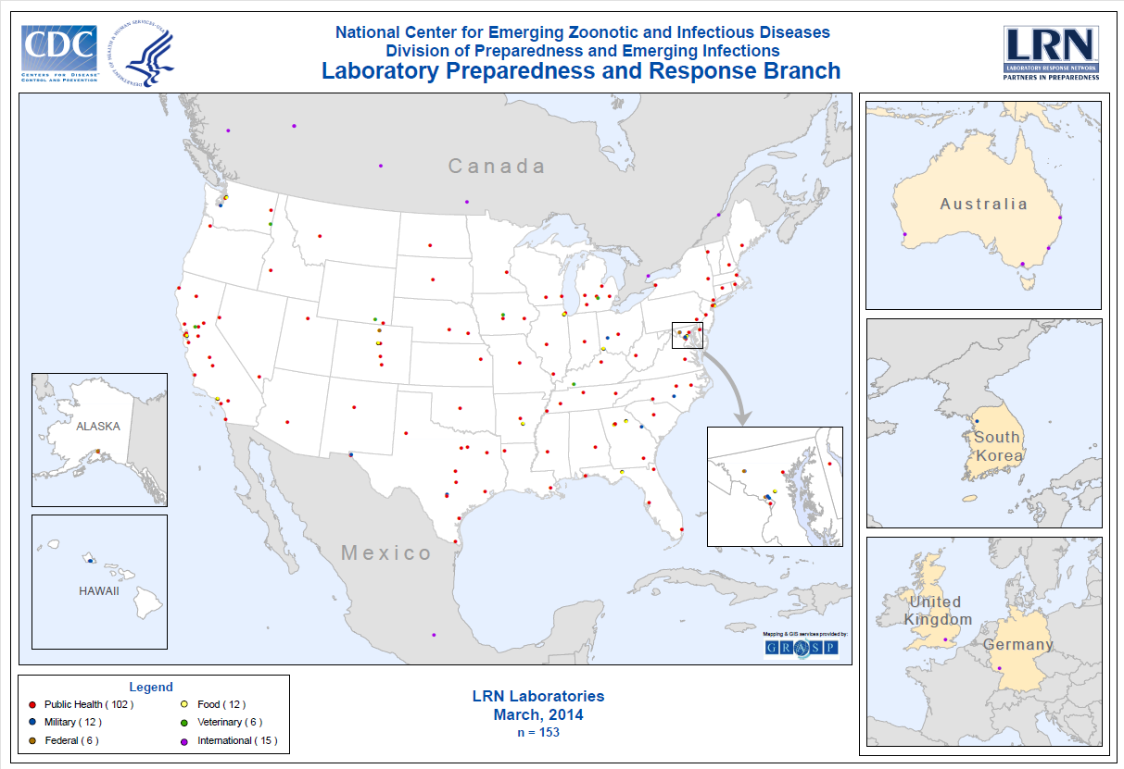
Laboratory Response Network (LRN) Reference Laboratories
More than 150 federal, state and local labs in 50 states and abroad
Notes:
Talking Points:
The foundation of the LRN is its member laboratories.
Points on the map represent both reference and national labs..
Reference labs are state and local public health labs, military labs, veterinary, Ag, food and water testing labs. The goal is to have at least one BSL3 lab in each state.
This structure is designed to enhance the public health infrastructure by integrating the expertise and capacity of labs nationwide and globally.
Increase consistency in capability and capacity in PHLs and in how they interact with CDC and improve interoperability among PHLs
Rather than a few labs performing rapid lab testing, more labs are capable of such testing in the event of an outbreak.

Slide 11
Emerging Infectious Diseases: it’s not all about biothreat agents
General preparedness to prevent and respond to
“All Hazards”
(aka, outbreak response and surveillance of whatever comes next!)
Notes:
Basic enhanced epidemiology and lab capacity (ELC) for foodborne, flu surveillance, zoonotic disease, etc.
Another defining event was concerns with H5N1 that first arose in 1998 and again 2003
Concerns with pandemic preparedness and lots of planning beginning around 2003
CDC began to develop new PCR methods, validated in PHLs and trying to get out to PHLs…a warm base
Then the pandemic hit and along with this a surge in funding
Infusions of funding after the 2009 Influenza A H1N1(2009) pandemic, ebola (2015-16), Zika and AR(2016-17)
Also separate funding Coops for TB and HIV
All of these meant to build public health infrastructure to respond to “all hazards”
All of these help to build laboratory and epidemiology surveillance and response capability/capacity (next slide)

Slide 12
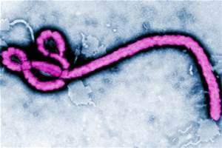
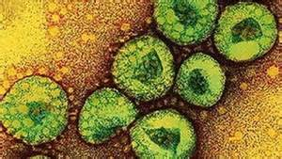
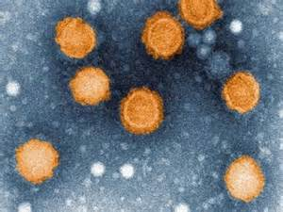
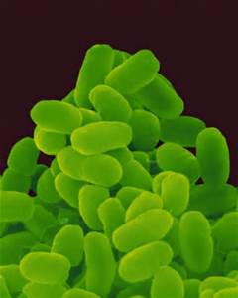
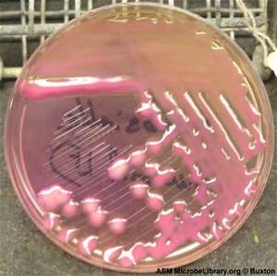
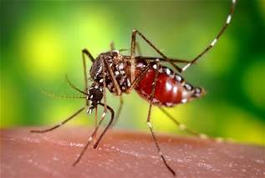
What Has “All Hazards” Looked Like Recently?
Mpox
SARS-CoV-2
Elizabethkingia spp.
Zika virus
Dengue
Chikungunya
Ebola virus
EV-D68
SARS/MERS CoV
VPDs (measles, mumps, pertussis)
Foodborne outbreaks
Antibiotic resistance
Influenza A H1N1/pdm09, H5N1,
H5Nx, H7N9, H3v, H1v
Notes:
We continue to see a mix of novel events and long standing threats
Others in recent past include priority BT agents, anthrax (intentional) and naturally occurring (Francisella, Burkholderia, Brucella); Monkeypox
Influenza threat include H5N1, 2009H1N1, H3N2v and H1N1v, H5N2, as well as recent severe seasonal H3N2
For each of the listed diseases, explain how the LRN/WCLN and its partners has responded to the threat; a common pattern
PH response at state and national levels
State-of-the-art diagnostics developed at CDC and verified/validated in subset of PHLs(WSLH consistently included)
Roll out of these methods to state PHLs→Serve as the state’s diagnostic facility on short term since commercial sources of test materials(for clinical labs) and testing services (by commercial and larger clinical labs) likely not available early on in outbreak
PHLs begin to message and train their clinical lab partners. (e.g training on biosafety, diagnostics coming down the pipe); PH message and train the clinical response community (Hospitals, etc.)and communities
As diagnostic methods developed for clinical labs, PHL role evolves to helping them evaluate new tests(provide validation panels) and once these are brought on line, serve more of a role as a reference lab (confirming results, collecting isolates and specimens, collecting and collating data and providing ongoing information exchange, communication and training
PH and hospitals need to be aware that this is going on with their clinical labs and be aware of the clinical lab’s “sentinel role”. This was the vision for the LRN!

Slide 13
The Wisconsin Clinical Laboratory Network:
An “All-hazards” Network of Sentinel Labs
Douglas
Bayfield
Ashland
Iron
Washburn
Sawyer
Vilas
Burnett
Price
Oneida
Forest
Florence
Polk
Barron
Rusk
Marinette
Lincoln
St. Croix
Dunn
Chippewa
Taylor
Langlade
Oconto
Clark
Marathon
Menominee
Pierce
Eau Claire
Shawano
Pepin
Wood
Portage
Waupaca
Door
Buffalo
Trempealeau
Jackson
Outagamie
Kewaunee
Brown
Juneau
Waushara
Winnebago
Manitowoc
Monroe
Adams
LaCrosse
Marquette
Calumet
Fond du Lac
Sheboygan
Vernon
Sauk
Columbia
Green Lake
Richland
Dodge
WCLN Sentinel Labs
Crawford
Washington
Ozaukee
Dane
Jefferson
Waukesha
Milwaukee
Grant
Iowa
LaFayette
Green
Rock
Walworth
Racine
Kenosha
Notes:
I gave that long background on bioterrorism and Biothreat agents, because the LRN model encouraged a broad outreach to clinical labs, rather than just specific disciplines like virology or mycobacteriology.
The Wisconsin clinical Lab Network grew out of this ‘all-hazards’ approach
Sentinel labs
Comprised of clinical laboratories
Not necessarily voluntary
An emphasis on biosafety
Employ strict BSL-2 laboratory practices, safety equipment and facility design
Presumptive diagnosis in covert event
RECOGNIZE and REPORT to a LRN Reference Laboratory any BT suspicion, incident or inquiry
RULE OUT suspected BT agents
REFER suspect isolates or specimens to a LRN Reference Lab
No testing role for environmental specimens in overt event
This map of WI shows the approximate location of the clinical laboratories I work with in the WCLN. Our efforts in networking began over 20 years ago in WI and we’ve been sharing our model with other states in how to develop a laboratory network.
Creating our WCLN required identification of each of our clinical laboratory partners and establishing points of contact within each lab
We started our WCLN list of labs from the laboratories in the virology and TB networks we had already developed Additionally we called all the WI’s hospital labs on a list provided by the Wisconsin Hospital Association.
Keeping our list of contacts up-to-date and accurate, is a constant challenge.
New hospitals have opened, and others have closed their doors
The primary change, however, has been the change from independent stand alone hospitals laboratories to networked hospital healthcare systems.

Slide 14


What is the WCLN?
Comprised of 135 clinical and public health laboratories
~60 laboratories perform microbiology testing
WCLN coordinated by the Wisconsin State Laboratory of Hygiene
WSLH partners with and is supported by a Laboratory Technical Advisory Group (LabTAG)
Notes:
What is the WCLN?
Created after Sept. 11, 2001 with the conception of the LRN the WCLN is comprised of a total of 135 hospital and large clinic laboratories and a few public health laboratories. Of these 135 laboratories only 60 are true Sentinel Clinical Laboratories possessing the required testing capabilities in accordance with the recently revised Sentinel Clinical Laboratory Definition.
In WI, laboratories are primarily associated with one of 11 healthcare systems that often consolidate microbiology testing to one location, with the remainder of the laboratories being located in small – midsize independent hospitals that are more often located in more rural areas.
Although WCLN is coordinated by WCLN we truly want member laboratories to feel that they jointly own the network. It is essential that we partner with and have the support of our LabTAG. LabTAG serves as the voice of the clinical labs in planning all WCLN activities which helps to keep our network strong.

Slide 15
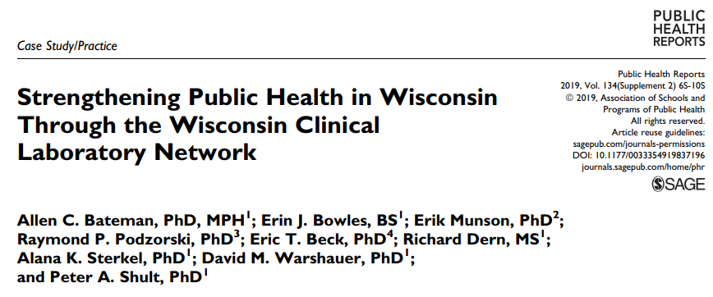
WCLN activities
Four main categories:
Emergency response
Training and education
Facilitating communication
Public health surveillance
Notes:
So, even though WCLN grew out of the all-hazards response to bioterrorism, there are many other aspects that have been incorporated. I’ll go over each of these in turn now.

Slide 16


Public Health Surveillance
Data, samples, isolates
Data summaries,
surveillance reports
Bacteriology (AR and invasive)
Mycobacteriology
Virology
Molecular gastropathogen
Notes:
As for public health surveillance, we request data, samples, and isolates from clinical labs to us at the state lab. We then provide data summaries and surveillance reports for many infectious diseases, including bacteriology, mycobacteriology, virology, and enteric pathogens.

Slide 17
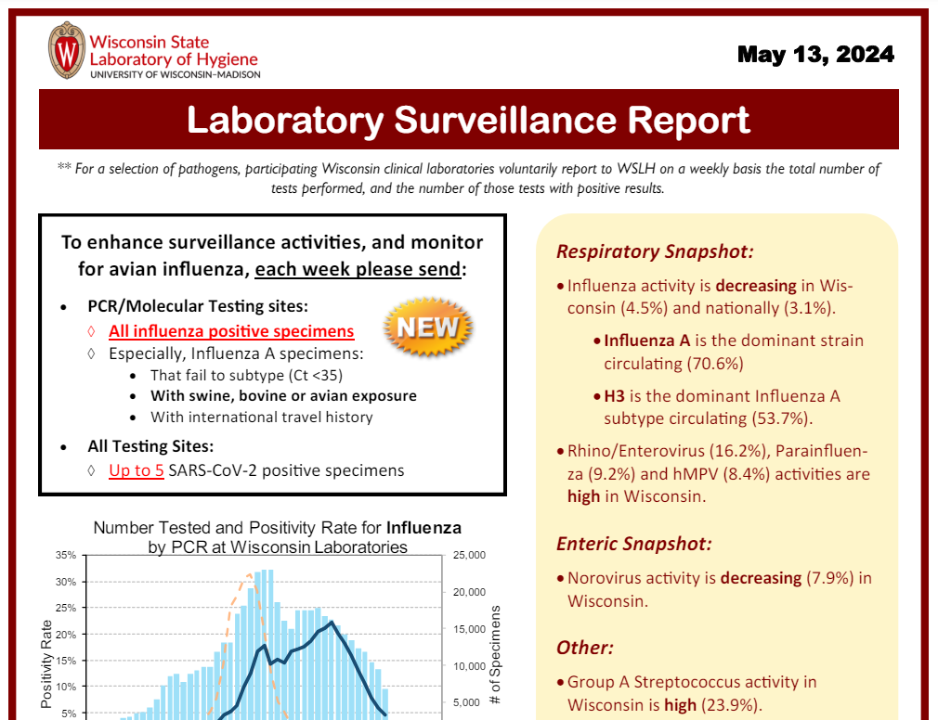
Public Health Surveillance

Slide 18
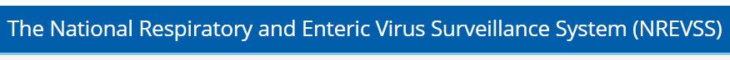

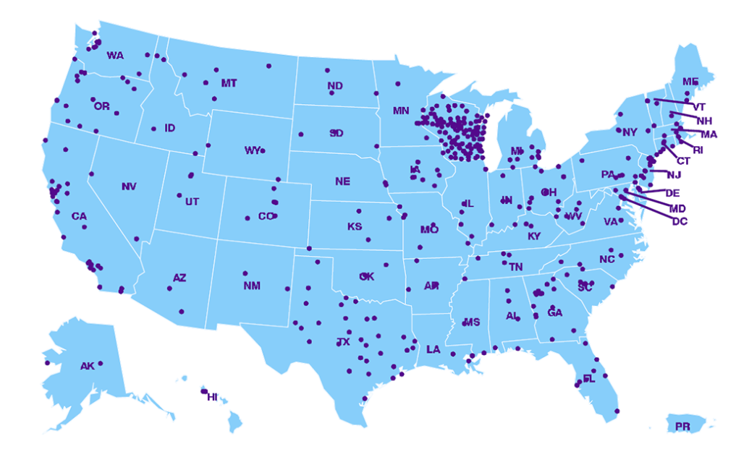
WCLN is the linchpin of strong surveillance in Wisconsin. Thank you to WCLN labs for your participation!

Slide 19
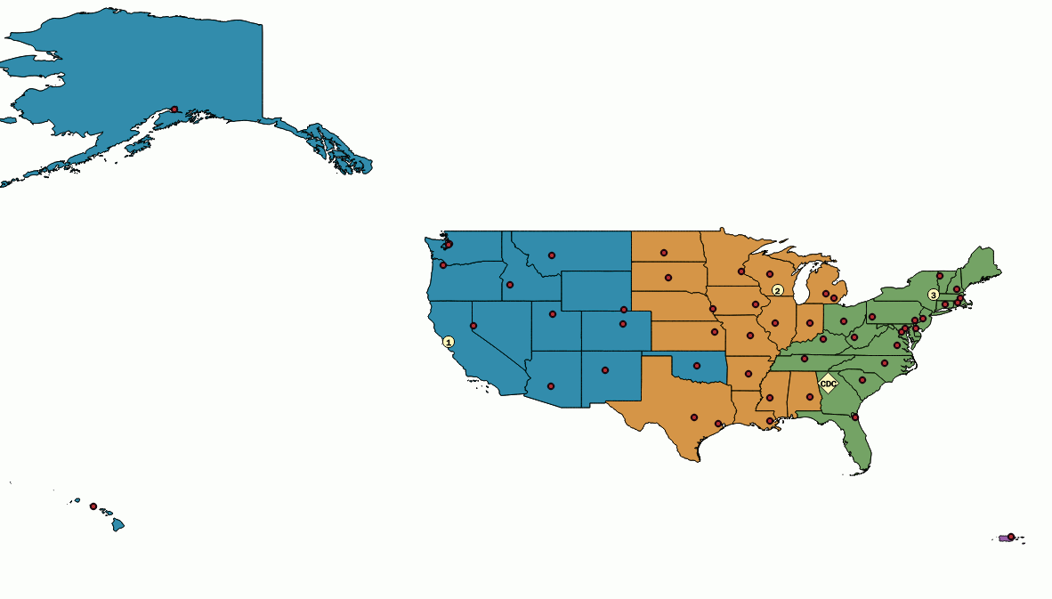

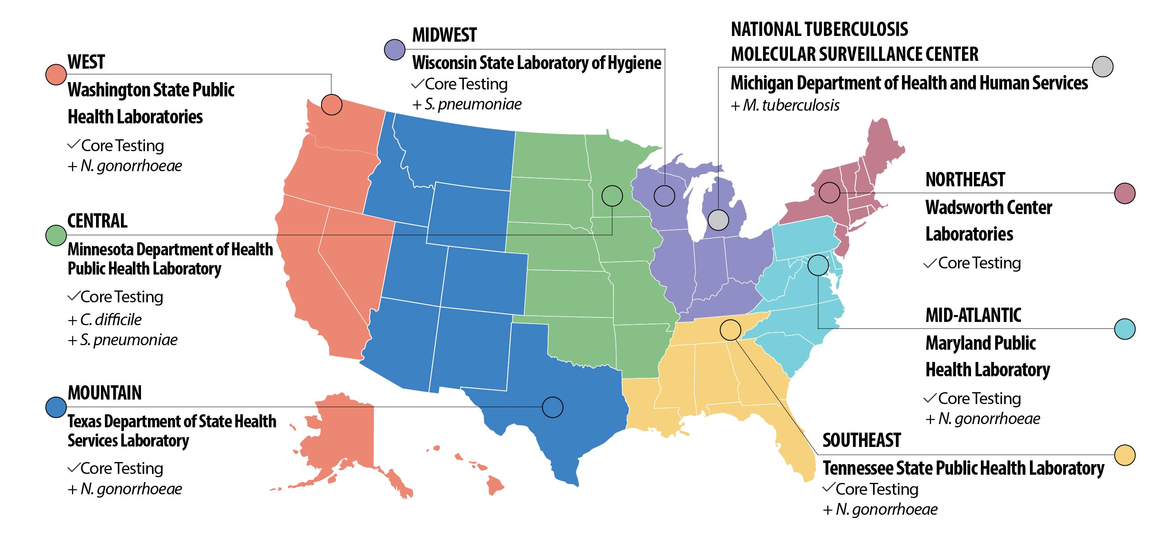
WSLH CDD as a National Reference Center
NIRCs
Influenza virologic surveillance (NIRC)
CaliciNET
  Norovirus surveillance
Vaccine Preventable Diseases (VPD)
  Viral and bacterial
Antibiotic Resistance
Laboratory Network (ARLN)
Bioinformatics Regional Resource
Parasitology
The ARLN
Notes:
NIRC: WGS, virus growth + HA for antigenic assessment, NAI testing
VPD: identification from CSF by PCR (clinical labs may not be able to do this), subtyping/serotyping for Bacteriology (S pneumo serotype replacement) to inform vaccine composition
ARLN: CRE ID/AST/PCRs, CRE colonization, C auris ID/AST, C auris colonization
CaliciNET: genotyping for overall surveillance information and outbreak detection

Slide 20
Outline
Intro to WSLH, CDD, and Virology team
Wisconsin Clinical Laboratory Network (WCLN)
Virology testing – diagnostic and surveillance
  Respiratory
  GI
  VPD
  Rabies
  Others

Slide 21
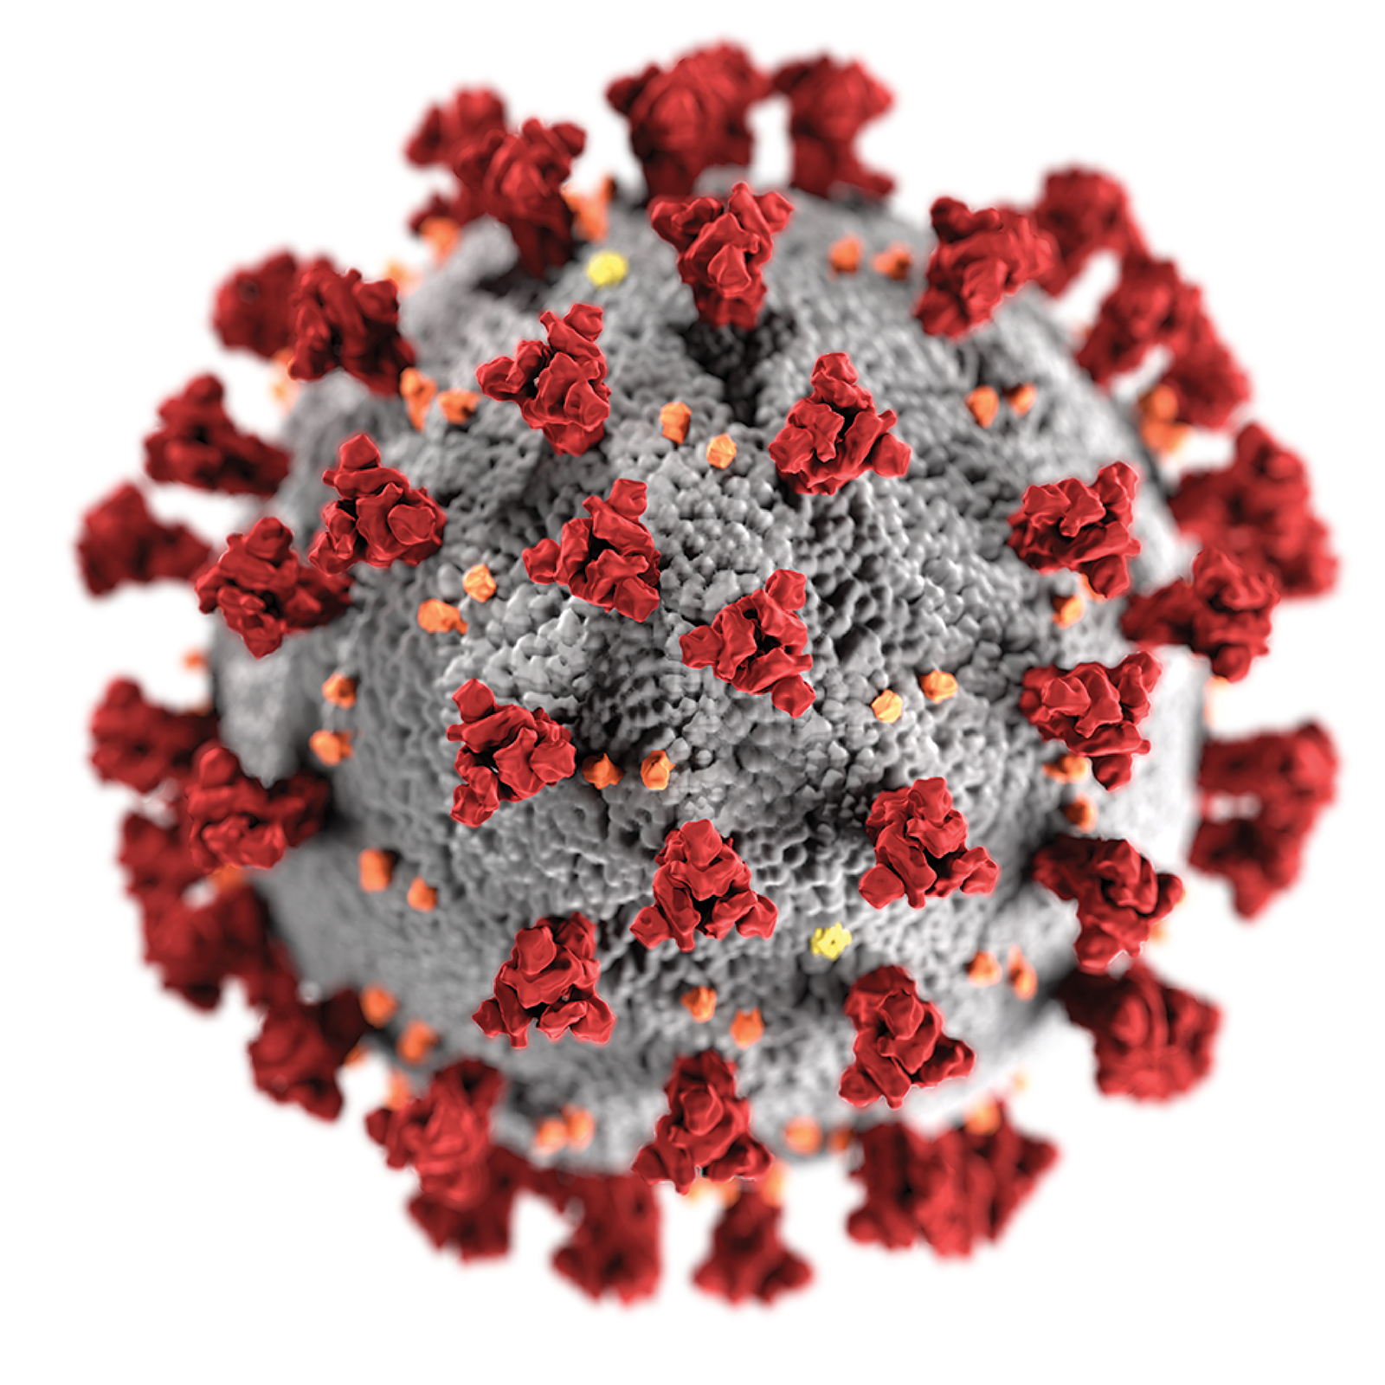
Diagnostic testing:
Public Health Labs and Emerging Infectious Diseases (EIDs)
Among the first labs to offer testing for EIDs
  Usually are viruses!
Typically, CDC-developed tests rolled out
  CDC
  State/local PHLs
  Commercial and clinical labs
Influenza H1N1 pdm09
MERS (2012-present)
Zika virus
SARS-CoV-2
Mpox

Slide 22
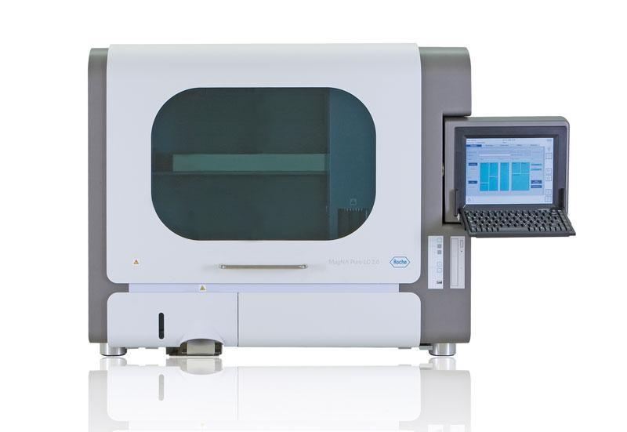
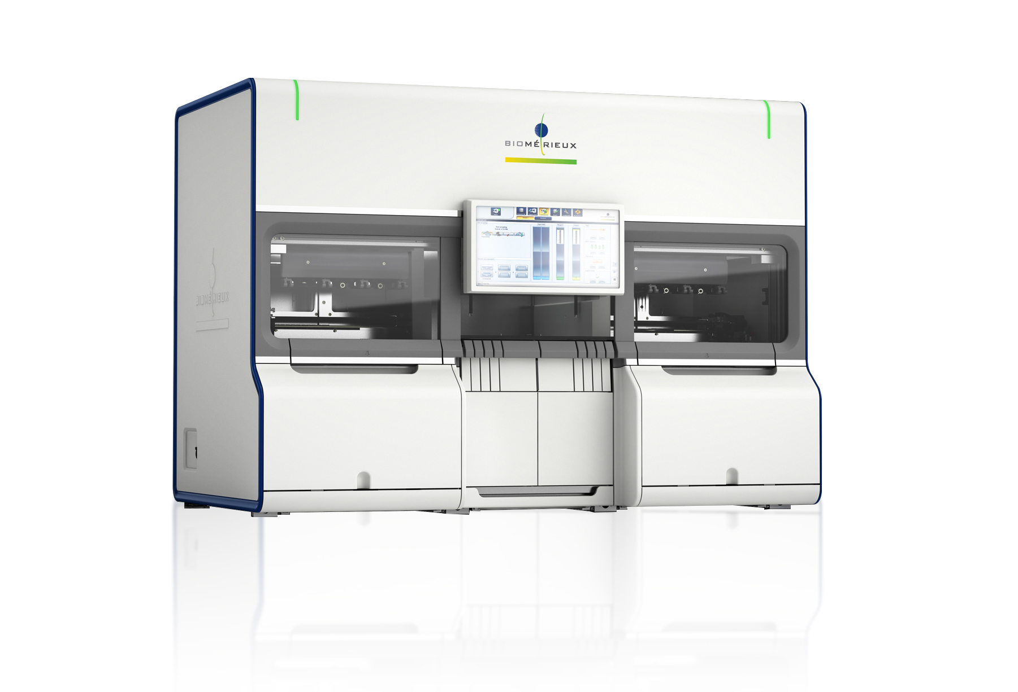
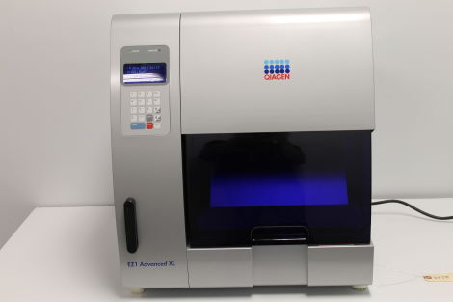
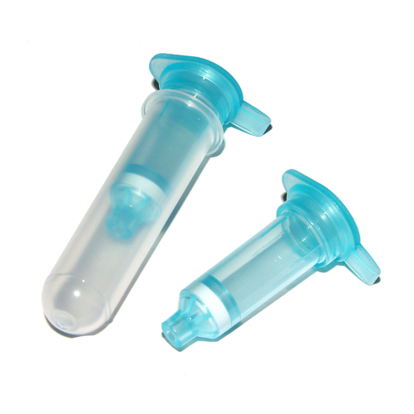
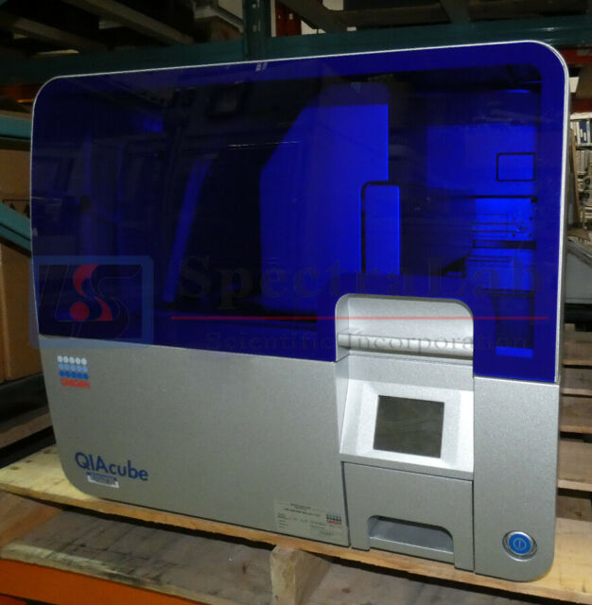
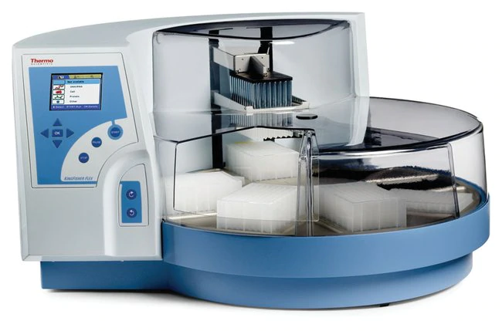
SARS-CoV-2 Testing Advancements at WSLH:
RNA extraction
Magna Pure LC - 24 samples
eMAG - 48 samples
EZ1 - 14 samples
Spin column – low volume
KingFisher Flex - 96 samples
QIAcube HT - 96 samples

Slide 23
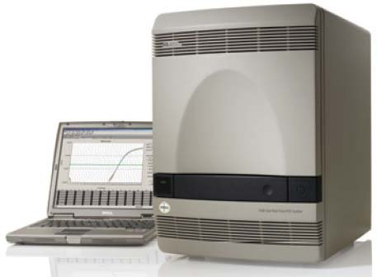
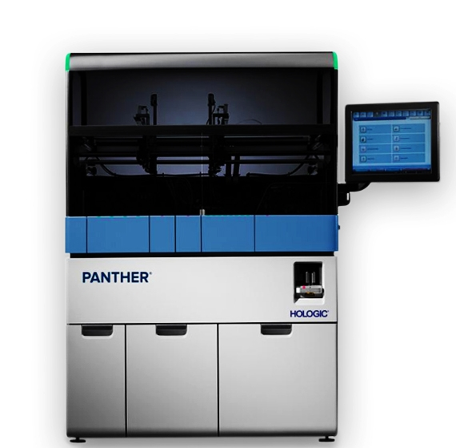

Max Testing
+
x2
Hologic Panther- 300/8hr

Slide 24
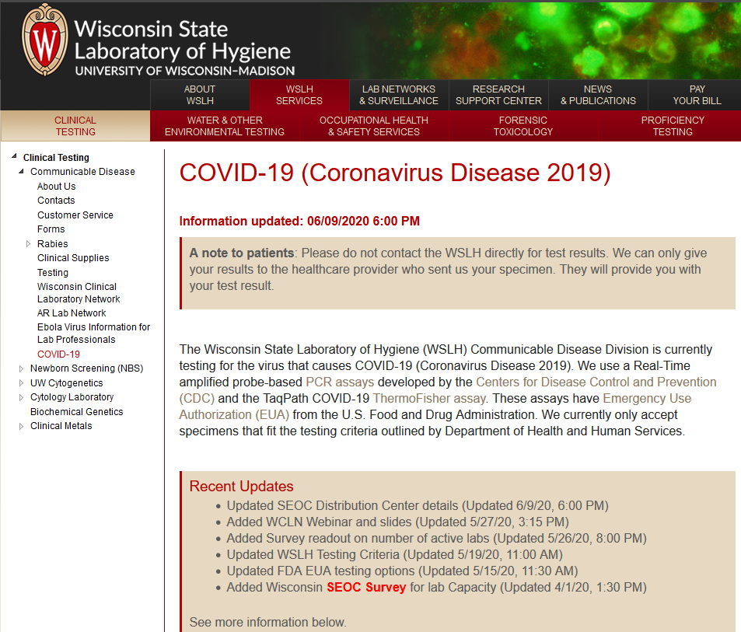
Statewide – Wisconsin Clinical Laboratory Network
Spring 2020:
  Detailed Webpage
  >120 Validation Panels
  15 Webinars
  >25 Lab Messages
  Email listserv for active community discussion
  Technical Consultants

Slide 25
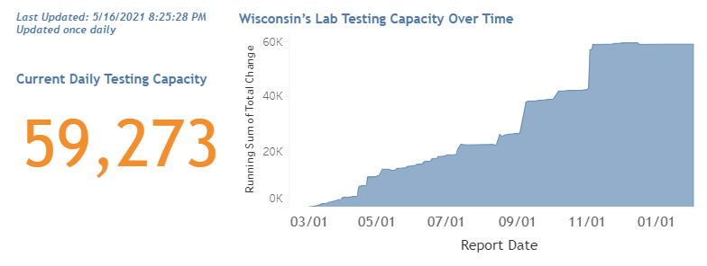
Statewide Estimated Daily Test Capacity

Slide 26
Respiratory Diagnostic Testing in Non-emergency Scenarios
    Respiratory outbreaks
      Work with DHS and/or local public health departments
      Run FluSC2 (flu A, flu B, and SARS-CoV-2) and respiratory pathogen panel to determine an etiology
      Etiology drives response
        Tamiflu for prophylaxis of LTCF residents, for example
    Flu subtyping (H5, H7) when contact with birds and symptomatic

Slide 27

Purposes of Respiratory Virus Surveillance
Depends on the pathogen
All respiratory viruses
  Situational awareness of what is circulating, to inform clinical decision-making and public health response
Influenza, RSV, and SARS-CoV-2
  Track circulating strains to inform vaccine strain selection
  Detect antiviral resistance
  Isolate viruses for inclusion into future vaccines (flu)
  Detect novel influenza viruses with pandemic potential (flu) or novel variants (SARS-CoV-2)

Slide 28
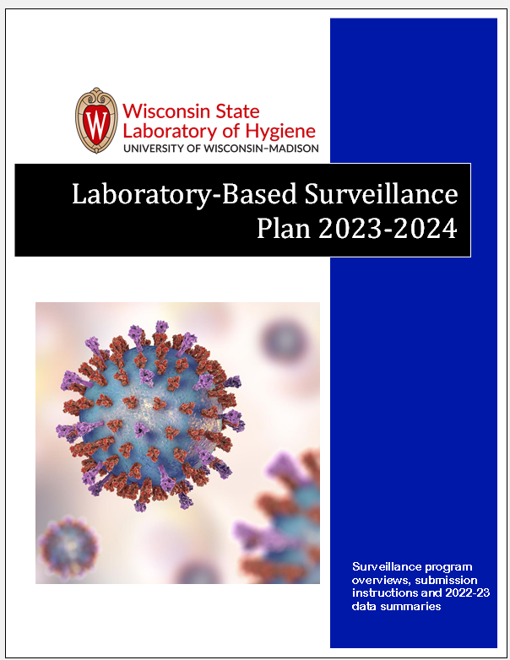
Respiratory Surveillance in Wisconsin
Plans are outlined in the “Laboratory-Based Surveillance Plan 2023-24” booklet
PDF version available online at
  www.slh.wisc.edu/wcln-surveillance/
  Two Branches of Surveillance:
Reporting of clinical testing data
Submission of surveillance specimens
Notes:
For the 2023-24 season, we have taken steps toward the goal of a more unified approach to surveillance of respiratory pathogens, particularly SARS-CoV-2 and influenza. The WSLH surveillance plan for 2023-24 is detailed in the Laboratory-based surveillance plan booklet. The booklet was sent out to clinical labs in the fall mailing, and the pdf version is also available online on the WSLH website.
There are two main branches of Surveillance methods utilized in Wisconsin, Reporting of clinical testing data and Submission of specimens for surveillance testing.

Slide 29
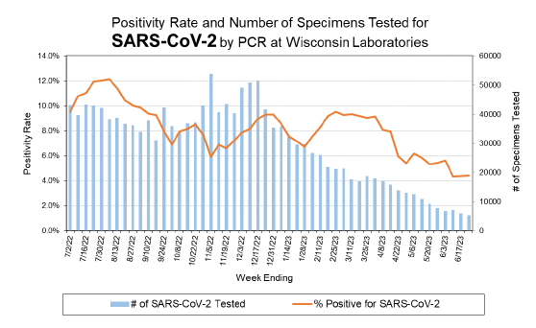
Reporting of Clinical Testing Data
Report data weekly all year!
  All Clinical labs
  Report # tested and # positive for PCR/molecular and/or rapid antigen testing performed
  Complete list of pathogens found in the Laboratory-based surveillance plan 2023-24
Testing data reporting helps track positivity rates of pathogens in WI
Notes:
For reporting of clinical testing data, we request that all clinical labs performing testing for respiratory pathogens report their testing numbers weekly, all year round. Data submitted should include the number tested and the number positive for each pathogen, as well as the test method that was used. We would like testing data for rapid antigen testing, and PCR or other Molecular testing methods.
Reporting testing data to the WSLH is even more important this season because COVID negative results are no longer reportable to DHS. Voluntarily reported testing numbers is now the main way to track positivity rates of COVID and other respiratory pathogens in WI! You may have noticed that many COVID data dashboards are no longer active, and this is due to the reduced availability of testing data! Positive COVID results are still reportable to DHS, and DHS will continue to track case numbers, as well as hospitalization and deaths.

Slide 30
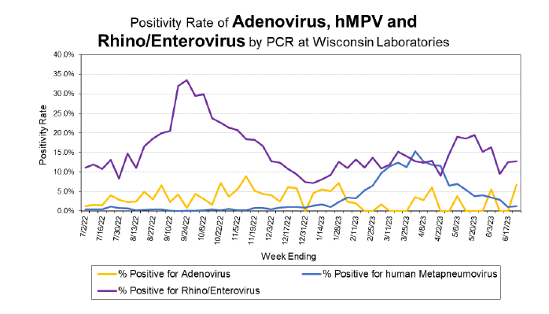
Why Submit Data?
To provide situational awareness
    What is circulating
    When season begins, peaks and ends
    Identify outbreaks
  To determine geographic spread
  To observe season-to-season trends
  To participate in national surveillance programs
Notes:
The testing numbers that you all submit allow us to track positivity rates over the course of the year! Using this data, we can asses what is circulating, when seasons begin, peak, and end, and can help identify outbreaks. We can also use this data to monitor trends of respiratory pathogens in each part of the state and to observe trends of respiratory pathogens from year to year. Finally, surveillance data from Wisconsin is submitted to national programs to enhance surveillance activities around the country.

Slide 31
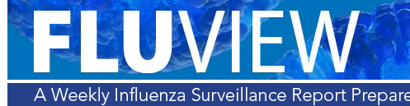
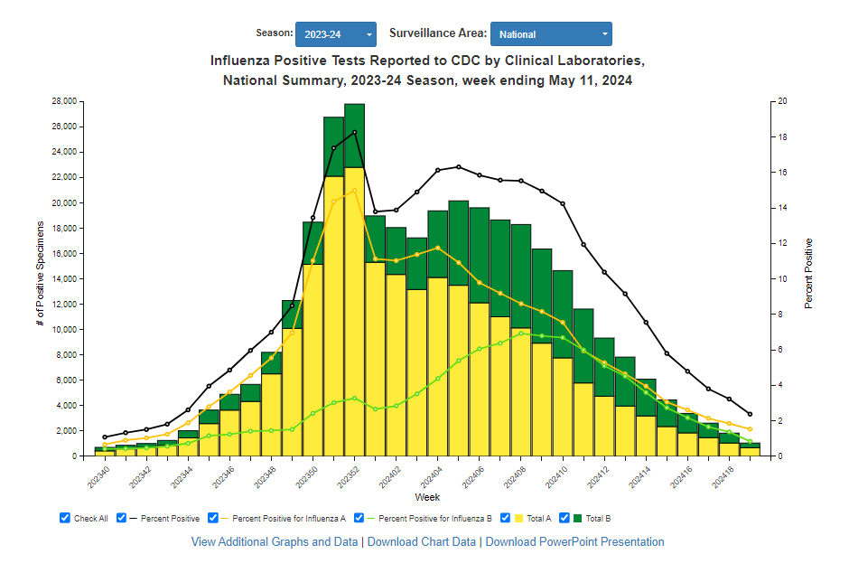
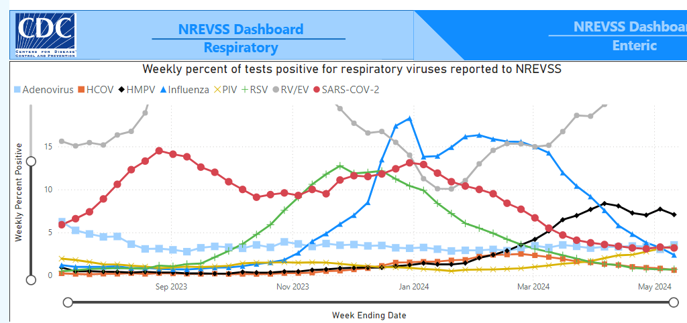
National Surveillance Programs
The National Respiratory and Enteric Virus Surveillance System (NREVSS, CDC)
COVID Data Tracker (CDC)
(CDC)
Notes:
The National respiratory and enteric virus surveillance system is a national surveillance program which tracks the positivity rates of viral pathogens across the country. As you can see on the map, Wisconsin has by-far the most clinical laboratories reporting to this surveillance program. Thank you all for your participation!!
Testing data is also submitted to COVID Data Tracker and to Flu View. Surveillance data for all of these programs can be found on the CDC website.

Slide 32
Respiratory Surveillance in Wisconsin
Plans are outlined in the “Laboratory-Based Surveillance Plan 2023-24” booklet
PDF version available online at
  www.slh.wisc.edu/wcln-surveillance/
  Two Branches of Surveillance:
Reporting of clinical testing data
Submission of surveillance specimens
Notes:
For the 2023-24 season, we have taken steps toward the goal of a more unified approach to surveillance of respiratory pathogens, particularly SARS-CoV-2 and influenza. The WSLH surveillance plan for 2023-24 is detailed in the Laboratory-based surveillance plan booklet. The booklet was sent out to clinical labs in the fall mailing, and the pdf version is also available online on the WSLH website.
There are two main branches of Surveillance methods utilized in Wisconsin, Reporting of clinical testing data and Submission of specimens for surveillance testing.

Slide 33
Respiratory Surveillance Network
Surveillance site types
  Enrolled Sentinel Surveillance Sites*
  University Health Clinics
  Rapid Influenza Testing Sites*
  PCR/Molecular Testing Sites*
*WCLN sites!
Notes:
Specimen submission requests are broken down by the surveillance site type. The surveillance site types include Enrolled sentinel surveillance sites, university health clinics, rapid antigen testing sites and PCR/molecular testing sites. The first two surveillance programs are designed to provide randomized specimens from patients presenting with respiratory symptoms.

Slide 34
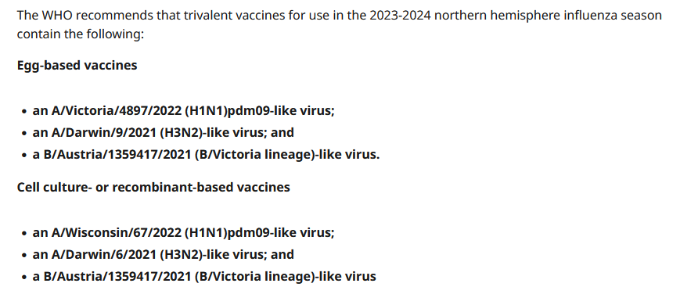
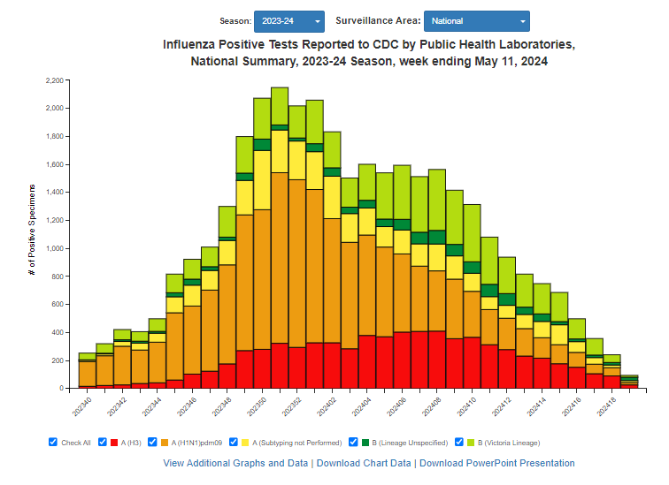
What Does WSLH do with Influenza Positive Specimens?
Provide confirmatory testing
  Look for repeated issues with commercial tests
Perform influenza A Subtyping and B Lineage with CDC primer sets
  Important for the detection of any variant or emerging influenza viruses with pandemic potential.
  Identify H5 if present
“National Influenza Reference Center” pipeline
  CDC performs influenza characterization
  WSLH performs whole genome sequencing and virus culture
  Original specimens can be used as vaccine candidates
NIRCs
Notes:
WSLH performs influenza and SARS-CoV-2 testing on all influenza surveillance specimens. Our PCR assay primers and probes are constantly analyzed by the CDC to ensure the ability to detect novel strains of influenza. Confirmatory testing with the CDC PCR can provide data to the rest of the state and to the FDA if there is a suspected issue with one of the commercial tests.
Additionally, Influenza A subtyping and B lineage are performed on all influenza positive surveillance specimens. These CDC PCR assays are used to detect and monitor for avian and swine variants as well as other novel influenza strains.
A subset of influenza positive surveillance specimens are also submitted for inclusion into the national influenza reference center pipeline. As a part of this national surveillance program, viruses are isolated and submitted to the CDC for influenza strain characterization. Whole-genome sequencing is also performed and can identify and rapidly characterize novel variants that are not being flagged by typical influenza tests. Aliquots of these original specimens are also sent to CDC and can be used as vaccine candidates. Wisconsin even has a strain that was incorporated in this years flu vaccine. This strain was isolated from a sample that was submitted to the WSLH for respiratory virus surveillance from South-Central Wisconsin.

Slide 35
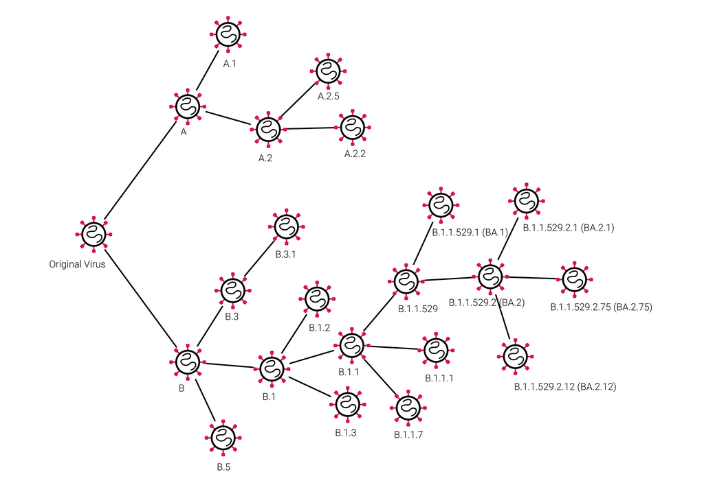
What Does WSLH do with SARS-CoV-2 Positive Specimens?
Perform whole genome sequencing
  To detect and monitor novel variants
  To monitor mutations that may affect diagnostic tests
Submit specimens to National SARS-CoV-2 Strain Surveillance (NS3) system
  Specimens are submitted for additional testing, virus isolation and characterization
  Evaluate SARS-CoV-2 variants to understand their impact on current vaccines, treatments, diagnostics and overall risk to public health
Notes:
Whole-genome sequencing is also performed on all SARS-CoV-2 positive specimens received at the WSLH. Sequencing is used to detect and monitor variants of SARS-CoV-2. COVID Sequencing data for the state of Wisconsin can be found on our SARS-CoV-2 genomic dashboard.
A subset of SARS-CoV-2 positive specimens are also submitted to the National SARS-CoV-2 Strain Surveillance system, or NS3. Whole genome sequencing is performed on these specimens as well as additional testing, including virus isolation and characterization. The goal of this program is to evaluate SARS-CoV-2 variants to understand their impact on current vaccines, treatments, diagnostics and overall risk to public health.

Slide 36
Outline
Intro to WSLH, CDD, and Virology team
Wisconsin Clinical Laboratory Network (WCLN)
Virology testing – diagnostic and surveillance
  Respiratory
  GI
  VPD
  Rabies
  Others

Slide 37
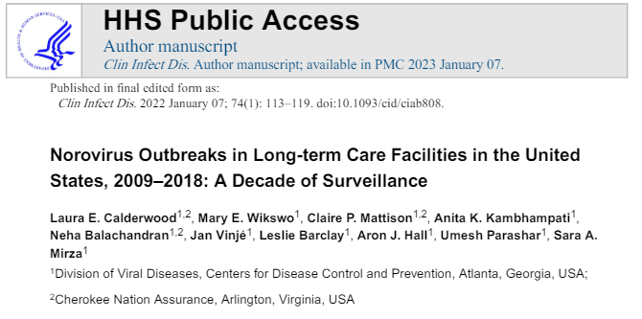
GI Diagnostic Testing - outbreaks
  LTCFs have a high burden of norovirus outbreaks
  Use diagnostic testing to determine if there is an outbreak
    similar or different pathogens?
  Tailor outbreak response to the pathogen identified

Slide 38
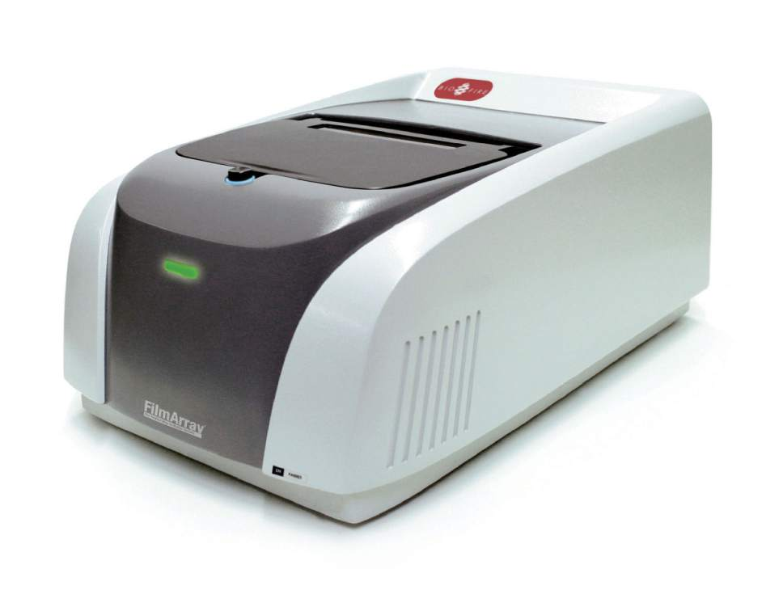
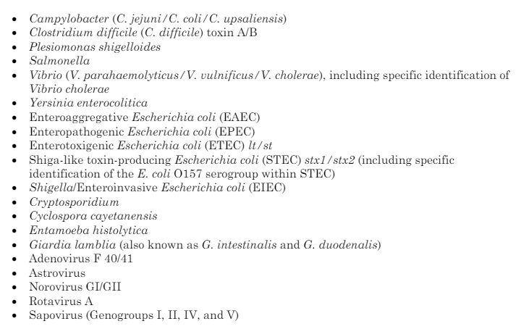
WSLH GI Diagnostic Testing - outbreaks
  Coordinate with DHS and/or local public health department
  Typically norovirus PCR first
  If norovirus PCR is negative, then run full BioFire panel
+

Slide 39
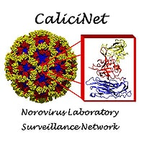
WSLH Norovirus Surveillance Testing
  Samples from outbreaks were historically sequenced to determine norovirus type (“outbreak-based surveillance”)
    Overall surveillance of circulating strains
      Inform future vaccines
    Identify outbreaks of similar strain
  Sample numbers from outbreaks declining in PHL nationwide due to increased PCR capacity in clinical labs
  Sporadic norovirus surveillance was born
    Residual sample from norovirus-positive samples from 5 clinical labs in WI
    Sent to WSLH for sequence-based typing
    WI provides >50% of all data nationally
      Thanks WCLN labs for sending specimens!

Slide 40
WSLH Norovirus Surveillance Testing: Sporadic vs Outbreaks

Slide 41
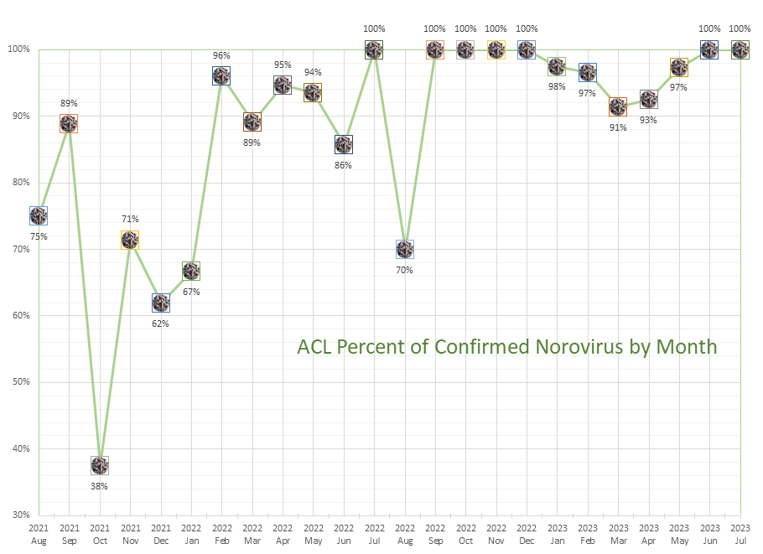
WSLH Norovirus Surveillance Testing: First Identification of BioFire False-positives
GPP (Aug and Sep '21) 85%
BioFire alone (Oct '21 - Jan '22) 63%
BioFire+Cepheid (Feb '22 - current) 94%

Slide 42
WSLH Norovirus Surveillance Testing: First Identification of BioFire False-positives
BioFire + Cepheid
Luminex, then BioFire
BioFire
BioFire

Slide 43
WSLH Norovirus Surveillance Testing: First Identification of BioFire False-positives

Slide 44
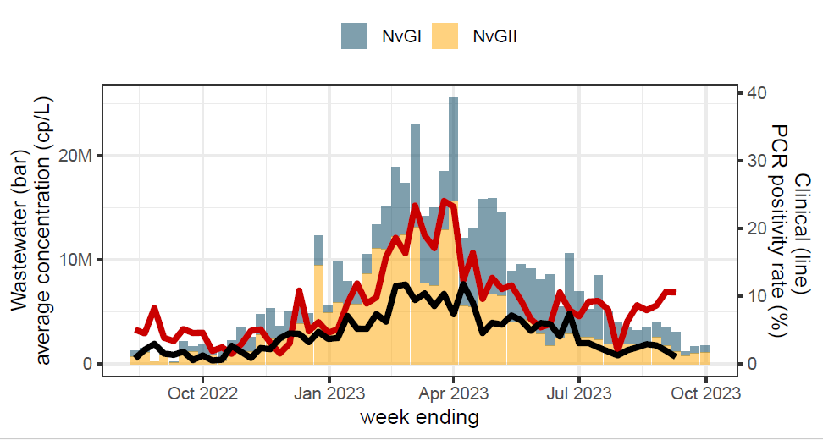
WSLH Norovirus Surveillance Testing: First Identification of BioFire False-positives

Slide 45
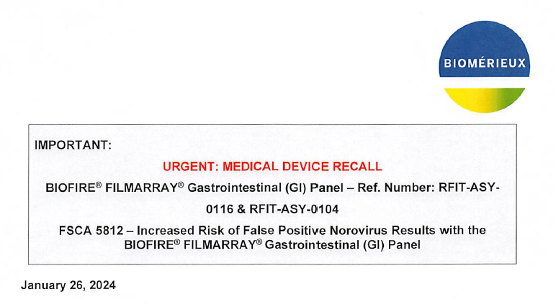
WSLH Norovirus Surveillance Testing: First Identification of BioFire False-positives
  Great example of surveillance identifying an issue with a diagnostic test!

Slide 46
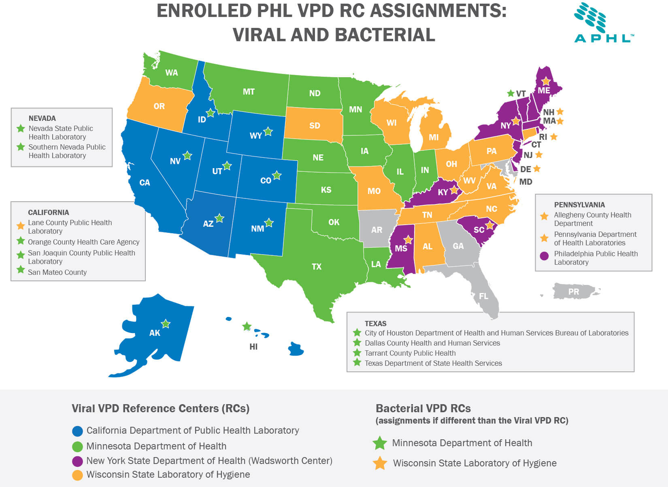
Vaccine Preventable Diseases Reference Centers

Slide 47
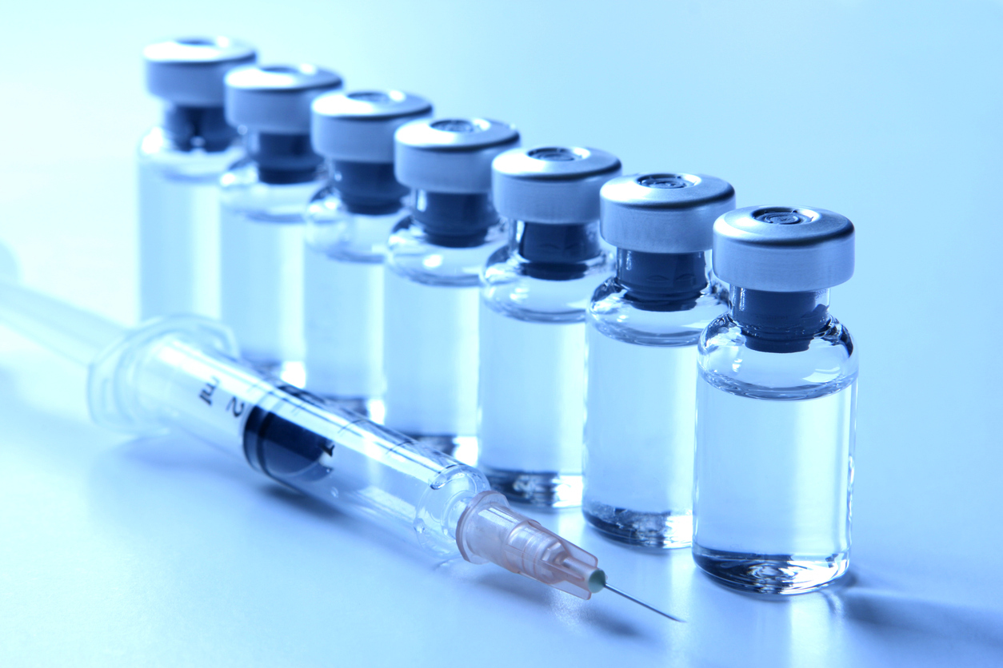
Vaccine Preventable Diseases
  VPD Reference Center testing:
    Measles PCR, measles vaccine PCR (MeVa), measles genotyping
    Mumps PCR, mumps genotyping
    Rubella PCR, rubella genotyping
    VZV PCR, VZV genotyping
    Bacterial testing
      H. influenzae and N. meningitidis serotyping
  PCR: diagnostic testing for WI and a quarter of the U.S.
  Genotyping for surveillance of circulating strains/genotypes
    Occasionally leads to diagnostic test updates
    Measles PCR currently
  MeVa to guide outbreak response
    Labor Day 2021 and Ft. McCoy outbreak

Slide 48

  We do rabies testing on animals. More to come later today.
https://healthyozarks.medium.com/rabid-news-a-bat-tests-positive-8fa0cf31956c

Slide 49
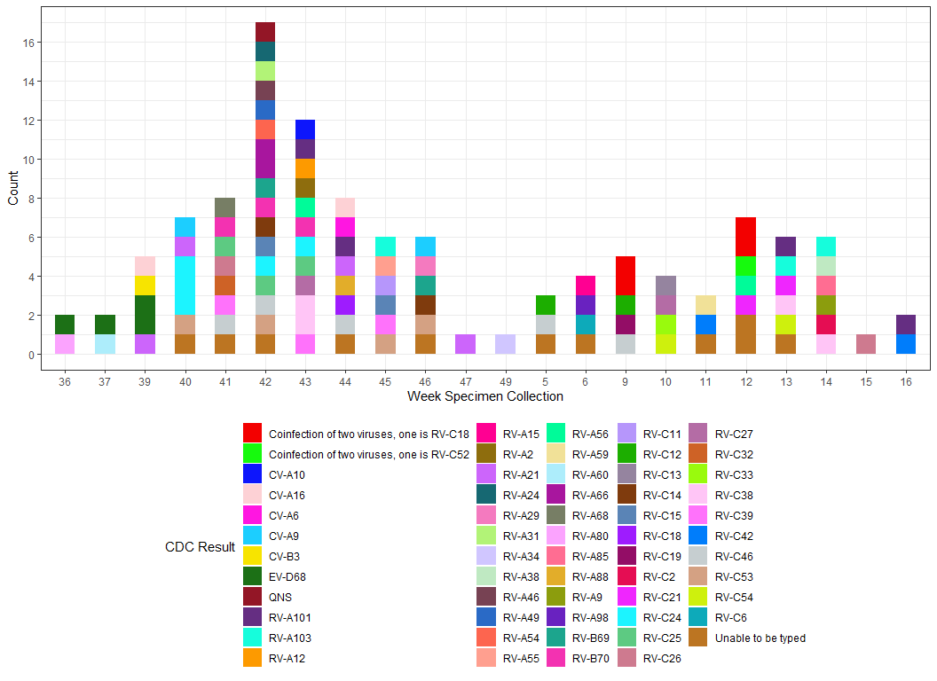
Rhinovirus/Enterovirus
  Initial 2022 study, testing at CDC
  Many different types, mostly rhinovirus

Slide 50
Rhinovirus/Enterovirus
  As a VPD Reference Center, CDC asked us to bring on
    RV/EV differentiation PCR
    EV typing by sequencing, to target EV types
  Tested 121 respiratory specimens positive for RV/EV
  All but 4 were rhinovirus ☹
  Be on the lookout for a request for CSF enterovirus positives (from BioFire M/E panel) in the near future!

Slide 51

Mpox 2022
(formerly monkeypox)
https://www.cdc.gov/poxvirus/monkeypox/response/2022/mpx-trends.html

Slide 52

Mpox

Slide 53


