Slide 1

Next Generation Sequencing for Surveillance of Hepatitis C Virus.
5/21/2024
Wisconsin Virology Conference
Mitchell Ramuta, PhD
Notes:
Today, I will be talking about a collaborative effort between the Wisconsin State Laboratory of Hygiene and Department of Health Services to increase HCV genomic surveillance capacity in Wisconsin.

Slide 2
Outline
Hepatitis C virus background
Center for Disease Control and Prevention HCV pilot grant
Building HCV next generation sequencing capacity at WSLH
Pilot grant progress
Future directions
Notes:
Here is an overview of today’s talk…

Slide 3
Outline
Hepatitis C virus background
Center for Disease Control and Prevention HCV pilot grant
Building HCV next generation sequencing capacity at WSLH
Pilot grant progress
Future directions

Slide 4
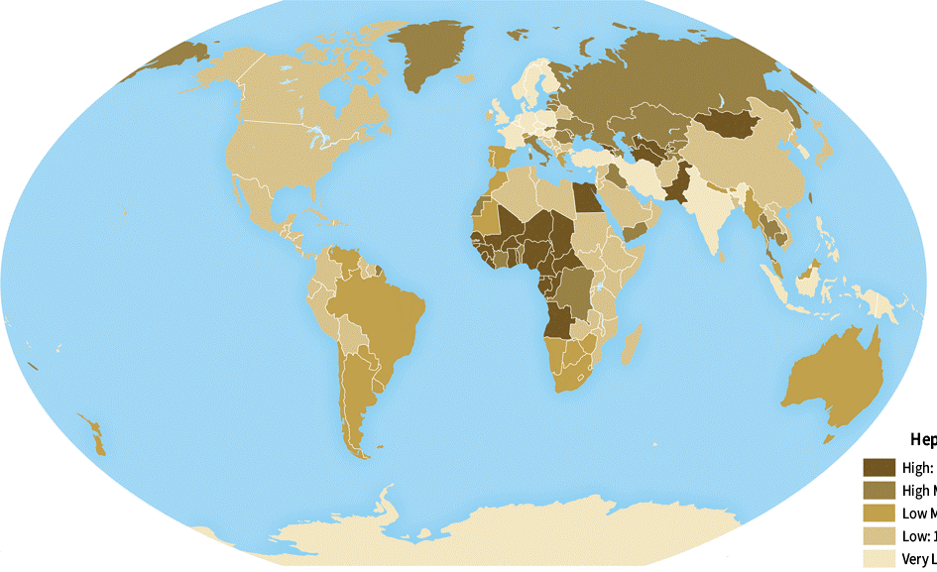
Hepatitis C Virus Impact
Leading cause of liver disease worldwide.
71 million people worldwide are living with HCV.
HCV is the most common blood borne infection in the United States.
Most common reason for liver transplantation in the United States.
Unlike other hepatitis viruses, there is no vaccine available to prevent HCV infection.
Worldwide Prevalence of HCV 2020
High >5%
High Moderate 2-5%
Low Moderate 1.5-2%
Low 1-1.5%
Very Low <1%
Notes:
HCV is a significant public health threat in the United States and worldwide.
It’s estimated that 71 million people are living with HCV worldwide.
In the United States, HCV is the most common blood borne infection (impacting ~3.5 million people) and most common reason for liver transplantation
Unlike Hepatitis A and B, there is no vaccine available for HCV

Slide 5
Hepatitis C Virus Infection
Acute Hepatitis C
Chronic Hepatitis C
Incubation period of 4-20 weeks.
Most people are asymptomatic or experience mild illness.
Symptoms include:
  Abdominal pain
  Nausea
  Fatigue
  Jaundice
  Dark urine
Spontaneous clearance.
Over half of infections progress to chronic HCV if untreated.
~40% people chronically infected with HCV are unaware of their infection.
Complications include:
  Chronic fatigue
  Liver damage and failure
  Cirrhosis
  Cancer
  Sometimes death
Notes:
- Hepatitis C is a viral infection that affects the liver. It can cause both acute and chronic illness, that can be life-threatening.

Slide 6
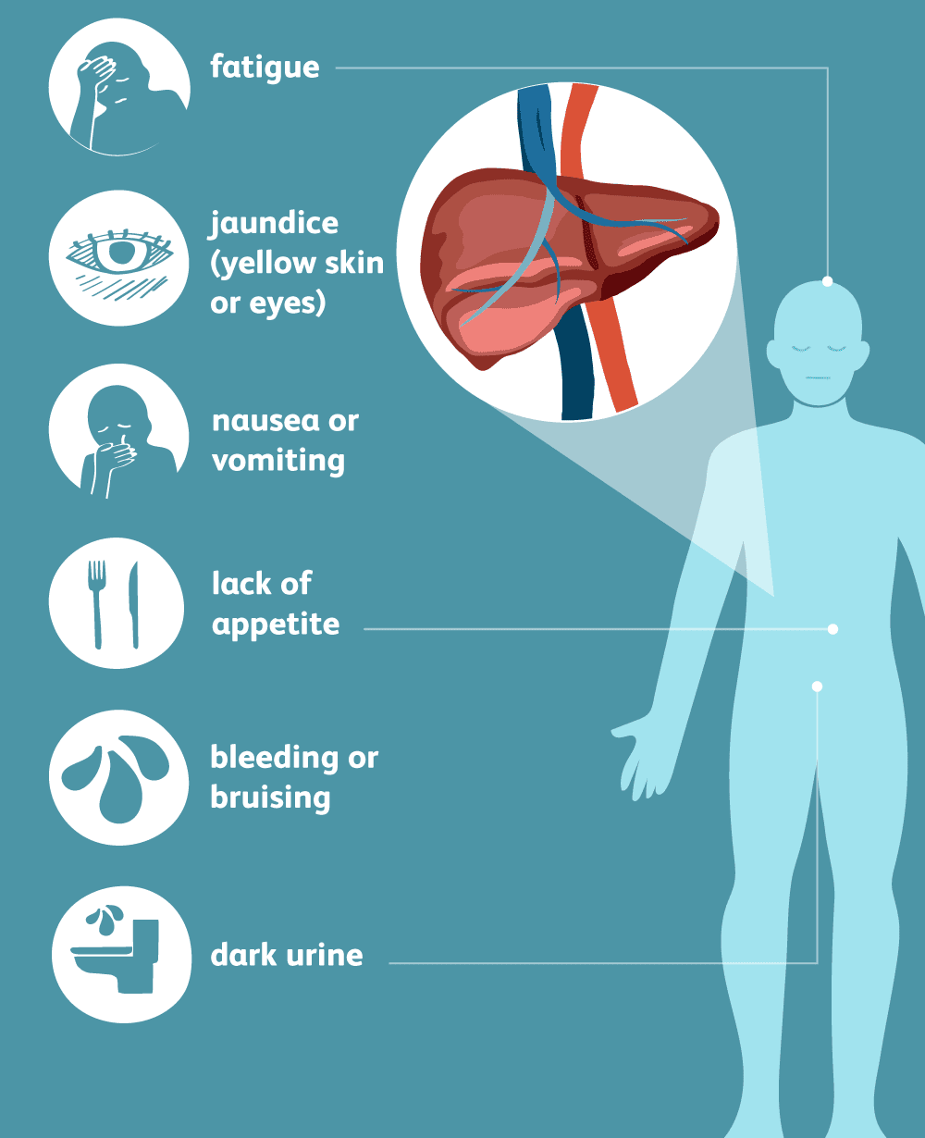
Hepatitis C Virus Infection
Acute Hepatitis C
Acute Hepatitis C
Incubation period of 4-20 weeks.
Most people are asymptomatic or experience mild illness.
Symptoms include:
  Abdominal pain
  Nausea
  Fatigue
  Jaundice
  Dark urine
Spontaneous clearance.
Notes:
Acute HCV infection occurs within the first 6 months after exposure.
Many people newly infected with HCV don’t have symptoms
For people who do develop symptoms, they usually include abdominal pain, nausea, fatigue, jaundice, and dark urine.
These symptoms are indistinguishable from other forms of acute viral hepatitis.
About 30% of individuals will spontaneously clear HCV during the first 6 months of infection without any treatment.

Slide 7
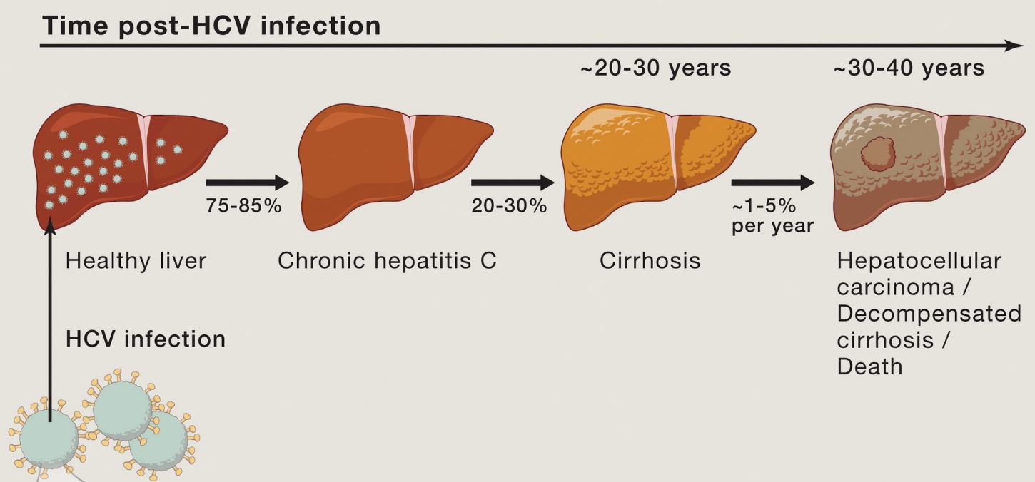
Hepatitis C Virus Infection
Chronic Hepatitis C
Chronic Hepatitis C
75-85% of infections progress to chronic HCV if untreated.
~40% people chronically infected with HCV are unaware of their infection.
Complications include:
  Chronic fatigue
  Liver damage and failure
  Cirrhosis
  Cancer
  Sometimes death
Notes:
Over half of infections progress to chronic HCV if left untreated.
Chronic HCV infection can be life-threatening.
However, about 40% of people with chronic Hepatitis C are unaware of their infection status
Complications of chronic HCV include:
Chronic fatigue
Cirrhosis
Cancer
And even death

Slide 8
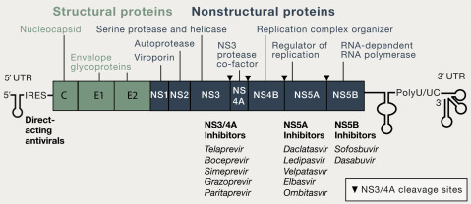
Hepatitis C Prevention and Treatment
Prevention:
No vaccine available for HCV.
Education, screening, and syringe service programs.
Treatment:
Several direct-acting antiviral (DAA) treatments are available.
Cure 95% of people who take them in 8-12 weeks.
Notes:
As I mentioned earlier, there are no vaccines available for HCV.
This emphasizes the importance of education, screening, and harm reduction programs for preventing onward transmission
However, the good news is that there are highly efficacious Direct-Acting Antivirals for HCV
The first therapy was approved by the FDA in 2011
Since then, there have been several other HCV therapies approved
These antivirals fall under 3 classes based on their HCV target (as shown on the figure to the right)
95% of individuals infected with HCV can be cured by completing a single 8-12 week course of treatment
- Despite the availability of highly efficacious and non-toxic therapies we face several challenges for treatment including:
Equitable access to affordable treatment.
People not knowing their infection status
And barriers to who can prescribe and receive HCV treatment.
NS3/4A (polyprotein cleavage)
NS5A (inhibits virus assembly)
NS5B (inhibits RNA dependent RNA polymerase)

Slide 9
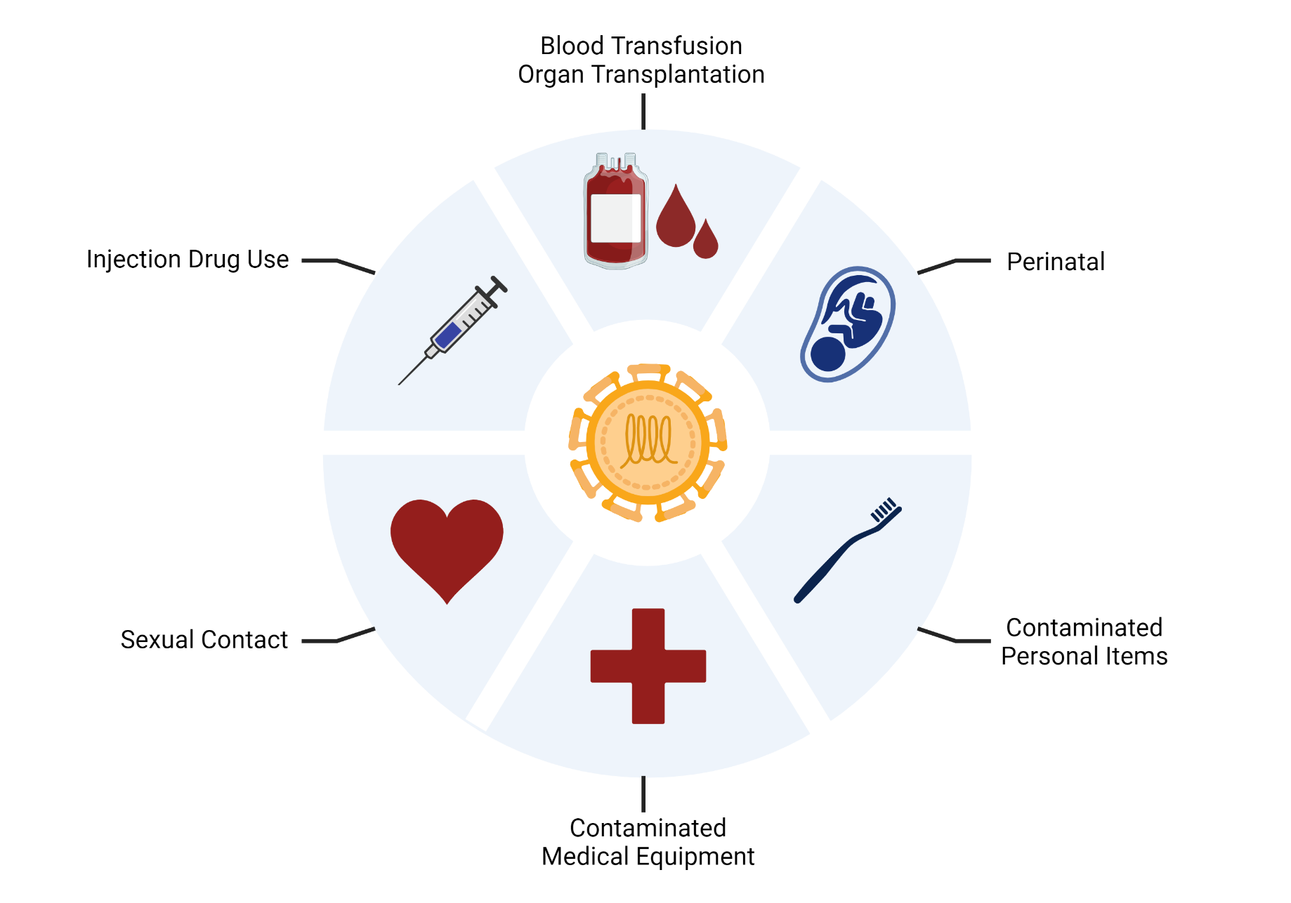
Hepatitis C Virus Transmission
Notes:
HCV is primarily spread through contact with infected blood.
Because most people with an HCV infection might not show symptoms, they may unknowingly transmit the virus to others.
Potential exposures include:
Vertical transmission from mother to infant
Sharing personal items contaminated with infectious blood (razors or toothbrushes)
Unprotected sex
Use of non-sterile equipment during medical care or tattooing and piercing
Receipt of donated blood, blood products, and organs before blood screening in 1992.
And lastly, sharing contaminated injection drug use equipment, which is the most common way HCV is transmitted in the United States.
I’ll talk more about the importance of these last two transmission routes in my next slides.

Slide 10
Hepatitis C Trends in the USA
Millennials
1981-1996
Gen X
1966-1980
Baby Boomers
1945-1965
These data were obtained from the CDC 2020 Viral Hepatitis Surveillance- United States Report
Notes:
In the United States we observe a bimodal distribution of newly reported HCV cases.
As seen on this figure, HCV is observed in the highest proportions among:
Older adults born between 1945-1965
And younger adults between the ages of 20-45.
Historically, the highest prevalence of chronic hepatitis C in the United States has been among baby boomers, who’s main risk factor was receiving blood transfusions or organ transplants before blood supply screening in 1992.
However, since 2016, adults younger than 45 have been most impacted by HCV in the U.S. and Wisconsin, most likely due to increases in the burden of injection drug use

Slide 11
Hepatitis C Trends in the USA
These data were obtained from the CDC 2024 National Viral Hepatitis Progress Report
Notes:
- Over the past decade, we have seen the prevalence of HCV sharply increase in the United States as a direct result of the opioid epidemic.
There has been a constant rise in cases from 2010 to 2021

Slide 12



HCV Elimination Efforts
Global Plans:
WHO Global Health Sector Strategy on Viral Hepatitis (2016-2030)
  90% reduction of HCV infections and 65% reduction of deaths by 2030.
National-level Plans:
CDC Division of Viral Hepatitis Strategic Plan (2020-2025)
US HHS Viral Hepatitis National Strategic Plan (2021-2025)
Notes:
The rapid increase in HCV prevalence and revolution of Direct Acting Antivirals against HCV has prompted several organizations and agencies to develop strategies for HCV elimination during the past decade .
On a global scale:
The World Health Organization developed a Global Health Sector Strategy for targeting all types of Viral Hepatitis in 2016.
The strategy targets a 90% reduction in new HCV infections and a 65% reduction in HCV deaths between 2016 and 2030.
On a national scale:
The Center for Disease Control and Prevention’s Division of Viral Hepatitis and United States Department of Human Health Services both released plans for reducing HCV burden in the US by 2025
These plans were created to keep us on track for 2030

Slide 13
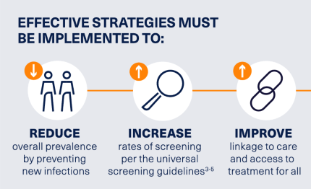
HCV Elimination Efforts
Common goals include:
Improving the accessibility to HCV testing.
Connecting high risk individuals with harm reduction services, such as syringe service programs.
Ensuring equitable treatment for people with HCV.
Notes:
These programs share common efforts for preventing viral hepatitis disease and death including:
Improving the accessibility to HCV testing
Connecting high risk individuals with harm reduction services, such as syringe service programs
Ensuring equitable treatment for people with HCV

Slide 14
United States HCV Elimination Progress
Notes:
Next, I’ll talk about how HCV elimination efforts have been going in the United States

Slide 15
Progress Towards HCV Elimination in the USA
These data were obtained from the CDC 2024 National Viral Hepatitis Progress Report
Notes:
One of the main goals of the HCV elimination plans, is to reduce the number of newly reported HCV infections.
On this slide I am showing the estimated number of new HCV infections In the United States in blue and the Annual targets in orange
We see a constant rise in estimated new HCV infections from 2010 until 2021.
2022 was the first time we saw a drop in cases.
However, this is still well above the HCV elimination target.
As you can see there is still a lot of work to be done to meet the elimination goals

Slide 16
Progress Towards HCV Elimination in the USA
* Rates are per 100,000 and age-adjusted to the 2000 US Standard Population.
These data were obtained from the CDC 2024 National Viral Hepatitis Progress Report
Notes:
Another goal of HCV elimination, is to reduce HCV related deaths.
On this slide I am showing the rate of Hepatitis C related deaths per year in the United States in blue and the Annual targets in orange
There has been a decrease in HCV related death rates since 2014.
As a country we have been meeting our annual targets each year.

Slide 17
HCV Trends in Wisconsin
Notes:
Next, lets look at HCV tends in Wisconsin
Over the past 10 years, the number of new HCV cases reported each year in Wisconsin has slowly declined
Wisconsin experienced the highest numbers of newly reported cases from 2014 – 2018
In 2022, there were 1,702 newly reported hepatitis C cases: 102 acute cases and 1,600 chronic cases.
This represents the lowest number of cases reported in over 20 years!

Slide 18
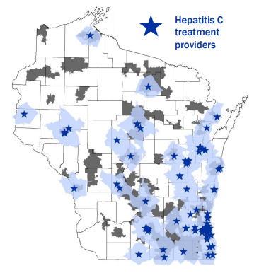
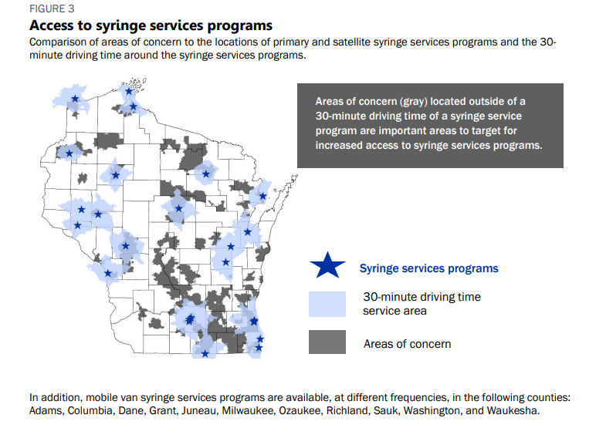
Controlling and Preventing HCV in Wisconsin
Hepatitis C Treatment Providers
Syringe Service Programs
Notes:
Over the years, Wisconsin DHS has made multiple collaborative efforts to combat the impact of HCV in the state
DHS’s work has focused on:
Increasing accessibility to HCV treatment and testing
Connecting high risk individuals with harm reduction services, such as syringe service programs to prevent onward transmission
The map on the left shows the distribution of Hepatitis C treatment providers across the state and the map on the right shows syringe services programs across the state
The areas highlighted in gray represent areas of concern for HCV and light blue represents surrounding areas that are within 30 minutes of a provider.
DHS has worked with providers and health systems to explore barriers to providing hepatitis C treatment and the importance of reducing these barriers.
Some of the major milestones to increasing accessibility to Hepatitis C treatment include:
In 2017, Wisconsin Medicaid allowed non-specialists, including primary care providers, to prescribe hepatitis C treatment.
In 2019, Wisconsin Medicaid no longer considered current or past alcohol or substance use when approving prior authorizations for hepatitis C treatment
- DHS will continue to support trainings for primary care providers, and will explore training primary care providers and using telemedicine to reach rural areas with gaps in services.
- Treatment requests will also be considered for patients who have previously received hepatitis C treatment.

Slide 19
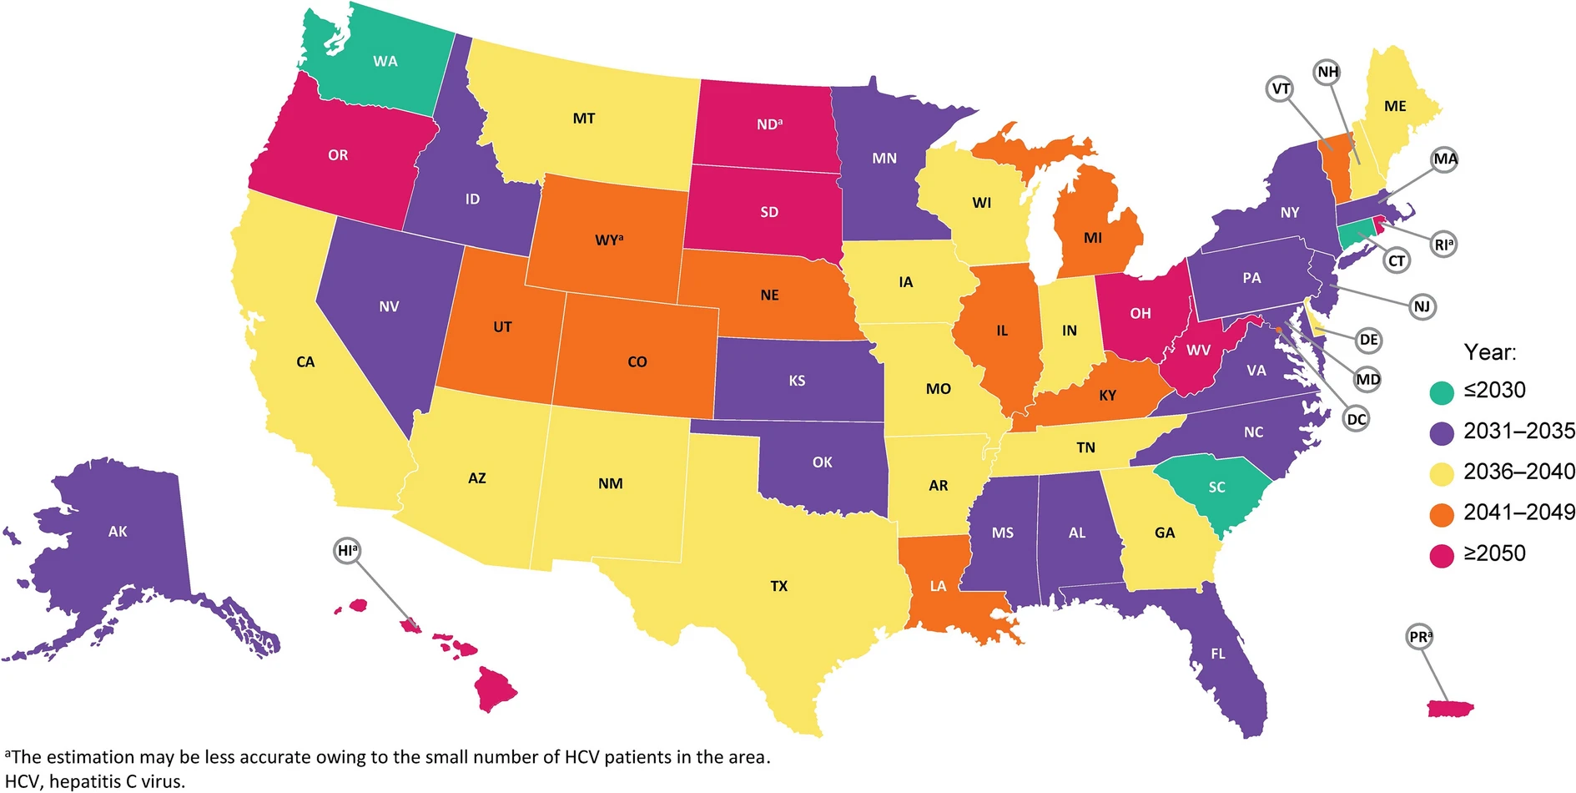
Estimating the Year Each State Will Achieve HCV Elimination Targets
Sulkowski, M., Cheng, WH., Marx, S. et al. Estimating the Year Each State in the United States Will Achieve the World Health Organization’s Elimination Targets for Hepatitis C.
Notes:
Although encouraging progress has been made so far, there is still a gap between the United States and WHO’s 2030 goals.
A study from 2020 assessed the progress of United States towards achieving the HCV elimination targets
The study suggested that only 3 states were on track for reaching elimination targets by 2030 goals as seen in green on this map
And Overall, the USA is projected to achieve HCV elimination by 2037.

Slide 20
How can we achieve our goal of HCV elimination?
Notes:
There are still many obstacles to realizing this strategic goal, and the lack of relevant epidemiological data has been identified as an important factor.
Many countries and states lack a complete disease surveillance system and epidemiological data related to HCV infection, so it is difficult to formulate targeted strategies

Slide 21
CDC HCV Elimination Plan Prioritizes:
Building capacity within jurisdictions to collect and use a core set of surveillance data to identify outbreaks, understand transmission networks, and prioritize prevention efforts.
Increasing proportion of funded jurisdictions that have analyzed and disseminated surveillance data for public health action to 90% by 2025
Increasing proportion of all viral hepatitis clusters/outbreaks that are reported to CDC within 30 days to 90% by 2022
Notes:
To improve HCV response in the US the CDC’s elimination plan prioritizes:
Building capacity within jurisdictions to collect and use a core set of surveillance data to identify outbreaks, understand transmission networks, and prioritize prevention efforts.
Increasing proportion of funded jurisdictions that have analyzed and disseminated surveillance data for public health action to 90% by 2025
Increasing proportion of all viral hepatitis clusters/outbreaks that are reported to CDC within 30 days to 90% by 2022

Slide 22
Outline
Hepatitis C virus background
Center for Disease Control and Prevention HCV pilot grant
Building HCV next generation sequencing capacity at WSLH
Pilot grant progress
Future directions
Notes:
Next, I’ll talk about the recent CDC efforts to increase genomic surveillance capacity in the United States

Slide 23
CDC HCV GHOST Pilot Grant
In 2023, the CDC DVH announced two pilot grants.
Focused on integrating genomic and epidemiologic surveillance for outbreak detection and response.
Genomic surveillance can help:
  Track trends in HCV infections.
  Identify HCV transmission clusters and outbreaks.
  Make data-driven decisions for recommendations and policies.
Wisconsin DHS and WSLH were awarded one of the grants in July 2023.
Notes:
Currently, HCV surveillance capacity is limited in the United States
To increase surveillance capacity, the CDC DVH funded two pilot grants for health departments to develop an integrated epidemiological and molecular surveillance system to identify HCV transmission clusters and outbreaks for public health action.
Integrating genomic surveillance within the existing epidemiologic surveillance system could:
Help track trends in HCV infections
Strengthen our ability to rapidly detect and respond to HCV outbreaks.
And help inform community responses that can quickly interrupt transmission.
We were awarded one of the grants in July 2023

Slide 24
WSLH HCV GHOST Study Goals
To support outbreak investigations and monitor HCV variants circulating in our communities.
To build an HCV genomic data repository to improve future surveillance efforts.
To help inform longer term surveillance programs across the US.
Notes:
Our year long study aimed:
To support outbreak investigations and monitor HCV variants circulating in our communities.
To build an HCV genomic data repository to improve future surveillance efforts.
To help inform longer term surveillance programs across the US.

Slide 25
Outline
Hepatitis C virus background
Center for Disease Control and Prevention HCV pilot grant
Building HCV next generation sequencing capacity at WSLH
Pilot grant progress
Future directions
Notes:
Next, I’ll talk about building sequencing capacity at WSLH during this past year.
In order to develop a HCV surveillance strategy in Wisconsin, we needed to :
Create a sample collection plan with the WCLN.
Build sequencing capacity at the WSLH.
Develop a system for integrating genomic and epidemiologic surveillance.

Slide 26
Where were we going to get HCV specimens?
Notes:
One of the major questions we had to figure out was ”Where were we going to get HCV(+) specimens from the state?

Slide 27

Sample Collection Plan
HCV specimens 2023-2024:
Wisconsin Clinical Laboratory Network (WCLN)
  138 clinical laboratories
Requested all HCV(+) serum specimens tested between 2023-2024.
HCV specimen repository:
Saved all HCV(+) serum specimens tested at the WSLH from 2019-2022.
Notes:
For this study, we focused on sequencing samples from 2 different sources:
For more contemporary samples, we reached out to our partners in the Wisconsin Clinical Laboratory Network to provide all HCV positive serum specimens with viral loads of >10,000 IU/ml tested in their labs.
The WCLN is a network of 138 clinical and public health laboratories in the state that work together to ensure a timely and effective response to clinical laboratory and public health needs, including: emergency preparedness, surveillance, diagnostics, training and education.
Relying on our close relationship with WCLN partners was essential for building surveillance capacity across the state!
For the second source of HCV specimens, we sequenced HCV samples from the state lab’s biorepository that were tested between 2019-2022
We wanted to sequence these samples to create a genomic data repository of HCV to improve future surveillance efforts since infection can cause chronic disease.

Slide 28
How were we going to sequence specimens?
Notes:
Next, we had to figure out how were we going to sequence HCV specimens.

Slide 29
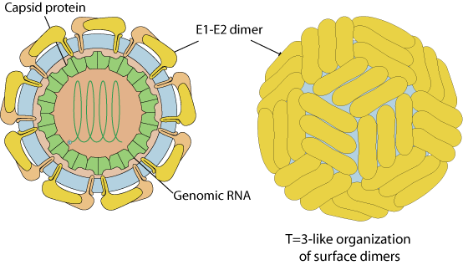
HCV Sequencing
Amplicon-based NGS approach developed by the CDC DVH.
Target: E2 protein.
  Hypervariable Region 1 (HVR1)
Illumina MiSeq
8 genotypes and 93 subtypes.
Global Hepatitis Outbreak and Surveillance Technology (GHOST)
Hepatitis C Virus Genome
5’-UTR
E2
NS5A
NS5B
3’-UTR
Envelope Glycoprotein 2 (E2)
HVR1
1295 nt
1619 nt
325 bp
Notes:
- To sequence HCV specimens, we used a targeted amplicon sequencing approach developed by the CDC Division of Viral Hepatitis.
This protocol targets a 325-nucleotide region within the Envelop Glycoprotein 2 known as hypervariable region 1
This is an important region for identifying all 8 HCV genotypes and transmission clusters
We used a CDC developed cloud-based bioinformatic pipeline called the Global Hepatitis Outbreak and Surveillance Technology for analyzing sequencing data.

Slide 30
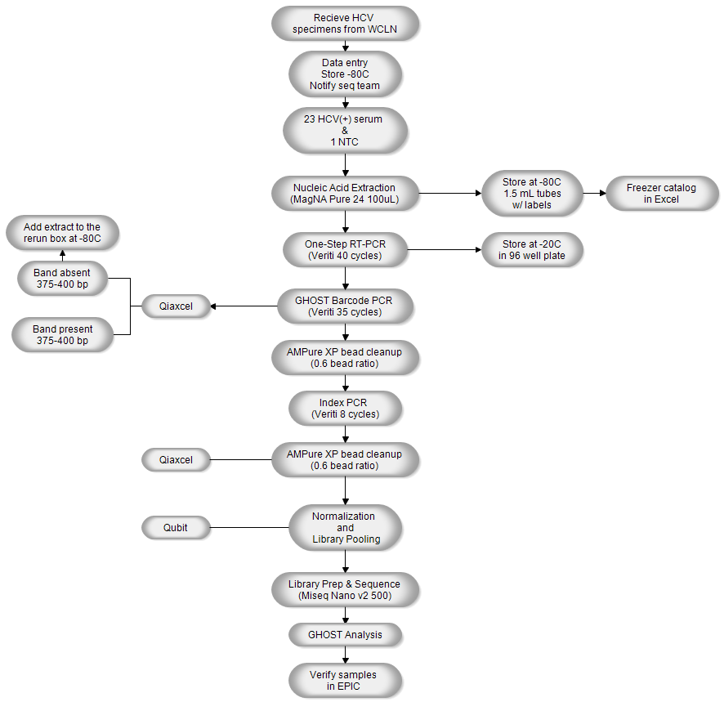
HCV GHOST NGS Workflow
Notes:
Here is an overview of the HCV sequencing and reporting workflow which takes between 3-4 days.
I know this figure is way too small to read, but I will walk through some of the important steps in the next slides

Slide 31
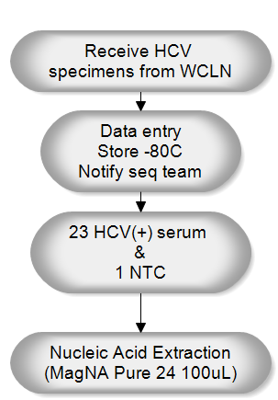
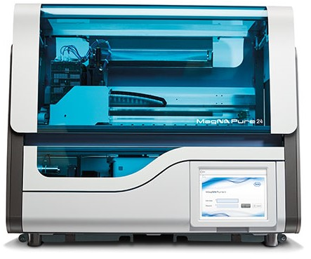
HCV Sample Collection and Extraction
Notes:
Once we received a batch of 23 HCV samples from WCLN partners, we would extract total nucleic acids using the MagNA Pure 24 instrument

Slide 32

HCV HRV1 Amplification
RT-PCR: 320-325 bp
Notes:
We would then perform reverse-transcription and amplification of the hypervariable region 1 using HCV specific primers

Slide 33
HCV HRV1 Amplification
RT-PCR: 320-325 bp
Barcode PCR: 375-400 bp
Notes:
After that, we perform another round of PCR to incorporate internal GHOST barcodes that were be used for quality control and analysis

Slide 34
HCV HRV1 Amplification
RT-PCR: 320-325 bp
Barcode PCR: 375-400 bp
Index PCR: 460-490 bp
Notes:
Then we perform a third round of PCR to add illumine indices for pooling and demultiplexing

Slide 35
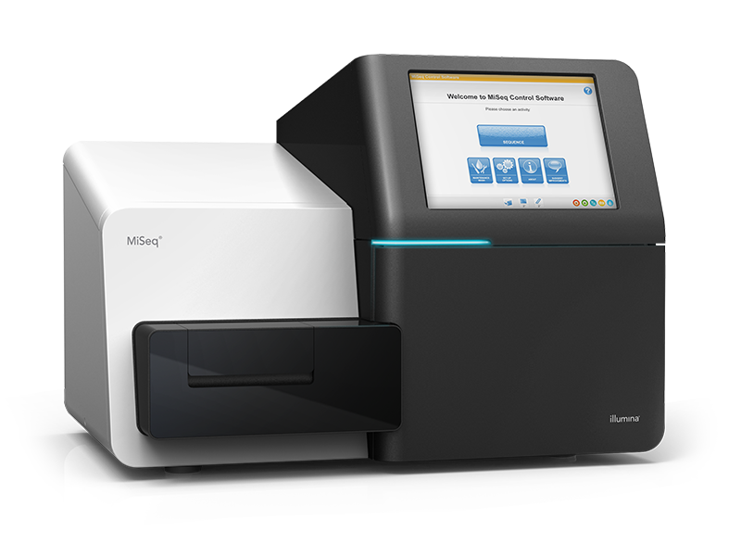
HCV Sequencing
Notes:
We then sequence the samples on a MiSeq using paired-end 250 bp sequencing.

Slide 36
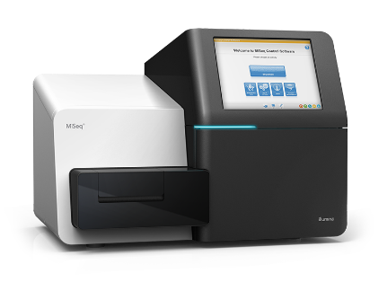
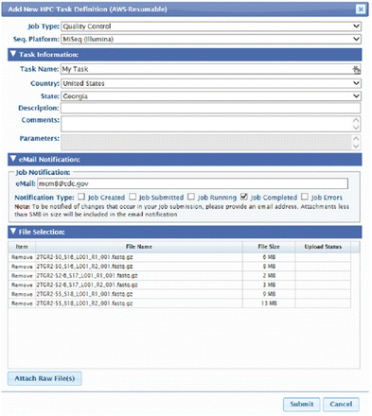
HCV GHOST Analysis
WSLH Data Generation
GHOST Quality Control
GHOST Analysis
MiSeq paired end reads
Sequencing run QC in Basespace
Demultiplex and generate Fastq files
Upload raw fastq.gz files to GHOST
Filter out reads with >3 N’s
Filter out read pairs <185bp
Filter out reads <Q30
Fail samples with barcodes >25%
Down sample to 20,000 reads
Calls HCV genotype
Identifies number of haplotypes
Creates epidemiology report with transmission clusters
Creates K-step networks to visualize intra-host diversity
Notes:
Once the run is complete, the reads are demultiplexed to generate fastq files for each sample
The raw fastq files uploaded to GHOST where they undergo strict QC parameters to get rid of low-quality reads, look for contamination, and down sample for analysis.
We then performed analysis on the batch of HCV specimens in GHOST to identify the genotype, assess intrahost diversity, and identify transmission clusters
GHOST then creates an epidemiology report summarizing the findings and makes transmission cluster maps and k-step networks for closely related samples.

Slide 37
Outline
Hepatitis C virus background
Center for Disease Control and Prevention HCV pilot grant
Building HCV next generation sequencing capacity at WSLH
Pilot grant progress
Future directions
Notes:
Next I’ll talk about our sequencing progress over the past year

Slide 38
HCV Specimens Sequenced from 2019-2024
Successfully sequenced 571 HCV specimens.
Distribution of samples from 2019-2024:
  2019: 136
  2020: 6
  2021: 50
  2022: 50
  2023: 213
  2024: 116
Notes:
Over the course of the year, we sequenced a total of 571 samples between September 2023 and April 2024
The pie cart on the slide shows the percent of total samples sequenced for each year
We prioritized sequencing samples from our WCLN partners collected during the funding period.
We sequenced a total of 213 and 116 samples from 2023 and 2024, respectively
We also sequenced a 242 samples from our sample repository.
As you can see, we don’t have an even distribution across the years, but we are hoping to continue to work through these samples in the future.

Slide 39
Wisconsin HCV Genotypes
Observed 13 different HCV subtypes.
Top 4 HCV genotypes (2019-2024):
  1a: 62%
  3a: 23%
  2b: 6%
  1b: 6%
Top 4 HCV genotypes in previous HCV NGS study in Wisconsin (2016-2017):
  1a: 67%
  3a: 23%
  2b: 6%
  1b: 2%
Notes:
Next Generation sequencing identified a total of 13 different HCV subtypes, including 4 individuals with dual genotypes
The figure on this slide shows the proportions of genotypes sequenced during the pilot grant
The top 4 genotypes observed are listed on this slide including….
These results were concordant with a previous genomic surveillance study in Wisconsin that sequenced 379 HCV specimens between 2016-2017

Slide 40

Transmission Clusters
GHOST identified 46 clusters.
Comprised of 102 people.
Cluster size ranged from 2-4 persons.
Dyads made up 80% of the transmission clusters.
Notes:
GHOST analysis identified 46 potential transmission clusters comprising 102 persons.
Cluster sized ranged from 2 to 4 persons.
Transmission clusters mostly composed of dyads making up 80%
We are just still in the early stages of linking epidemiological data with these transmission clusters to be able to draw more information from the GHOST analysis

Slide 41
Outline
Hepatitis C virus background
Center for Disease Control and Prevention HCV pilot grant
Building HCV next generation sequencing capacity at WSLH
Pilot grant progress
Future directions
Notes:
Lastly, I would like to talk about future directions for building HCV surveillance capacity in Wisconsin

Slide 42
Integrating Genomic and Epidemiologic Data
Developing a system for integrating genomic and epidemiologic surveillance data.
All HCV-positive tests are reported to the Wisconsin Electronic Disease Surveillance System (WEDSS).
Linking sequencing results to other public health data is essential for investigating disease outbreaks.
Network-based investigations could help make more data-driven decisions for public health action.
HCV GHOST Report
WEDSS Data
Wisconsin HCV Surveillance Report
Notes:
We are currently working on integrating genomic and epidemiologic data
All HCV-positive test results in Wisconsin are routinely reported to the Wisconsin Electronic Disease Surveillance System
Which is a secure, health information system used for reporting, investigation, and surveillance of communicable diseases across the state.
Integrating the GHOST results into WEDSS could help epidemiologists link sequencing data with important public health data for investigating outbreaks
We are excited for this next phase because we believe that Network-based investigations could help make more data-driven decisions for public health action

Slide 43
Long-Term HCV Surveillance Funding
Future goals for HCV surveillance include:
Providing epidemiologists with close to real-time data.
Helping the CDC with rolling out a new GHOST user interface.
Sharing our experience with HCV genomic surveillance in Wisconsin to help roll out surveillance to other states.
Continuing to build our HCV genomic data repository.
Notes:
DHS and WSLH were recently funded to continue HCV surveillance for the next 5 years.
Some of our goals for the future will focus on:
Sequencing HCV specimens on a monthly basis to provide epidemiologists with close to real-time data for identifying outbreaks.
We will also be helping the CDC with a new GHOST user interface to make it more useful for public health labs
We will also share our successes and challenges with the CDC DVH to help inform the roll out of genomic surveillance to other states.
Lastly, we will continue to build of HCV genomic data repository to improve future surveillance analysis

Slide 44
Thank you!
Wisconsin State Laboratory of Hygiene
Alana Sterkel, Allen Bateman, Alicia Mooney, Hannah Gander, Ava Gehrke, Claire LaFleur, Steven Konwal, Anna Bradley, and Joshua Kropp
Wisconsin Department of Health Services
Ryan Westergaard, Caroline Mohr, Kailynn Mitchell, Jie Hie, Kelsa Lowe, and DHS Hepatitis C staff
CDC Division of Viral Hepatitis
WCLN Partners

Slide 45
Questions?

Slide 46
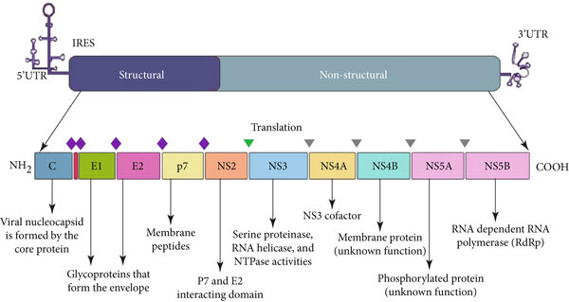
Hepatitis C Virus
Flaviviridae family
Enveloped, (+)ssRNA
~9.6kb genome
  7 non-structural proteins
  3 structural proteins
    Capsid protein
    Envelope protein E1
    Envelope protein E2
8 genotypes and 93 subtypes.

Slide 47
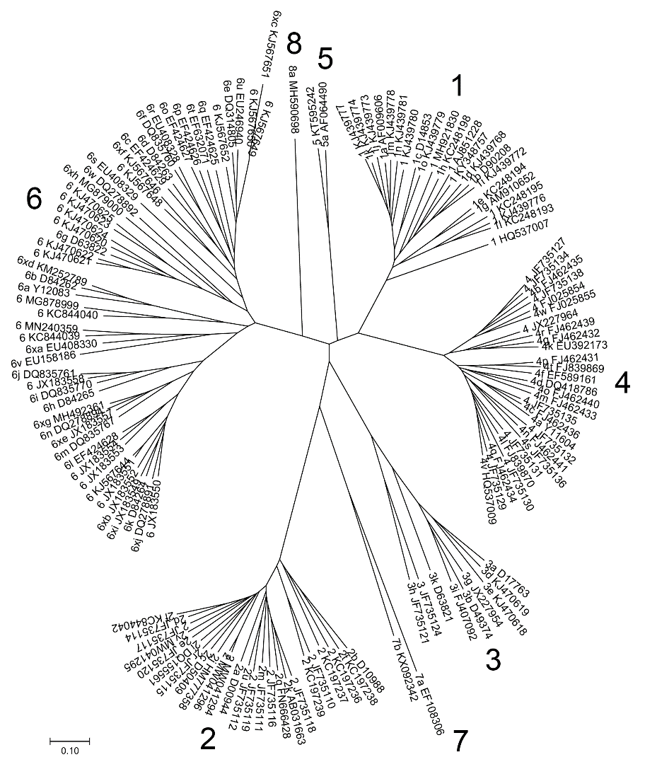
Hepatitis C Virus Genotyping
8 genotypes and 93 subtypes.
HCV genotypes differ in geographical distribution.
75% of Americans with HCV have genotype 1
Limited HCV genomic surveillance capacity in the US.
https://ictv.global/sg_wiki/flaviviridae/hepacivirus
Notes:
HCV strains belonging to different genotypes differ at 30–35% of nucleotide sites whereas strains that belong to the same subtype differ at <15% of nucleotide sites.

