Slide 1
Rabies Diagnostics, Past, Present and Future
Rich Griesser
Wisconsin State Laboratory of Hygiene- Communicable Disease Division

Slide 2
Rabies Diagnostics, Historical Perspective
Outline
Historical, pre-1900 identification
Virus isolation, in-vitro & in-vivo
Histopathology
Antigen detection
Molecular Methods
Lateral flow for surveillance
Antigenic & Genetic typing
Serology
Future Advances in Rabies diagnostics

Slide 3
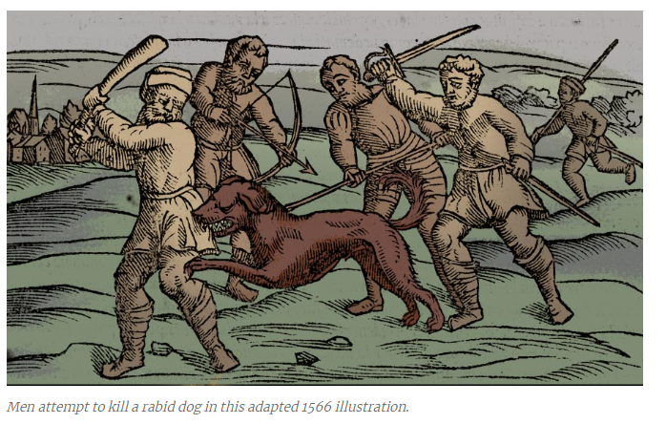
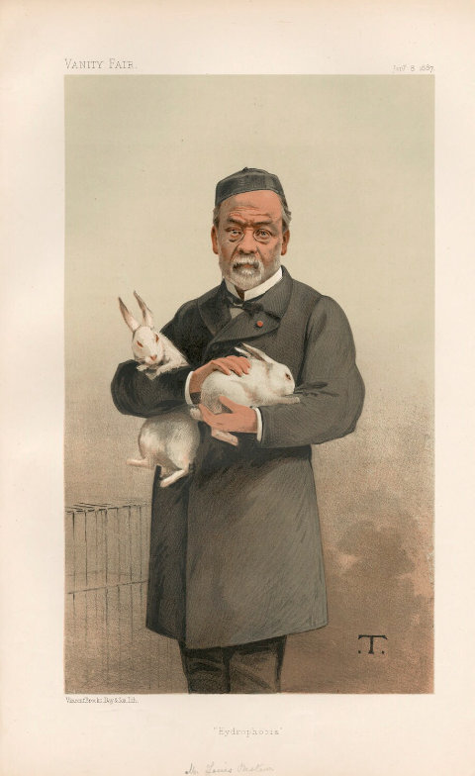
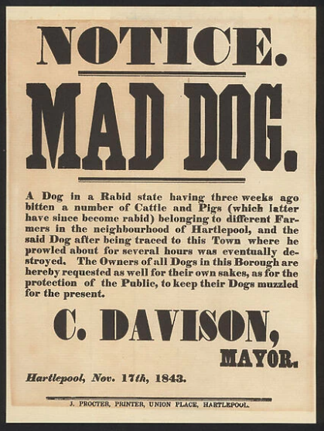
Rabies Diagnostics, the early days
Mosaic Esmuna Code of Babylon in 2300 B.C.
Babylonians had to pay a fine if their dog transmitted rabies to another person
First century A.D. Roman scholar Celsus correctly suggested rabies was transmitted saliva of the biting animal
Utilized clinical signs in animals to “diagnose”
Animal inoculation (1804-1970s)
Intracerebral Inoculation of dogs/rabbits with saliva from diseased animals
Pasteur: serial inoculation of rabbits
First vaccines in 1885
Mouse inoculation Test(MIT)
Webster & Dawson: increased sensitivity using Swiss mice
Dx in 7-15 days
Standard for routine diagnosis & still utilized as confirmatory test

Slide 4
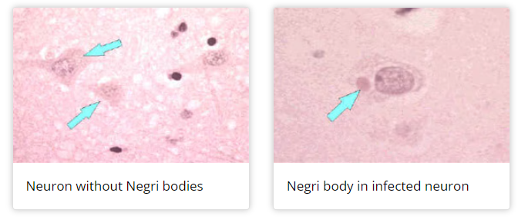
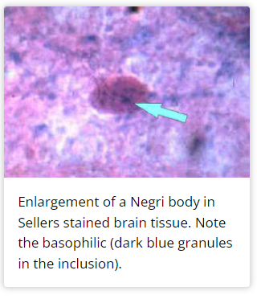
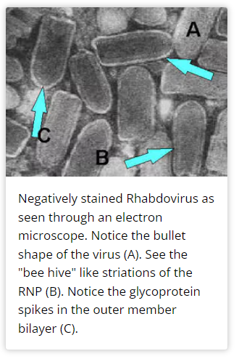
Rabies Diagnostics
Histopathology
Improved microscope technology
1903: Aldechai Negri describes inclusions in hippocampus of rabid animals
Intracytoplasmic inclusion bodies
Various stains allowed for differentiation from other intracellular inclusions
Detectable in 30-50% of cases
Diagnostic method of choice for over 20 years
Sellers(1927)
Simplified technique enabling staining of fresh brain with Seller’s stain
Testing performed in minutes
50-80% sensitivity/specificity
Confirmed with MIT
Gold-standard test until DFA
Electron Microscopy
Confirmed viral nature of negri bodies
Impractical & costly

Slide 5
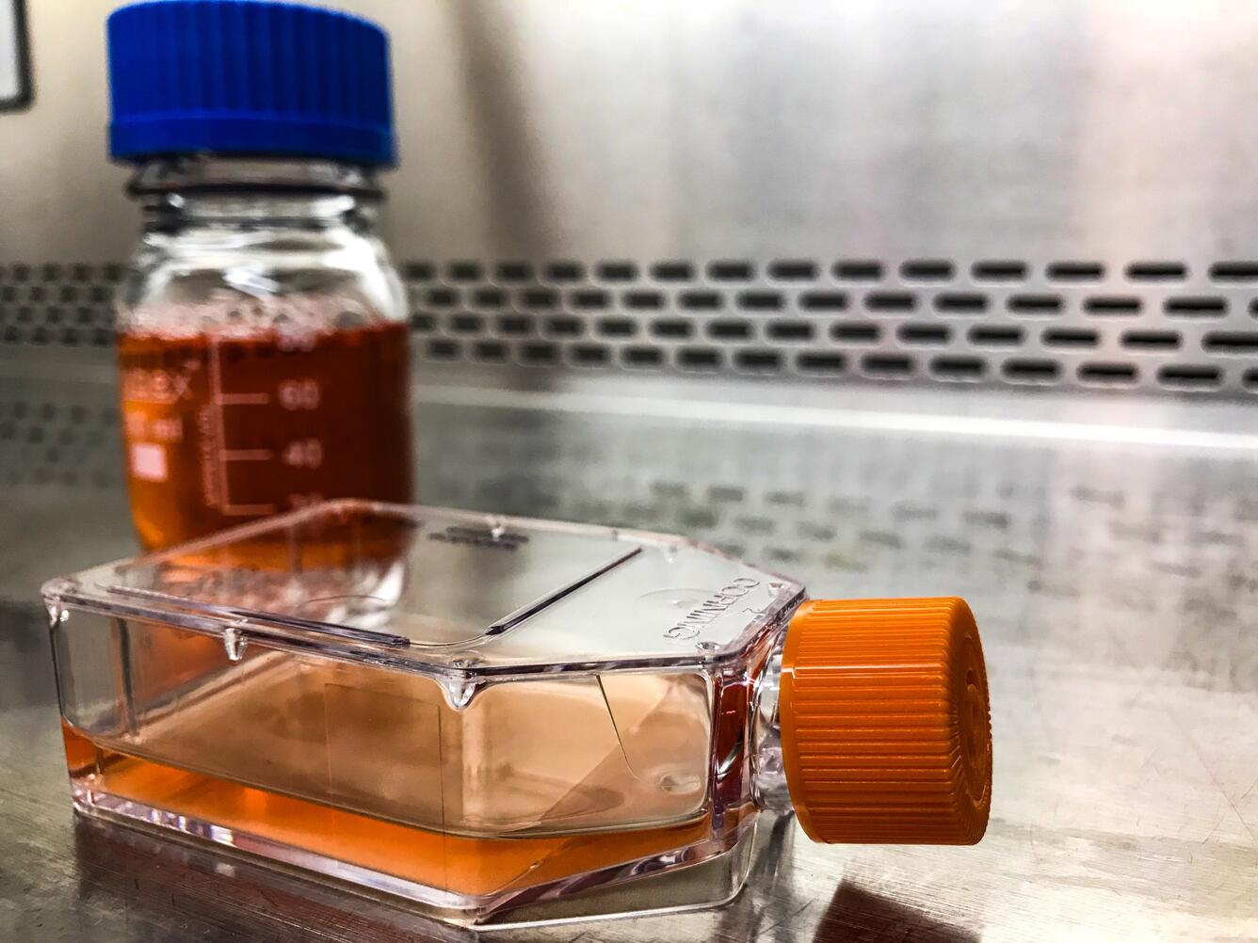
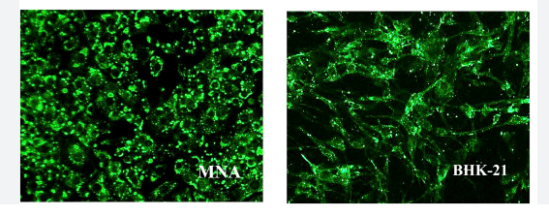
Rabies Diagnostics
Virus isolation, In-Vitro (1913-1990s)
Vaccine production, research and diagnosis
Rabies Tissue Culture infection Test (RTCIT)
First use for isolation of virus from suspect brain material in 1970s
Brain tissue/CSF/Saliva inoculated into MNA, BHK-21, others
Equal or better sensitivity to MIT
Still used by some as confirmatory test
WHO: MIT should be replaced with cell culture for capable labs
Limitations:
Slow turn-around
Lower sensitivity
Requires technical expertise

Slide 6
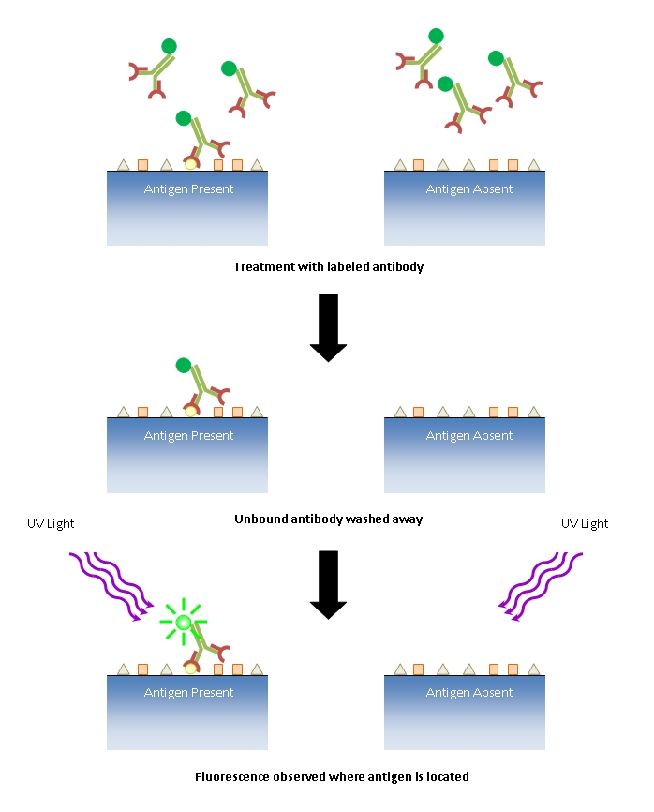
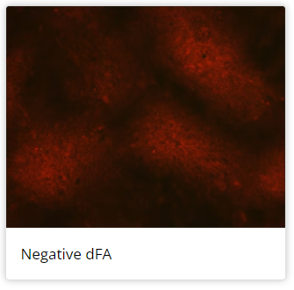
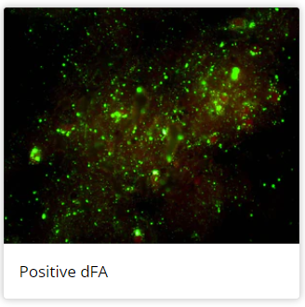
Rabies Diagnostics, Antigen Detection
Antigen Detection (1958-current)
DFA
Rabies virus anti-nucleocapsid IgG-FITC
Global Gold-standard
US National Standard Protocol 2003
Superior Sensitivity
Limitations
Must euthanize animal
Requires fresh brain tissue
Costly/limited availability of reagents
Maintenance of cold-chain
Expensive specialty equipment
Low sensitivity on ante-mortem specimens(nuchal biopsy/corneal impressions)

Slide 7
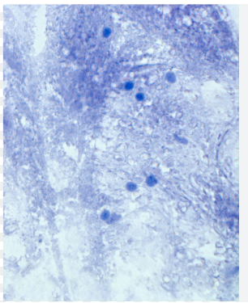
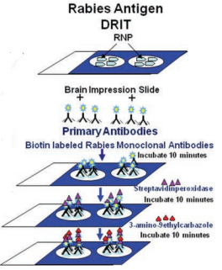
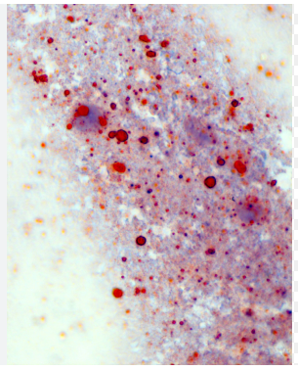
Rabies Diagnostics, Antigen Detection
Antigen Detection
Direct Rapid Immunohistochemistry Test
Modification of existing immunoperoxidase technique
Rabies virus biotinylated primary antibodies & streptavidin peroxidase enzyme
Enables use of basic light microscope and appropriate for field use
Dx in <1 hour
Negative DRIT test
Limitations
Must euthanize animal
Decreased sensitivity
Kit not commercially available
Not used for primary diagnosis in cases of public health concern
Positive DRIT test

Slide 8
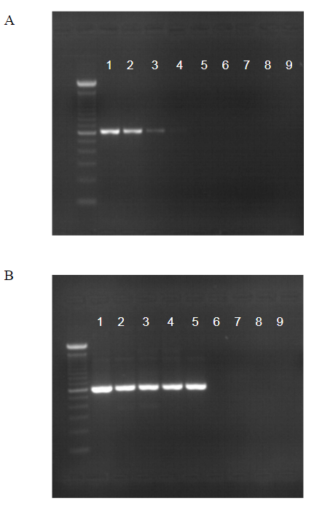
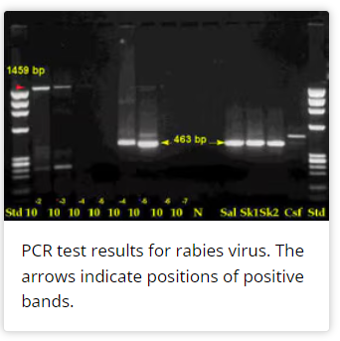
Rabies Diagnostics, Molecular Methods for Dx
Conventional RT-PCR: N/G gene
Time consuming
Lower sensitivity/Poor Precision
Result based on size discrimination
Requires sequencing confirmation
Hemi-nested PCR
High Sensitivity
Requires sequencing confirmation
High contamination risk
False Positives?
SYBR Green real-time RT-PCR
High sensitivity
Dye binds any dsDNA
Prone to non-specific amplification/False positives
Requires sequencing confirmation

Slide 9
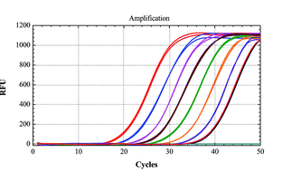
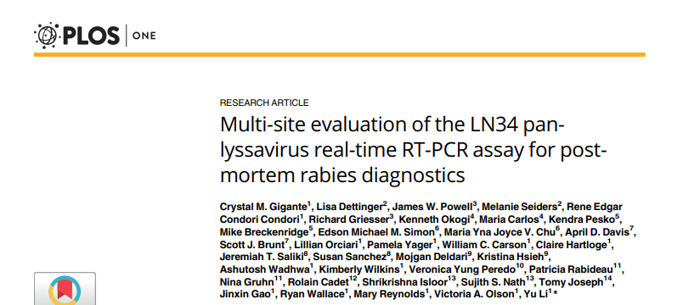
Rabies Diagnostics, Molecular Methods for Dx
LN34 Taqman real-time RT-PCR
One-step reaction
High sensitivity
Equal/better than hemi-nested RT-PCR
99.90% Sensitive/99.68% specific compared to DFA
Detects viral RNA in fresh, frozen, deteriorated and formalin fixed brain tissue
Can detect viral RNA in ante-mortem specimens
Serial saliva collections & nuchal skin biopsy
Lower sensitivity in CSF, urine and Hair follicles
Limitations: does not distinguish between lyssaviruses

Slide 10
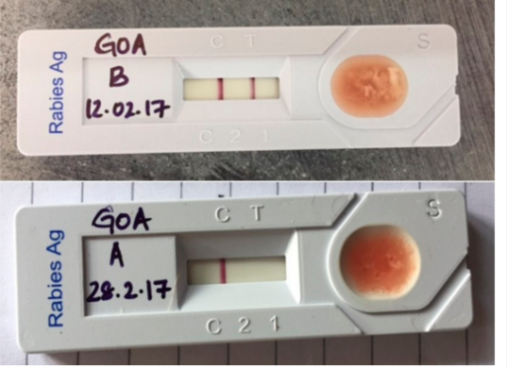
Rabies Diagnostics, Lateral Flow Assay
Lateral Flow Assays(LFA)
POC test, no need for central lab
Help with underreporting/surveillance
Low Cost
Widely available
No technical expertise needed to run test
Can accept multiple specimen types (Brain/Saliva)
Limitations
Many manufacturers
Variable specificity/sensitivity
The “good” ones may be okay for surveillance, the “bad” ones are really bad

Slide 11
Rabies Diagnostics, Variants
In Terrestrial animals:
Unique Variant primarily transmitted among members of a single reservoir species in a defined geographic region
Raccoons- eastern US
NCS- Montana, Dakotas, Minnesota, Wisconsin
SCS- Texas, Oklahoma, Kansas, Nebraska, Missouri, Louisiana
Gray Fox x2 (unique variants)-Arizona, Texas
Sustained transmission of virus variants outside reservoir species rare(cross species transmission)
Each CST event poses risk for viral adaptation resulting in sustained propagation in non-reservoir species
Could result in host-shift jeopardizing rabies management efforts

Slide 12
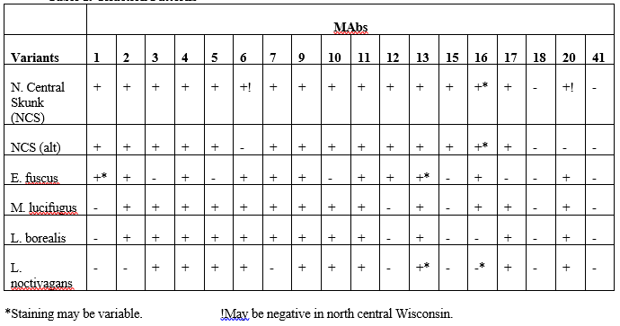
Rabies Diagnostics, Antigenic typing
Panel of MABs that target viral N protein
Produced in high concentrations
Highly conserved
Used to recognize different Rabies antigenic variants
Assess epidemiological situation
Recognize source of outbreaks
Identify wildlife reservoirs
Epi data allows for more efficient use of public health resources
Limitations:
Decreased resolution in insectivorous bats
Species identification is crucial

Slide 13
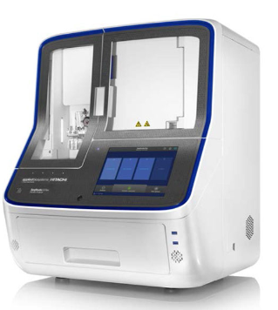
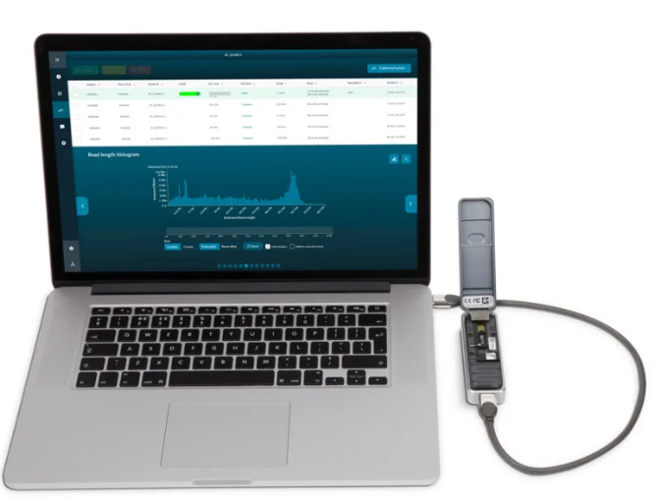
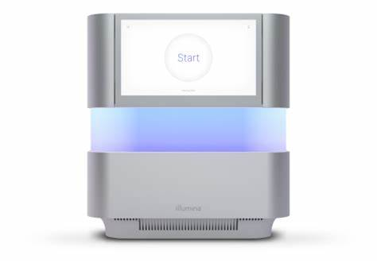
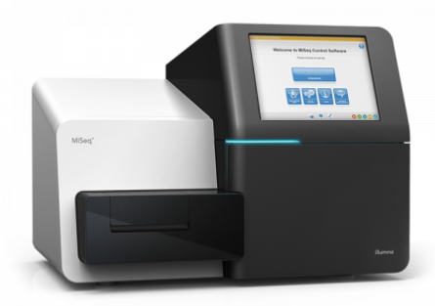
Rabies Diagnostics, Molecular Typing

Slide 14
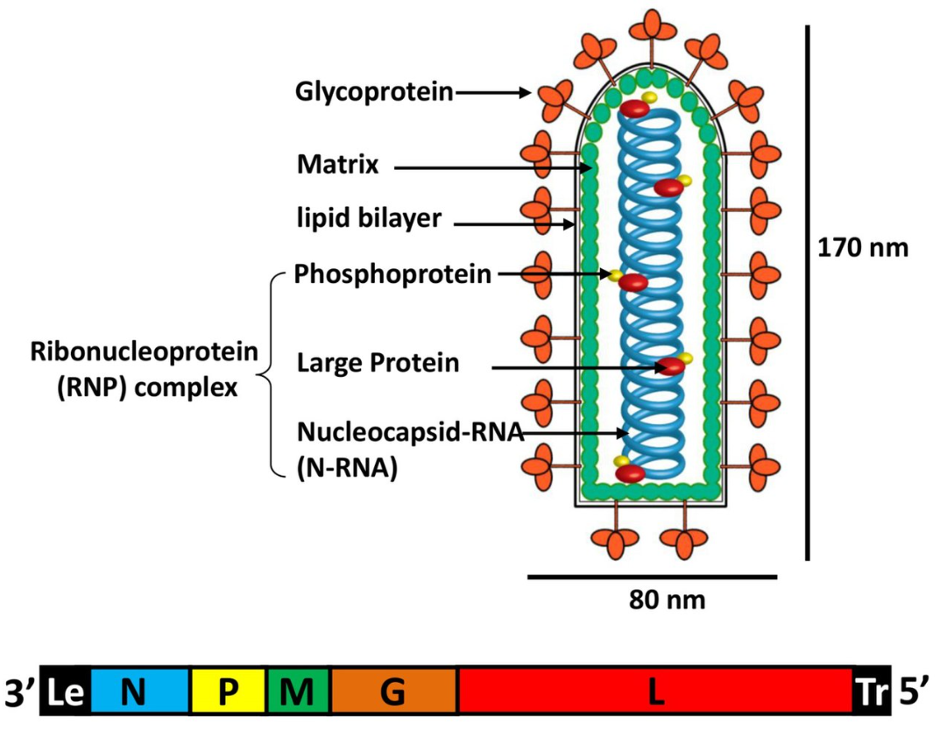
Rabies Diagnostics, Molecular Typing
WSLH Approach:
RT-PCR amplification of nucleoprotein and glycoprotein
Current tiled WGS approaches are variant specific
Simple 2-amplicon approach broadly amplifies all know lyssaviruses
N & G are traditional targets, more historical data
llumina DNA Prep library prep
NGS on Nextseq 2000
Align reads to reference for assembly

Slide 15
Rabies Diagnostics, Molecular Typing

Slide 16
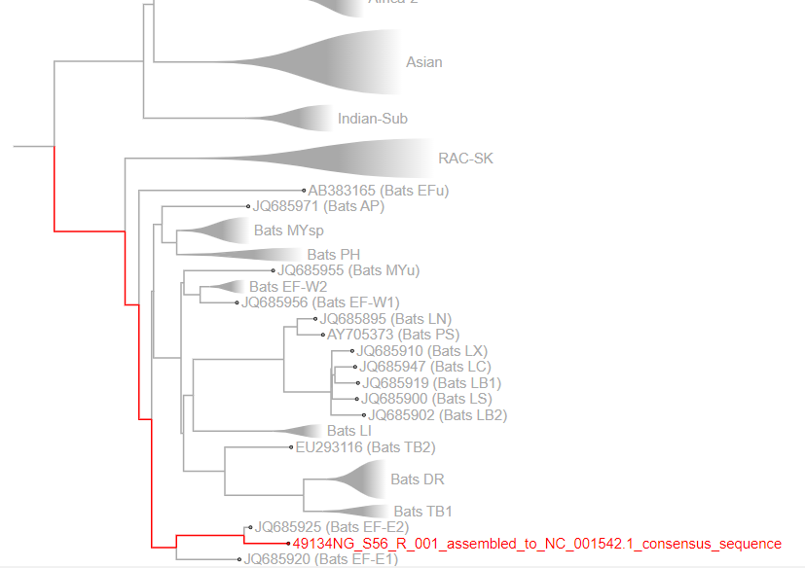
Rabies Diagnostics, Molecular Typing
RABV-GLUE Analysis:
Nucleotide/Amino Acid Comparison to reference
Phylogenetic Tree with references

Slide 17
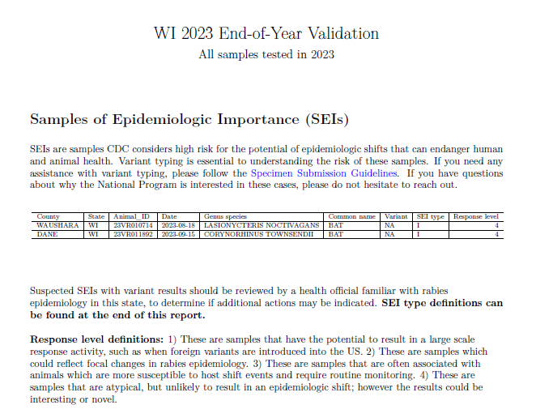
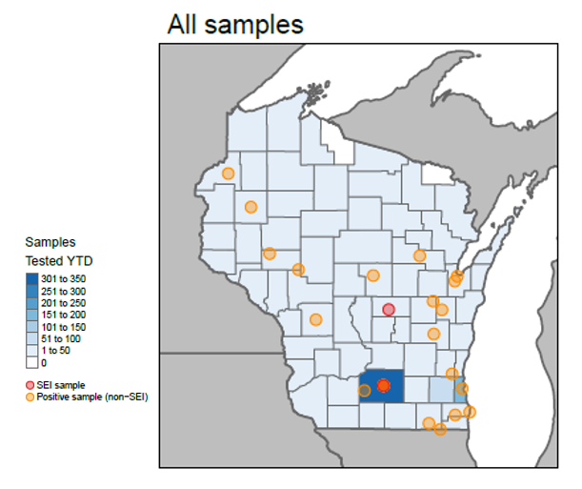
Rabies Diagnostics, Molecular Typing

Slide 18
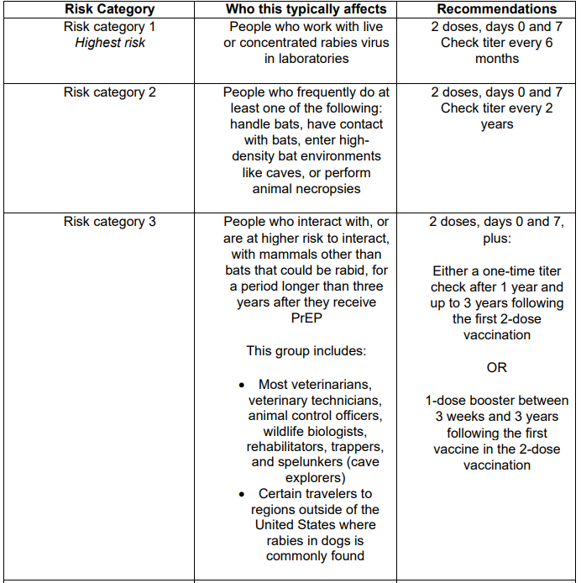
Rabies Diagnostics, Serology
ACIP Risk Groups
Not indicated for general U.S. population but Prep & serology is valuable for certain situations
Antigen function assays for detecting NA
Rapid Fluorescent Focus Inhibition Test & Fluorescent Antibody Virus Neutralization Test
NOT used to diagnose current infection
Gold-standard measure of NA per ACIP/WHO
Confirm adequate immune response to vaccination
Pet travel
Antigen Binding tests for detecting IgG/IgM
Indirect Immunofluorescence Assay and ELISA
Not a measure of functional NA
Results in hours instead of days
Some commercial ELISA kits are available
Large-scale screenings in populations

Slide 19
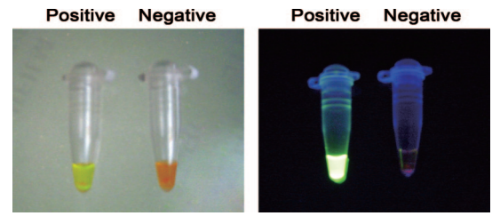
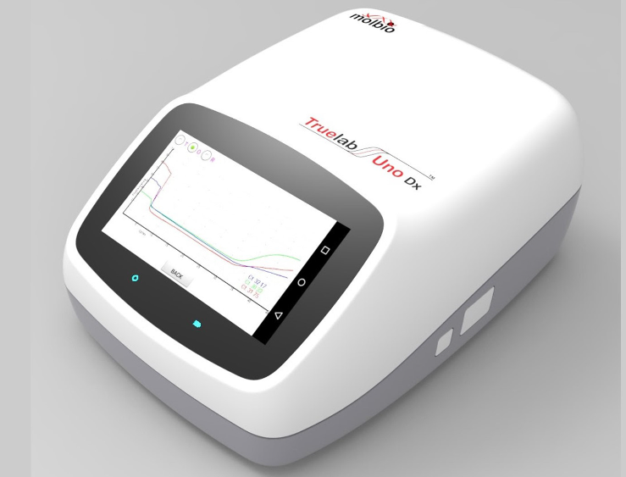
Rabies Diagnostics, Future Advances
Develop a national standard protocol mirroring DFA
Simplify molecular diagnostic methods for use in both developing & developed countries
Portable, POC molecular diagnostic testing methods under development
Lyophilized reagents to overcome cold-chain requirements
Sensitive & specific alterative isothermal molecular methods
loop mediated isothermal amplification(LAMP)
Recombinase polymerase amplification (RPA)
Pilot of a battery operated, chip-based real-time PCR platform in India demonstrated 92.3% specificity & 100% sensitivity to DFA
Potential for decentralizing laboratory services by eliminating need for sample transport

Slide 20
Rabies Diagnostics, Future Advances
Develop novel tests for ante-mortem and detection of disease prior to clinical signs
Exome miRNA as biomarkers for infection
Found in blood, urine, saliva, CSF
Study: exosomal miRNAs predicted lyssavirus infection in in-vitro (neural progenitor cells) with >99% accuracy
Further work is still needed to ensure these miRNAs are detectable in vivo at clinically relevant time points
RPA-CRISPR
Promising early detection assay in CSF
As early as 3 days post-infection in rat model
Detect 1 genomic copy in 1ul liquid

Slide 21
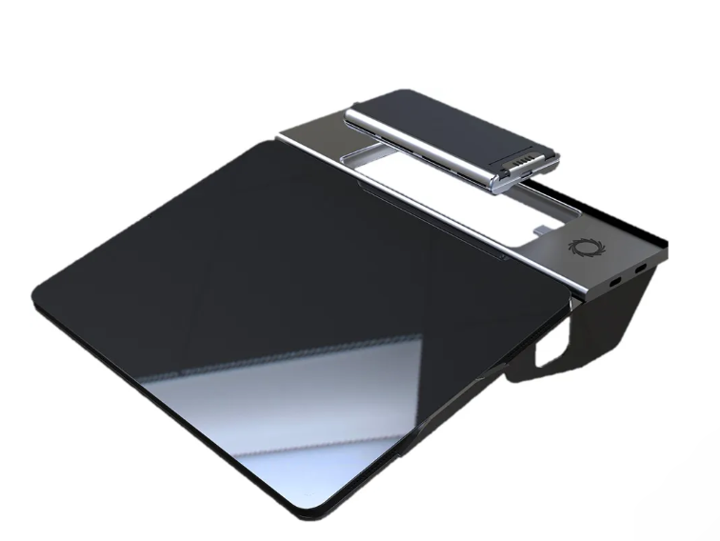
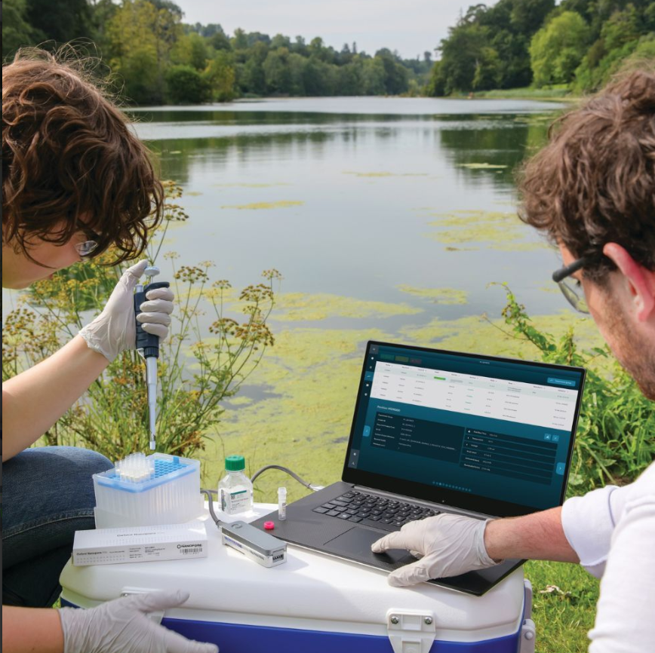
Rabies Diagnostics, Future Advances
Expand Advanced molecular techniques for labs with capacity & expertise
WGS generates detailed phylogenies that help define viral transmission in reservoir species
Develop sequencing protocols for use in the field/developing countries
ONT Minion
Development of chemistries & techniques that amplify whole-genomes of all samples (fresh/fixed)
llumina Ampliseq
RNA from lateral flow devices
Building of national, US-centric RABV database in CDC AMD portal
Help with US genomic surveillance and monitoring performance of NAAT for Dx

Slide 22
Rabies Diagnostics, Main takeaways
Rabies is an ancient disease. Diagnosis has advanced from crude, unscientific methods to highly sensitive and specific assays
Advancing diagnostic technologies allowed for production of early vaccines, for timely treatment of animal bite victims, to help investigators understand viral transmission patterns in wildlife and to aid public health investigations by identifying sources of outbreaks
The future of rabies diagnostics promises to expand highly sensitive and specific diagnostics to developing countries, offer early disease diagnosis using less invasive and ante-mortem testing, aid global rabies surveillance & control efforts and support promising experimental therapies

Slide 23
References
https://www.cdc.gov/rabies/about/index.html
Emerging Technologies for the Detection of Rabies Virus: Challenges and Hopes in the 21st Century Fooks AR, Johnson N, Freuling CM, Wakeley PR, Banyard AC, et al. (2009) Emerging Technologies for the Detection of Rabies Virus: Challenges and Hopes in the 21st Century. PLOS Neglected Tropical Diseases 3(9): e530. https://doi.org/10.1371/journal.pntd.0000530
Faye, M., Abd El Wahed, A., Faye, O. et al. A recombinase polymerase amplification assay for rapid detection of rabies virus. Sci Rep 11, 3131 (2021). https://doi.org/10.1038/s41598-021-82479-8
Ashwini MA, Pattanaik A, Mani RS. Recent updates on laboratory diagnosis of rabies. Indian J Med Res. 2024 Jan 1;159(1):48-61. doi: 10.4103/ijmr.ijmr_131_23. Epub 2024 Mar 4. PMID: 38376376; PMCID: PMC10954107.
History of Rabies in the Americas: From the Pre-Columbian to the Present, Volume I 2023 ISBN : 978-3-031-25051-4
Laboratory techniques in rabies Volume 2 Fifth edition. Volume 2 4 February 2019 Handbook ISBN: 978 92 4 151530 6
https://www.who.int/news-room/fact-sheets/detail/rabies
Lembo, Tiziana et al. (2006). Evaluation of a Direct, Rapid Immunohistochemical Test for Rabies Diagnosis. 12(2).

