Slide 1
Lead Hazard Awareness
WisCon Public Sector Consulting
June 2026

Slide 2
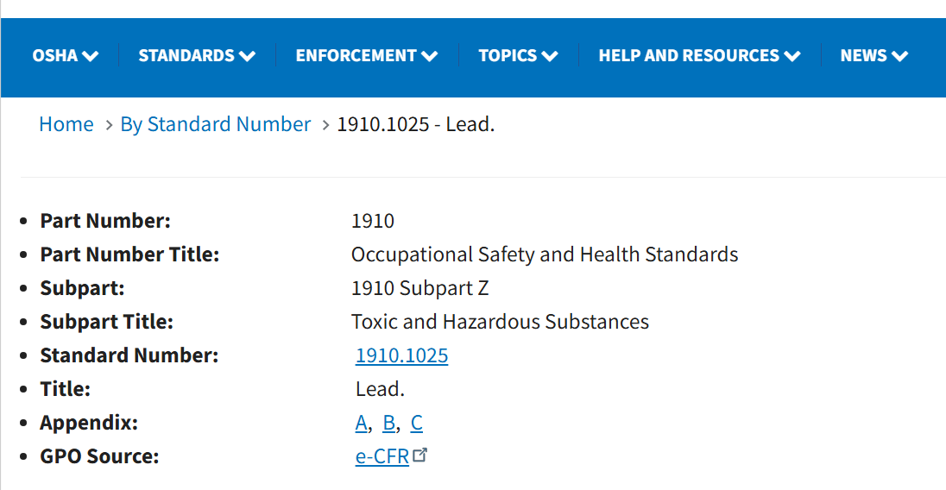
OSHA’s General Industry Lead Standard
The Occupational Safety and Health Administration’s (OSHA’s) Lead Standard for General Industry, 29 CFR § 1910.1025, can be found online at: 29 CFR 1910.1025

Slide 3
OSHA’s General Industry Lead Standard. Cont.
Has the goal of preventing adverse health effects for most workers
  Lower blood lead levels recommended for workers planning on having children
General Industry Lead Standard promulgated in 1978, challenged by both industry and labor
  1979 Court of Appeals stayed several provisions
  Additional legal actions occurred until the stay was lifted in 1997
  In May of 2003, all employers had to comply with the standard

Slide 4

OSHA’s General Industry Lead Standard. Cont.
In October 2022, OSHA issued an Advance Notice of Proposed Rule Making seeking public comment on the triggers for medical removal protection and medical surveillance provisions
  Other aspects of the standard could also be addressed
  No activity since
1. American Public Health Association, October 27, 2022, Re: Advance Notice of Proposed Rulemaking on blood lead level for medical removal Docket No. OSHA-2018-0004 (87 Federal Register 38343, June 28, 2022)
American Public Health Association submitted a paper to OSHA outlining the reasons why they felt the Standard was not “. . .sufficiently protective of workers’ health. . . “¹

Slide 5
OSHA’s General Industry Lead Standard, cont.
At the minimum, the Lead Standard requires employers to:
  Determine exposures to lead, typically by conducting air sampling
  Provide:
    Basic lead training to employees
    Implement housekeeping practices that reduce lead exposure
    Provide washing facilities
    Prohibit eating, drinking, smoking, vaping and other hand to face activities in work areas that have lead
    Provide personal protective equipment
Image: AdobeStock_414 683802

Slide 6
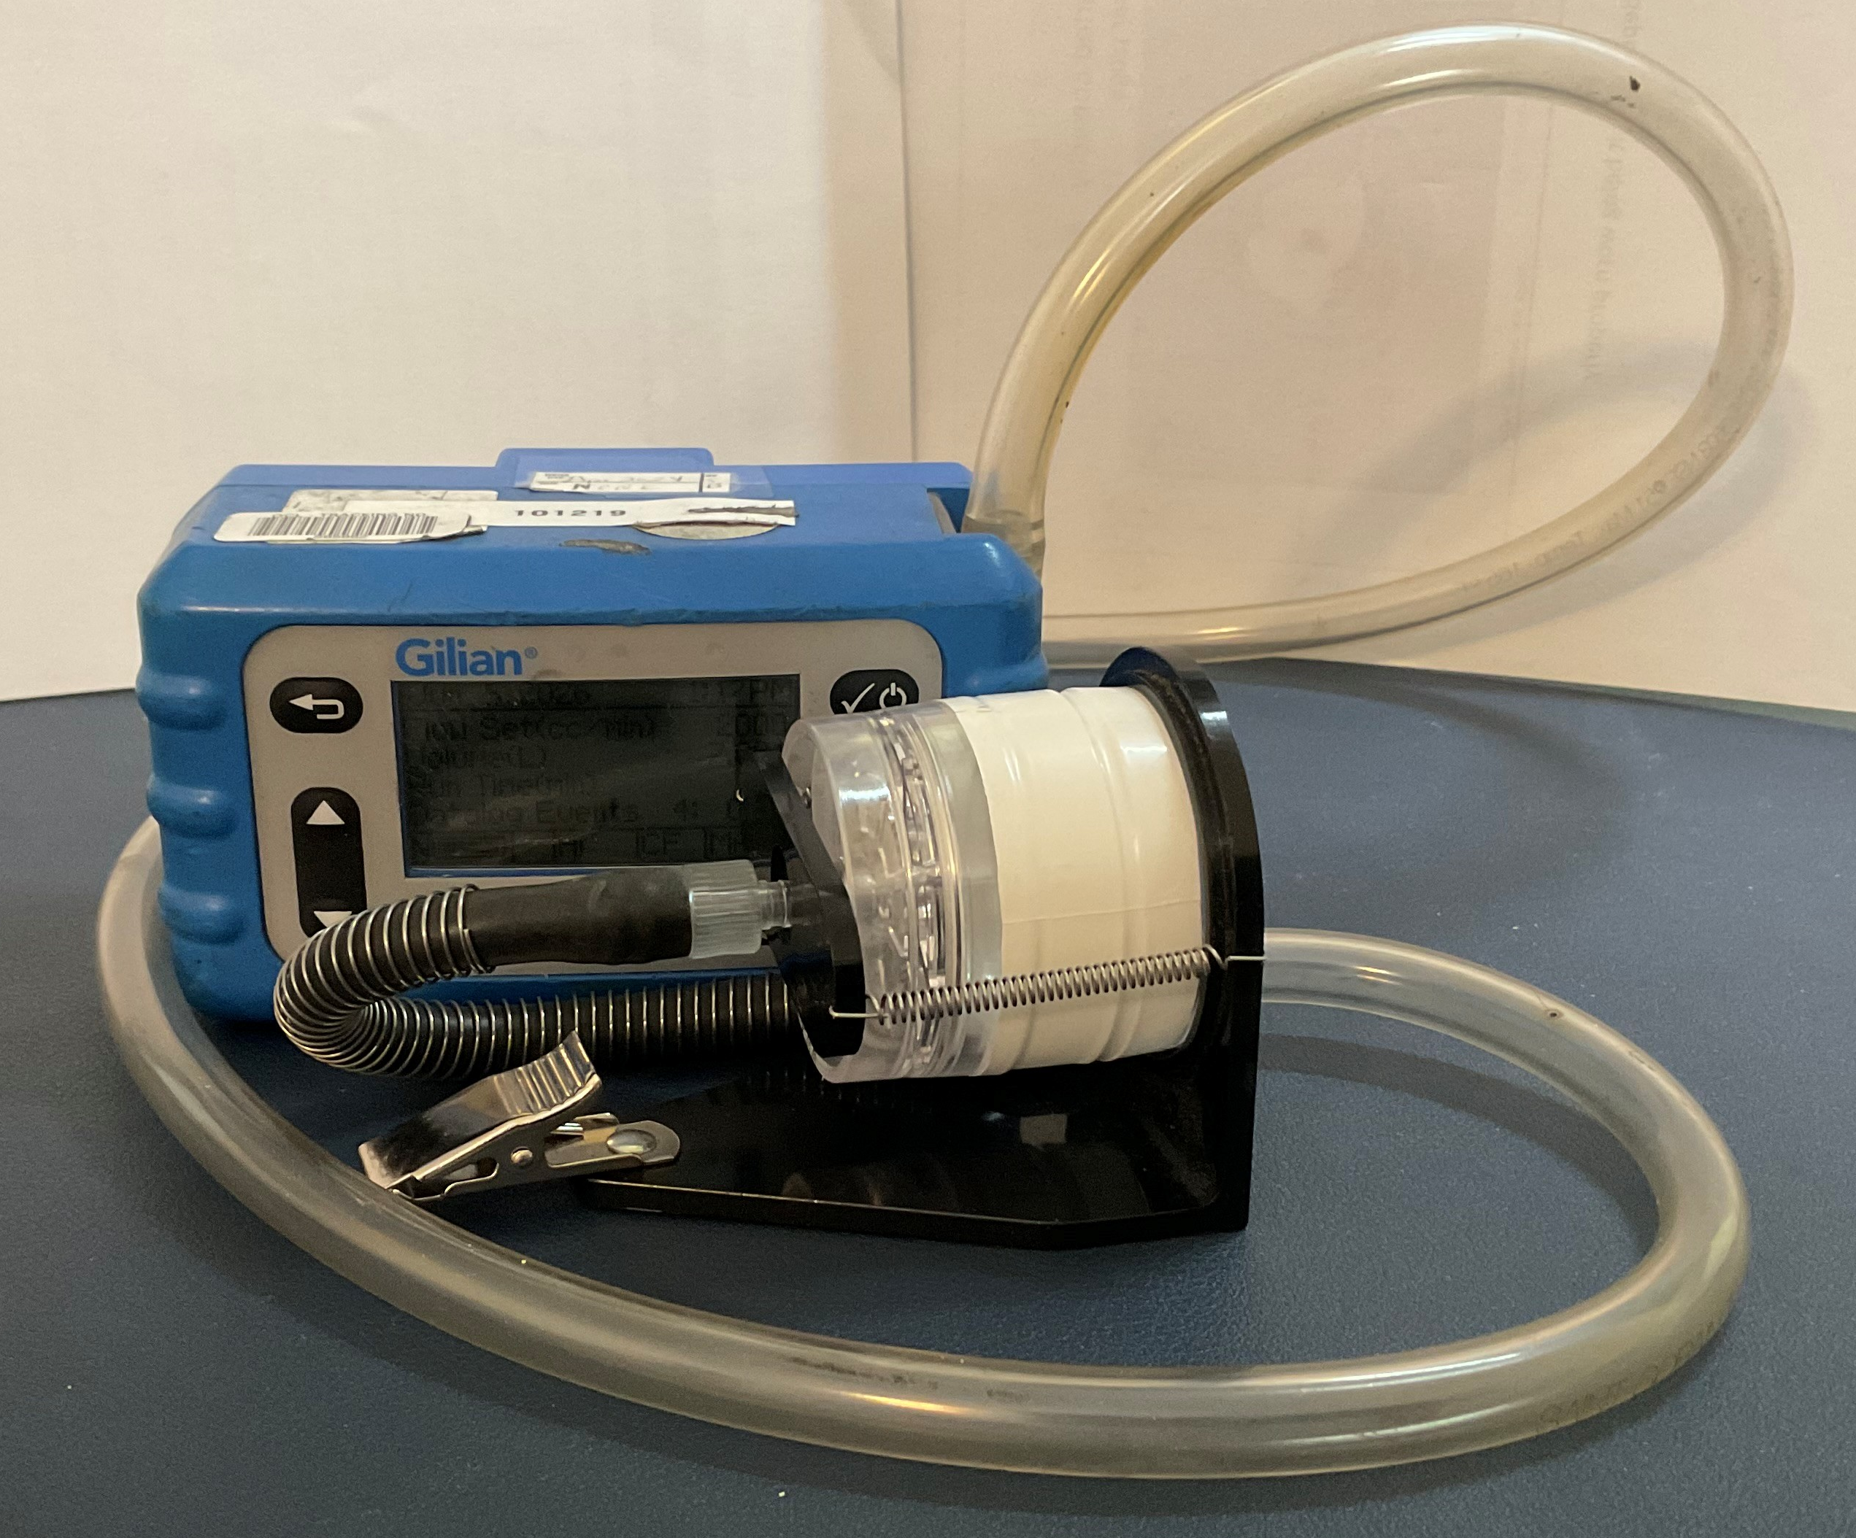
Workplace Exposure Limits, 8-hour day
Action Level (AL) of 30 µg/m³ - if exceeded
Permissible Exposure Limit (PEL) of 50 µg/m³ ⁻ if exceeded
Routine exposure monitoring
Medical surveillance
Training and education
Action level items plus
Respiratory protection and other personal protective equipment
Engineering and work practice controls
Hygiene facilities and practices
Housekeeping practices
Image: WisCon Equipment Photo – Mention/display of any company name in our presentation does not constitute an endorsement

Slide 7
OSHA’s General Industry Lead Standard, cont.
Additional actions that are required if exposures are above the Action Level or Permissible Exposure Limit include
  Medical surveillance and/or medical removal
  Engineering controls
  Hygiene facilities
  Laundry services
  Respiratory protection
  Signage
  Restricted work areas

Slide 8
Required Employee Information and Training
If there is potential exposure to airborne lead at any level, employers must inform employees of the content of Appendices A and B of the Lead Standard
  Appendix A Substance Data Sheet for Occupational Exposure to Lead
  Appendix B Employee Standard Summary
Additional training requirements are in place for employees who are exposure above the Action Level or for whom the possibility of skin or eye irritation exists

Slide 9
Overview of Lead Exposure
Acute and chronic health effects
A systemic poison
More dangerous to children and pregnant women
Causes reproductive harm in both men and women
Standard is based on 1978 data
Current knowledge has resulted in an effort to lower both occupational and non- occupational health limits

Slide 10
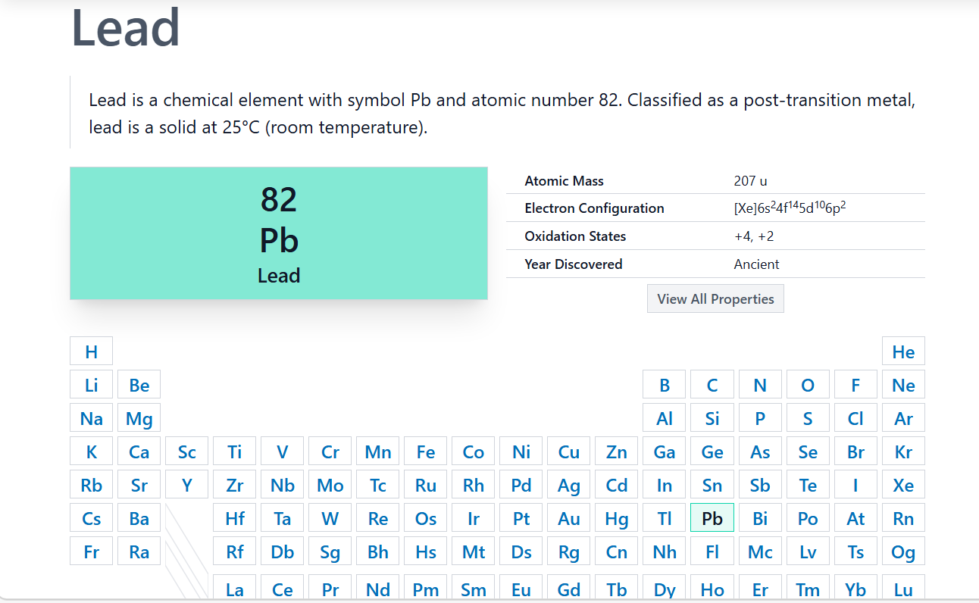
Characteristics
Image: Lead | Pb (Element) - PubChem

Slide 11
Characteristics, continued
It is a soft, malleable and corrosion resistant material
Lead is a toxic metal that can cause damage to the brain, nervous system, kidneys, reproductive system (both male and female) and cause other health problems
Can enter the body by inhalation or ingestion
Been used throughout time and considered valuable

Slide 12
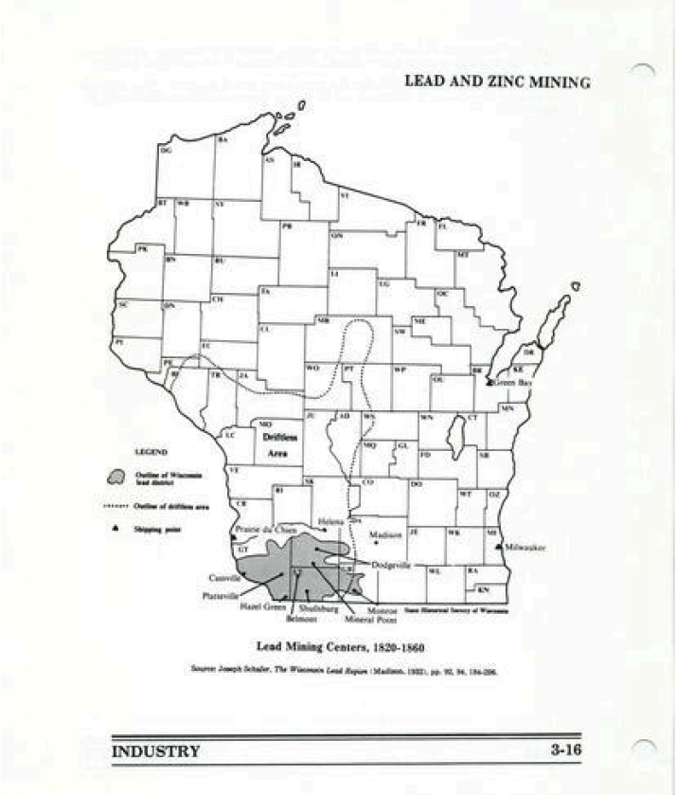
Wisconsin Lead Mining Centers, 1820-1860
Image: Wisconsin Historical Society, Unique ID W017YKN, Lead Mining Centers, 1820-1860 - WisHistory

Slide 13
Materials That May Contain Lead
May be present in a wide range of materials such as:
  Scrap metal
  Solder
  Bullet fragments and dust – lead free bullets may still have lead in the primer
  Sheeting cable housing (old telecommunication lines)
  Fishing lures, weights, ingots
  Exterior paint or paint manufactured outside the U.S. (banned 1978), varnishes
  Food
  Cosmetics

Slide 14
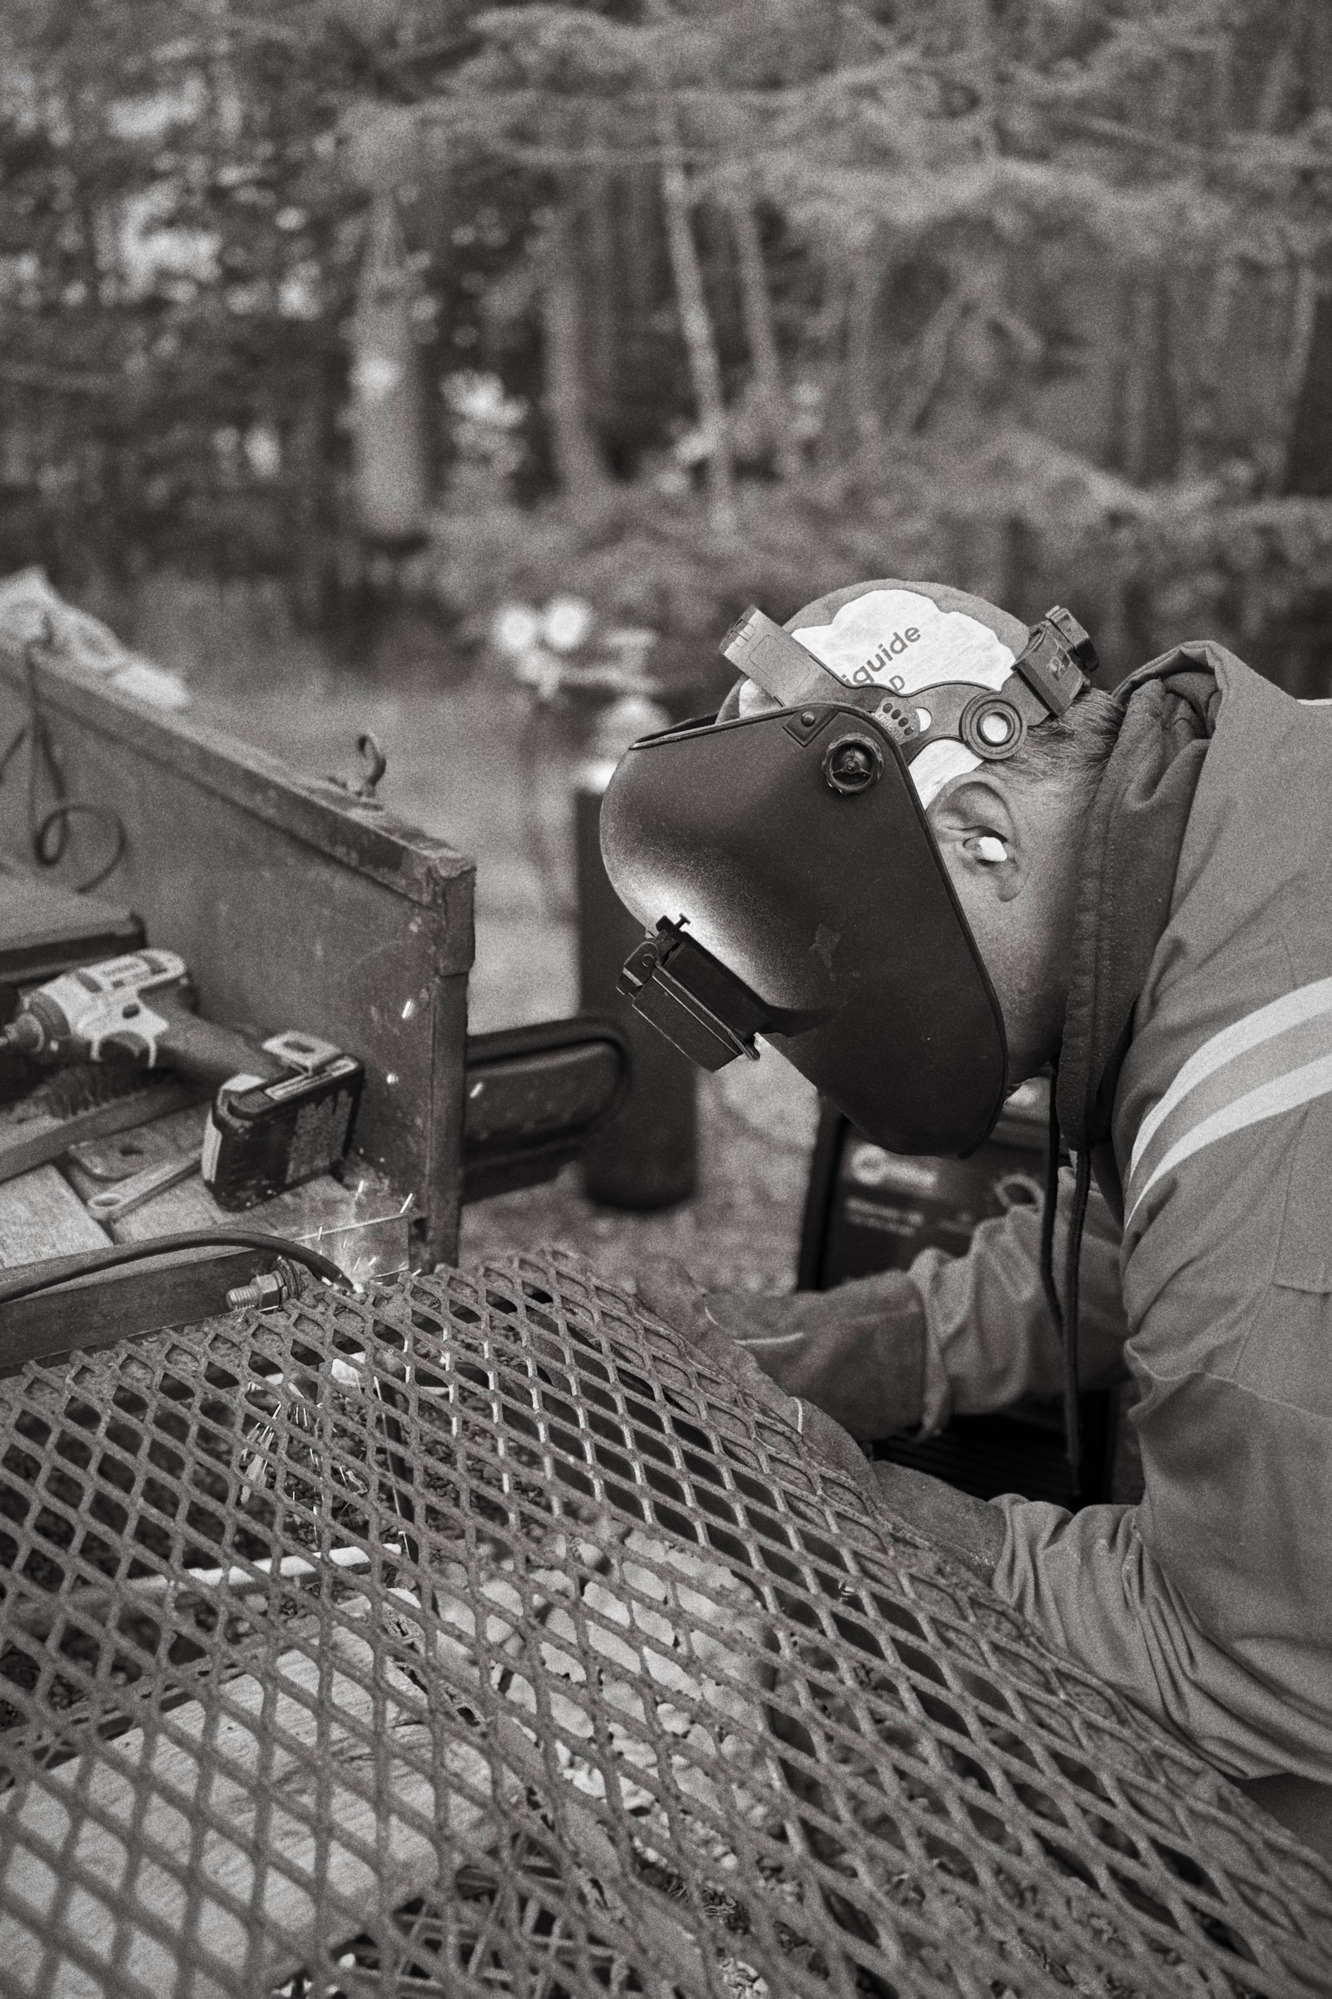
Lead Containing Materials
Since lead is a soft metal, lead containing materials can release lead fumes/dust when the material is:
  Heated
  Cut
  Ground on
  Welded
Image: Jonathan Cooper Pexels33894221

Slide 15
Where It Is Present
[Employer to list locations/products that contain lead]

Slide 16

Lead Exposure
Lead can enter the bloodstream by breathing or ingesting lead particles.
  When lead is present in the air in the form of dust or vapor, it can be absorbed by your lungs and upper respiratory tract
  If your hands have lead on them and you handle food, smoke, vape or apply cosmetics or these products are present in a place where there is airborne lead, you could ingest lead particles, which are then absorbed through your digestive system
Image: Lead - Overview | Occupational Safety and Health Administration

Slide 17

Lead Exposure, cont.
Once lead is taken into your body, it is then transferred into your bloodstream and subsequently soft tissues and bone.
Certain events can cause the lead to leach from your bones and re-enter your body, e.g., menopause
Image: AdobeStock_700 66369

Slide 18
Initial and Continuous Lead Exposure
Exposure periods as short as days or as long as several years can result in absorption that causes health impairment and disease
As exposure continues the amount stored in your body increases if you are absorbing more than you’re excreting
Image: PowerPoint Icon

Slide 19

Health Effects
Acute Overexposure –Short Term
Chronic Overexposure – Severe Damage to the Following Body Systems:
Fatal in large doses, acute encephalopathy – affects the brain
  Not common, but possible
Blood-forming
Nervous
Urinary
Reproductive
Cardiovascular
Image: Pavel Danilyuk, Pexels 8442616

Slide 20
Symptoms
Someone with chronic lead poisoning may not have symptoms, or their symptoms may not be recognized as being associated with lead exposure such as:
  Headache
  Joint and muscle pain
  Weakness
  Fatigue
  Irritability
  Depression
  Constipation
  Loss of appetite
  Abdominal discomfort

Slide 21
Reporting Symptoms
If you work with lead and experience any of these symptoms, discuss this with your supervisor
Assess your workplace exposure and the control measures in place to reduce your exposure
A medical determine of the cause of your symptoms may include taking a blood sample to determine your blood lead levels
Non-occupational exposures should also be addressed

Slide 22
Easily Travels Home With You

Slide 23
Take-home Contamination
Occupational lead exposures can result in exposures to household members such as children and spouses
Lead dust can be transferred from employees’ skin, hair, clothing, shoes and other personal items to vehicles and homes
Children and pregnant women are at a higher risk to the health hazards of lead
Images: PowerPoint Icons

Slide 24
Take Home Exposures Can Be Reduced
Changing clothes before going home and leaving soiled clothing at work for laundering
Storing street clothes separate from work clothes
Showering before leaving work
Leaving contaminated items such as tool boxes or work shoes/boots in the workplace or storing them in a heavy plastic bag, away from children
Images: PowerPoint Icons

Slide 25
Lead Contaminated Clothing
Normal cleaning and laundry methods may not be adequate in removing lead
  Use cleaning agents formulated to remove lead and other heavy metals
Performing these tasks can exposure the person performing them to lead
  Shaking out clothing
  Cleaning up residual contamination

Slide 26

Lead Contaminated Clothing
If you have to bring your work clothing home, consider using dissolvable plastic bags for transport
Wash work clothing separate from other household items and clean/ wipe down wash tub and dryer after use
Image: Judy Horn, Pexels 5365777

Slide 27
Non-Occupational Exposures
Home renovation
Yards, or playgrounds –historic use of leaded paint, leaded gasoline or industrial emissions
Drinking water in homes build before 1986
  Pipes
  Plumbing
  Fixtures
Hobbies
  Stained glass
  Pottery
  Lead fishing sinkers
Firearms
  Reloading shot
  Lead free bullets may still have lead in the primer

Slide 28
Summary
Lead exposure can occur from both occupational and non-occupational exposures
Lead dust can easily be brought home from the workplace
Workplace exposures mainly occur through the inhalation of fumes/dust, but can occur from ingestion via contaminated hands
As exposure continues the amount stored in your body increases if you are absorbing more than you’re excreting
[Employer to list locations/products that contain lead]

Slide 29
Summary, cont.
Lead is a systemic poison, it damages multiple organ systems
You may experience no symptoms or symptoms that are similar to non-lead poisoning illnesses
Lead poisoning symptoms include:
  Headache
  Joint and muscle pain
  Weakness
  Fatigue
  Irritability
  Depression
  Constipation
  Loss of appetite
  Abdominal discomfort

Slide 30
Additional Resources
Lead-Safe Wisconsin: Protecting Adults from Lead Exposure | Wisconsin Department of Health Services
Leave Lead At Work
Lead-Safe Wisconsin: For Families and Caregivers | Wisconsin Department of Health Services
Wisconsin 101, “Object History, Galena”, the official state mineral of Wisconsin, it is the raw material used to produce lead

