Slide 1
Qualitative Fit Testing
WisCon
Public Sector Consulting
Notes:
Today, We are going to be going over the procedures to perform a Qualitative Fit Test using the either the Bitrex or saccharin protocol for a filtering facepiece respirator, such as a N95 or other particulate respirators.

Slide 2
Introduction
After completing this training which includes a hands on portion, you will be able to perform qualitative fit testing as provided for in OSHA’s respiratory protection standard, 29 CFR 1910.134, Appendix A, 1910.134 App A - Fit Testing Procedures (Mandatory). | Occupational Safety and Health Administration (osha.gov)

Slide 3
Background
Conduct a workplace risk assessment to determine if there is a necessity for a Respiratory Protection Program (RPP) 1910.134
Components of RPP include:
  Written Program
  Respirator Selection
  Medical Evaluations
  Employee Training
  Fit Testing
  Use of NIOSH certified respirators
  Respirator Maintenance
  Program Evaluation
Notes:
There are eight Elements to a respiratory protection program, they include
A written program
The proper selection of appropriate respirators, including the specific types (makes and models) appropriate for that job or task and exposure(s)
Assessing any medical limitations people have when wearing those respirators in those working conditions
Testing to determine which respirator makes and models properly fit the specific worker
Written procedures on how to properly use the respirator
Maintaining the respirator so that it’s clean and working as expected
Training Employees
And finally how the respirator program is routinely evaluated to determine it’s effectiveness, and to make changes for continuous improvement.

Slide 4

Key Respiratory Protection Program Elements
Program administrator has overall responsibility for the RPP
Written program must have worksite specific procedures
Employer must provide at no cost:
  Respirators
  Training
  Medical evaluations
Other records to be maintained:
  Medical evaluations
  Fit test records
  Training
Image: PowerPoint Icon
Notes:
OSHA standard 29 CFR 1910.134(c), which requires the employer to develop and implement a written respiratory protection program with required worksite-specific procedures and elements for required respirator use.
This program must be administered by a suitably trained program administrator.
The employer must provide respirators, training, and medical evaluations at no cost to the employee.
A written copy of the current respiratory protection program must be retained by the employer and made available upon request to affected employees and OSHA. Furthermore, several other types of records are required to be maintained by the employer.
Examples include:
Medical evaluation
Fit test records
Certifications
In addition, the respiratory protection program shall be updated as necessary to reflect changes in workplace conditions that affect respirator use.

Slide 5

Medical Evaluations Overview
Medical evaluations are required prior to fit-testing and before the use of a respirator
Medical evaluations must be free for employees
Not everyone is able to wear a respirator
Image: PowerPoint Icon
Notes:
This presentation provides a brief overview and general information about medical evaluations that an employer must use to determine if an employee is able to wear a tight fitting respirator. OSHA’s respiratory protection standard requires that employers provide these evaluations for free to all workers who are required to wear respirators on the job.

Slide 6

Medical Evaluation
Performed by a physician or other licensed healthcare professional (LHCP)
Must consider employees health, specific job, respirator type, and working conditions
Covers the required questions from Appendix C of OSHA’s Respiratory Protection standard
Online evaluations are available at a cost
Source: Videoplasty.com, CC BY-SA 4.0, via Wikimedia Commons
Notes:
Employers must select a physician or other licensed healthcare professional, such as a registered nurse or physician's assistant, to perform the medical evaluation.
The evaluation must consider the workers health, specific job description, respirator type, and workplace conditions.
The questions are from Appendix C of OSHA's Respiratory Protection Standard.
The medical evaluation can be as simple as having the physician or other licensed healthcare professional review the responses on the questionnaire, or it could be an "in-person" medical examination.
The OSHA Respirator Medical Evaluation Questionnaire is designed to identify general medical conditions that could place a worker at risk of serious medical consequences, if a respirator is used.
The medical questionnaire must be administered in a manner that ensures that the worker understands its content.
It is important for workers to remember that responses to the medical questionnaire are confidential and may not be shared with the employer.

Slide 7
Making the Medical Determination
Starts by the by LHCP reviewing the employee’s answers to the Appendix C questionnaire. May require a follow-up medical exam
In some cases can require additional tests
Employer must ensure follow-up exam or testing is done during normal working hours or at a time convenient to the employee
Notes:
In many cases, the physician or licensed healthcare professional can make the medical determination based on the answers provided in the questionnaire.
But, sometimes the physician or licensed healthcare professional may decide that a follow-up medical examination is necessary to make the determination. Follow-up could include medical tests, consultations, or diagnostic procedures.
If a worker needs a follow-up medical examination, it’s the employer’s responsibility to pay for it and any associated tests. The employer must also ensure that the follow-up examination and any other medical testing are provided during the workers normal working hours, or at a time and place that's convenient for the worker. In addition, the employer must provide the worker with an opportunity to discuss the questionnaire and examination results with the physician or licensed healthcare professional.

Slide 8
Written Recommendation
The healthcare professional will make a written recommendation
This will focus on three things:
  How an employee is medically able to wear a respirator, e.g. with or without restrictions
  If an employee needs follow-up evaluations
  A statement that the healthcare professional has provided the employee a copy of their written recommendation
The written recommendation cannot include any confidential medical information about the employee
Notes:
Whatever method is used (reviewing the questionnaire; conducting an initial medical examination, or conducting a follow-up medical examination) the physician or licensed healthcare professional will provide both the employee and the employer with a written recommendation.
This recommendation document must state three things:
First, whether the worker is medically able to wear the respirator and if they have any medical limitations for using the respirator;
Second, the need, if any, for the worker to have follow-up medical evaluations;
And, third, a statement that the doctor or licensed healthcare professional has provided the worker with a copy of their written recommendation.
This written recommendation cannot include any confidential medical information about the worker.

Slide 9

When to Medically Reevaluated An Employee
The employee experiences adverse health symptoms
There is a change in a health condition, such as
  Diagnoses of a heart condition or lung disease
  Significant changes to weight, or
  Dental changes such as dentures or lost teeth
A medical professional, supervisor, or respirator program administrator deem it necessary
A change in workplace conditions occur such as additional PPE or exposure levels change
Source: Videoplasty.com, CC BY-SA 4.0, via Wikimedia Commons
Notes:
Even after the worker has been medically cleared to use a respirator on the job there will be times when they will have to be reevaluated by a physician or licensed healthcare professional. The worker must be reevaluated when:
they report medical signs or symptoms that are related to their ability to use a respirator, such as a heart condition, lung disease, or dental changes such as dentures of lost teeth;
A physician or licensed healthcare professional, a supervisor, or the respirator program administrator informs the employer that the worker needs to be reevaluated;
Information from the respiratory protection program, including observations made during fit testing and program evaluation, indicates a need for the worker to be reevaluated; or
A change occurs in workplace conditions that increases the burden on the employee while using the respirator; for example the worker’s job becomes more physically demanding, or they must wear additional protective clothing or exposure levels change

Slide 10
Reminders
When respirators are required by employers, medical evaluations are required
Medical evaluations must be provided at no cost to the employee
Questions from Appendix C of the Respiratory Protection Standard must be answered in the medical evaluation
Medical evaluations must be done before fit testing can occur

Slide 11
Fit Testing

Slide 12
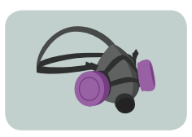
OSHA Requirement for Fit Testing
Respirator protection program
  Fit testing for tight fitting respirators before use
Image Source: NIOSH Types of Respiratory Protection, September 2019
Notes:
OSHA's Respiratory Protection Standard requires that employers who use respirators in the workplace have a written respiratory protection program. As part of that written program, the employer must ensure that employees who are required to wear a tight fitting respirator have been medically cleared prior to wearing a respirator. Fit testing can not be conducted before medical clearance is obtained. Additionally the proper fit of a respirator must be confirmed before an employee wears the respirator in a contaminated atmosphere. Air takes the path of least resistance, so if the respirator is not properly “sealed” to the user’s face, air will leak into the respirator via the facepiece, without going through the filters first.

Slide 13
Purpose of This Presentation
Train:
  Program administrators, or
  Fit test administrators
Qualitative fit test:
  Bitrex – Bitter tasting
  Sacchrin – Sweet tasting
Valid for any particulate filtering respirator
  Half mask, full face or filtering facepiece respirators such as an N95’s
Notes:
The purpose of this presentation is to train the respirator program administrator or fit test administrator on the proper procedures to perform a qualitative fit test using either Bitrex – a bitter tasting test agent or sacchrain – a sweet tasting test agent. The procedures are the same for both test agents. This test is valid for any particulate filtering respirator including filtering facepiece respirators such as N95s.

Slide 14

Planning for the Fit Test
No eating, drinking, smoking, vaping or chewing gum 15 minutes prior to test
Clean shaven
Medically cleared
Notes:
Planning for a fit test should begin before the participant arrives for their test. Participants should be given advanced notice that they must refrain from eating, drinking, smoking, vaping or chewing gum 15 minutes prior to the fit test. Additionally instruct anyone with facial hair that they must be clean shaven for the fit test. This would also be a good time to verify with the participant that they have been medically cleared to wear a respirator prior to arriving for their fit test.

Slide 15
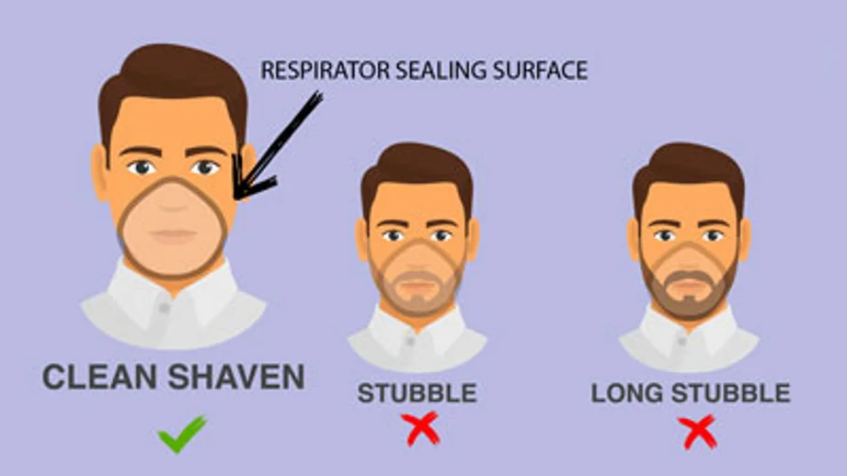
Respirator Sealing Surface
The respirator must tightly seal against the users face in order to protect the user
Ensure the following doesn’t interfere:
  Facial hair
  Facial scars
  Jewelry
  Glasses or goggles
  Other PPE
Image: Facial Hairstyles and Filtering Facepiece Respirators
Notes:
Tight-fitting respirators rely on a good facepiece seal to be able to provide protection to the user. If there is a leak in the seal of a tight-fitting respirator then the respirator cannot effectively reduce the wearer’s exposures to respiratory hazards. Before fitting a respirator, the program administrator or fit test administrator must be sure that nothing interferes with the seal of the respirator to the employee’s face. When assessing an employee for a respirator fit, conditions that can interfere with the respirator’s seal can include: Facial hair; Facial scars; Jewelry, glasses or goggles, or other personal protective equipment such as Face shields.

Slide 16
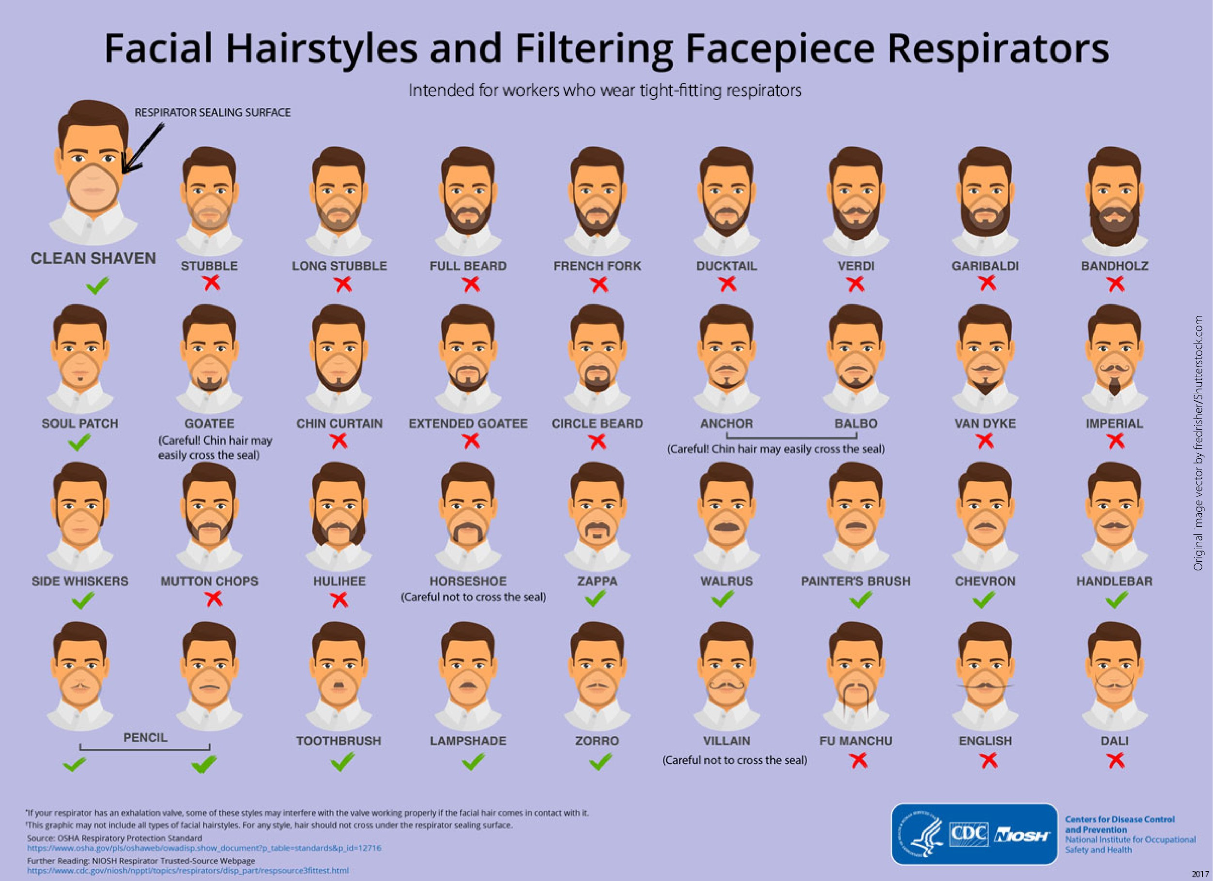
Facial Hair
Facial Hairstyles and Filtering Facepiece Respirators
Notes:
I would like to stress the importance of a clean shaven face for respirator wearers. Not just on the day of the fit test, but each time the respirator is worn. As previously mentioned, the particles in the air will take the path of least resistance and bypass the part of the respirator that captures or filters out the hazards if facial hair disrupts the seal. Studies have shown that even a day or two of stubble can begin to reduce a respirator’s protection. Research tells us that the presence of facial hair under the sealing surface causes 20 to 1000 times more leakage compared to clean-shaven individuals.
The following info graphic can help a fit test administrator determine if someone's facial hair is acceptable for use with a tight fitting respirator.

Slide 17

Differences for Fit Testing
Consider:
  The group you are working with
  Barriers to fit testing
  Cultural & religious differences

Slide 18
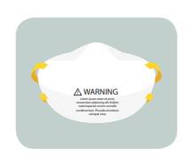
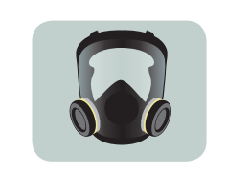
Respirator Selection
Pick the most acceptable respirator
  Provide a sufficient # of models/sizes
  Minimum of two sizes
Don the most comfortable mask
  Wear for several minutes to assess
Assess for comfort
Assess for fit
Images Source: NIOSH Types of Respiratory Protection, September 2019
Notes:
After assessing the sealing surface for the user, it is time to select a size/model of respirator for the user and assess for comfort and fit. Facilities should provide multiple models and sizes to account for differences in the respirator users facial features. Ensuring that you have at least two sizes available, such as small and regular will cover most respirator users. The fit test administrator should help the user choose a respirator that will best fit the user and their facial features. This process can be more of an art then science, but will become easier as the administrator becomes familiar with the respirators available at their facility.
After the initial respirator determination has been made, have the user don the most comfortable respirator, and wear the respirator for several minutes.
The next steps will be to asses the respirator for comfort and fit, which we will go into detail in the following slides.

Slide 19
Assessment of Comfort
Review the following points:
  Position of mask on nose
  Room for eye protection
  Room to talk
  Position of mask on face and cheeks
Notes:
After having the respirator user don (put on) a respirator that seems suitable for their facial features, the first step is to assess for comfort. As a side note, we assess comfort first because if a user is not comfortable in their PPE, they are less likely to wear the PPPE, or use it as intended or fitted. The first place to start is how the respirator feels on the bridge of their nose. Some respirators can place a large amount of pressure on the nose. If the respirator is comfortable, have the user try on their eye protection if required to use it. Ensure that they can comfortably wear their eye protection along with the respirator. Next ask the user if they have room to talk comfortably and how the respirator feels on their face and cheeks. If the user indicates that the respirator is comfortable, move on to assessing for adequate fit.

Slide 20
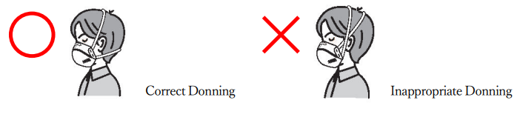
Adequacy of Fit
Criteria to determine fit:
  Chin properly placed
  Fit across nose bridge
  Adequate strap tension
    Do NOT cross straps
Image: Donning Method of N95 – Lambda-Line Series (sts-japan.com)

Slide 21
DEMONSTRATION OF RESPIRATOR FIT

Slide 22
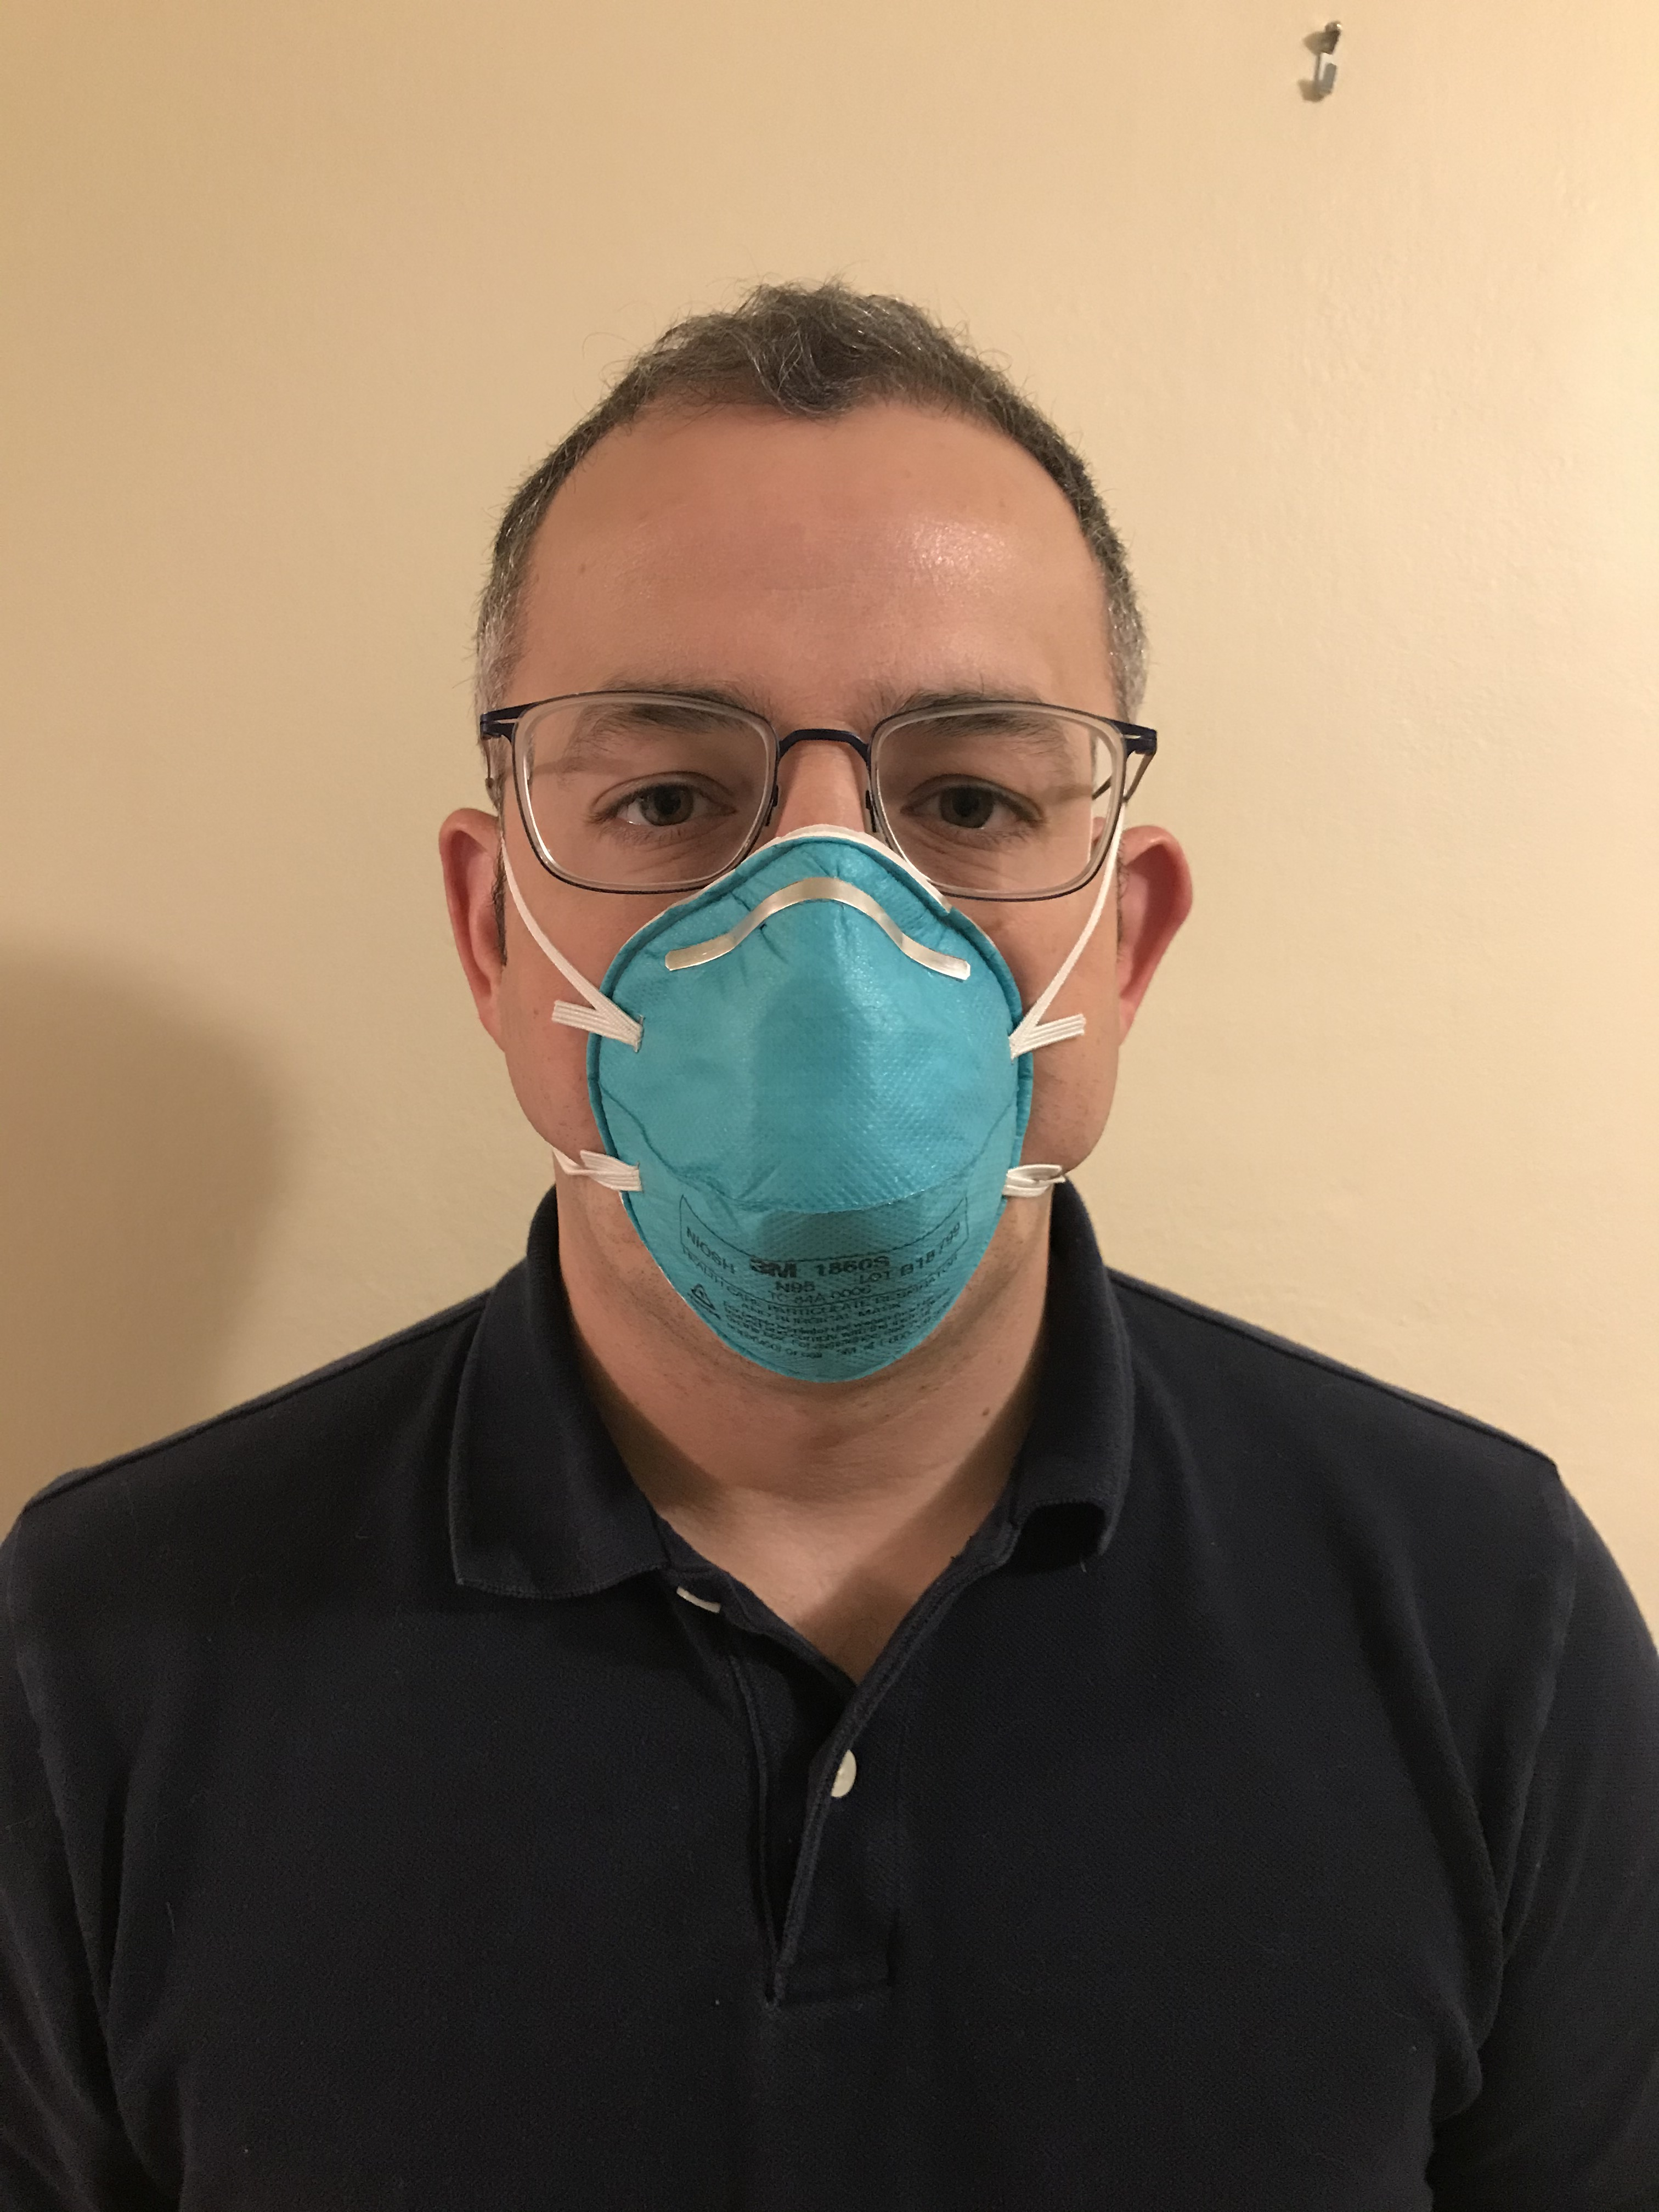
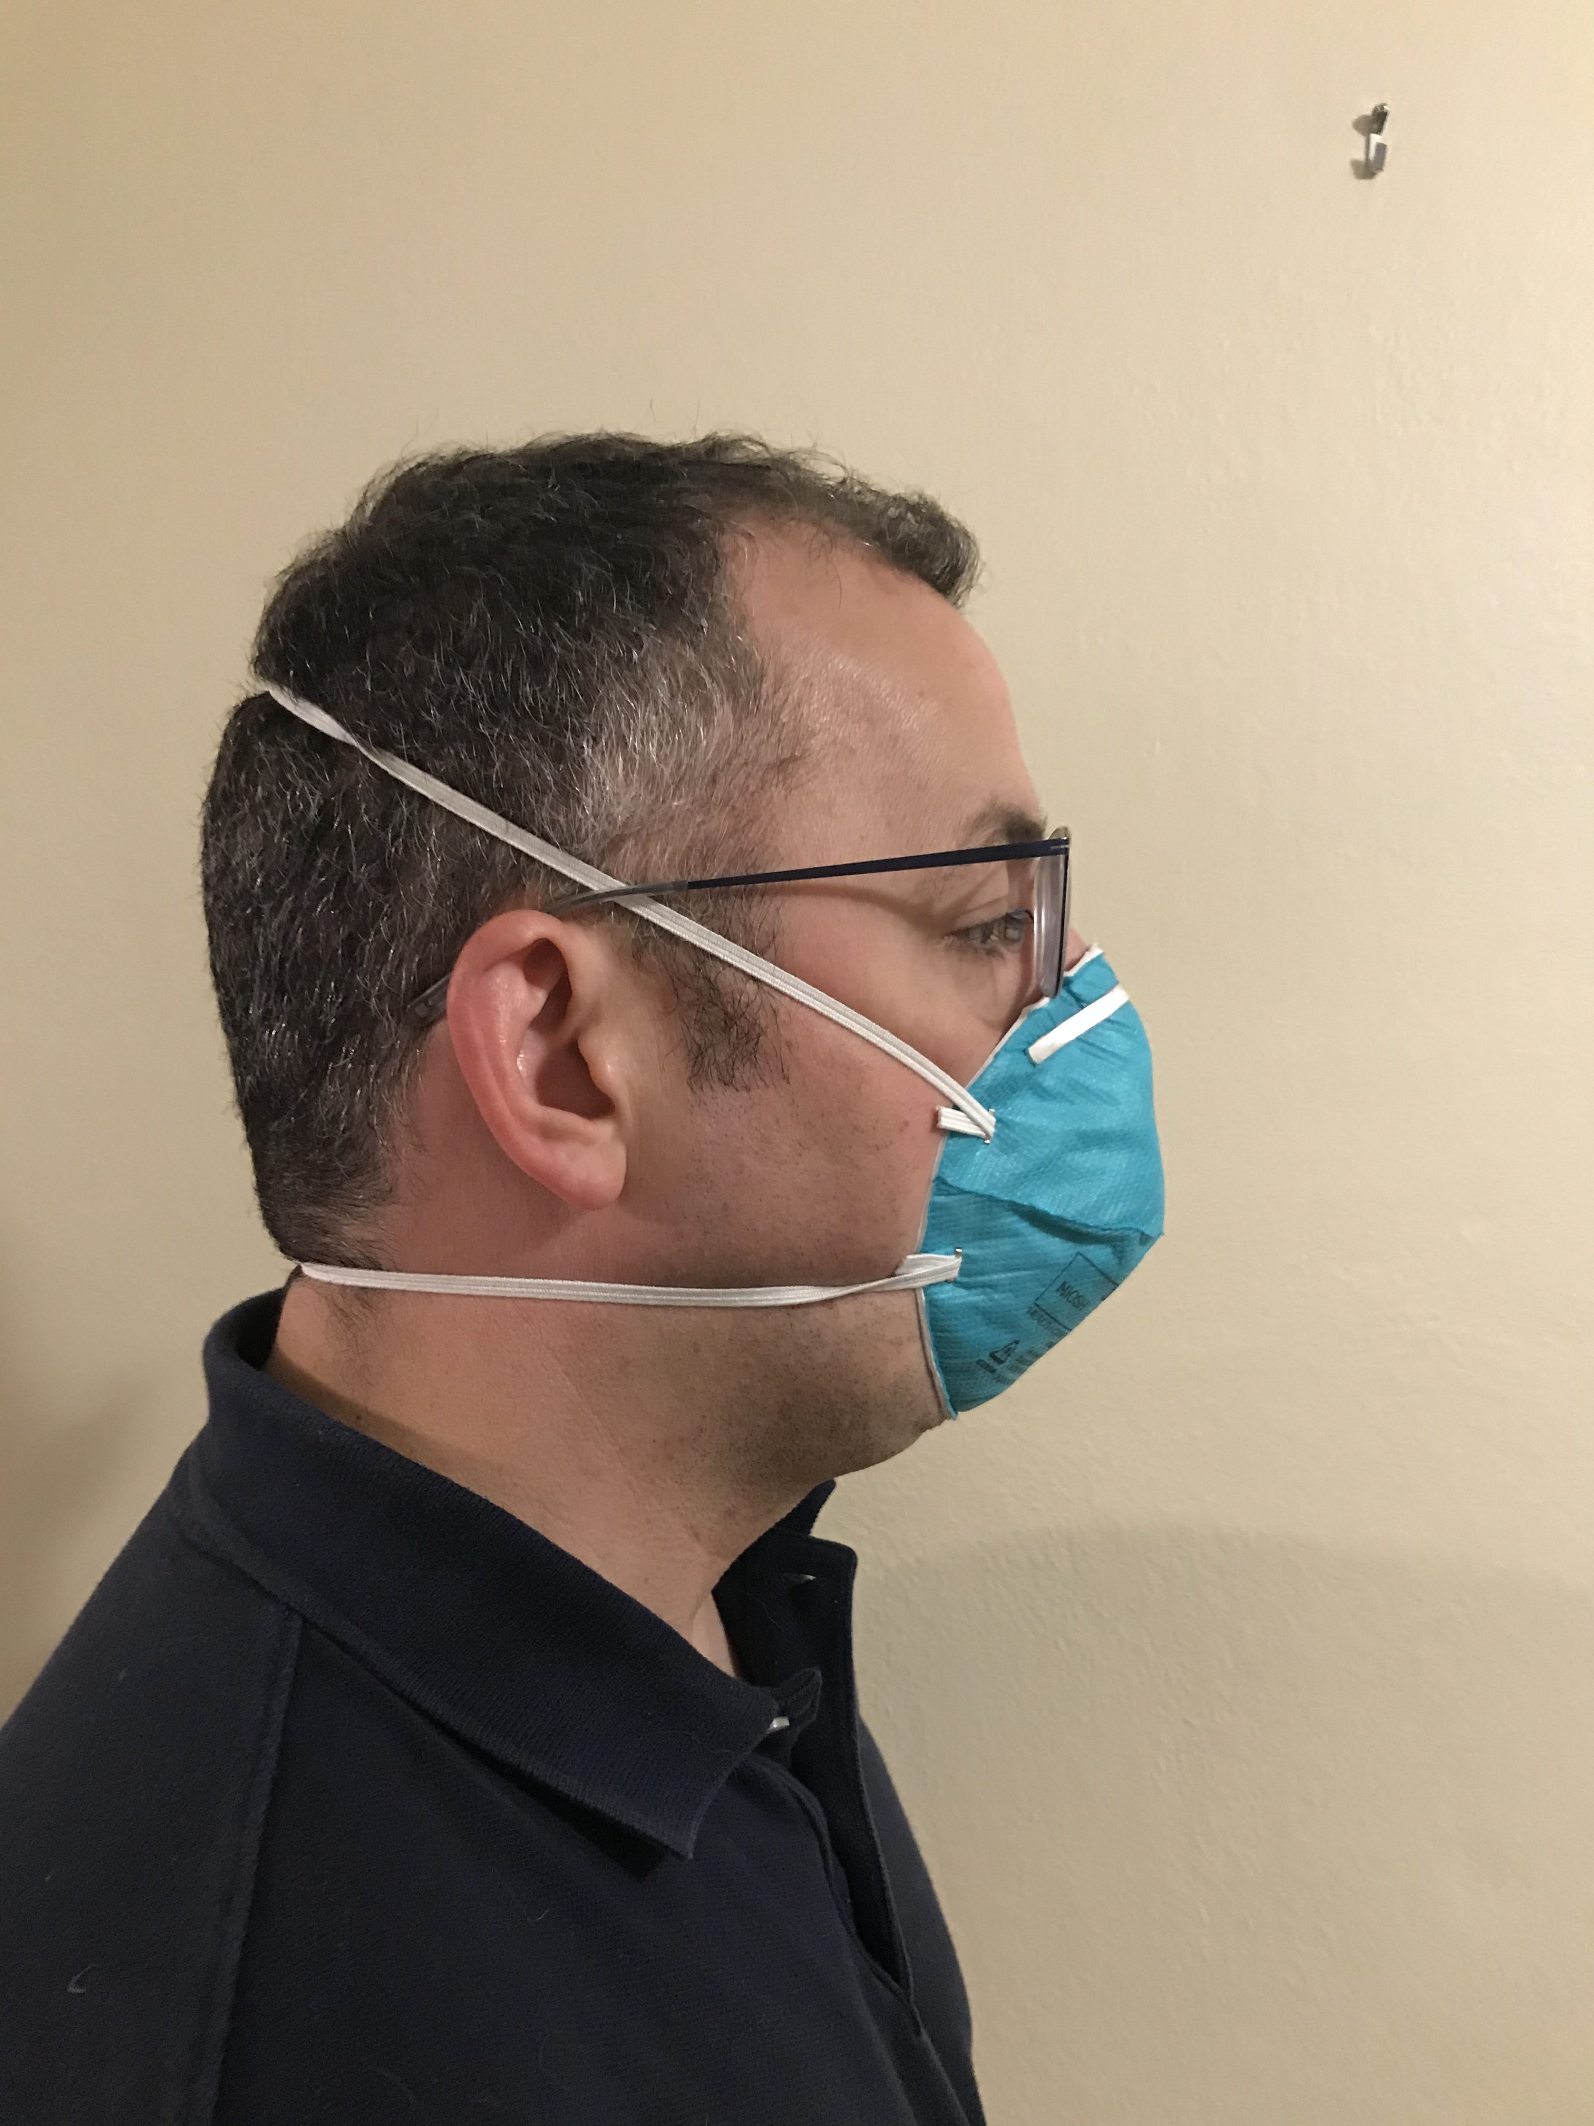
Too Small
Image: WisCon
Notes:
In this first example we will look at a respirator that is too small for the user. The first step is to determine if the chin is properly placed. If we look at the picture on the right, we can see that the respirator does not appear to be covering the entire chin. Additionally, the user indicated that they do not feel that their chin is sitting snugly in the mask, both indications that it may be too small. The next step is to look at the fit across the bridge of the nose. The user indicated that there was a lot of discomfort from the nose piece and if we look at the picture on the right, we can see that it is sitting fairly low on the user’s nose which is an additional indication that the respirator is too small. Finally, assess the strap tension. The user indicated that the respirator felt tight and uncomfortable. If we look at the picture on the left we can see that both the user’s face and the respirator are slightly deformed, indicating the strap tension is too high.

Slide 23
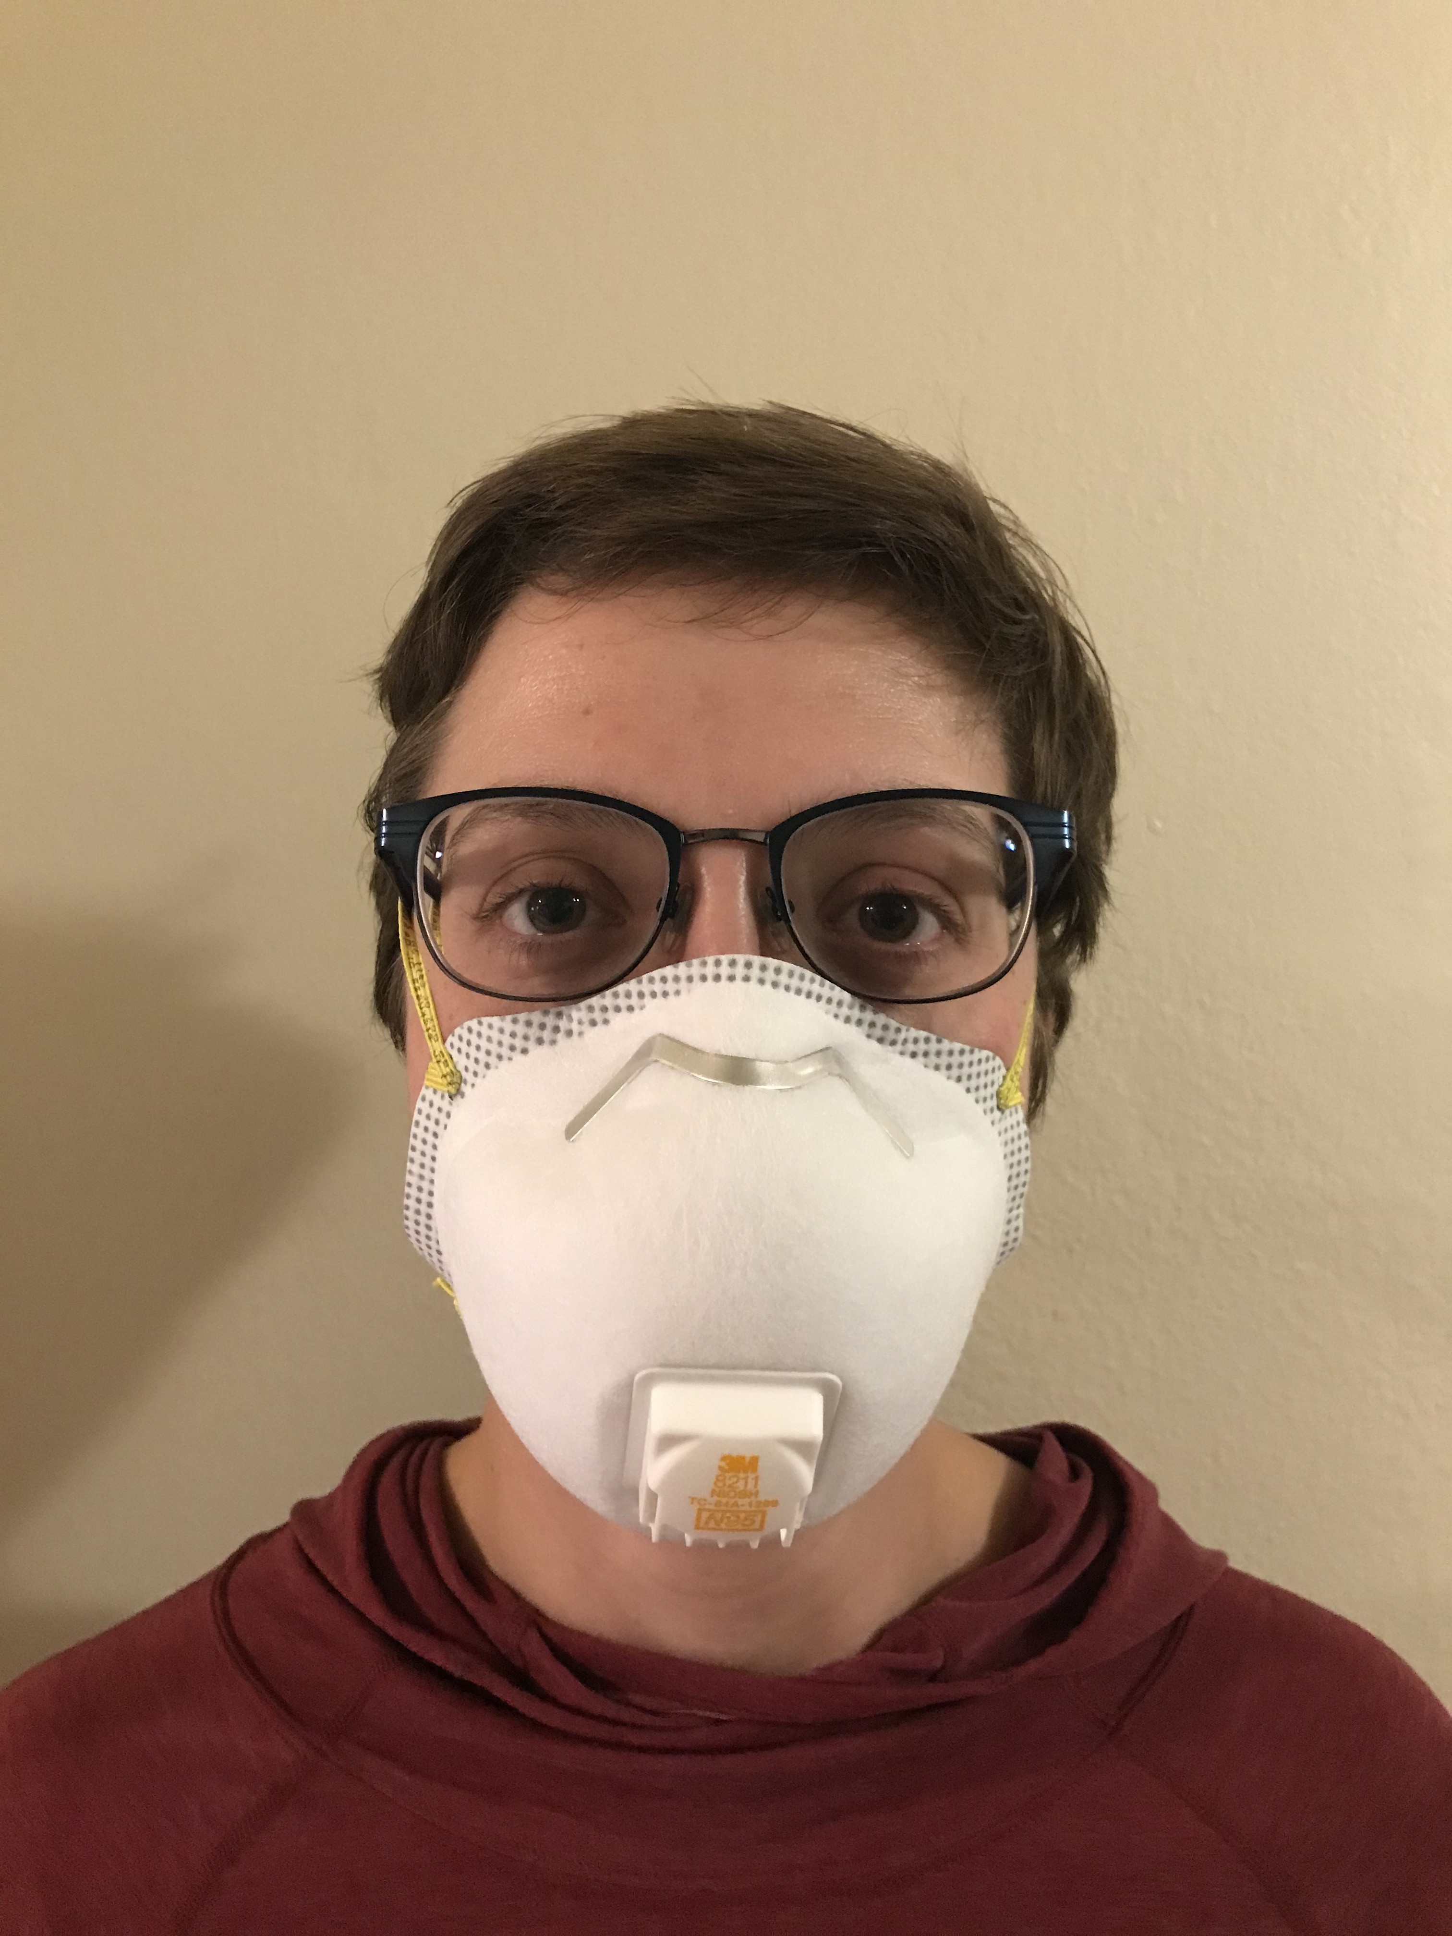
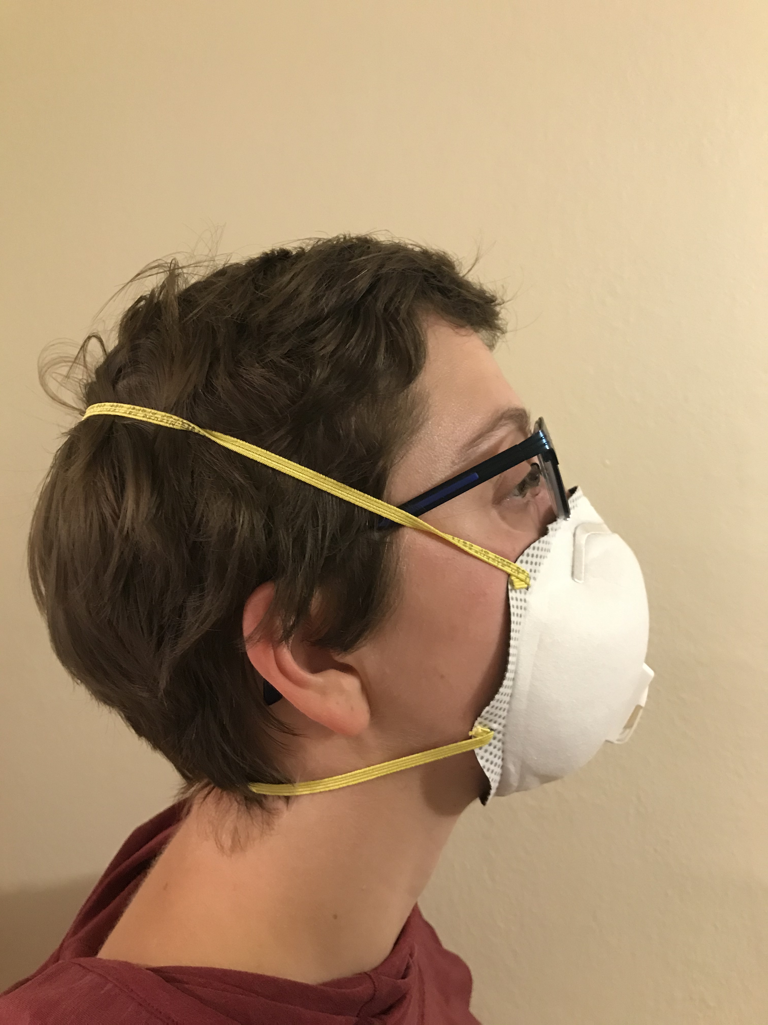
Too Large
Image: WisCon
Notes:
For this example we are going to cover is a respirator that is too large. The first step is to determine if the chin is properly placed. If we look at the picture on the right, we can see that the respirator extends well past the chin, potentially leaving gaps in the seal and indicating that the respirator is too big. The next step is to look at the fit across the nose bridge. Even with the nose clip adjusted the respirator appears to be spanning too far across the orbital cavity potentially leaving gaps in the respirator around the eyes or nose, as seen in the picture on the left. This indicates that the respirator is too big. Finally, assess the strap tension. The user indicated the respirator felt loose and that the straps were not snug.

Slide 24
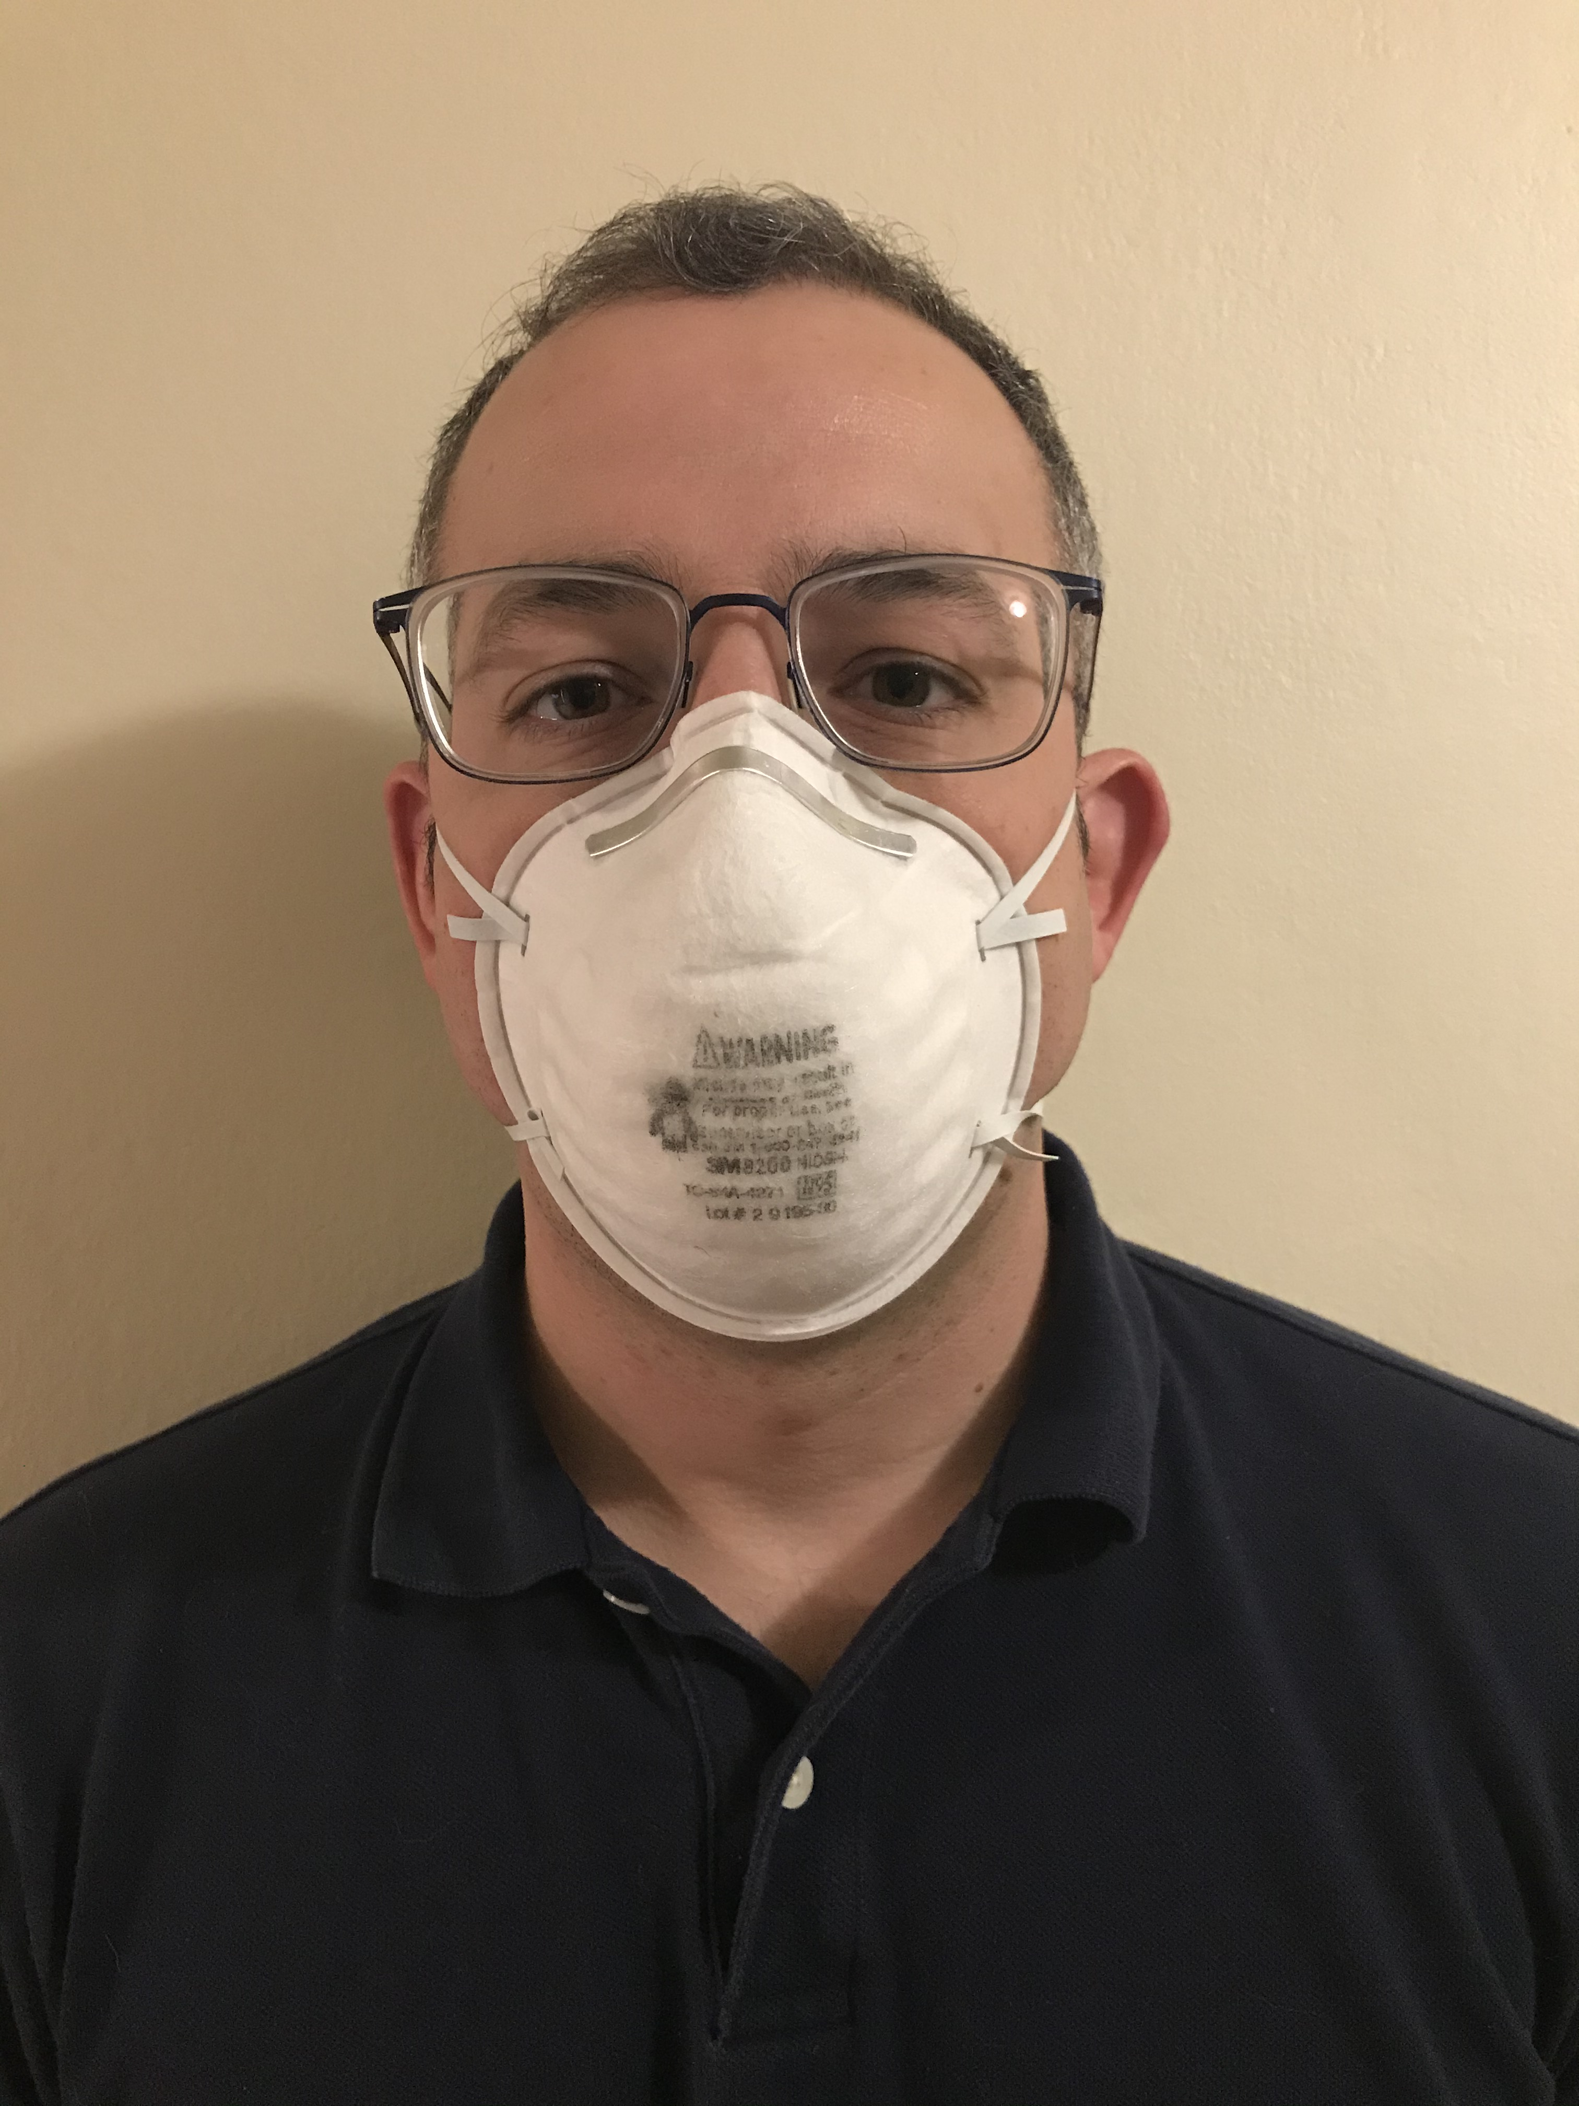
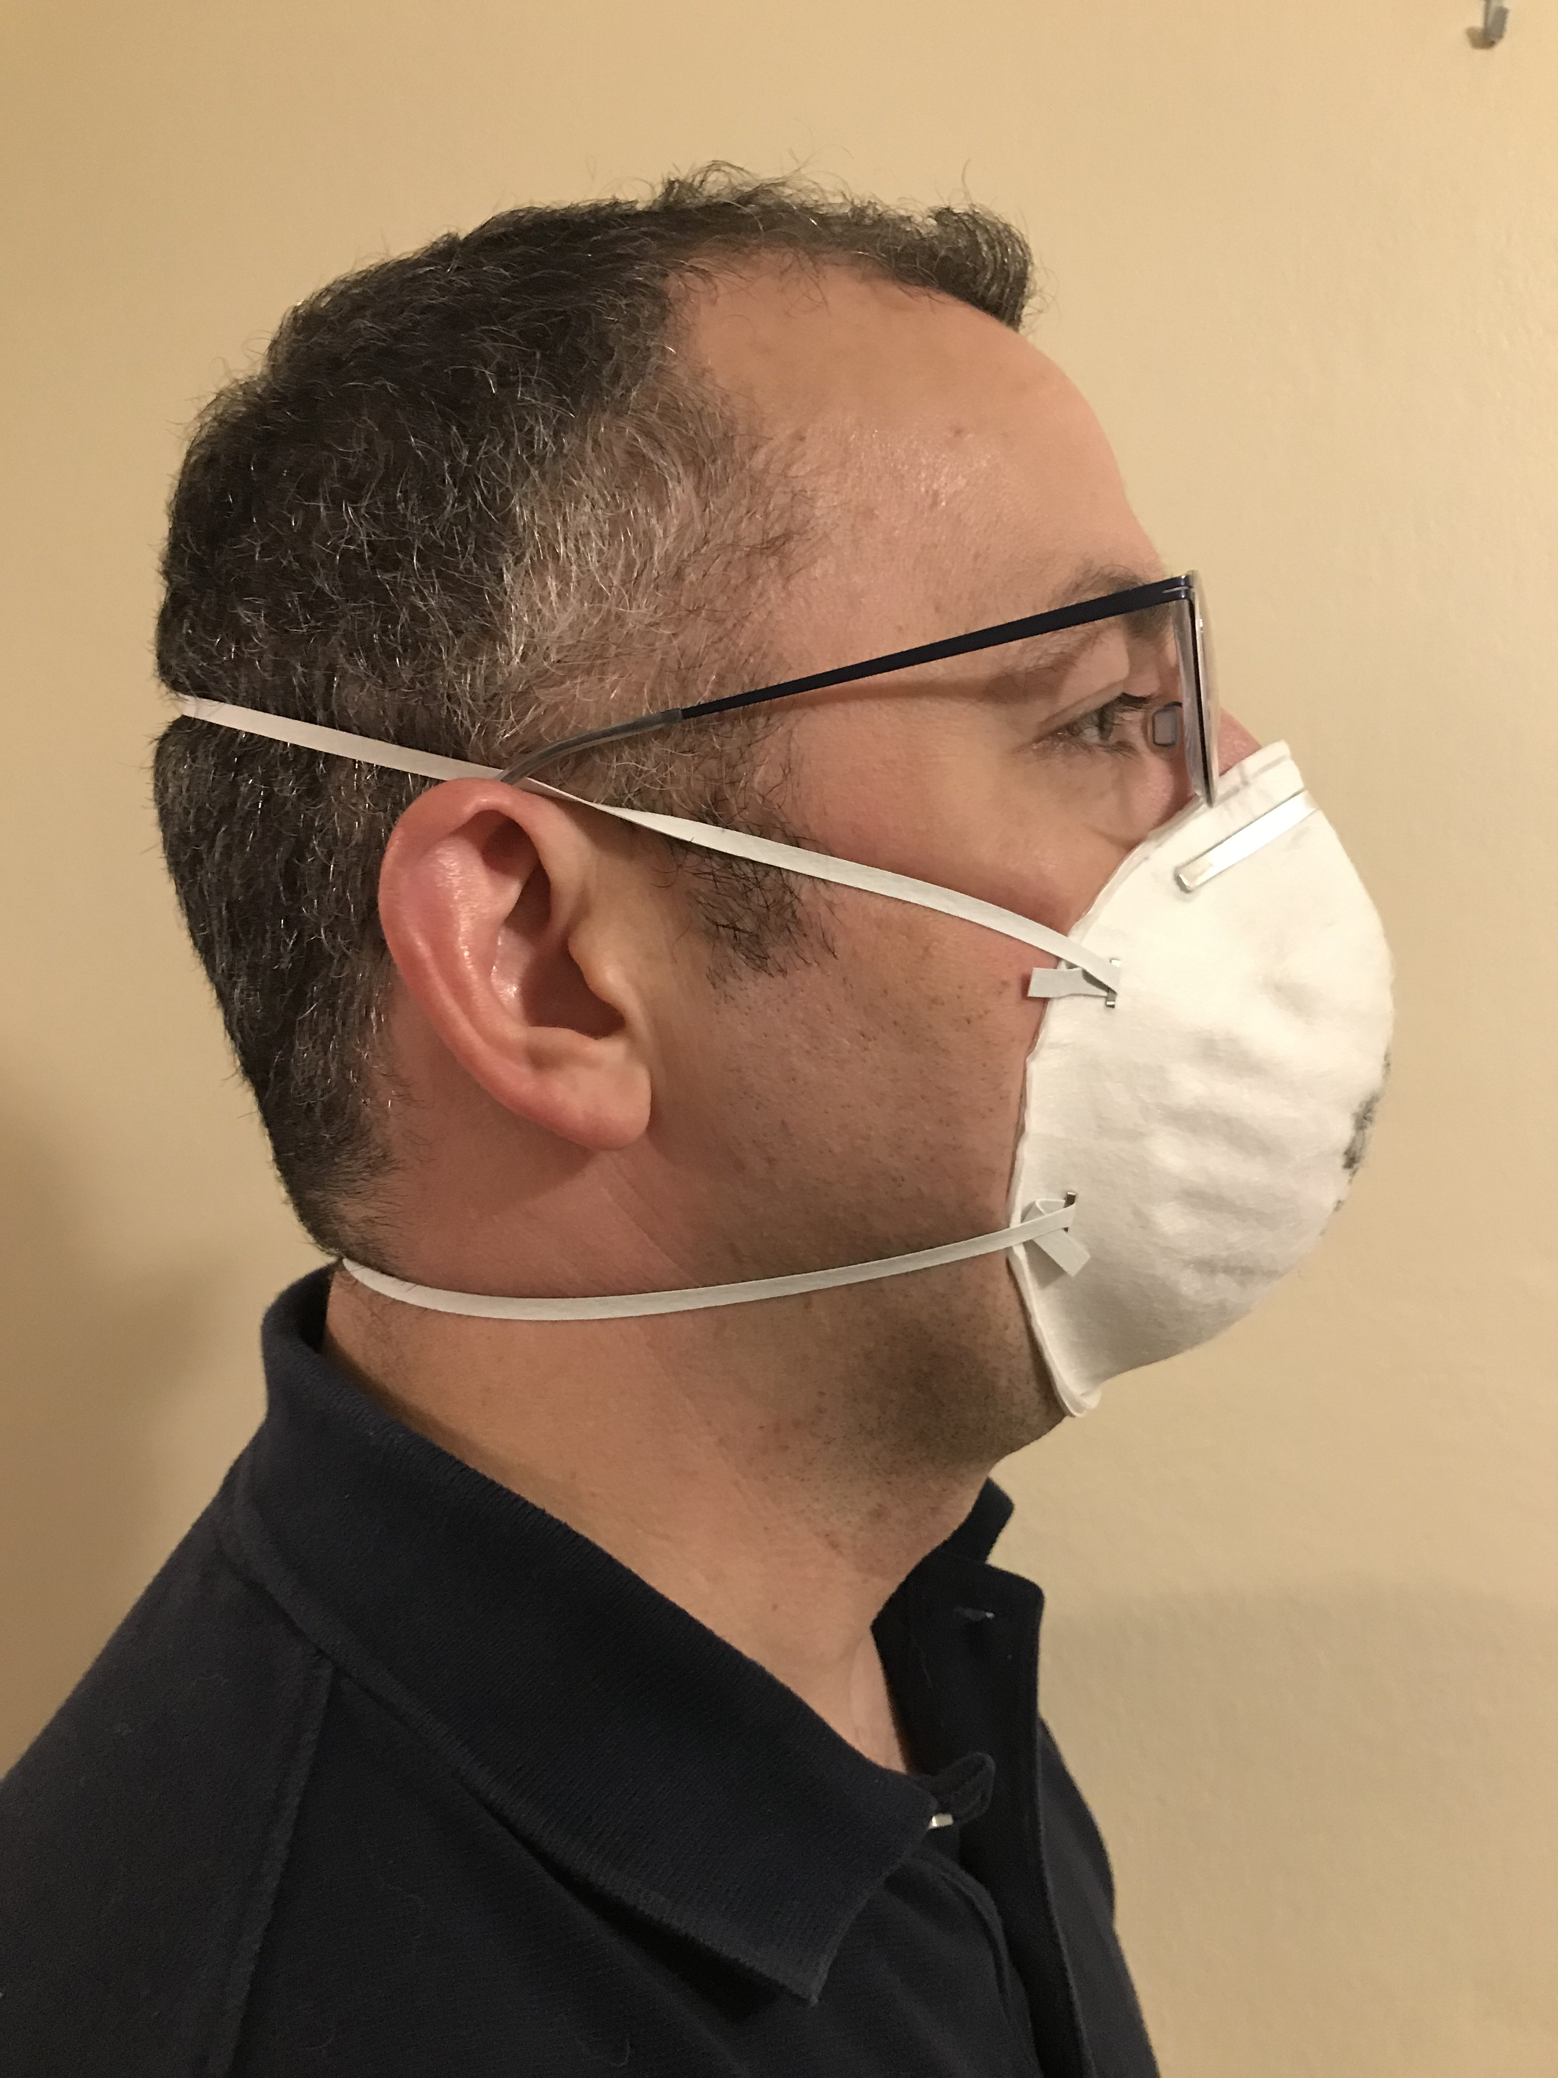
Adequate Fit
Image: WisCon
Notes:
The final example we are going to cover is a respirator that is fits adequately. To start out with, we can see in the photo on the right that that the chin appears to be seated well in the respirator without extending past the user’s chin. The next step is to look at the fit across the nose bridge. The photos show that the respirator is sitting well across the bridge but not spanning across the orbital cavity indicating good fit. Finally, we’ll assess the strap tension. The user indicated that the respirator felt snug, and the straps do not appear to be deforming the users face indicating adequate strap tension and overall good fitting respirator.

Slide 25
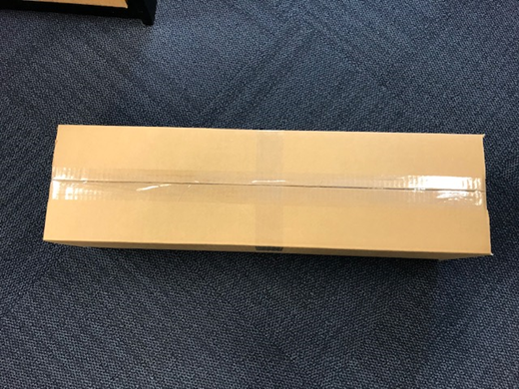
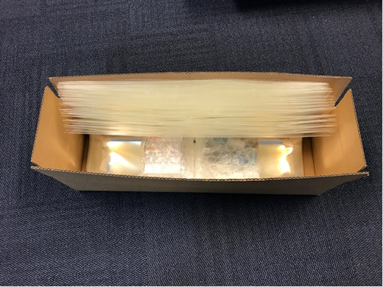
Fit Test Kit Example
Hoods
Test Solution
Nebulizers
Image: WisCon
Notes:
We will begin with the components of an example fit test kit. Your kit may be different, but should come with similar materials and instructions.

Slide 26
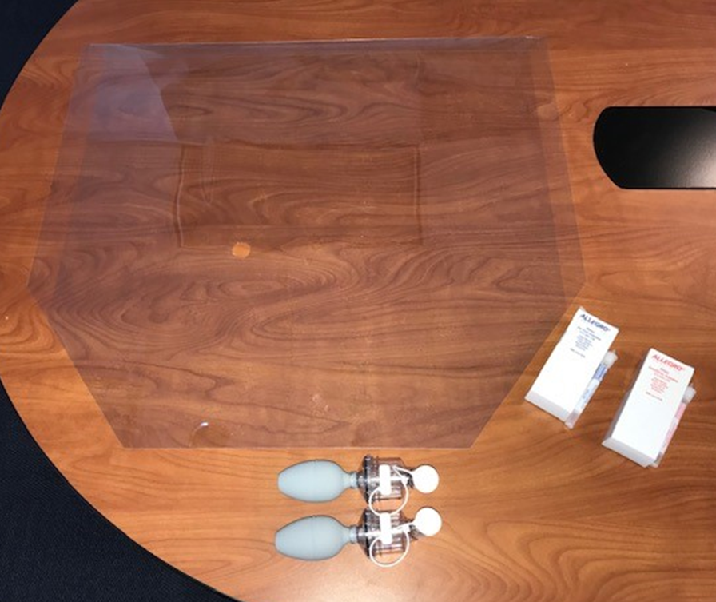
Fit Test Kit Components
Hoods
Test Solutions
Nebulizers
Image: WisCon
Notes:
After you unpack your kit, as pictured, you should have a fit test hood(s), 2 nebulizers and both sensitivity and test solutions.

Slide 27
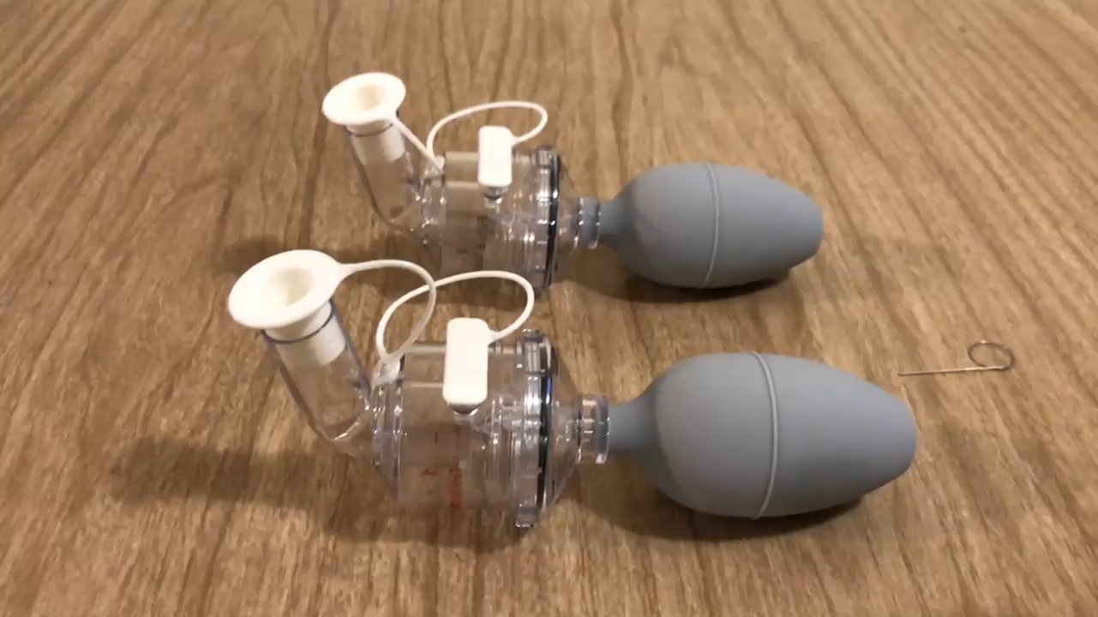
Nebulizer Preparation
  You will need 2 nebulizers
    Label one of the nebulizers fit test and the other sensitivity test
  For each nebulizer, check that the insert is present (as shown on the next slide)
  Unscrew the tops of nebulizers and fill one with ~1 mL of test solution and the other with ~1 mL of the sensitivity solution
  Thread the nebulizer tops back on
  Test each nebulizer
    Squeeze with your whole hand
Both plugs must be removed before use
Image: WisCon
Notes:
You will need two nebulizers. The first step to prepare the nebulizers is to ensure that the nebulizer insert is present and the orifice is clear. Once this is confirmed, fill 1 nebulizer with 1 milliliter of the Sensitivity solution and the 2nd nebulizer with 1 milliliter of the Test solution. After filling the nebulizers and threading the tops back on, remove both of the plugs on each nebulizer and test each nebulizer, they should generate a visible aerosol cloud. Be sure that you have a accountability mechanism in place to keep the two nebulizers separate. Many kits will provide a color coded label for the nebulizers.

Slide 28
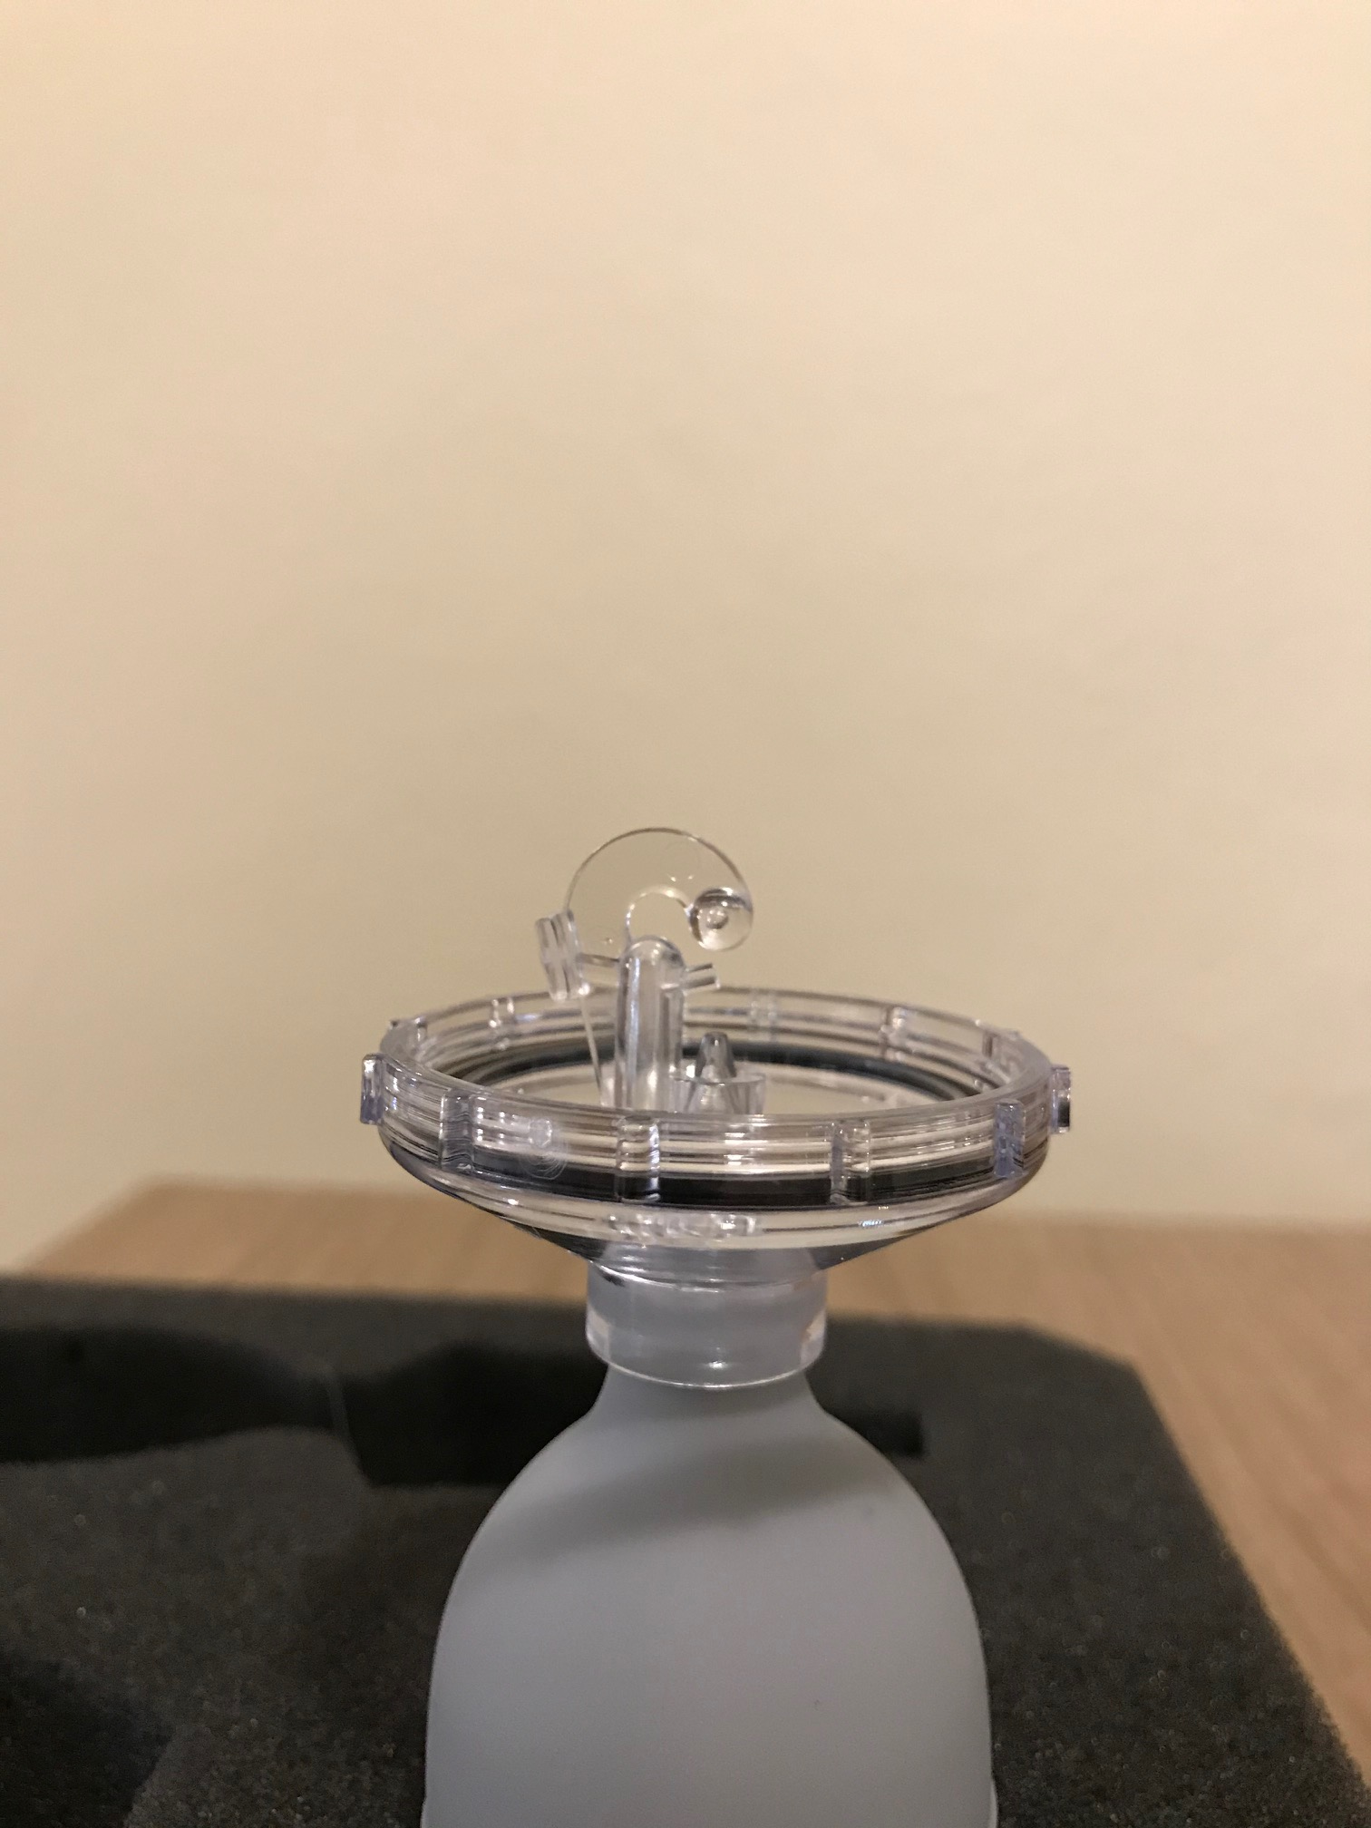
Nebulizer Troubleshooting
If nebulizer does not produce aerosol cloud
  Ensure that the plugs are removed
  Make sure insert is present
  Disassemble and wash with warm water
  Use wire tool to clean insert
Insert
Image: WisCon
Notes:
If you notice that your nebulizer is not producing a good aerosol cloud go through the following steps. The first is to check if one of the plugs is still in, if so, remove the plug(s) and try again. If you are still having poor aerosol generation check to see if the nebulizer insert is present, if it not, place the spare insert into the nebulizer

Slide 29
Pre Fit Test
Explain the fit testing procedure to the participant
Confirm that the participant is medically cleared to wear the specific respirator being fit tested
Verify any barrier to fit testing such as an inability to smell or taste sweet or bitter flavors
Notes:
Before you begin, the fit test procedure must be explained to the participant and confirm that medical clearance to wear that specific respirator has been granted.
During this time ask the participant if they have any medical conditions that would interfere with the test process such as unable to taste sweet or bitter flavors.

Slide 30
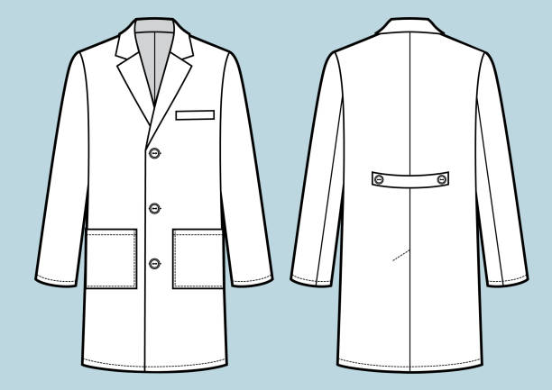
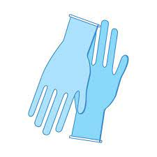
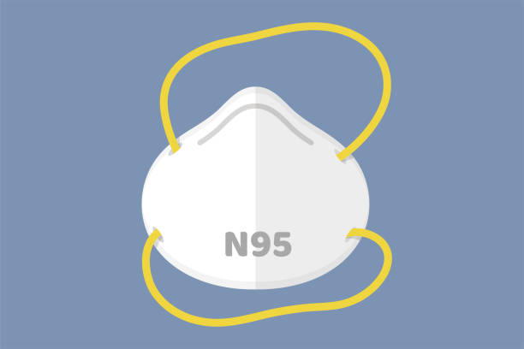
Fit Test Facilitator
Consider wearing an N95
A procedural gown or Lab Coat
Gloves
Notes:
Since they are aerosolized, the fit test solutions may cling to your clothes, skin and hair. The solutions are made from food grade materials, but they are bitter or sweet depending on the solution you are using.

Slide 31
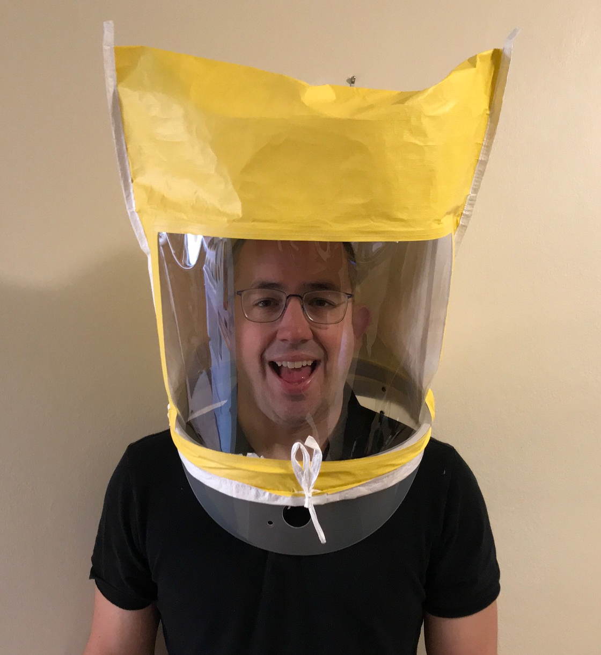
Sensitivity Screening
Without a respirator
Instruct the participant to:
  Don the test hood
  Open their mouth and extend their tongue slightly
  Breathe through their mouth during the test
Image: WisCon
Notes:
The first step is sensitivity screening, this establishes the participant’s ability to taste the test agent. Sensitivity testing is performed with the test hood over the participants head and without a respirator. Have the participant put the hood over their head. Position the hood so that there is approximately 6 inches between the hood window and their face. Instruct the participant to open their mouth and slightly extend their tongue and breathe through their mouth during the sensitivity test.

Slide 32
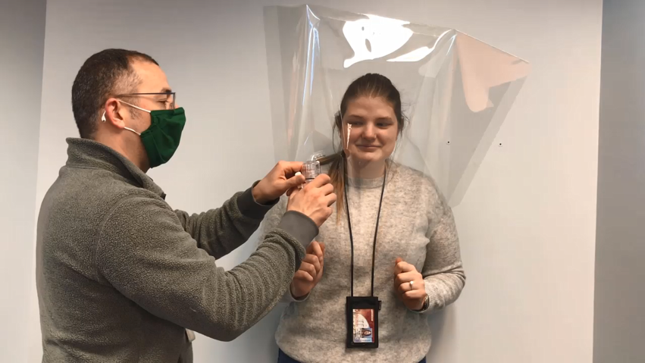
Sensitivity Screening
Assign sensitivity level:
  Between 1 and 10 squeezes = 10
  Between 11 and 20 squeezes = 20
  Between 21 and 30 squeezes = 30
Image: WisCon
Notes:
Sensitivity screening: start by inserting the nozzle of the nebulizer with the sensitivity solution into the hood. Be careful not to directly point the nozzle toward the participant’s face. Try slightly turning the nozzle to the left or right after inserting it into the hood.
Start with an initial set of 10 squeezes. Instruct the participant to tell you if they taste the test agent at any time during the 10 squeezes. If they taste the test agent at or before 10 squeezes, you can stop the test and assign a sensitivity level of 10 regardless of whether they tasted it before or at the 10th squeeze. If the participant does not taste the test agent after 10 squeezes. Begin to put an additional 10 squeezes into the hood. If they now taste the test agent before the 21st squeeze, assign a sensitivity level of 20. If the participant still can’t taste the test agent, begin to put a final set of 10 squeezes into the hood. If they can taste the test agent before the 31st squeeze, assign a sensitivity level of 30. If they can still not taste the test agent after 30 squeezes, the test is over and the participant cannot be tested with this method. Another fit testing method will need to be tried. Other fit testing methods include sweet solution if bitter was previously used, or visa versa and quantitative fit testing with a machine.
https://ccsearch-dev.creativecommons.org/photos/251b42af-3ba9-4cdb-93e0-8243fe19eae4

Slide 33
Sensitivity Screening
After the sensitivity test:
  Wait for the taste to clear
  Rinsing with water can help
Notes:
After completing the sensitivity test, have the participant wait few minutes to clear the test agent flavor from their mouth. Rinsing with water may help with clearing the flavor.

Slide 34
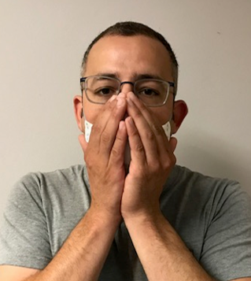
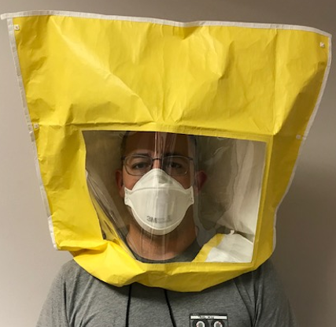
Fit Test Procedure – Using the Fit Testing Solution
Don the respirator
  Perform a user seal check
Don the test hood
Image: WisCon
Notes:
With the sensitivity test successfully completed, instruct the participant to don their respirator. Have them perform a user seal check to ensure that the respirator is fitted correctly. After the participant is comfortable, have them put the test hood over their head again, this time with their respirator on. Position the hood so that there is approximately 6 inches between the hood window and their face.

Slide 35
Fit Test Procedure Using the Fit Testing Solution
After initial pumps as determined by the sensitivity test, start timing the first step – each step is performed for 1 minute
Renew pumps every 30 seconds per chart
Sensitivity Test | 1 - 10 | 11 - 20 | 21 – 30
Sensitivity Rating | 10 | 20 | 30
Initial Pumps | 10 | 20 | 30
Every 30 Seconds | 5 | 10 | 15
Notes:
With fit test solution, pump the full number of squeezes determined during the sensitivity test, 10, 20, or 30 of the test solution into the test hood.
After the initial set of squeezes into the hood with the test solution, the participant can start the exercises.
To maintain the concentration of solution in the hood during the test, renew the test solution every 30 seconds by putting in one-half the number of squeezes determined in the sensitivity test. For example, if the participant’s sensitivity level was 10, then you would pump in an additional 5 squeezes every 30 seconds during the test. I would recommend that you have a stop watch to keep track. Remember not to aim the nozzle directly at the participant’s face.

Slide 36
Fit Test Procedure
Exercise 1: Normal Breathing
Add the number of pumps as determined by the sensitivity test
Start a one minute timer
After 30 seconds add additional solution (half the number of pumps that were initially used)
Notes:
We will now move into the test exercises. Perform all of the following exercises for 1 minute. To start the test we will put the full number of squeezes into the hood, either 10, 20, or 30. After 30 seconds, half the number of squeezes will be used.
The first exercise is normal breathing.
Remember to renew the test solution in the hood every 30 seconds with ½ the number to squeezes (either 5, 10, or 15 ) as determined during the sensitivity test.

Slide 37
Fit Test Procedure
Exercise 2: Deep Breathing
Add the number of pumps as determined by the sensitivity test
Start a one minute timer
After 30 seconds add additional solution (half the number of pumps that were initially used)
Notes:
Breathe deeply and regularly. Take caution so as not to hyperventilate.

Slide 38
Fit Test Procedure
Exercise 3: Head Side-to-Side
Add the number of pumps as determined by the sensitivity test
Start a one minute timer
After 30 seconds add additional solution (half the number of pumps that were initially used)
Notes:
Turning the head side to side. Instruct the participant to turn their head side to side stopping to take a breath at each shoulder.

Slide 39
Fit Test Procedure
Exercise 4: Head up and down
Add the number of pumps as determined by the sensitivity test
Start a one minute timer
After 30 seconds add additional solution (half the number of pumps that were initially used)
Notes:
Nodding your head up and down. Instruct the participant to slowly nod their head up and down taking a breath in the up and down position

Slide 40
Fit Test Procedure
Exercise 5: Talking out loud (Rainbow Passage)
Add the number of pumps as determined by the sensitivity test
Start a one minute timer
After 30 seconds add additional solution (half the number of pumps that were initially used)
Notes:
Talking out loud. Instruction the participant read the rainbow passage slowly out loud. Alternatively, they can count backwards from 100, or recite a memorized poem or song.

Slide 41
Rainbow Passage
When the sunlight strikes raindrops in the air, they act like a prism and form a rainbow. The rainbow is a division of white light into many beautiful colors. These take the shape of a long round arch, with its path high above, and its two ends apparently beyond the horizon. There is, according to legend, a boiling pot of gold at one end. People look, but no one ever finds it. When a man looks for something beyond reach, his friends say he is looking for the pot of gold at the end of the rainbow.

Slide 42
Fit Test Procedure
Exercise 6: Bend at the waist
or Jog in place
Add the number of pumps as determined by the sensitivity test
Start a one minute timer
After 30 seconds add additional solution (half the number of pumps that were initially used)
Notes:
Bending at the waist or jogging in place. Instruct the participant to bend over at the waist as if they were touching their toes. You may need to have them hold onto the hood. You may substitute jogging in place for this exercise.

Slide 43
Fit Test Procedure
Exercise 7: Normal breathing
FINAL TEST
Add the number of pumps as determined by the sensitivity test
Start a one minute timer
After 30 seconds add additional solution (half the number of pumps that were initially used)
Notes:
The last exercise is a repeat of the first exercise, normal breathing.

Slide 44
Fit Test Procedure
Pass
  Test agent not tasted, during any of the steps
Fail
  Test agent tasted during any of the steps
Notes:
PASS-If the participant does not report tasting the test agent during any of the steps, the participant has passed the test.
FAIL-If the test agent is tasted when performing any of the steps, the participant has failed. Options for a failed test are included on the next slide.

Slide 45
Test Failure Options
Re-don and re-adjust facepiece
  When re-testing, you must start again with the first exercise, Normal Breathing, and repeat all of the exercises
If re-testing doesn’t work, try a different:
  Model
  Size, or
  Type of respirator
Notes:
If the participant fails their fit test, have them remove the hood and respirator and wait a few minutes to clear the taste out of their mouth. Encourage them to rinse their mouth to help clear the taste. The first recommendation is to have the participant re-don and readjust the respirator and repeat the testing process from the beginning. If they fail the testing again, consider trying a different model, size, or type of respirator and repeat the fit testing process.

Slide 46
Cleaning
Test hood
  Dispose or
  Disinfect
Nebulizers
  Disinfect nozzle between fit test participants
  Wash nebulizers when all fit testing has been completed for the day
Notes:
Some of the fit test components must be cleaned between fit tests. If the hood in your kit is reusable, wipe the hood down on the inside and outside with an appropriate sanitizing wipe or solution. If you are using a disposable hood, discard the hood. The nebulizer nozzles should be disinfected with an appropriate wipe or solution between fit tests. At the conclusion of the fit testing for the day, wash the nebulizers with warm water and allow them to air dry before the next use.

Slide 47
Summary and Resources

Slide 48
Summary
The person conducting the fit testing needs be knowledgeable on the respiratory protection standard and be trained on the fit testing procedures
The medical evaluation needs to be completed prior to fit testing and is specific to the respirator model
Fit testing needs to occur prior to wearing a respirator in the workplace
The medical evaluation can be provided by:
  Online medical evaluation provider
  Occupational Health Clinic
  Licensed healthcare professional

Slide 49
Summary, cont.
The medical evaluation questionnaire comes from Appendix C of OSHA standard 29 CFR 1910.134
Employees need to be medically reevaluated based on a physician’s recommendation, traditionally every 1 to 2 years, or:
  Workers experience adverse health symptoms
  Have a change in health condition
  Become diagnosed with a heart condition, lung disease, significant changes to weight, or dental changes such as dentures or lost teeth
  A medical professional, supervisor, or respirator program administrator deem it necessary
  A change in workplace conditions occur such as additional PPE or exposure levels change

Slide 50
Summary, cont.
During respirator selection comfort and fit are assessed
Things that can effect the respirator sealing surface include:
  Facial hair, facial scars, jewelry, glasses/goggles, and other PPE
Facial hair will impact fit testing. The CDC offers a handout on what is or isn’t appropriate. Facial Hairstyles and Filtering Facepiece Respirators
  Example: Someone with a full beard can’t be fit tested

Slide 51
Summary, cont.
Qualitative fit testing relies on sense of taste using either Bitrex® or saccharin solutions
15 minutes prior to fit testing a person shouldn’t
  Eat, drink, smoke, vape or chew gum

Slide 52
Summary, cont.
If the sensitivity solution is not tasted during the sensitivity screening another fit testing method is needed
During the fit test if the fit testing solution is tasted, then the person who is being fit tested fails the test. Options for next steps can include:
  Redon & adjust the respirator
  Try a different model, size or type respirator
  Try quantitative fit testing (use of a different fit testing method)
  Wear a PAPR (use a type of respirator that doesn’t require fit testing)

Slide 53
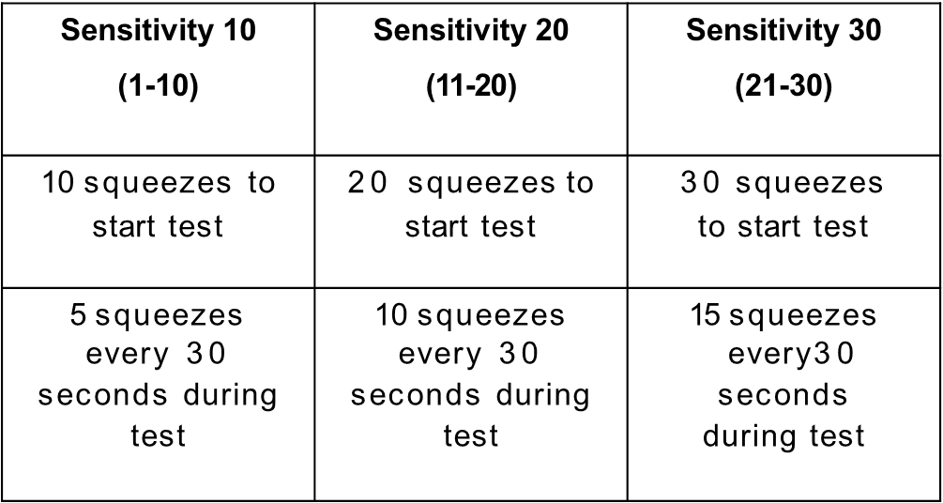
Summary, cont.
Sensitivity Screening
Fit Test Exercises – each exercise is performed for one minute
  Normal Breathing
  Deep Breathing
  Move Head Side to Side
  Move Up & Down
  Talking (Rainbow Passage)
  Bend at waist or Jog in Place
  Normal Breathing

Slide 54
WisCon Public Sector Consulting
Email: PublicSectorConsulting@slh.wisc.edu

